Slide 1

Data Management Project
Najeh Alhalawani - 2223737
Jamil Nassar - 2224424
NBA Data Warehouse Implementation - Spring 2025

Slide 2
Outline
Introduction to Data Warehouse Implementation
Dataset Discussion
DFM Model
ETL
DFM SQL Schema
DW Schema Diagram
OLAP Queries

Slide 3

Introduction
Use of Data Warehouse:
Historical Data Storage
Data Consistency
Analytics and Modeling
This project focuses on:
Integrating multiple NBA-related datasets into a unified Data Warehouse
Notes:
Combines data from different sources (e.g., sales, operations, marketing) into a single, unified repository.
Cleans and transforms data into a consistent format for reliable reporting and analytics
This project focus on integrating multiple NBA-related datasets into a unified Data Warehouse

Slide 4
Dataset
games.csv : all games played with the date, teams and some details like number of points scored, etc.
games_details.csv : details of games dataset, all statistics of players for a given game
players.csv : players details (name, team)
ranking.csv : ranking of NBA given a day
teams.csv : all teams of NBA
Players_data.csv : data on each player who has been part of an NBA teams

Slide 5
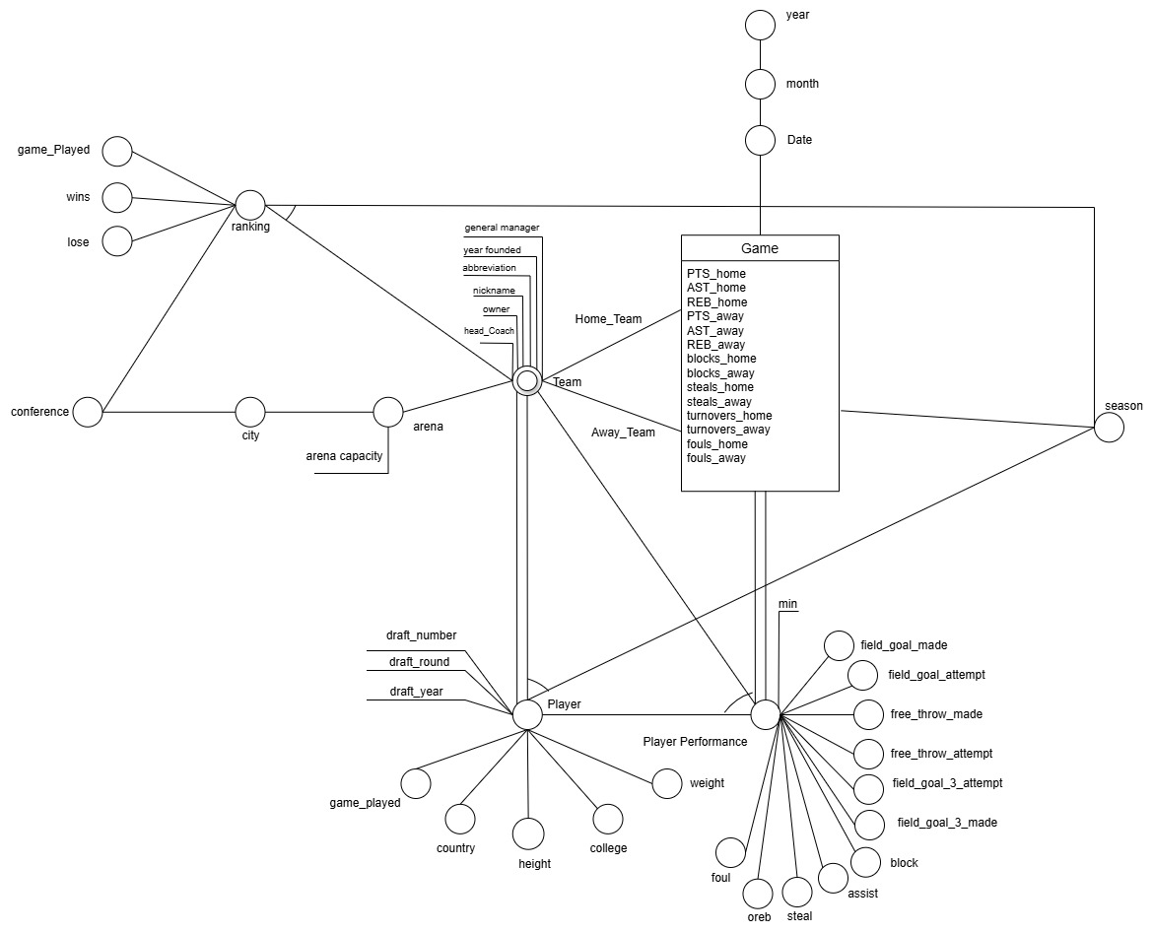
DFM Model
Fact : Game
Dimensions:
Home Team
Away Team
Date
Season
Cross dimensions:
Ranking
Player
Player Performance

Slide 6
ETL – Challenged Identified
Data inconsistencies
Missing values
Variations in naming conventions
Sheets without unique IDs

Slide 7
ETL – Our Approach
Remove Duplicates
Fill Missing Values
Map Values to IDs
Reference Mapping Across Sheets

Slide 8
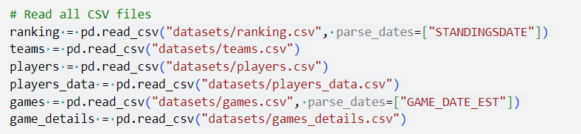
ETL – Extract
Extract : Read data from CSV files

Slide 9
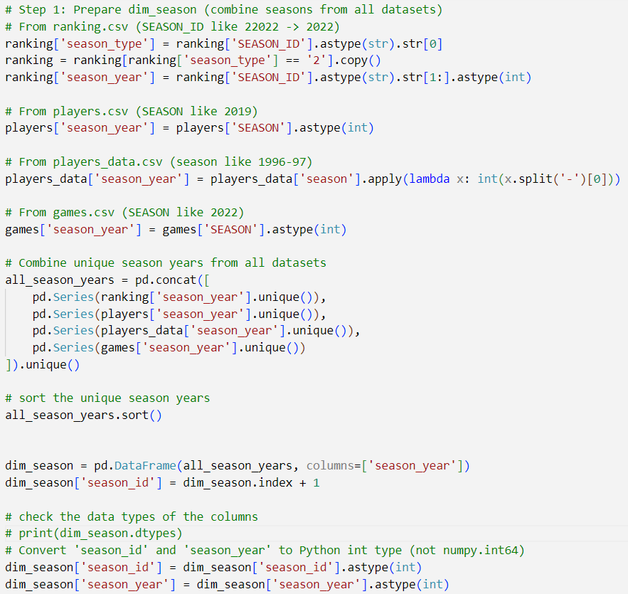
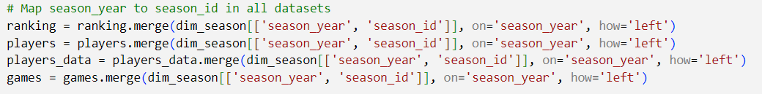
ETL – Transform
Season Dimension
Attribute standardization
Surrogate key generation
Dimension mapping
Concatenate values into a single dimension

Slide 10
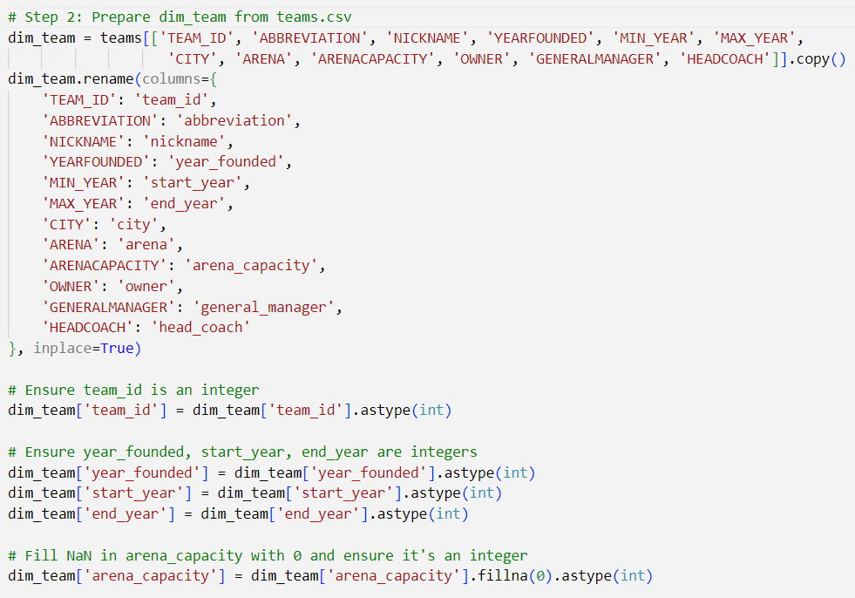
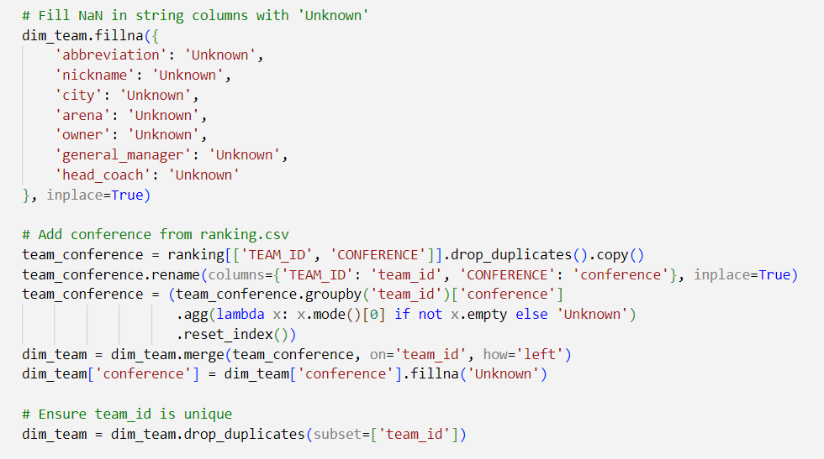
ETL – Transform
Team Dimension
Standardize attributes
Convert and validate data types
Add and drop columns
Handle missing data

Slide 11
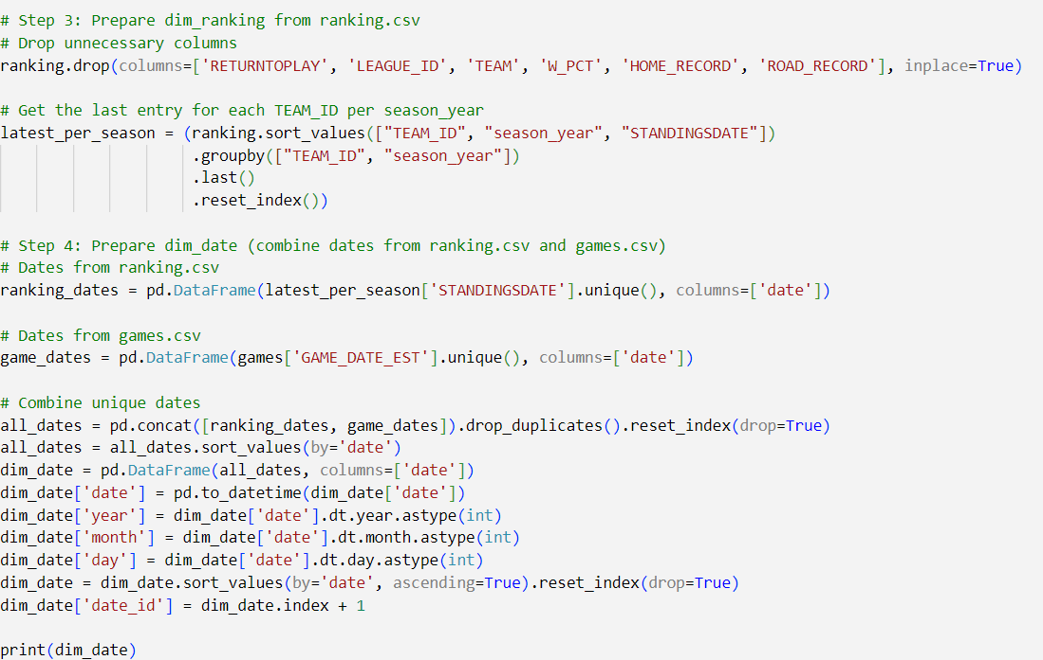
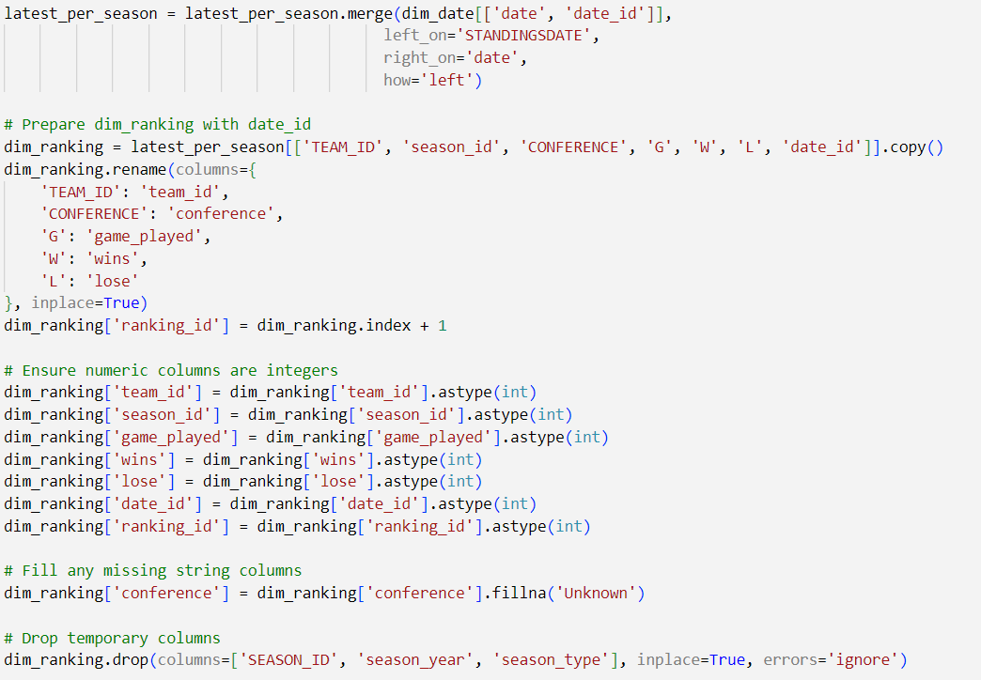
ETL – Transform
Ranking & Date Dimensions
Drop unnecessary columns
Convert data types
Create a date table
Insert surrogate keys
Ensure data uniqueness
Map keys
Handle missing data
Concatenate values into a single dimension

Slide 12
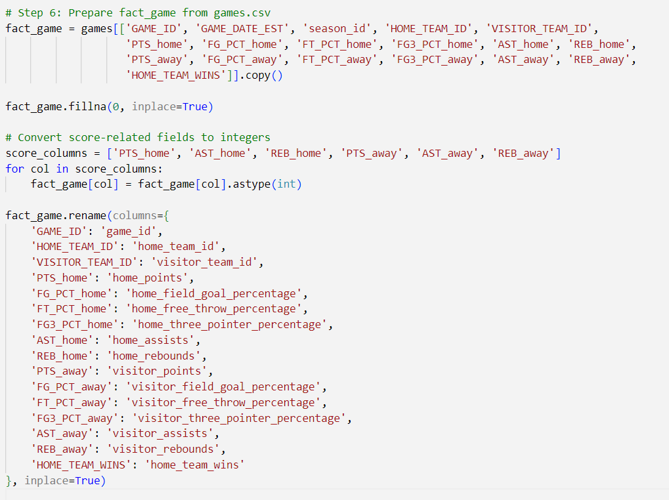
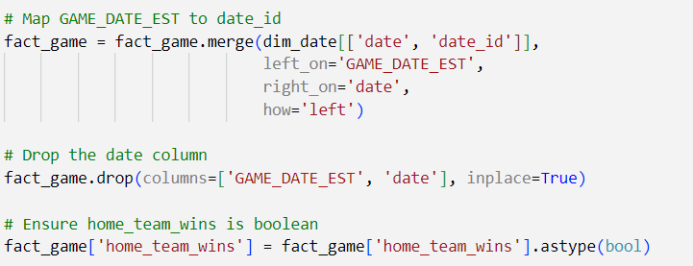
ETL – Transform
Game Fact
Ensure data types
Standardize attributes
Map keys
Drop columns
12

Slide 13
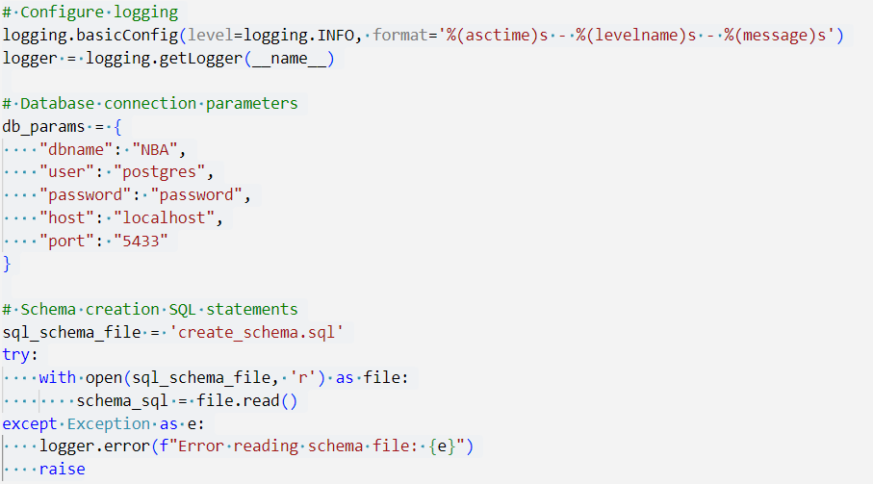
ETL - Load
Load: Load validated data into the Postgres database tables
Configure Logging and DB Parameters
Read SQL Schema File (Contains the SQL schema for table creation)
Notes:
of each dimension and fact in SQL language)

Slide 14
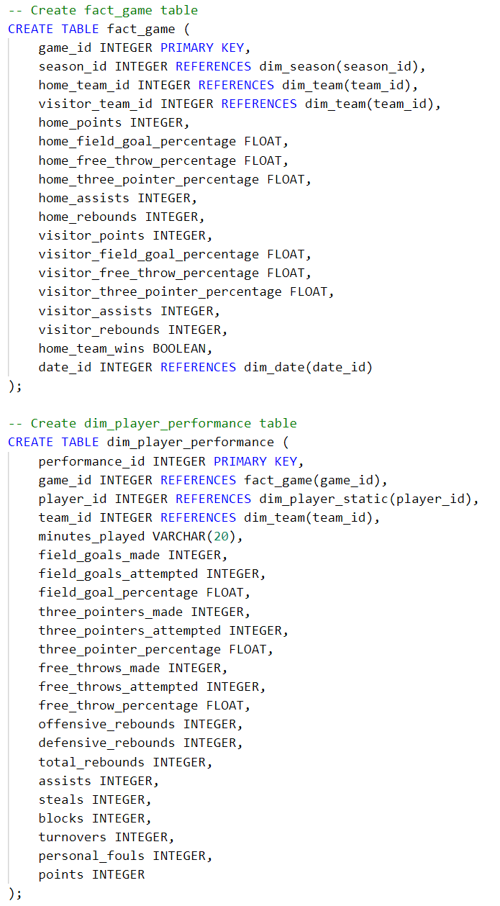
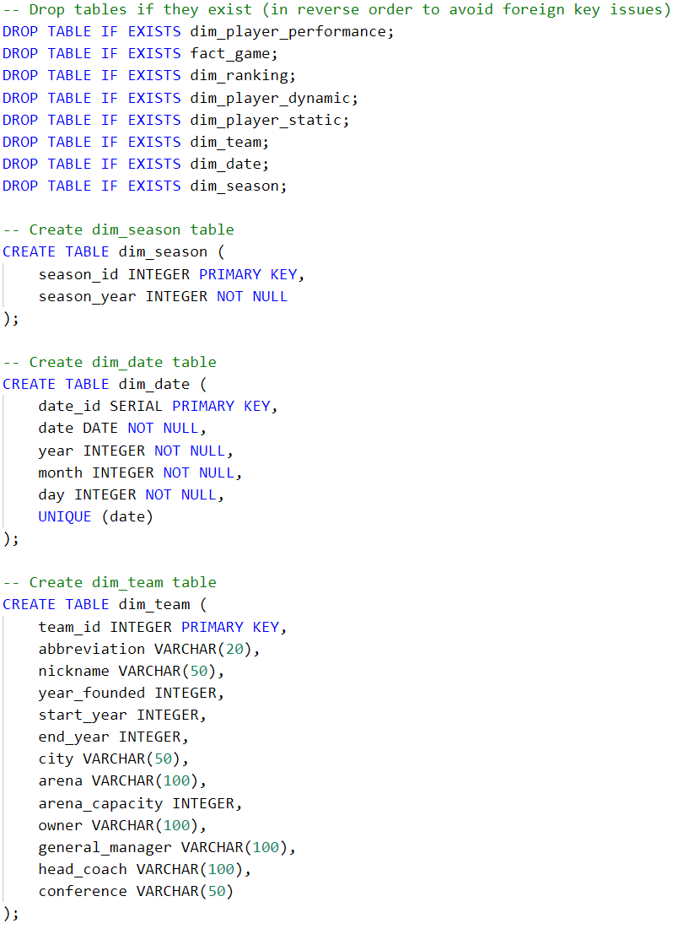
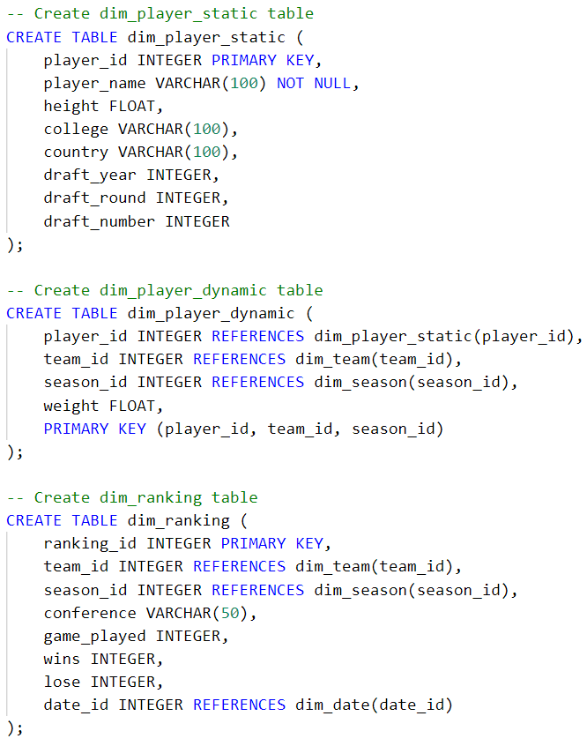
SQL Schema
Notes:
of each dimension and fact in SQL language)

Slide 15
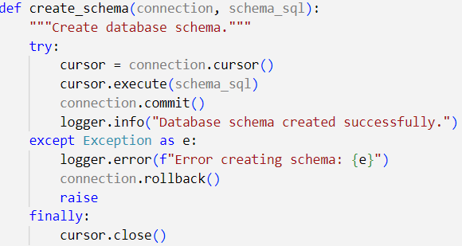
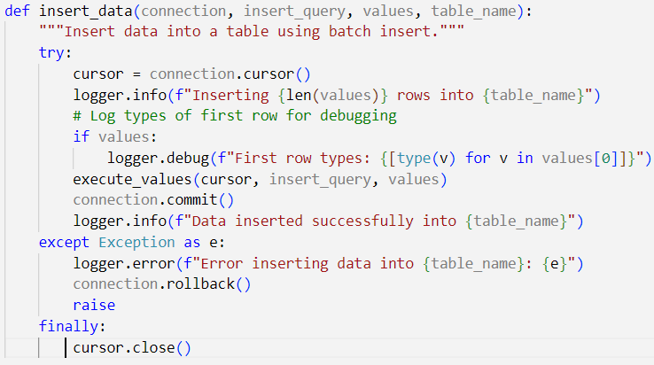
ETL - Load
Function to Create Schema
Function to Insert Data

Slide 16
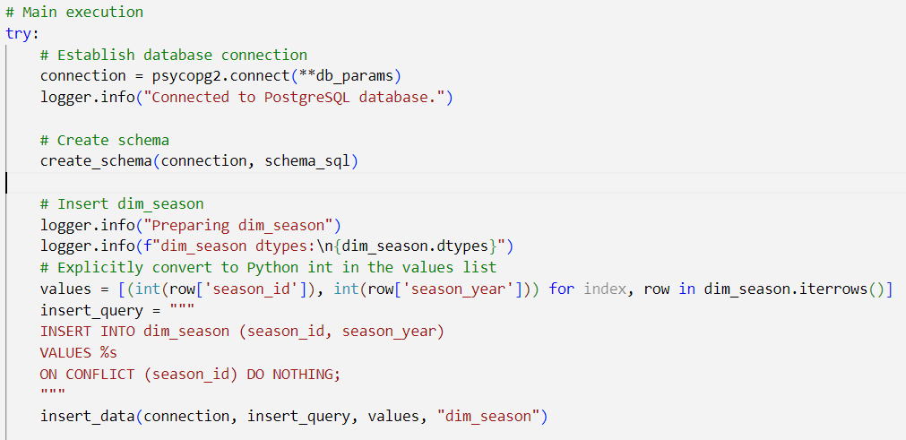
ETL - Load
Main Execution
Connect
Create Schema
Insert Data

Slide 17
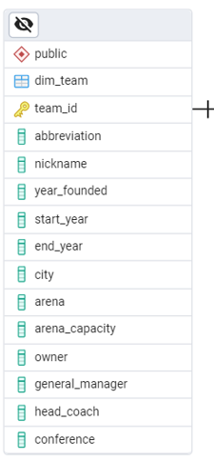
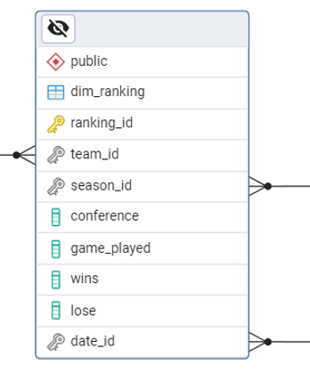
Data Warehouse Schema
Use of Snowflakes:
Normalized lookups
Tables decomposed into sub-dimensions
Avoid redundancy
The Team dimension is split into two tables (Team and Ranking)
Notes:
No create of key and link the two table to this key for the conference

Slide 18
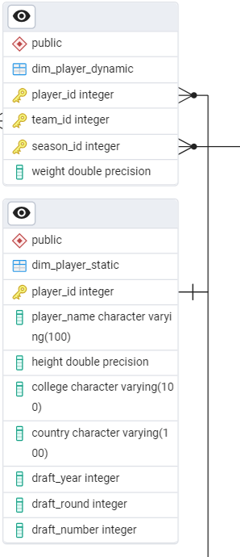
Data Warehouse Schema
Use of Snowflakes:
Normalized lookups
Tables decomposed into sub-dimensions
Avoid redundancy
The Player dimension is split into two tables (dynamic and static)
Notes:
player_dim split into 2 tables
Main which is player dynamic (contain player id ) data decencies
The subyable used to avoid the redundancy of info:
College
Country
Draft_year
Draft_round
Draft_numbet

Slide 19
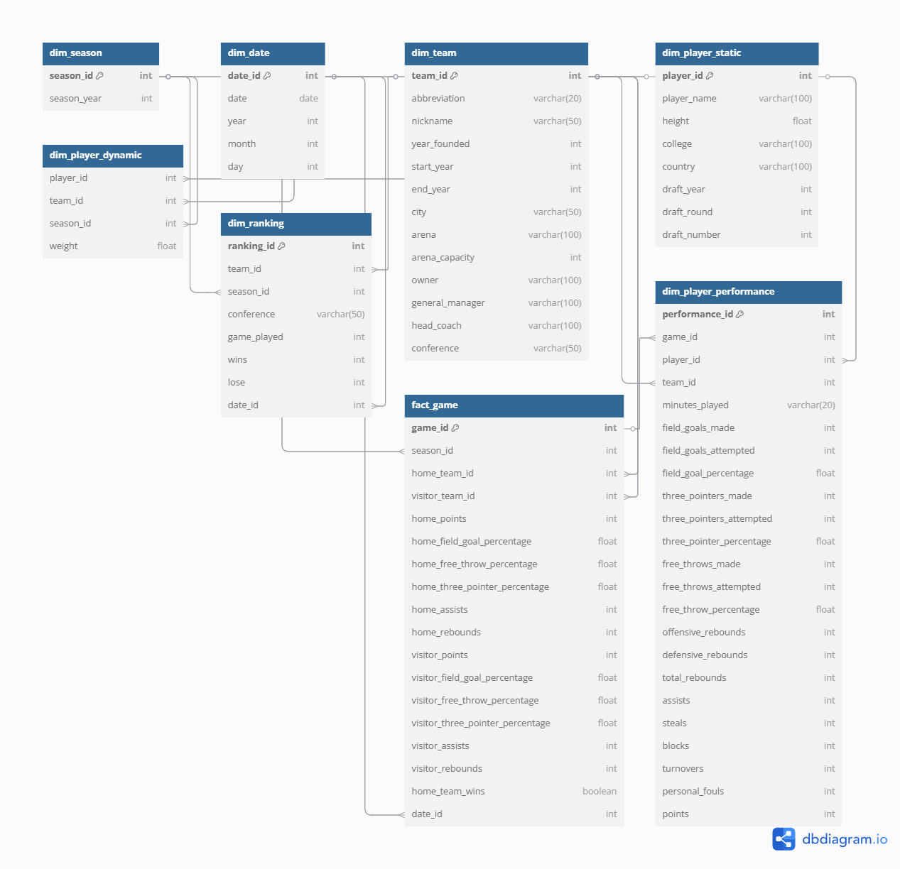
DW Schema
Notes:
player_dim split into 2 tables
Main which is player dynamic (contain player id ) data decencies
The subyable used to avoid the redundancy of info:
College
Country
Draft_year
Draft_round
Draft_numbet

Slide 20
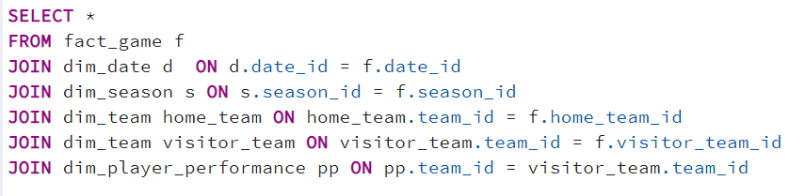
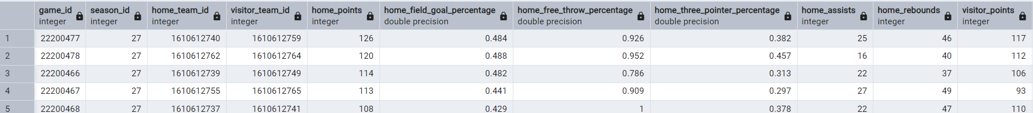
OLAP Queries
Query of building basic cube
Result

Slide 21
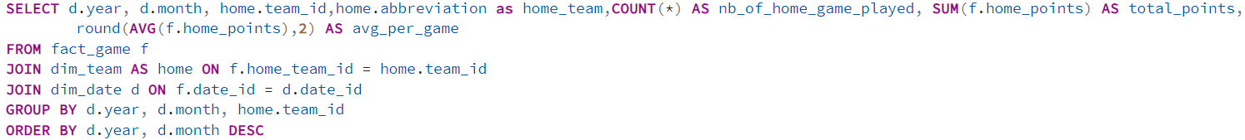
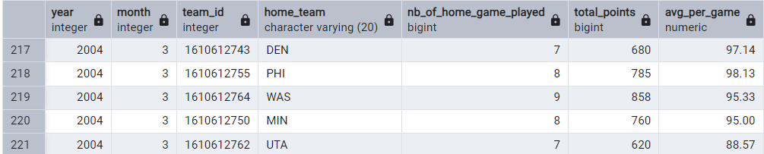
OLAP Queries
Roll up: Compute the Monthly Home Team Performance This means the sum of the points scored by each team in each month.
Result

Slide 22
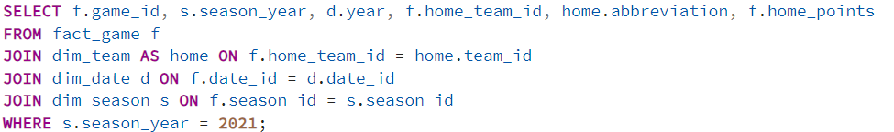
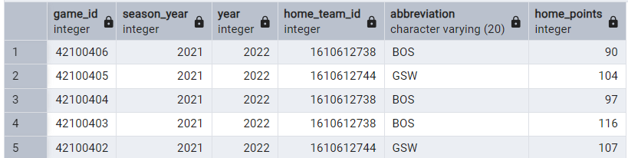
OLAP Queries
SLICE: Compute the query to get all the games in the season
Result

Slide 23
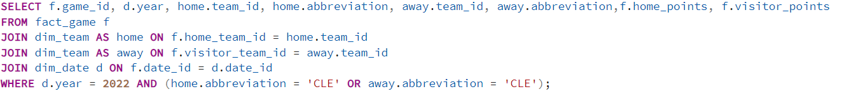
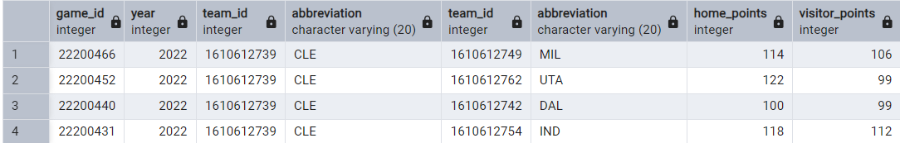
OLAP Queries
DICE : filter based on the year and the team abbreviation (ALL game played by the Cavaliers in the year 2022)
Result

Slide 24
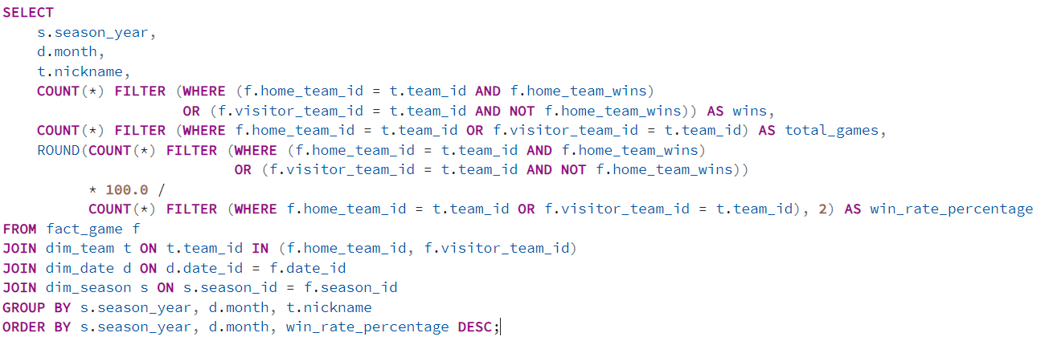
OLAP Queries
Analyze how win rates evolve per month over the seasons for each team

Slide 25
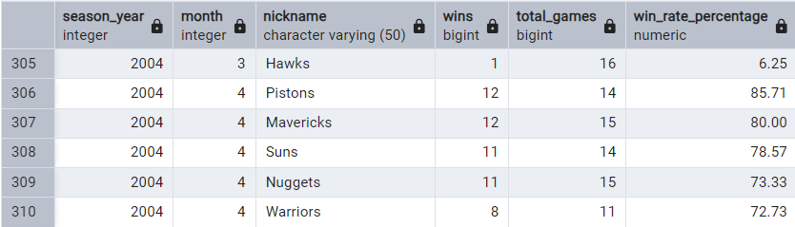
OLAP Queries
Result

Slide 26
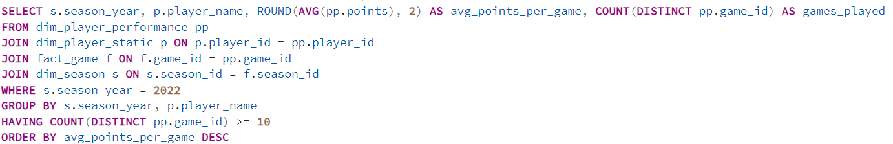
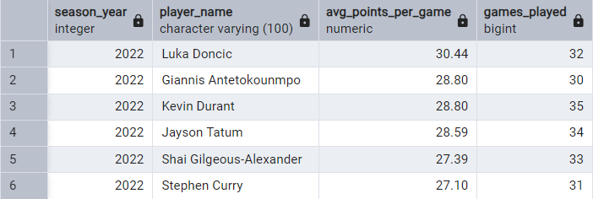
OLAP Queries
Returns the most efficient scorers over a season / over all seasons
Result

Slide 27
Conclusion
Successful Integration of Diverse Datasets, ensuring data consistency and integrity across sources
Implemented a scalable ETL process to extract data from heterogeneous sources, transform it (e.g., cleaning, normalization, aggregation), and load it into the data warehouse

Slide 28
Conclusion
Designed a snowflake schema to balance query performance and storage efficiency
Executed complex OLAP session queries to support multidimensional analysis (e.g., slice-and-dice, drill-down)

Slide 29
Conclusion
We now have a unified and fully homogenized NBA game analytics data warehouse covering the seasons from 2003 to 2022.

Slide 30
Thank You

Slide 31
References
https://www.researchgate.net/publication/237622501_Chapter_I_Conceptual_Modeling_Solutions_for_the_Data_Warehouse DOI:10.4018/978-1-60566-232-9.ch002
https://www.kaggle.com/datasets/nathanlauga/nba-games?resource=download&select=games.csv
https://www.kaggle.com/datasets/justinas/nba-players-data

Slide 32
Appendix
Github Project Link
https://github.com/najeh-halawani/NBA-Data-Warehouse

Slide 33
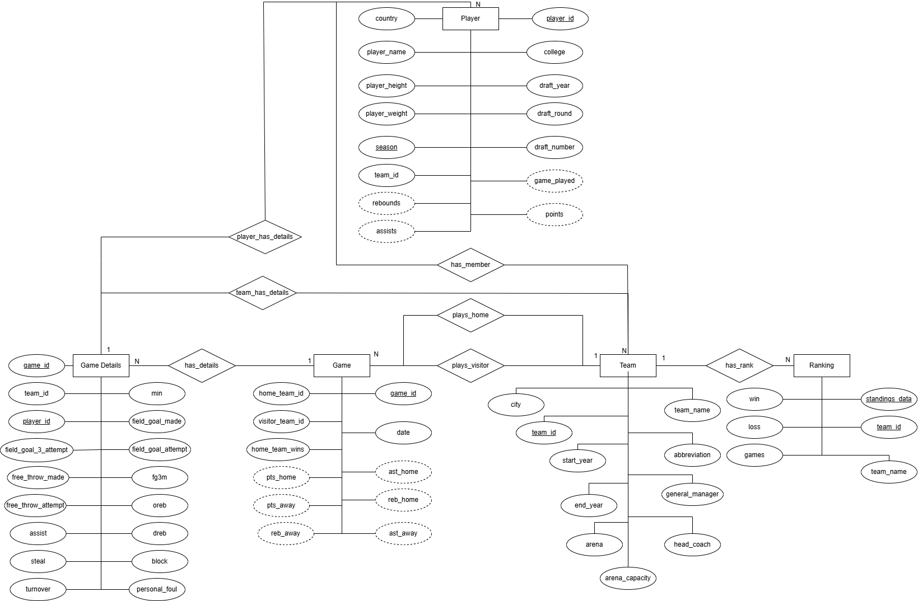
ER-Model
put
Notes:
CHECK IF ANY CHANGE SHOULD BE DONE IN THE PHOTO

