Slide 1
PowerPoint template March 2024

Slide 2
PowerPoint template March 2024

Slide 3
PowerPoint template March 2024

Slide 4
Find ready made cover photos for your presentation on the Brand Center

Slide 5
Find ready made cover photos for your presentation on the Brand Center

Slide 6
Visit Brand Center for pre-approved imagery to place in dynamic slices

Slide 7
Visit Brand Center for pre-approved imagery to place in dynamic slices

Slide 8
Instructions
Instructions are listed within each section below, please read carefully to understand how
to adopt the new template and switch existing content into the new branding
Incorporating slides from existing decks
Do not pull over entire slide. This can, and more than likely will, cause major formatting issues.
The exception to this rule is if the decks use the exact same template. Be cautious, however, just because decks may have similar looks, does not mean they use the same template.
The best way to ensure your content will be formatted correctly is to manually copy and paste each individual element into it’s respective placeholder from deck to the other.
As you add the new items to your template’s placeholder, you may to do some slight adjusting.
This is slightly more time consuming but will result in a better product and will maintain consistency.
If the formatting of the deck you are importing from is poor, don’t expect miracles when importing into this template. Manual adjustments will need to be made.
Open .potx file.
Immediately after opening, navigate to the file menu and select “Save As.”
Save the presentation with an appropriate file name and with the extension .pptx (this ensures the original template file will not be changed).

Slide 9
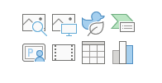
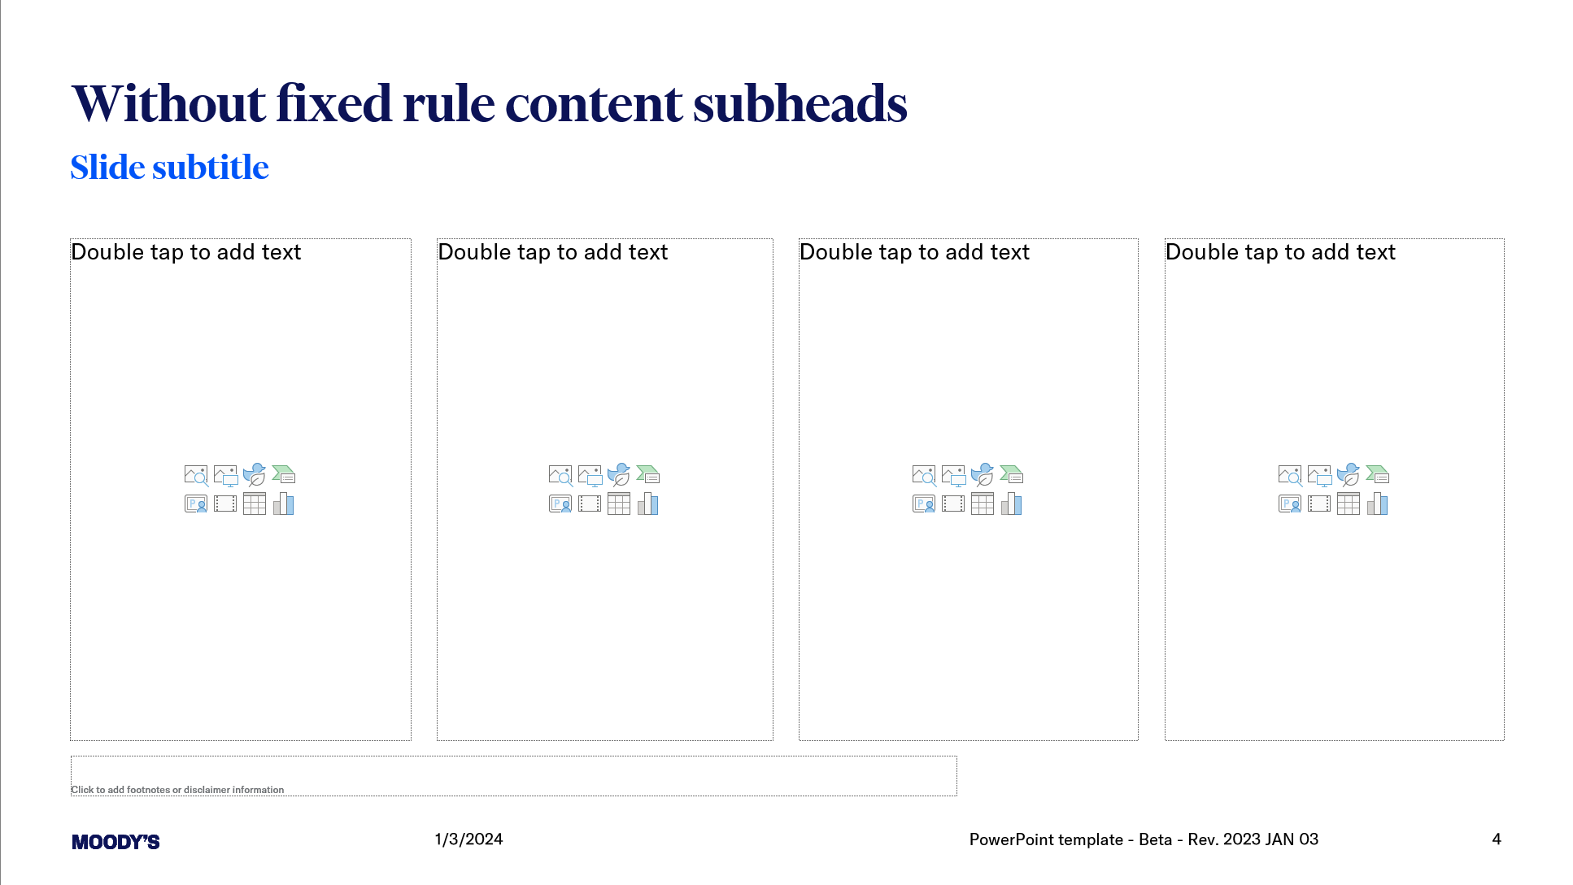
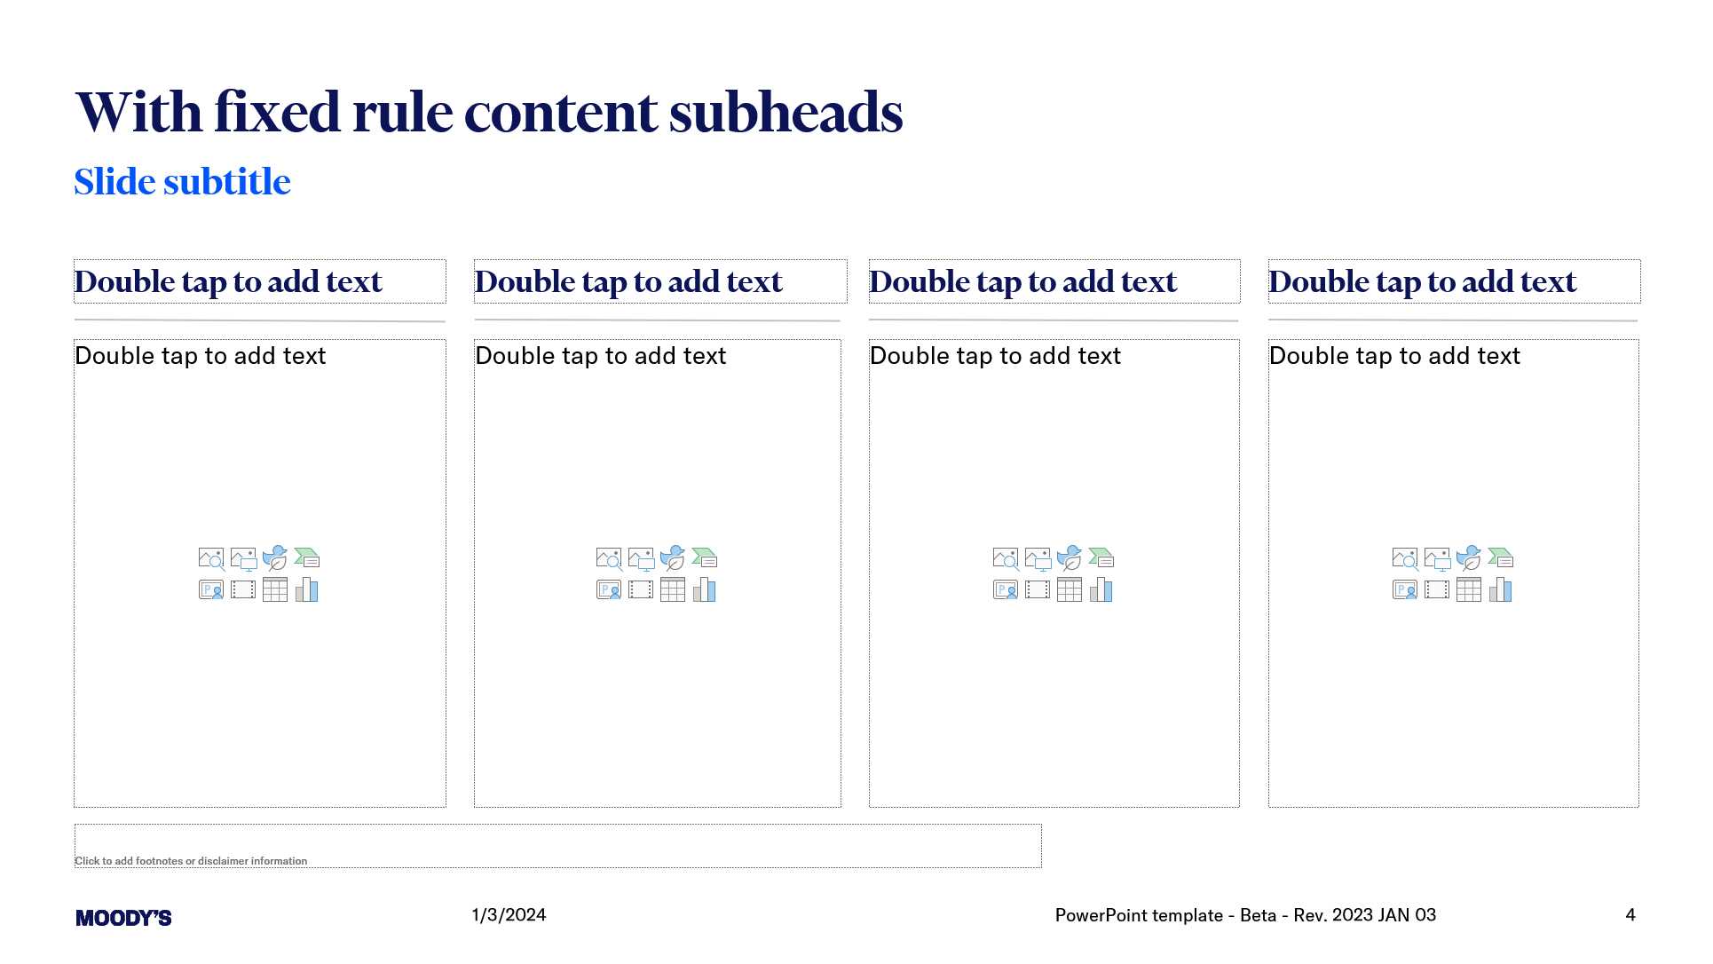
Instructions
Slide content and tools
There are two versions for most slides, one that features a fixed rule and a subhead above content boxes
There is a preformatted box for disclaimers/footnotes/data details at the bottom of every slide
Most slides feature `multi-purpose` boxes and may be used for text, tables, charts, or images.
Most content boxes feature scale to fit so if your content is longer than expected it will adjust automatically.

Slide 10

Instructions
Cover pages
For flexibility purposes, a set of different cover options is available for use
There are currently 7 cover options. You may choose the option either when adding a new slide or changing the layout of an existing slide.
Using the Ribbon; Home>New Slide
Using the Ribbon; Home>Layout
Do not change the design on any cover slide
Slides 1, 2, and 3 are preformatted layouts, use them as they are
You can customize slides 4, 5, 6, and 7 by selecting images from a complete library available on Brand Center

Slide 11
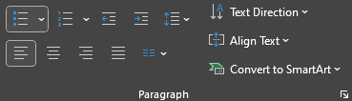

Instructions
Bullet points
Examples of bullet styles/hierarchy
Bullet points are a key component to building compelling presentations, always change levels by using the Increase/Decrease List Level buttons in the Home tab of the ribbon
Level 1
Level 2
Level 3
Level 4
When featuring a single level with short, concise list use Level 2 style
No other bullet style/indent level should appear on a slide that uses arrows/Level 2
For longer lists, or when you need multiple levels, continue increasing your list level
Levels have been preformatted, no need to style or configure manually
For applying bullets styles you have to select the text first (not the box), example:
Bullets styles only apply to boxes that already have the style preformatted, it won’t apply to any text box

Slide 12

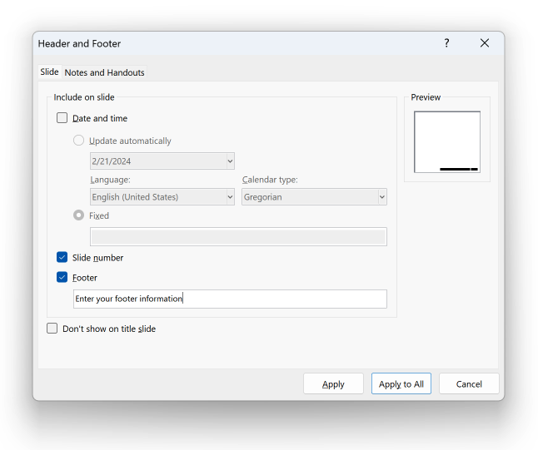
Instructions
Footers and page numbers
PowerPoint may not import your footers or page numbers properly.
If you do not see your footers or page number on a slide, click “Insert” > “Header & Footer“ from the menu bar and insert your footer text in the appropriate box. After, ensure both “Footer” and “Slide number” are selected, then click “Apply to All.”
You may need to deselect, “Apply to All” and then reselect and “Apply to All” for proper formatting to take effect.
If you add a new slide and do not see the appropriate footer, go to a slide with the footer, click “Insert” > “Header & Footer“ from the menu bar, select “Footer” and then click “Apply to All.”
Do not change the Header & Footer on the Master Slides

Slide 13
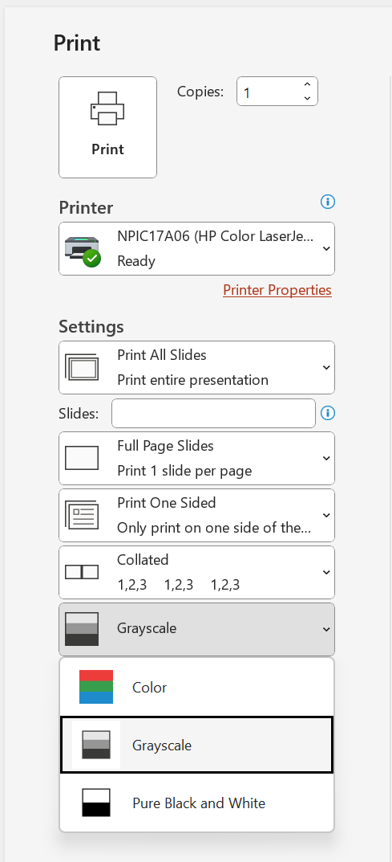
Instructions
Printer ink consumption
All slides have been created so that when printing on a grayscale or black and white printer, full-color backgrounds will be removed, as appropriate.
If you are printing on a color printer and are concerned about ink consumption, there are two options:
Change full-color slides to the matching white background version.
Print in grayscale by selecting the grayscale option from the print dialog menu (see sample to the right).

Slide 14
Instructions
Use of imagery
Slides have preformatted positions for images. Do not reshape image boxes.
When using imagery, be sure to fill the image box.
If you are using text over images, be sure to use images that provide sufficient contrast for legibility. Do not use text over busy images.
If using images from previous presentations, it may be easier to cut and insert the image into a new slide rather than bringing the slide over and applying formatting.
You may need to compress an image to keep file size down. There will be a tradeoff between file size and image quality. Be sure to consider how the presentation will be shown when compressing images to a lower resolution.
Only use approved Moody’s imagery.
Please visit Brand Center for Moody's approved imagery.

Slide 15

Instructions
Cropping images using dynamic slices
To achieve the intended appearance of Dynamic Slices do the following:
Choose an approved Moody’s image
While the image is selected using the Ribbon; Picture Format>Crop
Doing so will allow you to move and scale the image, inside the box
Do not use Dynamic Slices excessively or create new ones

Slide 16
Instructions
SEE A SAMPLE SET OF ICONS VISUALIZING THE COLOR AND STYLE
Icons
Overview
A complete library of icons is available on Brand Center
On light backgrounds, Moody's Blue and Bright Blue is used. On dark backgrounds, we use solely white for clarity and legibility
Do not use icons in any other colors

Slide 17
Instructions
SEE A SAMPLE SET OF ICONS VISUALIZING THE COLOR AND STYLE
Icons
Overview
A complete library of icons is available on Brand Center
On light backgrounds, Moody's Blue and Bright Blue is used. On dark backgrounds, we use solely white for clarity and legibility
Do not use icons in any other colors

Slide 18
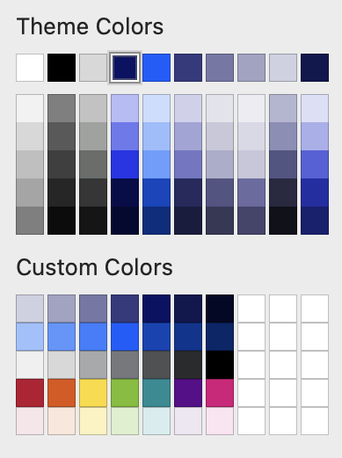
Instructions
Use the sidebar color palette for colorizing charts
Moody’s color palette
Please be advised that while the template utilizes colors from our palette, it does not incorporate every shade available. For comprehensive guidance and access to our full color spectrum, we encourage you to explore the Data Visualization guidelines on Brand Center
USAGE Primary palette: Moody’s Blue 10 and White should be the predominant colors in any layout. Secondary palette: neutral grays support the primary palette. Bright Blue 07 is useful for highlighting text and as a call-to-action in on-screen scenarios. Use Black for blocks of body copy. Tertiary palette: use sparingly, only in instances where data visualization requires an array of colors for differentiation.
Primary Moody’s Blue →
Secondary Bright Blue →
Secondary Neutral Grays →
Tertiary →

Slide 19
Instructions
Examples
Charts and colors
Overview
For an extended guide on visualizations and charts please reference the Data Visualization guidelines on Brand Center
See a sample set of how to apply color to your charts
When you have a chart with 4 or less categories next to a chart with more than 5, please use color palettes as similar as possible

Slide 20
Categorical palettes
Examples
Examples
Primary for 1 category
These are the primary options for a data visualization with one category.
Prioritize using our brand blues for most data visualizations.
Do not use these options together on one chart.
Categorical palettes are all accessibility approved.
ON LIGHT AND EXTRA LIGHT
Bright Blue 07
ON MOODY´S BLUE
Bright Blue 03

Slide 21
Categorical palettes
Examples
Primary for 2 categories
Created out of the primary categorical palette, those premade combinations prioritize our primary brand colors.
Only use those options for a data visualization with two categories.
COMBINATION 1
COMBINATION 2
Bright Blue 07
Teal 04
Bright Blue 07
Yellow 05
COMBINATION 3
COMBINATION 4
Bright Blue 07
Purple 10
Bright Blue 07
Orange 07
COMBINATION 5
Bright Blue 07
Magenta 08
COMBINATION 1
COMBINATION 2
Bright Blue 03
Teal 05
Bright Blue 03
Yellow 04
COMBINATION 3
COMBINATION 4
Bright Blue 03
Purple 07
Bright Blue 03
Orange 04
COMBINATION 5
Bright Blue 03
Magenta 06

Slide 22
Categorical palettes
Examples
Primary for 3 categories
Created out of the primary categorical palette, those premade combinations prioritize our primary brand colors.
Only use those options for a data visualization with three categories.
COMBINATION 1
COMBINATION 2
Bright Blue 07
Teal 04
Yellow 05
Bright Blue 07
Teal 04
Purple 10
COMBINATION 3
COMBINATION 4
Bright Blue 07
Teal 04
Orange 07
Bright Blue 07
Yellow 05
Purple 10
COMBINATION 5
COMBINATION 6
Bright Blue 07
Magenta 08
Green 10
Bright Blue 07
Orange 07
Purple 10
COMBINATION 1
COMBINATION 2
Bright Blue 03
Teal 05
Yellow 04
Bright Blue 03
Teal 05
Purple 07
COMBINATION 3
COMBINATION 4
Bright Blue 03
Teal 05
Orange 05
Bright Blue 03
Yellow 04
Purple 07
COMBINATION 5
COMBINATION 6
Bright Blue 03
Green 02
Magenta 06
Bright Blue 03
Orange 04
Purple 07

Slide 23
Categorical palettes
Examples
Primary for 4 categories
Created out of the primary categorical palette, those premade combinations prioritize our primary brand colors.
Only use those options for a data visualization with three categories.
COMBINATION 1
Bright Blue 07
Teal 04
Yellow 05
Purple 10
COMBINATION 3
Bright Blue 07
Teal 04
Orange 07
Magenta 08
COMBINATION 5
Bright Blue 07
Yellow 05
Magenta 08
Purple 10
COMBINATION 1
Bright Blue 03
Teal 05
Yellow 04
Purple 07
COMBINATION 3
Bright Blue 03
Teal 05
Orange 05
Magenta 07

Slide 24
Categorical palettes
Examples
Primary for +5 categories
ON LIGHT AND EXTRA LIGHT
In order of priority
Bright Blue 07
Teal 04
Yellow 05
Purple 10
Red 06
Orange 07
Magenta 08
Green 10
Blue 12
Blue 02
ON MOODY’S BLUE
In order of priority
Bright Blue 03
Teal 05
Yellow 04
Purple 07
Green 02
Orange 05
Magenta 07
Blue 07
Blue 03
Orange 01

Slide 25
Agenda 1
1 | Topic in GT America Regular Bold 14pt Detail in GT America 14pt, black
2 | This Agenda slide uses a table Insert (or delete) rows to adjust the number of topics
3 | Topic in GT America Regular Bold 14pt Detail in GT America 14pt, black
4 | Topic in GT America Regular Bold 14pt Detail in GT America 14pt, black
5 | Topic in GT America Regular Bold 14pt Detail in GT America 14pt, black

Slide 26
Agenda 2
1 | Topic in GT America Regular Bold 14pt Detail in GT America 14pt, black
2 | This Agenda slide uses a table Insert (or delete) rows to adjust the number of topics
3 | Topic in GT America Regular Bold 14pt Detail in GT America 14pt, black
4 | Topic in GT America Regular Bold 14pt Detail in GT America 14pt, black
5 | Topic in GT America Regular Bold 14pt Detail in GT America 14pt, black

Slide 27
Agenda 3
Topic in GT America Regular Bold 14pt
Bullet level one in GT America 14pt, using “Increase List Level” button
Bullet level one for all subsequent bullets
Poribus daercius eos re
Iusapis et eatet labo
Onsequid que sero
Modigenis et ipic totas
Aut audae pliquaest
Et eos apero occati ium
Il id et eostion sequis moluptatqui cus
Doluptas excesti orrorio
Et eos apero occati ium
Il id et eostion sequis moluptatqui cus
Doluptas excesti or
Dis atem aborporem harcip
Antorecume provit, to evelent deliquatur
Aliate voloriat laborepe

Slide 28
Agenda 4
Topic in GT America Regular Bold 14pt
Bullet level one in GT America 14pt, using “Increase List Level” button
Bullet level one for all subsequent bullets
Poribus daercius eos re
Iusapis et eatet labo
Onsequid que sero
Modigenis et ipic totas
Aut audae pliquaest
Et eos apero occati ium
Il id et eostion sequis moluptatqui cus
Doluptas excesti orrorio
Molut venderum volor
Accus reptae ea dolorum
Eexero mo conserumquo
Optat eum excepe magnis verovidias ma
Nam, adi coreprorem verum
Recepelit optatin nectaturia
Nequianti ullab into est accus idio voloribus eles eum
Iusapis et eatet labo
Onsequid que sero
Modigenis et ipic totas
Aut audae pliquaest
Et eos apero occati ium
Il id et eostion sequis moluptatqui cus
Doluptas excesti or
Dis atem aborporem harcip
Antorecume provit, to evelent deliquatur
Aliate voloriat laborepe

Slide 29
H1 Heading 48pt on up two lines only

Slide 30
H1 Heading 48pt on up two lines only

Slide 31
H1 Heading 48pt for more than two lines should not indent

Slide 32
H1 Heading 48pt for more than two lines should not indent

Slide 33
H1 Heading 48pt on up two lines only

Slide 34
H1 Heading 48pt for more than two lines should not indent

Slide 35
Executive summary style 1
Topic in GT America Bold 18pt
Bullet level one in GT America 14pt, using “Increase List Level” button
Bullet level one for all subsequent bullets
Bullet level one for all subsequent bullets
Exceria sunt et ilia voluptatem tem facepudist haris most
Sequatumene rereperro blatur sed eos et into ommos
Ullabor ibustor essitatum et ressim dellorro tet, occum
Vollo dit arum alicidu ciatem antiusam audaepta quatur
Harunti nctium iur sincto
Optae venis prempor rentius venimus doluptas ratquia
Ullatquiae perio etur aceror seditem utem
Nequi doluptam endios erestin nim idis veliaernatet
Aut quas sit exceperum quodi omnissi ni at optatioris audi
GT America Regular 14pt
Bullet level one in GT America 14pt, using “Increase List Level” button

Slide 36
Executive summary style 2
1 | Topic in GT America Regular Bold 14pt Detail in GT America 14pt, black
2 | This Agenda slide uses a table Insert (or delete) rows to adjust the number of topics
3 | Topic in GT America Regular Bold 14pt Detail in GT America 14pt, black
4 | Topic in GT America Regular Bold 14pt Detail in GT America 14pt, black
5 | Topic in GT America Regular Bold 14pt Detail in GT America 14pt, black
GT America Regular 14pt
Bullet level one in GT America 14pt, using “Increase List Level” button

Slide 37
Executive summary style 3
01
Key takeaway description is GT America Bold 18pt, list level 1
02
Nequianti ullab into est accus idio voloribus eles eum
03
Eations equistion nobis dolupturi qui adiatem tati oressequis
GT America Regular 14pt
Bullet level one in GT America 14pt, using “Increase List Level” button
04
Essint ex et aut ea nim re ped utemporibus
05
Simendestrum alit esto temque volut aut doluptatur
06
Repero beatus aut dio ipiet qui duciendis explatem sitatus vel ipsum ad

Slide 38
Executive summary style 4
Key takeaway description is GT America Bold 18pt, list level 1
Bullet level one in GT America 14pt, using “Increase List Level” button
Adjust the height of this bright blue band to accommodate more or less content
Do not adjust the width
GT America Regular 14pt
Bullet level one in GT America 14pt, using “Increase List Level” button
Exceria sunt, et ilia voluptatem am, tem facepudist haris most
Sequatumene rereperro blatur sed eos et into ommos
Ullabor ibustor essitatum et ressim dellorro tet, occum
Harunti nctium iur sincto
Ella cullestet elescia is molorum et ut ariatem faccae
Solor aceptat ad que est ea consequo qui dit
Aspit, sed era dissitiumque volesequate et offici odio
Dolorio et qui voloreprovid maionsed molor mo et qui que solupienis sunt

Slide 39
Executive summary style 5
Topic in GT America Bold 18pt
Bullet level one in GT America 14pt, using “Increase List Level” button
Bullet level one for all subsequent bullets
Bullet level one for all subsequent bullets
Exceria sunt et ilia voluptatem tem facepudist haris most
Sequatumene rereperro blatur sed eos et into ommos
Ullabor ibustor essitatum et ressim dellorro tet, occum
Vollo dit arum alicidu ciatem antiusam audaepta quatur
Harunti nctium iur sincto
Optae venis prempor rentius venimus doluptas ratquia
Ullatquiae perio etur aceror seditem utem
Nequi doluptam endios erestin nim idis veliaernatet
Aut quas sit exceperum quodi omnissi ni at optatioris audi
GT America Regular 14pt
Bullet level one in GT America 14pt, using “Increase List Level” button

Slide 40
H1 Heading 1-column slide
H2 Heading
H3 Heading
Preformatted list level 0, Intro in GT America Regular 14pt
Preformatted list level 1, GT America Regular 14pt, achieved by using “Increase List Level” button
Preformatted list level Bullet level 2, GT America Regular 14pt, achieved by using “Increase List Level” button
Preformatted list level Bullet level 3, GT America Regular 13pt, achieved by using “Increase List Level” button
Preformatted list level Bullet level 4, GT America Regular 12pt, achieved by using “Increase List Level” button
Preformatted list level Bullet level 5, GT America Regular 12pt, achieved by using “Increase List Level” button

Slide 41
H1 Heading - 2 line title 1-column slide
H3 Heading
Preformatted list level 0, Intro in GT America Regular 14pt
Preformatted list level 1, GT America Regular 14pt, achieved by using “Increase List Level” button
Preformatted list level Bullet level 2, GT America Regular 14pt, achieved by using “Increase List Level” button
Preformatted list level Bullet level 3, GT America Regular 13pt, achieved by using “Increase List Level” button
Preformatted list level Bullet level 4, GT America Regular 12pt, achieved by using “Increase List Level” button
Preformatted list level Bullet level 5, GT America Regular 12pt, achieved by using “Increase List Level” button

Slide 42
H1 Heading - 2-column comparison slide
H2 Heading
H3 Heading
H3 Heading
Essint ex et aut ea nim re ped utemporibus, simendestrum alit esto temque volut aut doluptatur repero beatus aut dio ipiet qui duciendis explatem sitatus vel ipsum ad eations equistion nobis dolupturi qui adiatem tati oressequis aut et aut aut aperatiatest.
Qui doluptatem et repudis moloren dipsam, te lab iminvel iberibus dolorum qui dolorernati verferum
Erumquas minulla borrovit assimi, toratem sant officiisse natium re velitate que volupti busda
Expel ea ducia nullabo reprero bearum faccus essimi, tem ut volesed que qui tempos id ut ilite
Vendiciatat eostia autemodipis reptiam volori nem nosa veliciuntius nonseque il ipsanis secto mi
Qui doluptatem et repudis moloren dipsam, te lab iminvel iberibus dolorum qui dolorernati verferum
Preformatted list level 0, Intro in GT America Regular 14pt
Preformatted list level 1, GT America Regular 14pt, achieved by using “Increase List Level” button
Preformatted list level Bullet level 2, GT America Regular 14pt, achieved by using “Increase List Level” button
Preformatted list level Bullet level 3, GT America Regular 13pt, achieved by using “Increase List Level” button
Preformatted list level Bullet level 4, GT America Regular 12pt, achieved by using “Increase List Level” button
Preformatted list level Bullet level 5, GT America Regular 12pt, achieved by using “Increase List Level” button

Slide 43
H1 Heading - 2 line title 2-column comparison slide
H3 Heading
H3 Heading
Essint ex et aut ea nim re ped utemporibus, simendestrum alit esto temque volut aut doluptatur repero beatus aut dio ipiet qui duciendis explatem sitatus vel ipsum ad eations equistion nobis dolupturi qui adiatem tati oressequis aut et aut aut aperatiatest.
Qui doluptatem et repudis moloren dipsam, te lab iminvel iberibus dolorum qui dolorernati verferum
Erumquas minulla borrovit assimi, toratem sant officiisse natium re velitate que volupti busda
Expel ea ducia nullabo reprero bearum faccus essimi, tem ut volesed que qui tempos id ut ilite
Vendiciatat eostia autemodipis reptiam volori nem nosa veliciuntius nonseque il ipsanis secto mi
Qui doluptatem et repudis moloren dipsam, te lab iminvel iberibus dolorum qui dolorernati verferum
Preformatted list level 0, Intro in GT America Regular 14pt
Preformatted list level 1, GT America Regular 14pt, achieved by using “Increase List Level” button
Preformatted list level Bullet level 2, GT America Regular 14pt, achieved by using “Increase List Level” button
Preformatted list level Bullet level 3, GT America Regular 13pt, achieved by using “Increase List Level” button
Preformatted list level Bullet level 4, GT America Regular 12pt, achieved by using “Increase List Level” button
Preformatted list level Bullet level 5, GT America Regular 12pt, achieved by using “Increase List Level” button

Slide 44
H1 Heading - 2-column comparison slide
H2 Heading
H3 Heading
H3 Heading
Essint ex et aut ea nim re ped utemporibus, simendestrum alit esto temque volut aut doluptatur repero beatus aut dio ipiet qui duciendis explatem sitatus vel ipsum ad eations equistion nobis dolupturi qui adiatem tati oressequis aut et aut aut aperatiatest.
Qui doluptatem et repudis moloren dipsam, te lab iminvel iberibus dolorum qui dolorernati verferum
Erumquas minulla borrovit assimi, toratem sant officiisse natium re velitate que volupti busda
Expel ea ducia nullabo reprero bearum faccus essimi, tem ut volesed que qui tempos id ut ilite
Vendiciatat eostia autemodipis reptiam volori nem nosa veliciuntius nonseque il ipsanis secto mi
Preformatted list level 0, Intro in GT America Regular 14pt
Preformatted list level 1, GT America Regular 14pt, achieved by using “Increase List Level” button
Preformatted list level Bullet level 2, GT America Regular 14pt, achieved by using “Increase List Level” button
Preformatted list level Bullet level 3, GT America Regular 13pt, achieved by using “Increase List Level” button
Preformatted list level Bullet level 4, GT America Regular 12pt, achieved by using “Increase List Level” button
Preformatted list level Bullet level 5, GT America Regular 12pt, achieved by using “Increase List Level” button

Slide 45
H1 Heading - 2-column comparison slide
H2 Heading
H3 Heading
H3 Heading
Essint ex et aut ea nim re ped utemporibus, simendestrum alit esto temque volut aut doluptatur repero beatus aut dio ipiet qui duciendis explatem sitatus vel ipsum ad eations equistion nobis dolupturi qui adiatem tati oressequis aut et aut aut aperatiatest.
Qui doluptatem et repudis moloren dipsam, te lab iminvel iberibus dolorum qui dolorernati verferum
Erumquas minulla borrovit assimi, toratem sant officiisse natium re velitate que volupti busda
Preformatted list level 0, Intro in GT America Regular 14pt
Preformatted list level 1, GT America Regular 14pt, achieved by using “Increase List Level” button
Preformatted list level Bullet level 2, GT America Regular 14pt, achieved by using “Increase List Level” button
Preformatted list level Bullet level 3, GT America Regular 13pt, achieved by using “Increase List Level” button
Preformatted list level Bullet level 4, GT America Regular 12pt, achieved by using “Increase List Level” button
Preformatted list level Bullet level 5, GT America Regular 12pt, achieved by using “Increase List Level” button

Slide 46
H1 Heading - 2-column comparison slide
H2 Heading
H3 Heading
H3 Heading
Preformatted list level 0, Intro in GT America Regular 14pt
Preformatted list level 1, GT America Regular 14pt, achieved by using “Increase List Level” button
Preformatted list level Bullet level 2, GT America Regular 14pt, achieved by using “Increase List Level” button
Preformatted list level Bullet level 3, GT America Regular 13pt, achieved by using “Increase List Level” button
Preformatted list level Bullet level 4, GT America Regular 12pt, achieved by using “Increase List Level” button
Preformatted list level Bullet level 5, GT America Regular 12pt, achieved by using “Increase List Level” button
Essint ex et aut ea nim re ped utemporibus, simendestrum alit esto temque volut aut doluptatur repero beatus aut dio ipiet qui duciendis explatem sitatus vel ipsum ad eations equistion nobis dolupturi qui adiatem tati oressequis aut et aut aut aperatiatest.
Qui doluptatem et repudis moloren dipsam, te lab iminvel iberibus dolorum qui dolorernati verferum
Erumquas minulla borrovit assimi, toratem sant officiisse natium re velitate que volupti busda
Expel ea ducia nullabo reprero bearum faccus essimi, tem ut volesed que qui tempos id ut ilite

Slide 47
H1 Heading - 3-column comparison slide
H2 Heading
H3 Heading
H3 Heading
H3 Heading
Preformatted list level 0, Intro in GT America Regular 14pt
Preformatted list level Bullet level 2, GT America Regular 14pt, achieved by using “Increase List Level” button
Preformatted list level Bullet level 3, GT America Regular 13pt, achieved by using “Increase List Level” button
Preformatted list level Bullet level 4, GT America Regular 12pt, achieved by using “Increase List Level” button
Preformatted list level Bullet level 5, GT America Regular 12pt, achieved by using “Increase List Level” button
Essint ex et aut ea nim re ped utemporibus, simendestrum alit esto temque volut aut doluptatur repero beatus aut dio ipiet qui duciendis explatem sitatus vel ipsum ad eations equistion nobis dolupturi qui adiatem tati oressequis aut et aut aut aperatiatest.
Qui doluptatem et repudis moloren dipsam, te lab iminvel iberibus dolorum qui dolorernati verferum
Erumquas minulla borrovit assimi, toratem sant officiisse natium re velitate que volupti busda
Expel ea ducia nullabo reprero bearum faccus essimi, tem ut volesed que qui tempos id ut ilite
Essint ex et aut ea nim re ped utemporibus, simendestrum alit esto temque volut aut doluptatur repero beatus aut dio ipiet qui duciendis explatem sitatus vel ipsum ad eations equistion nobis dolupturi qui adiatem tati oressequis aut et aut aut aperatiatest.
Qui doluptatem et repudis moloren dipsam, te lab iminvel iberibus dolorum qui dolorernati verferum
Erumquas minulla borrovit assimi, toratem sant officiisse natium re velitate que volupti busda
Expel ea ducia nullabo reprero bearum faccus essimi, tem ut volesed que qui tempos id ut ilite

Slide 48
H1 Heading - 4-column comparison slide
H2 Heading
H3 Heading
H3 Heading
H3 Heading
H3 Heading
Preformatted list level 1, Intro in GT America Regular 14pt
Preformatted list level Bullet level 2, GT America Regular 14pt, achieved by using “Increase List Level” button
Preformatted list level Bullet level 3, GT America Regular 14pt, achieved by using “Increase List Level” button
Essint ex et aut ea nim re ped utemporibus, simendestrum alit esto temque volut aut doluptatur repero beatus aut dio ipiet qui equistion nobis dolupturi qui adiatem tati oressequis aut et aut aut aperatiatest.
Qui doluptatem et repudis moloren dipsam, te lab iminvel iberibus dolorum qui dolorernati verferum
Erumquas minulla borrovit assimi, toratem sant officiisse natium re velitate que volupti busda
Essint ex et aut ea nim re ped utemporibus, simendestrum alit esto temque volut aut doluptatur repero beatus aut dio ipiet qui oressequis aut et aut aut aperatiatest.
Qui doluptatem et repudis moloren dipsam, te lab iminvel iberibus dolorum qui dolorernati verferum
Erumquas minulla borrovit assimi, toratem sant officiisse natium re velitate que volupti busda
Essint ex et aut ea nim re ped utemporibus, simendestrum alit esto nobis dolupturi qui adiatem tati oressequis aut et aut aut aperatiatest.
Qui doluptatem et repudis moloren dipsam, te lab iminvel iberibus dolorum qui dolorernati verferum
Erumquas minulla borrovit assimi, toratem sant officiisse natium re velitate que volupti busda

Slide 49
Main quote in Financier Display Semibold 42pt velesto reperum. Vident alitatempel iunto blanduciet prempora comnihicia dolorruptae volorum, velectae dem harchil eum rum lit exped iunto blanduciet olupta.
Firstname Lastname in GT America Medium 24pt

Slide 50
Main quote in Financier Display Semibold 42pt velesto reperum. Vident alitatempel iunto blanduciet prempora comnihicia dolorruptae volorum, velectae dem harchil eum rum lit exped iunto blanduciet olupta.
Firstname Lastname in GT America Medium 24pt

Slide 51
Main quote in Financier Display Semibold 42pt velesto reperum. Vident alitatempel iunto blanduciet prempora comnihicia dolorruptae volorum, velectae dem harchil eum rum lit exped iunto blanduciet olupta.
Firstname Lastname in GT America Medium 24pt

Slide 52

Photo layout
1:1
Vident alitatempel iunto blanduciet
Intro Paragraph. Essint ex et aut ea nim re ped utemporibus, repero beatus simendestrum alit esto temque volut aut.
Et fugit ma qui od utenistio est quatem eos velitatur, ulparum sed unt invendiorum restrum quas dolectur? Qui doluptatem et repudis moloren dipsam, te lab iminvel iberibus dolorum qui dolorernati verferum Erumquas minulla borrovit assimi, toratem sant officiisse natium re velitate que volupti busdam, sunt eatiatecte cus prae non natiumq uiantus.
Sitioreperum estemol eseque nobis venda dis expernatem arcipsandit as ex etur molupti voloribus, volupta ab illuptae sape sitis ditaesti opta nist quia apientium vellent anit vollores nectem ut exernatquiam aut volorer fernatur, omnihilia volum fuga.

Slide 53

Photo layout
Ultra wide
H3 Heading
Bullet level one in GT America 14pt, using “Increase List Level” button
Bullet level one for all subsequent bullets
Bullet level one for all subsequent bullets
H3 Heading
Bullet level one in GT America 14pt, using “Increase List Level” button
Bullet level one for all subsequent bullets
Bullet level one for all subsequent bullets
H3 Heading
Bullet level one in GT America 14pt, using “Increase List Level” button
Bullet level one for all subsequent bullets
Bullet level one for all subsequent bullets

Slide 54
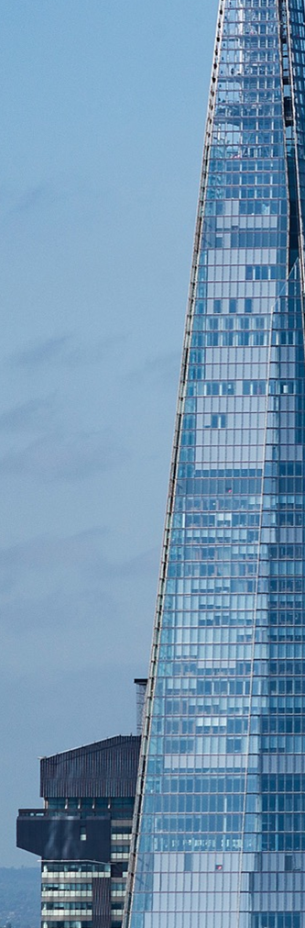
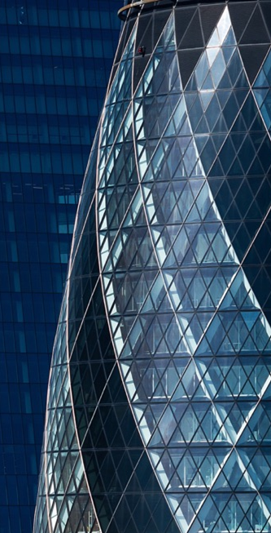
Dynamic slices
Light layout featuring split images
H3 Heading
Intro Paragraph. Essint ex et aut ea nim re ped utemporibus, repero beatus simendestrum alit esto temque volut aut.
Et fugit ma qui od utenistio est quatem eos velitatur, ulparum sed unt invendiorum restrum quas dolectur? Qui doluptatem et repudis moloren dipsam, te lab iminvel iberibus dolorum qui dolorernati verferum Erumquas minulla borrovit assimi, toratem sant officiisse natium re velitate que volupti busdam, sunt eatiatecte cus prae non natiumq uiantus.
Sitioreperum estemol eseque nobis venda dis expernatem arcipsandit as ex etur molupti voloribus, volupta ab illuptae sape sitis ditaesti opta nist quia apientium vellent anit vollores nectem ut exernatquiam aut volorer fernatur, omnihilia volum fuga.

Slide 55
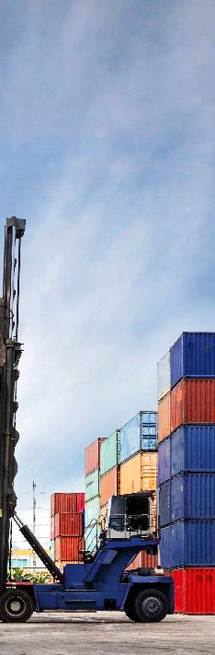

Dynamic slices
Dark layout featuring split images
Intro Paragraph. Essint ex et aut ea nim re ped utemporibus, repero beatus simendestrum alit esto temque volut aut.
Et fugit ma qui od utenistio est quatem eos velitatur, ulparum sed unt invendiorum restrum quas dolectur? Qui doluptatem et repudis moloren dipsam, te lab iminvel iberibus dolorum qui dolorernati verferum Erumquas minulla borrovit assimi, toratem sant officiisse natium re velitate que volupti busdam, sunt eatiatecte cus prae non natiumq uiantus.
Sitioreperum estemol eseque nobis venda dis expernatem arcipsandit as ex etur molupti voloribus, volupta ab illuptae sape sitis ditaesti opta nist quia apientium vellent anit vollores nectem ut exernatquiam aut volorer fernatur, omnihilia volum fuga.

Slide 56
Dynamic slices
Use this box for a quote with list level 1 or delete the text and use it for an image in the dynamic slice.
Light layout featuring color block and quote
H3 Heading
Intro Paragraph. Essint ex et aut ea nim re ped utemporibus, repero beatus simendestrum alit esto temque volut aut.
Et fugit ma qui od utenistio est quatem eos velitatur, ulparum sed unt invendiorum restrum quas dolectur? Qui doluptatem et repudis moloren dipsam, te lab iminvel iberibus dolorum qui dolorernati verferum Erumquas minulla borrovit assimi, toratem sant officiisse natium re velitate que volupti busdam, sunt eatiatecte cus prae non natiumq uiantus.
Sitioreperum estemol eseque nobis venda dis expernatem arcipsandit as ex etur molupti voloribus, volupta ab illuptae sape sitis ditaesti opta nist quia apientium vellent anit vollores nectem ut exernatquiam aut volorer fernatur, omnihilia volum fuga.

Slide 57

Dynamic Slices
Dark layout featuring color block and photo
Use this box for a quote with list level 1 or delete the text and use it for an image in the dynamic slice.
H3 Heading
Intro Paragraph. Essint ex et aut ea nim re ped utemporibus, repero beatus simendestrum alit esto temque volut aut.
Et fugit ma qui od utenistio est quatem eos velitatur, ulparum sed unt invendiorum restrum quas dolectur? Qui doluptatem et repudis moloren dipsam, te lab iminvel iberibus dolorum qui dolorernati verferum Erumquas minulla borrovit assimi, toratem sant officiisse natium re velitate que volupti busdam, sunt eatiatecte cus prae non natiumq uiantus.
Sitioreperum estemol eseque nobis venda dis expernatem arcipsandit as ex etur molupti voloribus, volupta ab illuptae sape sitis ditaesti opta nist quia apientium vellent anit vollores nectem ut exernatquiam aut volorer fernatur, omnihilia volum fuga.

Slide 58
Feature content
Comparing and contrasting
H3 Heading
Et fugit ma qui od utenistio est quatem eos velitatur, ulparum sed unt invendiorum restrum quas dolectur? Qui doluptatem et repudis moloren dipsam, te lab iminvel iberibus dolorum qui dolorernati verferum
GT America Bold 15pt, list level 1
GT America Regular 14pt, list level 2
Bulleted list GT America Regular 14pt, list level 3
Detail 2
Qui doluptatem et repudis moloren dipsam, te lab iminvel iberibus dolorum qui dolorernati verferum
Cae velit licatem uga
Nemquosam id quia nonsecu llatinis
Detail 3
Musaperem adit alis consequam que eaqui omnimendae volorio nectiun totatur
Unt lautatias nonsedis et aditisque molorehent doloribus denian

Slide 59
Feature content
Detail 1
GT America Regular 14pt, list level 2
Bulleted list GT America Regular 14pt, list level 3
Detail 2
Dolorum qui dolorernati
Detail 3
Qui doluptatem et repudis moloren dipsam, te lab iminvel iberibus
Comparing and contrasting
Single line subhead
Et fugit ma qui od utenistio est quatem eos velitatur, ulparum sed unt invendiorum restrum quas dolectur? Qui doluptatem et repudis moloren dipsam, te lab iminvel iberibus dolorum qui dolorernati verferum

Slide 60

Feature content
Detail 2
Qui doluptatem et repudis moloren dipsam, te lab iminvel iberibus dolorum qui dolorernati verferum
Cae velit licatem uga
Nemquosam id quia nonsecu llatinis
Entur reium evellest omnianda quiam
Comparing and contrasting in quadrants
Single line subhead
Use only one box for a photo
Use only one box for a quote
Multiple charts may be used
“Quote, Financier Semibold 21pt, list level 1. Qui doluptatem erat dolorum et repudis moloren dipsam, te lab blanduciet prempora”
Attribution, GT America Regular 14pt

Slide 61
Sample charts
Bar chart and pie chart

Slide 62
Sample charts
Line charts

Slide 63
Sample table layouts
Simple
Nos experis eaquo | Odiam ea dolor | Susdae occatistiis | Rumque simolenis | Ucilis sin event
Qui cora niscias dunto
Susdae occatistiis
Cus volorro magnim
Unto iliciis molore
Uptaturis et qui adipsam
Landucil maio
Ditam qui omnihillit
Bust ad eos is et
Vit labo

Slide 64
Sample table layouts
Bold headers and feature rows
Nos experis eaquo | Odiam ea dolor | Susdae occatistiis | Rumque simolenis | Ucilis sin event
Qui cora niscias dunto
Susdae occatistiis
Cus volorro magnim
Unto iliciis molore
Uptaturis et qui adipsam
Landucil maio
Ditam qui omnihillit
Bust ad eos is et
Vit labo

Slide 65
Sample table layouts
Complex with featured columns
Policy | Expiry | Location | State | Region | InsuredValue | Construction | BusinessType | Earthquake | Flood
Susdae
100242 | 2-Jan-21 | Urban | NY | East | 1,617,630 | Frame | Retail | N | N
100314 | 2-Jan-21 | Urban | NY | East | 8,678,500 | Fire Resist | Apartment | Y | Y
100359 | 2-Jan-21 | Rural | WI | Midwest | 2,052,660 | Frame | Farming | N | N
100315 | 3-Jan-21 | Urban | NY | East | 17,580,000 | Frame | Apartment | Y | Y
100385 | 3-Jan-21 | Urban | NY | East | 1,925,000 | Masonry | Hospitality | N | N
100388 | 4-Jan-21 | Urban | IL | Midwest | 12,934,500 | Frame | Apartment | Y | Y
100358 | 5-Jan-21 | Urban | WI | Midwest | 928,300 | Masonry | Office Bldg | N | N
Occatistiis
100264 | 7-Jan-21 | Rural | NY | East | 2,219,900 | Frame | Farming | N | N
100265 | 7-Jan-21 | Urban | NY | East | 14,100,000 | Frame | Apartment | Y | Y
100357 | 8-Jan-21 | Urban | NY | East | 4,762,808 | Masonry | Other | Y | Y
100399 | 8-Jan-21 | Urban | NY | East | 13,925,190 | Frame | Apartment | Y | Y
100329 | 9-Jan-21 | Urban | NY | East | 6,350,000 | Frame | Apartment | Y | Y
100429 | 9-Jan-21 | Urban | WI | Midwest | 4,036,000 | Masonry | Medical | Y | Y
100441 | 10-Jan-21 | Urban | NJ | East | 472,800 | Masonry | Retail | Y | Y

Slide 66

Team lead
Firstname Lastname
Title, Department
Et fugit ma qui od utenistio est quatem eos velitatur, ulparum sed unt invendiorum restrum quas dolectur. Qui doluptatem et repudis moloren dipsam, te lab iminvel iberibus dolorum qui dolorernati verferum.
Erumquas minulla borrovit assimi, toratem sant officiisse natium re velitate que volupti busdam, sunt eatiatecte cus prae non natiumq uiantus.
Sitioreperum estemol eseque nobis venda dis expernatem arcipsandit as ex etur molupti voloribus, volupta ab illuptae sape sitis ditaesti opta nist quia apientium
Vellent anit vollores nectem ut exernatquiam aut volorer fernatur
Omnihilia volum fuga.Litatiur sam et quam hil inulpa sandae preriaestio.
Itatur, si debit ero dolo tem dolorro fugitiae evelest evelitio.
Team name/role

Slide 67
Team lead
Team name/role
This bio can be set to use one or two columns.
Sitioreperum estemol eseque nobis venda dis expernatem arcipsandit as ex etur molupti voloribus, volupta ab illuptae sape sitis ditaesti opta nist quia apientium vellent anit vollores nectem ut exernatquiam aut volorer fernatur, omnihilia volum fuga.Litatiur sam et quam hil inulpa sandae preriaestio.
Sitioreperum estemol eseque nobis venda dis expernatem arcipsandit as ex etur molupti voloribus, volupta ab illuptae sape sitis ditaesti opta nist quia apientium vellent anit vollores nectem ut exernatquiam aut volorer fernatur, omnihilia volum fuga.Litatiur sam et quam hil inulpa sandae preriaestio. Itatur, si debit ero dolo tem dolorro.
Erumquas minulla borrovit assimi, toratem sant officiisse natium re velitate que volupti busdam, sunt eatiatecte cus prae non natiumq uiantus.
Ro denim esequam fugit, omnis a con eost as delique volupta temporescia num la si dolut velis. Itatur, si debit ero dolo tem dolorro.
Qui doluptatem et repudis moloren dipsam, te lab iminvel iberibus dolorum qui dolorernati verferum laboreperum int, qui occatem porehent modi utassequunt everum rem voluptae sitiur aut.
Erumquas minulla borrovit assimi, toratem sant officiisse natium re velitate que volupti busdam
Firstname Lastname
Title/department
Contact information 1
Contact information 2

Slide 68
Team lead
Firstname Lastname
Title/department
This bio can be set to use two columns. Et fugit ma qui od utenistio est quatem eos velitatur, ulparum sed unt invendiorum restrum quas dolectur. Qui doluptatem et repudis moloren dipsam, te lab iminvel iberibus dolorum qui dolorernati verferum.
Sitioreperum estemol eseque nobis venda dis expernatem arcipsandit as ex etur molupti Sitioreperum estemol eseque nobis venda dis expernatem arcipsandit as ex etur molupti voloribus, volupta ab illuptae sape sitis ditaesti opta nist quia apientium vellent anit vollores nectem ut exernatquiam aut volorer fernatur, omnihilia volum fuga.Litatiur sam et quam hil inulpa sandae preriaestio. Itatur, si debit ero dolo tem dolorro.
Ro ui doluptatem et repudis moloren dipsam, te lab iminvel iberibus dolorum qui dolorernati verferum laboreperum int, qui occatem porehent modi utassequunt everum rem voluptae sitiur aut.
Erumquas minulla borrovit assimi, toratem sant officiisse natium re velitate que volupti busdam
Les ant. Ut a namus magni bearit eum landebis sit auditio bero doles que dellandis experia ipsam, officab oreiunt hictur cus
Fugitasim conet a quis ipsant ut ut voluptas deliquos quidebi taernatessin consenita
Team name/role

Slide 69
Contact sheet 4-up
Firstname Lastname
Title/department
Firstname Lastname
Title/department
Firstname Lastname
Title/department
Firstname Lastname
Title/department

Slide 70
Contact sheet
5-up
Firstname Lastname
Title/department
Contact information 1
Contact information 2
Firstname Lastname
Title/department
Contact information 1
Contact information 2
Firstname Lastname
Title/department
Contact information 1
Contact information 2
Firstname Lastname
Title/department
Contact information 1
Contact information 2
Firstname Lastname
Title/department
Contact information 1
Contact information 2

Slide 71
Contact sheet
9-up
Firstname Lastname
Title/department
Contact information 1
Firstname Lastname
Title/department
Contact information 1
Firstname Lastname
Title/department
Contact information 1
Firstname Lastname
Title/department
Contact information 1
Firstname Lastname
Title/department
Contact information 1
Firstname Lastname
Title/department
Contact information 1
Firstname Lastname
Title/department
Contact information 1
Firstname Lastname
Title/department
Contact information 1
Firstname Lastname
Title/department
Contact information 1

Slide 72
Contact sheet
12-up
Firstname Lastname
Title/department
Contact information 1
Firstname Lastname
Title/department
Contact information 1
Firstname Lastname
Title/department
Contact information 1
Firstname Lastname
Title/department
Contact information 1
Firstname Lastname
Title/department
Contact information 1
Firstname Lastname
Title/department
Contact information 1
Firstname Lastname
Title/department
Contact information 1
Firstname Lastname
Title/department
Contact information 1
Firstname Lastname
Title/department
Contact information 1
Firstname Lastname
Title/department
Contact information 1
Firstname Lastname
Title/department
Contact information 1
Firstname Lastname
Title/department
Contact information 1

Slide 73
Thank you
Firstname Lastname
Title/department
Contact information 1
Firstname Lastname
Title/department
Contact information 1
Firstname Lastname
Title/department
Contact information 1

Slide 75
SCOR Managing Agency

Slide 76
Executive summary

Slide 77
Contractual position summary
Document | Date | Agreement Ref | Key point | Fee impact
Base Order Form | 23 Dec 2016 | 00073841.0 | Framework baseline for current service | Legacy baseline
Renewal Notification | 23 Dec 2023 | 00073841.7 | Annual renewal continuity | GBP 50,364
Renewal Notification | 23 Dec 2024 | 00073841.8 | Annual renewal continuity | GBP 52,379
Renewal Notification | 23 Dec 2025 | 00073841.9 | Annual renewal continuity | GBP 53,950
Amendment 1 | 23 Dec 2025 | 00073841.9 | Name/address + sanctions clause update | No explicit change

Slide 78
Commercial trend: annual renewal fees

Slide 79
Use case and operating model
1
2

Slide 80
Recent topics with SCOR
Topic | Client ask | Why it matters | Recommended follow-up
Renewal term | Single-year renewal instead of multi-year | Preference for flexibility in commitment horizon | Position multi-year as optional value lever, not prerequisite
Output delivery | Quarterly calibration output in CSV | Could reduce operational burden for SCOR team | Assess delivery model and commercial treatment
Corporate bond parameters | Clarify NumberOfBonds and Coupon settings | Directly impacts modeled returns | Provide documented parameter guidance
Dummy values | Implication of NumberOfBonds=1 and Coupon=0 | Risk of unrealistic outputs/model distortion | Run controlled test and share quantified impact

Slide 81
Recommended next steps

Slide 82
Thank you

