Slide 1
Scenario Generator FRR/Moody's

Slide 2
Introduction to the Scenario Generator

Slide 3
What is an Economic Scenario Generator?
Generates scenarios for various economic variables and asset returns using Monte Carlo simulation
Generate 1000s of different paths of an economy by stochastically modelling many different risk drivers
Interest rates, equity returns, corporate bond returns
Two main uses:
Real world projections for risk management
Market-consistent valuation for pricing
A simulation is a collection of many paths (trials)
x5,000
Single path
Distribution of paths
Notes:
The future value of economic variables and asset prices is uncertain, and this generates financial market risk for companies who hold financial assets and/or make financial promises to costumers.
An Economic Scenario Generator (ESG) is a set of mathematical models that, with appropriate parameterization, describe the future behaviour of economic variables and asset prices.
Thus, our ESG is useful in answering questions about the value of, or risk characteristics of, cash flows which depend upon the future value of economic variables.
Moody’s Analytics Economic Scenario Generator is implemented as a Monte-Carlo tool capable of generating large numbers of possible scenarios for capital markets.
It enables business managers to perform two types of analysis that put quite different demands on the asset modeller:
Economic capital assessment and capital management – this is achieved with Real-World projections
Pricing – this is achieved with Market-consistent valuation
By using computer simulation techniques it is possible to generate a very large number of scenarios for future behaviour of the capital markets, driven by a stochastic model, in order to understand financial risk.
Moody’s Analytics Economic Scenario Generator is implemented using Monte Carlo simulation, which generates 1000s of different paths of the economy, attained by stochastically modelling different risk drivers.
A (Monte Carlo) simulation is a collection of paths (called trials), and by studying the distribution of the paths it is possible to get a feel for the expected behaviour of the risk drivers being modelled, and thereby of the economy.
The fundamental risk drivers in the ESG models are real and nominal interest rates, equity returns (individual shares, sector and market indices, …), credit (corporate bonds, credit derivatives, credit spreads, …), currency (FX rates), inflation (consumer price inflation, …)
Both Real World projections and Market Consistent Valuation of insurers’ assets and liabilities usually involve the use of Monte Carlo scenarios produced by an Economic Scenario Generator. This is because, as mentioned in previous slide, the complex, path-dependent, nature of these assets and liabilities usually prohibits the use of the other valuation techniques, such as the use of analytic formulae.
------------------------------
Both Real World projections and Market Consistent Valuation of insurers’ assets and liabilities usually involve the use of Monte Carlo scenarios produced by an Economic Scenario Generator. This is because, as mentioned in previous slide, the complex, path-dependent, nature of these assets and liabilities usually prohibits the use of the other valuation techniques, such as the use of analytic formulae.
(As mentioned in the previous slide) Moody’s Analytics Economic Scenario Generator is implemented using Monte Carlo simulation, which generates 1000s of different paths of the economy, attained by stochastically modelling different risk drivers.
A (Monte Carlo) simulation is a collection of paths (called trials), and by studying the distribution of the paths it is possible to get a feel for the expected behaviour of the risk drivers being modelled, and thereby of the economy.
The fundamental risk drivers in the ESG models are real and nominal interest rates, equity returns (individual shares, sector and market indices, …) credit (corporate bonds, credit derivatives, credit spreads, …) currency (FX rates), inflation (consumer price inflation, …)
“Monte Carlo simulation techniques can be used in situations where it is possible to understand the factors which affect a problem, but where it is difficult to say what happens when all of the factors apply at the same time. For the problems that financial analysts are concerned with, we think we know something about the behaviour of capital markets as well as the structure of financial products and other ‘rules’ which determine the future behaviour of liabilities. Monte Carlo simulation can be used to understand how assets and liabilities might behave in a hypothetical environment. Various characteristics can be mapped out by using a computer to generate different capital market environments. In each simulated market future (also called a ‘scenario’ or a ‘trial’), a path for the behaviour of assets and liabilities is projected. By keeping a record of each simulation result, it is possible to create an estimate of the probability of different outcomes by seeing how often they are observed in the overall simulation. (…) Like any other piece of analysis, Monte Carlo models are only as good as the assumptions fed in by the modeller, including both the choice of models as well as the individual parameters for each model.”
“The Barrie&Hibbert ESG is a framework of mathematical models and calibration methods that can be used for a wide range of applications. It offers a range of models for each risk factor, each of which has different features and levels of sophistication. This allows us to select the model that best meets a particular challenge without introducing unnecessary complexity. The models and associated calibrations presented in this note represent our choice for generating realistic scenarios for liability valuation.”

Slide 4
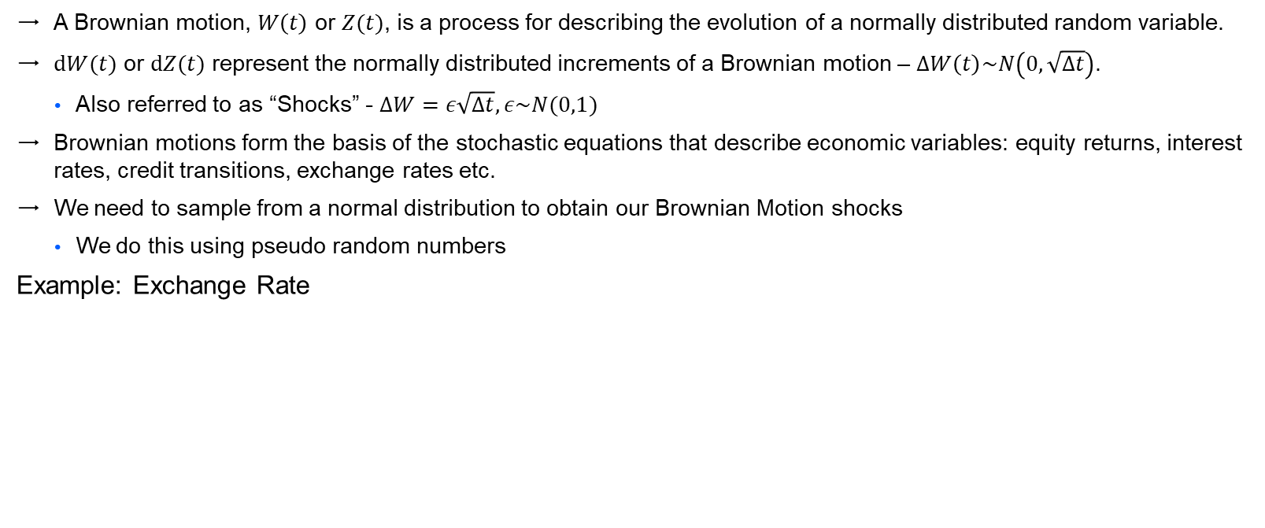
Economic Scenarios and Brownian Motion
A Brownian motion, $W\left(t\right)$ or $Z(t)$, is a process for describing the evolution of a normally distributed random variable.
$dW(t)$ or $dZ(t)$ represent the normally distributed increments of a Brownian motion – $ΔW\left(t\right)\sim N\left(0,\sqrt{Δt}\right)$.
Also referred to as “Shocks” - $ΔW=ε\sqrt{Δt}, ε\sim N(0,1)$
Brownian motions form the basis of the stochastic equations that describe economic variables: equity returns, interest rates, credit transitions, exchange rates etc.
We need to sample from a normal distribution to obtain our Brownian Motion shocks
We do this using pseudo random numbers
Example: Exchange Rate
f(W_{t} , t)
Notes:
Brownian motion is described by the Wiener process
A Wiener Process is a particular type of continuous-time Markov stochastic process, and is sometimes referred to as Brownian Motion. However, to be accurate, a Wiener Process refers to a mathematical model used to describe Brownian motions, which refer to microscopic particles zigzagging under the continuous buffering of a gas, first observed by Robert Brown.
We denote these Wiener Processes by $dW(t)$ or $dZ(t)$, which follow a normal distribution with 0 mean and standard deviation equal to the square root of the time increment: $dW\left(t\right)∼N\left(0,\sqrt{dt}\right)$.
Wiener Processes form the random component of the stochastic equations that describe economic variables, such as equity returns, credit transitions, exchange rates, etc.
Notes:
$ΔZ=ε\sqrt{Δt}, ε∼N\left(0,1\right)⇒ΔW\left(t\right)∼N\left(0,\sqrt{Δt}\right),W\left(t\right)∼N\left(0,\sqrt{t}\right)$
The standard normal variables $ϵ$ are referred to as shocks
(when we use an ESG to tackle questions of risk and value, we produce a large number of economic scenarios driven by ESG models. Each single scenario represents a possible future path, and corresponds to one particular set of the mathematical shocks that represent the future news.)
$ΔZ$ follows a Markov process: a Markov process is a stochastic process where only the present value of a variable is relevant for predicting the future, which implies that the value of the variable at any future time is independent of its value at future times.
“(…) the models that make up our ESG must reflect the uncertainty that we have over future values. For example, we do not know what value a stock index will be one year from now, or the rate of inflation over the coming year. Therefore, these models do not tell us what these values will be in the future. Rather, they incorporate an unpredictable (random or stochastic) component that represent the future information – unknown today – that will drive changes in these variables. By considering a range of values for these random components – known as ‘shocks’ – we are able to generate a large number of potential future scenarios for the variables. Therefore, when we use an ESG to tackle questions of risk and value, we produce a large number of economic scenarios driven by ESG models. Each single scenario represents a possible future path, and corresponds to one particular set of the mathematical shocks that represent the future news.”

Slide 5
Use Cases
Valuation Complex liabilities with uncertain cashflow
Solvency
/ Capital Modelling for
Solvency II Regulation
Risk Management
Wide range of Real-World applications
Notes:
Motivation:
Insurance companies and pension funds are in the risk management business, in the sense that they act as financial intermediaries who pool and manage risks on behalf of individuals
The risk exposures come in many different forms (risks arising from pure insurance exposures, risks arising from variations in asset values, operational risk, etc.)
Market Consistent Valuation
Pricing – this is achieved with Market-consistent valuation:
Where the primary purpose of the model is to value any contingent claim in a way which is consistent with traded financial assets (market-consistent valuation).
Market-consistent valuations is more straightforward in the sense that, once we have collected a set of market prices the objective is to select a model and configure it so that it recovers specified prices within an acceptable level of tolerance. (However, market-consistent valuation will sometimes have to use real-world parameters in the calibration, when there is no market data available for the types of financial risk the insurer is offering).
The business manager will be able to answer questions such as:
“What is the fair price for a product (or a set of financial promises)?”
“How should the charge for any financial guarantee be invested in order to minimize the asset-liability mismatch created by the product?”
Real World Projections
Economic capital assessment and capital management – this is achieved with Real-World projections:
Projection of assets and liabilities, in a way which is consistent with our ‘real-world’ views of the possible future behaviour of assets and liabilities.
The projection application of a model should be capable of capturing vires on important features of the world in which the financial entity operates, for example:
The existence of risk premiums associated with equity risk, term risk, credit risk or currency risk.
The shape of distributions for asset returns – in particular the potential frequency of extreme outcomes.
The dependency of asset returns through time.
The correlation of returns between different asset types.
The business manager will be able to answer questions such as
“How confident can we be that the financial intermediary will meet its obligations?”
“How much capital is required so that liabilities can be met with a specified level of confidence?”
“Given this capital requirement, how should the capital cost be regarded to the business unit?”
“How variable is this economic capital requirement likely to be in the future?”
“How can assets be invested to minimize the amount of economic capital (and its future liability)?”
Capital Modelling:
Isurance companies need to define a sufficient level of capital such that they can withstand a 1 in 200 year (1/200=0.5%) event in terms of the risks they face – both market (e.g. changes in interest rates) and non-market risk (e.g. mortality risk).
“VaR is typically used by firms and regulators in the financial industry to gauge the amount of assets needed to cover possible losses.”
Risk Management
Takes long term views to understand strategies for managing risk
---------------------------------------------------------------
1 year-VaR: essentially we are asking the question” What is the maximum percentage I can - with 99.5% confidence - expect to lose over the next year?”; “what is my worst case scenario?”
“VaR is typically used by firms and regulators in the financial industry to gauge the amount of assets needed to cover possible losses.”
---------------------------------------------
Motivation:
Insurance companies and pension funds are in the risk management business, in the sense that they act as financial intermediaries who pool and manage risks on behalf of individuals
The risk exposures come in many different forms (risks arising from pure insurance exposures, risks arising from variations in asset values, operational risk, etc.)
Our focus is on the risk that an intermediary will fail to meet its obligations due to mismatch between the value of its assets and the liabilities it has promised to pay as they fall due.
In particular, we are interested in the possible behaviour of assets over the very long planning horizons faced by insurance companies and pension funds.
Most financial instruments don’t have closed form solutions for their pricing and projection, and therefore simulation methods are used when no analytical methods are available.
“The future value of economic variables and asset prices is uncertain, and this generates financial market risk for companies who hold financial assets and/or make financial promises to costumers. An Economic Scenario Generator (ESG) is a set of mathematical models that, with appropriate parameterization, describe the future behaviour of economic variables and asset prices. Thus our ESG is useful in answering questions about the value of, or risk characteristics of, cash flows which depend upon the future value of economic variables.”
ESG
By using computer simulation techniques it is possible to generate a very large number of scenarios for future behaviour of the capital markets, driven by a stochastic model, in order to understand financial risk.
Moody’s Analytics Economic Scenario Generator is implemented as a Monte-Carlo tool capable of generating large numbers of possible scenarios for capital markets.
It enables business managers to perform two types of analysis that put quite different demands on the asset modeller:
Real World Projections
Economic capital assessment and capital management – this is achieved with Real-World projections:
Projection of assets and liabilities, in a way which is consistent with our ‘real-world’ views of the possible future behaviour of assets and liabilities.
The projection application of a model should be capable of capturing vires on important features of the world in which the financial entity operates, for example:
The existence of risk premiums associated with equity risk, term risk, credit risk or currency risk.
The shape of distributions for asset returns – in particular the potential frequency of extreme outcomes.
The dependency of asset returns through time.
The correlation of returns between different asset types.
The business manager will be able to answer questions such as
“How confident can we be that the financial intermediary will meet its obligations?”
“How much capital is required so that liabilities can be met with a specified level of confidence?”
“Given this capital requirement, how should the capital cost be regarded to the business unit?”
“How variable is this economic capital requirement likely to be in the future?”
“How can assets be invested to minimize the amount of economic capital (and its future liability)?”
Market Consistent Valuation
Pricing – this is achieved with Market-consistent valuation:
Where the primary purpose of the model is to value any contingent claim in a way which is consistent with traded financial assets (market-consistent valuation).
Market-consistent valuations is more straightforward in the sense that, once we have collected a set of market prices the objective is to select a model and configure it so that it recovers specified prices within an acceptable level of tolerance. (However, market-consistent valuation will sometimes have to use real-world parameters in the calibration, when there is no market data available for the types of financial risk the insurer is offering).
The business manager will be able to answer questions such as:
“What is the fair price for a product (or a set of financial promises)?”
“How should the charge for any financial guarantee be invested in order to minimize the asset-liability mismatch created by the product?”

Slide 6
Real World Modelling
Our offering
SG Engine
Calibration Tools
A Monte Carlo Engine with a number of financial models used for the evolution of interest rates, equity, exchange rates, credit spreads etc.
Highly flexible tools allowing users to calibrate the SG models to a range of data and assumptions, or to their own in-house views.
Own Views
WD 2 RW Calibrations
Our experienced advisory team helps users calibrate the SG to a range of assumptions, including calibrations to narrative scenarios.
Our quarterly standard calibrations produced for over 30 economies and a number of equity assets by our dedicated team of quantitative analysts.
Real World Scenarios
Notes:
We can think of our Market Consistent offering split in two different services:
On one side we have our ESG software suit, including the Scenario Generator and the Automation Module
On the other side we have our Calibration services offering, including our calibration tools and our standard calibrations released on working day two of each quarter
ESG engine:
the ESG can be viewed as a set of mathematical models that, with appropriate parameterization, describe the future behaviour of economic variables and asset prices.
Moody’s Analytics Economic Scenario Generator is implemented as a Monte-Carlo tool capable of generating large numbers of possible scenarios for capital markets.
Calibration tools:
Excel based tools that allow to produce calibration files to be input into the ESG
Automation module:
Market consistent software that allows to produce a high number of market consistent stress scenarios in an automated way, using both the ESG and the calibration tools
During this workshop we will talk in more detail about the ESG and the ESG AM

Slide 7
Market Consistent Modelling
Our offering
SG Engine
Calibration Tools
A Monte Carlo Engine with a number of financial models used for the evolution of interest rates, equity, exchange rates, credit spreads etc.
Highly flexible tools allowing users to calibrate the SG models to a range of market data.
Automation Module
WD 2 MC Calibrations
SG Automation Module brings together the SG Engine, Calibration Tools and Stress Functionality to help users automate hundreds of scenario runs.
We offer comprehensive quarterly standard calibrations, that cover close to 30 economies, range of yield curves (incl. EIOPA styled) and other assets. In addition to this, we offer bespoke calibration services.
Market Consistent Scenarios
Notes:
We can think of our Market Consistent offering split in two different services:
On one side we have our ESG software suit, including the Scenario Generator and the Automation Module
On the other side we have our Calibration services offering, including our calibration tools and our standard calibrations released on working day two of each quarter
ESG engine:
the ESG can be viewed as a set of mathematical models that, with appropriate parameterization, describe the future behaviour of economic variables and asset prices.
Moody’s Analytics Economic Scenario Generator is implemented as a Monte-Carlo tool capable of generating large numbers of possible scenarios for capital markets.
Calibration tools:
Excel based tools that allow to produce calibration files to be input into the ESG
Automation module:
Market consistent software that allows to produce a high number of market consistent stress scenarios in an automated way, using both the ESG and the calibration tools
During this workshop we will talk in more detail about the ESG and the ESG AM

Slide 8
Scenario Generator Model Structure
Equity Returns
Property Returns
Alternative Asset Returns (e.g. Commodities)
Corporate Bond Returns
Credit Risk Model
Real-Economy: GDP and Real Wages
Initial swap and government nominal bonds
Nominal Rate Model
Inflation Expectations (Nominal - Real)
Exchange Rate
(PPP or Interest Rate Parity)
Index linked government bonds
Real Rate Model
Realised Inflation and Alternative Inflation Rates (e.g. Medical)
Foreign Nominal Interest Rate
Equations describe stochastic evolution of key economic variables
Correlations ensure plausible economic relationship between asset classes
Notes:
We can think about MA’s ESG a structural model, which means that we impose economic structure on the modelling framework
The figure illustrated provides an overview of the structure of our modelling framework
Nominal Short Rate Model is the core ESG model, and risky asset returns are derived from these/ The key structural relationship is the link between the returns on risk and risk-free assets. We define the return on risky assets as the risk free return plus a risky excess return component
We explicitly model the term structure of nominal an real interest rates; expected inflation is then derived as the difference between the short-term nominal and real rates. As is documented in financial economic theory, there is a close theoretical link between nominal, real and inflation rates, and this is intentionally reflected in the structure of the ESG
Figure illustrates one economy
Interlink between all economies modelled in the ESG
Very complex multi dimensional modelling framework
----------------------------
Stochastic models introduce random variables to perturb the system in a realistic way to produce paths that are similarly volatile to those seen in the real world. The ESG is a collection of stochastic models representing a range of asset classes. The way in which these models are structured in a single economy is shown on the diagram.
This means that the risk associated with different asset classes are clearly isolated and allows each of them to be considered separately, moreover, it means that it is easier to investigate the distinctive features of different asset classes from a risk management perspective. The structure also embeds some uncontroversial economic principles; the linkages between real interest rates, nominal interest rates and inflation for example. The exhibit is a description of a single economy in the ESG; in each economy these relationships hold. All economies are linked together by changing the relationships between the perturbation to the stochastic models.
Nominal Short Rate Model is the core ESG model, and risky asset returns are derived from this.
Perhaps most importantly, a nominal yield curve model is the mechanism that defines the discount factors that we use to derive present values for cash flows.
[1.Perhaps most importantly, a nominal yield curve model is the mechanism that defines the discount factors that we use to derive present values for cash flows.
2. The nominal yield curve models also define the prices of any interest rate dependent contingent cash flows, option or guarantees through the specification of interest rate volatilities.
3. The nominal yield curve plays an important role in the derivation of returns for many asset classes in the Scenario Generator software.]
This means that the risk associated with different asset classes are clearly isolated and allows each of them to be considered separately, moreover, it means that it is easier to investigate the distinctive features of different asset classes from a risk management perspective. The structure also embeds some uncontroversial economic principles; the linkages between real interest rates, nominal interest rates and inflation for example. The exhibit is a description of a single economy in the ESG; in each economy these relationships hold. All economies are linked together by changing the relationships between the perturbation to the stochastic models.
-----
MA’s ESG is a structural model, which means that we impose economic structure on the modelling framework
The figure illustrated provides an overview of the structure of our modelling framework
The key structural relationship is the link between the returns on risk and risk-free assets. We define the return on risky assets as the risk free return plus a risky excess return component
We explicitly model the term structure of nominal an real interest rates; expected inflation is then derived as the difference between the short-term nominal and real rates. As is documented in financial economic theory, there is a close theoretical link between nominal, real and inflation rates, and this is intentionally reflected in the structure of the ESG
Figure illustrates one economy
Interlink between all economies modelled in the ESG
Very complex multi dimensional modelling framework

Slide 9
Calibration and Validation Approach
Choose market instruments and find their market prices
Produce calibration (.bhc) files containing parameters
Load calibration (.bhc) file into the SG simulation (.bhs) file
Find model parameters that give ‘best-fit’ to market data
Set distributional parameters - model aligns with economic assumptions
Set economic assumptions
Produce documentation detailing methodology and calibration reports
Run simulation and validate the calibration
Choose historical data series and expert judgement

Slide 10
Real World Calibrations – Best Views
Aim is to produce realistic (forward looking) distributions. Relevant for analysing the behaviour of ‘real-world’ financial market risk over both short term (1 Year), medium- and long-term horizons with stable calibrations. This calibration is deemed unconditional (through-the-cycle approach).
Calibrations are not likely to change significantly as market conditions change – targets and assumptions are set on an unconditional basis.
Best Views ‘approach’ is to produce stable medium/long term interest rate projections (e.g. we assume market participants have relatively stable medium/long term views).
The greater interest rate stability gives rise to more stable income distributions for annuity projections and other interest rate linked liabilities.
Interest rate stability is achieved by using flexible term premia.
1 year projections will vary due to change in initial market prices (e.g. yield curves).
Model choices are highlighted below:
Nominal Rates | Equity | Real Rates | Credit
E(D)2FBK | SVJD Constant Volatility | 2-Factor Hull White | G2 Dual Term Premium
Notes:
“The Best Views calibration is our recommended multi-year ‘real-world’ scenario generator model configuration and calibration for use with the ESG. The purpose of the calibration is for long term risk and asset-liability management; for example quantifying the level of risk and potential exposures in different investment strategies over periods which span from a few years up to several decades. The Best Views calibration represents a specific set of economic models and parameterization methodologies that are capable of producing sensible forward looking vires on the evolution of the range of financial and economic variables that are available as outputs from the ESG software.”
Real World Best Views calibrations have been available since end-December 2013. These calibrations are multi-year real world and are designed to assign the most realistic set of probabilities to future outcomes of financial and economic variables. They are based on assumptions that market participants have relatively stable long term views on economic outcomes and variables. For nominal and real yield curves this is achieved by using the most flexible term-premium and functionality available in the ESG. In addition, the Best Views calibrations provide the ability to model government and swap curves simultaneously and a broader range of equity assets modelled with stochastic volatility and jumps. [The Best-Views calibrations are designed to complement the Dynamic-Equilibrium calibrations introduced at Q3 2013.]
The aim is to produce realistic (forward looking) distributions. Relevant for analysing the long term behaviour of ‘real-world’ financial market risk.
In contrast to market consistent calibrations, real world calibrations are not likely to change significantly as market conditions change (e.g. stable quarter on quarter).
Expectation for the outcomes of financial and economic variables in the very long term are stable from one quarter to the next and from one economy to the next. It is not reasonable to expect inflation rates in 30 years’ time to be 5%, and then to change this expectation in one year’s time to 10%; this stability in the way we derive and update assumptions over time is desirable. In the very long term global assumptions apply; this implies a degree of convergence in economic conditions across the world’s economies. It should be emphasized however that significantly diverging conditions between economies and market, where the market is deemed to expect them, are built into standard calibrations.
The real-world calibration task is however, far more challenging in the sense that there simply is no unique “best” answer to the set of calibrations surrounding long-term assumptions for risk, credit and term premiums, volatility and correlations as well as long-horizon distributions for inflation, interest rates and currency values.
Best views’ approach is to produce stable medium/long term interest rate projections (e.g. we assume market participants have relatively stable medium/long term views).
The greater interest rate stability gives rise to more stable income distributions for annuity projections and other interest rate linked liabilities.
Interest rate stability is achieved by using flexible term premia.
By developing views about the outcome of financial variables, given a set of observable market data, implicit views on the risk premia available to be earned in different investments are being taken. The Best Views calibration naturally assumes that these premia are changing over time as market prices change, given a stable set of long term assumptions for economic outcomes. (The Dynamic Equilibrium calibration takes the alternative approach to stability, ensuring stable risk premia embedded in asset prices as market data change (and implicitly assuming changes in economic expectations over time).)

Slide 11
Market Consistent Calibrations
Aim is to obtain a market-consistent (MC) valuation of liabilities using risk neutral methods.
It is important to produce calibrations that match available market prices for relevant instruments (e.g. price market instruments at time 0).
The choice of ‘relevant’ market instrument should reflect the liabilities held.
Insurance liabilities are complex and may contain path-dependent options and guarantees. Therefore it is also important to produce calibrations that allow for realistic dynamics.
We would expect parameters to change fairly frequently to reflect changes to the market instruments being priced.
Model choices across our MC Premium and MC Standard services are highlighted below:
Nominal Rates | Equity | Real Rates | Credit
LMM+ E(D)2FBK 2F Hull-White | SVJD TVDV Constant Volatility | GLMM 2-Factor Vasicek | G3 Credit Model G2 Credit Model
Notes:
Our calibration service can be split into RW and MC calibrations
Our MC service aims to obtain a market consistent valuation of liabilities using risk neutral methods
[Risk-neutral valuation –the equation does not involve any variables that are affected by the risk preferences of investors. Given the no-arbitrage assumption, where we assume that we are in a world where investors are risk-neutral, the expected return on all investment assets is the risk free rate of interest. This is because, in a risk-neutral world investors do not require a premium to induce them to take risks. This implies that the present value of any cash flow in a risk-neutral world can be obtained by discounting its expected value at the risk-free rate. The assumption that the world is risk neutral does, therefore, considerably simplify the analysis of derivatives.]
This implies that we want our calibrations to be able to match the market prices available for market instruments
The choice of relevant market instruments should reflect the liabilities held
While the focus of MC calibrations is on replicating market prices, the complex nature of many insurance liabilities implies that, it is important to produce calibrations that allow for realistic (real world) dynamics (e.g. capture path-dependent options and guarantees)
In contrast to RW BV calibrations, we would expect parameters to change fairly frequently to reflect market data changes
The table summarizes the MA models that our clients would typically use for MC calibrations; additional to these models, for which we produce calibrations as part of our standard calibration service, we can support other model choices, such as the FINMA requirements for Swiss Solvency Testing (SST)
-----------------------------------------------------
The aim is to obtain a market-consistent (MC) valuation of liabilities using risk neutral methods
Important to produce calibrations that match available market prices for relevant instruments
The choice of relevant market instrument should reflect the liabilities held
Insurance liabilities are complex and may contain path-dependent options and guarantees. It is, therefore, important to produce calibrations that allow for realistic dynamics.
We would expect parameters to change fairly frequently to reflect changes to market instruments being priced.
“A basic application of models is to perform a market-consistent valuation of insurance or pensions liabilities. The fundamental idea is straightforward – if a set of promised cash flows or contingent claims sells for certain price in the market, from an economic standpoint, the owner of such a set of cash flows should put the same, consistent value on them when they form part of the liabilities of a long-term financial institution. In practice, this requires the modeller to identify a set of relevant market instruments and then collate their prices (typically discount bonds, equity and interest rate options). Model parameters are then chosen so that the model and calibration ‘recover’ the market prices as closely as possible. Once the model is set up to be consistent with market prices it can then be used to value any other similar cash flows such as the liabilities of a financial intermediary.”

Slide 12
Climate Pathways

Slide 13

What is Climate Pathways?
SG Climate Pathways allows firms to integrate climate risk into their risk management process using economic scenarios which incorporate climate transition and physical risk together with market risk.
Climate aware risk factors and asset returns can be easily incorporated into existing risk management processes.

Slide 14
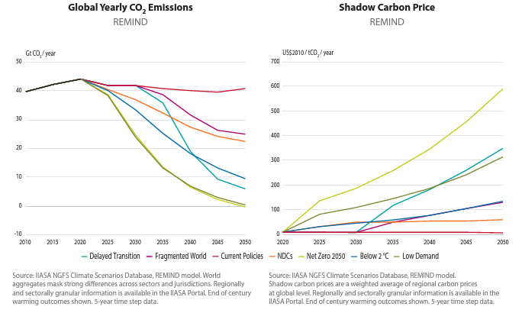
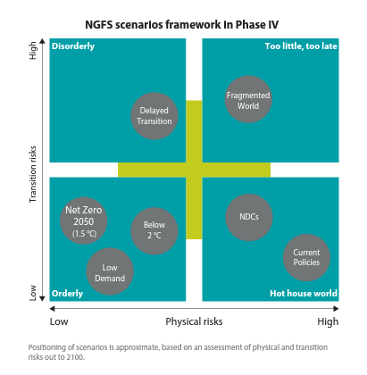
Modelling Physical and Transition Risk Scenarios
Notes:
This is the NGFS framework which is our default approach. These scenarios have been developed specifically for the financial sector.
There have been several phases of these scenarios over the last few years. The latest version is Phase 4 which was released at the end of last year.
If we focus on the diagram on the left, we can see 4 boxes and a total of 7 NGFS scenarios. Instead of discussing each of these scenarios individually lets look at these boxes. On the x-axis we have physical risk and on the y axis we have transition risk.
Starting off with the bottom right box. “Hot House World”, we have high Physical Risk. One example scenario is current policies (if we do nothing leading to increased emissions and global warming).
Moving to the bottom left. “Orderly”, we have low Physical Risk and three scenarios all relating to below 2 degrees in line with the Paris Agreement.
Top left we have “Disorderly”. In this box we have one transition scenario “Delayed Transition”. The reflects if we don’t deal with the transition in as orderly as we could.
Top right we have “Too Little, Too Late”. Phase 4 is the first time we have a scenario in this box. “Fragmented World” is a divergent scenario, which means there are different policies in different parts of the world. Some countries implement 80% of their Net Zero targets – whereas other countries proceed on their current policies and don’t do anything. This is a question people bring up from time to time and it leads to a 2.5 degree of warming.
The middle chart here is very important. The scenarios differ in terms of the level of greenhouse emissions but also how quickly they reduce. So for Net Zero 2050 in light green here we see that the carbon emission reduces rapidly. The chart on the right, introduces the financial implications and strength of policy response. Price of carbon increases where emissions reduce the most. Strong policies are required to ensure transition happens.

Slide 15
Strategic Asset Allocation

Slide 16

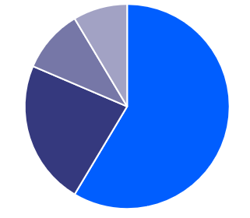
Case Study – SAA Process
Return
USD Equity
Risk & Return
Income
Configure asset classes & capital market assumptions
Create candidate portfolios (SAAs)
Stochastic projection of candidate SAAs
SAA analysis and selection
EUR RE
EUR credit
Capital
Liability
Surplus
Risk
Efficient frontier

Slide 17
Case Study – SAA Process
Calibration Tools API to perform automated alternative calibrations
SG API to update SG with alternative asset allocation and calibration scenarios
Calibrations
Run Scenario Generator
Capital Market Assumptions
Calibration Targets
Candidate Portfolios
Run Scenario Generator
Output Files
Portfolio Optimisation
Risk & Return
Income
Capital
Surplus

Slide 18
Portfolio Optimisation Capability
 | Mean-Variance Optimisation | Mean-CVaR Optimisation | Proxy Optimisation
Mean-Variance | X |  | X
Mean-CVaR |  | X | X
Arbitrary Risk/Return |  |  | X
Linear Constraints | X | X | X
Turnover Constraints | X | X | X
Dynamic Optimisation |  |  | X
Benchmark | X | X | X
Ease of use/implementation | X | X

Slide 19
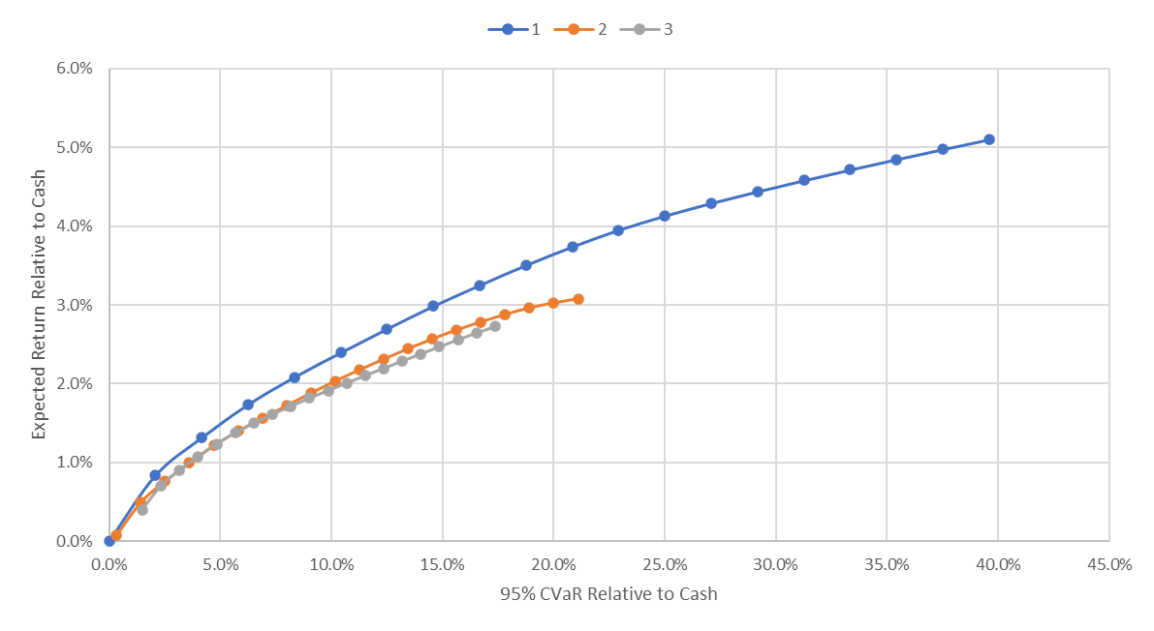
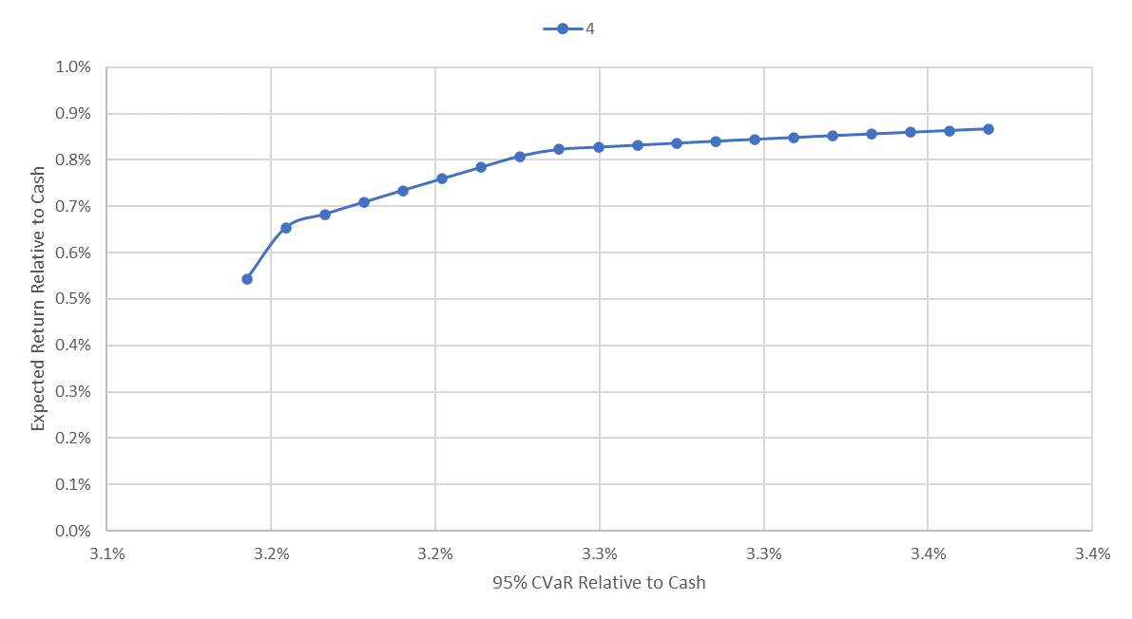
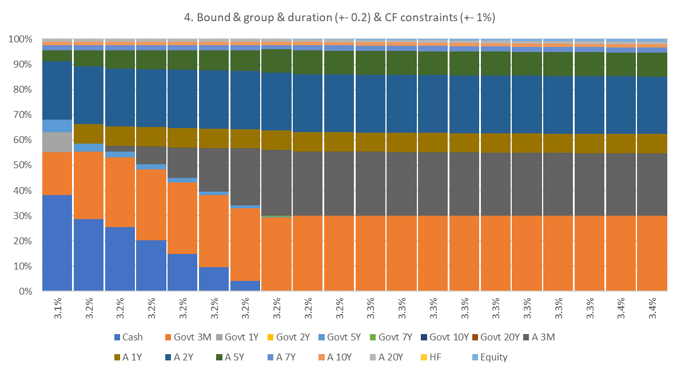
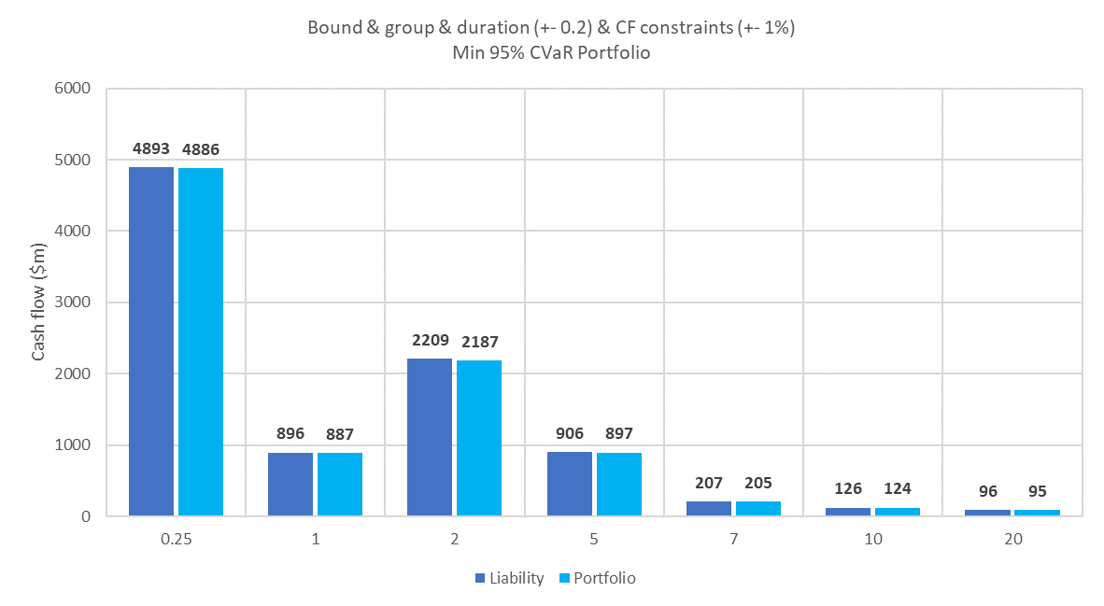
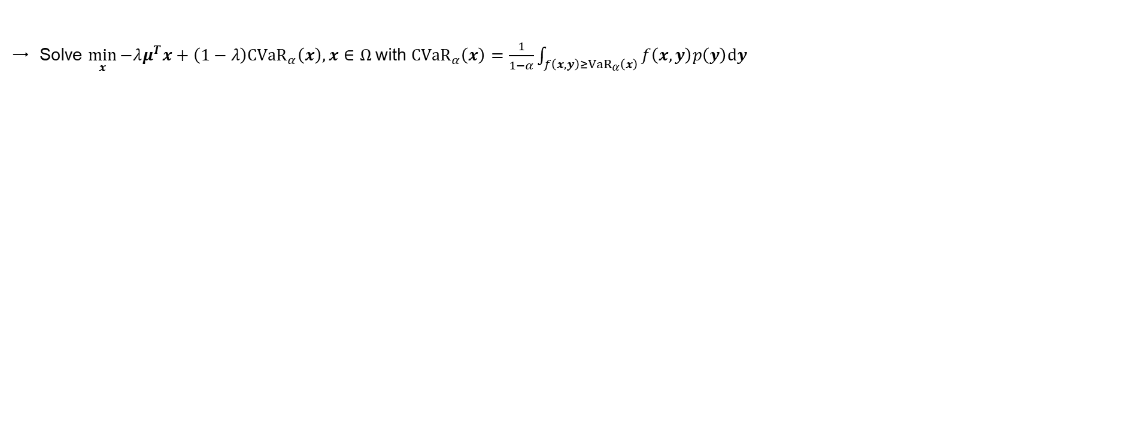
CVaR Optimisation
Solve $\min_{x}{{−λμ^{T}x+\left(1−λ\right)CVaR}_{α}\left(x\right),}x∈Ω$with ${CVaR}_{α}\left(x\right)=\frac{1}{1−α}\int_{f\left(x,y\right)≥{VaR}_{α}\left(x\right)}{f\left(x,y\right)p\left(y\right)dy}$

Slide 20
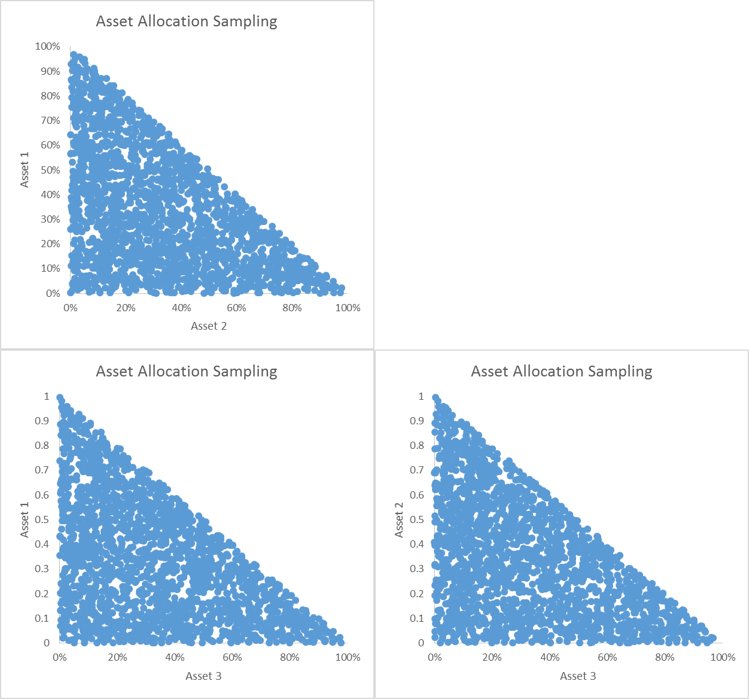
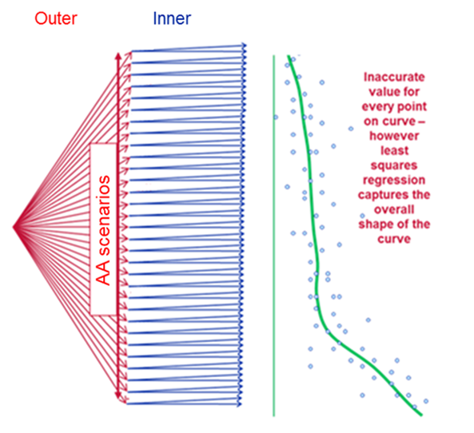
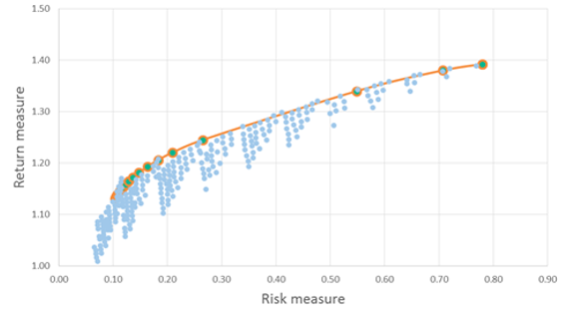
Proxy Optimisation
Sampling
Construct large number of sample asset allocations incorporating investment constraints
Fitting: 10k different asset allocations to build regression function
Validation: 1000 different asset allocations for validating regression functions
Optimisation: 1m different asset allocations to evaluate regression functions
Balance # asset classes, # scenarios, # sample portfolios with run time
Proxy Fitting
Run SG for each of the asset allocations sampled
Inner scenarios = economic scenarios
Outer scenarios = asset allocation scenarios
Regress metrics of interest against asset allocation weights
Optimisation
Evaluate fitted functions for “risk” & “return” at large number of possible asset allocations to obtain efficient frontier

Slide 21
21

Slide 22
SCOR Managing Agency

Slide 23
Executive summary

Slide 24
Contractual position summary
Document | Date | Agreement Ref | Key point | Fee impact
Base Order Form | 23 Dec 2016 | 00073841.0 | Framework baseline for current service | Legacy baseline
Renewal Notification | 23 Dec 2023 | 00073841.7 | Annual renewal continuity | GBP 50,364
Renewal Notification | 23 Dec 2024 | 00073841.8 | Annual renewal continuity | GBP 52,379
Renewal Notification | 23 Dec 2025 | 00073841.9 | Annual renewal continuity | GBP 53,950
Amendment 1 | 23 Dec 2025 | 00073841.9 | Name/address + sanctions clause update | No explicit change

Slide 25
Commercial trend: annual renewal fees

Slide 26
Use case and operating model
1
2

Slide 27
Recent topics with SCOR
Topic | Client ask | Why it matters | Recommended follow-up
Renewal term | Single-year renewal instead of multi-year | Preference for flexibility in commitment horizon | Position multi-year as optional value lever, not prerequisite
Output delivery | Quarterly calibration output in CSV | Could reduce operational burden for SCOR team | Assess delivery model and commercial treatment
Corporate bond parameters | Clarify NumberOfBonds and Coupon settings | Directly impacts modeled returns | Provide documented parameter guidance
Dummy values | Implication of NumberOfBonds=1 and Coupon=0 | Risk of unrealistic outputs/model distortion | Run controlled test and share quantified impact

Slide 28
Recommended next steps

Slide 29
Thank you

