Slide 1
Project Goals and Objectives
Demonstrate Sales Performance Across Regions:
Showcase regional sales figures. Use visuals to highlight growth or decline.
Compare performance for strategic insights.
Explore Product-specific Insights:
Analyze product-wise sales trends.Identify top and underperforming products.
Visualize product-related metrics effectively.
Customer Analysis and Retention Strategies:
Analyze customer segmentation. Identify high-value customers.
Explore demographics and preferences.
Return Analysis and Improvement Recommendations:
Analyze return rates and reasons. Identify products with high return rates.
Suggest strategies for improvement.
Time Series Analysis for Future Predictions:
Use historical data for future sales forecasts.
Showcase model accuracy.Provide actionable insights for decision-making.

Slide 2
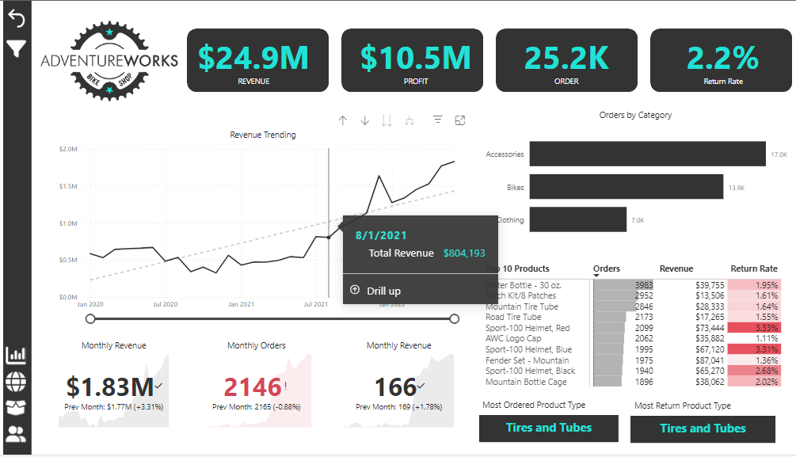

Slide 3
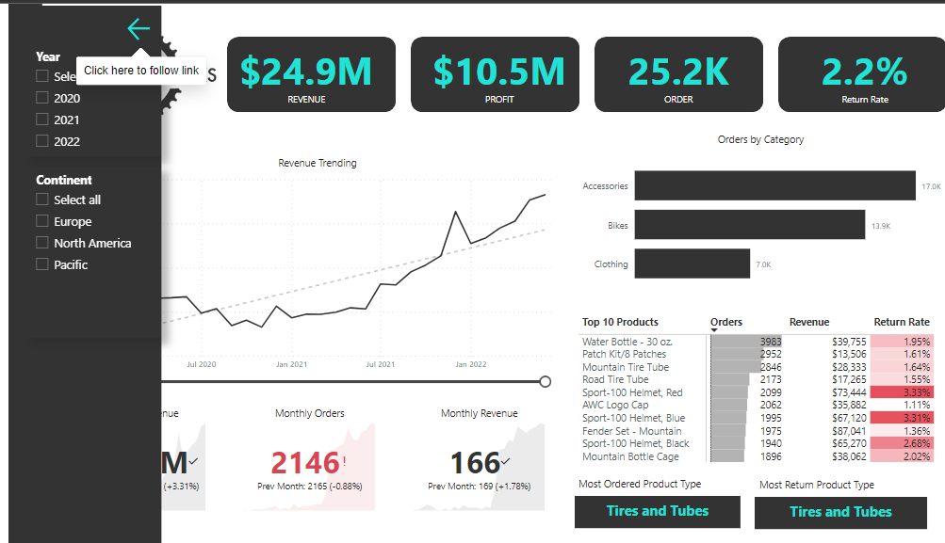

Slide 4
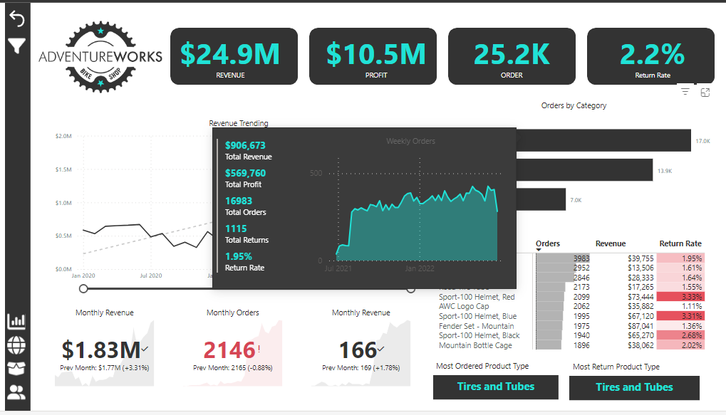

Slide 5
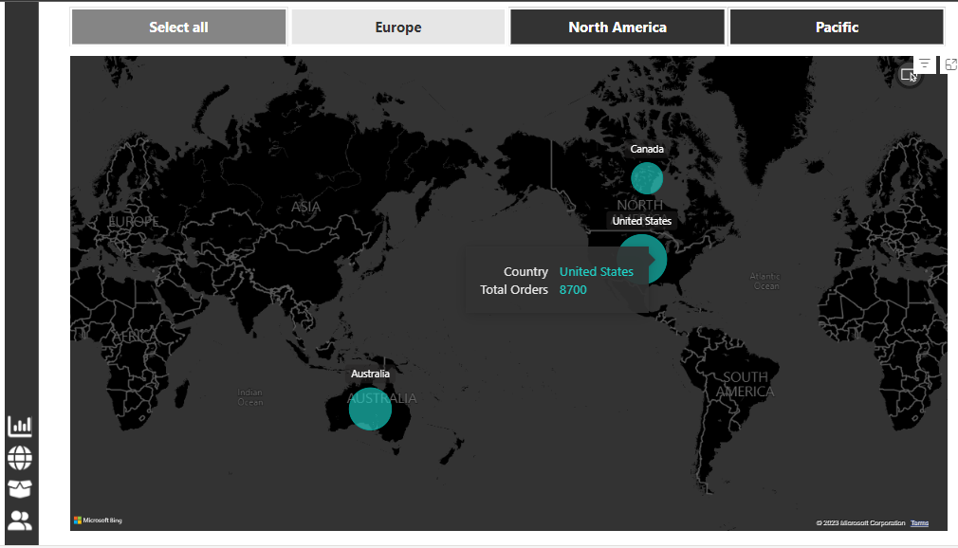

Slide 6
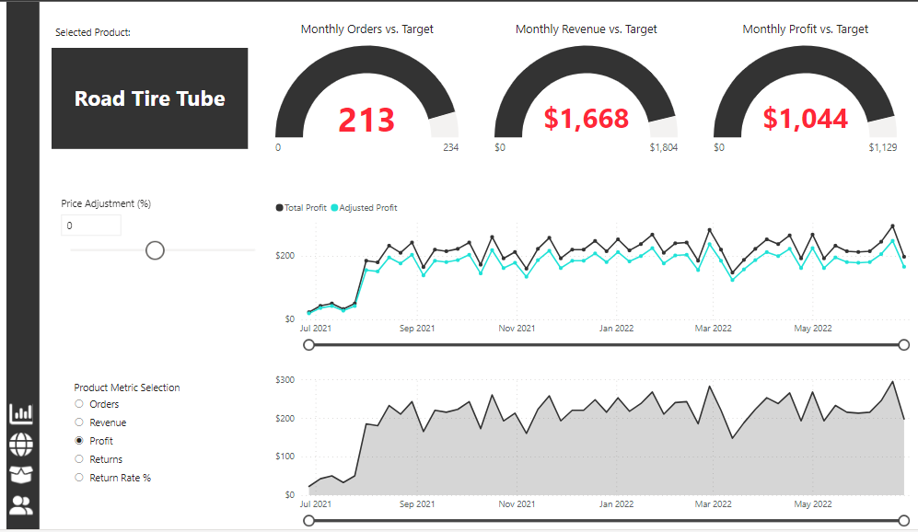

Slide 7
