Slide 1
Thesis Progress
March 25th, 2020
Neel Ajjarapu

Slide 2
Summary
Current State
Attack set up, but is stalling mid-execution
Diagnosis and Solution
The Floodlight controller either needs to have modules added so that it can issue legitimate flow rules or needs to process the OpenFlow protocol handshake better. I believe it is the former
Path Forward
This is the most viable SDN attack, so would recommend giving 1 more week to troubleshoot

Slide 3
Attack Overview
Need to create modules so controller can issue legitimate flow rules
Need to continue working through bit-level OpenFlow implementation
App 1
App 2
App 3
Open Floodlight Controller
IP: 192.168.56.102
Port: 6633
Malicious Switch
s1
Dpid: 8a:7e:73:f5:3d:41
Dpid: 8a:7e:73:f5:3d:41
IP: 192.168.56.1:51078
s2
Dpid: 0e:8e:f9:41:66:48
s3
Dpid: 72:30:dc:fa:f2:47
h1
h2
h3
h4

Slide 4
Steps
Setup mininet network with Floodlight controller
Retrieve switch DPID (datapath_id) and name through REST API request
Create socket-layer python script from malicious computer connecting to the controller to port 6633
Complete TCP handshake [Current attack stalling here]
Complete OpenFlow handshake [DoS attack executed]
In 7 second window
Send feature_in_request
Receive flow table rule as response

Slide 5
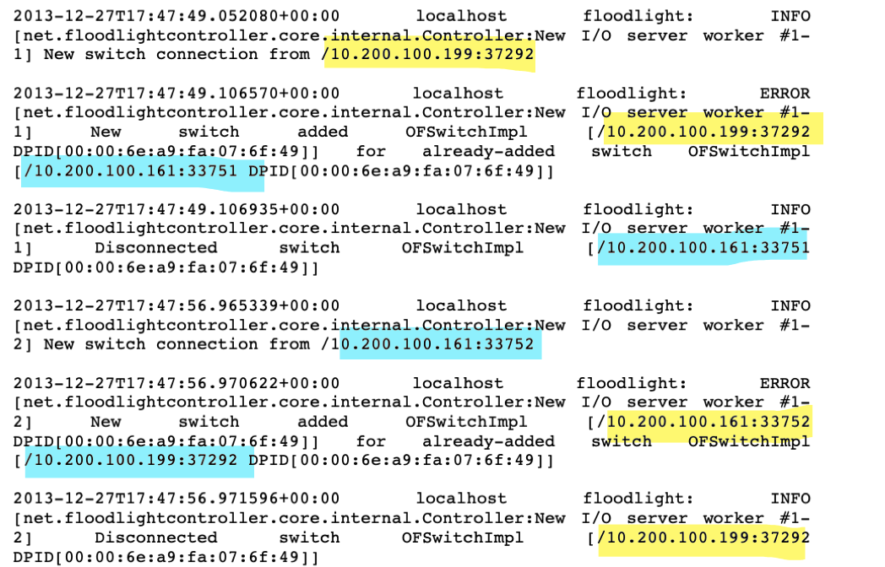
Anticipated Results
Controller detects new (attacker) switch
(+0.05s) Attacker switch is added / is recognized as an existing connection
(+0.004s) Legitimate switch is disconnected
(+7.8s) Legitimate switch attempts to reconnect
(+0.01s) Legitimate switch is recognized as existing connection with legitimate switch
(+0.0010s) Attacker switch is disconnected

Slide 6
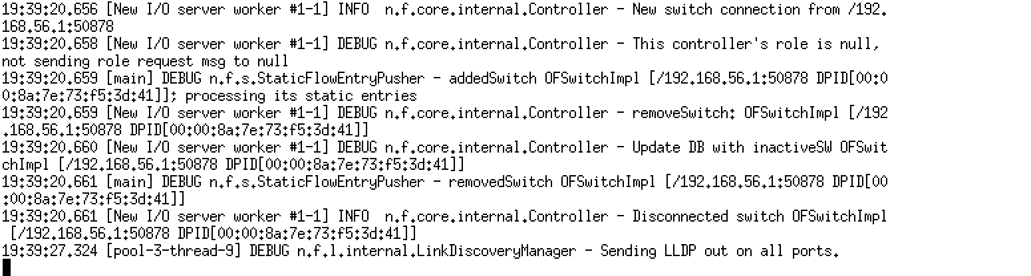
Current Results
Attack is not able to proceed because “controller’s role is null”
Issue has limited documentation
Current hypothesis is the lack of implementation of Floodlight module means that even if a feature_in_request was sent from a switch to the controller, no flow rules could be issued, and so the controller does not care to add the switch. Alternatively, the OpenFlow protocol implementation could be incorrect.

Slide 7
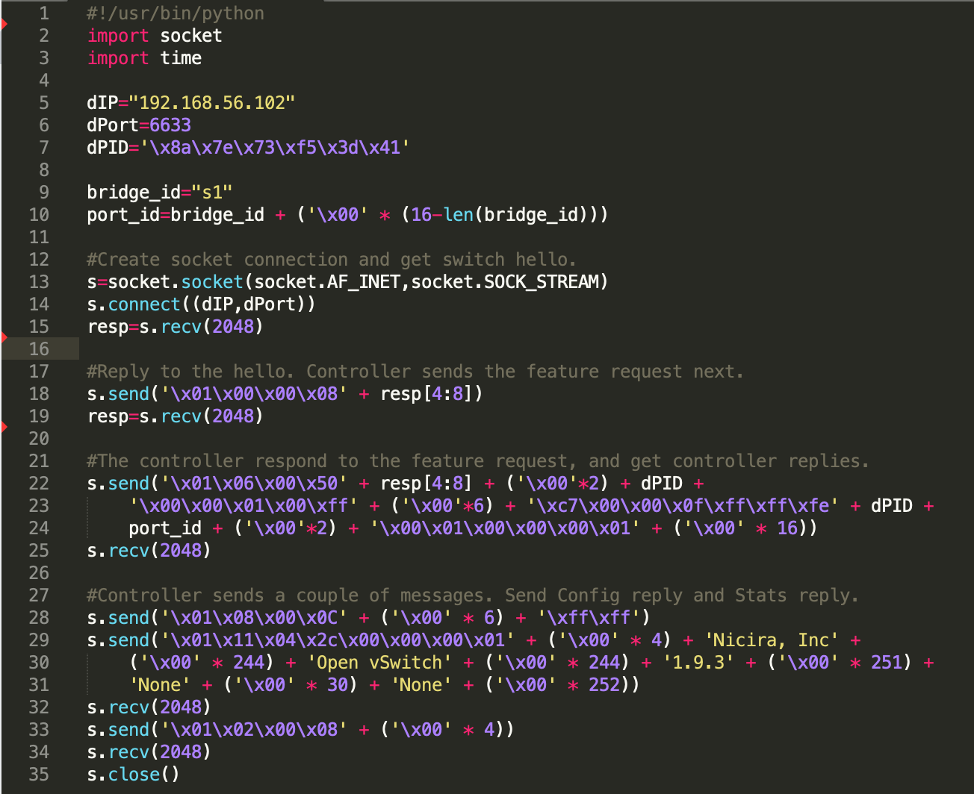
Code for Exploit
Handshake seems to be stalling here – right after the TCP handshake before OpenFlow handshake. Therefore the issue is likely in the network setup
OpenFlow handshake is “dumb” / does not process to server hello
Code adapted from Dover “A denial of service attack against the Open Floodlight SDN controller

Slide 8
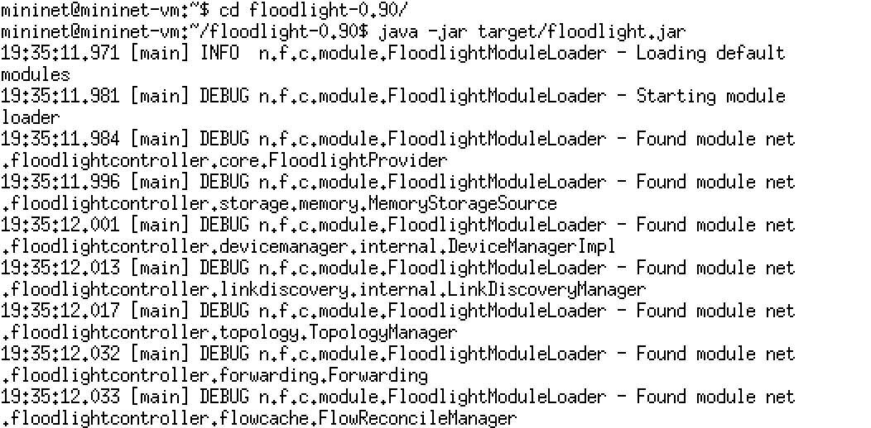
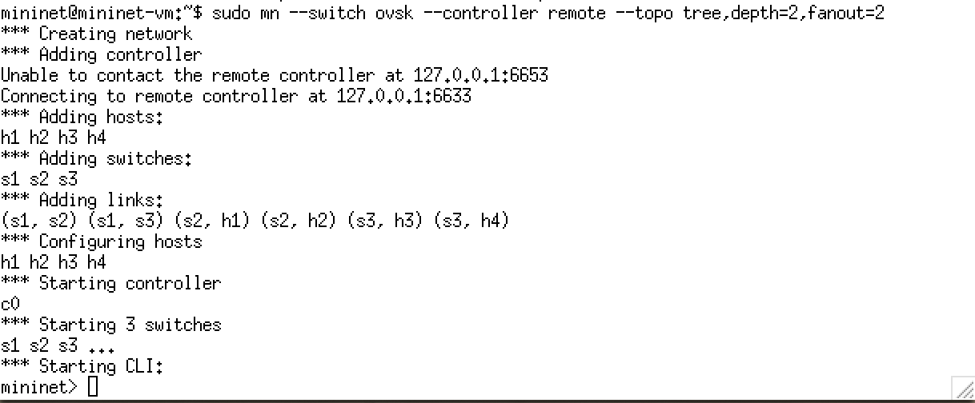
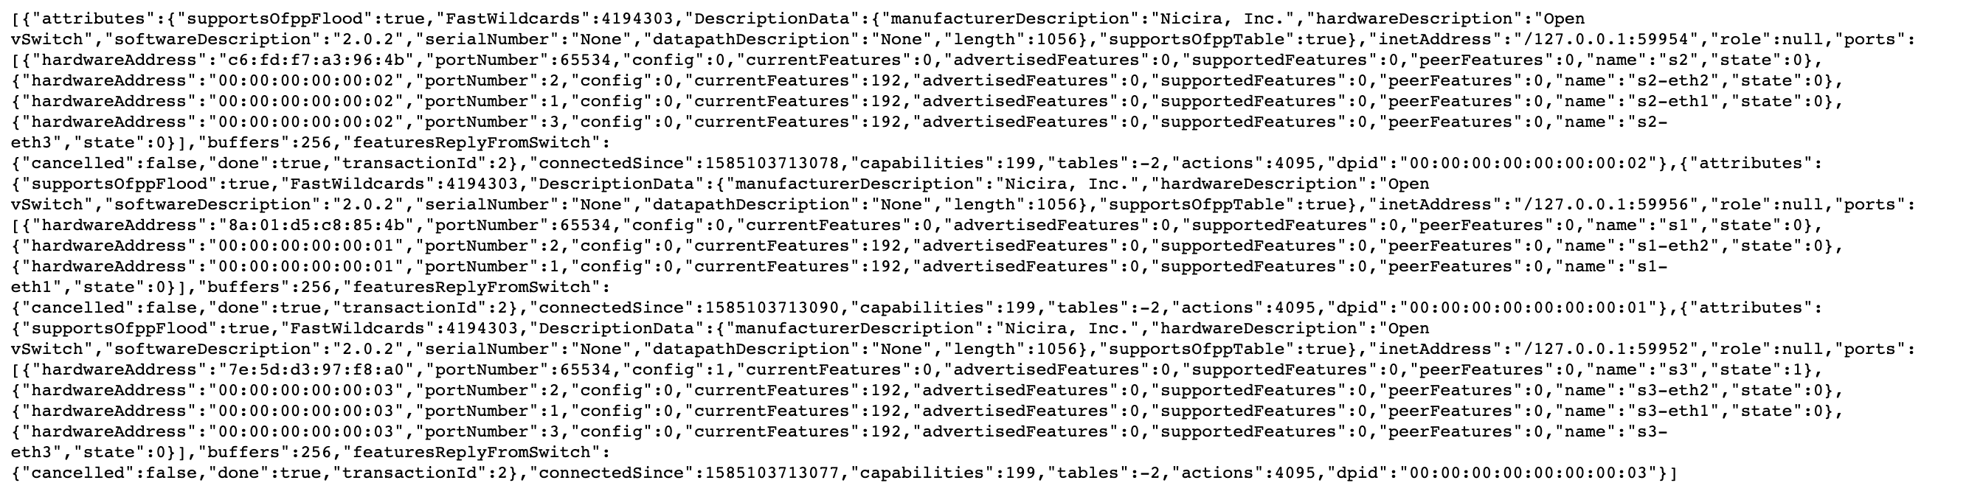
Attack Setup
a)
b)
Mininet setup
Floodlight connecting to mininet network
JSON access of switch information via REST API
c)

Slide 9
Potential Solutions
Need to construct or find preconstructed Floodlight modules and create functional network with applicable flow rules to avoid “null controller role”. Currently the northbound API where modules are added is not being used
Since we are emulating a physical network, we need to as closely replicate the setup
OpenFlow bit-level implementation is currently obscured (may require rewriting exploit in C to use OpenFlow library)

