Slide 1
Reservation System
Computer Science proposal

Slide 2
Introduction
The process in reserving a room usually involves manual input and can take few more hours in our time. Reservation of rooms is somehow an essential in organizations such as schools. This helps students occupy a space without being told to leave. It also helps in organizing a meeting within a club or class.
In NDDU, a student goes through a couple of process wherein they hop from building to building just to reserve a spot for their meetings and other club activities. It uses manual processing wherein students are required to have access with a reservation form. This system is very inefficient for students who has less time and need for immediate reserved room.

Slide 3
Current reservation system
In NDDU, the reservation system uses a paper-based system wherein they are to request a form, fill the form, and let professors in-charge to sign it. This kind of process requires too much time and is very inefficient for students in need of a room. The current system requires the student to access a reservation form from the PPO wherein they fill up the needed materials, what room to reserve, and what reason is it need for. After the filling the form, the student goes through different buildings (OSA, dean’s office and PPO) where he/she lets the in-charged personnel to sign their request to validate it. The process is very time consuming because the building isn’t near each other.

Slide 4
The problem
Due to their legacy system where paper is involved. It takes a lot of storage space to store these papers and it is also time consuming when looking for the request form. Confirmation also takes a lot time because of the distance between needed offices. Students who reserve the room are forced to go back and forth in these offices just to get the confirmation done.

Slide 5
Proposed solution
After analyzing the problems of the current system in the university, the researchers came up with a solution that would speed up the process of reservation and increase the efficiency rate of the entire operation.
The researchers decided to create a software system wherein most of the manual process will be converted into a digital interface and a more interactive system. The proposed system includes the ff:
The system is needed to be access within a local access network where two different offices can communicate without real-life interaction. This process is mainly used for confirmation of reserved rooms. In line with that, a database is present to store and retrieve information from certain requests. A list of available rooms will also be included with their available date and time. A user-friendly interface will be made for easy navigation of the software.

Slide 6
Flow chart

Slide 7
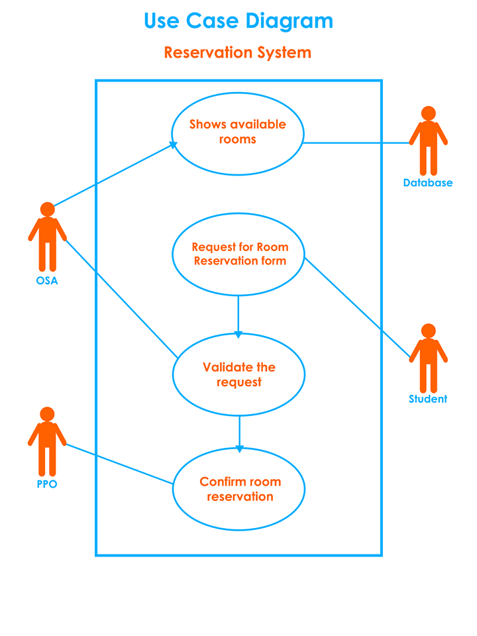

Slide 8
COnclusion
In conclusion, the researchers decided to digitalize the reservation system to increase efficiency and lower the cost of time for the students and the offices combined.

