Slide 1
Learn HTML
Lesson 1

Slide 2
Download an IDE
Use visual studio code
Once installed, you will see a welcome page

Slide 3
Opening your first web app
On your VSCode Welcome page, you will see a link “open folder”.
OR you can go to File->Open Folder
This will be the working folder you will work on
Press this link
Create a new folder on desktop with the name “lesson 1” and open it

Slide 4
Creating your first page
On the lesson 1, select the icon that says new file:
Now type in index.html
Remember to use lowercase.

Slide 5
Adding extensions to your VSCode
On the left side of VSCode, you will see an icon that says “Extension”
You can use this to add different extensions to your VSCode
For example:
You can update the formatting of your html page to a more organized form using “prettier” extension
You can have the file type icons in your navigation back using “vscode-icons” extension

Slide 6
Adding information to index.html
In your index.html file, the first thing you will type is “html” and press enter.
You will see opening and closing tags automatically generated.
These are known as opening and closing tags.
Everything that you will write in your html page will go inside these tags.
Next create a ”head” tag, and a “body” tag.
This will be the basic structure of your html page.

Slide 7
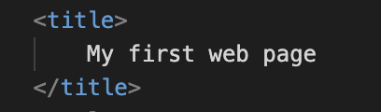
The <title></title> tag
In the head element, you will add the “title” tag.
You can write the title of your page in between the opening and closing title tags.
For example:
This will be seen on the tab of your page, once you run your application.

Slide 8

Running your application
Go to extensions icon, and search “live server”, and install it
Now right click on your html page and select “open with live server”.
This will run your application on your local computer.
You can also start the server by clicking the “Go Live” icon at the bottom of VSCode.

Slide 9
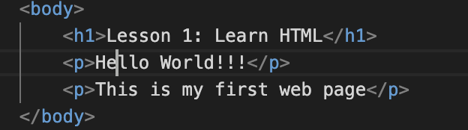
Adding text to page
Inside the <body> element add a <h1> tag. This is the biggest heading in your page. Ideally you should have one h1 heading.
Inside the h1 tag, give any heading, for example:
<h1>Lesson 1: Learn HTML</h1>
Now add two paragraph tags <p></p>
Save it. Go check the page.

Slide 10
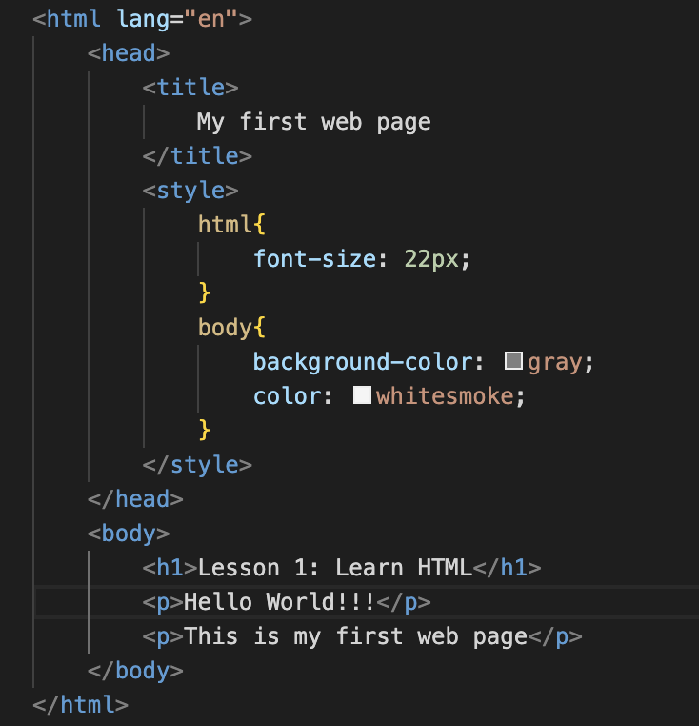
Adding css
In order to change the look and feel of your page, you can add styling using style tag, right under the <title> tag in the head element:

Slide 11
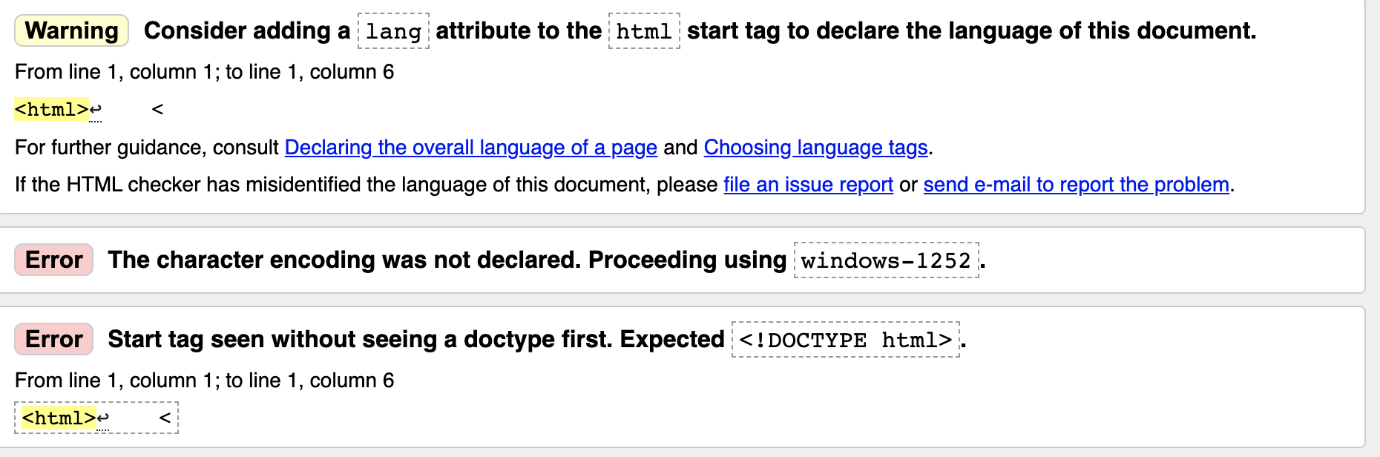
Check for errors
Go to https://validator.w3.org/
And upload your index.html file and press check.
You will see some warnings and errors.

Slide 12
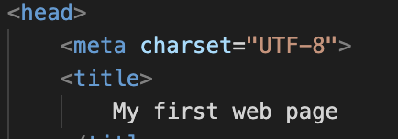
Removing warnings and errors
You can remove the first warning by adding the language attribute in the html tag:
<html lang = “en”>
For the first error, add the following<meta> tag:
For the second error, copy past the DOCTYPE tag at the start of the document

Slide 13
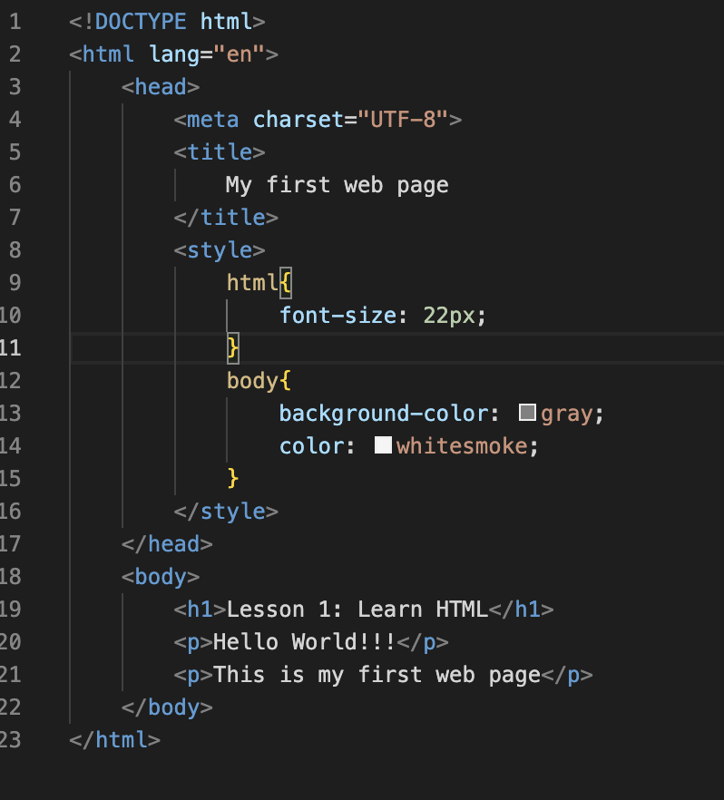
Final html document after removing errors and warnings
You can save and upload this
again, and your errors and
warnings will be gone

Slide 14
Meta data for html

