Slide 1

PREDICTING OPTIMAL LOCATION
FOR SYRIAN STYLE RESTAURANT IN
TORONTO
By :Najla Kousi

Slide 2
Arabic Syrian style restaurant
The Market opportunity for the restaurant :
Higher the number of Syrian and Arabic style food and restaurant in the market and share the food culture in Toronto .
The main goal of this project is to find the best location to open the restaurant in Toronto so it is in a place that attracts a lot of people.

Slide 3
DATA ACQUISITION
The main goal :
we can see that the numbers of the Syrian refugees are increasing especially in Canada in Toronto.
the problem that I will be looking to solve is that there is not a lot of Syrian style restaurants in Toronto i will talk in the report about the best location that I can open the restaurant so I will be able to higher the Syrian food in the market .
for the business to be successful we will choose a location that will be away from the other restaurants and most important that the location is very close to downtown because as we know it's a very tourist popularity..

Slide 4
The data source :
Toronto postal code data scraped from Wikipedia page
Number of restaurants and their type and location in every neighborhood will be obtained using Foursquare API
Coordinates of downtown Toronto will be obtained using Google latitude and longitude of the CN tower

Slide 5
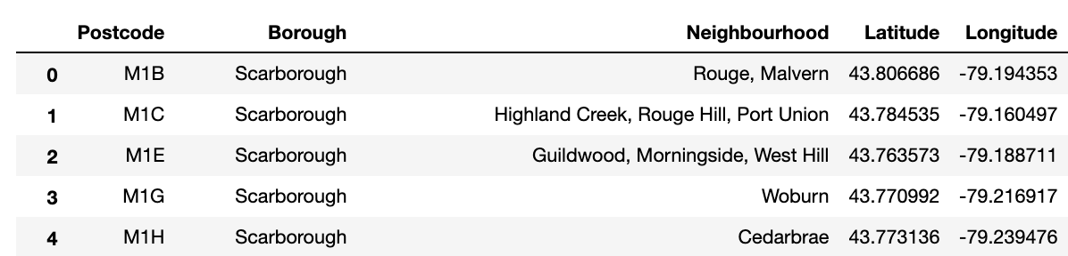
The process of the data preparation and the cleaning
as we can see the data source has been refined to be developed the panda's data frame which will include the borough, neighborhood, postal code and finally the longitude .

Slide 6
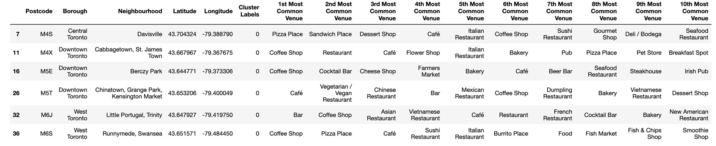
Continue
as you can see we found 10 best places of the neighborhood we found it by using the data of the Foursquare API location and after that, we refined so it will have only the neighborhoods that have a food category the best 10 one

Slide 7
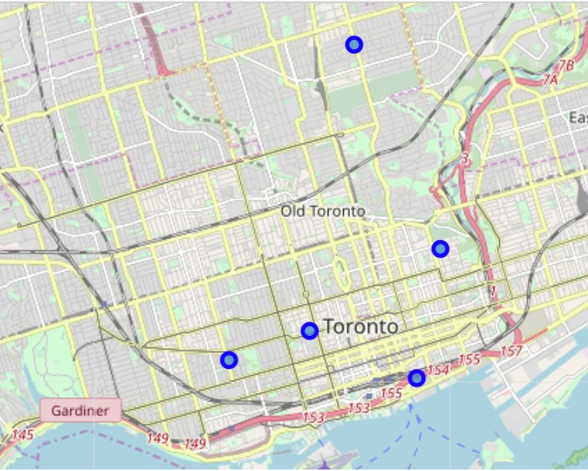
FOLIUM MAP
as we said that we used the Folium maps so we can find the hotspots that will be perfect for the restaurant visualize the locations

Slide 8
HOTSPOT AREAS
as we can see that when we applied the explore URL with the Arabic Syrian style restaurant place category ID to every hotspot of the restaurant we can see that the result is that there isn't a lot of results close to the hotspots
we can see that the parameters that were in the URL that is limit the results to be 500m radius and allow for 100 results
we can see from the result that there are not many results near me and told me to try something more general, reset your filters, or expand the search area.
finally, we can see that from the result we have that all the six restaurant hotspots don't have an Arabic Syrian style restaurant in the 500m radius, and all of them can be the perfect hotspots for us

Slide 9
RESULTS AND DISCUSSION
after a lot of research, we found the CN tower, or Canadian National Tower that has been built by a railway company of the same name is the main tourist attraction of Downtown Toronto so the Berczy Park is the perfect place to open the restaurant but we have our own rules the restaurant hotspot location should be 10 or more food category places provided by Foursquare API It does not have many Syrian style restaurants in a 500m radius is the closest to our chosen tourist attraction, the CN Tower.

Slide 10
Conclusion
as we know how much the Arabic Syrian restaurants are not very common in Toronto like the other city's
so after all the work we think that the Berczy Park is the perfect place for the restaurants it's a great spot and it will help us a lot to make the type of food higher in the market and the place don't have a lot of same style of the restaurant so it's perfect and it will attract a lot of people

