Slide 1
Business Intelligence Task 11 QnA in BI
Comparative Analysis of LGBT Experiences Across EU Countries
Najma Khonsa Tsabita 1232002090

Slide 2
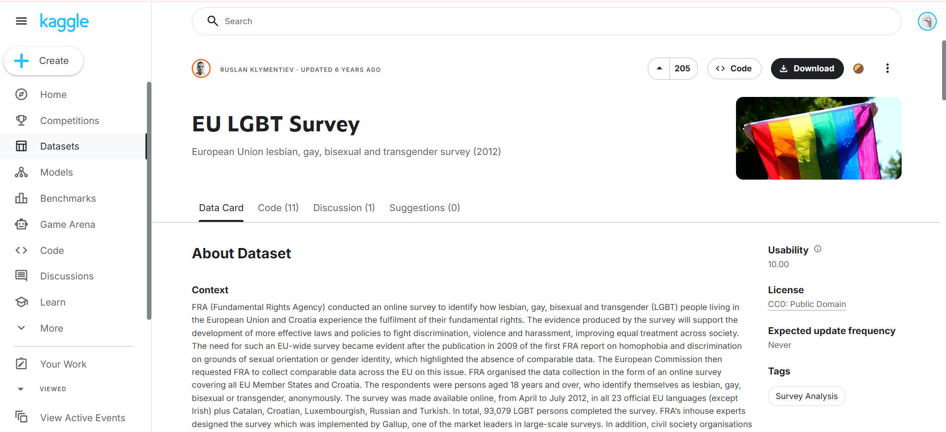
2

Slide 3
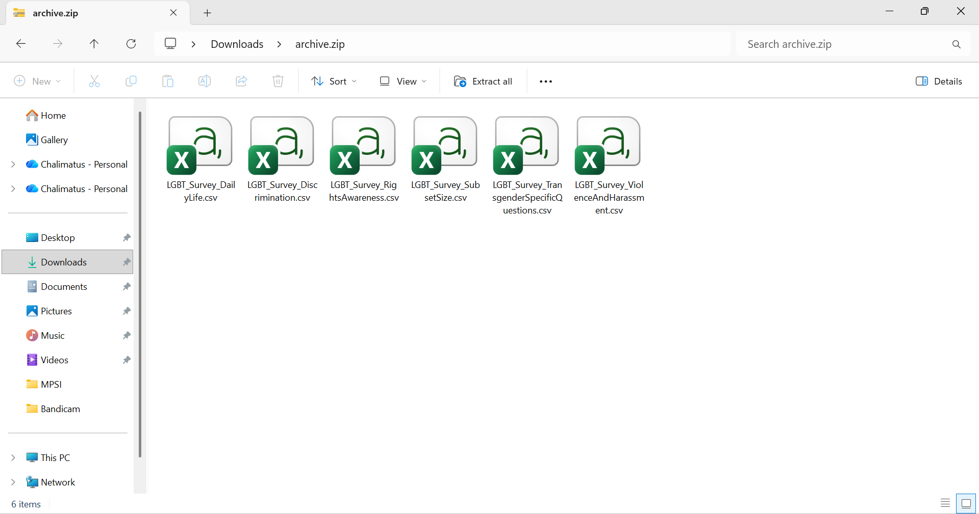
3

Slide 4
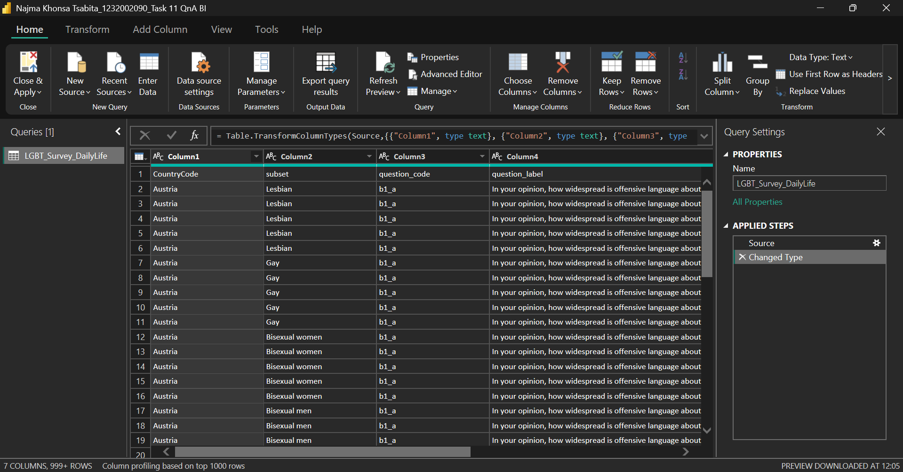
4

Slide 5
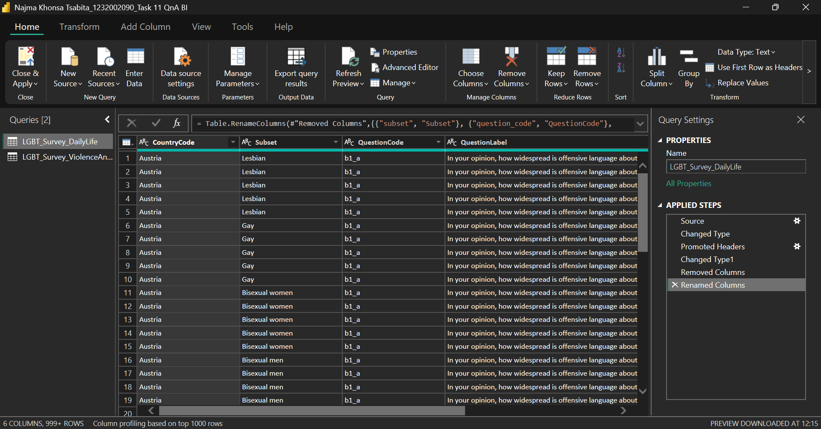
5

Slide 6
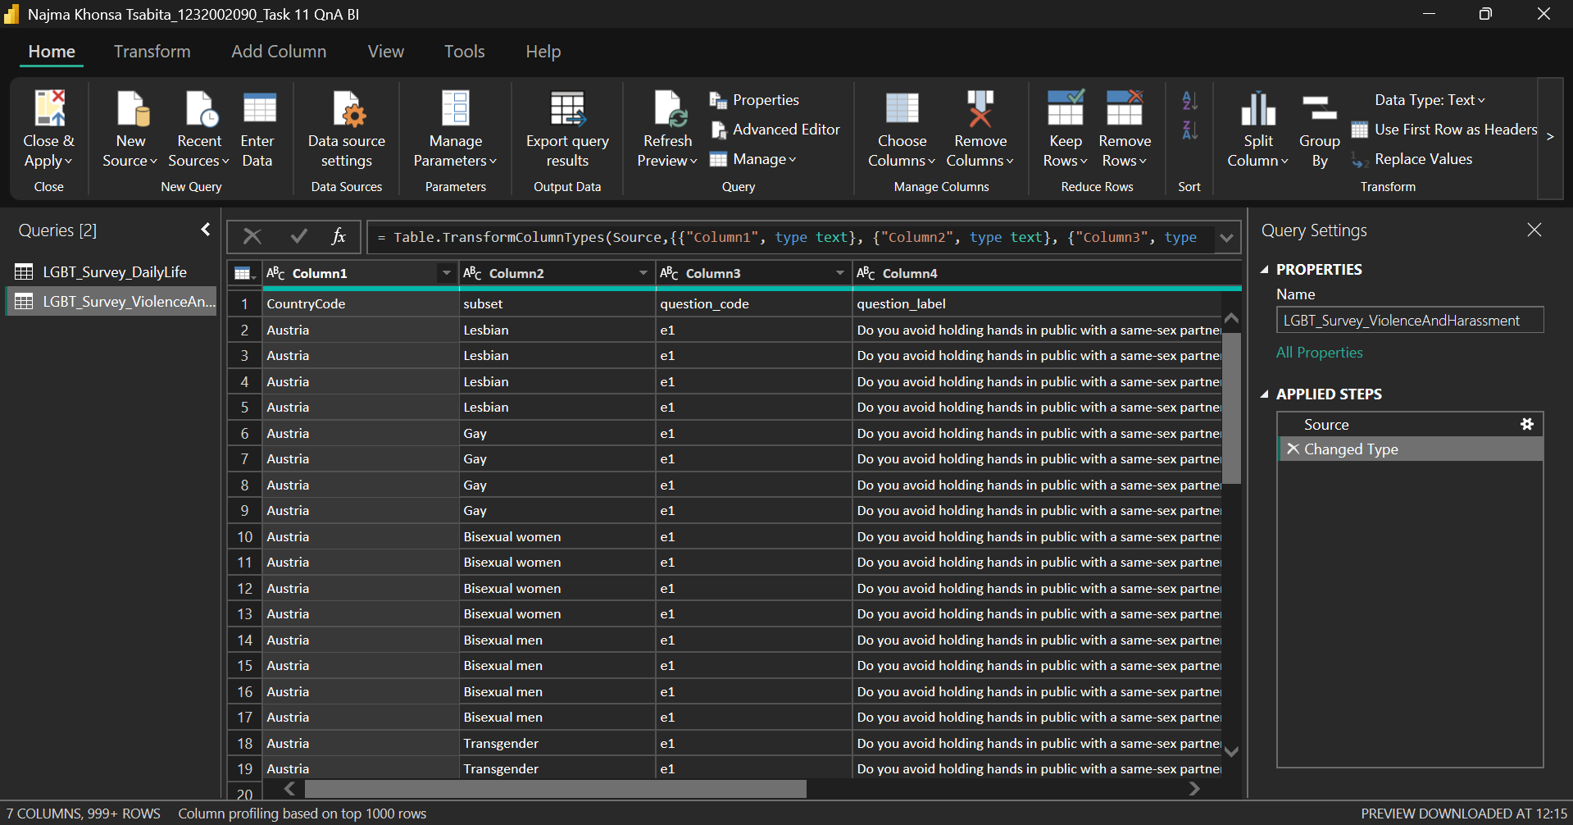
6

Slide 7
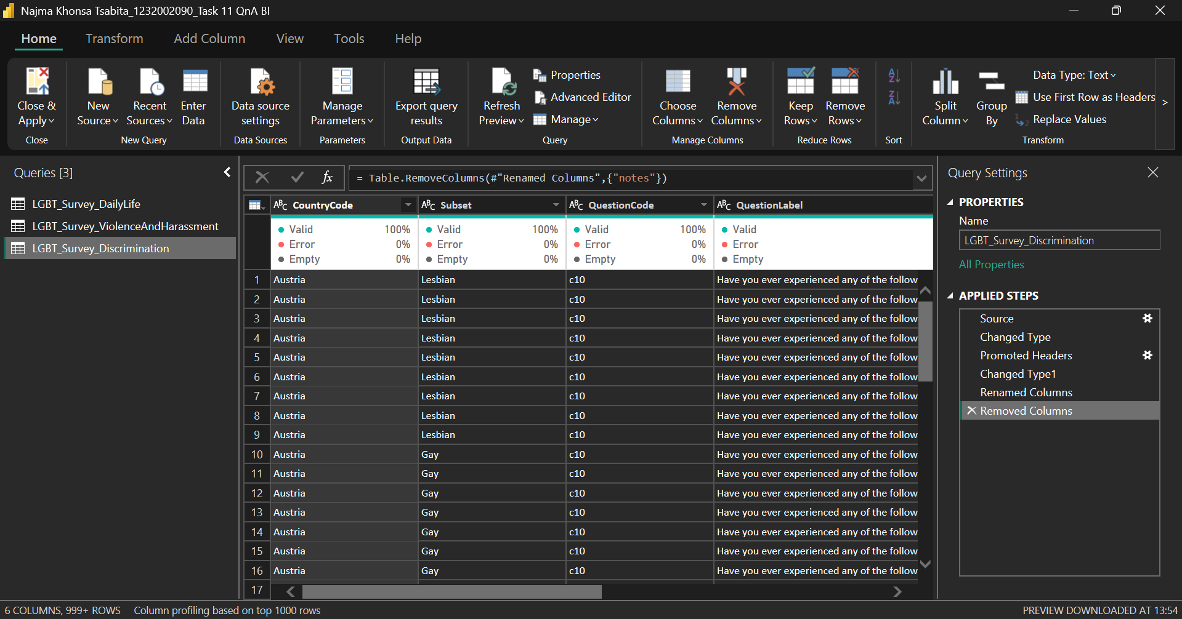
7

Slide 8
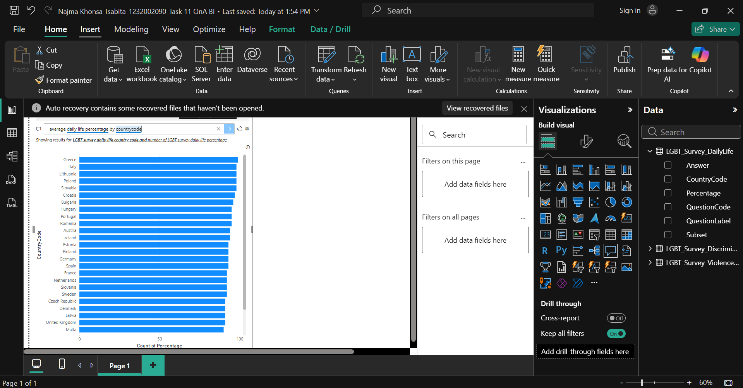
8

Slide 9
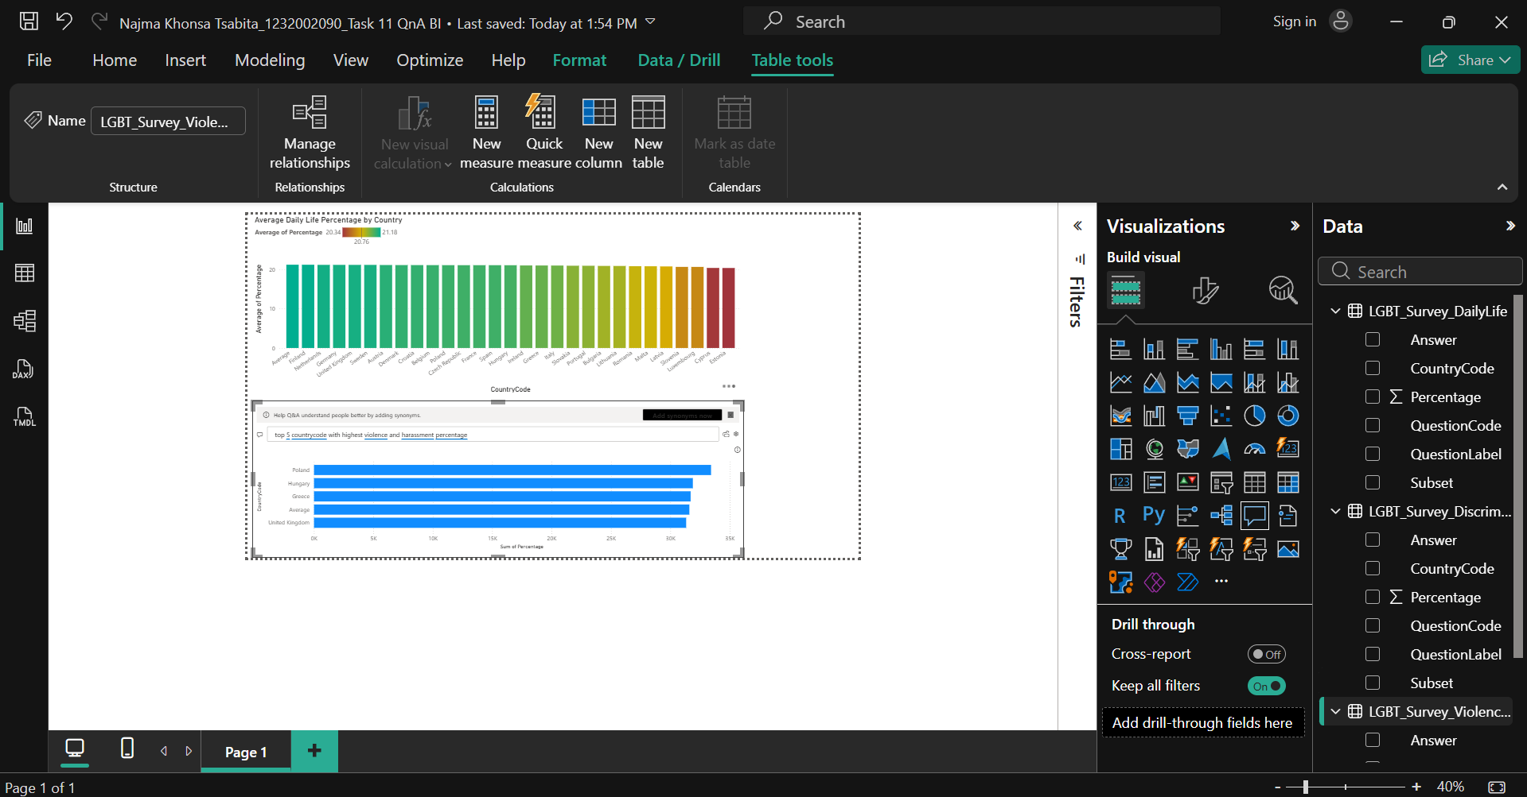
9

Slide 10
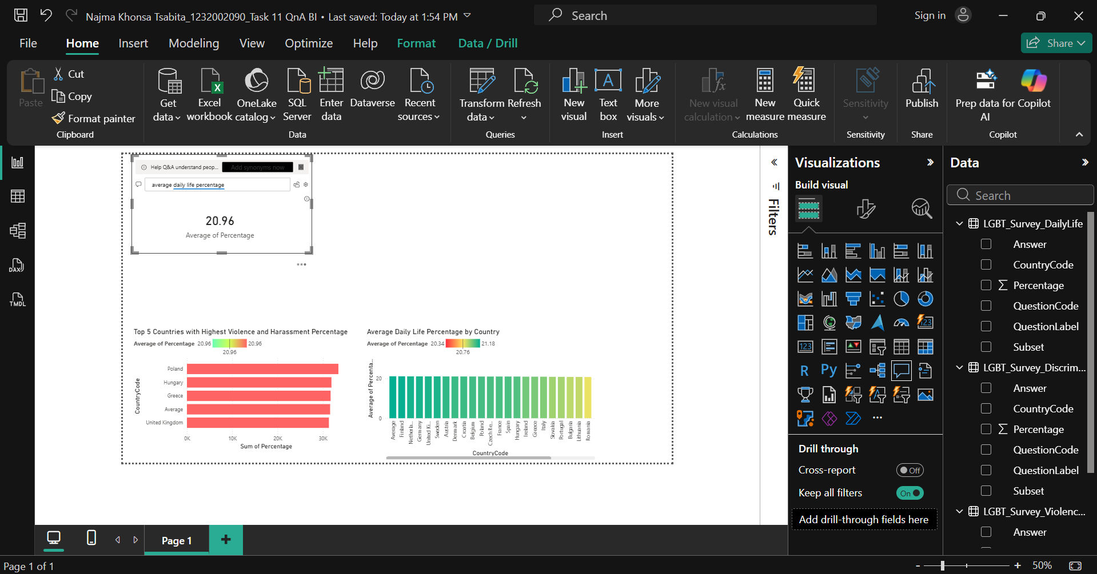
10

Slide 11
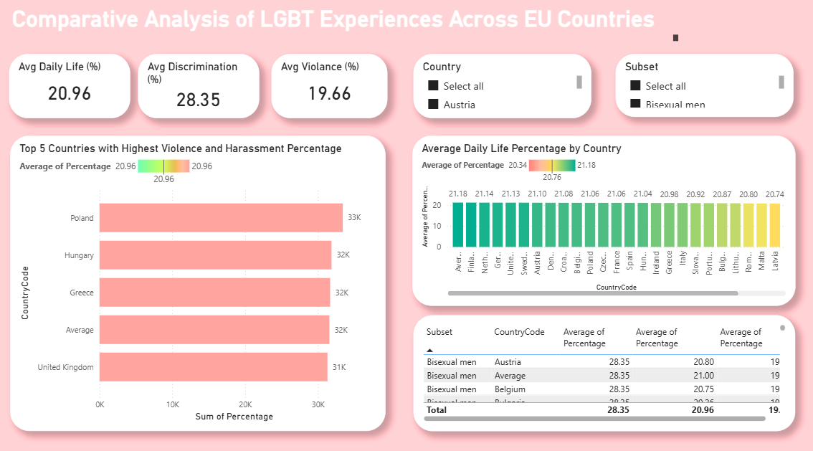
11

Slide 12
Business Intelligence
Thank You
Najma Khonsa Tsabita 1232002090

