Slide 1
Business Intelligence Task 9 Drilling
Sales Performance Dashboard with Drilling Analysis
Najma Khonsa Tsabita 1232002090

Slide 2
Pada implementasi ini, digunakan dataset Grocery Sales Database dengan hierarki:
  Category → Class → Product
  Country → City → ZipCode
  Year → Month → Date
Pembuatan Dashboard
Dashboard dibuat dengan fokus pada fitur drilling:
  Drill Down
  Drill Up
  Drill Through
  Visual hierarchy
  Interactive filters & slicers
Visual utama yang digunakan:
  KPI Cards → Total Sales, Total Quantity, Total Orders
  Bar Chart → Sales by Category (3-level drill)
  Bar Chart → Sales by Location (3-level drill)
  Line Chart → Sales by Year (3-level drill)
  Drill-Through Report Page → Detail per kategori atau per lokasi
Metodelogi
2

Slide 3
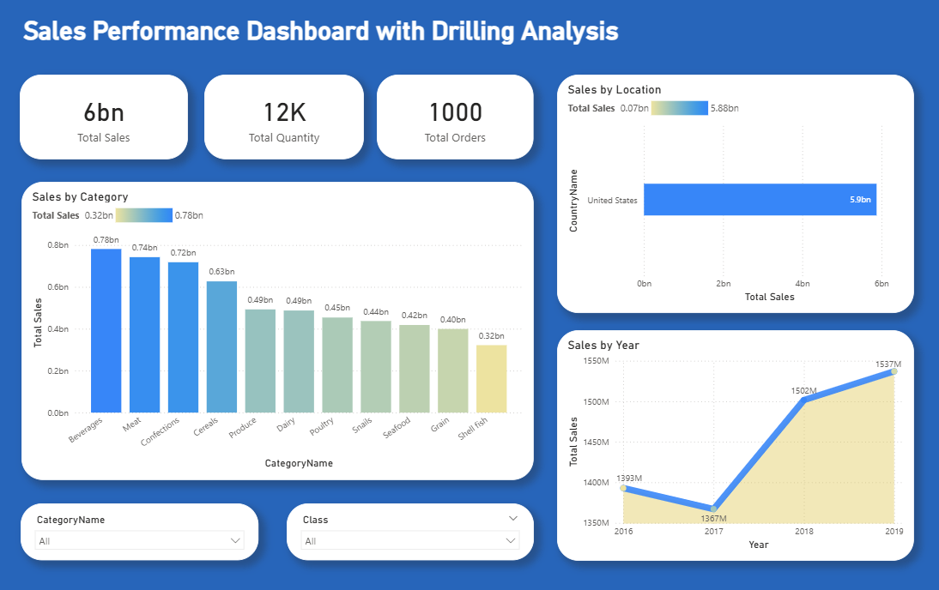
3

Slide 4
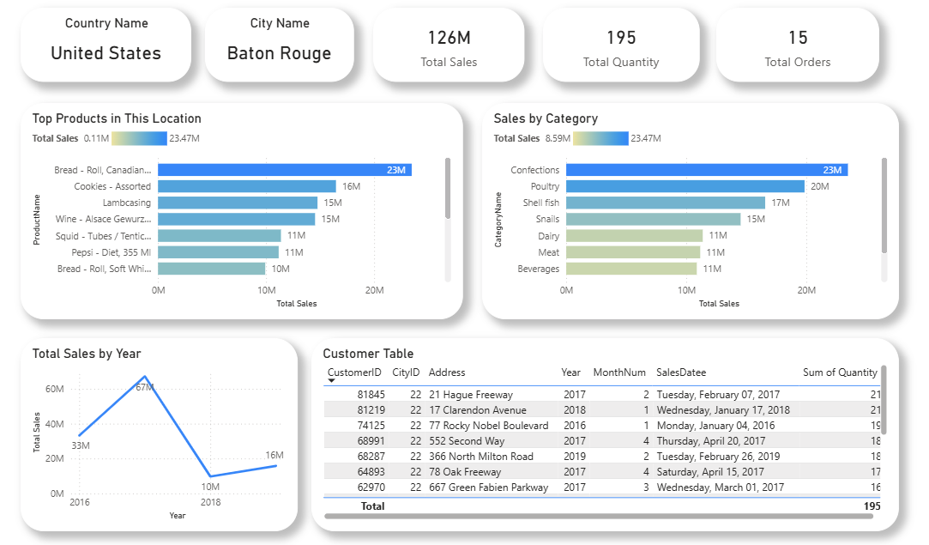
4

Slide 5
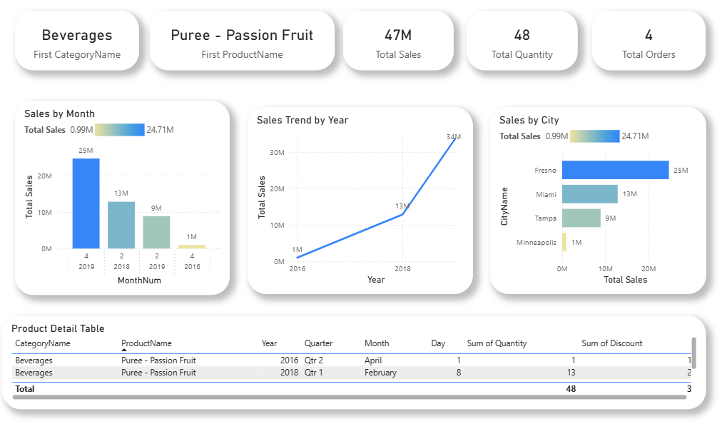
5

Slide 6
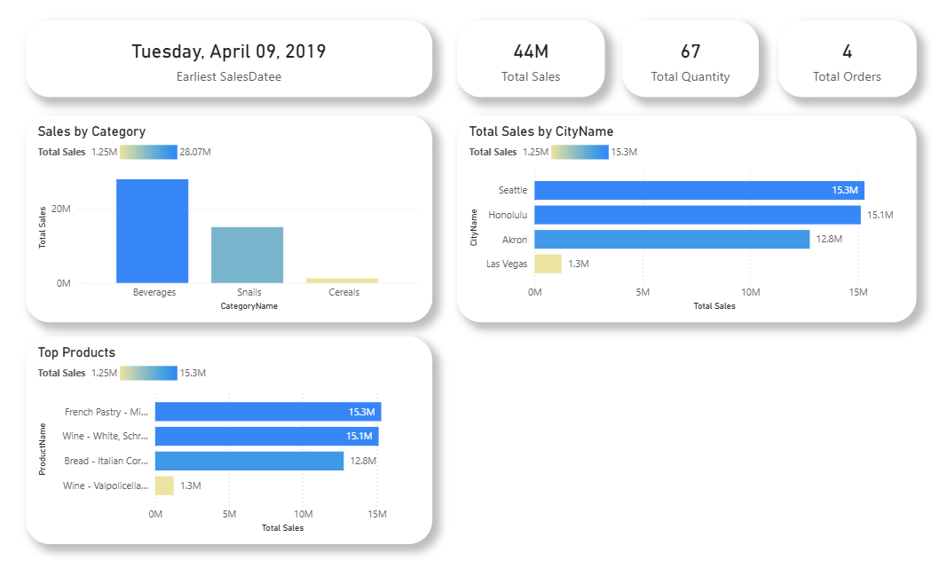
6

Slide 7
Business Intelligence
Thank You
Najma Khonsa Tsabita 1232002090

