Slide 1

BOOK MY STYLE
NAJMATH M V
MES24MCA-2039
Department of Computer Applications
MES College of Engineering, Kuttippuram
20-08-2025

Slide 2
PRODUCT OWNER NOWSHAD C V ASSISTANT PROFESSOR DEPARTMENT OF COMPUTER APPLICATIONS MES COLLEGE OF ENGINEERING, KUTTIPPURAM

Slide 3
TABLE OF CONTENTS
Introduction
Objective
Existing System
Proposed System
Motivation
Functionalities
Module Description
Developing Environment
Sprint Backlog
Product Backlog
User Story
Project Plans
Data Flow Diagrams
ER Diagram

Slide 4
BOOK MY STYLE
Book My Style is an online platform that makes booking salon appointments quick and easy, eliminating long wait times and phone hassles.
Users can browse salons, services, and staff availability to choose their preferred services and professionals.
The platform provides real-time updates and notifications to keep customers informed.
Salon owners and admins can efficiently manage appointments, staff schedules, services, and access analytics.

Slide 5
OBJECTIVES
Create a user-friendly online platform for convenient salon bookings, removing the need for phone calls and wait times.
Allow customers to browse salons, select services and professionals, and get real-time updates and notifications.
Enable salon owners to efficiently manage appointments, staff, and services through a dedicated dashboard.
Provide admin control with analytics, ensuring a smooth experience using modern web technologies and improving service quality.

Slide 6
EXISTING SYSTEM
Booking done mainly through phone calls or walk-ins.
Customers face long wait times and uncertainty about availability.
Salon owners manage appointments manually, leading to scheduling conflicts.
Limited or no online presence for salons.
No real-time updates or notifications for customers.

Slide 7
PROPOSED SYSTEM
Online platform for easy and quick salon appointment booking.
Customers can browse salons, services, and staff availability anytime.
Real-time updates and notifications keep customers informed.
Salon owners manage appointments and staff schedules digitally.
Admin panel for overall management and analytics.
Reduces errors, saves time, and improves booking efficiency

Slide 8
MOTIVATIONS
Traditional salon bookings are slow and inconvenient.
Customers face long waits and uncertain availability
Manual management causes errors and conflicts.
There is a need for a simple, digital booking solution.
Improve customer experience and salon management through technology.

Slide 9
FUNCTIONALITIES
Book Appointments Easily – Customers can book, change, or cancel salon appointments anytime.
Book Appointments Easily – Customers can book, change, or cancel salon appointments anytime.
Manage Salons and Services – Salons can list their services, staff, and working hours.
Get Updates and Reminders – Notifications for booking confirmations, changes, and upcoming appointments.
Share Feedback – Customers can rate and review their experience.
Track and Improve – Admin can monitor activity and create reports to improve the platform.

Slide 10
MODULE DESCRIPTION
Customer Module
Register, log in, and manage profile details.
Search salons using filters like location, price, service type, and ratings.
View salon details, available time slots, and service information.
Book, reschedule, or cancel appointments.
View booking history and receive notifications/reminders.
Give feedback and ratings for services.
Salon Owner Module
Register salon with details and required documents.
Add, edit, or remove services with pricing, duration, and images.
Manage staff profiles, work schedules, and availability.

Slide 11
MODULE DESCRIPTION
Approve, reschedule, or cancel bookings.
View and respond to customer feedback and ratings.
Admin Module
Secure login to access the admin dashboard.
Approve or reject salon registrations.
Manage customer and salon owner accounts.
Detect and prevent booking conflicts.
View analytics, service trends, and platform performance.
Analyze feedback for system improvements.

Slide 12
DEVELOPING ENVIRONMENT
Operating System: Windows 10 / 11
Front End: HTML, CSS, JavaScript
Back End: Python Django Framework
Database: SQLite
Framework: Django
IDE / Code Editor: Visual Studio Code
Version Control: Git
Browser: Google Chrome

Slide 13
SPRINT BACKLOG
Backlog tem | Status And Completion Date | Original Estimation in Hours | Day 1 hrs | Day 2 hrs | Day 3 hrs | Day 4 hrs | Day 5 hrs | Day 6 hrs | Day 7 hrs | Day 8 hrs | Day 9 hrs | Day 10 hrs
SPRINT1
Customer registration | 18/08/2025 | 3 | 1 | 1 | 1 | 0 | 0 | 0 | 0 | 0 | 0 | 0
Customer login | 19/08/2025 | 2 | 1 | 1 | 0 | 0 | 0 | 0 | 0 | 0 | 0 | 0
Salon owner registration | 19/08/2025 | 3 | 1 | 1 | 1 | 0 | 0 | 0 | 0 | 0 | 0 | 0
Admin access setup | 20/08/2025 | 3 | 1 | 1 | 1 | 0 | 0 | 0 | 0 | 0 | 0 | 0
SPRINT 2
Add/manage services | 10/09/2025 | 4 | 1 | 1 | 1 | 1 | 0 | 0 | 0 | 0 | 0 | 0

Slide 14
SPRINT BACKLOG
Manage staff and schedules | 12/09/2025 | 3 | 1 | 1 | 1 | 0 | 0 | 0 | 0 | 0 | 0 | 0
Customer search and filter | 15/09/2025 | 5 | 1 | 1 | 1 | 1 | 1 | 0 | 0 | 0 | 0 | 0
Customer appointment booking | 17/09/2025 | 4 | 1 | 1 | 1 | 1 | 0 | 0 | 0 | 0 | 0 | 0
SPRINT 3
Notifications and reminders | 02/10/2025 | 3 | 1 | 1 | 1 | 0 | 0 | 0 | 0 | 0 | 0 | 0
Rating and review system | 05/10/2025 | 3 | 1 | 1 | 1 | 0 | 0 | 0 | 0 | 0 | 0 | 0
Admin analytics and feedback | 08/10/2025 | 5 | 1 | 1 | 1 | 1 | 1 | 0 | 0 | 0 | 0 | 0

Slide 15
SPRINT BACKLOG
Final testing and debugging | 10/10/2025 | 6 | 1 | 1 | 1 | 1 | 1 | 1 | 0 | 0 | 0 | 0

Slide 16
PRODUCT BACKLOG
ID | NAME | PRIORITY <high/medium/low> | ESTIMATE (Hours) | STATUS <Planned/In progress/Completed>
1 | CUSTOMER REGISTRATION | High | 5 | PLANNED
2 | CUSTOMER LOGIN | High | 5 | PLANNED
3 | SALON OWNER REGISTRATION | High | 6 | PLANNED
4 | ADMIN ACCESS | High | 6 | PLANNED
5 | APPROVE/REJECT SALON REGISTRATIONS | HIGH | 8 | PLANNED

Slide 17
PRODUCT BACKLOG
ID | NAME | PRIORITY <high/medium/low> | ESTIMATE (Hours) | STATUS <Planned/In progress/Completed>
6 | ADD AND MANAGE SERVICES | High | 10 | PLANNED
7 | MANAGE STAFF AND SCHEDULES | MEDIUM | 8 | PLANNED
8 | SEARCH SALONS | High | 12 | PLANNED
9 | VIEW SERVICES AND PRICING | High | 8 | PLANNED
10 | BOOK APPOINTMENT | HIGH | 12 | PLANNED

Slide 18
PRODUCT BACKLOG
ID | NAME | PRIORITY <high/medium/low> | ESTIMATE (Hours) | STATUS <Planned/In progress/Completed>
11 | SELECT SPECIFIC STYLIST | MEDIUM | 6 | PLANNED
12 | VIEW BOOKING HISTORY | MEDIUM | 5 | PLANNED
13 | NOTIFICATIONS AND REMINDERS | High | 8 | PLANNED
14 | RATE AND REVIEW SERVICES | MEDIUM | 7 | PLANNED

Slide 19
PRODUCT BACKLOG
ID | NAME | PRIORITY <high/medium/low> | ESTIMATE (Hours) | STATUS <Planned/In progress/Completed>
15 | APPROVE/CANCEL BOOKINGS | HIGH | 7 | PLANNED
16 | FEEDBACK AND ANALYTICS | MEDIUM | 7 | PLANNED
17 | MANAGE USERS AND OWNERS | High | 8 | PLANNED
18 | PLATFORM ANALYTICS | MEDIUM | 7 | PLANNED
19 | ANALYZE FEEDBACK AND RATING | MEDIUM | 6 | PLANNED

Slide 20
USER STORY
User Story ID | As a type of User | I want to <Perform some task> | So that i can <Achieve Some Goal>
1 | Customer | Register | Create an account to book services
2 | Customer | Login | Access the platform
3 | Salon Owner | Register | Add my salon to the platform
4 | Admin | Admin | Access the entire system
5 | Admin | Approve or reject salon registrations | Ensure quality and trust

Slide 21
USER STORY
User Story ID | As a type of User | I want to <Perform some task> | So that i can <Achieve Some Goal>
6 | Salon Owner | Add and manage services | Inform customers of available options
7 | Salon Owner | Manage staff and schedules | Avoid conflicts and manage workload
8 | Customer | Search salons by location or service | Find nearby or suitable salons
9 | Customer | View services and pricing | Choose what fits my need and budget
10 | Customer | Book an appointment | Schedule salon services easily

Slide 22
USER STORY
User Story ID | As a type of User | I want to <Perform some task> | So that i can <Achieve Some Goal>
11 | Customer | Select a specific stylist | Get service from someone I trust
12 | Customer | View booking history | Keep track of past appointments
13 | Customer | Receive notifications and reminders | Stay updated on bookings
14 | Customer | Rate and review services | Help others and share my experience
15 | Salon Owner | Approve or cancel bookings | Control salon workflow

Slide 23
USER STORY
User Story ID | As a type of User | I want to <Perform some task> | So that i can <Achieve Some Goal>
16 | Salon Owner | View feedback and analytics | Improve service based on customer responses
17 | Admin | Manage users and salon owners | Control access to the system
18 | Admin | View platform analytics | Monitor system usage and performance
19 | Admin | Analyze feedback and ratings | Identify improvements for the platform

Slide 24
PROJECT PLAN
User StoryID | Task Name | Start Date | End Date | Days | Status
1 | Sprint 1 | 12/08/2025 | 14/08/2025 | 11 | Planned
2 |  | 15/08/2025 | 16/08/2025 |  | Planned
3 |  | 17/08/2025 | 18/08/2025 |  | Planned
4 |  | 19/08/2025 | 20/08/2025 |  | Planned
5 |  | 21/08/2025 | 22/08/2025 |  | Planned
6 | Sprint 2 | 05/09/2025 | 07/09/2025 | 16 | Planned
7 |  | 08/09/2025 | 09/09/2025 |  | Planned
8 |  | 10/09/2025 | 13/09/2025 |  | Planned

Slide 25
PROJECT PLAN
9 |  | 14/09/2025 | 15/09/2025 | 13 | Planned
10
 |  | 16/09/2025 | 17/09/2025 |  | Planned
11 | SPRINT 3 | 25/09/2025 | 26/09/2025 | 10 | Planned
12 |  | 27/09/2025 | 30/09/2025 |  | Planned
 |  |  |  |  | Planned
13 |  | 29/09/2025 | 30/09/2025

Slide 26
PROJECT PLAN
14 |  | 01/10/2025 | 02/10/2025 |  | Planned
15 |  | 03/10/2025 | 04/10/2025 |  | Planned
16 |  | 05/10/2025 | 06/10/2025 |  | Planned
17 |  | 07/10/2025 | 08/10/2025 |  | Planned
18 |  | 09/10/2025 | 09/10/2025 |  | Planned
19 |  | 10/09/2025 | 10/09/2025 | 16 | Planned

Slide 27
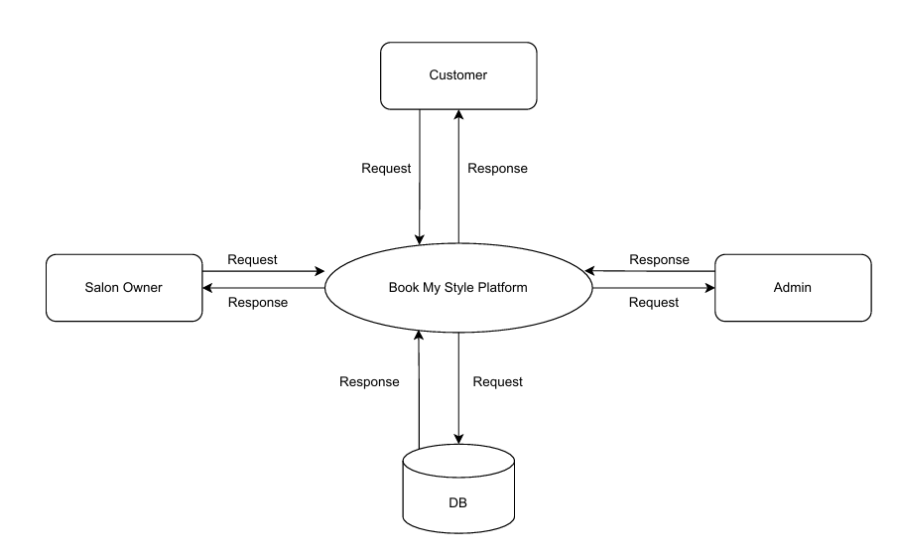
DATA FLOW DIAGRAM
LEVEL 0

Slide 28
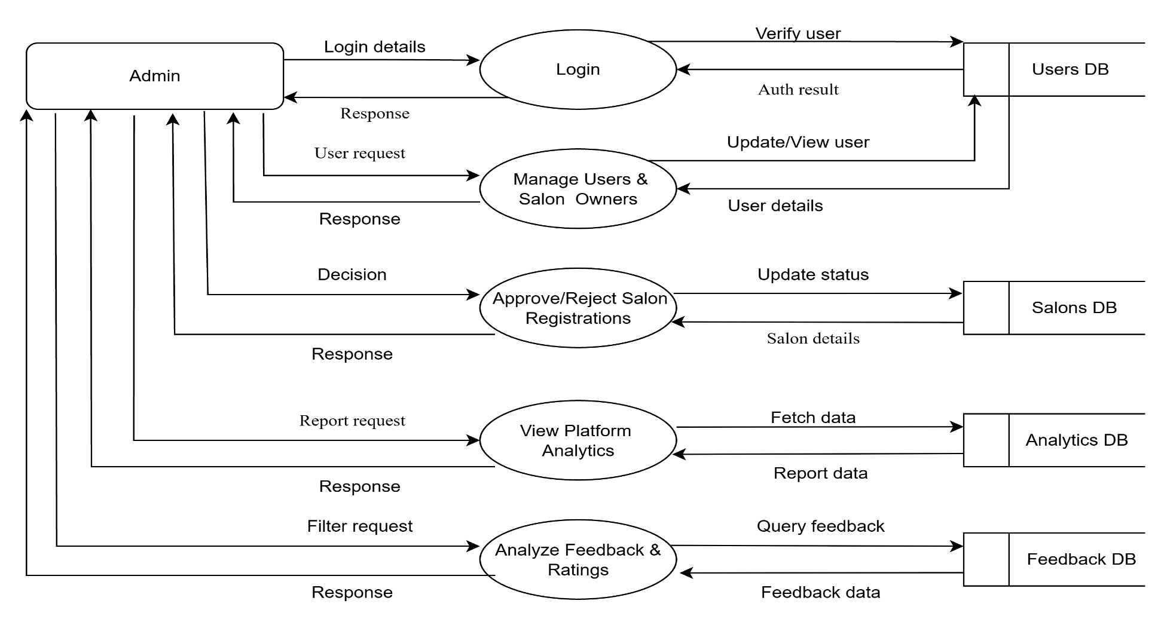
DATA FLOW DIAGRAM
Level 1

Slide 29
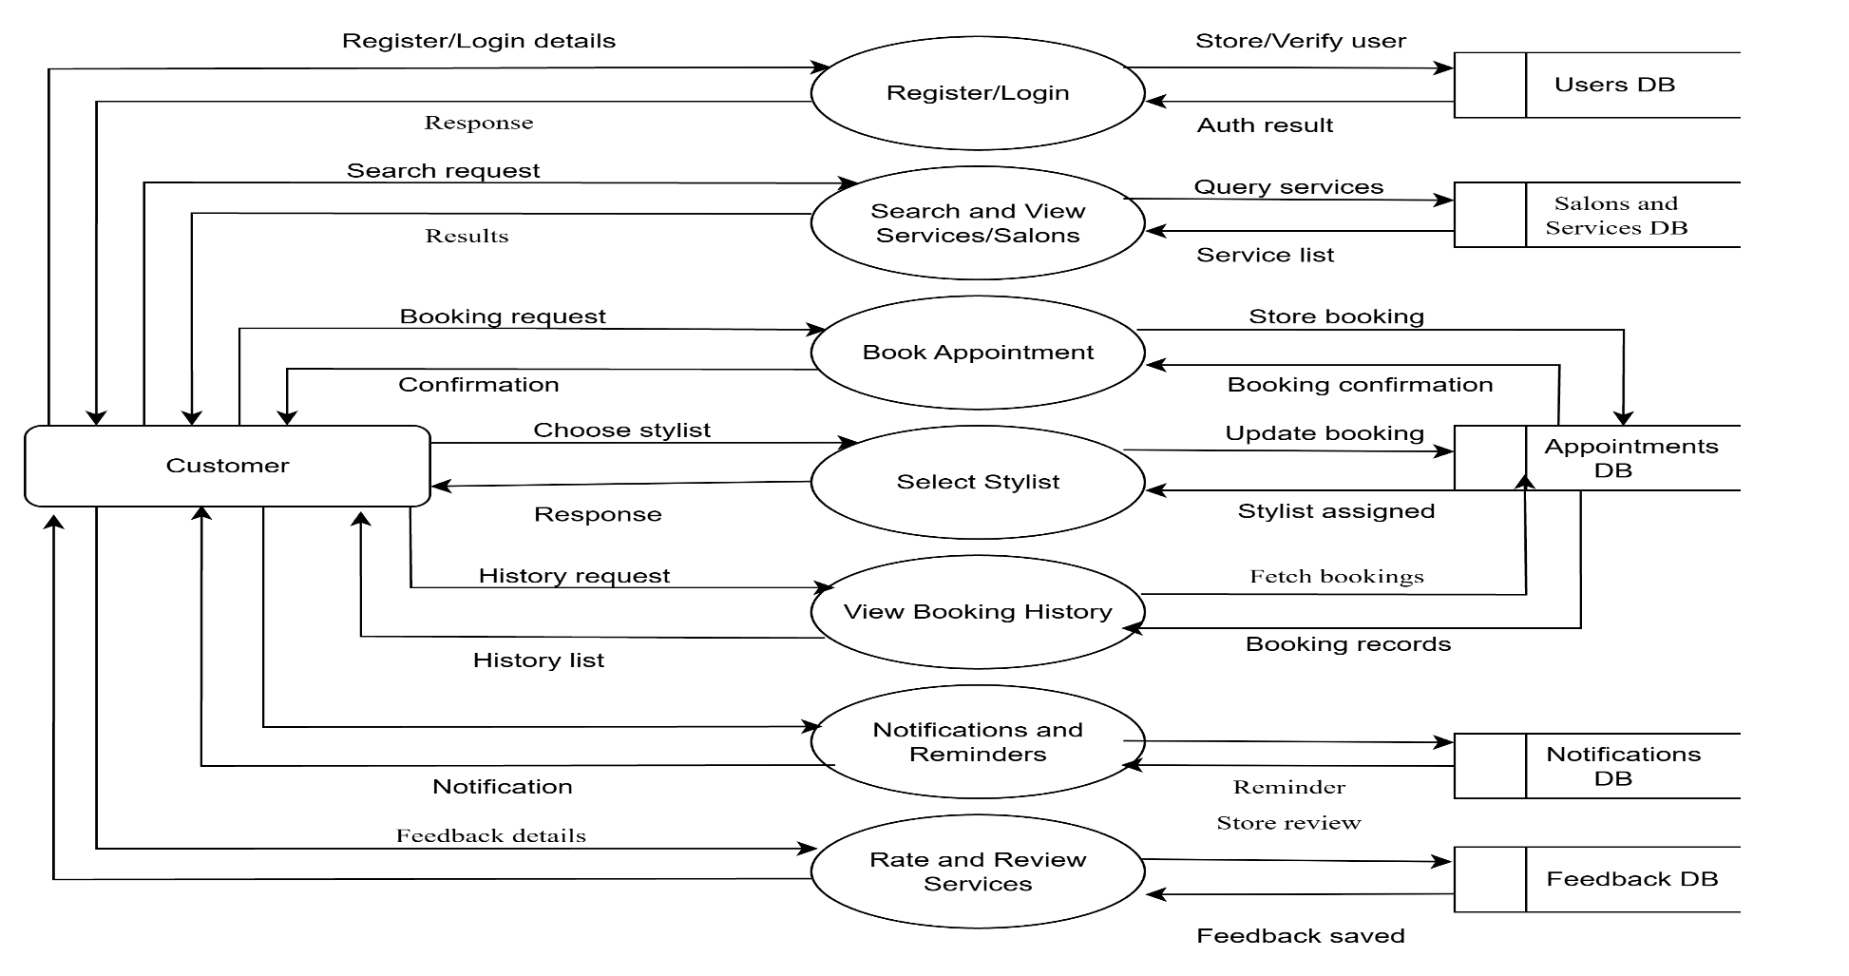
DATA FLOW DIAGRAM
Level 1.1

Slide 30
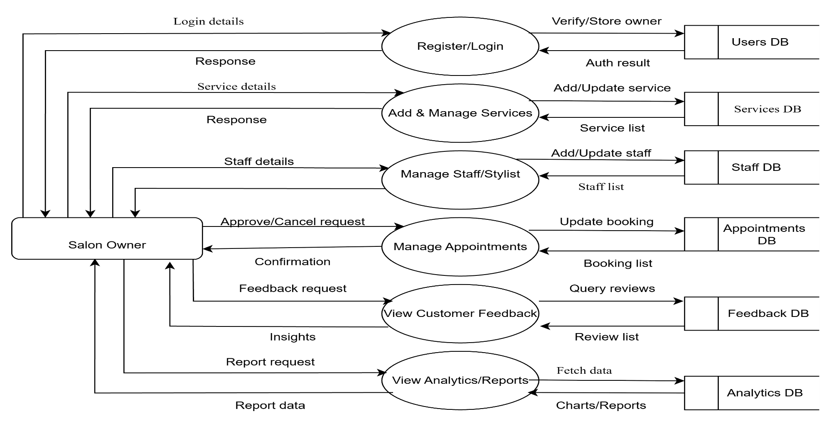
DATA FLOW DIAGRAM
LEVEL 1.2

Slide 31
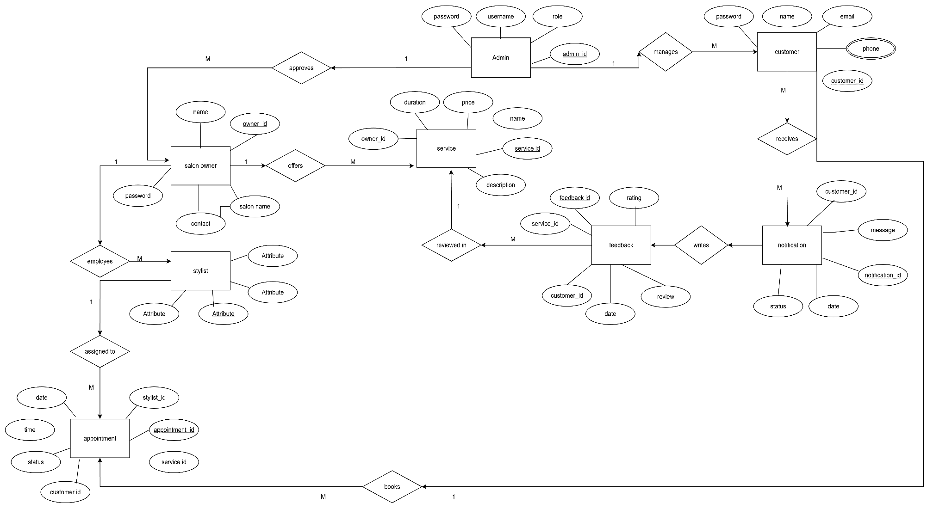
ER DIAGRAM

Slide 32
THANK YOU

