Slide 1
Intelligent Inventory Management System: A Modern Method with AI and Machine Learning
Student Name: Md Najmol Hasan
Student ID: 30082892

Slide 2
Introduction
• Background
Several challenges noticed in inventory management such as inefficiency, stock outs and poor demand forecasting.
The traditional systems heavily depend on the manual input as well as historical data which is leading to the inaccuracies.
• Proposed Solution
Develop the AI-driven Intelligent Inventory Management System.
Concentrates on the real-time inventory tracking, automated processes as well as demand forecasting.

Slide 3
Background
• Traditional Inventory Management Systems
Dependent on the historical data and manual procedures.
Challenges:
Slow to familiarize to altering the market conditions.
High error rates because of the manual data entry.
Unsuccessful demand forecasting.
• The Requirement for Innovation
Growing complexity in the supply chains.
Increasing reliance on the predictive analytics as well as real-time data.

Slide 4
AI and Machine Learning in Inventory Management
• Role of AI and ML
Demand Forecasting: Assess market conditions, external factors and sales trends.
Pattern Recognition: identify the anomalies and then enhance the accuracy.
Real-time Decision Making: Automate reordering also improve the inventory levels.
• Benefits
Decrease the stockouts and also overstocking by up to 25%.
Enhance the customer satisfaction as well as operational efficiency.

Slide 5
Project Objectives
• Main Objective:
Improve the supply chain performance with the AI-powered inventory management system.
• Key Objectives:
Conduct research on the present systems as well as technologies.
Develop a user-friendly and scalable system.
Use machine learning for demand forecasting.
Automate the inventory tracking as well as reordering.
Integrate with present ERP systems.
Assess the performance via severe testing.

Slide 6
Methodology
• Research Approach:
Prepare literature reviews and recognize gaps in the traditional inventory systems.
Collect requirements via technical analysis and user surveys.
• Development Steps:
1. System Design: Modular architecture with usability and scalability.
2. Data Collection: Historical data from the inventory records, external factors and sales trends.
3. Execution of System: Use of the Agile methodology with the cycles of iterative development.
4. Testing and Validation: Difficult testing at integration, system and unit levels.

Slide 7
System Design
• High-Level Architecture:
User Interface Layer: Web app for the inventory tracking, responsive across all devices.
Application Layer: Backend logic also APIs developed with the Django.
Machine Learning Layer: Demand forecasting and the inventory optimization by using TensorFlow.
Data Layer: MySQL database for the inventory as well as configuration data.
Integration Layer: RESTful APIs for the integration of ERP and IoT.
• Modular Approach:
Confirms the scalability and also ease of maintenance.

Slide 8
Database Design
• Overview:
Key tables: Products, Suppliers, Inventory, Users and Orders.
Structured for effective storage and also retrieval.
• Optimization:
Data normalization to decrease the redundancy.
Indexing for the quicker queries.
Key Features:
Tracks the stock levels, reorder the points also history.
Confirms the data security via user role management.

Slide 9
Machine Learning Models
• Demand Forecasting Model:
Input: Historical sales, external factors and seasonal trends.
Output: Exact predictions of the product demand.
Algorithm: LSTM or Long Short-Term Memory neural network.
• Inventory Optimization Model:
Input: Demand rates, holding costs, stockout penalties and lead times.
Output: Optimal reorder points also quantities.
Algorithm: Reinforcement Learning by using Deep Q-Networks.

Slide 10
User Interface
Dashboard: Significant inventory metrics as well as alerts.
Inventory View: Displays the stock levels with search also filter options.
Order Management: Maintains the incoming as well as outgoing orders.
Forecasting: Delivers inventory planning and demand predictions.
Reports: Customizable analytics for the actionable insights.

Slide 11
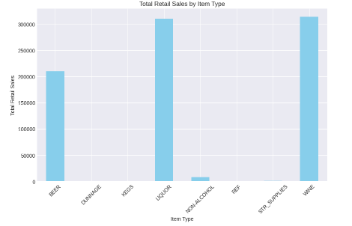
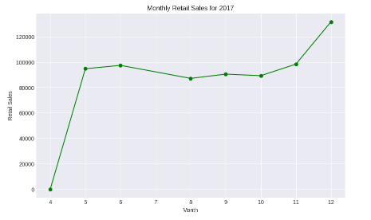
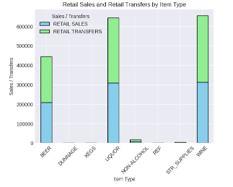
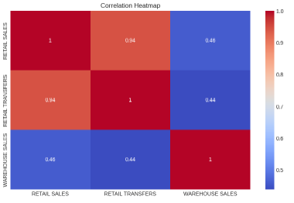
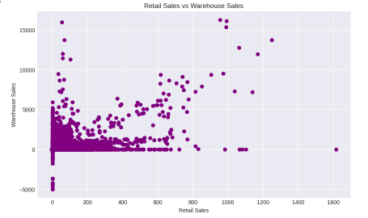
Testing and Validation
Various testing process is applied here such as unit testing, system testing, integration testing and many more.
A python code is developed to analyze the data present the selected database named Warehouse_and_Retail_Sales.csv
Here, a bar plot, line plot, stacked bar plot, scatter plot and heatmap are developed.

Slide 12
User Interface
Enhanced forecast accuracy.
Decreased holding costs and stockouts.
Improved the operational efficiency.
Positive feedback from the users.

Slide 13
Challenges and Limitations
Data quality also availability.
Integration with the legacy systems.
Initial resistance to the adoption.
Computational costs of the models of ML.

Slide 14
Future Work
Incorporation of the blockchain for transparency.
Development of the mobile applications.
Execution of the advanced ML algorithms.
Discovering predictive maintenance for the inventory tools.

Slide 15
Conclusion
Developed inventory management with AI and ML.
Enhanced accuracy, user satisfaction and efficiency.
Set the stage for the future innovations.

Slide 16
References
Brigitta Zsoter, D. D. Á. B. G. H. (2023). Ethical aspects of inventory management in an agricultural enterprise. Analecta Technica Szegedinensia, 17, 40-45.
Reza Pulungan, S. P. N. (2013). Design of An Intelligent Warehouse Management System. Information Systems International Conference (ISICO).
Zhang, S., Huang, K. and Yuan, Y., 2021. Spare parts inventory management: A literature review. Sustainability, 13(5), p.2460. https://www.mdpi.com/2071-1050/13/5/2460/pdf
Mashayekhy, Y., Babaei, A., Yuan, X.M. and Xue, A., 2022. Impact of Internet of Things (IoT) on inventory management: A literature survey. Logistics, 6(2), p.33. https://www.mdpi.com/2305-6290/6/2/33/pdf
Becerra, P., Mula, J. and Sanchis, R., 2022. Sustainable inventory management in supply chains: Trends and further research. Sustainability, 14(5), p.2613. https://www.mdpi.com/2071-1050/14/5/2613/pdf

Slide 17
Thank You

