Slide 1
Lossless Compression-Statistical Model

Slide 2
Lossless Compression
One important to note about entropy is that, unlike the thermodynamic measure of entropy, we can see no absolute number for the information content of a given message
The probability figure we see is actually the probability for a given model that is kept inside the human brain. It is just a model, not an absolute number

Slide 3
Lossless Compression
In order to compress data well,we need to select models that predict symbols with high probabilities
A symbol that has a high probability has low information content and will need fewer bits to encode
Lossless data compression is generally implemented using one of two different types of modeling
  statistical or dictionary-based

Slide 4
Lossless Compression
Statistical modeling reads in and encodes a single symbol at a time using the probability of that character’s appearance
    Huffman coding
    Shannon-Fano coding
    Arithmetic coding
Dictionary-based modeling uses a single code to replace strings of symbols
    LZ77
    LZ78
    LZW

Slide 5
Minimum Redundancy Coding
Given the probabilities, a table of codes could be constructed that has several important properties
Different codes have different number of bits
Codes for symbols with low probabilities have more bits, and codes for symbols with high probabilities have fewer bits

Slide 6
Shannon-Fano Algorithm
Though the codes are of different bit lengths, they can be uniquely decodes
  For a given list of symbols, develop a corresponding list of probabilities or frequency counts
  Sort the lists of symbols in descending order
  Divide the list into two parts, such that the total frequency counts of the two parts are as close as possible.
  Assign 0,1 to the upper, lower parts, respectively
  Recursively apply the same procedure to each of the two halves until each symbol has become a leaf

Slide 7
Shannon-Fano Algorithm
Symbol Count Code
A 15 0 0
2nd division
B 7 0 1
First division
C 6 1 0
3rd division
D 5 1 1 0
4th division
E 5 1 1 1

Slide 8
Huffman Coding
Huffman codes are built from the bottom up, starting with the leaves of the tree and working progressively closer to the root
  The two free nodes with the lowest weights are located
  Create a parent node, whose weight is the sum of the two son nodes, for these two nodes
  Let the newly created parent node be a free node and the two son nodes be removed from the list
  Assign 0,1 to the two son nodes paths, arbitrarily
  Repeat the Huffman Algorithm until only one free node is left

Slide 9
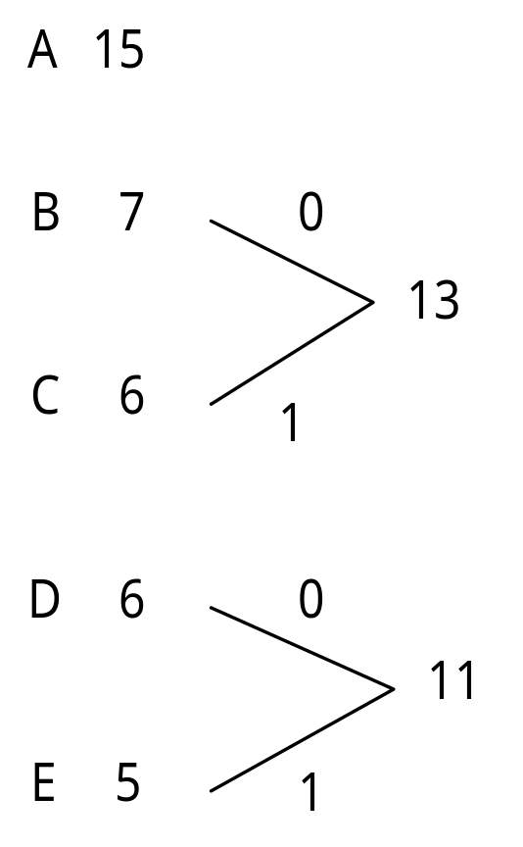
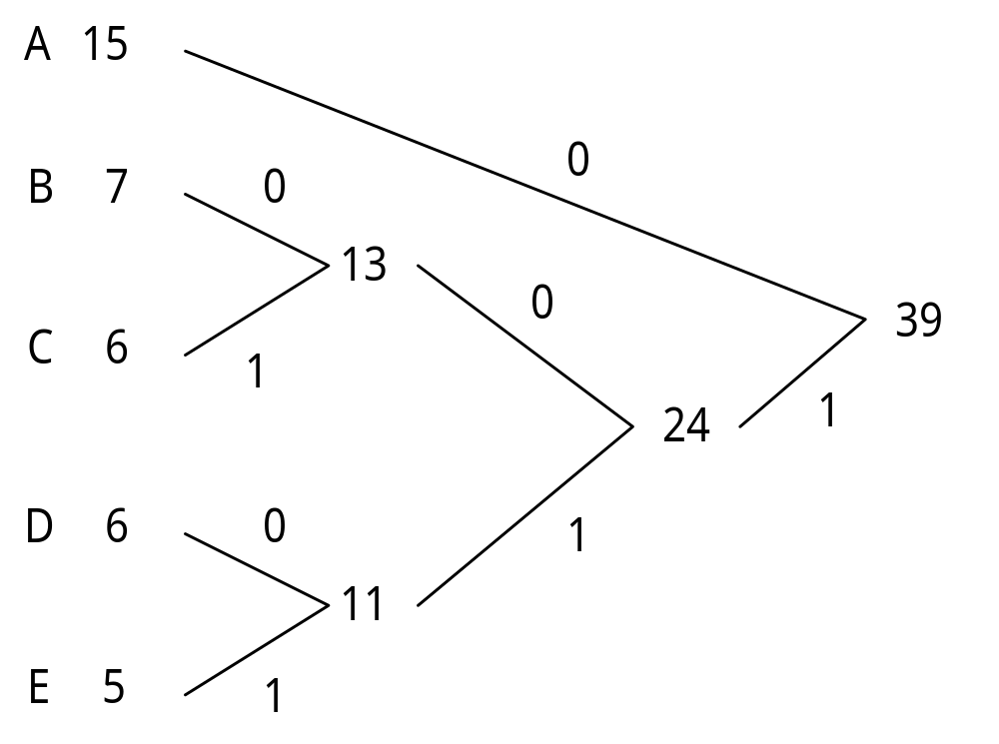
Huffman Coding

Slide 10
Huffman Coding
Huffman coding will always at least equal the efficiency of Shannon-Fano coding, so it has become the predominate coding method of this type
It was shown that Huffman coding cannot be improved or with any other integral bit-width coding stream
JPEG, MPEG, and etc

Slide 11
Adaptive Huffman Coding
Adaptive coding lets us use higher-order modeling without paying any penalty for added statistics
It does this by adjusting the Huffman tree on the fly, based on data previously seen and having no knowledge about future statistics
Sibling property
  A tree is said to exhibit sibling property if the nodes can be listed in order of increasing weight and if every node appears adjacent to its sibling in the list

Slide 12
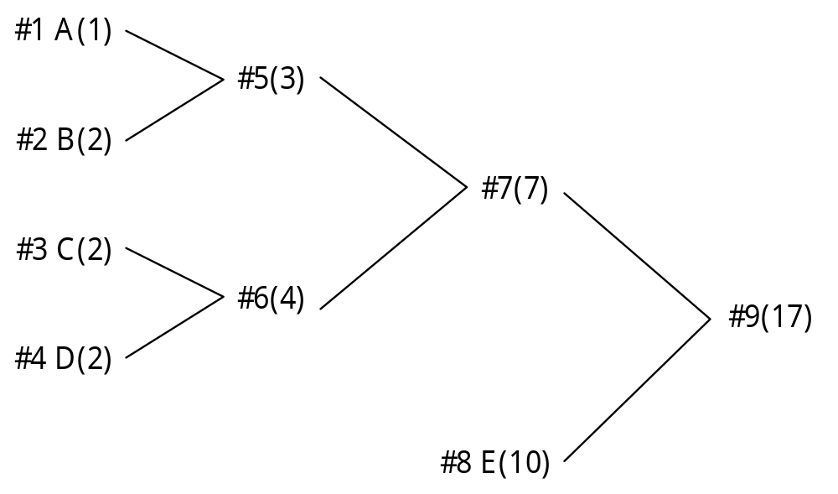
Adaptive Huffman Coding
A binary tree is a Huffman tree if and only if it obeys the sibling property

Slide 13
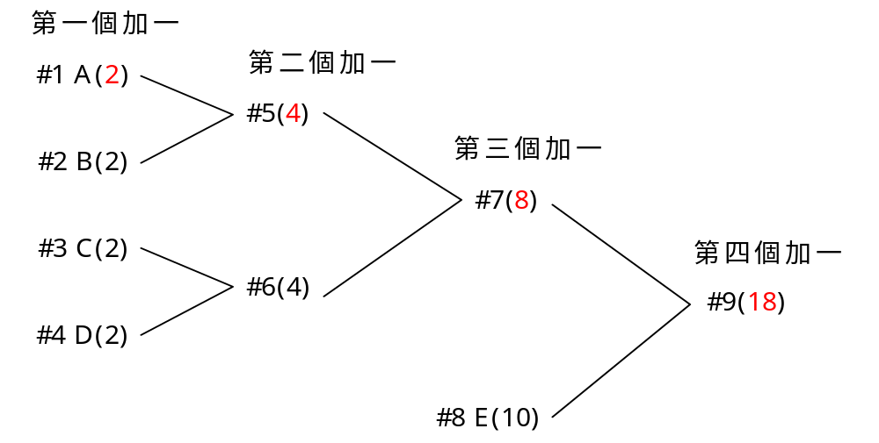
Adaptive Huffman Coding
Thus, maintain the sibling property during the update assure that we have a Huffman tree before and after the counts are updated

Slide 14
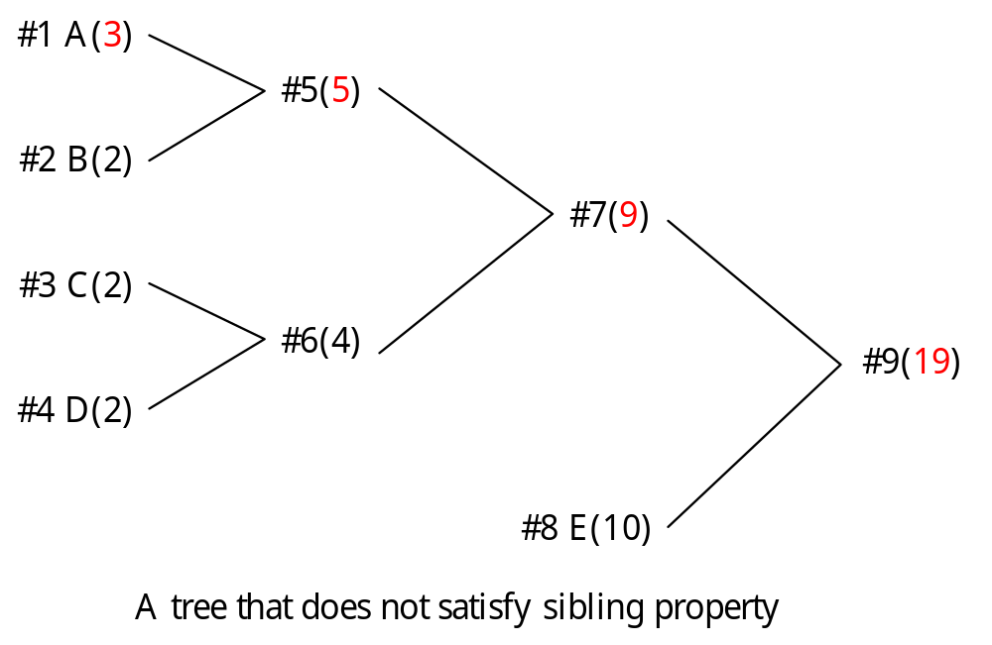
Adaptive Huffman Coding

Slide 15
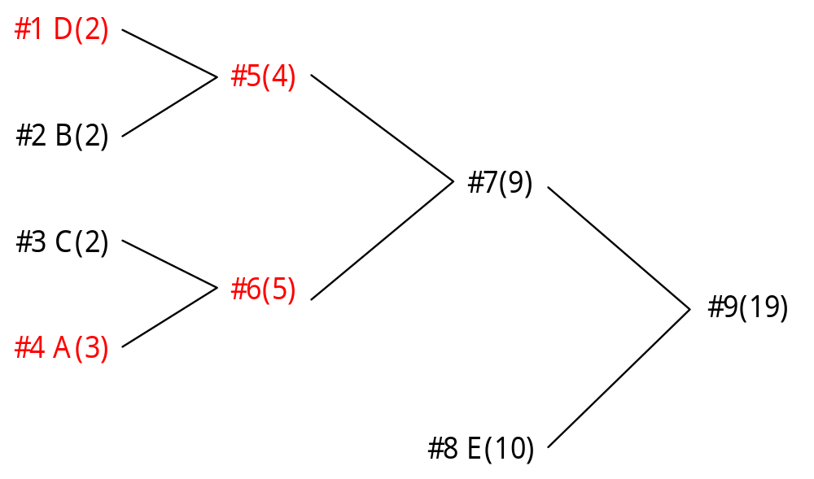
Adaptive Huffman Coding

Slide 16
Adaptive Huffman Coding
If the newly incremented node now has a weight of w+1, the next higher node will have a weight of w when updating is needed
There may be more nodes after the next higher one that have a value of w as well. The update (swap) procedure moves up the node list till it finds the last node with a weight of w
That node is swapped with the node with weight w+1

Slide 17
Adaptive Huffman Coding
In this example, D is swapped with A
The next node to be incremented will be the new parent of the incremented node. In this example, it is node #6
As each node is incremented, a check is performed for correct ordering. A swap is performed if necessary

Slide 18
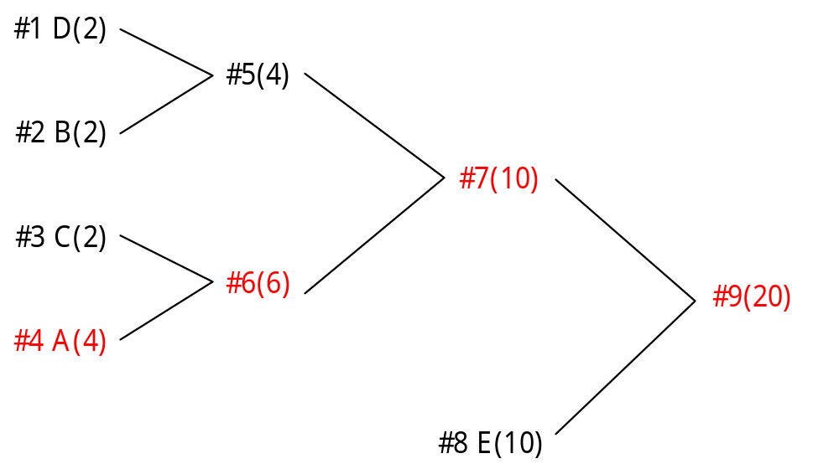
Adaptive Huffman Coding

Slide 19
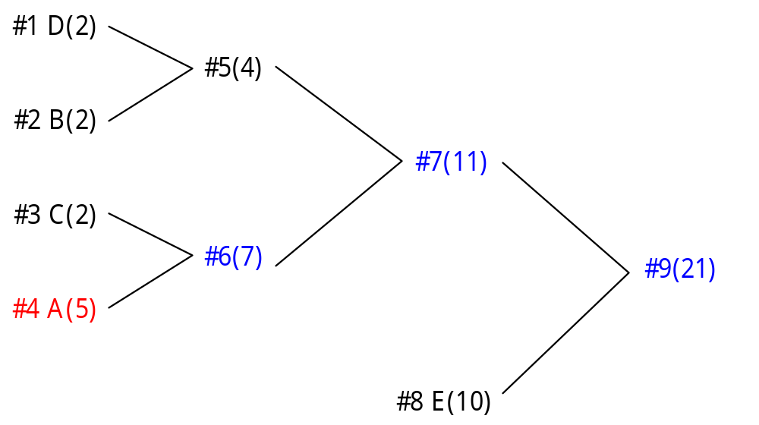
Adaptive Huffman Coding
Not a Huffman tree

Slide 20
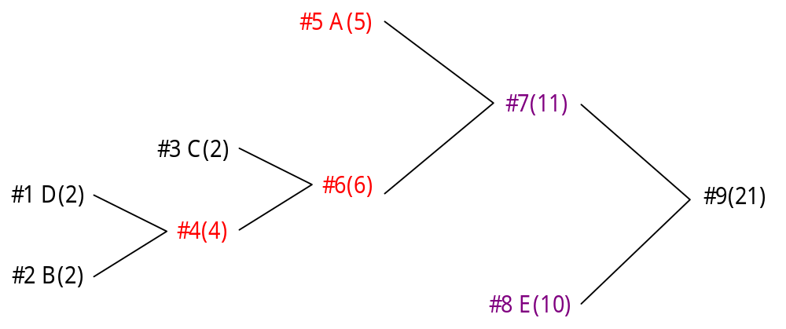
Adaptive Huffman Coding
Still not a Huffman tree

Slide 21
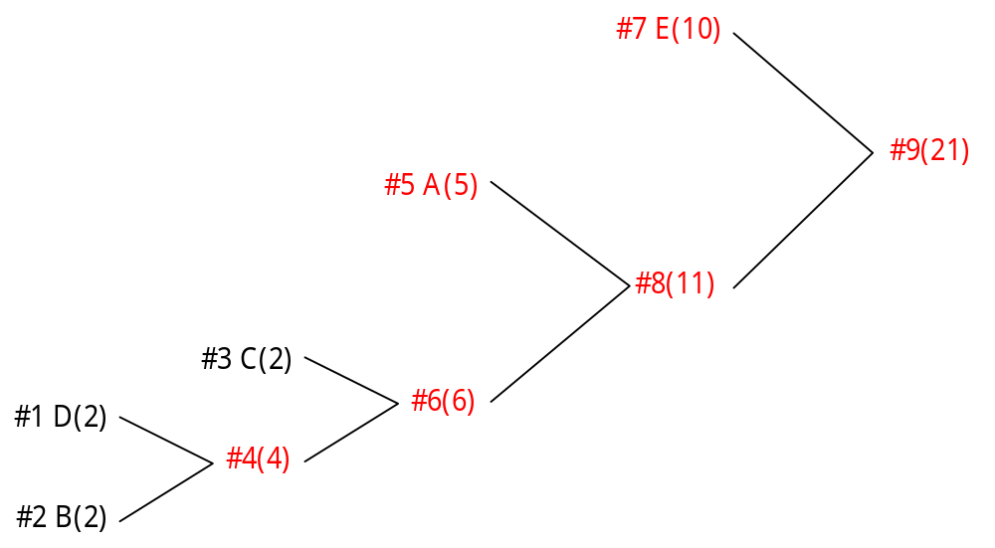
Adaptive Huffman Coding
Now, it is a Huffman tree again

Slide 22
Adaptive Huffman Coding
Note that the code length for A changes from 3 to 2
And the code length for B and D changes from 3 to 4

Slide 23
Adaptive Huffman Coding
Initialization
  Create a Huffman tree with two symbol EOF and ESCAPE with weight being 1
  Let C be the incoming character
  If C is in the Huffman tree, then transmit the Huffman code for C and update the Huffman tree, else transmit the Huffman code for ESCAPE and the plain 8-bit character for C, and then update the Huffman tree for ESCAPE and C

Slide 24
Adaptive Huffman Coding
The overflow problem
  the weight of the root exceeds the capacity as the program progresses long enough
  The longest possible Huffman code exceeds the range of the integer used as a stack
    It is needed because the encoding and decoding phases treat the Huffman tree path in reverse order
Solution
  Recalling the weight by a factor of 1/2
  It can possibly reshape the tree

Slide 25
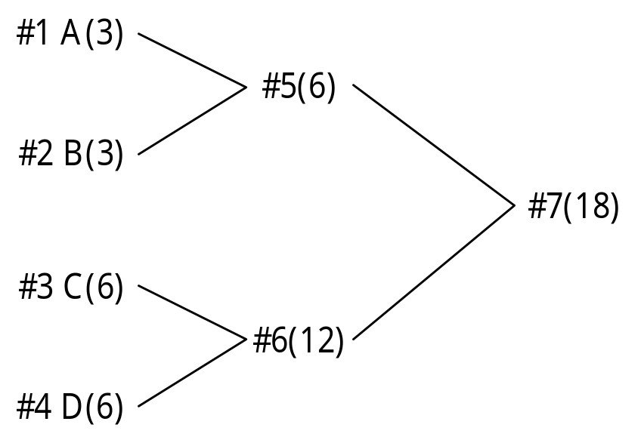
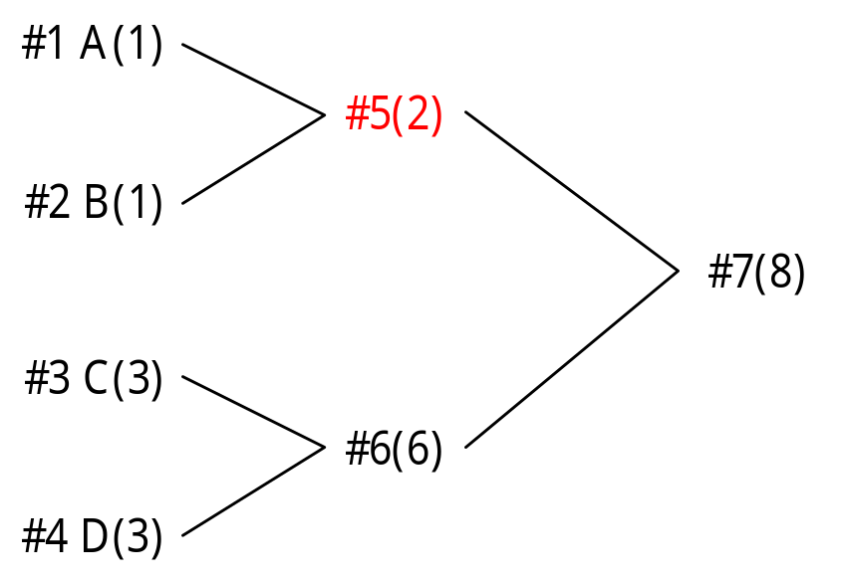
Adaptive Huffman Coding
Problems occur when divided by 2

Slide 26
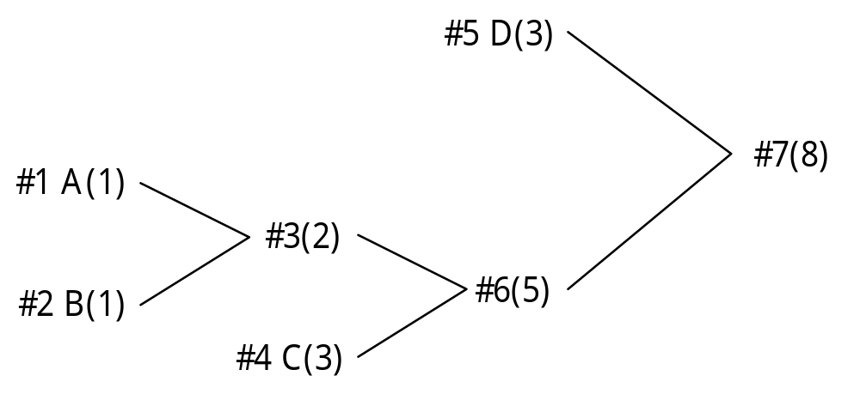
Adaptive Huffman Coding
Rebuilding the tree is sometimes needed

Slide 27
Arithmetic Coding
Huffman coding has been proven the best fixed length coding method available
Yet, since Huffman codes have to be an integral number of bits long, while the entropy value of a symbol may (as a matter of fact, almost always so) be a faction number, theoretical possible compressed message cannot be achieved

Slide 28
Arithmetic Coding
For example, if a statistical method assign 90% probability to a given character, the optimal code size would be 0.15 bits
The Huffman coding system would probably assign a 1-bit code to the symbol, which is six times longer than necessary
Arithmetic coding bypasses the idea of replacing an input symbol with a specific code. It replaces a stream of input symbols with a single floating-point output number

Slide 29









Character probability Range
^(space) 1/10
A 1/10
B 1/10
E 1/10
G 1/10
I 1/10
L 2/10
S 1/10
T 1/10
Suppose that we want to encode the message
BILL GATES

Slide 30
Arithmetic Coding
To encode the first character B properly, the final coded message has to be a number greater than or equal to 0.20 and less than 0.30
After the first character is encoded, the low end for the range is changed from 0.00 to 0.20 and the high end for the range is changed from 1.00 to 0.30
The next character to be encoded, the letter I, owns the range 0.50 to 0.60 in the new subrange of 0.20 to 0.30
So, the new encoded number will fall somewhere in the 50th to 60th percentile of the currently established.
Thus, this number is further restricted to 0.25 to 0.26

Slide 31
Arithmetic Coding
Encoding algorithm for arithmetic coding
    Low = 0.0 ; high =1.0 ;
    while not EOF do
    range = high - low ; read(c) ;
    high = low + range×high_range(c) ;
    low = low + range×low_range(c) ;
    enddo
    output(low);

Slide 32
Arithmetic Coding
  New character Low value high value
  B 0.2 0.3
  I 0.25 0.26
  L 0.256 0.258
  L 0.2572 0.2576
  ^(space) 0.25720 0.25724
  G 0.257216 0.257220
  A 0.2572164 0.2572168
  T 0.25721676 0.2572168
  E 0.257216772 0.257216776
  S 0.2572167752 0.2572167756

Slide 33
Arithmetic Coding
Decoding is the inverse process
Since 0.2572167752 falls between 0.2 and 0.3, the first character must be ‘B’
Removing the effect of ‘B’ from 0.2572167752 by first subtracting the low value of B, 0.2, giving 0.0572167752
Then divided by the width of the range of ‘B’, 0.1. This gives a value of 0.572167752

Slide 34
Arithmetic Coding
Decoding algorithm
    r = input_code
    repeat
    search c such that r falls in its range ;
    output(c) ;
    r = r - low_range(c) ;
    r = r/(high_range(c) - low_range(c));
    until EOF or the length of the message is reached

Slide 35
r c Low High range
0.2572167752 B 0.2 0.3 0.1
0.572167752 I 0.5 0.6 0.1
0.72167752 L 0.6 0.8 0.2
0.6083876 L 0.6 0.8 0.2
0.041938 ^(space) 0.0 0.1 0.1
0.41938 G 0.4 0.5 0.1
0.1938 A 0.2 0.3 0.1
0.938 T 0.9 1.0 0.1
0.38 E 0.3 0.4 0.1
0.8 S 0.8 0.9 0.1
0.0

Slide 36
Arithmetic Coding
In summary, the encoding process is simply one of narrowing the range of possible numbers with every new symbol
The new range is proportional to the predefined probability attached to that symbol
Decoding is the inverse procedure, in which the range is expanded in proportion to the probability of each symbol as it is extracted

