Slide 1
Big Data Analytics CSCI-4341
Lecturer: Dr. SHARYAR WANI

Slide 2
Submitted By Name: Huda Md Najmul Matric No : 1627521

Slide 3
Dataset Description
There are 2 datasets has been given, which are CSV file
Survey Data Demographic
Survey Data Technologies normalized
Survey Data Demographic: The dataset comprises about 11000 values that explain the survey's results in a tabular manner, as well as personal questions and comments from the survey respondent, such as social media, salary, age, gender, dependents, and so on.
There are 71 columns in Survey Data Demographic, and 14 columns in Survey Data Technologies normalized.
Survey Data Technologies normalized: This dataset has more than 7000 values where it is shown that the technology in the computer science field and its demand in the upcoming year.

Slide 4

Data Science Question:
Which social media influenced most for choosing ?
Which country people have chosen their profession as Developer most?
How often people tend to feel open to new opportunities?
How often people’s desire of platform change?
Depends on satisfaction level how satisfied they are as a developer?

Slide 5
Objective:
Produce an appropriate data science question for research analysis.
Create a relationship between the dataset's columns by comparing them.
Determine the dataset's primary goal.
To create queries in order to sift out valuable data for EDA.

Slide 6
Methodology:
Data sets: The data set are given.
Tools : Google Colab
Library :
pandas, NumPy, matplotlib.
plot functions.
Spark

Slide 7
Data set 1

Slide 8
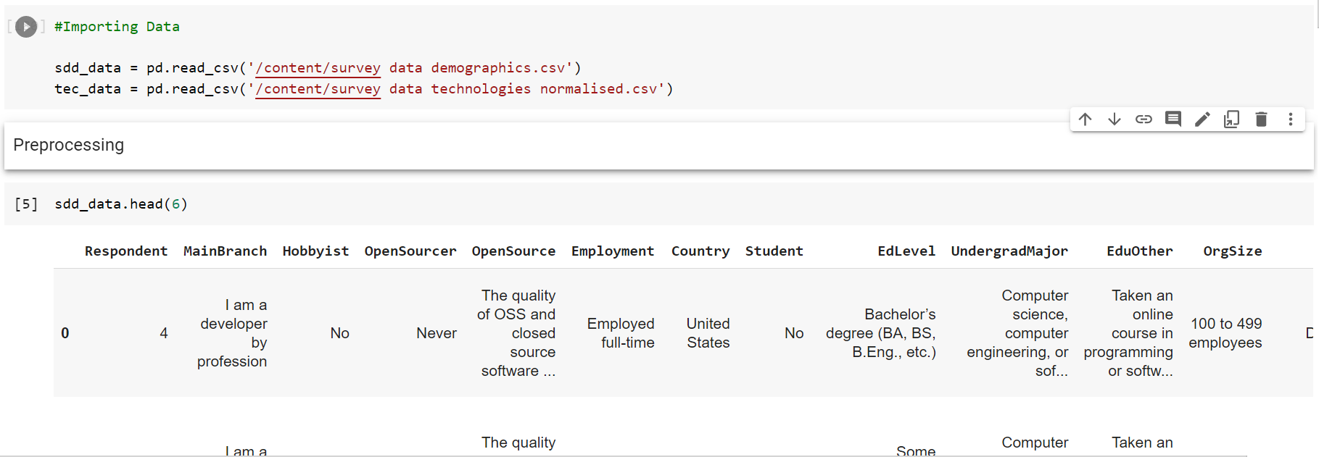
Results & Visualizations (Data set 1):
Importing data set and Returning the first 6 rows of the dataframe.

Slide 9
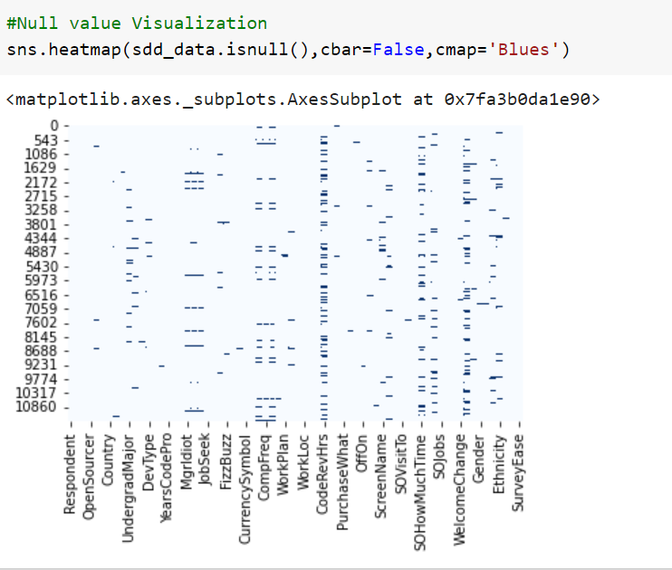
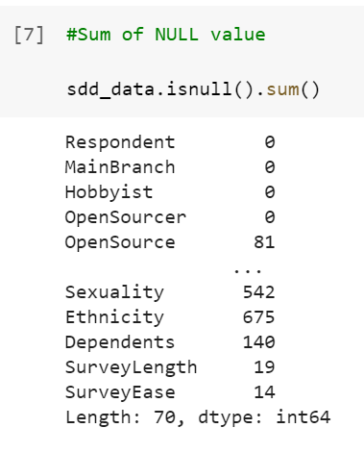
Results & Visualizations (Data set 1):
Check the null values and sum of them. Here we can see that there are null values in some column.

Slide 10
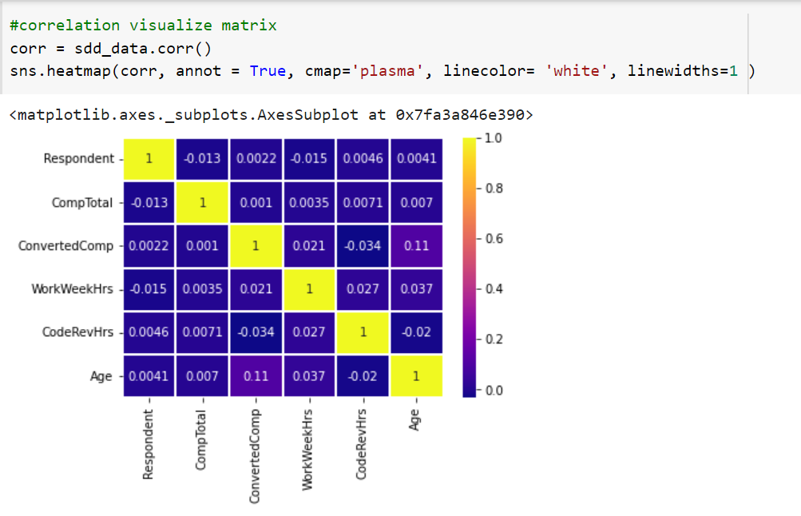
Results & Visualizations (Data set 1):
Correlation among the column

Slide 11
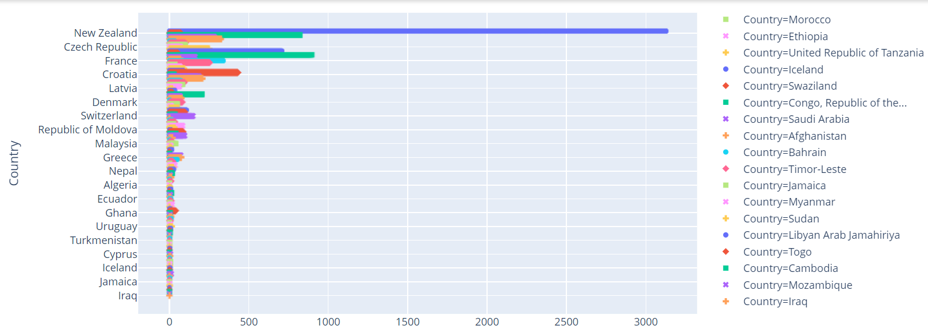
Results & Visualizations (Data set 1): This bar plot shows “Which country people have chosen their profession as Developer most?”

Slide 12
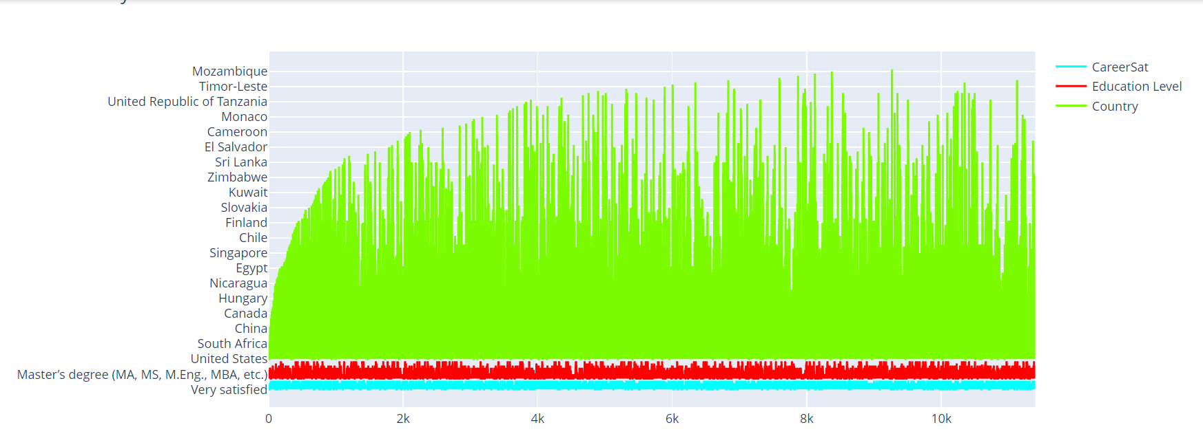
Results & Visualizations (Data set 1): This line graphs shows the “Country vs Education Level Vs Satisfaction” about their job as developer

Slide 13
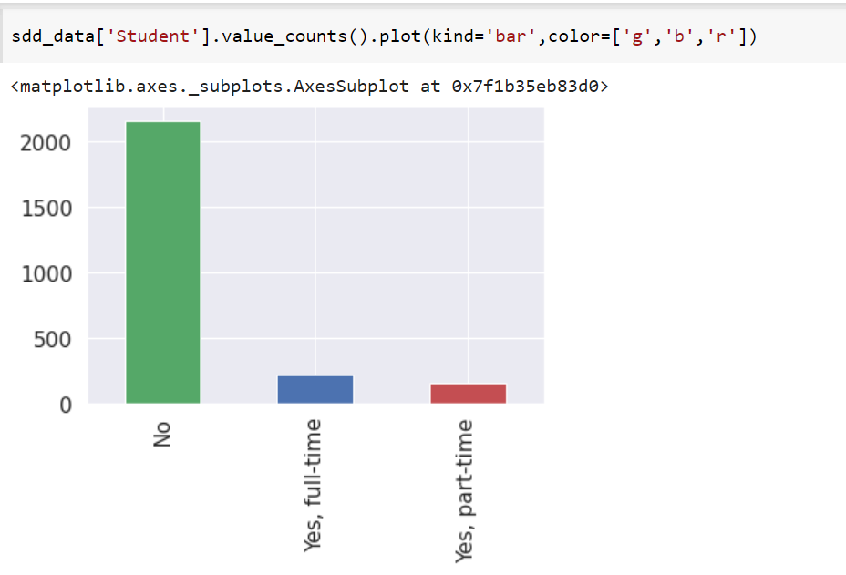
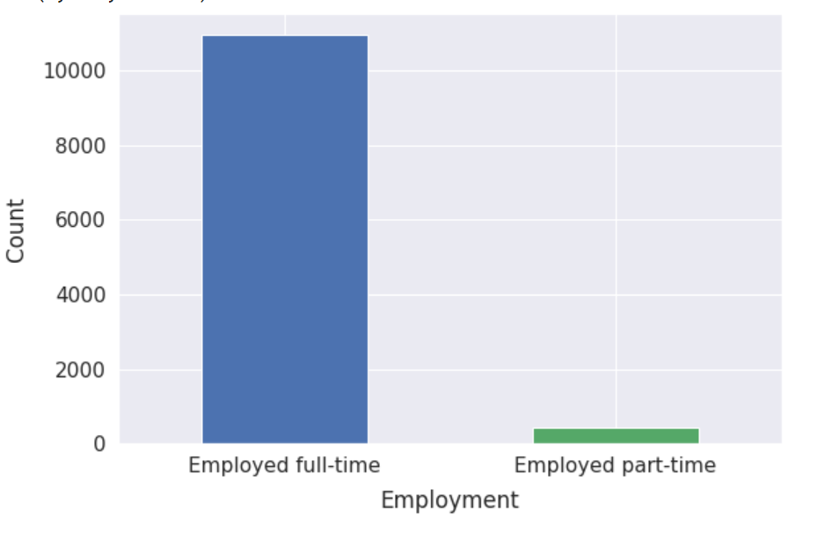
Results & Visualizations (Data set 1): People who work as a parttime and full time employ and student Who took developer job full time, part time and No

Slide 14
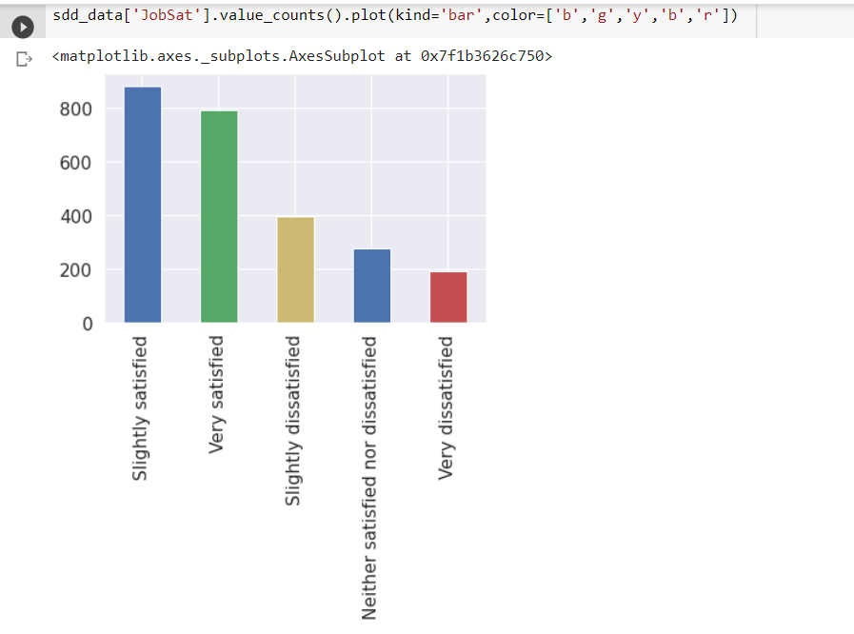
Results & Visualizations (Data set 1):
Here the bar plot shows satisfaction level of their job.

Slide 15
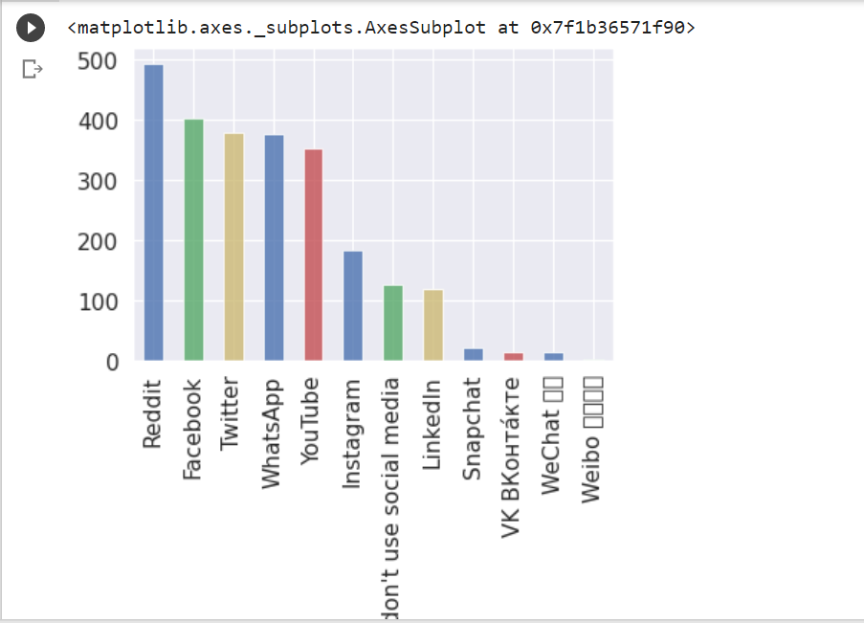
Results & Visualizations (Data set 1):
The plot shows which social media influenced most .

Slide 16
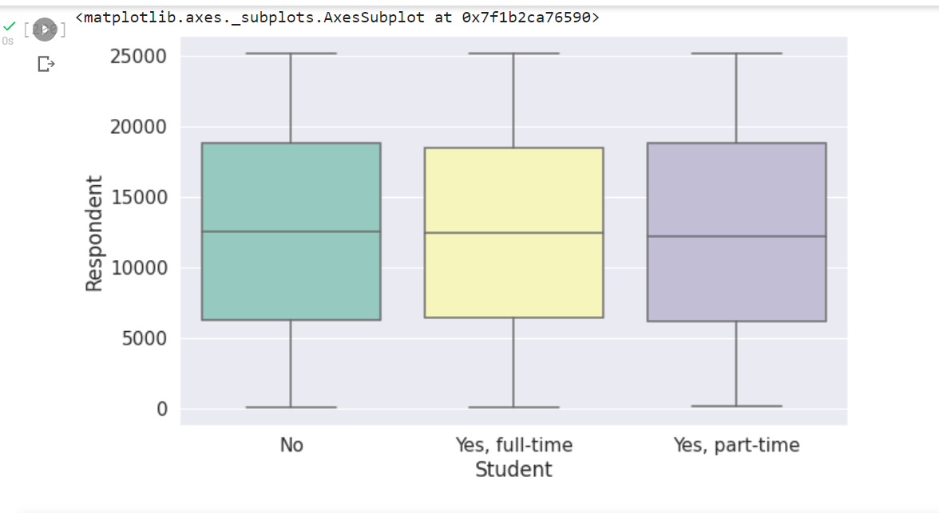
Results & Visualizations (Data set 1): Bar plot for job level

Slide 17
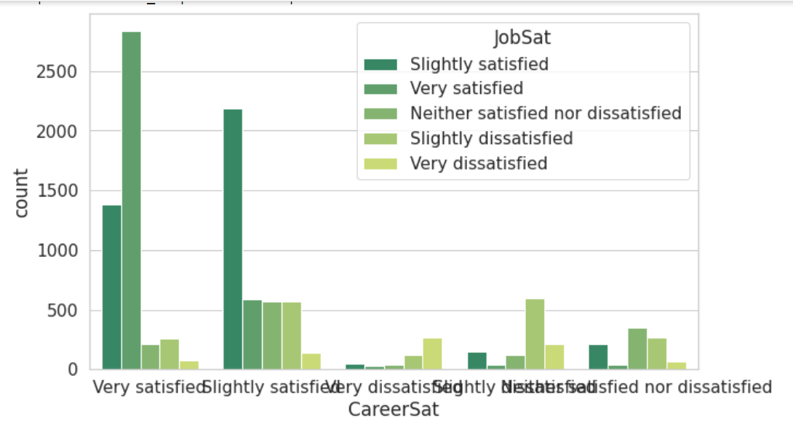
Results & Visualizations (Data set 1):Group the satisfaction level

Slide 18
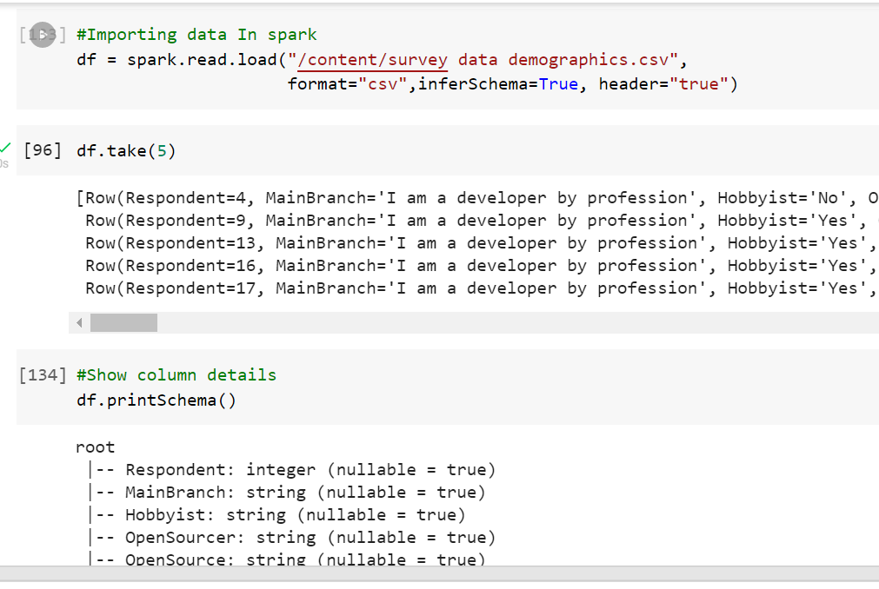
Results & Visualizations (Data set 1):
Import data in spark and show column details.

Slide 19
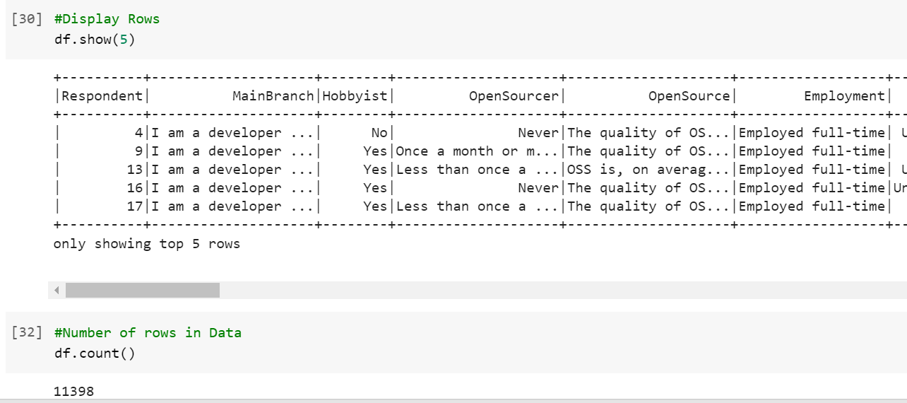
Results & Visualizations (Data set 1): in Pandas Dataframe we have the df.head() function, here in spark have the show() function. And total number of rows in the dataframe.

Slide 20
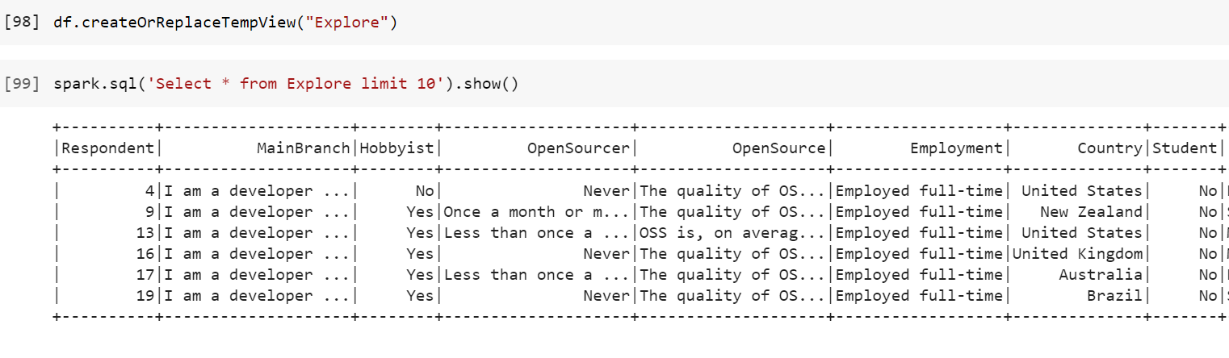
Results & Visualizations (Data set 1): data Querry using Spark

Slide 21
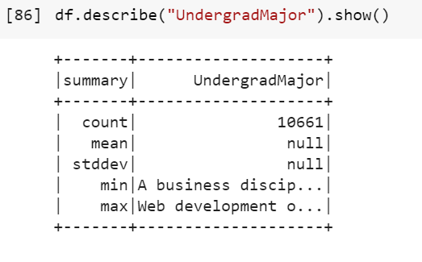
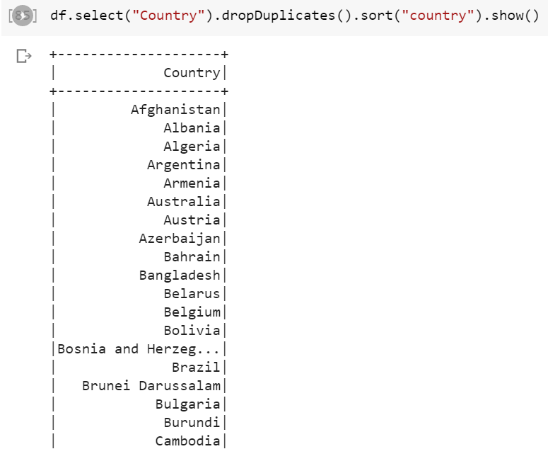
Results & Visualizations (Data set 1):
Quiring undergrade major subject and delete duplicate value using spark

Slide 22
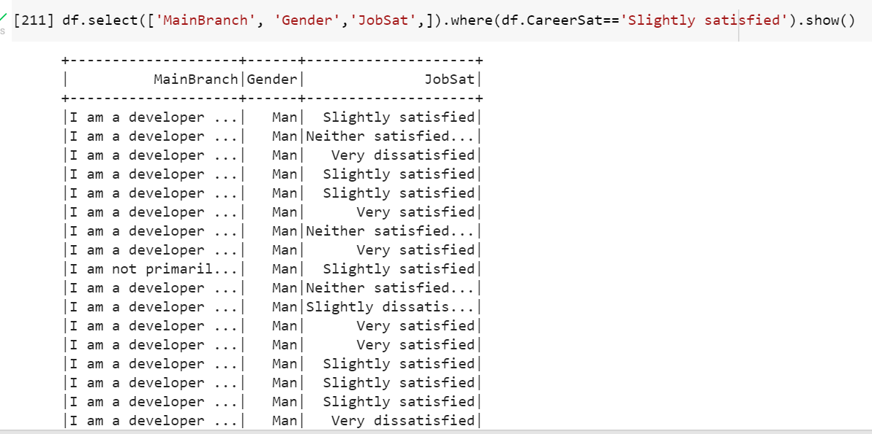
Results & Visualizations (Data set 1): Job satisfaction and number of people slightly satisfied with their job

Slide 23
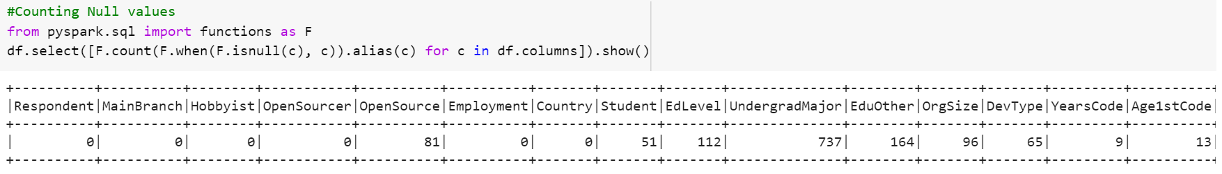
Results & Visualizations (Data set 1):check for missing values. We can see that we have columns with null values.

Slide 24
Data set 2

Slide 25
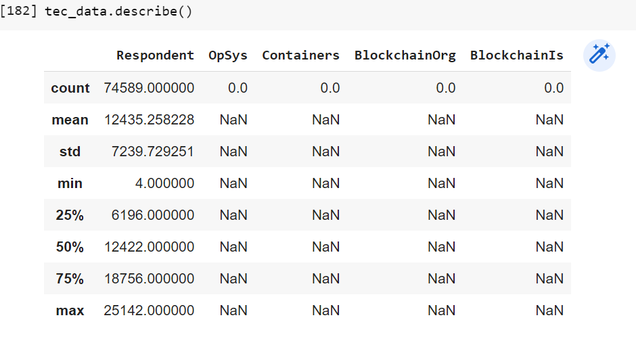
Results & Visualizations (Data set 2): Description of data set 2

Slide 26
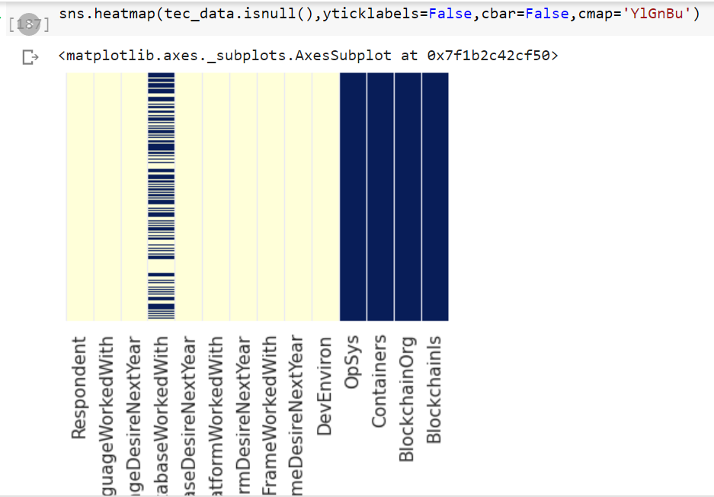
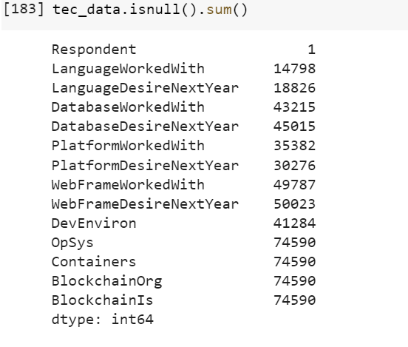
Results & Visualizations (Data set 2): Heatmap of null values after fill in missing value

Slide 27
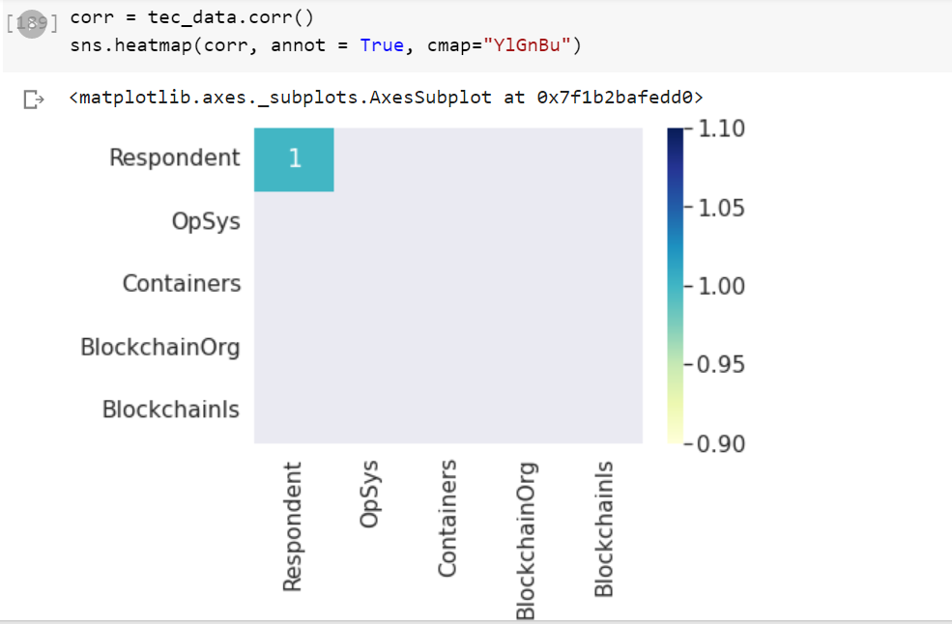
Results & Visualizations (Data set 2):
Correlation among the column

Slide 28
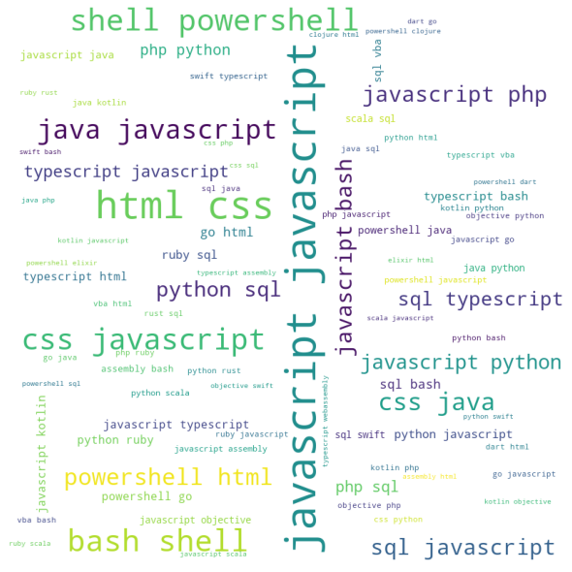
Results & Visualizations (Data set 2):
Word Map for the developer languages.

Slide 29
References:
https://github.com/ajcr/100-pandas-puzzles
https://www.analyticsvidhya.com/blog/2020/11/a-must-read-guide-on-how-to-work-with-pyspark-on-google-colab-for-data-scientists/
https://matplotlib.org/stable/tutorials/introductory/pyplot.html
https://www.geeksforgeeks.org/matplotlib-practice-exercise-and-solutions/

Slide 30
Thanks!

