Slide 1

Problem Statement
What Problems are we going to solved?

Slide 2
Research Objectives
Identify the level of Stress among primary school students towards STEM.
Analyse the correlation between emotion and stress among primary school students by using neural networks.

Slide 3
Research Significance
Who and how will be benefited from this research?

Slide 4
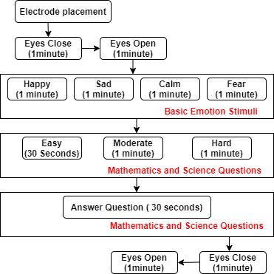
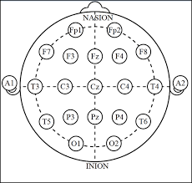
Research Protocol
Figure 2. Electrode Placement
Figure 1. Experimental Design

Slide 5
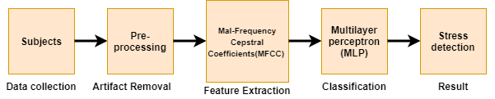
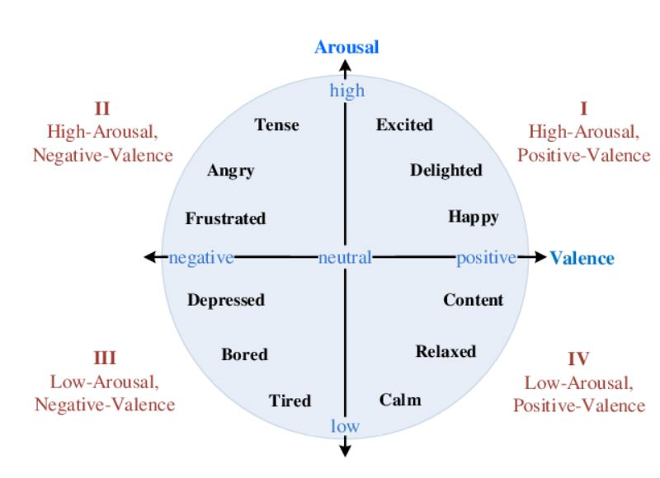
Methodology
Figure 3 Data Analysis Process
Figure 4 Russel’s Model Of Affect

Slide 6
Result Analysis

Slide 7
LOW GRADE STUDENT
Subject
1,3 and 4
MID GRADE STUDENT
Subject
2 and 5
HIGH GRADE STUDENT
Subject
6 and 7

Slide 8
LOW GRADE STUDENT
Subject
1,3 and 4

Slide 9
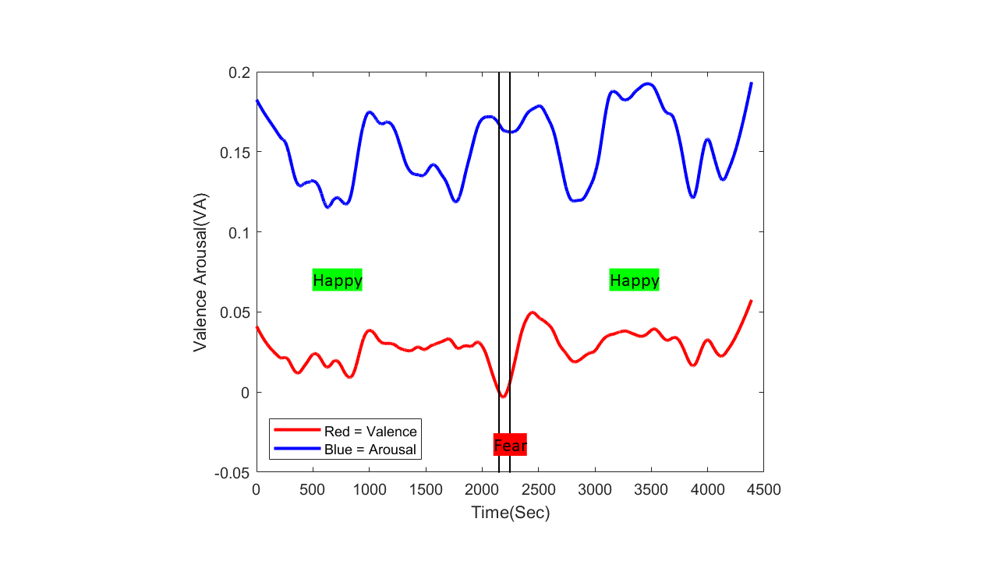
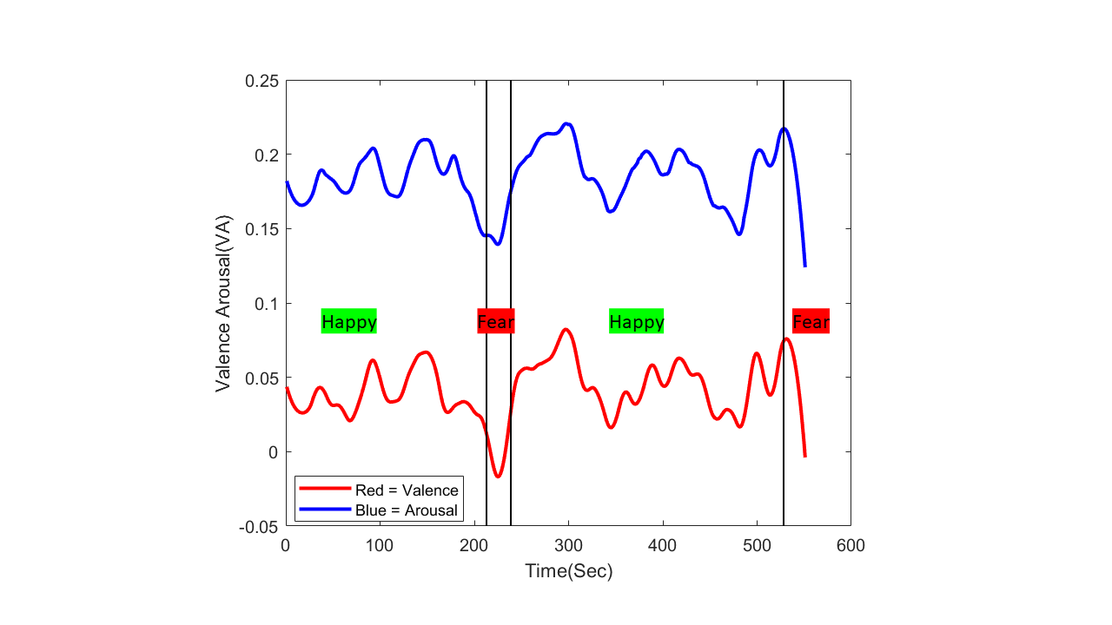
Brain Signal : Positive Valance and Positive Arousal
Emotion : Happy
Subject 1

Slide 10
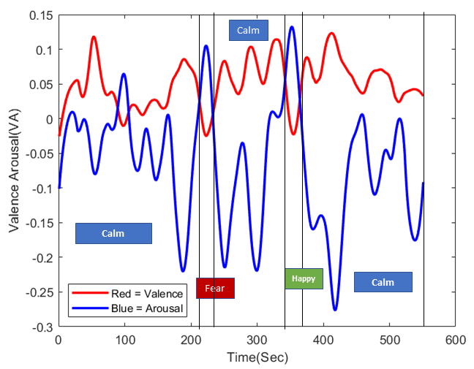
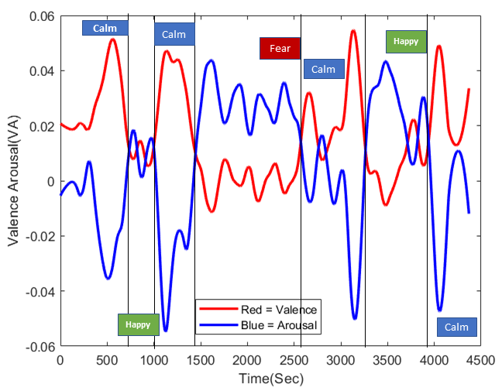
Brain Signal : Positive Valance and Negative Arousal
Emotion : Calm
Subject 3

Slide 11
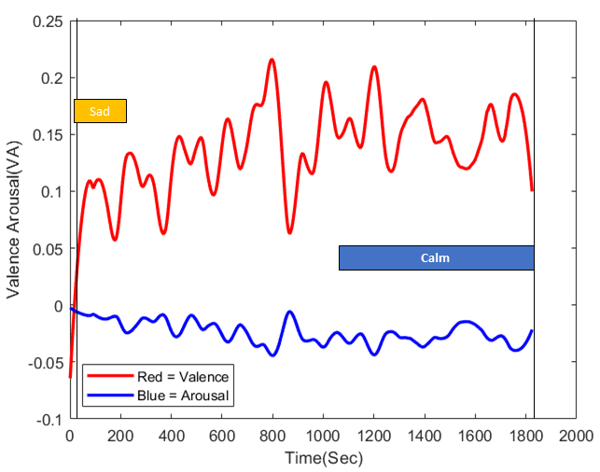
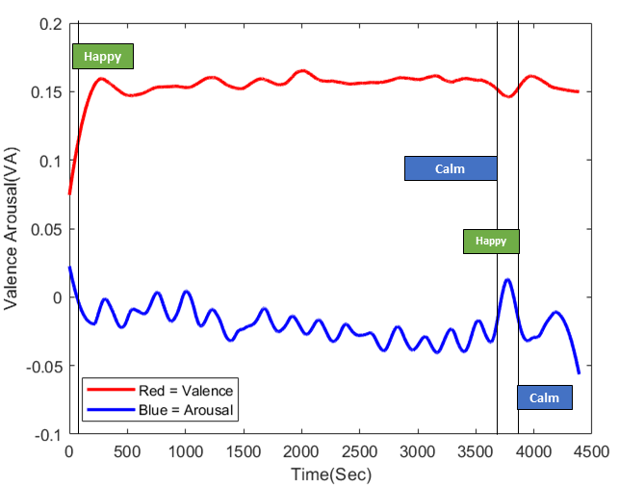
Brain Signal : Positive Valance and Negative Arousal
Emotion : Calm
Subject 4

Slide 12
MID GRADE STUDENT
Subject
2 and 5

Slide 13
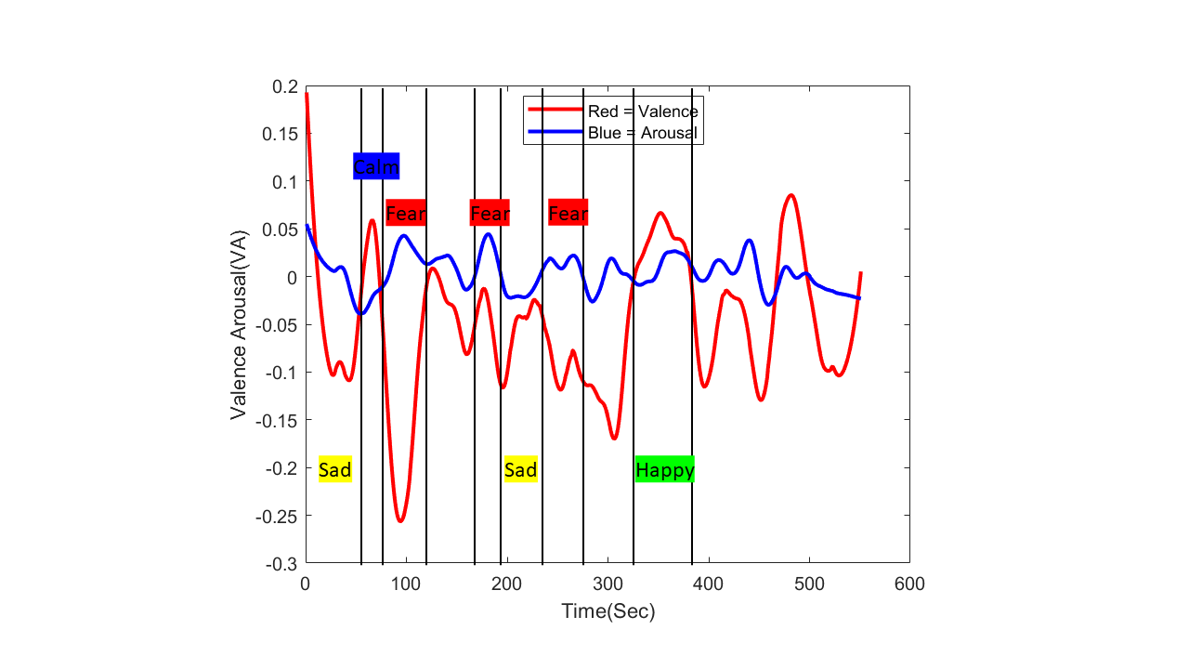
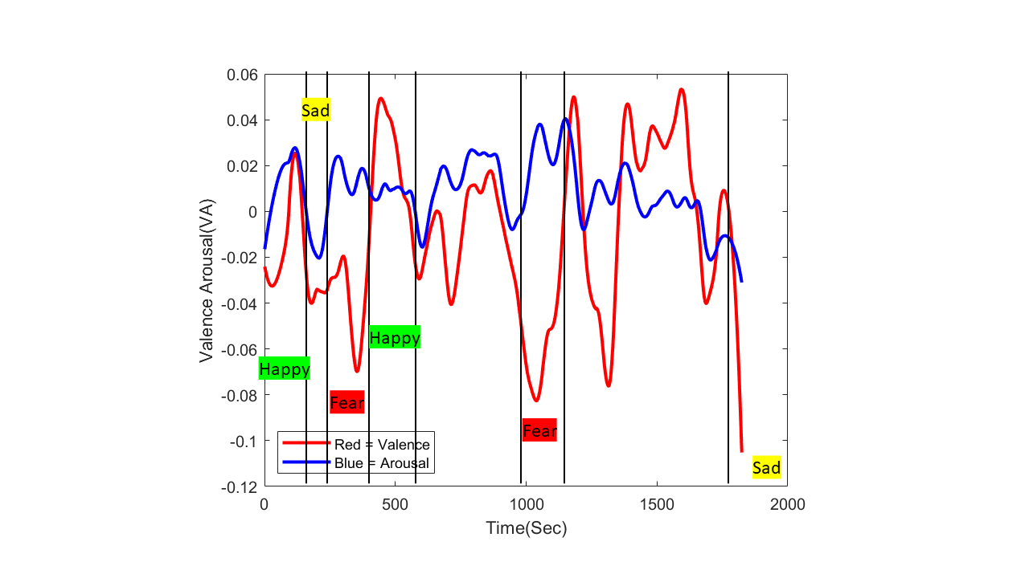
Brain Signal : Mostly Negative Valance and Positive Arousal
Emotion : Fear
Subject 2

Slide 14
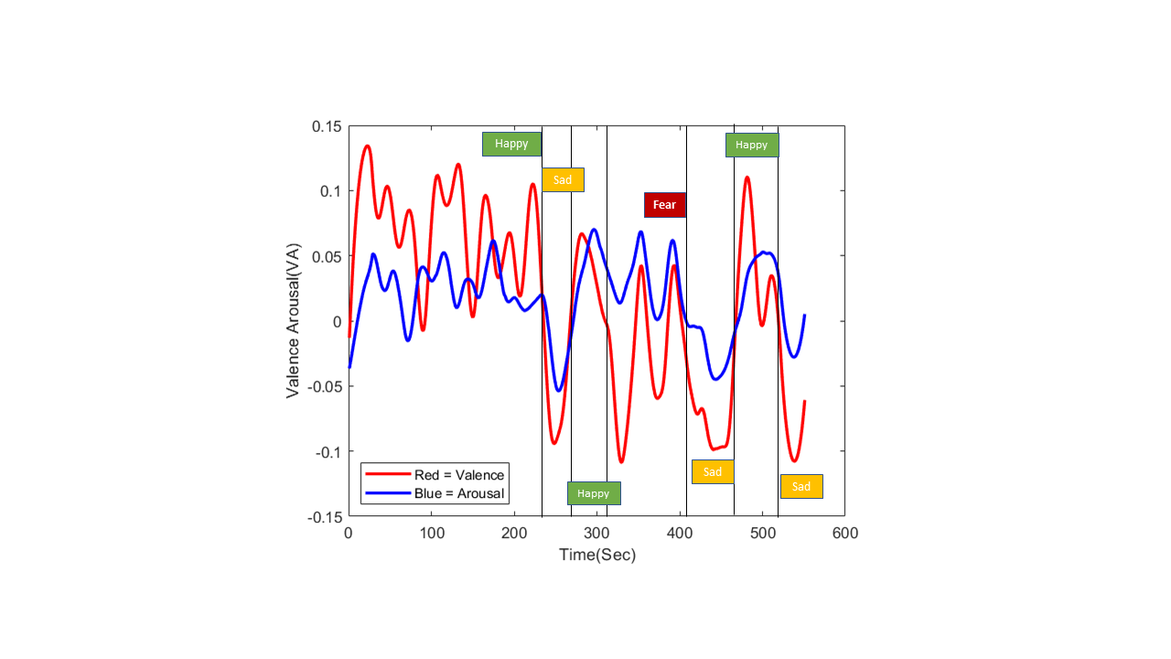
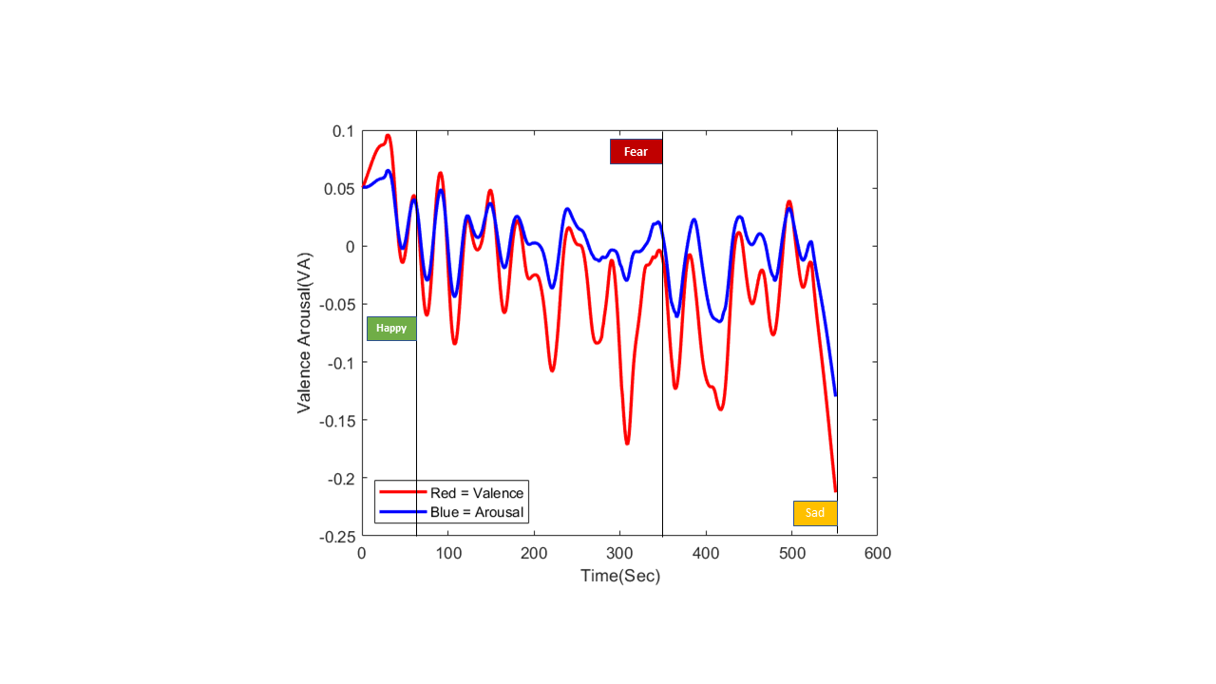
Brain Signal : Mostly Negative Valance and Positive/ Negative Arousal
Emotion : Happy,Fear and Sad
Subject 5

Slide 15
HIGH GRADE STUDENT
Subject
6 and 7

Slide 16
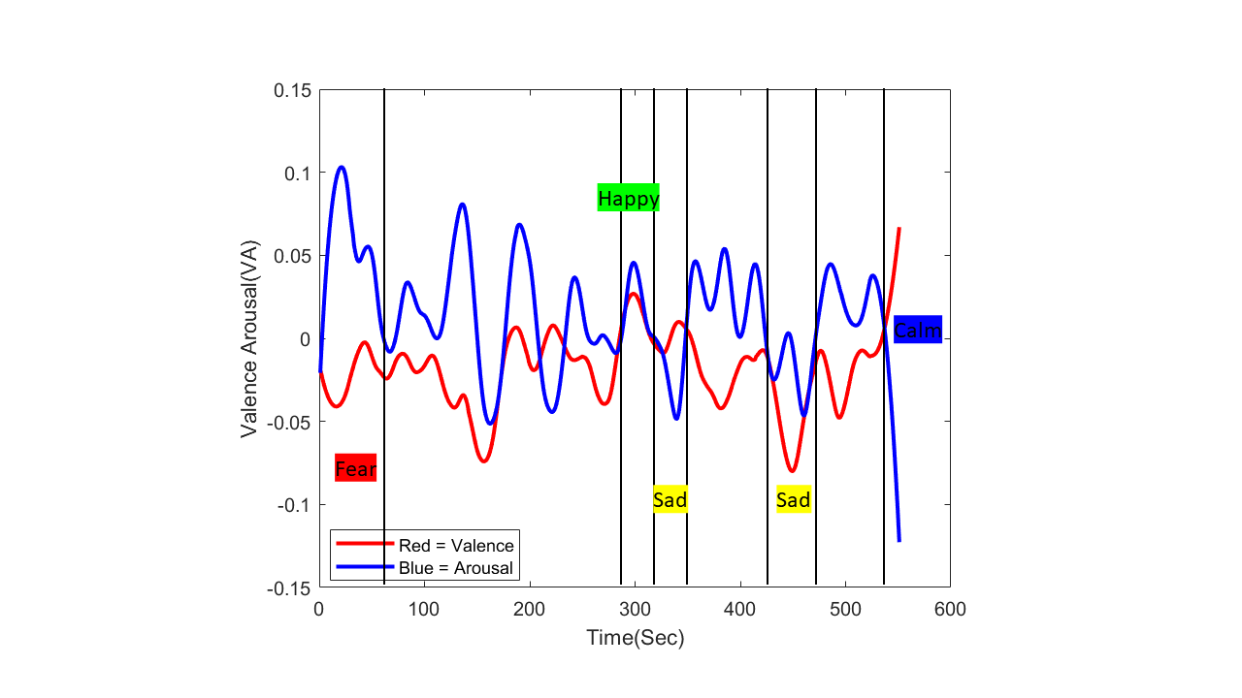
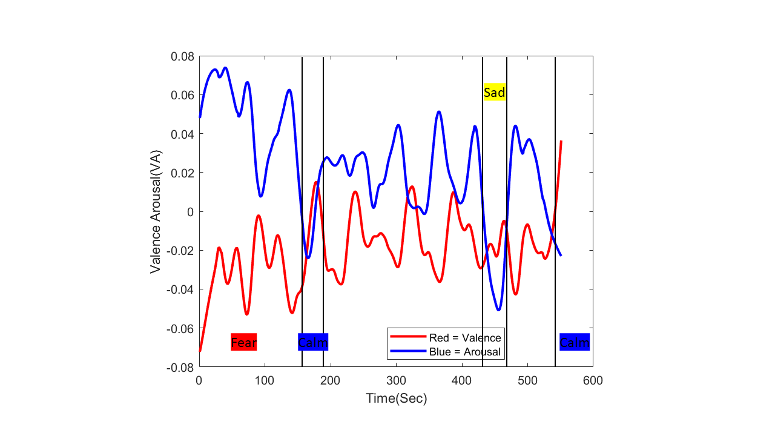
Brain Signal : both positive and negative valence and arousal
Emotion : Mix Emotion
Subject 6

Slide 17
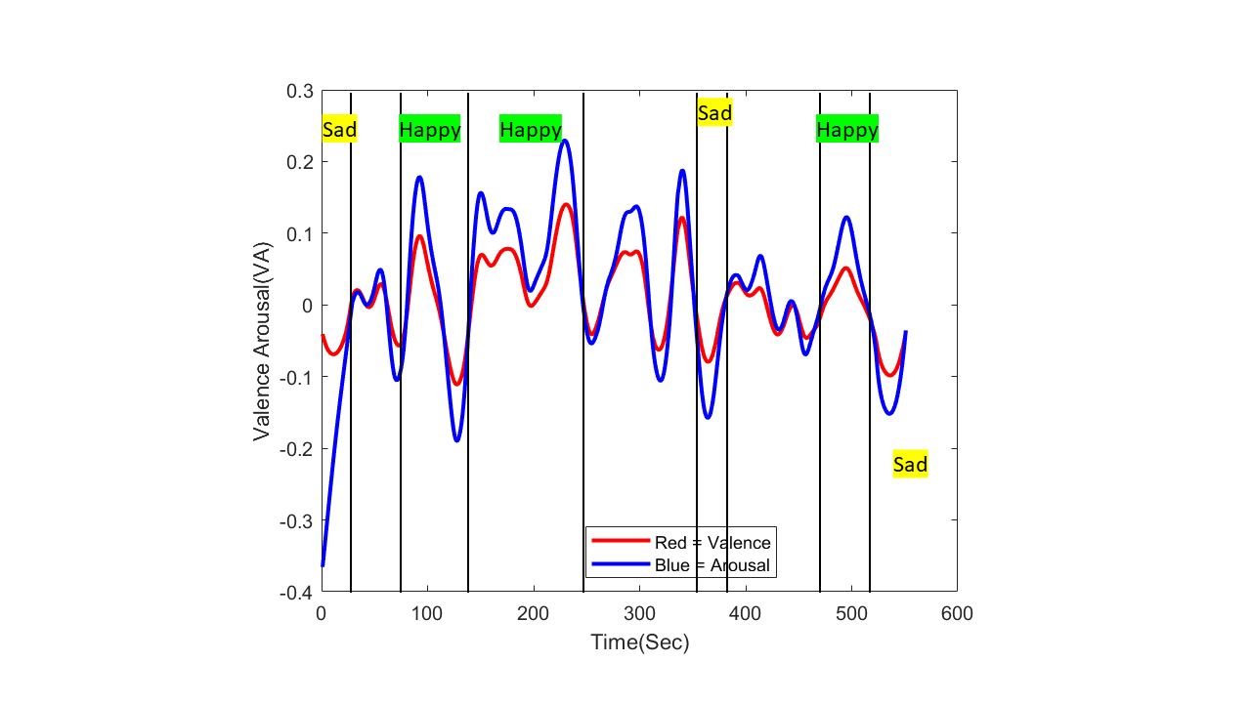
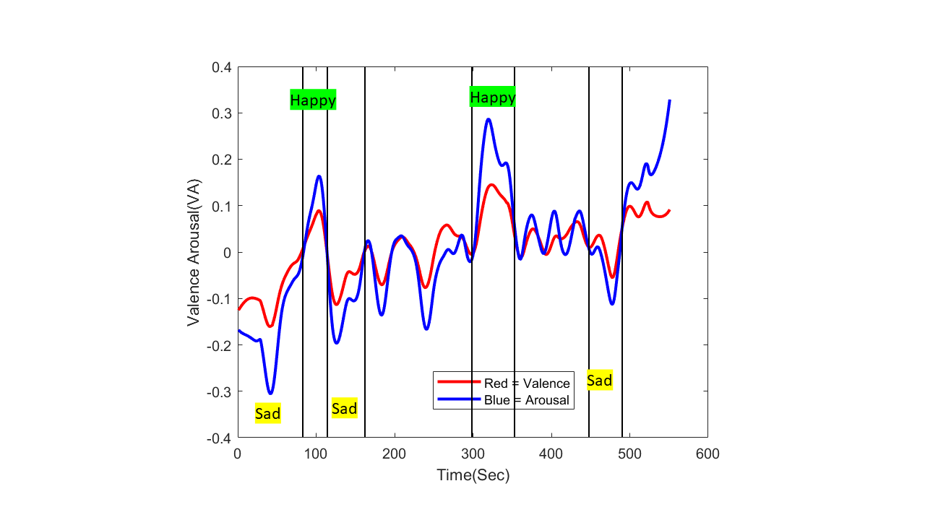
Brain Signal : both positive and negative valence and arousal
Emotion : Mix Emotion
Subject 7

Slide 18
Conclusion
Our analysis of the result shows that, the lowest grade students are having positive ve valence and arousal which shows happy emotion While intermediate scorer subjects are having both positive +ve and negative -ve valence which shows fear emotion High grade students having stress due to high expectation to score high in exam but still manage to answer questions correctly

Slide 19
Future Work
We’ll also be looking towards analyzing more data, since more data will lead to a more accurate and consistent outcome Finally, we'll compare stress levels and early detection of anxiety among STEM students

Slide 20


