Slide 1




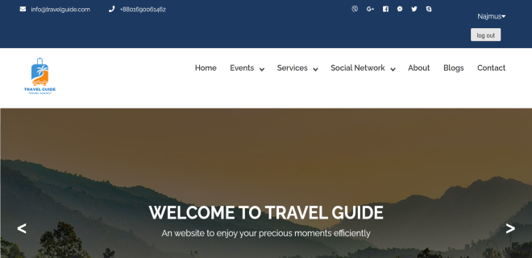
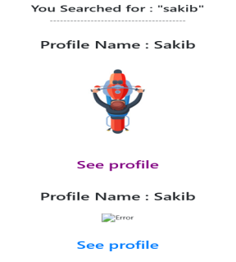
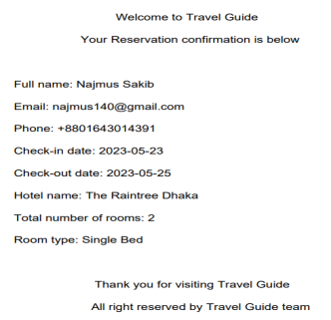
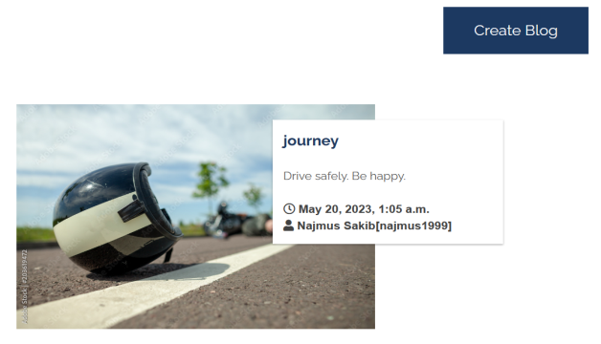
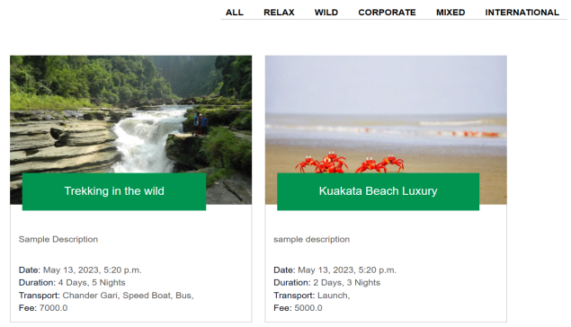


Travel
Guide
Presented By :
Najmus Sakib (2019-1-60-050)
Md. Monwar Hossain (2019-1-60-052)
Sajeeb Karmoker (2019-1-60-095)
Auishi Shaha (2019-1-60-229)
To enjoy your precious moments effitienty
info@travelguide.com
+8801690061462
Introduction
Our website strives to make your travel planning and experience as smooth as possible. With our comprehensive range of services, user-friendly interface, and a wealth of information at your fingertips, we aim to be your trusted companion on your journey. So, start exploring and embark on your next adventure with confidence.
Our Services
Arranging Events
Booking Suitable Hotels and Buses
Search for User
Message User
Global Chat Box
Creating Blogs
Conclusion
Our website is your ultimate destination for all your travel needs. With a user-friendly interface, a wide range of services, and a vibrant community, we make travel planning and exploration a breeze. From finding the perfect hotels and buses to connecting with fellow travelers, reading insightful reviews, and discovering exciting events, our website offers everything you need to create unforgettable journeys. Start your adventure today and experience the world with confidence. Join us on Travel Guide and unlock endless possibilities for your next travel experience.
Technologies

