Slide 1
Nextcloud + Euro-Office
A Secure, Air-Gapped Office & File Sharing Solution
Designed for organisations that need full control over their data
without relying on the internet

Slide 2
The Challenge
Many organisations need to share files and edit documents collaboratively
Cloud services (Google Workspace, Microsoft 365) require an internet connection and send data to external servers
Government agencies, defence, healthcare and other sectors often operate on networks with no internet access (air-gapped)
They still need the same productivity tools: file sync, calendar, contacts, document editing
Existing solutions may carry security risks, licensing costs or vendor lock-in

Slide 3
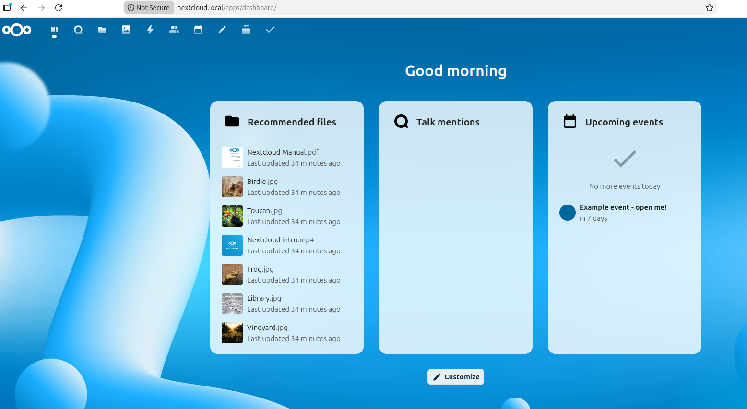
What is Nextcloud?
A self-hosted platform for file sharing and collaboration
Dropbox/Google Drive replacement you control completely
Features: files, calendar, contacts, email, chat, video calls
Runs on your own hardware - your data never leaves your network
Open source - free to use, no per-user licensing fees
Large ecosystem of apps and integrations

Slide 4
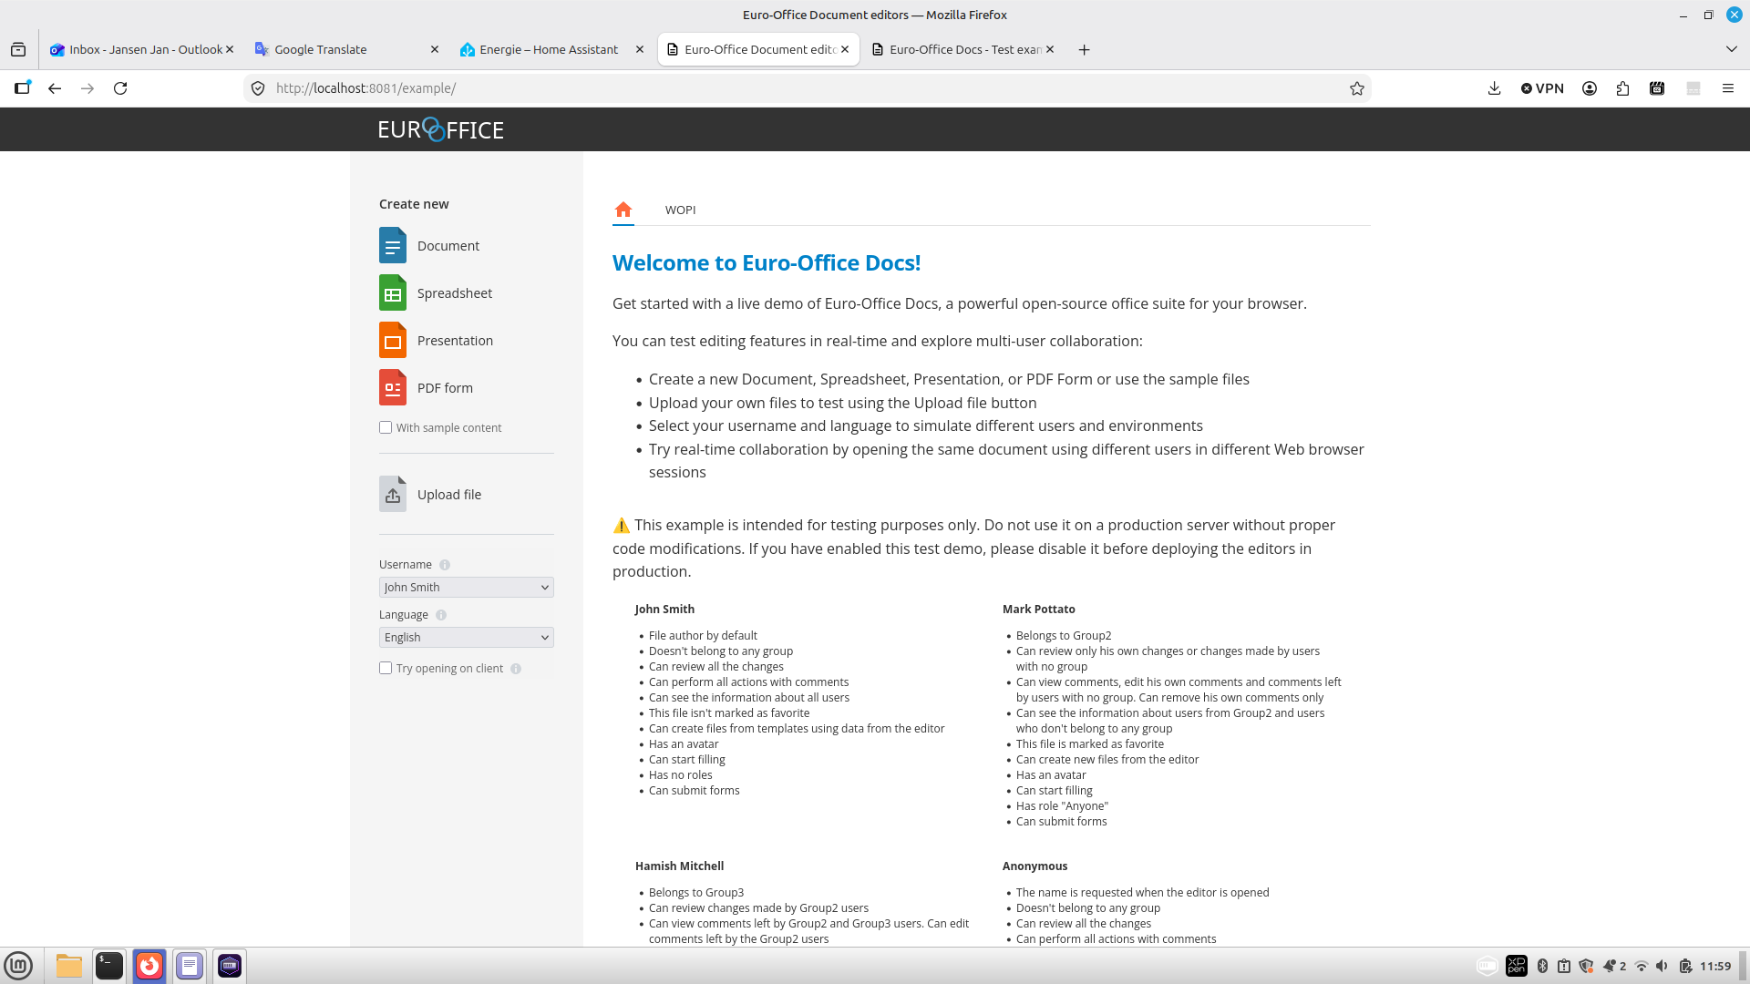
What is Euro-Office?
An office document suite designed for government agencies
Real-time collaborative editing of documents, spreadsheets and presentations
Stripped of external connections and telemetry - safe for classified networks
Integrates directly into Nextcloud for seamless workflow
Supports common formats: .docx, .xlsx, .pptx, .odt and more
Self-hosted - no data leaves your infrastructure

Slide 5
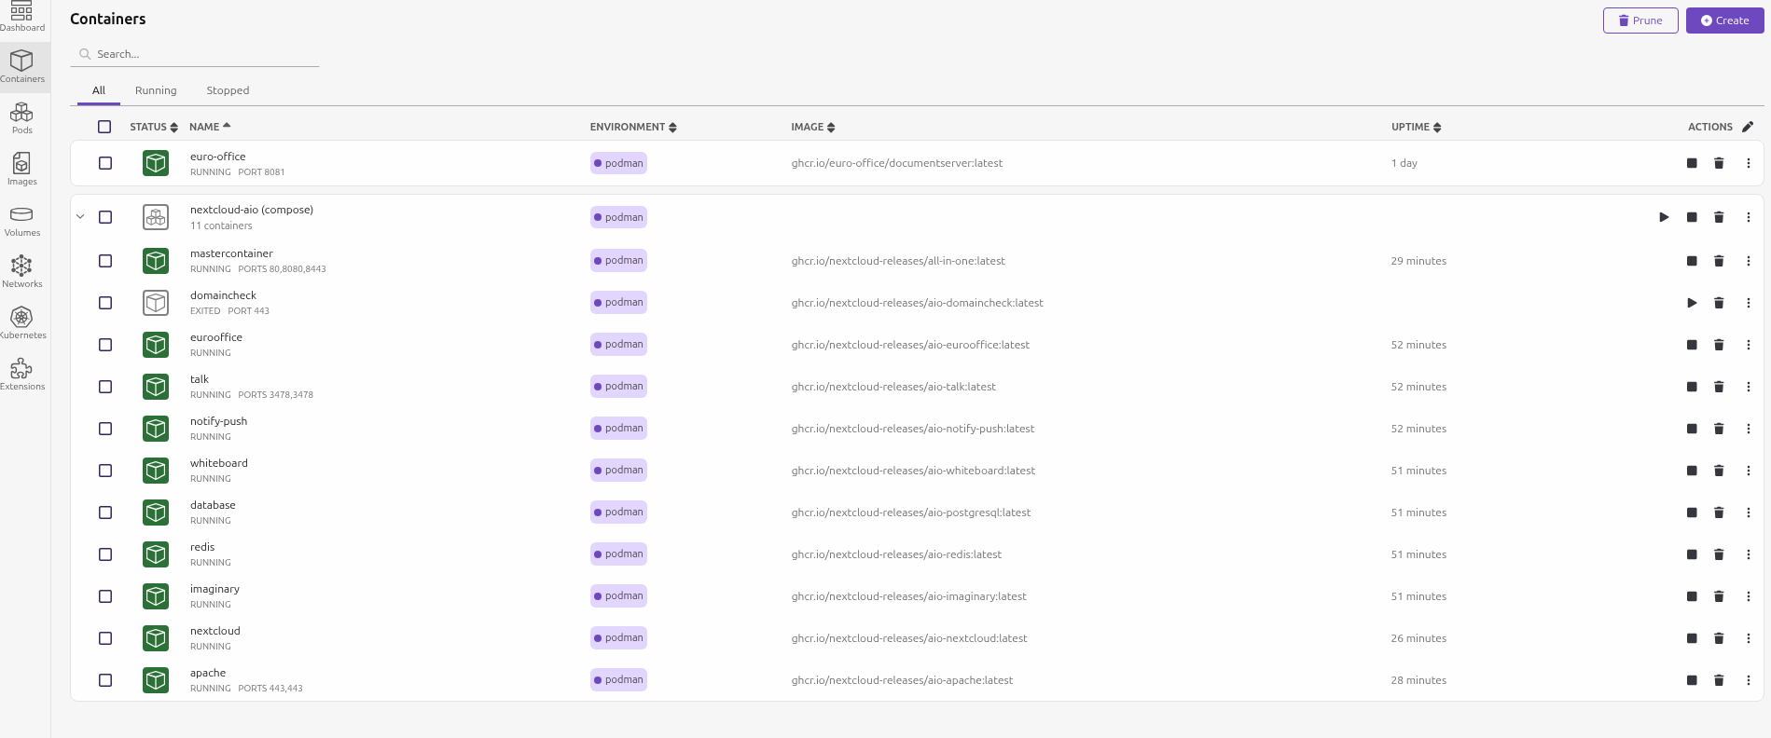
How They Work Together
Nextcloud provides the file storage, sharing, and user management
Euro-Office provides the document editing and collaboration engine
Users open a document in Nextcloud and it opens in Euro-Office automatically
Multiple people can edit the same document in real time
Changes are saved directly back to Nextcloud - no separate step needed
All running on your own servers, on your own network

Slide 6
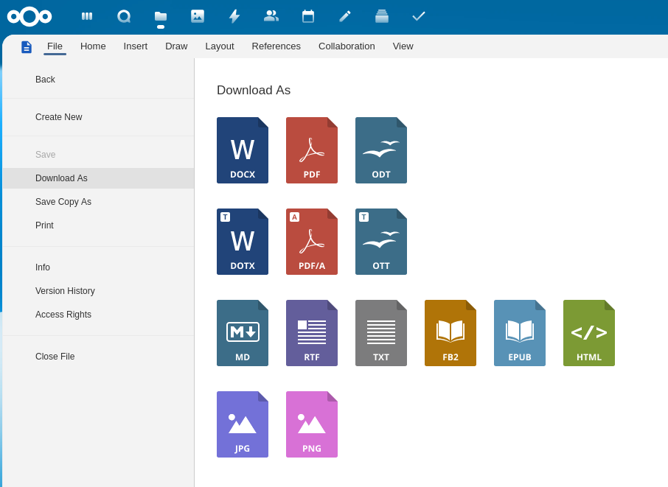
Supported Document Formats
Word processing: .docx, .odt, .txt
Spreadsheets: .xlsx, .ods, .csv
Presentations: .pptx, .odp
PDF viewing and editing
Import and export from Microsoft Office formats
Collaborative editing with change tracking

Slide 7
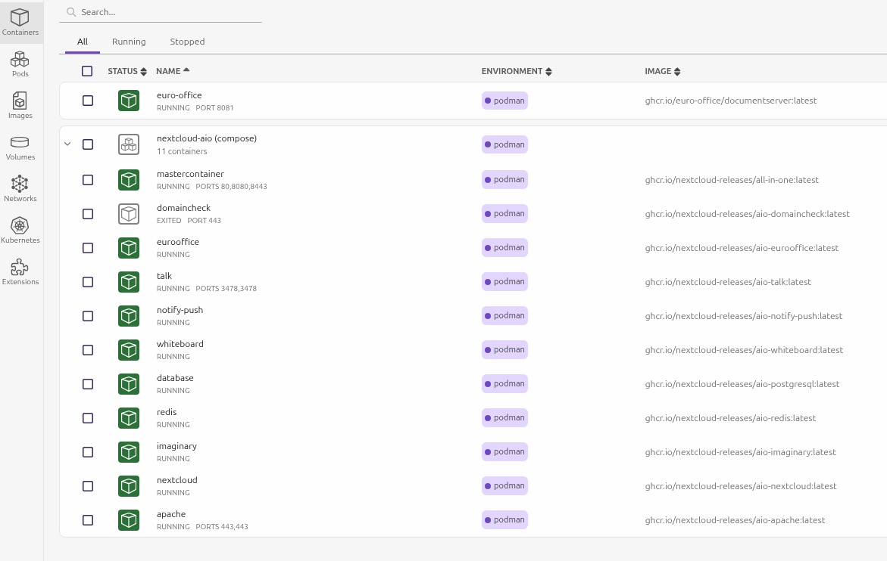
The System in Action
Everything runs in isolated containers - like lightweight virtual machines
Containers include: Nextcloud, Euro-Office document server, database, cache, and web server
Managed through a single control panel (AIO - All-in-One)
Automatic restart on system reboot
Can also run on Kubernetes for larger deployments

Slide 8
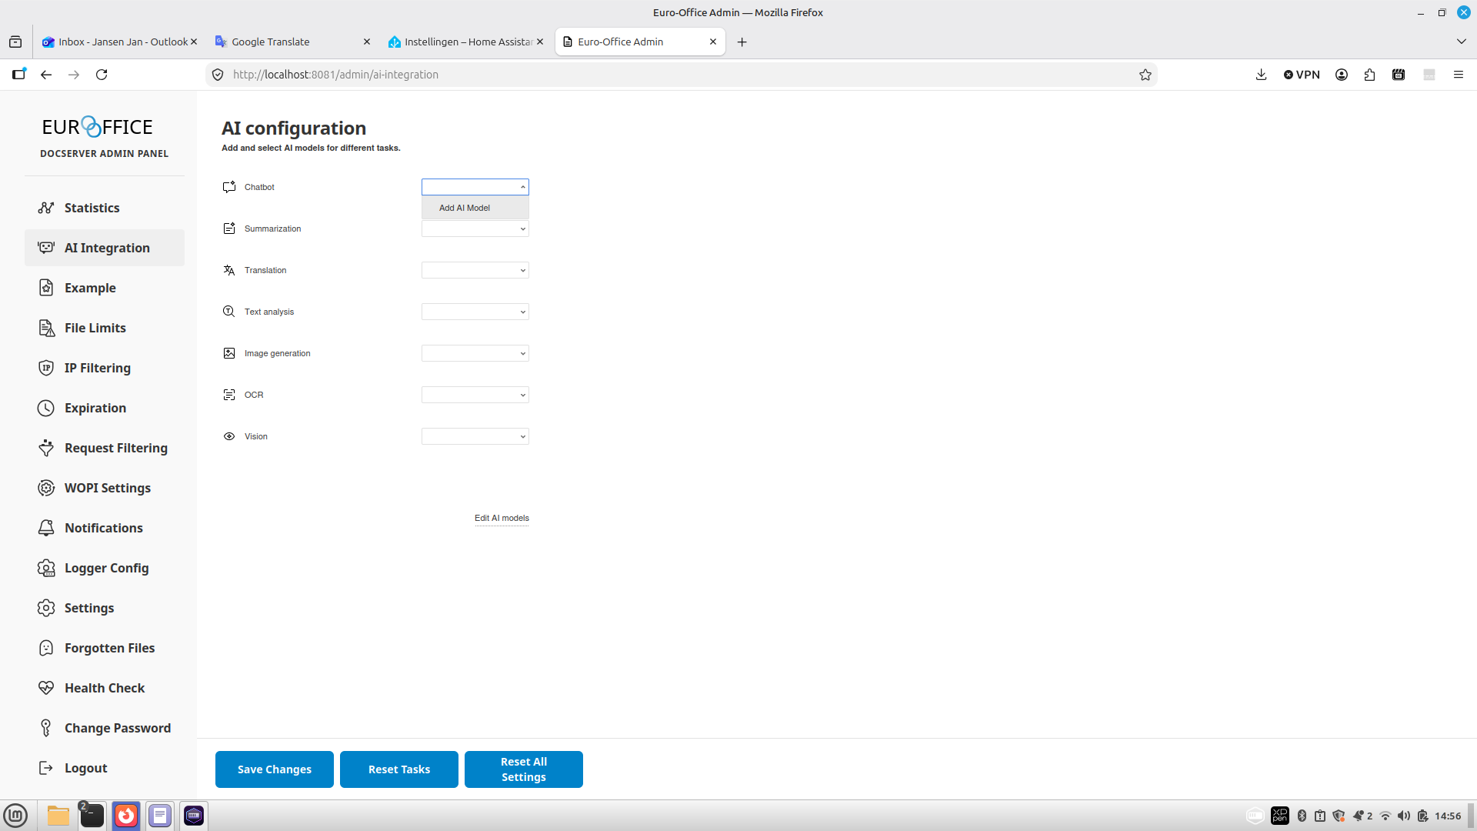
Built-in AI Integration
Euro-Office supports configurable AI models for document assistance
AI runs locally - no data is sent to external cloud AI services
Models can be added and configured through the admin interface
Suitable for organisations exploring AI-assisted document workflows
Can be fully disabled if AI features are not desired

Slide 9
Deployment Options
Option A: Single Server (Podman)
Option B: Cluster (Kubernetes)
Runs on a single Linux computer
Uses Podman (a secure container engine)
Quick to set up - about 1-2 hours
Ideal for small teams (up to ~50 users)
No special hardware required
Backup with standard tools
Runs on multiple servers (cluster)
Uses Kubernetes for management
Scales to hundreds of users
Higher availability and fault tolerance
Requires more infrastructure
More complex to set up and maintain

Slide 10
Advantages
+ Complete data sovereignty - your data never leaves your premises
+ No internet dependency - works fully offline (air-gapped)
+ Free and open source - no licensing fees or vendor lock-in
+ Secure by design - rootless containers, no central server daemon
+ Government-grade compliance (FedRAMP, NIST, SOC 2 aligned)
+ Real-time document collaboration like Google Docs / Office 365
+ Runs on standard Linux hardware - no special equipment needed
+ Full ecosystem: file sync, calendar, contacts, chat, video calls
+ Easy to maintain with automated container management
+ Can start small and scale to a Kubernetes cluster later

Slide 11
Disadvantages
- Requires Linux system administration knowledge to install and maintain
- Initial setup involves several technical steps and configuration fixes
- Self-signed security certificates cause browser warnings (must be accepted)
- Some mobile apps may not work with self-signed certificates
- Not officially supported by Nextcloud AIO when using Podman (community guide)
- Certain features like automatic backups need manual configuration
- Updates require manual intervention - not fully automatic
- Kubernetes deployment is significantly more complex to set up
- No commercial support - relies on community and open-source documentation
- Euro-Office is less feature-rich than Microsoft 365 or Google Workspace

Slide 12
Why Podman Over Docker?
Feature | Docker | Podman
Architecture | Central daemon (single point of failure) | Daemonless (each container is isolated)
Default privilege | Requires root access | Runs rootless by default
Licensing | Paid for large organisations | Free and open source (Apache 2.0)
Government Linux | Deprecated by Red Hat | Default engine in RHEL 8+
Audit trail | Actions hidden behind daemon | Direct user ID tracking

Slide 13
Who Benefits from This Solution?
Government agencies handling classified or sensitive information
Healthcare organisations subject to patient data regulations (GDPR, HIPAA)
Defence and military networks with no internet connectivity
Education institutions wanting to keep student data in-house
Any organisation that wants to own and control its own IT infrastructure
Teams that need Microsoft Office-like functionality without Microsoft licensing costs

Slide 14
Summary
Nextcloud + Euro-Office provides a complete, self-hosted office suite
Your data stays on your network - no internet connection required
Secure, compliant, and free from vendor lock-in
Runs on affordable Linux hardware using modern container technology
Suitable for organisations of all sizes, from small teams to large agencies

Slide 15
Thank You
Questions?
Documentation: najnesnaj.github.io

