Slide 1

Presentation On
Woman’s Safety and Tracking using GPS and GSM
Computer Peripheral & Interfacing Project (IOT)
Presented By:
Fahim Hasan
ID: B190305029
Najnin Sultana Shirin
ID: B190305031
Department of Computer Science
and Engineering,
Jagannath University, Dhaka
Presented To:
Tanvir Ahammad,
Lecturer
Department of Computer Science and Engineering,
Jagannath University, Dhaka

Slide 2
Problem Statement
Addressing Women's Safety Concerns: The project aims to tackle the pressing issue of women's safety, acknowledging the prevalent instances of harassment and violence.
Technology Integration: By combining GPS and GSM technologies, the project intends to develop a comprehensive tracking system for women.
Emergency Assistance: The system will allow women to easily signal for help, share their location with trusted contacts or authorities, and receive timely assistance during emergencies.

Slide 3

Purpose of the Project
The purpose of the project is to develop a comprehensive safety and tracking solution for women using GPS (Global Positioning System) and GSM (Global System for Mobile communication) technologies.
This solution aims to enhance women's safety by providing them with a means to signal for help, share their location, and receive timely assistance during emergencies.
Ultimately, the project seeks to contribute to creating a safer and more inclusive society where women feel empowered and protected from violence and harassment.

Slide 4
Main Feature of this Project
Emergency button
Real-time Location Tracking.
Emergency alert message with location.
Emergency call.

Slide 5
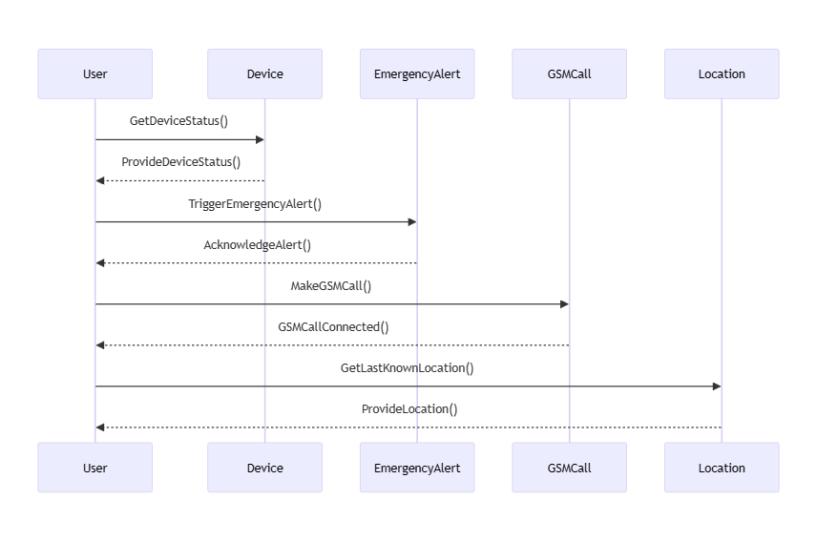
Sequence & Workflow Diagram

Slide 6
Methodology of the Project
ALGORITHM
𝐒𝐭𝐞𝐩 𝟏: Initialize A9G and Serial Monitor with 115200 baud rates.
𝐒𝐭𝐞𝐩 𝟐: Connect AGPS TX Pin to Arduino pin7 and RX to pin8.
𝐒𝐭𝐞𝐩 𝟑: Once power is on set SMS mode to text mode.
𝐒𝐭𝐞𝐩 𝟒: Set A9G to show the output on serial monitor.
𝐒𝐭𝐞𝐩 5: Turn on the GPS and it takes 2 min to 3 min to activate AGPS sensor.
𝐒𝐭𝐞𝐩 6: If s button pressed call SendMessage() function to send message.
𝐒𝐭𝐞𝐩 7: If c button is pressed call MakeCall() function to make call.
𝐒𝐭𝐞𝐩 8:If h button is pressed call HangUpCall() to hang up call.
𝐒𝐭𝐞𝐩 9: If l button is pressed call ReadLocation() to get the location.
𝐒𝐭𝐞𝐩 10: From that we have to extract the required data.
𝐒𝐭𝐞𝐩 11: Finally, the required location is sent to the mobile
Used AT Command in A9G Module
AT+CMGF=1 (Set SMS mode to text mode)
AT+CNMI=2,2,0,0,0 (Set GSM module to show the output on serial monitor)
AT+GPS=1 (Turn on GPS)
AT+CMGS=\“x\“ (Send message to the x number)
ATDx (Make call x phone number)
ATH (Hang-up call)
AT+LOCATION=2 (Get GPS address)

Slide 7
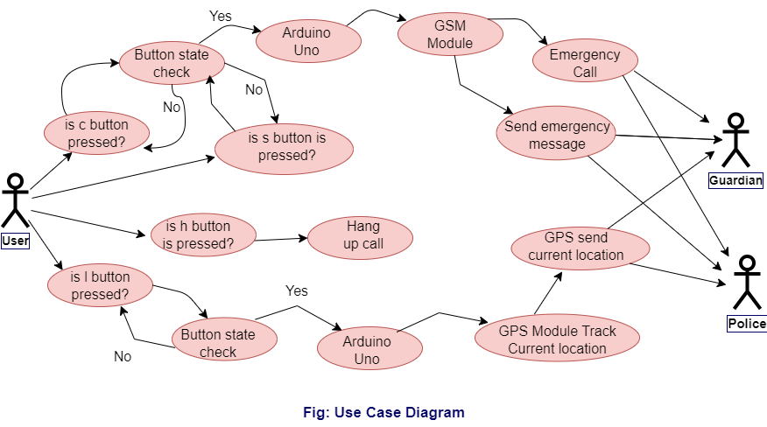
Use Case Diagram

Slide 8

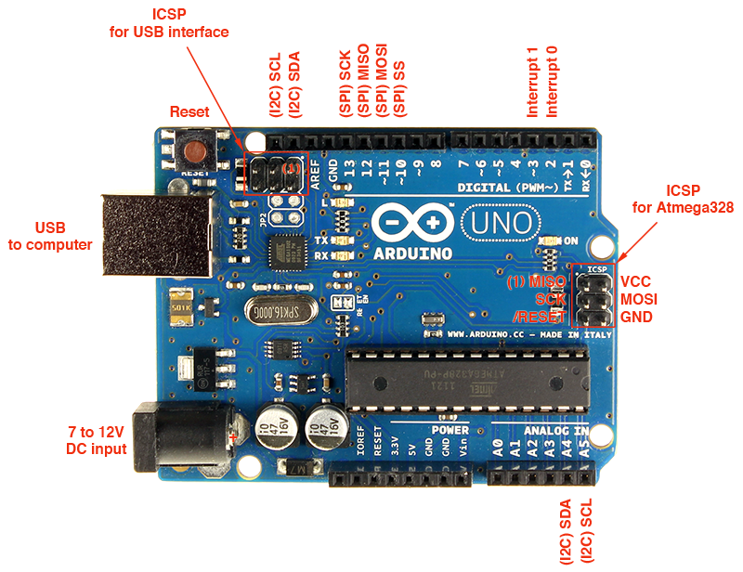
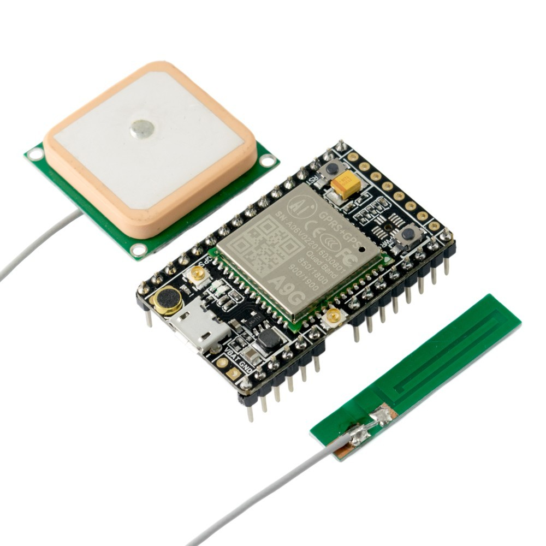
Tools and devices:
Arduino Uno
A9G GSM+GPS Module
NANO SIM CARD
GPS ANTENA
GSM ANTENA
Power Supply (5V)

Slide 9



Prototype
Police
Guardian
Switch
(Text Message)
Power Supply
Send Location Message & call
Switch
(Call)
Arduino Uno
GPS Module
Switch
(Hang Up Call)
User
GSM Module
Switch
(Send Location)

Slide 10
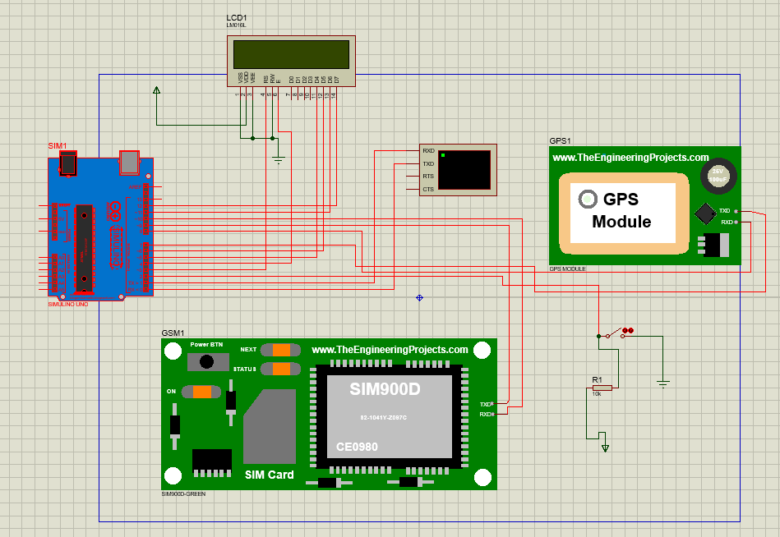
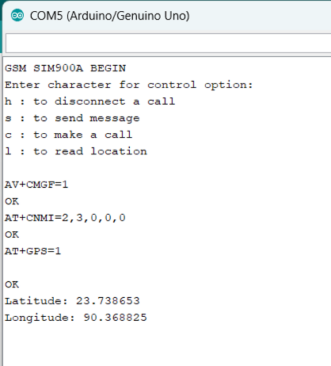
Circuit Diagram

Slide 11
References:
Microsoft Word - z47 Implementation of Women Safety System using Internet of Things (researchgate.net)
IOT Based Smart Device for Women Safety.pdf (ijaem.net)
Arduino based Women Safety Device with GPS Tracking and Emergency Alerts (circuitdigest.com)
A9G GSM/GPRS+GPS Module with Arduino - Getting Started (how2electronics.com)
A9G GSM/GPRS+GPS Module Wiki - DFRobot

Slide 12





