Slide 1
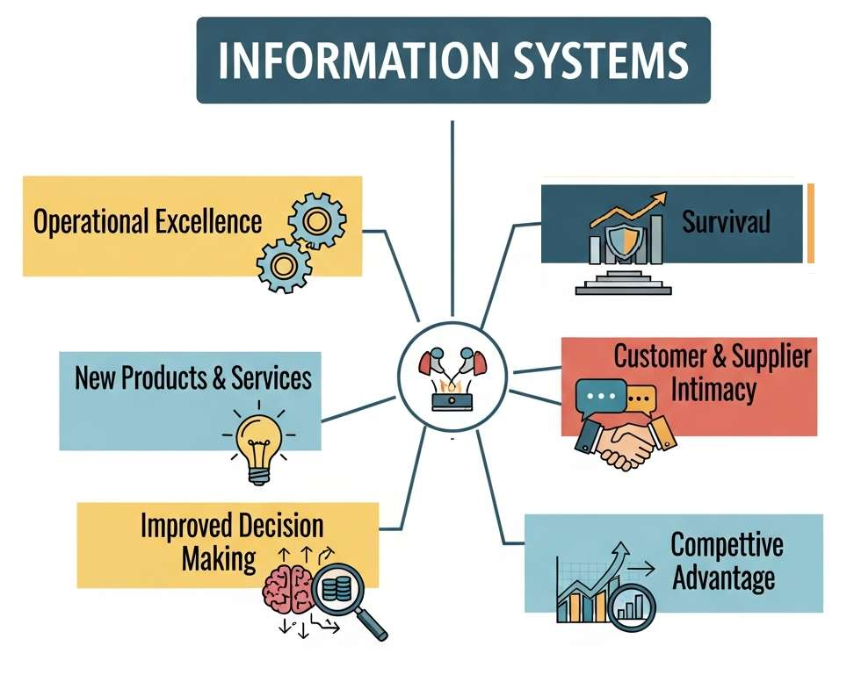
Information Systems in Global Business
Information Systems Management
Lecture 2
Course code: MIS0611401
Najnin Sultana Shirin
Lecturer, CSE, Uttara University

Slide 2
Introduction
IS are the backbone of modern organizations
Integrate hardware, software, data, people, processes
Collect, process, store, distribute information
In a globalized economy, IS are strategic assets, not just support tools
Enable international competition
Manage complex supply chains
Deliver value to customers worldwide
2

Slide 3
1. Importance of Information Systems
Nervous system of modern organizations
Coordinate operations across borders
Manage complex supply chains
Respond quickly to market changes
Integrate people, processes, technology
Turn raw data into meaningful information
Support informed decisions by managers and employees
3

Slide 4
Key Functions in Business
Supply Chain Management
CRM
Financial Systems
Knowledge Sharing
Analyzes customer data, personalizes service
Amazon: recommendation systems
Secure, accurate processing
Banking systems
Connects employees worldwide
Microsoft Teams, Slack
Tracks inventory, logistics, supplier performance in real time
Walmart: operational excellence
4

Slide 5
Strategic Impact
Efficiency
Innovation
Competitiveness
Survival
Automates repetitive tasks
Reduces costs, improves productivity
Supports new products and services
Apple iTunes digital music model
Analytics and real-time insights
Competitive edge for strong IS firms
Adoption necessary in many industries
Banks introducing ATMs
5

Slide 6
2. Six Strategic Business Objectives
Operational Excellence: streamline processes, cut costs, boost productivity
New Products & Services: innovation, digital transformation
Customer & Supplier Intimacy: stronger relationships, responsiveness
Improved Decision Making: less uncertainty, real-time analytics
Competitive Advantage: outperform rivals
Survival: adoption needed to stay competitive
6

Slide 7
Operational Excellence and New Products
Operational Excellence
New Products & Services
Streamlines processes, cuts costs, improves productivity
Automation and integrated workflows remove inefficiency
Consistency across operations
Walmart real-time inventory: fewer stockouts and less excess stock
Lower costs, higher satisfaction
Support new products, services, business models
Foundation for digital transformation
Apple iTunes: digital music distribution
Netflix: DVD rentals to online streaming
Reshaped entertainment worldwide
7

Slide 8
Intimacy and Decision Making
Customer & Supplier Intimacy
Improved Decision Making
Essential for long-term success
CRM analyzes data, personalizes experiences
Supplier systems ensure smooth collaboration
Amazon: tailored suggestions
Dell: suppliers integrated into production, fewer delays
Business decisions face uncertainty and incomplete information
IS gives real-time analytics and dashboards
Verizon dashboards monitor network and service metrics
Faster, more accurate decisions
Confident, strategic action; lower risk
8

Slide 9
Competitive Advantage and Survival
Competitive Advantage
Survival
Effective IS users outperform rivals: efficient, innovative, responsive
Uber: connects drivers and passengers, convenience and transparency
Zara: fast-fashion supply chain, rapid response to trends
IS can redefine industries
Adoption is essential, not optional
Firms that fail risk becoming obsolete
Banks needed ATMs
bKash: digital banking, mobile payments
Stay aligned with customer expectations and standards
9

Slide 10
Six Objectives
Center: Information Systems, the strategic hub
Six surrounding nodes, one per objective
Arrows show how IS enables each objective
Operational excellence supports competitive advantage
New products and services drive customer intimacy
Improved decision-making strengthens survival
IS is a strategic asset, not just a technical tool
Enables efficiency, innovation, relationships, decisions, competitiveness, survival
10

Slide 11
3. Case Studies: Excellence and New Products
Operational Excellence
New Products & Services
Global: Walmart real-time inventory
Bangladesh: Grameenphone manages telecom infrastructure for uninterrupted service
Lower downtime, efficient resource allocation, better satisfaction
Global: Apple iTunes digital distribution
Bangladesh: bKash mobile financial services
Banking access through phones
New revenue streams
Promotes financial inclusion
11

Slide 12
Case Studies: Intimacy and Decisions
Customer & Supplier Intimacy
Improved Decision Making
Global: Amazon personalizes shopping
Bangladesh: Daraz analytics tailor product recommendations
Apex Footwear: IS in supply chain, timely supplier communication, fewer production delays
Global: Verizon real-time dashboards
Bangladesh: BRAC Bank analyzes transactions, detects fraud, faster lending decisions
Less uncertainty, more customer trust, quick market response
12

Slide 13
Case Studies: Advantage and Survival
Competitive Advantage
Survival
Global: Uber disrupted taxis
Bangladesh: Pathao and Shohoz built ride-sharing and delivery
Convenience and transparency
Edge over traditional transport and logistics
Reshaped urban mobility
Global: Citibank adopted ATMs to survive
Bangladesh: traditional banks embraced mobile banking and digital payments
Pressure from fintech such as bKash
Risk losing customers to digital-first firms
13

Slide 14
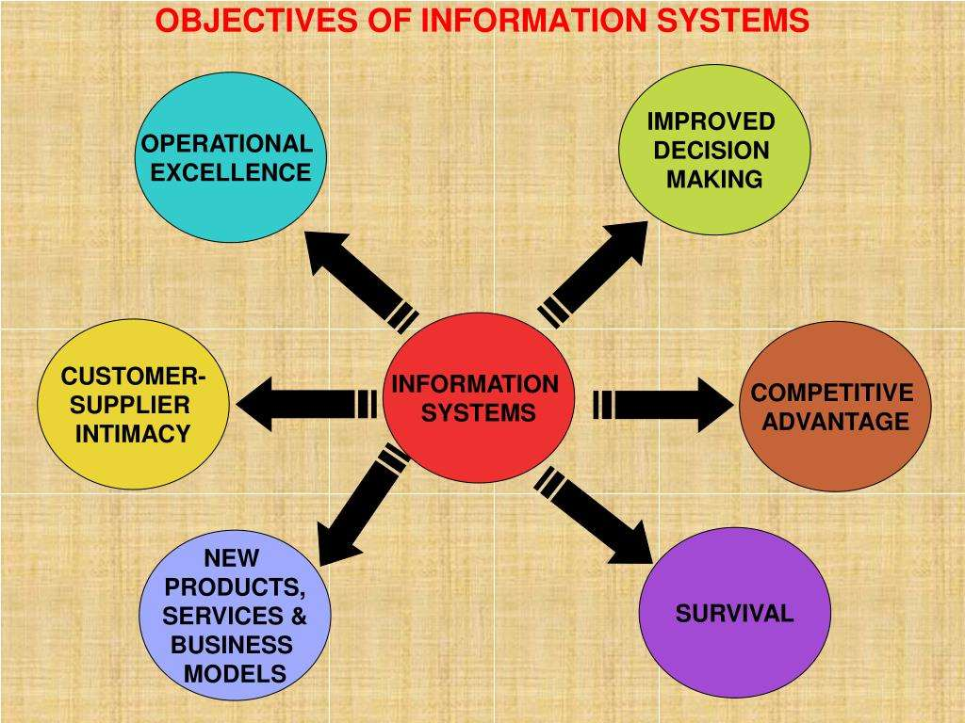
Objectives of Information Systems: Figure
IS at the center, six objectives around it
IS is the core enabler of modern business strategy
Objectives are interconnected through IS
IS is the digital backbone for achieving them
14

Slide 15
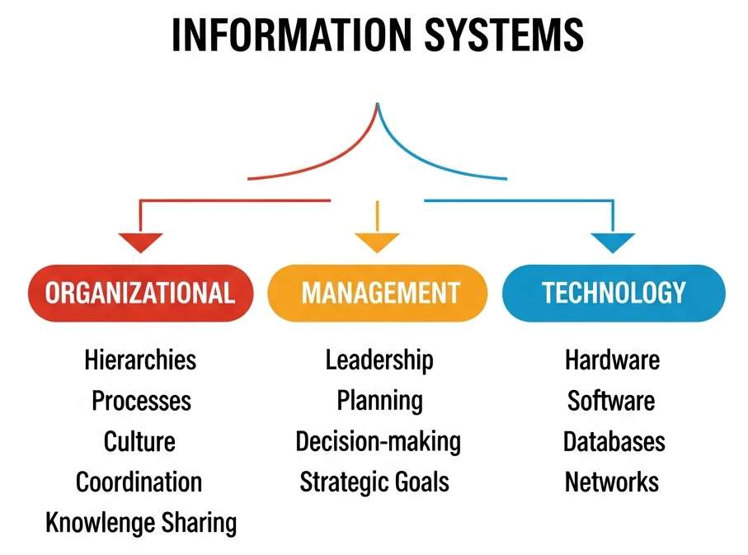
4. Dimensions of Information Systems
IS are multidimensional, not just technology
Three critical dimensions: organizational, management, technology
Each contributes uniquely to how IS delivers value
Organizational: hierarchies, processes, culture, coordination, knowledge sharing
Management: leadership, planning, decision-making, strategic goals
Technology: hardware, software, databases, networks
Figure shows how the three connect to IS
15

Slide 16
Organizational and Management Dimensions
Organizational
Management
IS embedded in structure and culture
Reflect hierarchies, processes, interaction
Unilever aligns supply chain, marketing, finance across countries
Knowledge-sharing culture benefits from Teams, Slack
Mirrors and supports organizational design
Leadership, planning, decision-making
Data and insights to set goals, monitor performance
BRAC Bank executives track transactions, detect fraud, plan services
IS investments align with strategy
Without strong leadership, IS cannot deliver full potential
16

Slide 17
Technology Dimension
Core Infrastructure
Examples
Hardware, software, databases, networks
Enables data collection, storage, processing, communication
Ensures IS can scale, stay secure, adapt
Adapts to AI, IoT, cloud computing
Amazon: massive databases, analytics software, global networks, real-time personalization
bKash: mobile platforms, secure databases, cloud infrastructure, millions of daily transactions
17

Slide 18
5. Dimensions Case Study: Org and Management
Organizational
Management
Global: Unilever coordinates hierarchies and processes across countries
Grameenphone: IS for telecom infrastructure and customer service
Culture of collaboration and responsiveness: CRM, dashboards
Apex Footwear: supplier communication, fewer delays
Global: Verizon dashboards guide strategic decisions
BRAC Bank: analyzes transactions, detects fraud, plans products
Faster, data-driven decisions
Pathao: plans routes, pricing, logistics aligned with goals
18

Slide 19
Case Study: Technology and Integrated View
Technology
Integrated View
Global: Amazon databases, analytics, networks
bKash: mobile platforms, secure databases, cloud; scalable, secure, adaptable; serves urban and rural users
Daraz: e-commerce platforms, apps, AI analytics for personalization
Dimensions are interdependent
Technology: tools; management: strategic use; organization: how IS is applied
Pathao: organizational (logistics, drivers), managerial (operations planning), technological (apps, GPS)
IS is a framework for efficiency, innovation, competitiveness
19

Slide 20
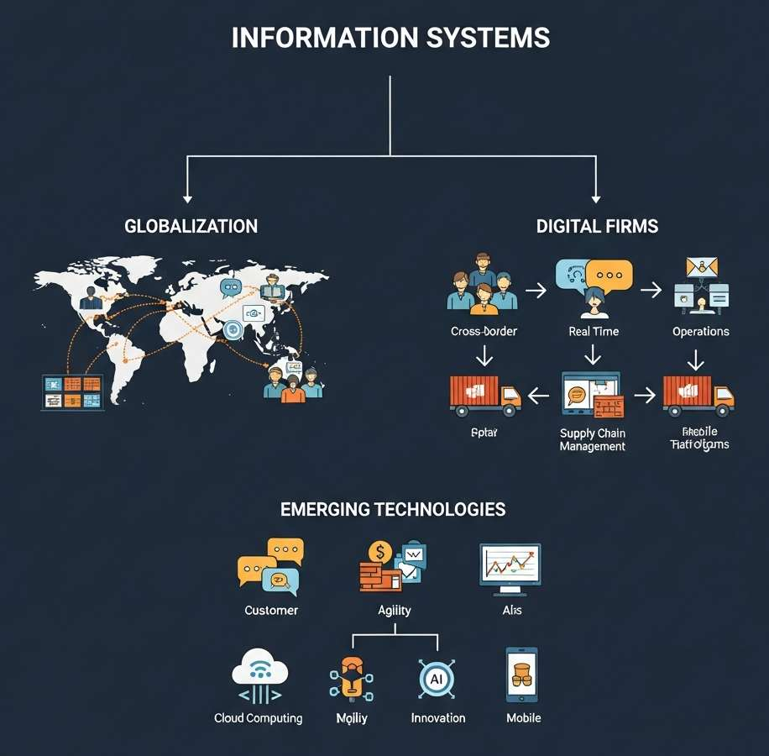
6. Contemporary Trends
Three major trends: globalization, digital firms, emerging technologies
IS evolves from support tool to strategic driver of transformation
Globalization: cross-border operations
Digital Firms: core processes digitally enabled
Emerging Technologies: cloud, IoT, AI, mobile platforms
20

Slide 21
Globalization and Digital Firms
Globalization
Digital Firms
Integrates global supply chains
Coordinates international teams, real-time communication
Coca-Cola: worldwide production and distribution, consistency
Grameenphone: urban and rural connectivity
Reduces barriers, expands reach, global talent pools
Core processes digitally enabled: customers, supply chain, finance
Amazon digitizes supply chain, interface, logistics
bKash: transactions, support, compliance all digital
Agility, efficiency, scalability
21

Slide 22
Emerging Technologies
Cloud computing, IoT, AI, mobile platforms reshape IS capabilities
Tesla: IoT and AI in connected vehicles
Netflix: cloud computing for worldwide streaming
Pathao: mobile platforms and GPS for ride-sharing and delivery
Enhance personalization, scalability, innovation
Keep firms competitive in dynamic markets
22

Slide 23
References
Laudon & Laudon. Management Information Systems: Managing the Digital Firm (Pearson)
Turban & Volonino. Information Technology for Management
O'Brien & Marakas. Introduction to Information Systems
Stair & Reynolds. Principles of Information Systems
O'Brien & Marakas. Management Information Systems, McGraw-Hill/Irwin, 10th Ed., 2011
Pearlson & Saunders. Strategic Management of Information Systems, Wiley, 5th Ed., 2013
Ward & Peppard. Strategic Planning for Information Systems, Wiley, 3rd Ed., 2013
23

