Slide 1
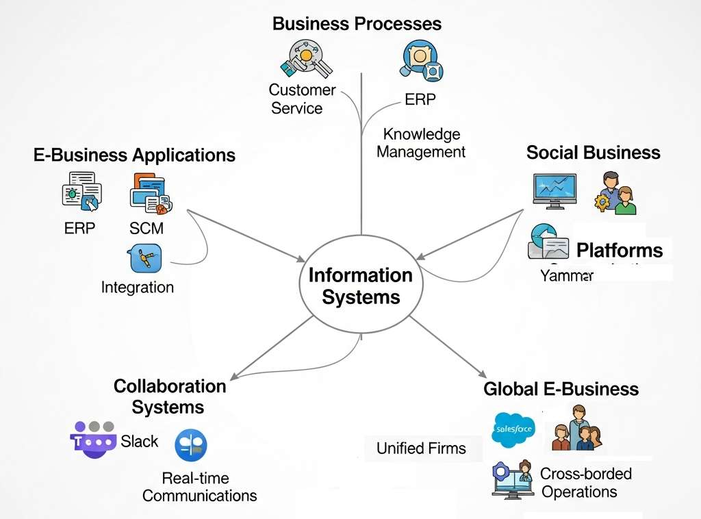
Global E-Business and Collaboration
Information Systems Management
Lecture 2
Course code: MIS0611401
Najnin Sultana Shirin
Lecturer, CSE, Uttara University

Slide 2
Introduction
Global e-business is more than online buying and selling
Integration of digital technologies into all business operations across borders
Connects suppliers, customers, employees and partners worldwide
Organizations operate seamlessly in a global marketplace
Well-designed strategy aligns IS with organizational goals
Result: efficiency and competitive advantage
IS transforms firms into digital enterprises: efficiency, innovation, teamwork
2

Slide 3
Global E-Business and Collaboration: Overview
IS at the center enables five key areas:
Business processes
E-business applications
Collaboration systems
Social business
Global e-business
Each area connects back to IS: the backbone of modern organizations
Arrows: IS integrates workflows, fosters collaboration, supports global operations
IS turns firms into digital enterprises competing in a globalized economy
3

Slide 4
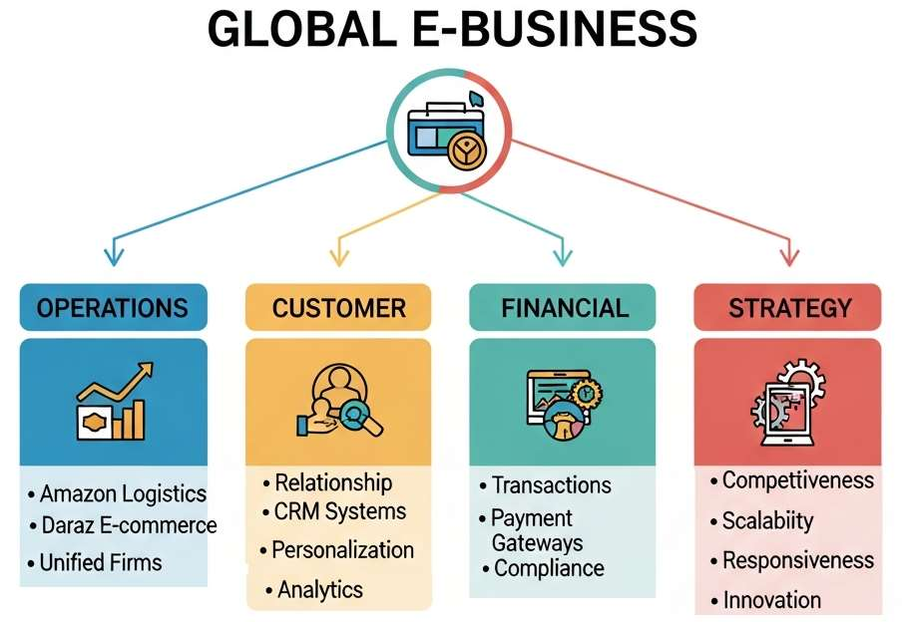
1. Global E-Business
Use of IS to manage and integrate business processes across international boundaries
Coordinate supply chains
Manage customer relationships
Conduct financial transactions across regions
Amazon: global logistics and customer service through IS
Daraz (Bangladesh): e-commerce across multiple South Asian countries
Firms operate as unified entities despite geographical dispersion
4

Slide 5
Global E-Business: Four Pillars
Center: Global E-Business, supported by four pillars
Operations integration
Customer relationship management
Financial transactions
Strategic importance
Each pillar shows how IS lets firms function as unified entities across borders
Arrows: flow of data and processes
IS is the backbone of globalization in business
5

Slide 6
Operational Integration and CRM
Operational Integration
Customer Relationship Management
IS integrates operations across countries
Amazon syncs logistics, warehouses, customer service
Same service for a U.S. or Bangladeshi customer
Daraz coordinates listings, payments, deliveries on one IS platform
CRM personalizes experiences across diverse markets
Collect and analyze customer data
Tailor to local preferences, keep global consistency
Amazon recommendations adapt to regional patterns
Daraz analytics suggest products for Bangladeshi customers
6

Slide 7
Financial Transactions and Strategic Importance
Financial Transactions
Strategic Importance
IS secures and smooths cross-border payments
Integrated gateways handle multiple currencies and regulations
bKash enables digital payments for Daraz
Bridges local finance with global platforms
Expands customer base while keeping trust and compliance
A strategic necessity, not just efficiency
No global IS integration risks losing competitiveness
Enables scalability, responsiveness, innovation
Quick adaptation to global market changes
COVID-19: firms with strong global IS pivoted online and kept continuity
7

Slide 8
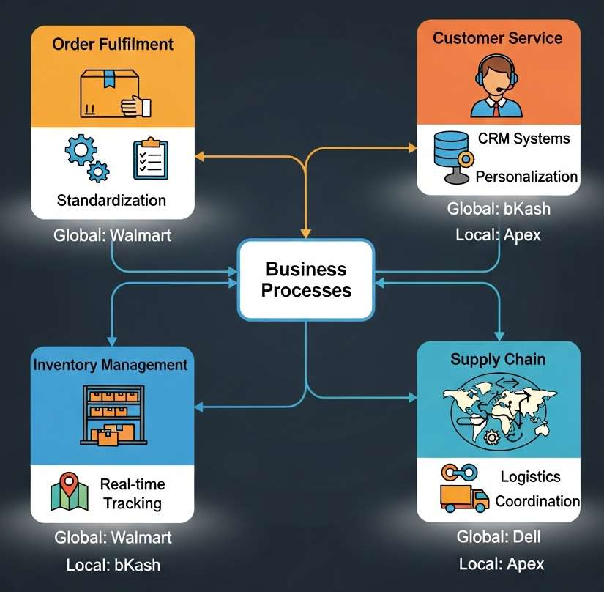
2. Business Processes
Backbone of organizations
Structured sets of activities with specific outcomes
Examples: order fulfillment, customer service, inventory
Not random tasks: structured workflows, consistent and efficient
Order fulfillment: receive order, check inventory, process payment, ship, update records
Without IS: manual, slow, error-prone
IS: standardized, automated, monitored in real time
8

Slide 9
Business Processes: Examples
Walmart (Global)
Apex Footwear (BD)
Automation and Optimization
Scalability and Consistency
Real-time inventory across thousands of stores
Sale updates stock, triggers restocking, coordinates suppliers
Fewer stockouts, less excess inventory
Lower costs, higher satisfaction
IS in production and distribution
Digitized workflows reduce delays
Monitors raw material, schedules, logistics
Less waste, better responsiveness
Local firm, global standards
Automates data entry, order tracking, reporting
Analyzes metrics, finds bottlenecks
Dashboards show supply chain delays
Smarter, adaptive processes
Processes scale as firms grow
Same execution in one city or many countries
Builds trust with customers and suppliers
Reliable service everywhere
9

Slide 10
Business Processes: Figure Summary
Center: Business Processes, supported by four areas
Order fulfillment, customer service, inventory management, supply chain
IS enables automation, personalization, real-time tracking, logistics coordination
Global: Walmart, Amazon; Local: Apex, bKash
Arrows: IS ensures consistency, scalability, efficiency
Processes become strategic assets, not routine tasks
10

Slide 11
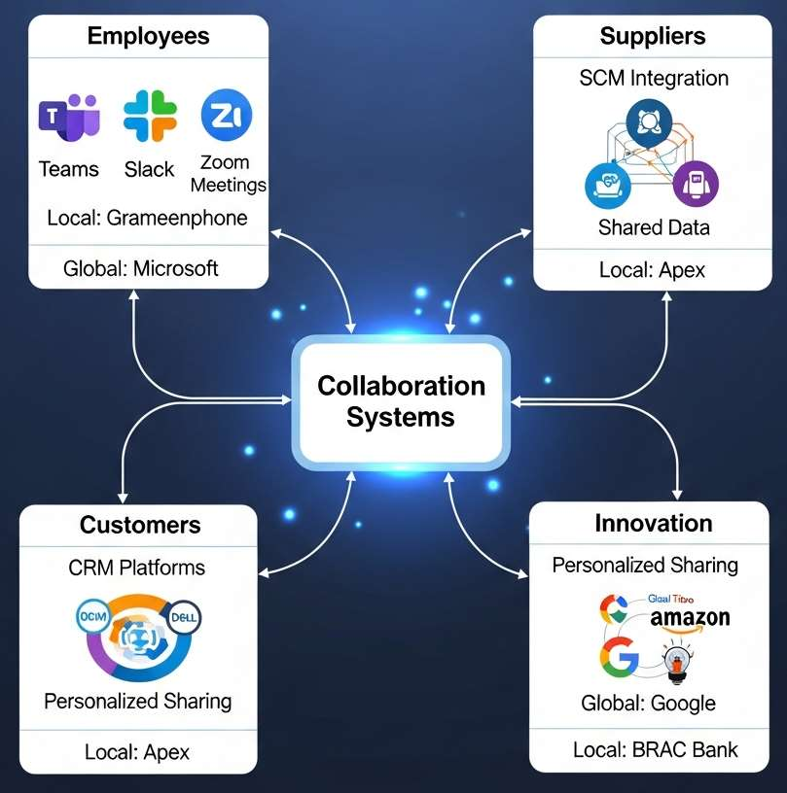
3. Collaboration Systems
Essential tools for modern organizations
Employees, suppliers, customers work together regardless of location
Platforms for communication, file sharing, project management
Break down barriers of distance and time
Real-time communication, document sharing, joint problem-solving
Integrated workflows foster teamwork and innovation
Microsoft Teams: chat, video, file sharing hub
Slack: streamlined channels, less email overload
Zoom: instant global virtual meetings
Staff in different countries collaborate as if in one office
11

Slide 12
Collaboration Systems: Bangladesh and Benefits
Grameenphone
BRAC Bank
Benefits
Coordinates nationwide telecom operations
Smooth communication: technical and customer service teams
IS dashboards and collaboration platforms
Aligns financial services teams
Faster decisions, better customer support
Efficiency: less duplicated effort
Innovation: instant idea sharing
Flexibility: seamless remote and cross-border work
Transparency: accountability, task visibility
Less delay, better coordination, real-time knowledge sharing.
12

Slide 13
Collaboration Systems: Figure Summary
Center: Collaboration Systems, linking employees, suppliers, customers, innovation
Teams, Slack, Zoom enable communication and coordination
Global: Amazon, Dell, Google, Microsoft
Bangladesh: Grameenphone, Apex, bKash, BRAC Bank
Foster efficiency, transparency, creativity
Strategic enablers of innovation and competitiveness, not just communication tools
13

Slide 14
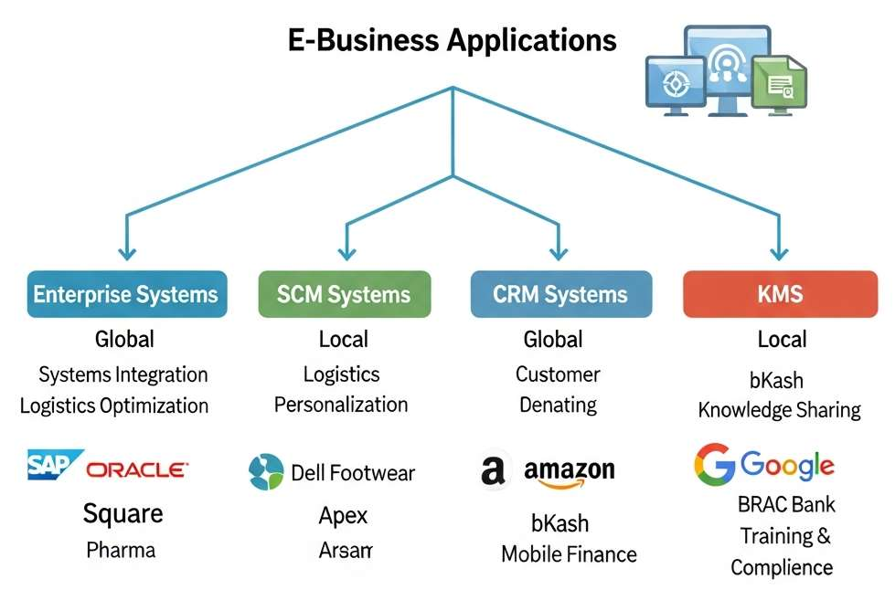
4. E-Business Applications
Backbone of digital enterprises
Integrate and optimize core business functions
Help firms operate efficiently, innovate, collaborate
Work in global and local contexts
Four types: enterprise systems, SCM, CRM, KMS
14

Slide 15
Enterprise Systems and SCM
Enterprise Systems (ERP)
Supply Chain Management
Integrate finance, HR, and operations into one platform
Remove data silos, smooth information flow
Global: SAP and Oracle manage payroll, accounting, and supply chains across countries
BD: Square Pharmaceuticals integrates production, distribution, and finance
Optimize logistics and supplier relations
Track inventory, forecast demand, coordinate suppliers
Global: Dell integrates suppliers into production, cutting delays and costs
BD: Apex Footwear manages raw materials, schedules, distribution
15

Slide 16
CRM and Knowledge Management
CRM Systems
Knowledge Management (KMS)
Personalize interactions, improve satisfaction
Analyze customer data, tailor services
Global: Amazon recommendations based on behavior
BD: bKash manages relationships, tracks mobile transactions, personalizes services
Share knowledge across the organization
Access to best practices, training, institutional knowledge
Global: Google Workspace, SharePoint
BD: BRAC Bank trains staff, shares compliance updates, keeps branch service consistent
16

Slide 17
E-Business Applications: Figure Summary
Center: E-Business Applications, four pillars
Enterprise systems, SCM, CRM, KMS
Global: SAP, Dell, Amazon, Google
Bangladesh: Square Pharma, Apex, bKash, BRAC Bank
Firms operate efficiently, innovate continuously, collaborate effectively
Applies to multinationals and local enterprises
17

Slide 18
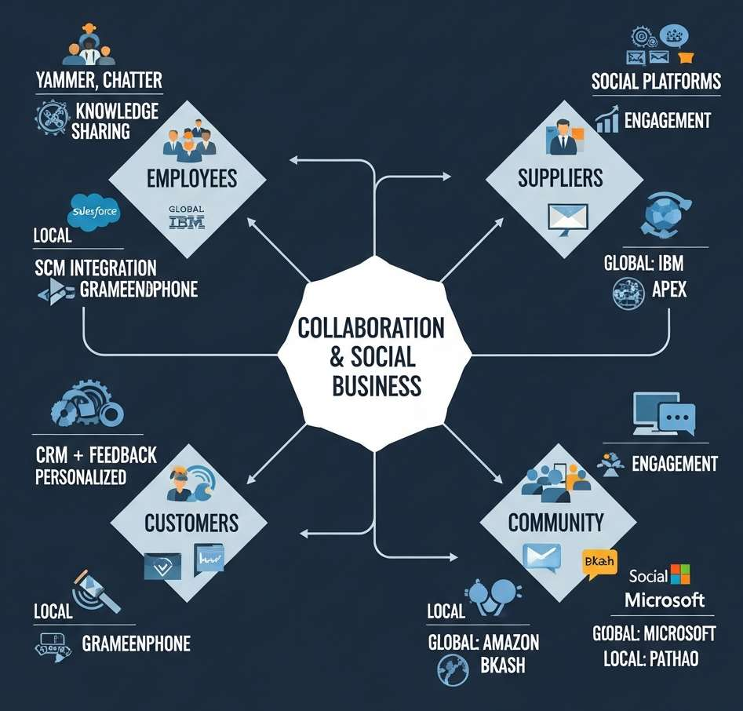
5. Collaboration and Social Business
Go beyond traditional communication tools
Social networking features built into business processes
Enable transparency, responsiveness, innovation
Combine collaboration tools with social networking
Unlike Teams, Slack, Zoom: community-driven interaction
Employees, suppliers, customers share ideas, feedback, knowledge
Breaks silos, builds a culture of participation
18

Slide 19
Social Business: Examples
Global
Bangladesh
Salesforce Chatter: social networking in CRM for sales and service
Yammer (Microsoft): internal social network for updates, ideas, documents
IBM Connections: social networking, knowledge sharing, project collaboration
Interactive communities inside organizations
Pathao: connects drivers and customers, feedback, coordination, loyalty
bKash: social features in app, shared experiences, personalized support
Grameenphone: engages employees and customers, knowledge sharing, innovation
Stronger relationships, community around services
19

Slide 20
Benefits and Figure Summary
Benefits
Figure Summary
Transparency: visible, accountable processes
Responsiveness: real-time feedback, agility
Innovation: diverse voices, creativity
Engagement: connected employees and customers
Center: Collaboration and Social Business
Links employees, suppliers, customers, communities
Global: Salesforce Chatter, Yammer
BD: Pathao, bKash, Grameenphone
Arrows: two-way communication, not top-down
Social business builds communities
20

Slide 21
References
Laudon & Laudon. Management Information Systems: Managing the Digital Firm (Pearson)
Turban & Volonino. Information Technology for Management
O'Brien & Marakas. Introduction to Information Systems
Stair & Reynolds. Principles of Information Systems
O'Brien & Marakas. Management Information Systems, McGraw-Hill/Irwin, 10th Ed., 2011
Pearlson & Saunders. Strategic Management of Information Systems, Wiley, 5th Ed., 2013
Ward & Peppard. Strategic Planning for Information Systems, Wiley, 3rd Ed., 2013
21

