Slide 1
Chapter 1
Information Systems in Business Today
Book
Management Information Systems
Fourteenth Edition
Kenneth C. Laudon, Jane P. Laudon

Slide 2
Learning Objectives
Understand the effects of information systems on business and their relationship to globalization.
Explain why information systems are so essential in business today.
Define an information system and describe its management, organization, and technology components.
Describe the different academic disciplines used to study information systems and explain how each contributes to our understanding of them.

Slide 3
What is a Management Information System?
Management information system is a system consisting of people, machines, procedures, databases and data models, as its elements. The system gathers data from the internal and external sources of an organization.
The acronym of Management Information System is MIS
Management is the art of getting things done through and with the people in formally organized groups.
An MIS helps decision making by providing timely, relevant and accurate information to managers.

Slide 4



Elements of Management Information System
Procedure
MIS
Machine
People
Data Models
Databases
Fig 1

Slide 5
Role of Management Information Systems in an Organization
The Management Information Systems ensures that an appropriate data is collected from the various sources, processed, and sent further to all the needy destinations. The system is expected to fulfill the information needs of an individual, a group of individuals, the management functionaries, the managers and the top management. MIS satisfies the diverse needs through a variety of systems such as Query Systems, Analysis Systems, Modeling Systems and Decision Support Systems, MIS helps in Strategic Planning, Management Control, Operational Control and Transaction Processing.
MIS helps the clerical personnel in the transaction processing and answers their queries on the data pertaining to the transaction, the status of a particular record and references on a variety of documents. MIS helps the junior management personnel by providing the operational data for planning, scheduling and control, and helps them further in decision making at the operations level to correct an out of control situation.

Slide 6
Role of Management Information Systems in an Organization(cont.)
MIS helps the middle management in short them planning, target setting and controlling the business functions. It is supported by the use of the management tools of planning and control. MIS helps the top management in goal setting, strategic planning and evolving the business plans and their implementation. MIS plays the role of information generation, communication, problem identification and helps in the process of decision making. MIS, therefore, plays a vital role in the management, administration and operations of an organization.

Slide 7
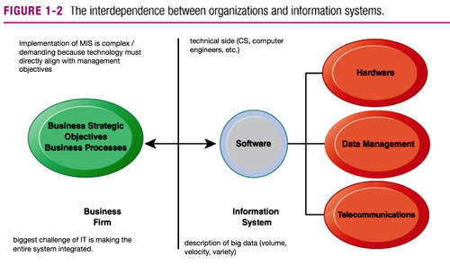
The Interdependence Between Organizations and Information Technology
Fig 2: In contemporary systems there is a growing interdependence between a firm’s information systems and
its business capabilities. Changes in strategy, rules, and business processes increasingly require changes in hardware,
software, databases, and telecommunications. Often, what the organization would like to do depends on what its systems
will permit it to do.

Slide 8
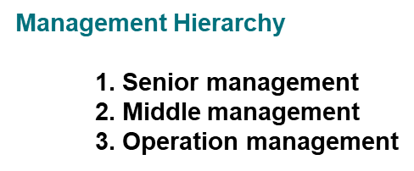
Two important things to understand in management.
Managerial Function
Management Hierarchy
Managerial Function
  1. Planning
  2. Organizing
  3. Staffing
  4. Directing
  5. Controlling

Slide 9
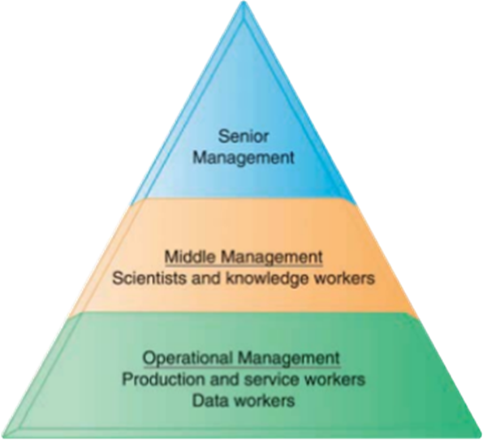
Management Hierarchy
Fig 3: Management Hierarchy

Slide 10
Management Hierarchy in depth
Senior Management
Senior Managers supervise and guide their staff to ensure employees align with the company’s vision and objectives. They provide leadership, mentorship, and direction to help team members develop their skills and perform at their best. Approving recruitment and termination, developing organizational objectives etc.
Middle Management
  Scientist & Knowledge Workers
Operational Management
  Production & Service Workers
  Data Workers

Slide 11
Strategic Business Objectives of Information System
Business firms invest heavily in information systems to achieve six strategic business objectives:
1. Operational excellence
2. New products, services, and business models
3. Customer and supplier intimacy
4. Improved decision making
5. Competitive advantage
6. Survival

Slide 12
Strategic Business Objectives of Information System(cont.)
1. Operational excellence:
Improvement of efficiency to attain higher profitability
Information systems, technology an important tool in achieving greater efficiency and productivity
Walmart’s Retail Link system links suppliers to stores for superior replenishment system

Slide 13
Strategic Business Objectives of Information System(cont.)
2. New products, services, and business models:
Business model: describes how company produces, delivers, and sells product or service to create wealth
Information systems and technology a major enabling tool for new products, services, business models
Examples: Apple’s iPad, Google’s Android OS, and Netflix

Slide 14
Strategic Business Objectives of Information System(cont.)
3. Customer and supplier intimacy:
Serving customers well leads to customers returning, which raises revenues and profits.
Example: High-end hotels that use computers to track customer preferences and used to monitor and customize environment
Intimacy with suppliers allows them to provide vital inputs, which lowers costs.
Example: JCPenney’s information system which links sales records to contract manufacturer

Slide 15
Strategic Business Objectives of Information System(cont.)
4. Improved decision making
Without accurate information:
Managers must use forecasts, best guesses, luck
Results in:
Overproduction, underproduction ,Misallocation of resources , Poor response times
Poor outcomes raise costs, lose customers
Example: Verizon’s Web-based digital dashboard to provide managers with real-time data on customer complaints, network performance, line outages, and so on.

Slide 16
Strategic Business Objectives of Information System(cont.)
5. Competitive advantage
Delivering better performance
Charging less for superior products
Responding to customers and suppliers in real time
Examples: Apple, Walmart, UPS

Slide 17
Strategic Business Objectives of Information System(cont.)
6. Survival
Information technologies as necessity of business
Industry-level changes
Example: Citibank’s introduction of ATMs
Governmental regulations requiring recordkeeping
Examples: Toxic Substances Control Act, Sarbanes-Oxley Act

Slide 18
Data and Information
Data is a raw and unorganized fact that is required to be processed to make it meaningful. It can be considered as facts and statistics collected together for reference or analysis. Data does not directly help in decision making.
Example: student test scores.
Information refers to processed, organized, and structured data. It gives context for the facts and facilitates decision making. In other words, information is processed data that makes sense to us. Information directly helps in decision making.
Example: Average score of class that is derived from given data.

Slide 19
Data and Information(Cont.)
1. Data: Records or Historical Records
2. Information: Processed Data
DATA
PROCESSING
INFORMATION
Fig 4:
Overview of Data & Information

Slide 20
System
A system may be defined as a set of elements which are joined together to achieve a common objective. The elements are interrelated and interdependent.
The set of elements for a system may be understood as input, process, and output. A system has multiple inputs; these inputs are processed through a transformation process to convert these inputs into outputs.
The three elements of a system are shown as follows:
Input
Process
Output

Slide 21
Three activities of information systems produce information organizations need
Input: Captures raw data from organization or external environment
Processing: Converts raw data into meaningful form
Output: Transfers processed information to people or activities that use it.

Slide 22
Various Function of Information System
An information system contains information about an organization and its surrounding environment.
Three basic activities—input, processing, and output—produce the information organizations need.
Feedback is output returned to appropriate people or activities in the organization to evaluate and refine the input.
Environmental actors, such as customers, suppliers, competitors, stockholders, and regulatory agencies, interact with the organization and its information systems.

Slide 23
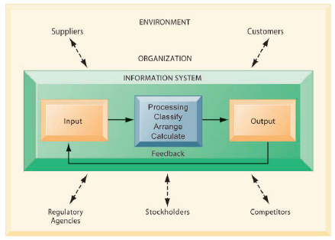
Various Functions of Information System
Fig 5: Various Functions of Information System

Slide 24
Various Functions of Information System
One of the most widely used bases for organizing activities in almost every organization is the business function.
Business activities are grouped around functions such as production, marketing, finance personnel, etc... Resulting in the respective department or an area of the business organization. These departments or functional areas are commonly known as the functional areas of business.
There is no standard classification of such sub-system in an organization, but a typical set of functions in a manufacturing organization includes:
  Production
  Marketing
  Finance and accounting
  Materials and
  Personnel systems

Slide 25
Various Functions of Information Systems
Marketing (ব্যবসা)
Sales order
Forecasting
Sales analysis
Billing
Distribution
Stock availability
Sales quota control
Pricing
Product promotion
Production (উত্‍পাদন)
Production planning and control
Engineering standards
Quality control
R & D etc

Slide 26
Various Functions of Information Systems
Finance and accounting
Financial planning
Budgeting
Cost accounting
Asset accounting
Accounts Receivable
Payroll
Accounts payable, etc.
Materials (উপাদান)
Material planning
Bill of material
Cost estimate
Warehousing planning etc...

Slide 27
Various Functions of Information Systems
Personnel
Employee recruitment
Employee selection
Employee development
Employee transfers
Employee retirements etc...
Notes:
**Personnel : সেই সমস্ত মানুষ যারা একটি কোম্পানি, সংস্থা অথবা সশস্ত্র বাহিনীর কোনো একটিতে কর্মরত

Slide 28
Different Types of Information
Information could be classified on the basis of the purpose for which it is utilised, into three main categories
  Strategic information - it is required by the managers at the strategic level of management for the formulation of organisational strategies.
  Tactical information - information in this category is used in short term planning and is of use at management control level.
  Operational information - it applies to short periods which may vary from an hour to a few days.

Slide 29
Need for Information System
Meeting global challenges
Capturing opportunities in marketplace
Supporting corporate strategy
Linking departments whose functions are different
Enhancing worker productivity
Increase in quality of goods and services

