Slide 1




Predicting the Argumenthood of English Prepositional Phrases
Najoung Kim, Kyle Rawlins, Benjamin Van Durme & Paul Smolensky
To be presented @ AAAI-2019

Slide 2
Summary
Argument vs Adjunct distinction seems to be important in linguistics
PP Arg. vs Adj seems tricky
Can machines learn how to make this distinction?
Is this task useful?

Slide 3
Arguments and Adjuncts
Adjuncts (or modifiers) of “open”
John opened the window this morning with Mary.
Argument (or complement) of “open”
Related: “core” vs “non-core”

Slide 4
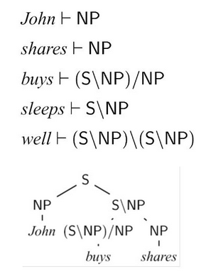
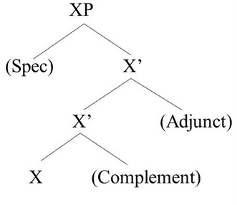
Arguments and Adjuncts
Important theoretical concepts in linguistics & has psychological reality (Tutunjian and Boland, 2008)
Often given distinct representations in many formalisms
From Levy, Eisner & Klein

Slide 5
Arguments and Adjuncts in NLP
Core vs non-core distinction recognized as a task in literature
Explicitly required by certain formalisms (e.g., CCG)
Important for porting resources (e.g., PropBank -> CCGBank)
Important for tasks such as parsing and PP attachment
But unannotated in major resources such as the Penn TreeBank (mainly because it’s hard!) and UD (similar reasons; to avoid internal inconsistencies)
Maybe useful for structure-aware semantic role labeling (Marcheggiani & Titov. 2017, He et al. 2017)

Slide 6
Can machines do it?

Slide 7

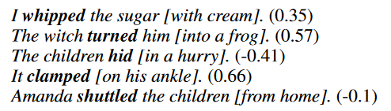
Task summary
Binary
Large-ish dataset (19k train)
Discrete labels (arg=1, adj=0)
Labels heuristically generated from VerbNet
Type-level classification task
Gradient
Small, proof-of-concept dataset
Degree of argumenthood
Crowdsourced human judgments
Token-level regression task

Slide 8
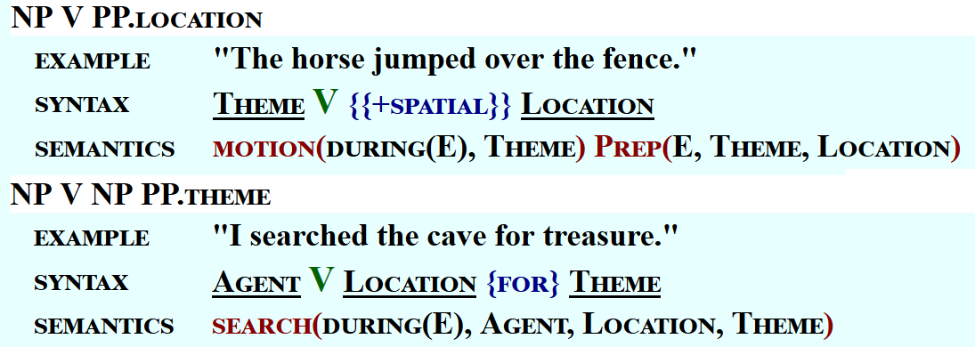
Experiment 1: Binary Arg-Adj classification
Use VerbNet subcategorization frames as proxy for arg/adj labels
If a subcat frame exists for a {V, P} in the database, it is an argument construction!

Slide 9
Experiment 1: Dataset
Generate an exhaustive list of all possible {Verb, Prep} given:
All verbs in VerbNet (2714 unique verbs)
All prepositions in VerbNet excluding multiword preps (60 single-word prepositions)
2714*60 =162,480 unique {Verb, Preposition} tuples
If tuple exists in VerbNet, it is an argument (label 1)
Problem: heavily skewed label ratio (~1:10)

Slide 10
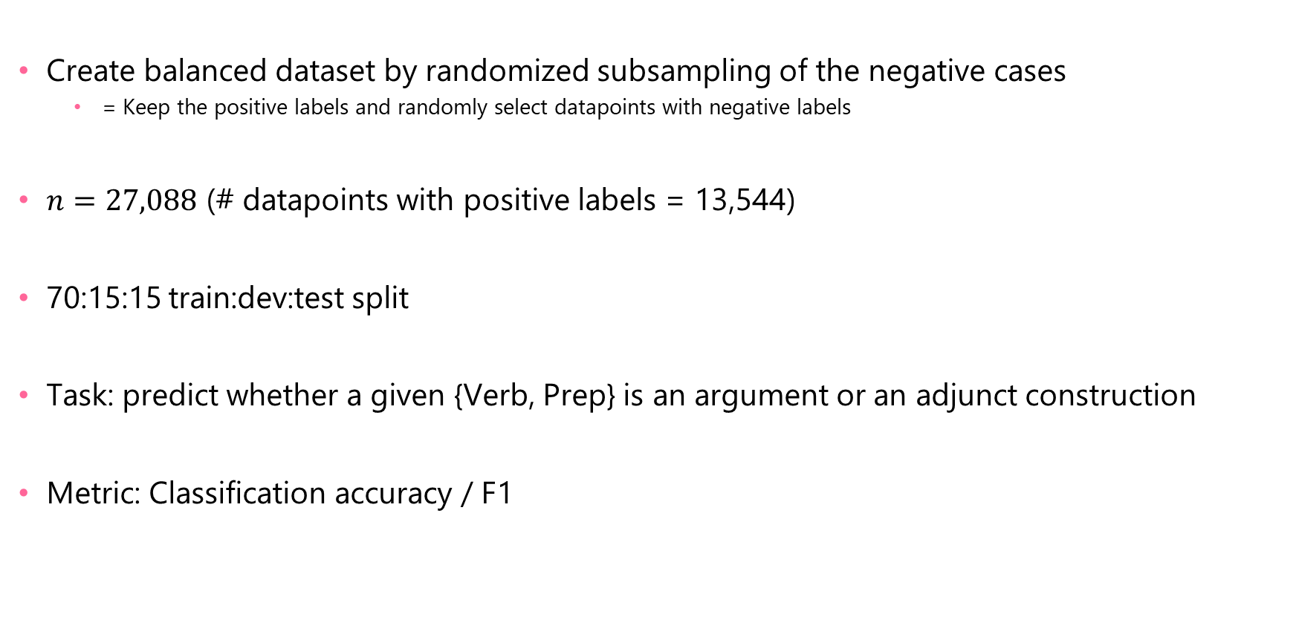
Experiment 1: Dataset
Create balanced dataset by randomized subsampling of the negative cases
= Keep the positive labels and randomly select datapoints with negative labels
$n=27,088$ (# datapoints with positive labels = 13,544)
70:15:15 train:dev:test split
Task: predict whether a given {Verb, Prep} is an argument or an adjunct construction
Metric: Classification accuracy / F1

Slide 11
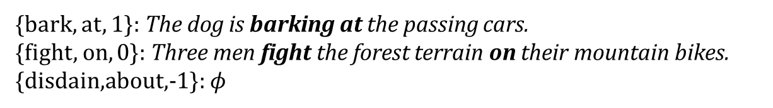
Experiment 1: Dataset (Token-level variant)
The meaning of the NP complement of the PP also affects argumenthood! (obv)
Find actual examples of the {Verb, Prep, label} in a corpus
Token-level variant of the task
Ternary classification task including “unobserved” label (-1)
{bark, at, 1}: The dog is barking at the passing cars.
{fight, on, 0}: Three men fight the forest terrain on their mountain bikes.
{disdain,about,-1}: $φ$

Slide 12
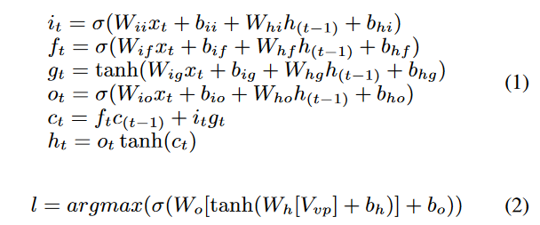
Experiment 1: Model
Use word embeddings to encode input tuples
Bidirectional LSTM (BiLSTM) + multilayer perceptron (MLP) works the best

Slide 13
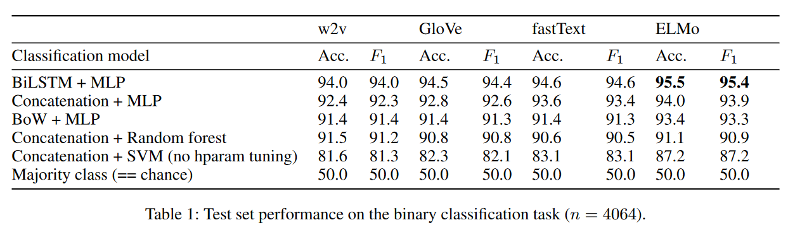
Experiment 1: Results
Vector representation of words using corpus data (predictive)
Count-based
w2v+char ngrams
“Pretrained” with LM objective
Sequential info does seem to matter a little bit…

Slide 14
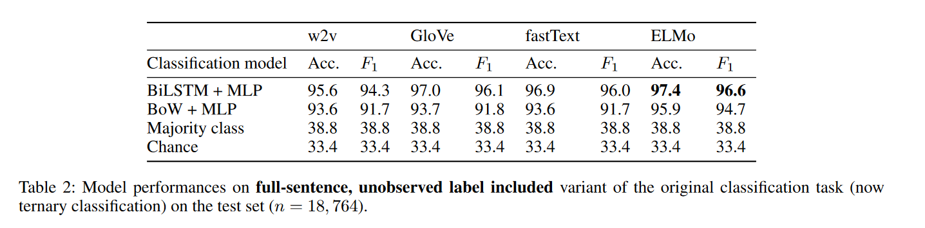
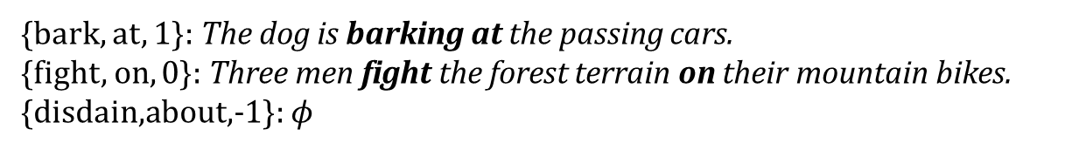
Experiment 1: Results
{bark, at, 1}: The dog is barking at the passing cars.
{fight, on, 0}: Three men fight the forest terrain on their mountain bikes.
{disdain,about,-1}: $φ$

Slide 15
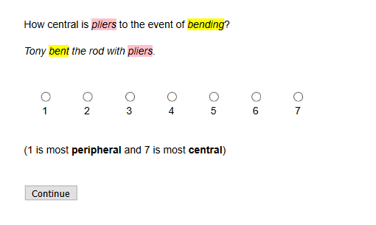
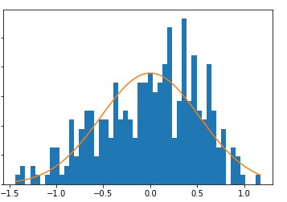
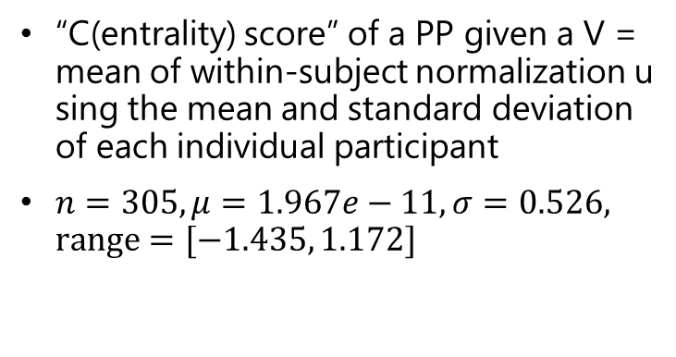
Experiment 2: Gradient argumenthood prediction
“C(entrality) score” of a PP given a V = mean of within-subject normalization using the mean and standard deviation of each individual participant
$n=305, μ=1.967e−11, σ=0.526, range=[−1.435, 1.172]$

Slide 16
Experiment 2: Gradient argumenthood prediction
All sentences are adaptations from example sentences in VerbNet or PropBank
All sentences contain a single main verb and a PP dependent of that verb

Slide 17
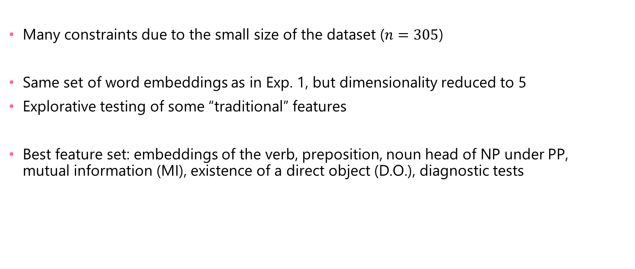
Experiment 2: Model
Many constraints due to the small size of the dataset ($n=305$)
Same set of word embeddings as in Exp. 1, but dimensionality reduced to 5
Explorative testing of some “traditional” features
Best feature set: embeddings of the verb, preposition, noun head of NP under PP, mutual information (MI), existence of a direct object (D.O.), diagnostic tests
“It measures how much knowing one of these variables reduces uncertainty about the other”

Slide 18
Experiment 2: Model
MLP regressor
Model used in Exp. 1 overfits severely

Slide 19
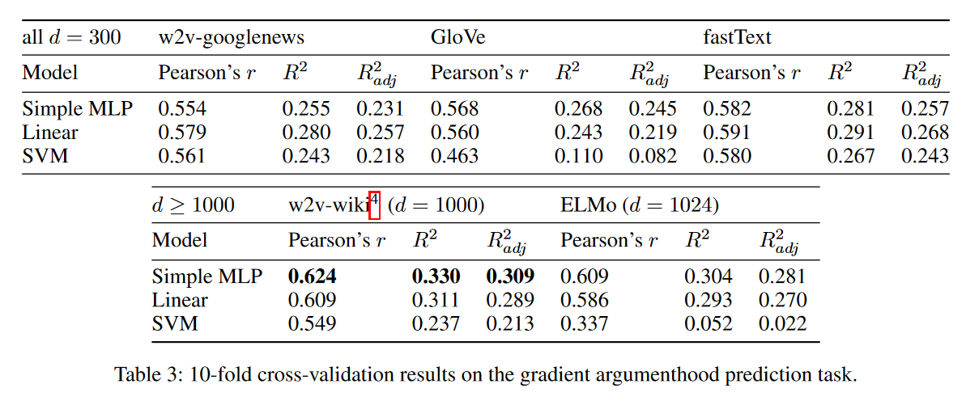
Experiment 2: Results
Observation: Higher-dimensional projections seem to be better, even though the actual embeddings fed into the model were PCA-reduced

Slide 20
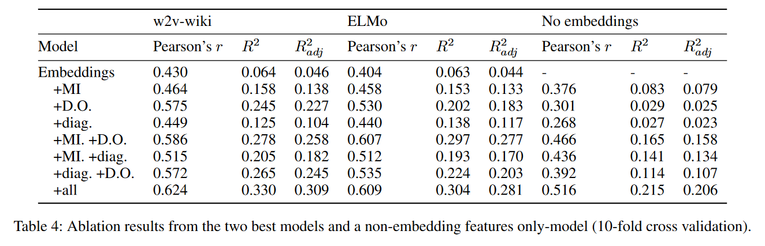
Experiment 2: Ablation study
Large contributions of non-embedding features
Maybe some redundancy in embeddings & mutual information
Diagnostic tests are weakly informative (lines up with what they are like in practice)

Slide 21
Why is arg/adj distinction a useful standalone task?
We said in the beginning MAYBE arg/adj is useful for SRL, parsing, etc.
We explore this issue by asking the following two questions:
Is it actually useful in some ways?
Is it worthy to formulate as a separate task?
Caveat: we only conduct this analysis for the binary task because the gradient dataset is too small ☹

Slide 22
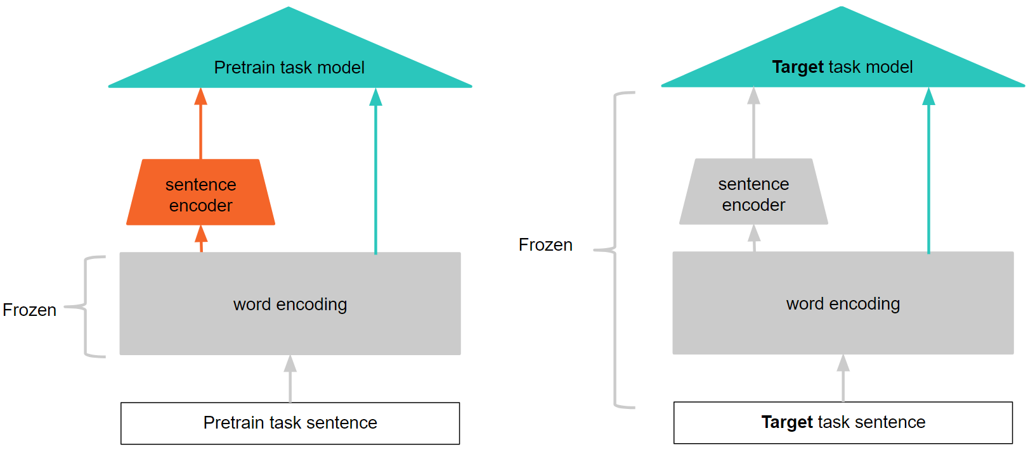
Usefulness in improving sentence representations
Select 3 tasks that might benefit from better PP arg/adj information (SRL on Wall Street Journal, SRL on Ontonotes corpus, PP attachment disambiguation)
Pretrain-freeze-test setup
First, (pre)train on our PP task
Test on target task with frozen encoder weights

Slide 23
Usefulness in improving sentence representations
Rational: If learning to make correct PP argumenthood distinction teaches models knowledge generalizable to the new tasks, the classifier trained on top of the fixed-weights encoder will perform better on those tasks compared to a classifier trained on top of an encoder with randomly initialized weights.
First, (pre)train on our PP task
Test on target task with frozen encoder weights

Slide 24
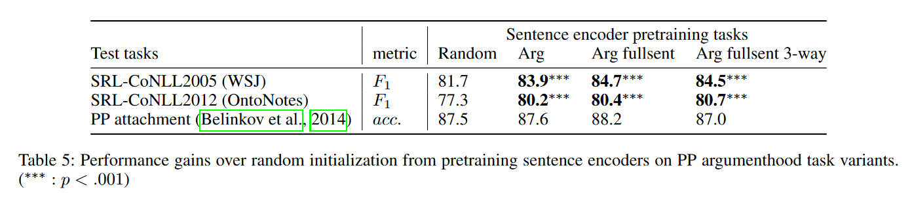
There is improvement!

Slide 25
Is it worthy enough to be a standalone task?
Two subquestions:
Would it be the same/better to use an existing task that provides similar information? (e.g., PP attachment disambiguation (Belinkov et al. 2014)
Can we attribute the performance gain we just saw to simply seeing more datapoints at train time?

Slide 26
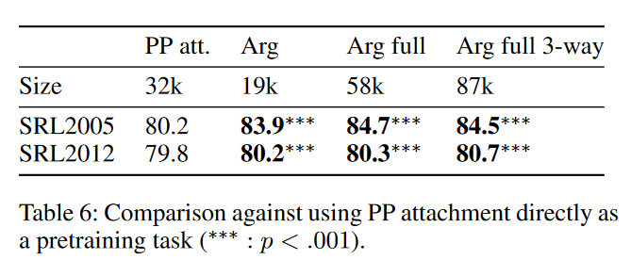
No!
Would it be the same/better to use an existing task that provides similar information? (e.g., PP attachment disambiguation (Belinkov et al. 2014)
No, because PP arg/adj is works significantly better than PP attachment disambiguation
Can we attribute the performance gain we just saw to simply seeing more datapoints at train time?
No, because the training dataset sizes vary a lot and does not correlate with better performance

Slide 27
Summary
Proposed two PP argument vs adjunct distinction tasks (binary and gradient)
95.5 accuracy / 95.4 F1 for binary classification task r=0.624 for gradient argumenthood task
Showed that a principled prediction of both binary and gradient argumenthood judgments is possible with informed selection of lexical features
Justified the utility of the binary by reporting performance gains on multiple SRL tasks through encoder pretraining

Slide 28
THANKS!

Slide 29

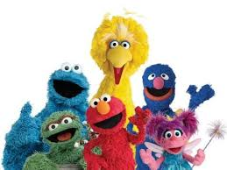


Acknowledgements
Funding: JHU CogSci & NSF INSPIRE #1344269
JSALT Sentence Rep Team
Comments from..
Esp. Alex Wang, Ian Tenney, Patrick Xia, Katherin Yu, Jan Hula, Edouard Grave, Yinghui Huang, Shuning Jin, Raghu Pappagari, Berlin Chen for codebase, and PIs Sam Bowman & Ellie Pavlick
Rachel Rudinger, C. J. Lutken, Geraldine Legendre, Lilia Rissman, Audience at WeCNLP 2018, Semlab, Paul’s lab, Anonymous reviewers

Slide 30
REFERENCES
Belinkov, Y., Lei, T., Barzilay, R., & Globerson, A. (2014). Exploring compositional architectures and word vector representations for prepositional phrase attachment. Transactions of the Association for Computational Linguistics, 2, 561-572.
Carreras, X., & Màrquez, L. (2005, June). Introduction to the CoNLL-2005 shared task: Semantic role labeling. In Proceedings of the ninth conference on computational natural language learning (pp. 152-164). Association for Computational Linguistics.
He, L., Lee, K., Lewis, M., & Zettlemoyer, L. (2017). Deep semantic role labeling: What works and what’s next. In Proceedings of the 55th Annual Meeting of the Association for Computational Linguistics (Volume 1: Long Papers) (Vol. 1, pp. 473-483).
Marcheggiani, D., & Titov, I. (2017). Encoding Sentences with Graph Convolutional Networks for Semantic Role Labeling. In Proceedings of the 2017 Conference on Empirical Methods in Natural Language Processing (pp. 1506-1515).
Pradhan, S., Moschitti, A., Xue, N., Uryupina, O., & Zhang, Y. (2012, July). CoNLL-2012 shared task: Modeling multilingual unrestricted coreference in OntoNotes. In Joint Conference on EMNLP and CoNLL-Shared Task (pp. 1-40). Association for Computational Linguistics.
Tutunjian, D., & Boland, J. E. (2008). Do we need a distinction between arguments and adjuncts? Evidence from psycholinguistic studies of comprehension. Language and Linguistics Compass, 2(4), 631-646.

