Slide 1

Heart Disease Risk Factor Analysis
Final Project Report — Python • SQL • Power BI. End-to-end analysis of UCI heart disease records to identify demographic and clinical factors most associated with heart disease.

Slide 2

Objective & Tools
Objective
Tools
Identify demographic and clinical factors associated with heart disease using reproducible data workflows.
Python (Pandas, Matplotlib, Seaborn), MS SQL Server, Power BI.
Workflow
Data cleaning → EDA → SQL-driven analysis → Interactive reporting in Power BI.

Slide 3

Dataset & Cleaning
Dataset
UCI Heart Disease Dataset (Kaggle). Final records: 296 patients. 14 attributes.
Cleaning
Removed duplicates, fixed types, and excluded invalid placeholders (ca=4, thal=0) rather than treating them as valid.

Slide 4

Overall Prevalence & Summary Metrics
296
Total Patients
160
Heart Disease
136
No Disease
54.52
Average Age

Slide 5
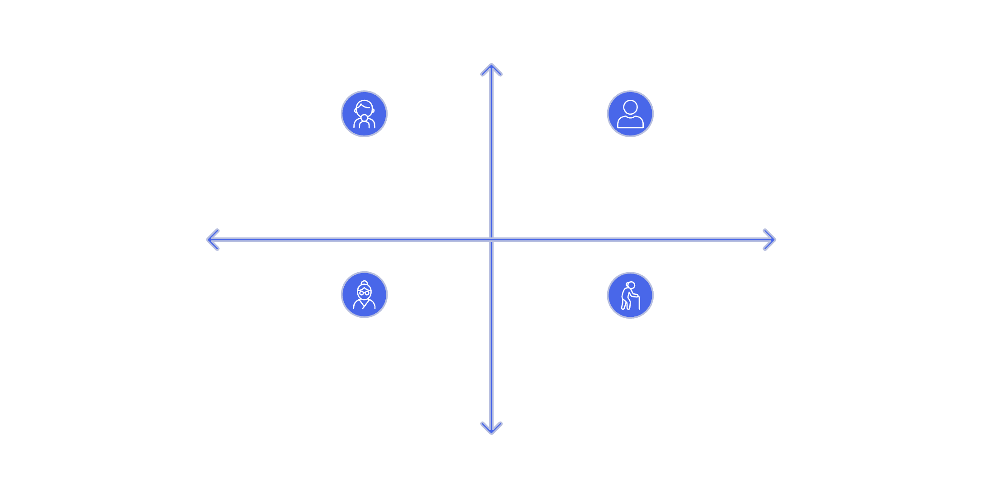

Disease Rate by Age & Gender
Higher Disease Rate
Gender
Female: 95 total, 71 disease cases → 74.7% disease rate. Male: 201 total, 89 disease cases → 44.3% disease rate.
Under 40 — 71.4%
40–54 — 69.4%
Younger Age → ?
Older Age → ?
Females show higher disease rate despite smaller cohort.
55–64 — 36.8%
65+ — 51.2%
Lower Disease Rate

Slide 6

Chest Pain & Vessel Findings
Chest Pain Type
Type 0: 27.7% disease rate. Type 1: 81.6%. Type 2: 78.3%. Type 3: 69.6%. Chest pain presentation is a strong indicator.
Number of Major Vessels (ca)
0 vessels: 74.6% disease rate → declines to 15.0% for 3 vessels. Clear inverse trend in this dataset.

Slide 7



Physiological Measures vs Disease
Cholesterol
1
Avg: No disease = 251 mg/dl; Disease = 243 mg/dl — lower in disease group here.
Max Heart Rate
2
No disease avg = 138 bpm; Disease avg = 158 bpm.
Fasting Blood Sugar
3
High: 53.5% disease rate; Normal: 54.2% — effectively no difference.
Resting BP Category
4
Normal: 61.7% (highest), Elevated: 56.8%, High (140+): 45.4% — non-linear relationship.

Slide 8

Exercise-Induced Angina — Counterintuitive Pattern
Patients without exercise-induced angina: 199 total, 137 disease cases → 68.8% disease rate. Patients with angina: 97 total, 23 disease cases → 23.7% disease rate.
This counter-intuitive result highlights the need to validate assumptions with data.

Slide 9
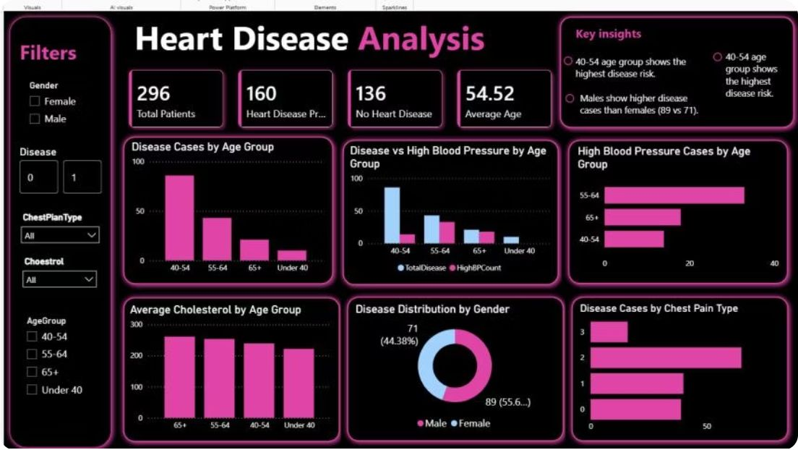
Power BI Dashboard
Interactive dashboard built with slicers for Gender, Disease Status, Chest Pain Type, and Age Group. Visuals include summary metrics, age-group and chest-pain charts, cholesterol and BP comparisons, and gender donut chart.
296 Total Patients
160 Heart Disease (54.1%)
Filters for dynamic exploration

Slide 10

Conclusions & Recommendations
Key Conclusion
Clinical presentation (chest pain type, vessel findings, exercise angina) is more strongly associated with disease than single measures like cholesterol or resting BP in this dataset.
Recommendations
Prioritize chest pain characteristics and vessel imaging for screening; validate assumptions with data; use multivariable approaches rather than relying on single risk factors.
Next Steps
Extend analysis with larger datasets, incorporate multivariate models, and validate findings clinically before changing screening protocols.

