Slide 1

Telecom Customer Churn Prediction
End-to-end analytics: Python (pandas) | SQL | Power BI. Analysis of 7,043 customers to identify drivers of churn and recommend retention actions.

Slide 2

Project Objectives
Data Prep
Business Analysis
Clean and feature-engineer the raw dataset using Python (pandas).
Use SQL to answer key churn questions and quantify risk segments.
Visualization
Action
Design an interactive Power BI dashboard for stakeholders.
Translate findings into clear, actionable retention recommendations.

Slide 3

Dataset Overview
IBM Telco Customer Churn dataset — 7,043 customers, 21 attributes. Includes demographics, account details (tenure, contract, payment), subscribed services, and churn label.
Demographics: gender, senior citizen, partner, dependents
Account: tenure, contract type, payment method, billing
Services: phone, internet, security, tech support, streaming

Slide 4

Data Cleaning & Feature Engineering
01
Standardize
Column names → lowercase snake_case.
02
Fix Missing
total_charges blank → numeric 0 for tenure=0.
03
Types & Drops
Convert categories; drop customer_id.
04
Engineered Features
tenure_group, avg_monthly_spend, num_services, is_new_customer.

Slide 5
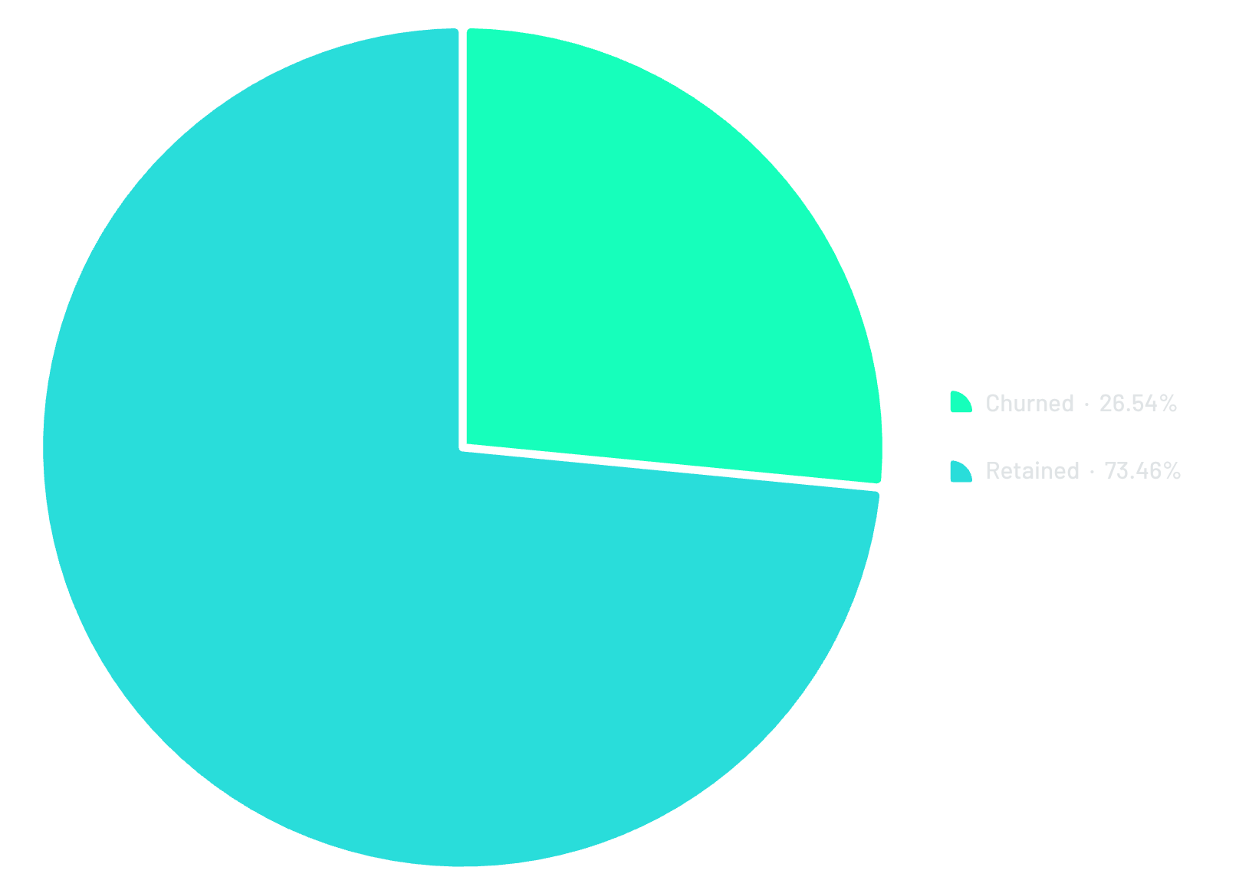

Overall Churn Snapshot
Out of 7,043 customers, 1,869 churned (26.54%) and 5,174 retained (73.46%).
Churn rate: 26.54%

Slide 6



Highest-Risk Segments
Month-to-Month Contracts
Fiber Optic Customers
Electronic Check Payments
3,875 customers; 1,655 churned → 42% churn rate (highest by contract).
3,096 customers; 1,297 churned → 41.89% churn rate; avg monthly $91.5.
2,365 customers; 1,071 churned → 45% churn rate (~3x automatic payments).

Slide 7

Tenure & Loyalty
Churn risk is highest in the first year (0–12 months: 47%), then declines sharply as tenure increases. Average tenure: churned = 17 months; retained = 37 months.
0–12 months
25–48 months
Churn 47%
Churn 20%
First 12 months are the critical retention window.
13–24 months
49–60 months
Churn 28%
Churn 14%

Slide 8





Additional Patterns
Senior Citizens
1,142 customers; 476 churned → 41% vs 23% for non-seniors.
Number of Services
Zero services churn 43.75% vs 26.34% for customers with ≥1 service.
Paperless Billing
Paperless users churn 33% vs 16% for paper billing.
Monthly Charges
Churned avg $74.44 vs retained avg $61.27 — higher spenders are churning more.

Slide 9
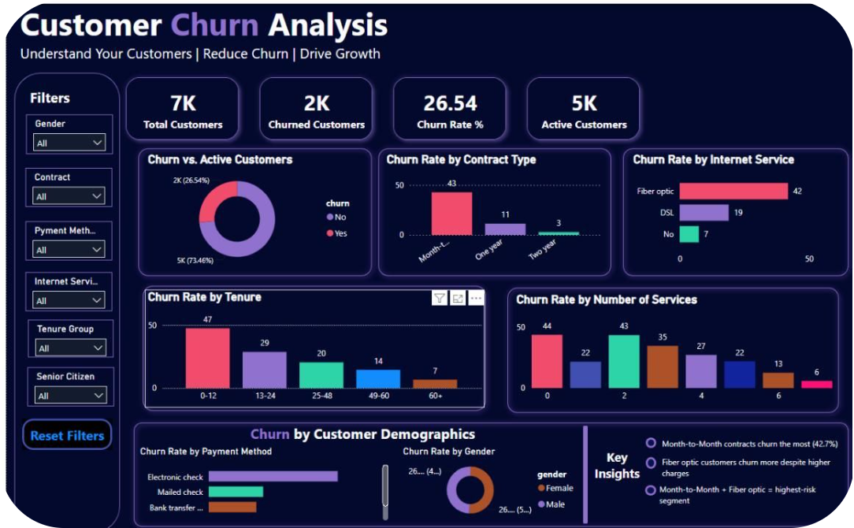
Power BI Dashboard
Interactive dashboard with slicers for gender, contract, payment method, internet service, tenure group, and senior citizen — enabling exploration of churn by segment.
Summary cards: 7K total, 2K churned, 26.54% churn rate, 5K active
Key visuals: churn by contract, internet service, tenure, number of services, payment method

Slide 10




Key Insights & Recommendations
1
2
3
Top Insights
Recommendations
Conclusion
- Month-to-month churn highest (42.7%). - Month-to-month + Fiber optic = 54% (highest-risk). - First 12 months most critical (47%). - Electronic check churn ~3x automatic payments. - Seniors churn 41% vs 23% non-seniors.
- Incentivize annual/2‑year contracts via targeted discounts. - Investigate fiber plan pricing & service quality. - Prioritize retention in first 12 months. - Promote automatic payments over electronic checks. - Upsell add-on services to increase stickiness.
Analysis of 7,043 records (Python, SQL, Power BI) identifies contract type, tenure, internet service, and payment method as primary churn drivers — providing a data-driven foundation for targeted retention strategies.
Focus immediate retention on month-to-month + fiber customers and new customers within their first year.

