Slide 1
BIG DATA
Project Presentation on Crystal Ball Event Prediction
Sachin Kushwaha (984681)
Sujan Thapa (984477)

Slide 2
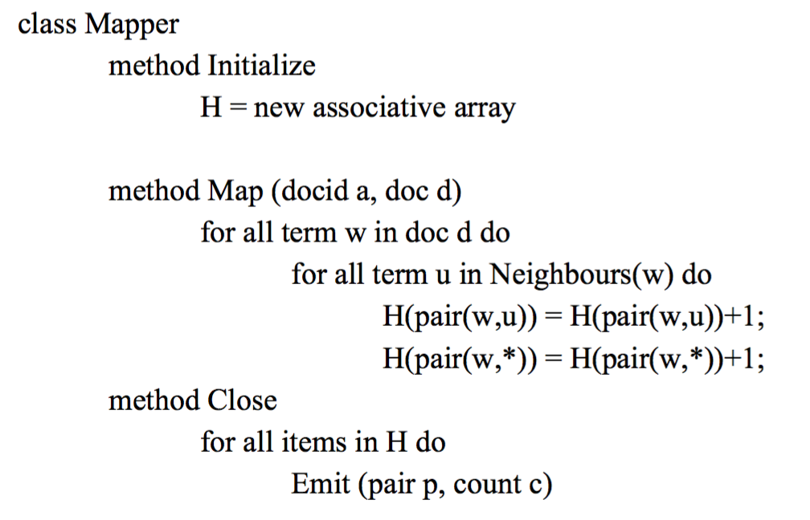
Pseudo code - PAIR approach Mapper

Slide 3
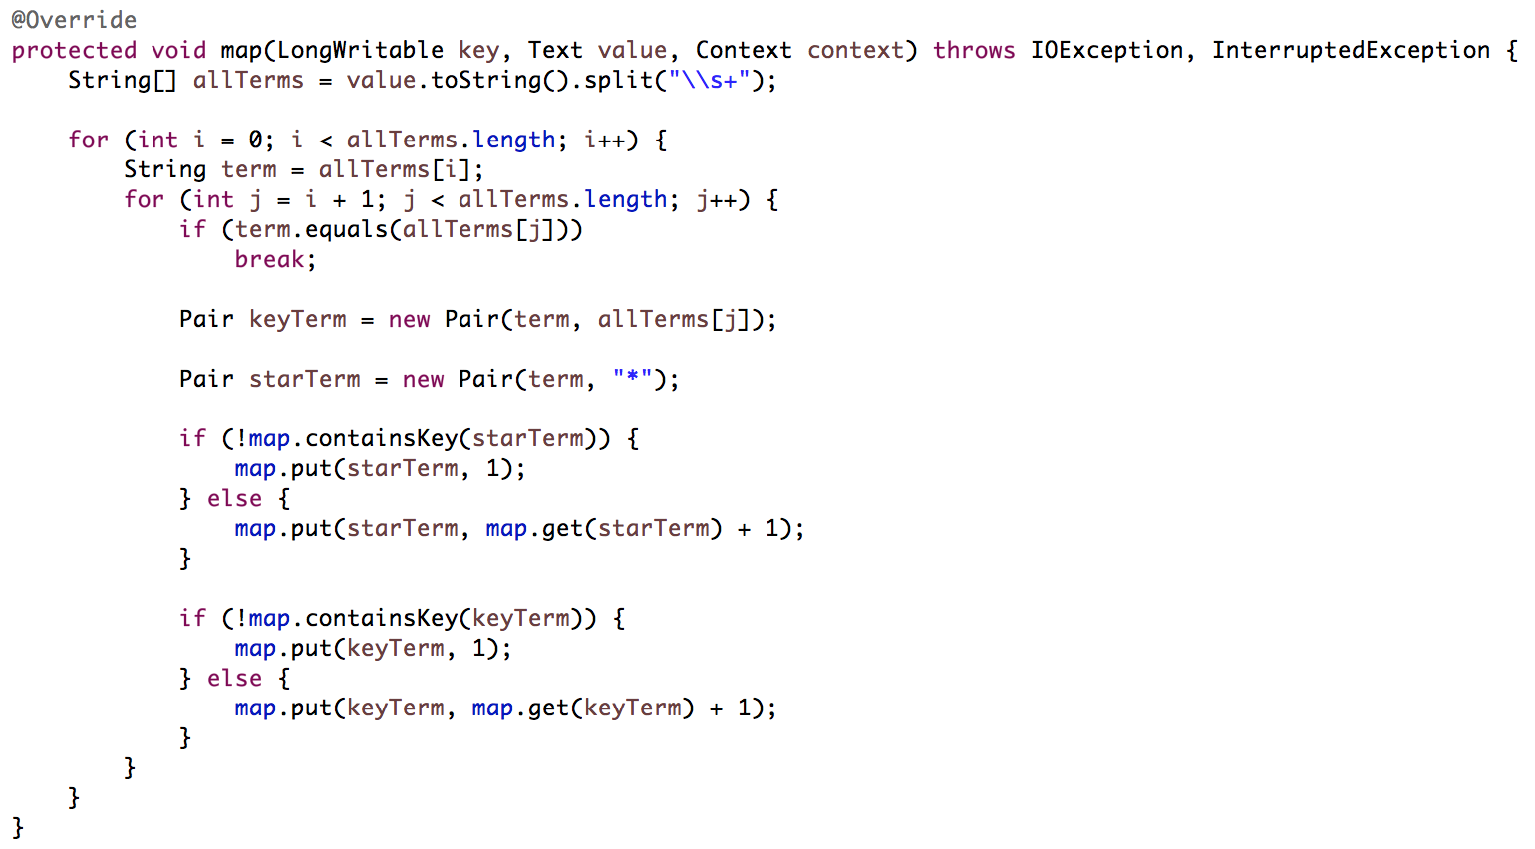
Java code - PAIR approach Mapper

Slide 4
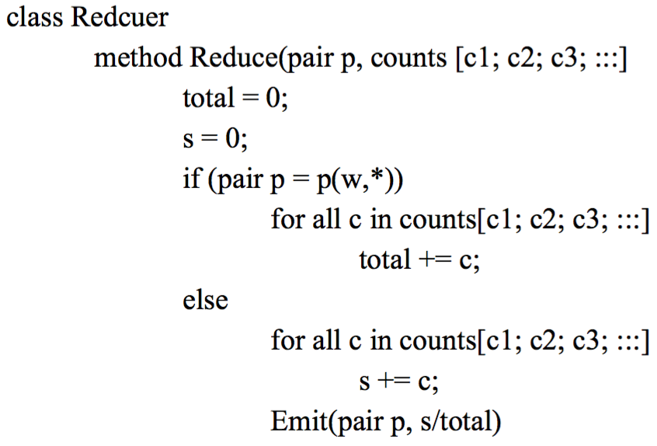
Pseudo code - PAIR approach Reducer

Slide 5
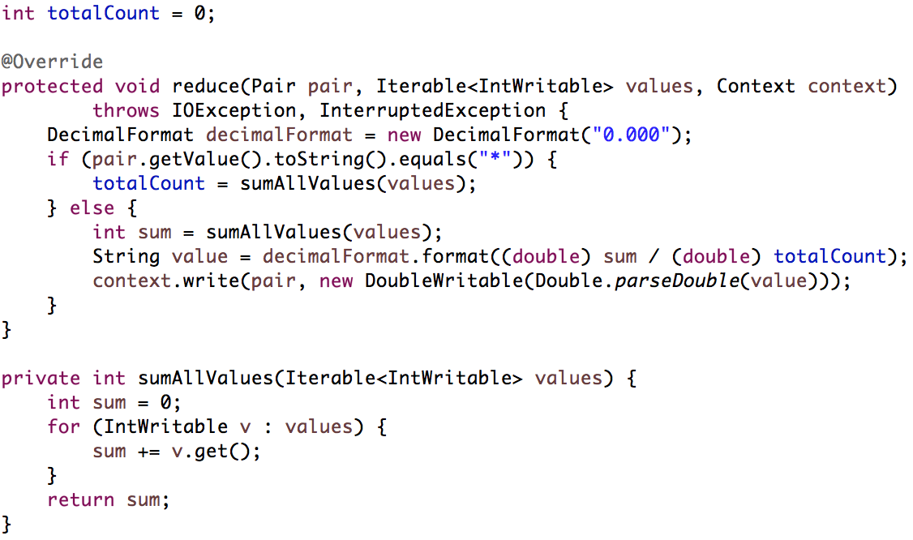
Java code - PAIR approach Reducer

Slide 6
Result - PAIR approach
(12, 18) 0.091
(12, 29) 0.182
(12, 34) 0.364
(12, 56) 0.182
(12, 79) 0.091
(12, 92) 0.091
(29, 12) 0.308
(29, 18) 0.077
(29, 34) 0.308
(29, 56) 0.154
(29, 79) 0.077
(29, 92) 0.077
(34, 12) 0.25
(34, 18) 0.083
(34, 29) 0.25
(34, 56) 0.25
(34, 79) 0.083
(34, 92) 0.083
(56, 12) 0.3
(56, 18) 0.1
(56, 29) 0.2
(56, 34) 0.3
(56, 92) 0.1
(79, 12) 0.2
(79, 18) 0.2
(79, 29) 0.2
(79, 34) 0.2
(79, 56) 0.2
(92, 12) 0.25
(92, 18) 0.083
(92, 29) 0.25
(92, 34) 0.25
(92, 56) 0.083
(92, 79) 0.083

Slide 7
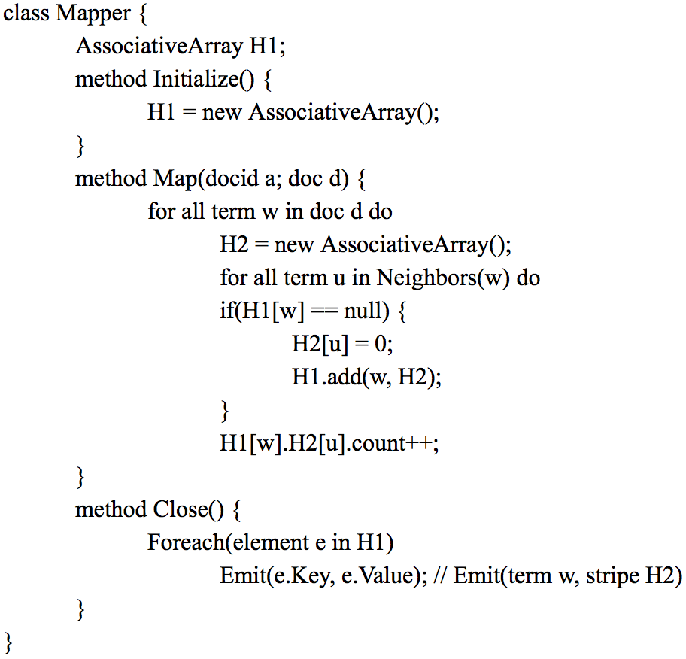
Pseudo code – STRIPE approach Mapper

Slide 8
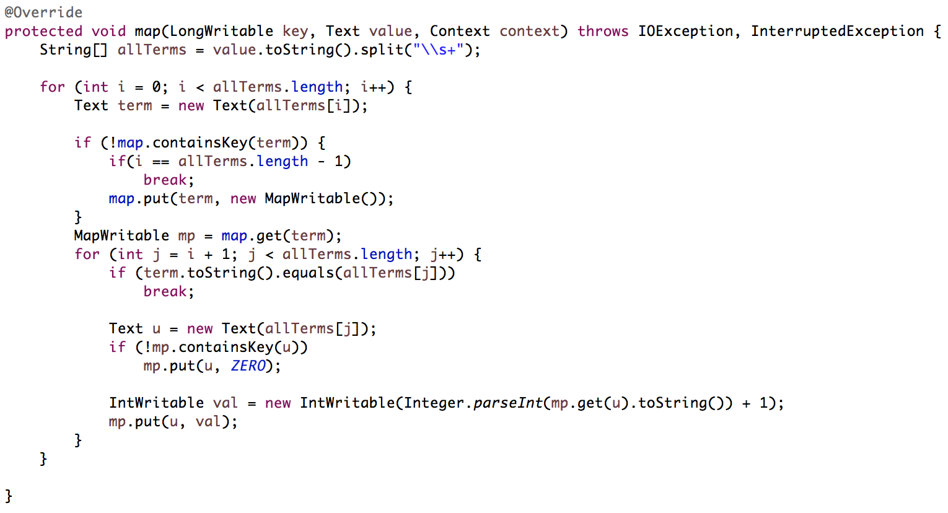
Java code – STRIPE approach Mapper

Slide 9
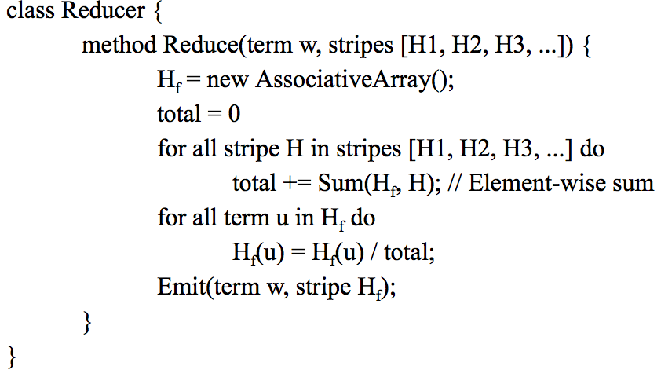
Pseudo code – STRIPE approach Reducer

Slide 10
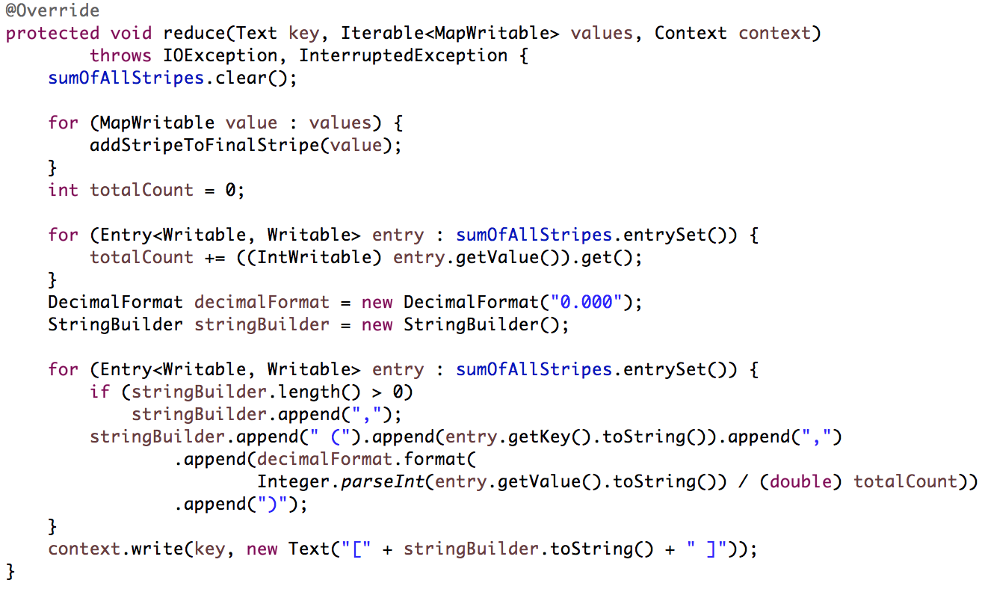
Java code – STRIPE approach Reducer 1

Slide 11
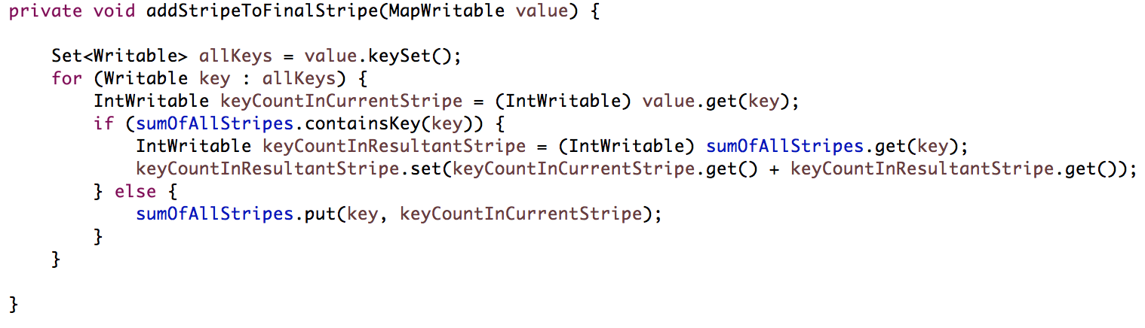
Java code – STRIPE approach Reducer 2

Slide 12
Result – STRIPE approach
12 [ (34,0.364), (56,0.182), (79,0.091), (29,0.182), (18,0.091), (92,0.091) ]
29 [ (12,0.308), (34,0.308), (56,0.154), (79,0.077), (18,0.077), (92,0.077) ]
34 [ (56,0.250), (12,0.250), (79,0.083), (29,0.250), (18,0.083), (92,0.083) ]
56 [ (12,0.300), (34,0.300), (29,0.200), (18,0.100), (92,0.100) ]
79 [ (56,0.200), (12,0.200), (34,0.200), (29,0.200), (18,0.200) ]
92 [ (34,0.250), (12,0.250), (56,0.083), (79,0.083), (29,0.250), (18,0.083) ]

Slide 13
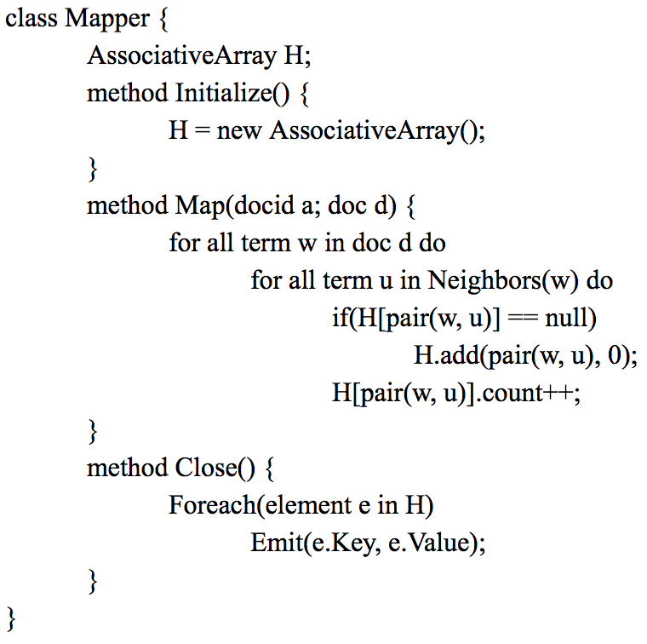
Pseudo code – HYBRID approach Mapper

Slide 14
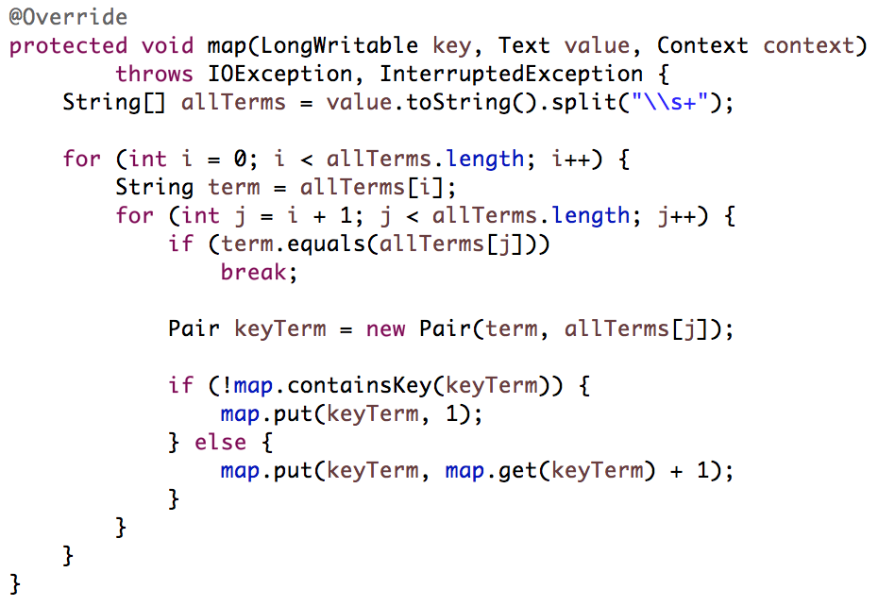
Java code – HYBRID approach Mapper

Slide 15
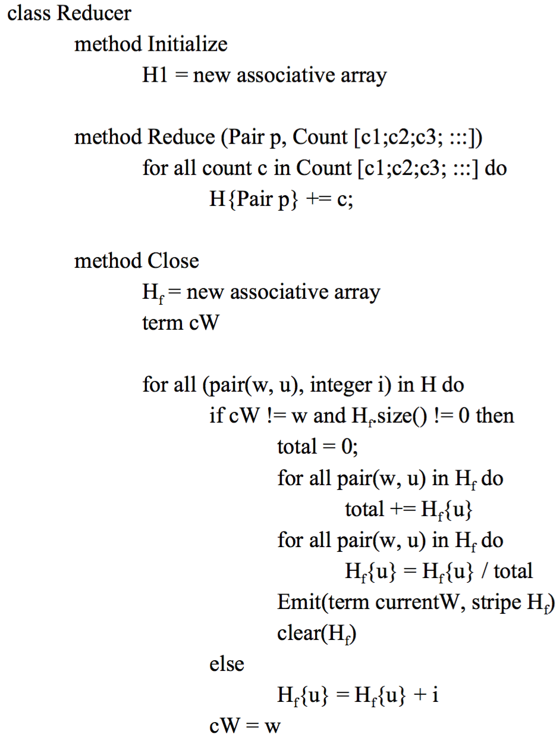
Pseudo code – HYBRID approach Reducer

Slide 16
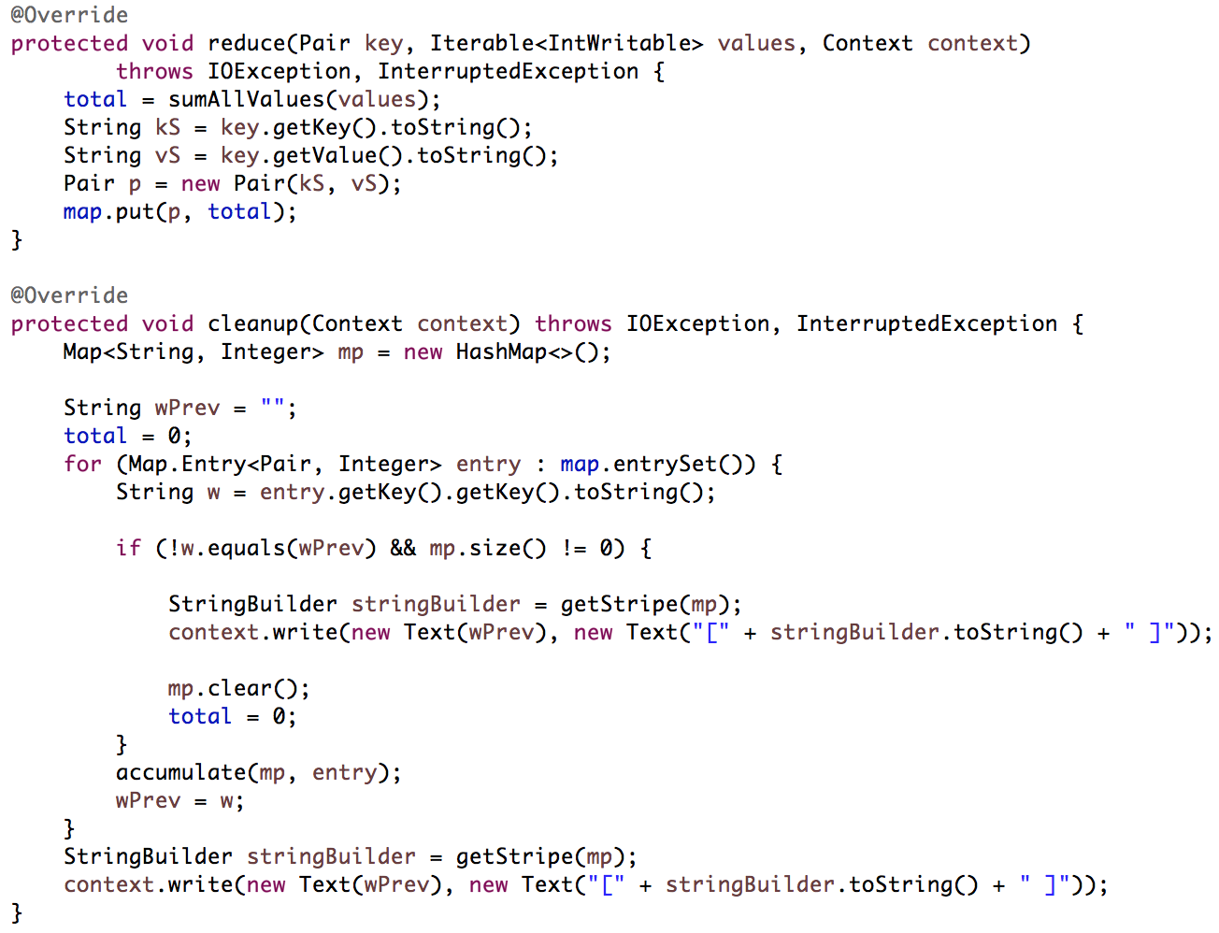
Java code – HYBRID approach Reducer 1

Slide 17
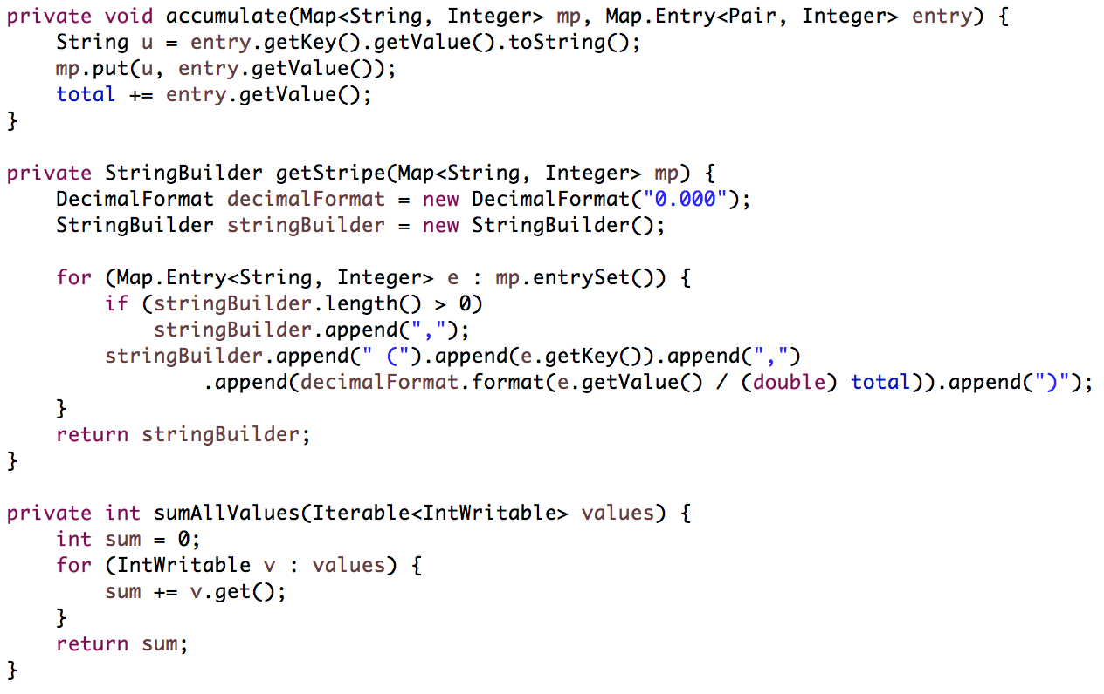
Java code – STRIPE approach Reducer 2

Slide 18
Result – HYBRID approach
12 [ (34,0.364), (56,0.182), (79,0.091), (18,0.091), (29,0.182), (92,0.091) ]
29 [ (12,0.308), (34,0.308), (56,0.154), (79,0.077), (18,0.077), (92,0.077) ]
34 [ (12,0.250), (56,0.250), (79,0.083), (18,0.083), (29,0.250), (92,0.083) ]
56 [ (12,0.300), (34,0.300), (18,0.100), (29,0.200), (92,0.100) ]
79 [ (12,0.200), (34,0.200), (56,0.200), (18,0.200), (29,0.200) ]
92 [ (12,0.250), (34,0.250), (56,0.083), (79,0.083), (18,0.083), (29,0.250) ]

Slide 19
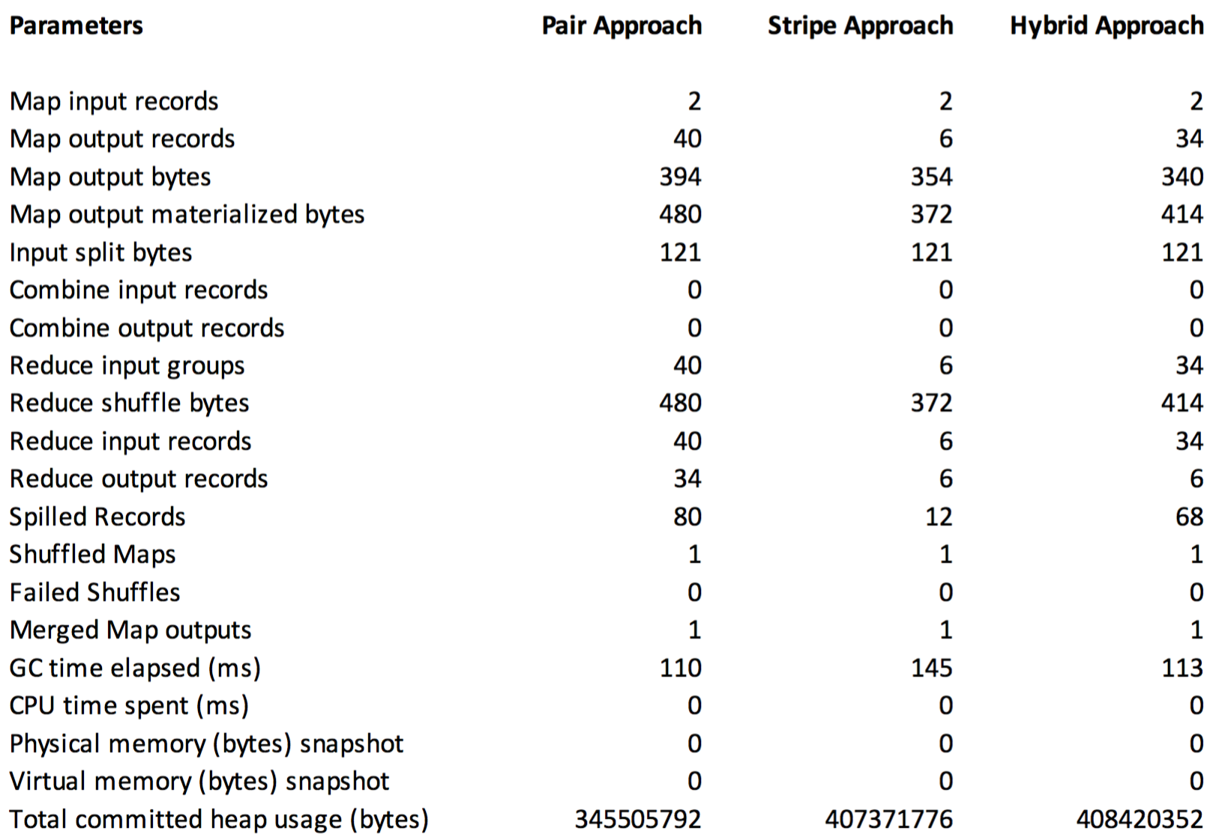
Comparison

