Slide 1
BIG DATA
Project Presentation on Crystal Ball Event Prediction
Sachin Kushwaha (984681)
Sujan Thapa (984477)

Slide 2
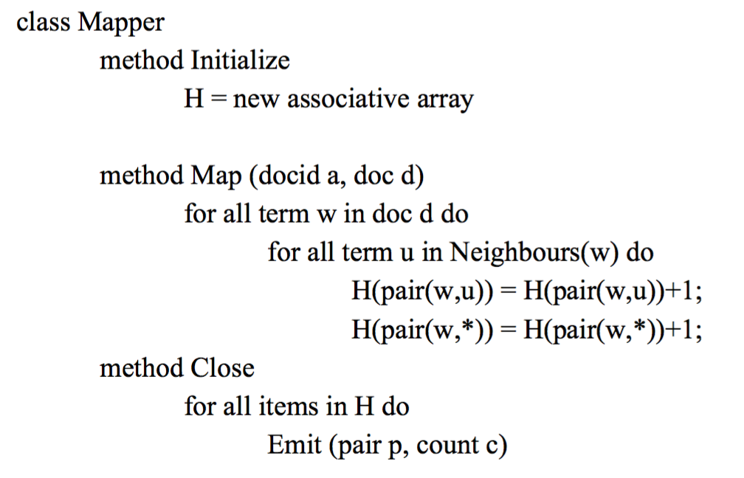
Pseudo code - PAIR approach Mapper

Slide 3
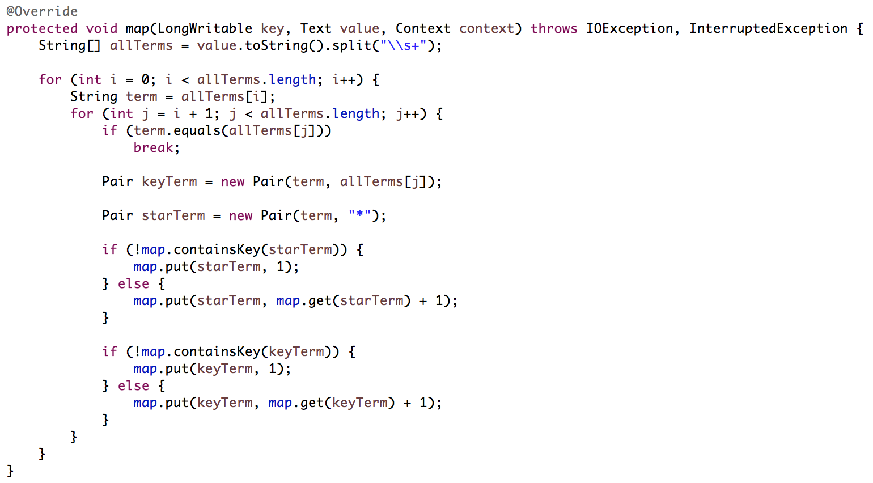
Java code - PAIR approach Mapper

Slide 4
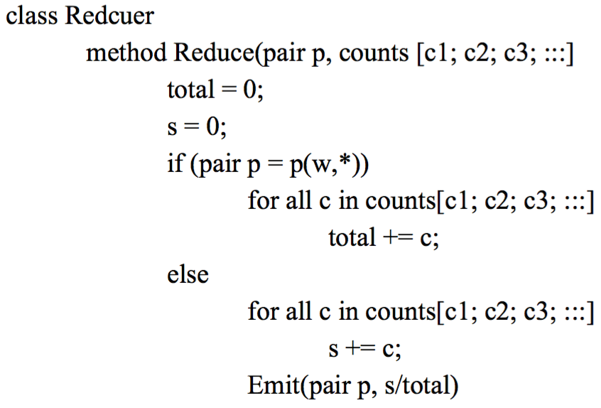
Pseudo code - PAIR approach Reducer

Slide 5
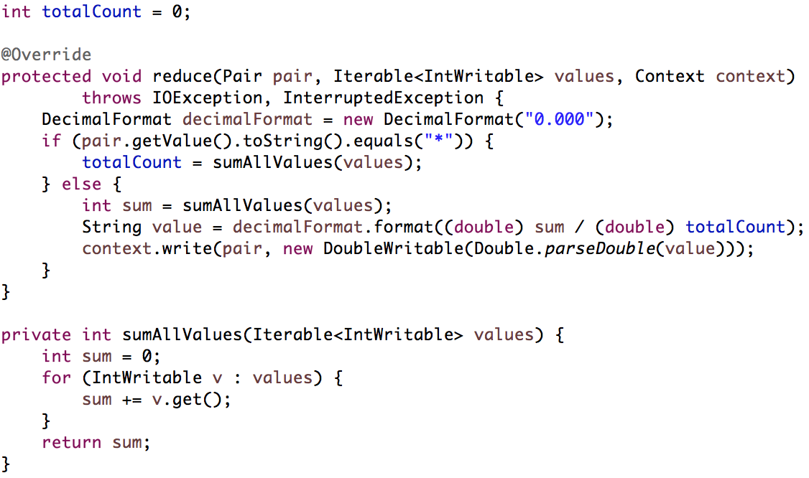
Java code - PAIR approach Reducer

Slide 6
Input
34 56 29 12 34 56 92 29 34 12
92 29 12 34 79 29 56 12 34 18

Slide 7
Result - PAIR approach
(12, 18) 0.091
(12, 29) 0.182
(12, 34) 0.364
(12, 56) 0.182
(12, 79) 0.091
(12, 92) 0.091
(29, 12) 0.308
(29, 18) 0.077
(29, 34) 0.308
(29, 56) 0.154
(29, 79) 0.077
(29, 92) 0.077
(34, 12) 0.25
(34, 18) 0.083
(34, 29) 0.25
(34, 56) 0.25
(34, 79) 0.083
(34, 92) 0.083
(56, 12) 0.3
(56, 18) 0.1
(56, 29) 0.2
(56, 34) 0.3
(56, 92) 0.1
(79, 12) 0.2
(79, 18) 0.2
(79, 29) 0.2
(79, 34) 0.2
(79, 56) 0.2
(92, 12) 0.25
(92, 18) 0.083
(92, 29) 0.25
(92, 34) 0.25
(92, 56) 0.083
(92, 79) 0.083

Slide 8
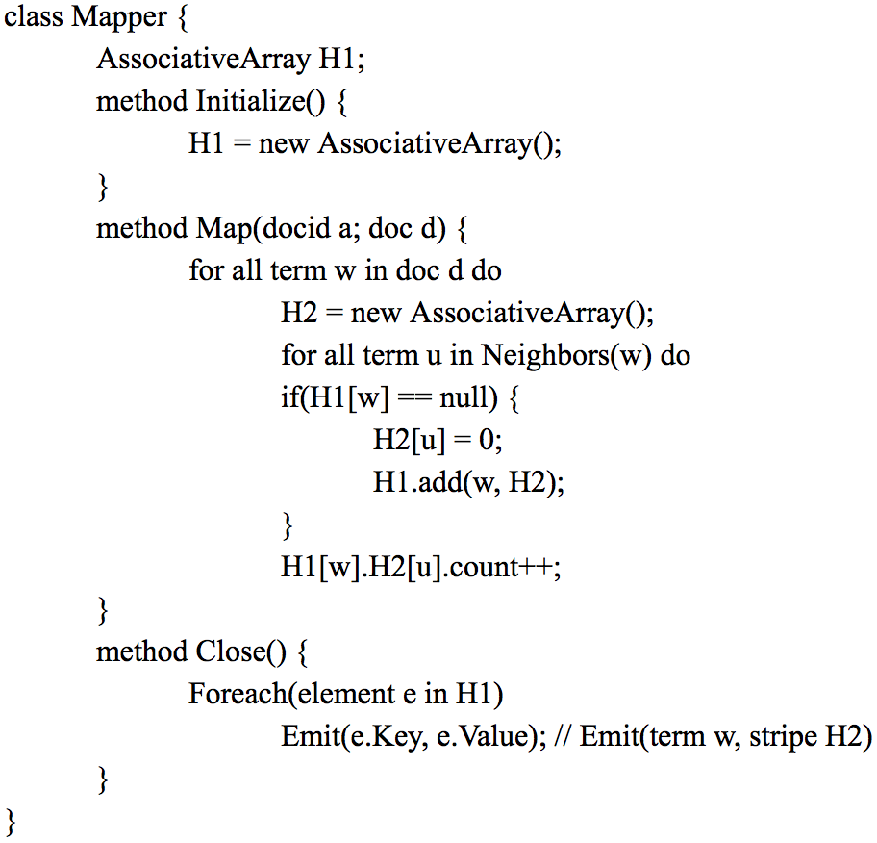
Pseudo code – STRIPE approach Mapper

Slide 9
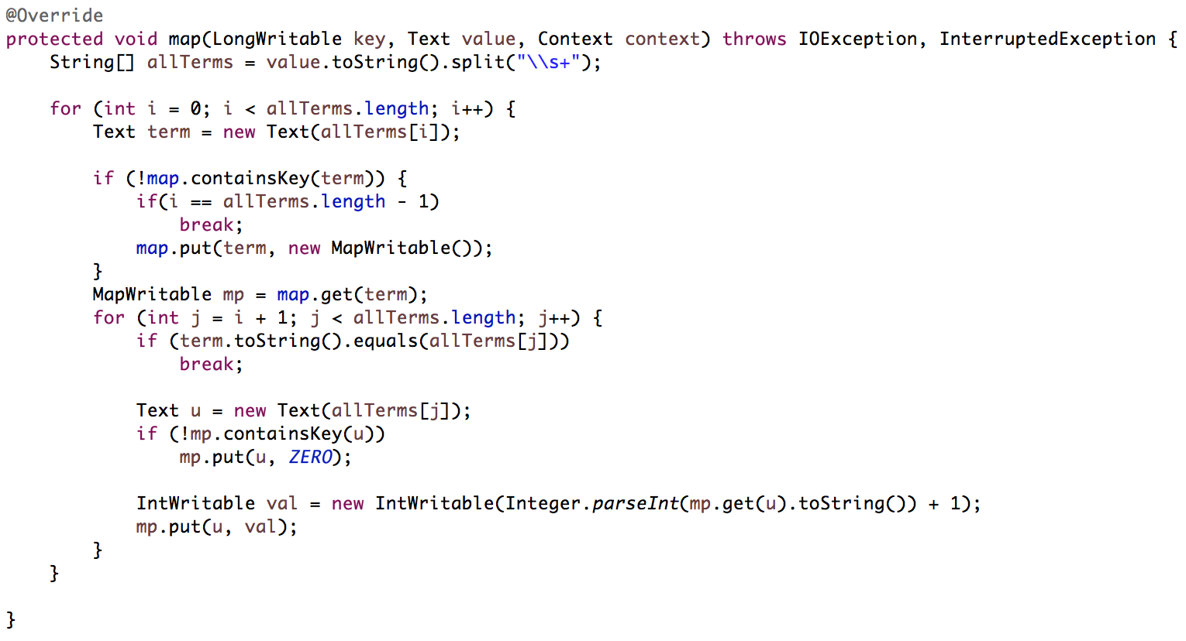
Java code – STRIPE approach Mapper

Slide 10
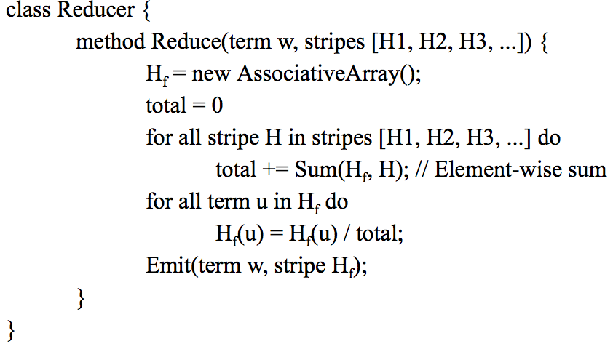
Pseudo code – STRIPE approach Reducer

Slide 11
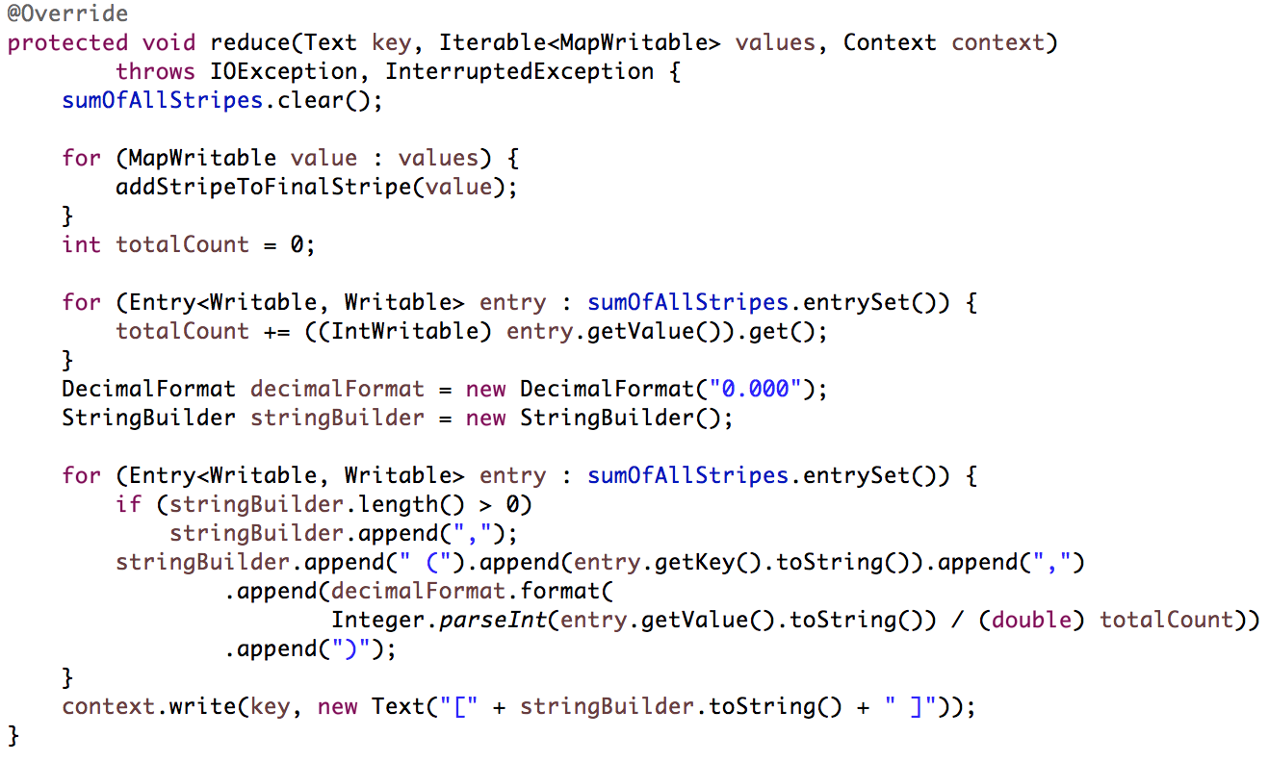
Java code – STRIPE approach Reducer 1

Slide 12
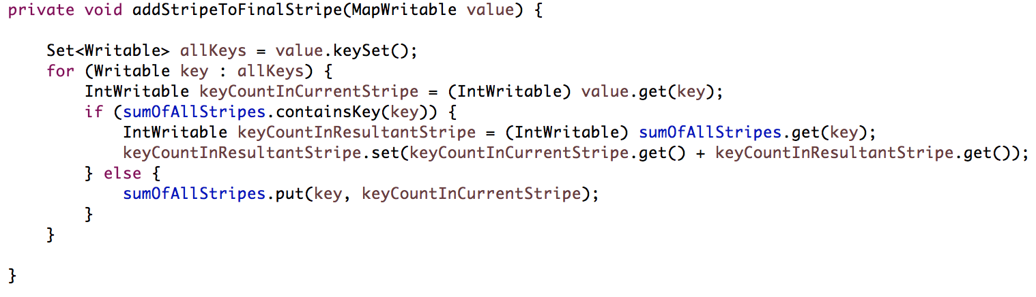
Java code – STRIPE approach Reducer 2

Slide 13
Result – STRIPE approach
12 [ (34,0.364), (56,0.182), (79,0.091), (29,0.182), (18,0.091), (92,0.091) ]
29 [ (12,0.308), (34,0.308), (56,0.154), (79,0.077), (18,0.077), (92,0.077) ]
34 [ (56,0.250), (12,0.250), (79,0.083), (29,0.250), (18,0.083), (92,0.083) ]
56 [ (12,0.300), (34,0.300), (29,0.200), (18,0.100), (92,0.100) ]
79 [ (56,0.200), (12,0.200), (34,0.200), (29,0.200), (18,0.200) ]
92 [ (34,0.250), (12,0.250), (56,0.083), (79,0.083), (29,0.250), (18,0.083) ]

Slide 14
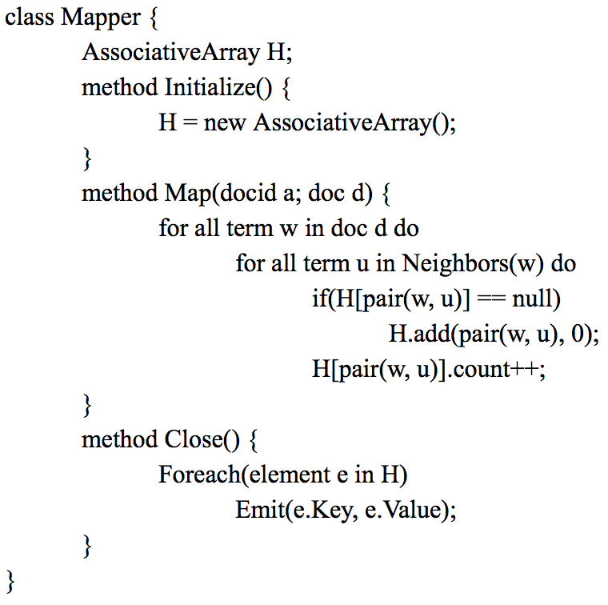
Pseudo code – HYBRID approach Mapper

Slide 15
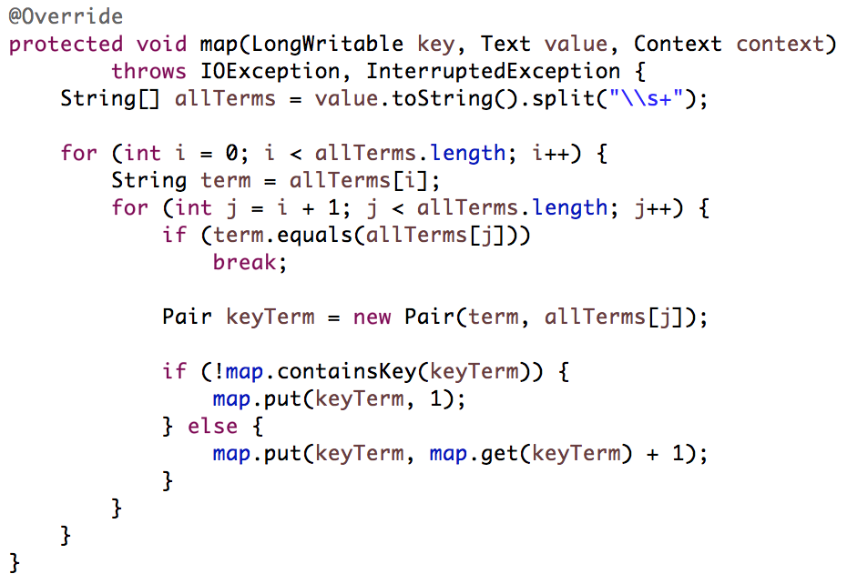
Java code – HYBRID approach Mapper

Slide 16
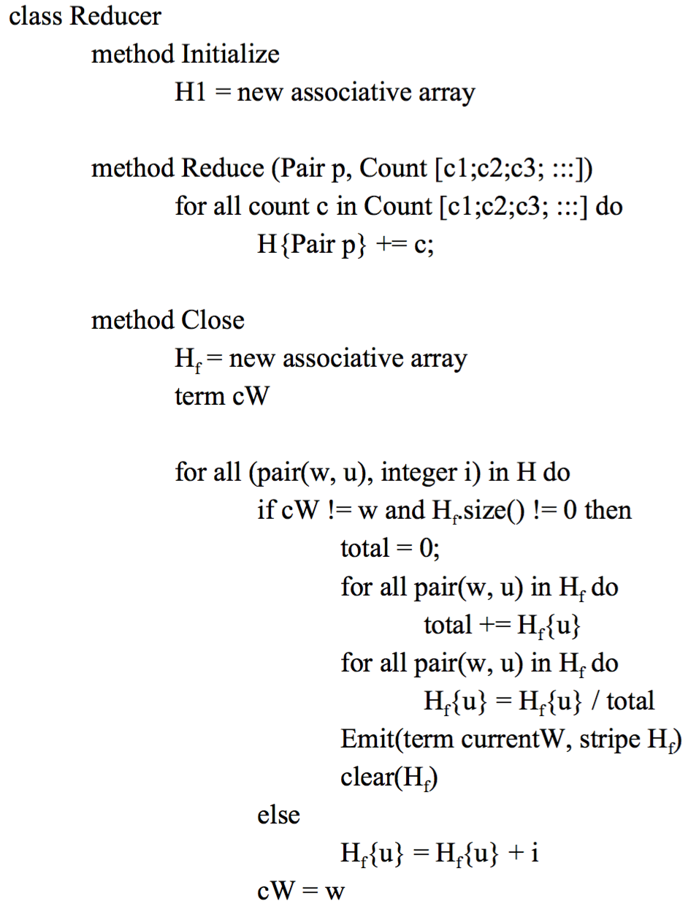
Pseudo code – HYBRID approach Reducer

Slide 17
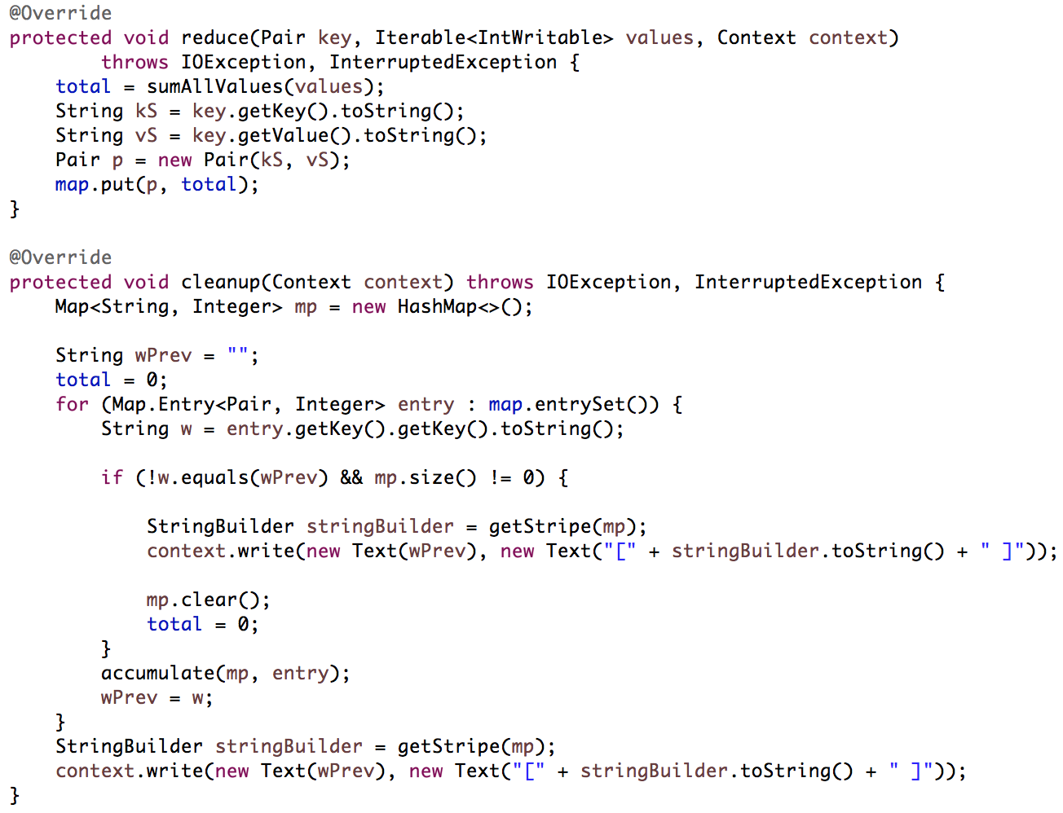
Java code – HYBRID approach Reducer 1

Slide 18
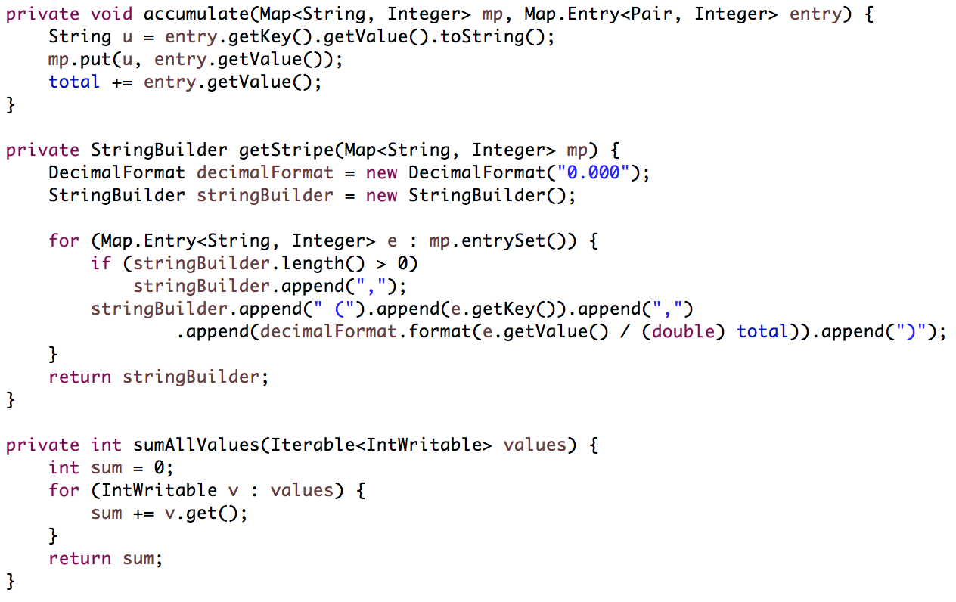
Java code – STRIPE approach Reducer 2

Slide 19
Result – HYBRID approach
12 [ (34,0.364), (56,0.182), (79,0.091), (18,0.091), (29,0.182), (92,0.091) ]
29 [ (12,0.308), (34,0.308), (56,0.154), (79,0.077), (18,0.077), (92,0.077) ]
34 [ (12,0.250), (56,0.250), (79,0.083), (18,0.083), (29,0.250), (92,0.083) ]
56 [ (12,0.300), (34,0.300), (18,0.100), (29,0.200), (92,0.100) ]
79 [ (12,0.200), (34,0.200), (56,0.200), (18,0.200), (29,0.200) ]
92 [ (12,0.250), (34,0.250), (56,0.083), (79,0.083), (18,0.083), (29,0.250) ]

Slide 20
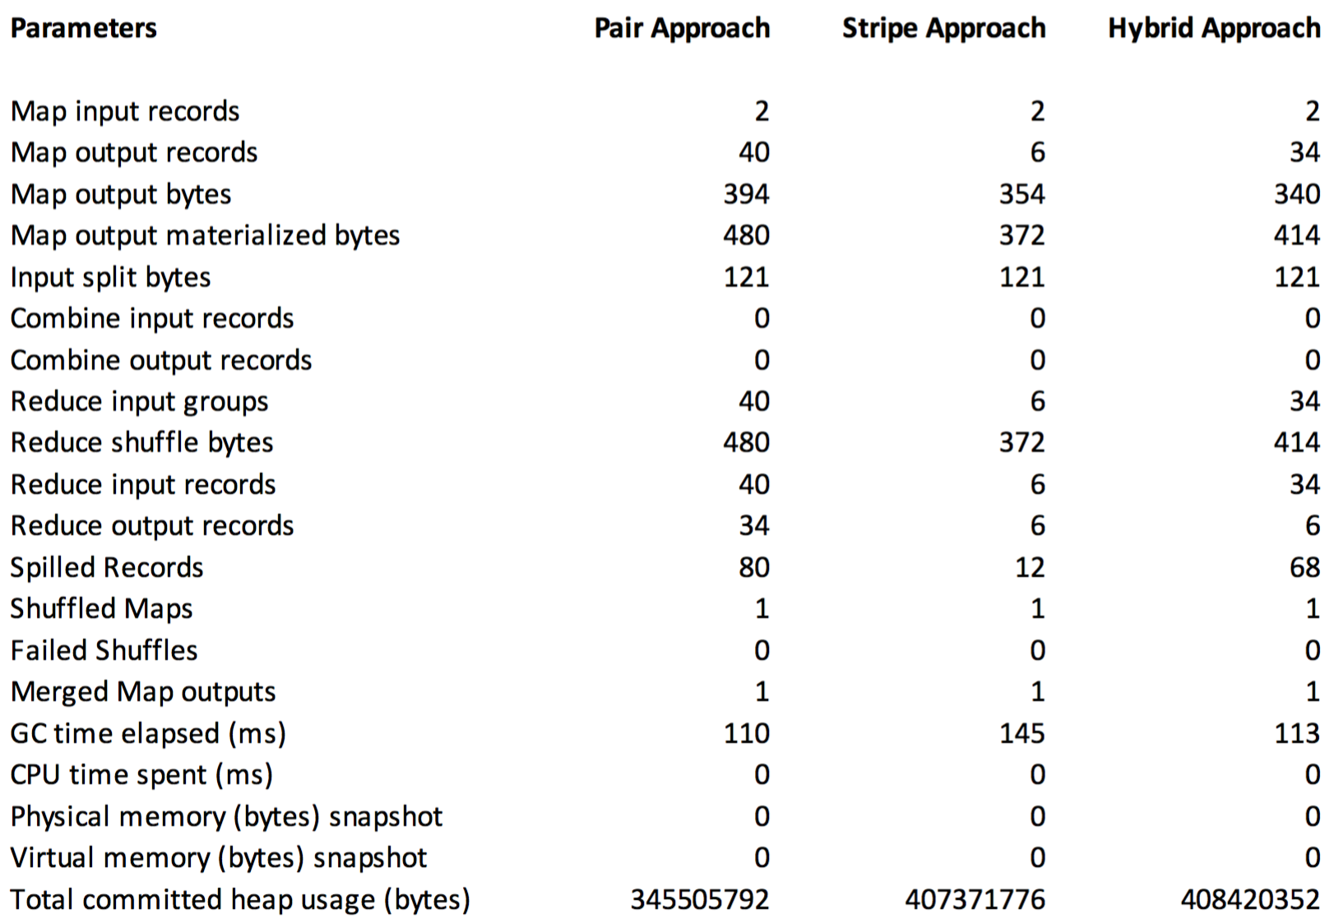
Comparison

