Slide 1
SuSE Studio ve SuSE Appliance Toolkit ile JeOS
R. Tolga Korkunçkaya
Novell Türkiye
tkorkunckaya@novell.com
2 Nisan 2010
Özgür Yazılım ve Linux Günleri
Bilgi Üniversitesi, İstanbul
Notes:
The purpose of today's call is to establish a dialogue with the partner teams and ensure that everyone is aware of how the PartnerNet program is being focused to better support our partners in achieving our business goals in FY2010 and beyond. Over the last couple of months you've begun seeing communications on this, and want to now start delving into the details and understanding the immediate impact on us and our partners.
I'm joined today by Scott Lewis, Vice President of Partner Marketing, Programs and Enablement who is prepared to walk us through the details of the changes. Scott and his team have spent countless hours researching industry best practices, building and refining the model to ensure we'll have an architecture and engine to support a thriving partner ecosystem.
The work we'll be reviewing today is the culmination of the work that began last July as part of the Partner transformation initiative. The first major component was the introduction of the programs that were introduced in February (like deal registration, the volume incentive rebate, on demand training, etc).
Now that we have a strong business proposition in place and six months of momentum in the marketplace with our partners, this next phase builds upon that foundation and allow us to better recognize and reward partners for the value they offer to fuel our growth.
NEXT SLIDE

Slide 2




Slide 3
Ajanda
SuSE Linux
SuSE Studio
SuSE Appliance Toolkit
SuSE LifeCycle Management Server
WebYast
Notes:
Let's review the agenda.
We'll briefly review our strategy and I'll share with you some indicators that point to the momentum we've gained to date.
Then Scott will jump right into the heart of the PartnerNet program, covering:
The Value-based approach which includes a simplified specialization model, performance values and entry values.
He will talk about the fees and benefits structures, and
Our plans for integrating PlateSpin partners into the Novell ecosystem
That will wrap up the presentation, then I'll review Next Steps, Key Dates to keep in mind before opening it up for questions.

Slide 4
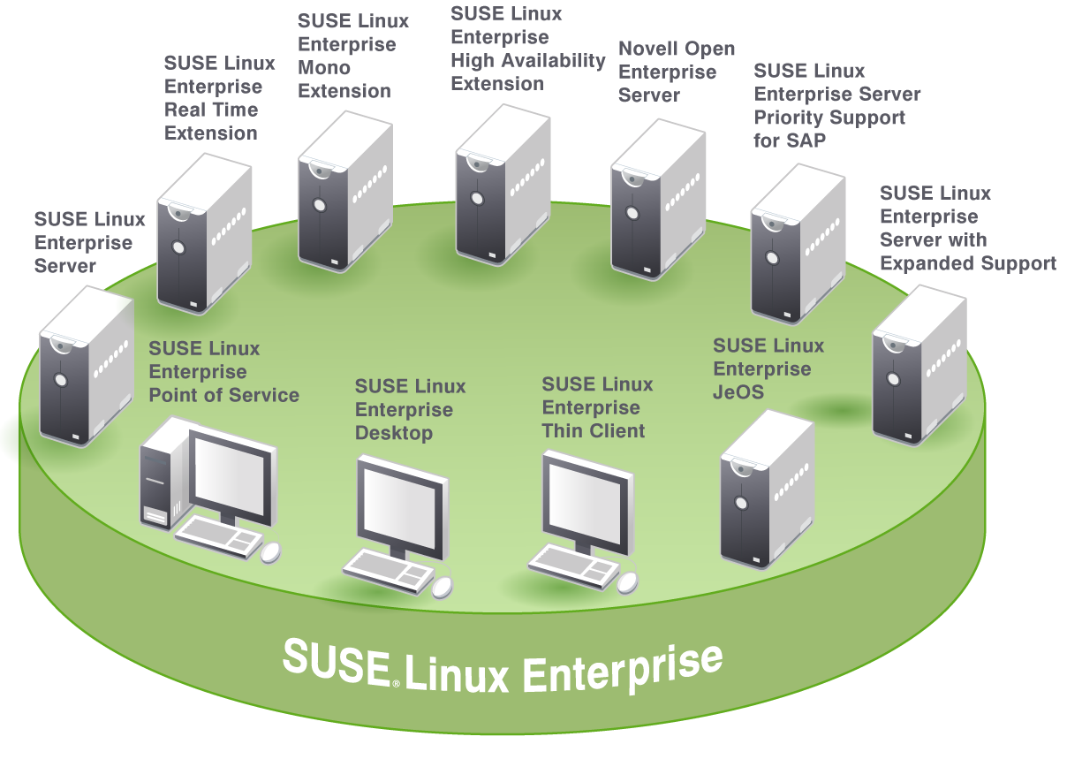
SUSE® Linux Enterprise
The most interoperable platform for mission-critical computing from desktop to data center – physical and virtual
Notes:
SUSE Linux Enterprise is the most interoperable platform for mission-critical computing – from the desktop to the data center. It delivers products that meet a wide range of your computing needs.
Our flagship server product, SUSE Linux Enterprise Server, provides reliability and high performance for workloads ranging from network infrastructure to enterprise databases and applications. It’s complemented by several value-added product extensions – for real time computing, high availability clustering, running .NET applications on Linux, and increasing the performance of virtual machine guests. And we offer specialized support offerings for SAP applications on Linux, and for customers migrating from other Linux distributions to SUSE Linux Enterprise Server. For the retail industry, we deliver a point of service offering tailored to the specific needs of the store environment.
Our flagship desktop offering, SUSE Linux Enterprise Desktop, is the market’s only enterprise-quality Linux desktop. It includes OpenOffice.org Novell Edition, the leading open source office productivity suite. SUSE Linux Enterprise Desktop and OpenOffice.org provide seamless interoperability with your existing technologies and a tremendous opportunity to reduce your end user computing costs. It is complemented by our thin client offering, which partners such as Wyse and Dell bring to market.
We also provide a slimmed-down version of SUSE Linux Enterprise Server that is an appliance-ready operating system. We call this SUSE Linux Enterprise JeOS. (Note: JeOS is pronounced “juice”.)‏
These platform products share a common codebase and common management tools, making it easy to manage disparate systems and get more value out of your Linux investment.

Slide 5
SUSE® Linux Enterprise JeOS
Just Enough Operating System
Sadece gereken parçaları içeren, özellikle sanal ortamlar için ideal OS
En önemli avantajları
  En basit şekilde özelleştirilmiş bir OS oluşturma
  SUSE Linux Enterprise Server taban olarak kullanıldığında sertifikasyonların hepsi geçerli
  Farklı hipervizörler için “Mükemmel misafir” OS
  Dilediğin kadar optimize et
Oluşturduktan sonra yönetim araçları katkısı
Ürün yaşam döngüsü kontrolü
Notes:
The SUSE Appliance Program is Novell's initiative to make it faster and easier to build appliances on SUSE Linux Enterprise than any other platform. There are three main elements to the program: Technology, Program Elements, and Partnerships.
First, the technology. We have SUSE Linux Enterprise and the Just Enough Operating System (JeOS – pronounced “juice”), which provide the foundation for appliances. In SUSE Linux Enterprise 11, we have taken steps to make the OS far more appliance-friendly by creating a more granular package structure.
Beyond SUSE Linux Enterprise, we have also created a series of tools to make it fast and easy to build and manage appliances. SUSE Studio is our GUI, web-based tool for building, testing and configuring appliances. Kiwi is our command line tool, designed for use with existing build systems. And the SUSE Appliance Update Server is our management tool, enabling customers to update existing appliances with patches and upgrades for middleware and the operating system.
Second, we offer program elements. Novell offers specific appliance pricing and support to software vendors, providing the specialized care that they need. We also offer software vendors free redistribution of software appliances built on SUSE Linux Enterprise.
Finally, we have partnerships to bring appliances to market. For example, we work closely with VMware on SUSE Linux Enterprise appliances that run on VMware.
What does this all mean to you, the customer? First, you can benefit from turnkey virtual appliances from your favorite software vendors – allowing you to simplify deployment and ongoing management, and save money in the process. And you can be confident that as the appliance market matures, Novell will be there leading the way, with technology, program elements and partners. It’s just one more way that the ubiquity of SUSE Linux Enterprise gives you the greatest flexibility and most choices.

Slide 6
SUSE Studio

Slide 7
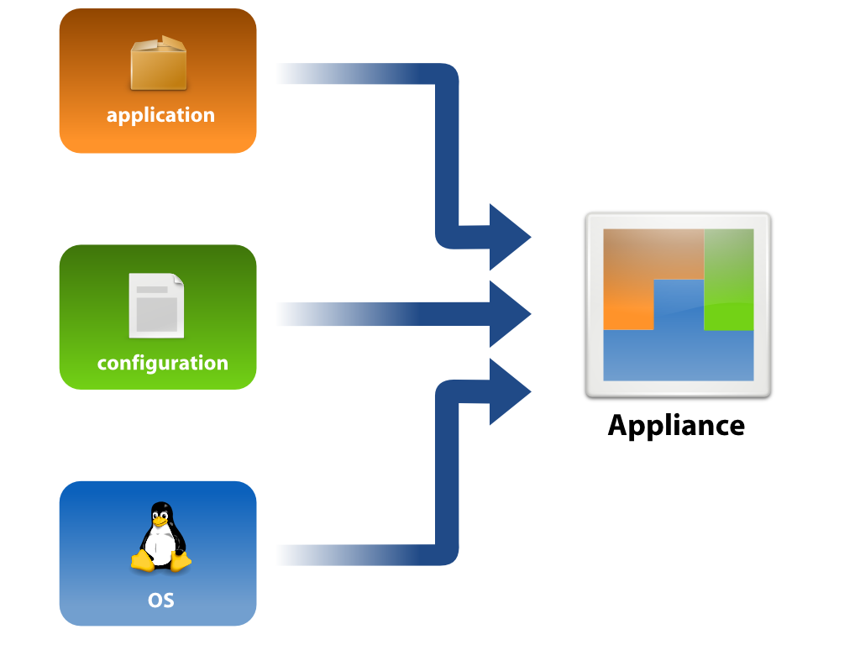
SuSE Studio

Slide 8


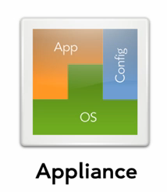





SuSE Studio
USB stick / hard disk image
Live CD/DVD (.iso)
OVF
Kiwi Conf. Paket
Notes:
Support for creating images in OVF (Open Virtualization Format, an open standard for packaging and distributing virtual appliances), Microsoft's Hyper-V, and Amazon's EC2 AMI format (including deployment to EC2) is planned.
A proposal for OVF, then named "Open Virtual Machine Format", had been submitted to the Distributed Management Task Force (DMTF) in September, 2007, by Dell, HP, IBM, Microsoft, VMware and XenSource[1].

Slide 9

SuSE Studio Online Gezintisi
* Ekran görüntüleri sunum ile birlikte ayrıca paketlenmiştir. Lütfen oradan devam ediniz...

Slide 10
SUSE Appliance Toolkit
Notes:
First: let's start with the value of appliances

Slide 11
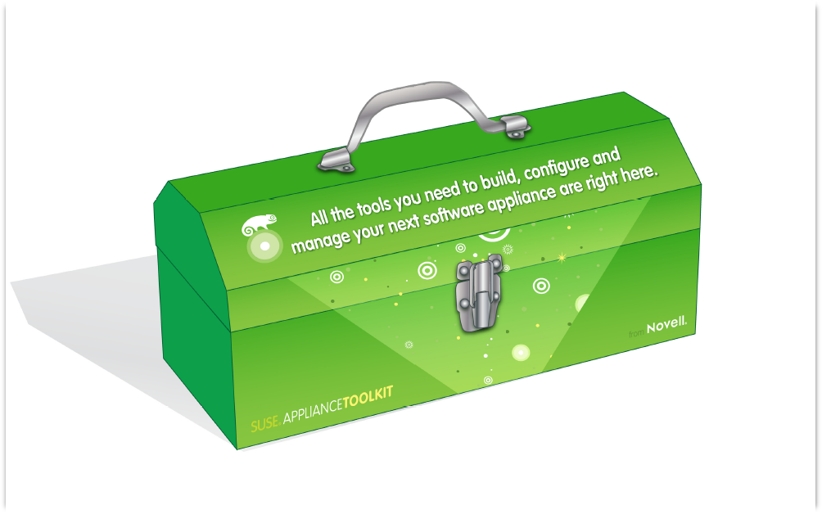
SUSE Appliance Toolkit
+ OS özelleştirme
+ Kurulum basitleştirme
+ Bakım kolaylaştırma
* Build
Manage
Maintain
SUSE Appliance Toolkit içerisinde yer alan araç-gereç bir uygulama bütününü oluşturma, özellştirme, yönetme, test etme, ürün yaşam döngüsünü kontrol etme, izleme, güncelleme ve hatta müşteriye satış noktasında tüm ihtiyacı karşılayacak şekilde düşünülmüştür.
* Yap, işlet, devret

Slide 12



SuSE Appliance Toolkit
SUSE Appliance Toolkit
SUSE Studio Onsite
WebYaST
SUSE Lifecycle Management Server
SuSE Linux Enterprise Server
SuSE Linux Enterprise JeOS
SuSE Linux Enterprise Server for Amazon* EC

Slide 13
SuSE Studio Onsite
SUSE Studio'nun ayrı bir sunucu üzerinde (size özel) koşan halidir.
VT desteği olan bir fiziksel sunucu üzerinde koşmalı ki oluşturduğumuz ürünleri test etme şansımız olabilsin.
Tavsiye edilen minimum 8GB bellek ve 100GB veri deposu
Ayrı yönetici hakları ve kullanıcı yönetimi arayüzü
  Nagios and Munin
  Web UI port 80
  Davetiye ile yeni kullanıcı kaydı

Slide 14
SUSE Lifecycle Management Server

Slide 15
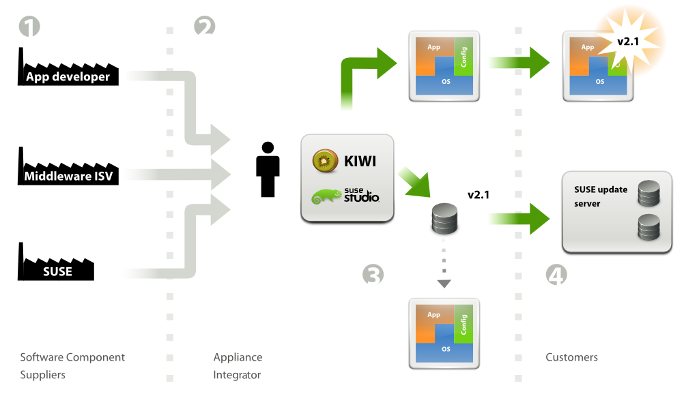
Güncelleme İşlemi

Slide 16
SUSE Lifecycle Management Server
İşletim sistemi güncellemeleri ile yazılım güncellemelerinizi birlikte uç noktadaki müşterinize iletebileceğiniz tam otomatik bir alt yapıdır.
Müşterilerinizin güncellemeleri alımını kontrol edebilir, farklı süreler belirleyebilirsiniz. (subscription)
Novell güncellemelerini müşteriniz uygulamadan önce müşterinizin şartlarının aynısında kendiniz test etme şansına sahip olursunuz.
CRM sisteminiz için API mevcuttur.
Kayıt sistemi mevcuttur. (Registration)

Slide 17
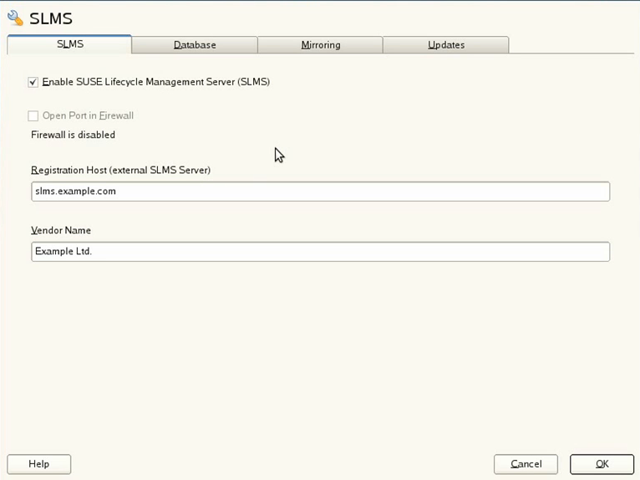
SLMS YaST Modül: Ayarlar

Slide 18
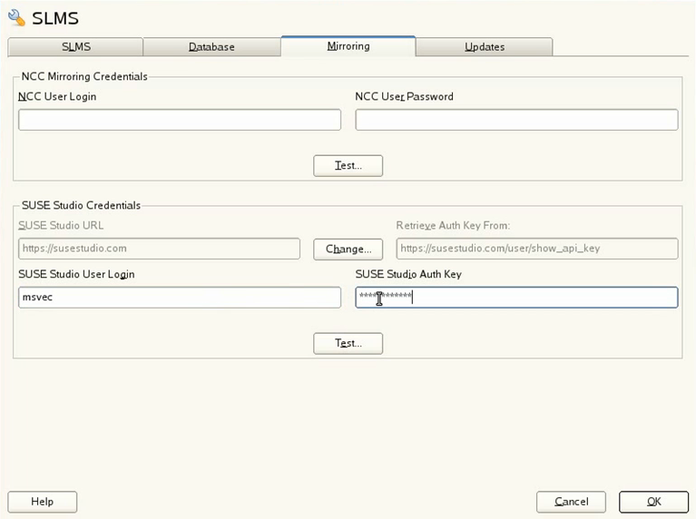
SLMS YaST Modül: Ayarlar

Slide 19
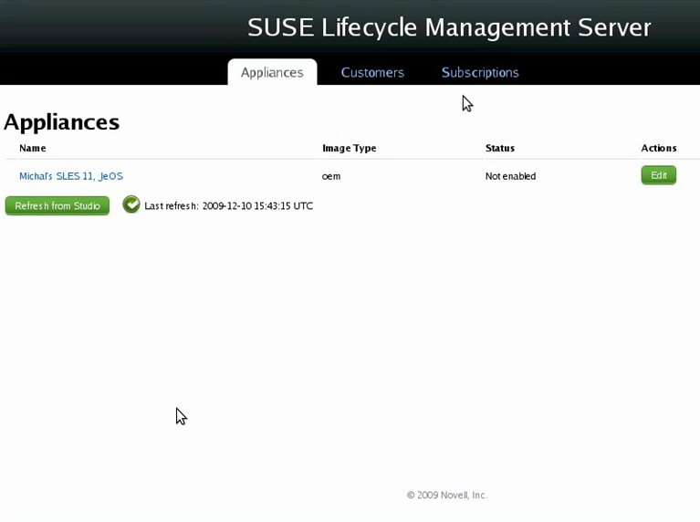
SLMS WebUI

Slide 20
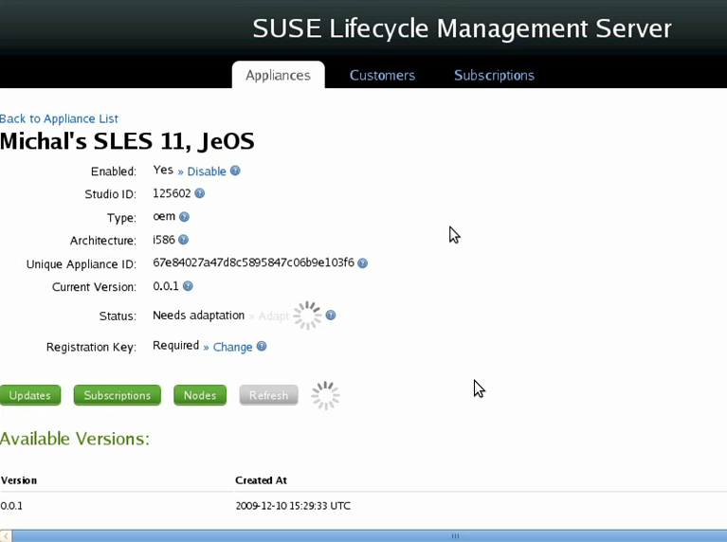
SLMS WebUI

Slide 21
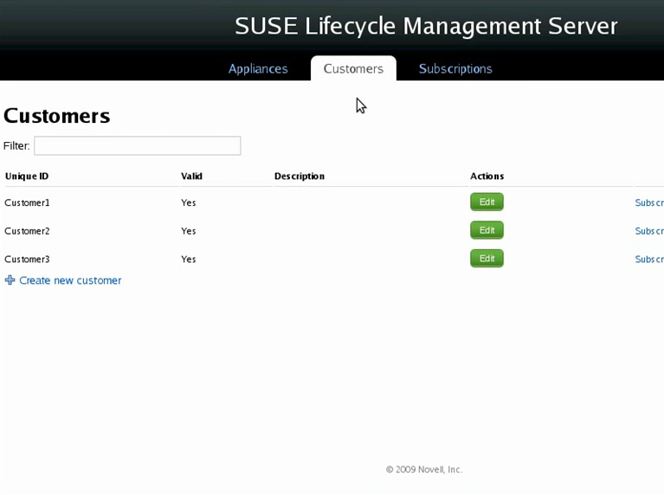
SLMS WebUI

Slide 22
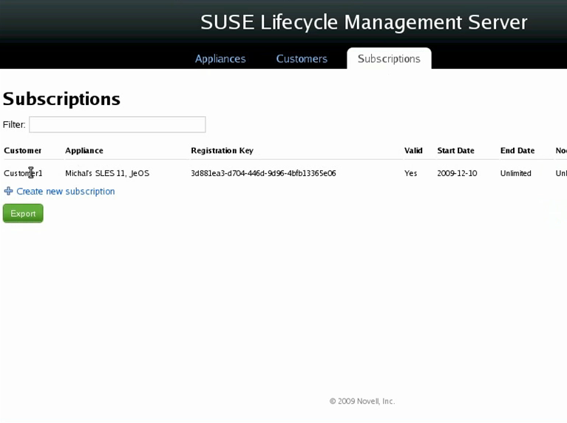
SLMS WebUI

Slide 23
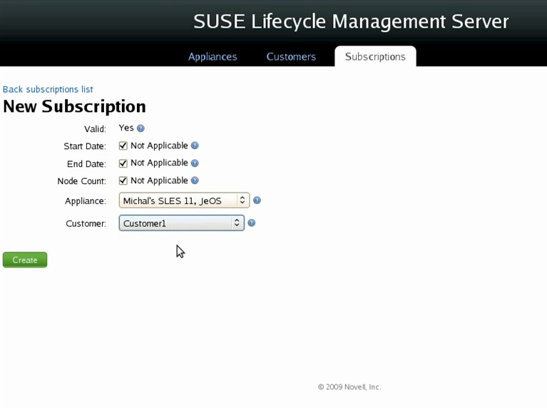
SLMS WebUI

Slide 24
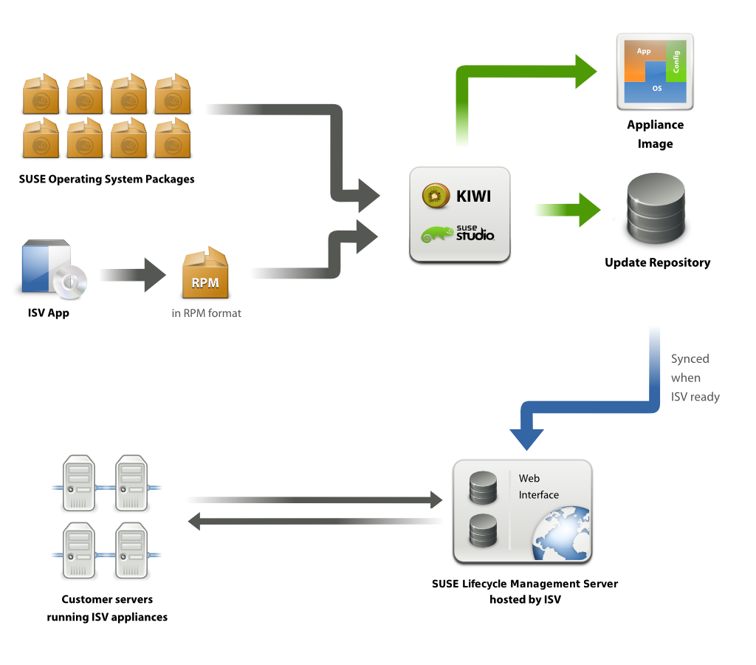
Güncelleme Akış Şeması

Slide 25
WebYaST

Slide 26

WebYaST
WebYaST web tabanlı HTTP REST ucuna bağlanan kontrol arayüzüdür.
YaST ayarlama modüllerinin bir kısmını kapsar.
“Kara Kutu” tabir ettiğimiz appliance yönetimi içindir.
Temel Amacı: Bootstrap yaparak kutuyu ayağa kaldırmaktır.
Açık Kaynak Lisanslıdır.
Kullanıcı dostu bir arabirim (UI), sunar ve firmanıza veya müşteriye özgün şekilde yeniden tasarlanabilir.
    Theme desteği mevcuttur.
Notes:
SMT is integrated with Novell Customer Center and provides a repository identical to Novell Update.novell.com, as well as a registration target syncing with NCC upstream (to facilitate entitlement tallying by customer and Novell) This is very helpful in tracking entitlements in large deployments by the customer and by Novell.
The SMT maintains all the capabilities of Novell Customer Center, while allowing a more secure centralized deployment. It is included with every SUSE Linux Enterprise subscription and is therefore fully supported.
The more the SMT is the key infrastructure piece to enable the SUSE Linux Enterprise with Expanded Support offering (RHEL replacement).

Slide 27
WebYaST Modülleri
Temel ayarlar sihirbazı
Tarih/Zaman, Zaman dilimi, NTP
Sistem durumu, kapat, yeniden başlat
Sistem durumu izleme
Güncelleme
Ağ ayarları
Lisanslama/EULA ve Kayıt
Kullanıcılar
Servis durdur/başlat/durum
Log/Grafikler

Slide 28
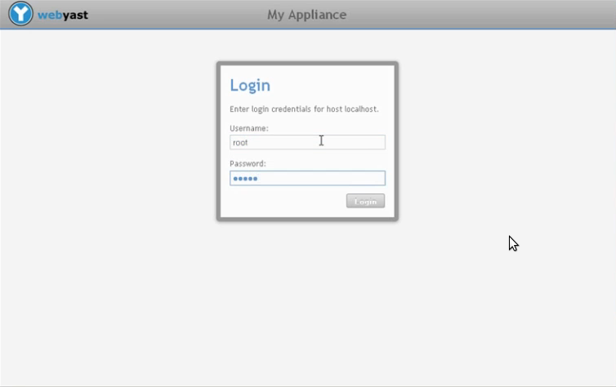
WebYaST ile Sistem Önyükleme

Slide 29
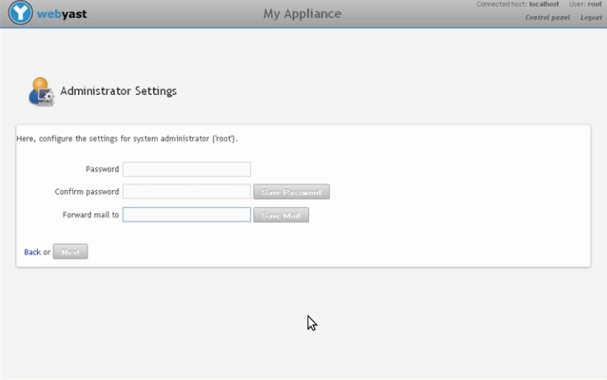
WebYaST ile Sistem İlklendirme

Slide 30
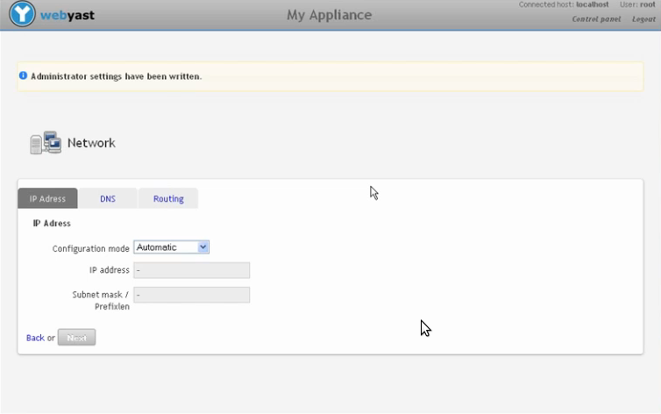
WebYaST ile Sistem İlklendirme

Slide 31
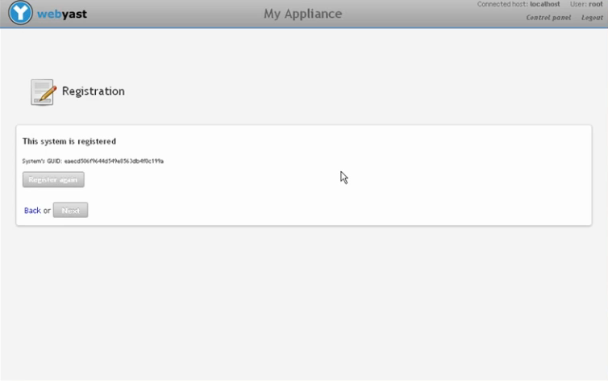
WebYaST ile Sistem İlklendirme

Slide 32
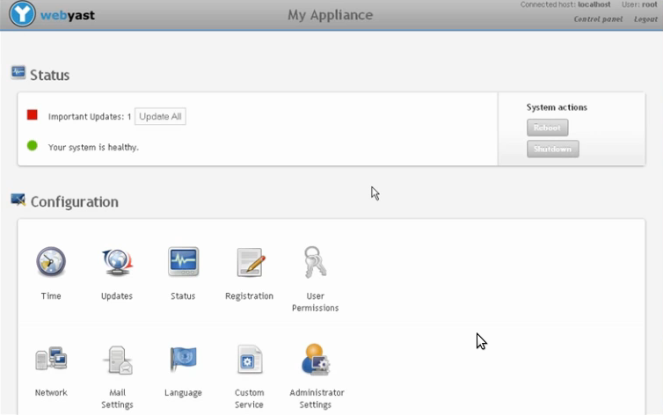
WebYaST ile Sistem Ayarları

Slide 33
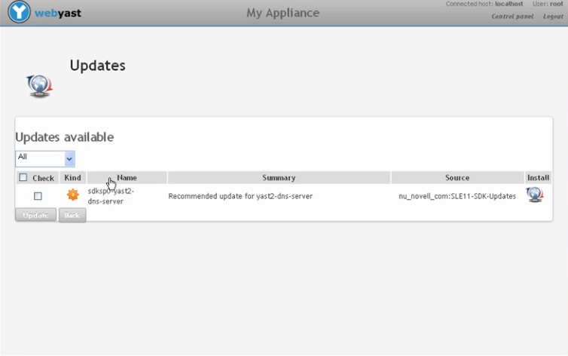
WebYaST ile Sistem Güncelleme

Slide 34
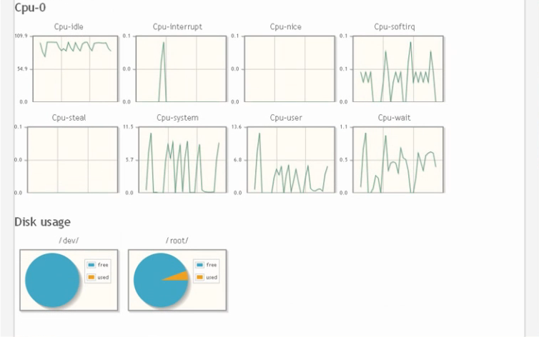
WebYaST ile Sistem İzleme

Slide 35
WebYaST Modül Geliştirme
REST plugin iskeletini kullanarak kolaylıkla yeni plugin geliştirme başlangıcı
Gereksinim: yast2-devtools >= 2.18.6
Gereksinim: Ruby ile yazılım geliştirme bilgisi
Adımlar:
1. zypper install yast2-devtools
2. Git deposundan WebYaST kaynağı alınır,
3. y2tool create-new-package rest-plugin <plugin_name> <author> <email>

Slide 36
Emeği geçen tüm gönüllülere ve İstanbul Bilgi Üniversitesine
teşekkürler...

Slide 37
Bizimle çalışmak ister misiniz?
info-tr@novell.com adresine özgeçmişinizi gönderebilirsiniz...

Slide 39
Unpublished Work of Novell, Inc. All Rights Reserved.
This work is an unpublished work and contains confidential, proprietary, and trade secret information of Novell, Inc. Access to this work is restricted to Novell employees who have a need to know to perform tasks within the scope of their assignments. No part of this work may be practiced, performed, copied, distributed, revised, modified, translated, abridged, condensed, expanded, collected, or adapted without the prior written consent of Novell, Inc. Any use or exploitation of this work without authorization could subject the perpetrator to criminal and civil liability.
General Disclaimer
This document is not to be construed as a promise by any participating company to develop, deliver, or market a product. It is not a commitment to deliver any material, code, or functionality, and should not be relied upon in making purchasing decisions. Novell, Inc. makes no representations or warranties with respect to the contents
of this document, and specifically disclaims any express or implied warranties of merchantability or fitness for any particular purpose. The development, release, and timing of features or functionality described for Novell products remains at the sole discretion of Novell. Further, Novell, Inc. reserves the right to revise this document and to make changes to its content, at any time, without obligation to notify any person or entity of such revisions or changes. All Novell marks referenced in this presentation are trademarks or registered trademarks of Novell, Inc. in the United States and other countries. All third-party trademarks are the property of their respective owners.

