Slide 1
WebSphere Application Server Community Edition
Berk Alev
WebSphere Ürün Yöneticisi

Slide 2
Ajanda
IBM ve Yazılım Grubu
Open Source
IBM ve Open Source
WebSphere Application Server CE
Özet
Sorular

Slide 3







IBM Ürün Ailesi
Tivoli
WebSphere
DB2
Lotus
Rational
IT Yapısının
Yönetimi
Entegrasyon
Bilgi Yönetimi
İletişim
Yazılım
Geliştirme

Slide 4

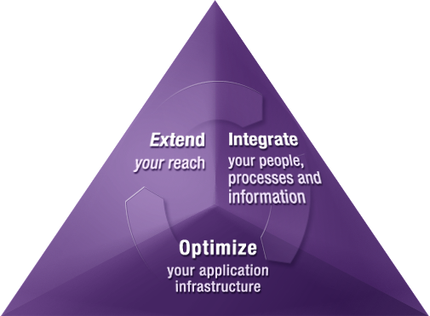
We make IT work for business
Uygulama Sunucusu
5.000.000 Hazır kod ile uygulamalarınızı daha güvenilir, hızlı ve ölçümlenebilir ortamlara taşıyın
Entegrasyon
Mevcut Uygulamalarınız arasında her türlü iletişim
Süreç Yönetimi
Modelle, Geliştir, Devreye Al, İzle
Notes:
Review high level….then on to DB2

Slide 5
Ajanda
IBM ve Yazılım Grubu
Open Source
IBM ve Open Source
WebSphere Application Server CE
Özet
Sorular

Slide 6
Open Standards
“Open” ve “Open standards” ne demek?
  Bu konu ile ilgili bir çok tanım var
  Mantıklı olanlardan bir tanesi:
    Bir çok üretici tarafından desteklenmesi
    Endüsrtiye özel olması
    Uzun vadeli öngörüsü olması
    Herkes (?) tarafından kabul edilmesi
Kurumlar için open standard
  Tercih – Bugün yapacağım tercih, ilerde yapacaklarımı etkilememeli.
  Esneklik – Farklı teknoloji tercihi yapmış iş ortaklarımla kendi teknolojilerimi entegre edebilirim.
  Hız – Yeni uygulamaları daha hızlı geliştirme
  Hız – Pazar değişkenlerine daha hızlı cevap verme
  Yetenek – Bunları yapabilecek insan kaynağı bulabilme
Notes:
Open Standards benefits customers by offering choice, flexibility, speed of building new solutions, and access to pools of skilled resources.
IBM cooperates on standards and competes on implementation.
Open Standards are key – whether implemented in open source or commercial (private source) software.
Everyone of course claims that their standards are “open” – included proprietary vendors using closed standards to lock customers in. So what are the requirements for “open” standards. We suggest there are 3 key characteristics:
Broad adoption and use – with implementations from multiple vendors
Published specifications, with a process to provide public input
A direction towards stewardship by an independent body – whether an official standards body or an open source community
From the customer perspective, open standards offer:
Vendor choice – both today and tomorrow avoiding vendor lock-in
Flexibility of integration with internal and external IT infrastructures which have made different technology decisions
The ability to build new solutions quickly that combine multiple components
And the ability to react to new business opportunities and threats quickly
Access to a wider pools of skilled resources

Slide 7






Open Standard’a bir kaç örnek
Programming Interfaces
  POSIX, LSB, Portland
Document Formats
  Open Document Format
Interoperability
  OSGi, Open Healthcare Framework
Web Services
  SOAP, WSDL
SOA Programming Model
  SCA/SDO
Systems Management
  SNIA
Notes:
Open standards serve multiple areas of need, have many different starting points, and are governed
by a variety of organizations
Programming interfaces are increasingly supporting open standards – often documenting de facto
standards and then promoting them to encourage consistency and application portability
Document formats are an areas which has been highly proprietary in the pats, but is now opening
up as users realize they need independence from any one vendor and should be able to access their
documents in the future
Interoperability has perhaps been one of the biggest successes of open standards, and is now extending
into application frameworks (OSGi) and vertical industry frameworks (Open Healthcare Framework)
Web Services are an area where competing IT vendors have cooperated on open standards to enable
interoperability for their common customers
Enabling interoperability further, an open standards SOA programming model (SCA/SDO) is being developed
And as a final example. Open standards have been defined for common systems management activities

Slide 8

Open Source nedir?
Lisanslama Yöntemi
  Kodlara erişim
  Kuruma göre uyarlama
  Kullanıcıların haklarına öncelik
Geliştirme Metodolojisi
  Yazılım Geliştirmede ortak Hareket
  Kişisel Gelişim
Kullanıcı, Geliştirici ve Sponsorlardan oluşan bir topluluk
  Katılım herkese açık
Notes:
Open Source is three main things – a way of developing software, a licensing approach which prioritises the rights of users, and a community with open participation.
The first component of Open Source is the approach to licensing the software. Open Source is not freeware, shareware or unlicensed – it’s just licensed in a different way to traditional commercial software. In formal terms, Open Source means that the license is one of about 60 licenses authorised by OSI - the Open Source Initiative (their logo is shown on the slide). Although there are many licenses, only a few, such as the GPL license used for Linux and the Apache license, are in broad use.
The next component of Open Source is a development methodology which uses a community approach to developing software, based around peer review. Since the code is openly published, everyone can see whether it is good or bad code – and offer feedback on how to improve it. This then promotes a meritocracy of developers – you get to be a key player by writing good code.
Finally, Open Source is all about open community – not just for developers, but for users and partners as well. Projects such as Linux, Apache and Eclipse offer a level playing field where anyone can participate, based on merit. These open communities are very different from vendor controlled communities like MySQL and JBoss where true open participation is prohibited.

Slide 9





Open Source Projelerine bir kaç örnek
Apache
  Web Server
  Community initiated (apache.org)
Linux
  Operating System kernel
  Individual initiated (Linus Torvalds)
Eclipse
  Universal Integration platform
  Extensible application framework supporting solution based plug-ins
  IT Vendor initiated
Mozilla
  Browser and client technology
  Hybrid (Netscape + community)
Notes:
Open Source projects come in all shapes and sizes and can have very different starting points – three examples are Apache, Linux and Eclipse.
Apache started as a community developing a web server, and has now grown to be the host of a wide variety of open source projects under the auspices of the Apache Software Foundation.
The Linux kernel started with an individual – Linus Torvalds – developing an operating system, but has now developed into a community approach across IT vendors such as IBM and Red Hat, organisations such as OSDL, and individuals
Eclipse started with an IT vendor - IBM - donating the code of WebSphere Studio Workbench to open source and setting up a foundation, but has grown into a collaborative effort of IT vendors to build a common open source integrated development environment.
Mozilla started with funding from AOL’s Netscape division and others, and is now a not-for-profit foundation and community of developers and users which produces the open-source Firefox web browser and Thunderbird e-mail software. There have also been subsequent code donations from various sources, including accessibility code donated by IBM to Firefox.
The common theme across all three projects is the importance of “open” community with participation and collaboration encouraged from all sources. (And, not controlled or filtered by a single vendor with vested interests.)

Slide 10
Open Source Neden Önemli?
Innovatif yaklaşımda çok etkili
  BT Sağlayıcıları, üniversiteler ve bireyler arasında etkileşim
  Bu etkileşime heryerden katılım
Open Source, Open Standard’ları belirlemede önemli rol oynar
  Bir çok populer Open Source uyarlama, daha sonra standard oluyor.
Kurumlar için avantajlı
  Daha çok tercih ve esneklik
  Düşük maliyet
Yeni iş fırsatları yaratabilir.
Notes:
Open Source is important because it can bring together people from a variety of backgrounds to help solve common problems, which then benefit a wide range of users and customers.
It can be an important source of innovation because of the collaboration it enables between developers from different backgrounds. Its community approach enables more people to solve common problems faster
Open source encourages the implementation and acceptance of open standards, and the open source implementations can have wide distribution and acceptance

Slide 11
Open Source nereye gidiyor?
2010 yılında, yeni marka uyarlamalarıın %35’inde open source komponenteler olacak. Bunların %40’ını işletim sistemi, %35’i arakatman yazılımları olacak. (Saugatuck 10/07)
Open source her sektörde var: Finans (9%), Hizmetler (9%), Eğitim 8%), Sağlık (7%) . Ayrıca kurumların %28’i “open source”u fima politikası olarak benimsemekte ve teşvik etmekte. (Gartner, 7/07)
2011itibarı ile, open-source yazılımların diğer yazılımlara etkisi 46 Milyar doları bulacak, (Gartner 02/07)
Open Source üreticilerine olan yatırım %33.1 artarak $73.95M’dan $98.45M’a ulaşacak (Computerwire 7/07)
Open source ürticilerin satınalması 2003’de 6 iken, 2007 to 30’a ulaştı(2008 de daha da artması bekleniyor)

Slide 12
Neden Kurumlar Open Source kullanır?
Kuruma Yaraları
Düşük Satınalma Maliyeti
Sınırsız Yazılıma Erişim
  Kendine özel geliştirme
  Mevcutu kullanma
Tercih ve Esneklik
  Donanım ve Yazılım Uyumu
  Moduler ve Parçacıklar
  Birden çok destek imkanı
Yazılım kalitesi
  Kaynak koda erişim
  Hızlı uygulama geliştirme
Yenilikçilik - Community
  Bir elin nesi var iki elin sesi var
  Sorunlarınızı başkaları da yaşamış olablir
Kuruma Zorlukları
Destek
Entegrasyon
  Diğer open source yazılımlar ile
  olmayanlarla
Uygulamalar ne kadar kritik?
Ne kadar gelişmiş?
  Özellikler, ölçümleme?
  Topluluk/ Endustri benimsemesi
  Farklı bir iş modeli
Çok fazla tercih var

Slide 13











Hangi alanlarlarda Open Source?
Mature
Web Servers
Operating
Systems
Web
Browsers
Client Collaboration
Development
Tools
Application
Servers
Services
Yetkinlik
Enterprise Search
Databases
Systems
Management
Grid / OGF
SOA
Open Hardware
Emerging
Kurum Adaptasyonu
Source: IBM, February 2007
Notes:
The maturity level of different software segments vary significantly – you need to understand these differences to effectively evaluate the risk associated with deploying an open source project into your environment.
On this chart we’ve estimated open source areas and example projects against maturity and customer adoption.
Open source is mature in some areas
In other areas it’s starting to make progress and be adopted, such as:
Application servers – such as Apache Tomact, Apache Geronimo, WAS CE, and JBoss
Office Software – such as OpenOffirce
Databases – such as MySQL, PostgreSQL, and Apache Derby
And in still other areas, Open Source is really just emerging

Slide 14
Markalar ve Open Source: Kaynak Koduna Erişim
Neden kaynak koda erişmek isteriz?
  Developer’lar ürünü incelemeyi severler (read-only)
  İhtiyaçlara göre kodu geliştirebilir.
  Kritik durumlarda hızlı bir “fix” yazılabilir
  Kodu değiştirebilir (çok az görülen ve maliyetli bir durum)
Soru: Open Source bir yazılım yukardaki ihtiyaçları her zaman karşılar mı?
  Her zaman hızlı mı? Üstüne vakit harcamaya değer mi?
  Open source projeler çok popüler… ama bazen bu popülerlik yok olabilir
  Hızlı “fix”ler çok tehlikeli olabilir – ve öngörülmeyen sorunlar çıkarabilir
  Kodu değiştirmek çok maliyetli
Masum amaçlı (read-only) müdaheleler dışında, bir çok kurum kaynak koduna müdahale etmiyor. Stratejik avantajlar sağlar ise durum farklı.

Slide 15


Kurumlar Open Source ve Marka ürünler arasında yeni bir denge arıyor.
Gidişat
Tamamen Open Source
Tamamen Marka

Slide 16
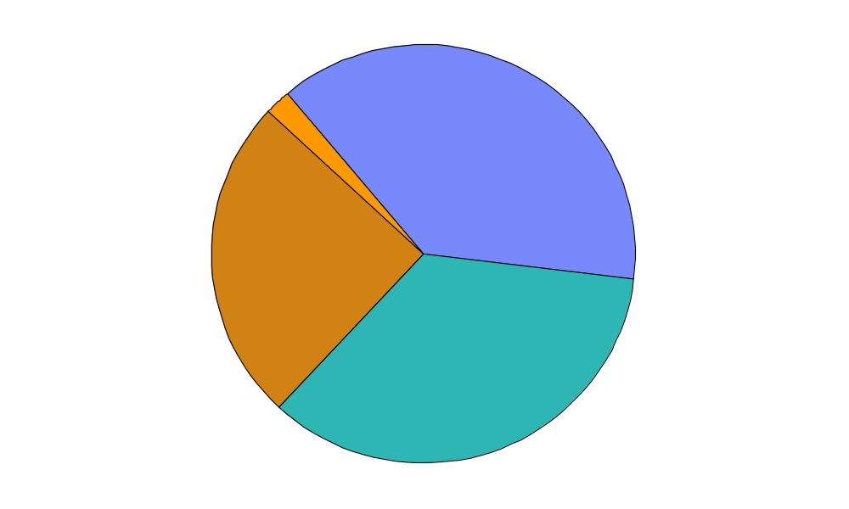
Open Source ve Marka Ürünler
2%
Öncelik Open Source’da
38%
Öncelik Marka Ürünlerde
25%
Karışık, Open
Source ağır basıyor
35%
Karışık, Marka daha ağır
Source: InformationWeek, November 2004
Notes:
64% of our customers have tomcat
Just to give you an idea of where open source applications stand today, look at this InformationWeek surveyed more than 400 IT professionals late last year. Two thirds of the companies in the survey are actively using open source. Three in five reported an environment of open source and commercial software.
These % speak volumes for the almost ubiquitous adoption of Open Source as a tool in the armory of how firms choose to compete
On top of that, the open source database market alone is expected to grow to a $1 billion market in three years. This may seem a small number in the grand scheme of the overall database market but with double digit growth rates this dollar figure will soon be very meaningful.
IBM is providing a leadership role in this market. We are not reacting to this reality: we are providing guidance! We use a hybrid approach, and as a result can be more pragmatic. This provides us many advantages in the market not the least of which is having a strategy that has a good chance of succeeding. Our messaging needs to be balanced. In particular, any messaging about our middleware needs to be consistent with our overall OSS strategy; we should not say something that implies that OSS is bad as a justification to use our commercial code (after all, there is some OSS inside it).
Similarly, we want to avoid messaging that is ‘either/or”, “one size fits all”, that ”OSS code is not better than commercial code”, etc. For example many OSS proponents now argue that it’s only a matter of time until OSS replaces commercial software – they don’t realize that almost all of the investment in software has been by companies to run their own business, that they do of course buy commercial software, but there is so much legacy code out there, and so much innovation in some very complex technologies, that it’s completely unrealistic to believe that OSS will take over the software industry

Slide 17
Open Source bir tehlike değil…
bir AVANTAJ!

Slide 18
Ajanda
IBM ve Yazılım Grubu
Open Source
IBM ve Open Source
WebSphere Application Server CE
Özet
Sorular

Slide 19
Open Source ‘a 9+ Yıllık IBM Desteği
1999 / 2000
  IBM forms Linux Technology Center
  Leads Apache projects Xerces (XML4J), Xalan, SOAP
  IBM forms Open Source Steering Committee
  Creates OSI-approved IBM Public License
  Strategic participation in Mozilla
  IBM becomes founding member of OSDL
2001
  Linux contributions to networking, serviceability, performance
  Mods to Apache 2.0 HTTP server
  Founder of Eclipse.org – contributing Platform
  Common Public License approved – used by Eclipse
  Creates internal bazaar using OSS methodology
2002
  Linux contributions to scalability (8-way+), reliability (stress testing, defect mgmt, doc)
  Leads Apache Web Services projects WSIF and WSIL
  Leads Eclipse projects GEF (editing), EMF (modeling), XSD (XML Schema)
  IBM contributes eServer support for Globus Toolkit 2x
2003
  IBM and SuSE achieve EAL2+ Common Criteria security cert
  Leads Apache projects Pluto (Portlet API) and WSRP4J (Remote Portal)
  Leads Eclipse projects Hyades (testing), Visual Editor, AspectJ, Equinox rich client
  Globus Toolkit 3 contributions for OGSA, OGSI
2004/2005
  IBM and Novell/SuSE achieve EAL4+ and Common Operating Environment compliance
  Eclipse becomes independent org – IBM contributes UML2, Web Tools, Voice Tools
  Globus Toolkit 4 to be WS-I compliant
  Contributed 500 Patents to Open Source
  Partner with Zend PHP
  IBM enhances Apache partnership
  - Incubates project Derby (Cloudscape Java database)
  - Contributes voice recognition technology
  - Supports Geronimo J2EE project – acquires Gluecode for skills
  Firefox accessibility contribution
More than 1000 developers involved in OSS projects
IBM leads 80+ OSS projects
IBM contributes to 150+ OSS projects
Notes:
IBM has been involved in Open Source projects for over 8 years – and is now involved in over 150 Open Source projects. So we have a lot of experience.
IBM’s involvement started when we first open sourced an IBM software research project on alphaWorks – and soon after that we formalized our involvement through the formation of the internal “Open Source Steering Committee” and the creation of the Linux Technology Center as an organization for engineers and programmers involved in open source projects.
Apache was the first major Open Source project IBM became involved with as a contributor as well as a consumer of technology, and then came our widely known involvement in Linux.
In 2001, we donated the WebSphere Studio Workbench code to open source as the Eclipse IDE project, and since then we have contributed code, skills and resources to a wide variety of open source projects and software.
Recent initiatives include the Open AJAX initiative to accelerate toolkits for developing rich client graphical web applications, and our investments in the Apache Geronimo J2EE web application server project.

Slide 20
IBM ve Open Source?
IBM’in Stratejik Yaklaşımı: Open Source, Apache Geronimo ve WebSphere Application Server Community Edition
Gerçek Open Souce Dünyası : Project Zero
Kalıcılık: IBM ve Çözüm Ortakları
Güvenilir Destek ve Hizmet: IBM ve Çözüm Ortakları
Uzun vade: Büyüme ihtiyacı doğarsa Marka ürünlere geçiş (fbook)
Maliyet: Sadece destek

Slide 21
IBM’in Open Source Hedefleri
Innovasyon: Open Source’a gereken tüm enerji ve destek
Katkı: Önemli ve Lider bir oyuncu, hem katılımcı olarak hem de tüketici
Geliştirme: Open Source ürünleri ve bunlardan ortaya çıkan katma değerlere odaklanıp geliştirerek pazara sunmak
Büyüme: Open Source dünyasına yeni kullanıcılar eklemek ve yeni pazarlara girmek için teşvik. Tüm bunlar yeni iş fırsatları yaratacaktır
Embed Layer Extend
Enhance
Support
Community Innovation
Integrate
Contribute
Participate .. Donate ...Sponsor..
Notes:
IBM’s Open Source approach is built around four goals – Innovation, Contribution, Enhancement – and Growth. IBM’s involvement in open source is not simply altruistic – we see significant new business opportunities through open source for us, our partners, and our customers.
We’ve found this diagram useful to explain IBM’s overall Open Source approach, and to show how all our different initiatives fit in within a common framework.
At the centre is Community Innovation. We see a lot of current and future innovation in Open Source, and we want to harness and fuel that innovation.
In order to do so, we are actively contributing to a range of open source communities where we see value. This contribution covers a spectrum:
Participate – working as part of existing open source communities to help develop the technology – for example, our involvement in Linux
Donate – contributing code, patents and other resources to the open source community, both as part of existing communities and to start new projects – for example, our donation of accessibility code to the Firefox web browser
Sponsor – setting up and supporting foundation and cross-vendor organisations to accelerate open source adoption and usage – for example, our formation of the Eclipse foundation
We then enhance open source with our own skills, technologies and people – so that our customers, partners and IBM will benefit. Again, this covers a spectrum:
Support – offering IBM service and support both for open source offerings such as Apache Geronimo and Eclipse, and for associated IBM commercial software offerings such as WAS Community Edition and Rational Software Development Platform

Slide 22
3 örnek
WAS CE: eşi benzeri yok ☺
DB2 CE: en güvenilir DB artık ücretsiz
Symphony: Neden ofis ürünlerine para verelim?
WebSphere
DataSphere
Lotus
Notes:
IBM’s Open Source approach is built around four goals – Innovation, Contribution, Enhancement – and Growth. IBM’s involvement in open source is not simply altruistic – we see significant new business opportunities through open source for us, our partners, and our customers.
We’ve found this diagram useful to explain IBM’s overall Open Source approach, and to show how all our different initiatives fit in within a common framework.
At the centre is Community Innovation. We see a lot of current and future innovation in Open Source, and we want to harness and fuel that innovation.
In order to do so, we are actively contributing to a range of open source communities where we see value. This contribution covers a spectrum:
Participate – working as part of existing open source communities to help develop the technology – for example, our involvement in Linux
Donate – contributing code, patents and other resources to the open source community, both as part of existing communities and to start new projects – for example, our donation of accessibility code to the Firefox web browser
Sponsor – setting up and supporting foundation and cross-vendor organisations to accelerate open source adoption and usage – for example, our formation of the Eclipse foundation
We then enhance open source with our own skills, technologies and people – so that our customers, partners and IBM will benefit. Again, this covers a spectrum:
Support – offering IBM service and support both for open source offerings such as Apache Geronimo and Eclipse, and for associated IBM commercial software offerings such as WAS Community Edition and Rational Software Development Platform

Slide 23
Ajanda
IBM ve Yazılım Grubu
Open Source
IBM ve Open Source
WebSphere Application Server CE
Özet
Sorular

Slide 24

WebSphere Application Server Family
WebSphere meets the broadest range of Quality of Service needs
Manage CE
with XD for
greater QoS &
central admin…
WebSphere Extended Deployment
Ultimate scalability & performance; functional depth & breadth
WebSphere Application Server Network Deployment
WebSphere
Application Server
Customer
Needs
Migrate to WAS / ND for
greater QoS & performance –
Migration tools & docs
make migration easier…
WebSphere
Application Server / WAS-Express
Reduced acquisition costs; Small footprint..
WebSphere Application Server Community Edition
Get started quickly –
Free download,
no budget approval.
Built on common WebSphere code
Built on open source technology
Fast deployment
Capabilities
High Qualities of Service
Notes:
So Where does WASCE fit within the websphere family? CLICK You can start with wasce with the its free download and fast deployment.
CLICK As your needs for scalability and performance grow, you can migrate to other Websphere servers, all the way to mainframe applications
CLICK You can use Websphere Extended Deployment or Websphere XD to manage and administer multiple WAS CE installs in multiple clusters.
CLICK And XD can also manage a mixed environment of WAS CE and other Websphere servers.
IBM offers customers the broadest product range of Application Infrastructure , from WebSphere Extended Deployment at the high end to WebSphere Application Server Community Edition at the low end. No other vendor can really match this range.
NEXT SLIDE

Slide 25
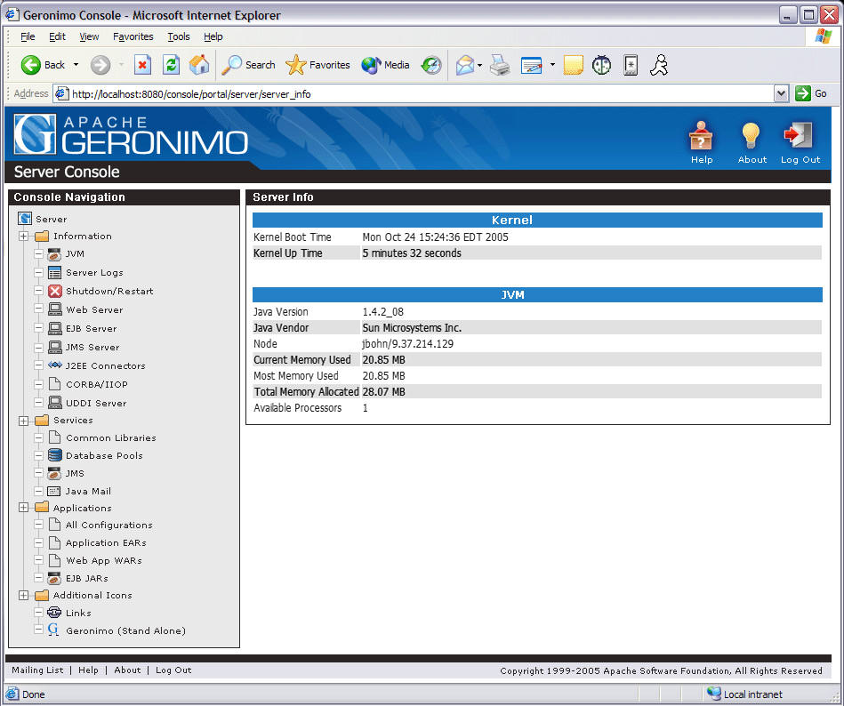
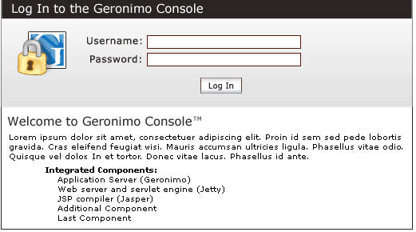
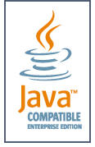
What is Apache Geronimo?
Geronimo Application Server
Open-source, Java EE 5 compatible app server (June 4, 2007)
Started in August 2003
Small footprint: core is 19 MB
Top-level Apache project
Apache Software License 2.0
Comprises over 30 open source packages
Obtained official J2EE 1.4 certification in November 2005

Slide 26




Architectural Overview
Integration of multiple open source projects
ActiveMQ
Tomcat
TranQL
OpenJPA
Cayenne
OpenEJB
Axis
CXF
Derby
Howl
MX4J
Jetty
Notes:
Remember Geronimo was sanctioned to reuse the best-of-breed open source projects when feasible. Fundamentally, Geronimo is a component integration environment.
Welcome to Apache OpenJPA, a Java EE persistence project of the Apache Software Foundation . It is a feature-rich implementation of the persistence part of Enterprise Java Beans 3.0 , also known as the Java Persistence API (JPA), and is available under the terms of the Apache Software License . OpenJPA can be used as a stand-alone POJO persistence layer, or it can be integrated into any EJB3.0 compliant container and many lightweight frameworks.
Apache Cayenne is an open source persistence framework licensed under the Apache License, providing object-relational mapping (ORM) and remoting services. With a wealth of unique and powerful features, Cayenne can address a wide range of persistence needs. Cayenne seamlessly binds one or more database schemas directly to Java objects, managing atomic commit and rollbacks, SQL generation, joins, sequences, and more.

Slide 27




WebSphere Application Server Community Edition 2.0
(WAS CE)
A lightweight JEE5 application server built on open source Apache Geronimo technology
Small
Foot Print
(~60MB download)
World-class
Support Options (3 tiers)
JEE5 Compatible
No Upfront
Costs
Built on Apache technology - The Gold Standard in Open Source
Notes:
So what is WebSphere applications server community edition or WAS CE
WAS CE is a way for IT departments to quickly respond to rapidly developing business needs in a cost effective way
It is based on Apache Geronimo project from the apache software foundation.
The Geronimo project mission is to provide a lightweight and flexible J2EE application server solution
To Adopt latest technology to increases IT responsiveness to business needs such as JEE5 compliance. Geronimo is an unusual project because it includes many other open source projects: Tomcat, Axis, OpenEJB, ActiveMQ and many others.
It is Free to use in development and production; You Get started quickly without budget approval then grow as needed
And it is Backed by world-class IBM support with a choice of 3 levels of support options
Other Notes:
Apache has been the most popular web server on the Internet since April of 1996. The November 2005 Netcraft Web Server Survey found that more than 70% of the web sites on the Internet are using Apache, thus making it more widely used than all other web servers combined.
In June 2007, the Geronimo 2.0 release candidate passed the Sun Compatibility Test Suite and certified on Java Enterprise Edition 5.0. Geronimo is the second application server to achieve JEE 5 certification, after Sun’s Glassfish server but before JBoss. Quite an accomplishment since the open source community released version 1 of Geronimo approximately 1 ½ years earlier.
NEXT SLIDE

Slide 28
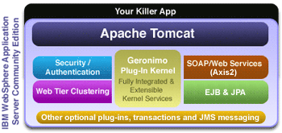
The WebSphere Community Edition Environment
WAS CE supports full J2EE stack which includes: a Servlet container, an EJB container, messaging provider (JMS) and Java Connector (JCA) container.
Services such as Security/Authentication, Web Services, JMS, etc. are provided by the Geronimo Plug-in Kernel.
EJB and JPA are supported.
Additional plugins can be applied to the Kernel and accessed rather than embedded in application code.
Notes:
Let me explain some of the key features of WASCE 2.0
Leverages Apache Geronimo 2.0
WAS CE offers the innovations in Apache Geronimo, including overall server hardening, ___, and the Geronimo plug-in architecture. As discussed on the previous slide, the plug-in architecture allows developers to create plugins to extend the functionality of the application server; numerous plugins already exist, and the open source community is creating more plugins to integrate new technologies into Geronimo and WAS CE.
Java EE 5.0 compatible [omitted – discussed in detail on next slide]
Database support
WAS CE includes the IBM Cloudscape embedded database for development and production use; customers who buy WAS CE support automatically get support for Cloudscape as well. WAS CE also supports the use of free databases such as IBM DB2 Express-C and MySQL, as well as the most popular commercial databases such as IBM DB2, MS SQL Server, and Oracle.
Eclipse plug-in with Europa support
WAS CE offers an Eclipse plug-in that now supports the Eclipse Europa release. Europa is the 3.3 packaged release combining several Eclipse projects.
Centralized configuration and control
WAS CE includes an easy-to-use console for managing the application server, including deploying and undeploying applications, configuring system services, and tuning the application server’s performance.
The Geronimo architecture is built from the ground up to support customization of the application server at runtime. This means that you can easily tune WAS CE via the console, and your changes take effect immediately—giving you immediate control of the server and reducing the need for downtime resulting from configuration changes.
Platform support
WAS CE supports many popular platforms as shown. Check the detailed WASCE website for the latest updates and other info at http://ibm.com/websphere/wasce >‘System Requirements’ > ‘Detailed System Requirements
Small Footprint
It’s easy to get started with WAS CE—the download is only around 60MB, so developers can easily download it, install, and get going, usually in less than 10 minutes. WAS CE’s small size also means it’s easy to embed in a larger stack, which helps both customers and ISVs build a total solution using WAS CE.
Improved reliability for most commonly deployed applications
WAS CE supports the clustering features of Apache Tomcat as its servlet container to provide failover for web applications, increasing your application’s availability to users. WAS CE is compatible with load balancers such as Apache’s 2.0 mod_jk and Apache 2.2 mod_proxy_ajp
More flexible and rapid deployment across multiple configurations
WASCE supports 5 different ways to deploy your application. Deploy from the console, from an IDE like Eclipse, use the deploy tool, hot deploy using the deploy folder where the developer can deploy by inserting a WAR or EAR file, and finally, in place deployment from tools like Maven.
Liberal product license
The WAS CE license enables customers and partners to use WAS CE in whatever way meets their needs, without any obligation to pay for a license.
Portability to other servers in the WebSphere Application Server family
The Eclipse plug-in’s J2EE profiling tool helps ensure that applications are fully J2EE-compatible, which in turn simpifies the task of migrating applications from WAS CE to WAS.
Migration documents
WAS CE’s documentation includes migration guides that assist in the effort to migrate applications to WAS CE, as well as in migrating applications from WAS CE to WAS. A JBoss migration tool is availabel
Translated documentation
Documentation for WAS CE is available in the eight languages shown in addition to English.

Slide 29
The WebSphere Community Edition Environment (cont.)‏
Clustering for increased reliability and performance.
Transactional database (Apache Derby) included.
Centralized configuration and control
Runtime customization.
Centralized user management
Eclipse Plug-in for deployment and debugging (even remotely)‏
Migration articles to help move from Tomcat/JBoss to WAS CE
IBM support available

Slide 30
WAS Community Edition 2.0: Key features
WAS CE 2.0 – Highlights
NEW: Java EE 5.0 compatible
  Implements latest Java enterprise standards
  Dramatically improves developer productivity
NEW: Support for Linux x86-64 platform
WAS CE 2.0 – Customer Benefits
Benefits of Java EE 5
Greater developer productivity…
…accelerates time to value…
…increases IT responsiveness to business
…needs…
…and reduces development and
…maintenance costs.
Benefits of Web Service enhancements
Increases code reusability…
…encourages developers to leverage existing
…assets…
…reduces enterprise-wide duplication of
…effort and functionality…
…and reduces development and
…maintenance costs.
Java EE 5 at a glance
NEW: Simplified component & persistence models
  Java Persistence API (JPA) 1.0, EJB 3.0
  Brings benefits of lightweight IoC framework, and streamlines development of persistence code
NEW: Updated Web application technologies
  Servlet 2.5, JSP 2.1
  JavaServer Faces (JSF) 1.2, JSTL 1.2
  Eases development of web applications
NEW: Enterprise application technologies
  Java Transaction API (JTA) 1.1
  JavaMail 1.4, JAF 1.1
  Java Authorization Contract for Containers (JACC) 1.1
  Improves robust transaction support and enhances security of Java EE applications
NEW: Web Services enhancements
  JAX-WS 2.0, JSR-109 1.2
  JAXB 2.0, StAX 1.0, WS-Metadata 2.0
  Enhances interoperability and dramatically speeds development of web services for easy integration with your SOA
Notes:
Lets talk about some of the new features of WAS CE 2.0 The new WAS CE 2.0 release supports the full Java EE 5 standard and provides features that simplify development of applications and services. Some Specific examples of Java EE 5 technology and their benefits, include:
Support for the new EJB3.0 programming model developed in the OpenEJB open source project. EJB3.0 simplifies development of EJB components and is much easier than the 2.1 version
Support for the Java Persistence API developed in the OpenJPA open source project. This new API simplifies the development of Java applications using data persistence and is comparable to what JBoss Hibernate offers.
Support for new application standards such as Servlet 2.5, JSP 2.1, JTA 1.1, and JavaBeans Activation Framework (JAF) 1.1 which simplifies development and improves transaction support and security.
And last but not least is Support for JEE 5 web services standards developed in the Axis 2 open source project and other supporting projects. This improves application development through support of key Web services standards, and an annotation-based model for Web Service providers and clients. This dramatically speeds development of web services for easy integration with your SOA
NEXT SLIDE

Slide 31
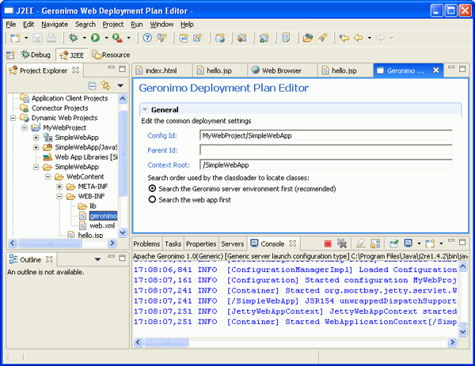
Tooling for developers
Full Eclipse 3.3 (Europa) support via Web Tools Project (WTP 2.0) and WAS CE plugin
IBM Rational Application Developer (V7)
IBM Rational Software Architect (V7)

Slide 32
WAS CE: Known Upsells & Competitive Wins
Cummins | Upsell
OfficeMax | Upsell
Conde Nast | Upsell, JBoss halted
Medco | Upsell
US Navy | Upsell, JBoss defeat
First Rand Corp | Upsell
TNT Logistics | Upsell
XO Communications | Upsell, BEA out
BFM Insurance Group | Upsell
City Of Cleveland | Upsell
Jigsaw Interactive | Upsell
Ciberbit S | Upsell
ClientSoft BV | Upsell
Prudential - Vietnam | Upsell
Army Heavy Armor | Upsell
Canal+ | Upsell
Lawson | Upsell
DT Group | Upsell
Homebase | Upsell
Pay by Touch | Upsell, JBoss defeat
Sparkassen | Upsell
Beijing Univ Sci/Tech | JBoss defeat
World Bank | JBoss defeat
Ford Motor | JBoss halted
Enigma | JBoss defeat
Qwest | JBoss halted
CapGemini | Upsell, JBoss defeat
Daimler Chrysler | JBoss defeat
US PTO | JBoss defeat
eBay | Tomcat replaced
Notes:
May want to update
The upsells listed here are all situations where we needed WAS CE just to open a conversation, but then during the sales discussion, the customer concluded that commercial middleware was the best fit for their needs. As of 3Q06 we have 21 customers on the upsell list; as of 1H06 the revenue from these customers exceeded $1 million. And that doesn’t include the customers we don’t know about

Slide 33



Sorular?
Teşekkürler...

