Slide 1
Kendi İşletim Sisteminizi Oluşturun
Notes:
Hello my name is shane shields. As you can see I was not born or raised in turkey. But after getting my citizenship I say ne mutlu turkum.
Şimdi her kez, beni ilk defa tanıdıktan sonra, her zaman bir kaç sorular soruyor.
Nerelesin, evlimisin, ne zaman turkiye geldiniz. Bence sizleriniz aynı şeyler merak ediyorsunuz. Merak etme. Bu sorular şimdi cevaplayacağım ve sunumunuza devam edeceğim.
Ben 11 sene önce avustralyadan turkiyeye geldim. Ben evliyim ve bir fabrikada sistem destek sorumlu ve system yönetici olarak çalışıyorum.
Tabıki özgür yazılım ve kesinlikli Linux çok seviyorum ve her yerde linux kullanıyorum.
Say hello and introduce myself maybe a bit of history, why I came to turkey, where am I from, what I do for a living. Please bear with my turkish.

Slide 2
Neden Kendimiz Linux Dağıtım Oluşturuyoruz?
Şirketin standart Linux ihtiyacı olabilir.
Linux'u fazla bilmeyen arkadaşlara, daha basit bir dağıtım hazırlanabilir.
İngilizce bilmeyene, kolay yüklenebilir dağıtım yapabilmek için.
Özel amaçlı kısıtlı bir Linux hazırlanabilir.
Ana Linux'un şeklini sevmediğin için.
Notes:
Several reasons we want our own Linux. Here are some of the most popular ones. There are hundreds of distributions around Why did they start.
Companies even countries (china) might want a standard set of features. Examples. Oracle.
Prepare a simple linux for friends and family. Desktop setups. Reduce no./choice of programs. (firefox, games, music mp3 setup.
Those who don't know english and pre-setup final installation in native language.
Wish to prepare a special linux for a single purpose, web server, file server, gateway, tv,video (mythtv) center.
Unhappy with the way the host linux is set up and wish to change it. Color scheme, wallpaper, list of programs, window manager.
Make a more up to date distribution. Less patch downloads.
Will concentrate on ubuntu but there are similar methods for other distributions like fedora

Slide 3
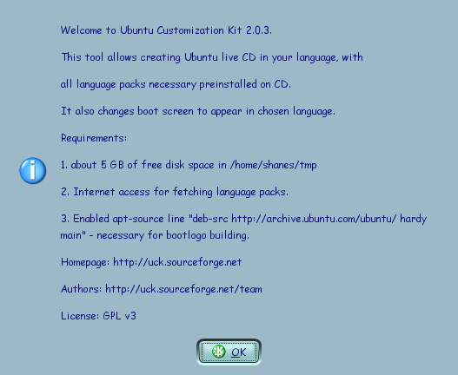
Başlangıç
Web sitesinden UCK paketini indir.
Gerekli depoları tanımla.
Program Yükle.
  Otomatik olarak gerekli bağlantılı programları yükleyecek
Programı başlat.
Notes:
Uck sourceforge program download, not part of ubutnu repository.
Need to enable required repositories for package download. Main, universe, multiverse and security
right click on downloaded program and install (gdeb) or with apt, dpkg, aptititude, required dependant programs will automatically install.
Start the program and see the following screen. Click ok to continue. Duh!
Finally you need to have internet access or it won't work.

Slide 4
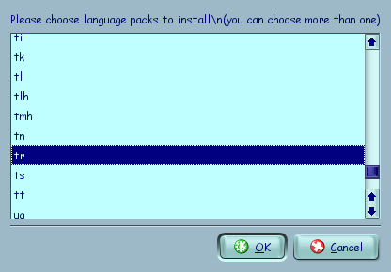
Dil seçin.
Yüklenecek Dilleri seçiniz.
Birden fazla dil seçebilirsiniz.
Notes:
You need to choose the language packs that will be installed when you make the distribution. This enables the installed distribution to support the chosen languages.
You can choose to install more than one language. Some languages cause the program to fail due to missing packages. Turkish no problem with kubuntu hardy and that is all I am concerned about.

Slide 5
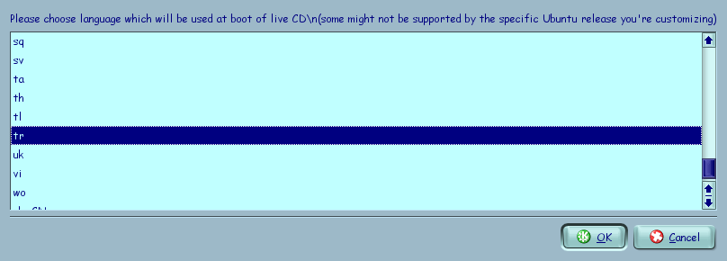
CD Boot Dili Seçin.
CD boot dilini seçebilirsiniz.
Dikkat! Bazı Ubuntu dağıtımları bu özelliği desteklemeyebilir.
Notes:
When the cd boots you can have it display in a specific language. Preferably one that your target understands unless you are playing a joke.
Some ubuntu distributions may not support this feature especially the earlier versions.

Slide 6
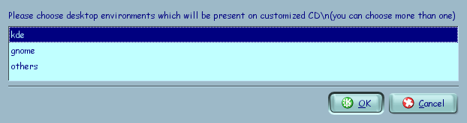
Pencere Yöneticisini Seçin.
Sevdiğiniz pencere yöneticisini seçebilirsiniz.
Birden fazla seçebilirsiniz.
İsterseniz standart olmayan yöneticiler seçebilirsiniz.
Notes:
Choose your desktop environment, you can choose either kde, gnome or others. Of course kde is my preferred choice but I don't want to get into an argument over it. (who is fener, galatasaray and kde, gnome)
You can choose more than one to be present on the final installation where they can choose on startup which they wish to use.
You can choose a non standard wm to be primary one.

Slide 7
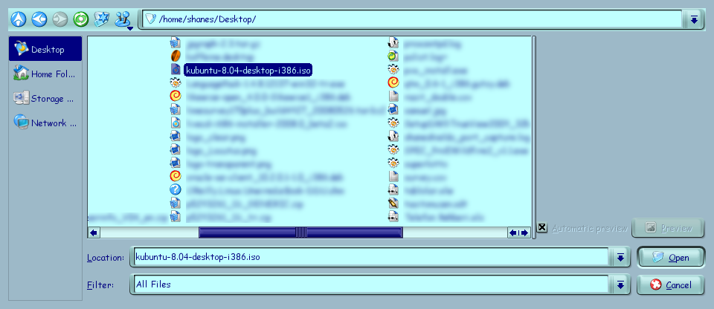
Kaynak Dağıtım Seçiniz.
Kaynak dağıtımdan, kendi dağıtımınızı hazırla!
Güvenliğiniz için en son İSO imajı kullanmayı tavsiye ediyorum.
Notes:
From the source distribution you can make your own distribution. It doesnt have to be the latest distribution. Ubuntu, kubuntu, xbuntu can be used. As long as the repositories are available. Older versions will have to download and install more patches.
For your security use the latest iso image. Less patches to install, latest versions of programs,

Slide 8
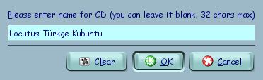
CD İsim Seçin.
Dağıtım CD ismini buraya yazabilirsiniz.
En fazla 32 karakter olmalı.
İsterseniz boş bırakabilirsiniz.
Notes:
Choose a name for your distribution cd. Turkish characters can be used. May not work for different languages.
Maximum of 32 characters same as normal cd titles
you can leave it blank but why waste a chance to advertise

Slide 9
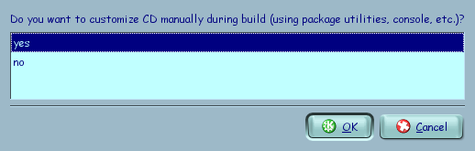
Daha İleri Seçenekler
Oluşturmada kişiselleştirme için “yes” seçin.
Seçilmezse sadece bir kopya yapacak.
Bunu istemeyebiliriz.
Notes:
If you wish to customize the packages or other parts of your Linux distribution you need to choose yes. This will allow you to add or remove packages, manually change scripts, run levels or anything else
If you don't choose yes then it will basically just be a copy of the original image.
We don't want that or else why are we running this customization program.

Slide 10
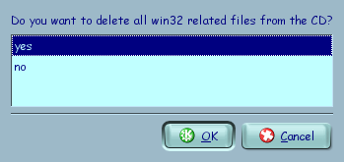
Windows Destek.
Standart *ubuntu windows'u destekliyor.
windows'dan yükleme başlatılabilir.
Desteklememek isterseniz “no”, yani hayır, seçin.
Notes:
Standard ubuntu cd's have some windows programs on them which allows them to start automatically on windows. This gives a welcome screen and some choices.
You can choose to start the standard ubuntu installation from the windows environment which will then reboot the computer into the installation cd.

Slide 11
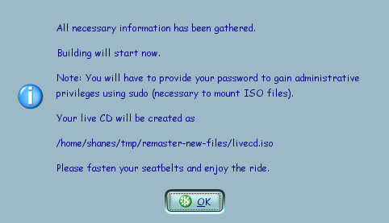
Gerçek İşler Başlıyor.
Gerekli bilgi toplanmış.
Bazı işler için “sudo” kullanıyor.
Sudo haklarınız uygun olmalı.
Bir kahve veya çay için.
Notes:
Now the real work starts.
We have gathered the required information. There will be a need for more information later on when we choose our packages.
In order to mount the iso image you need to have access to the sudo command.
If you don't have rights to sudo you need to add or be added to the administrator group or have yourself added to the sudo configuration file.
Sit back and have some tea or coffee as this can take a while.

Slide 12
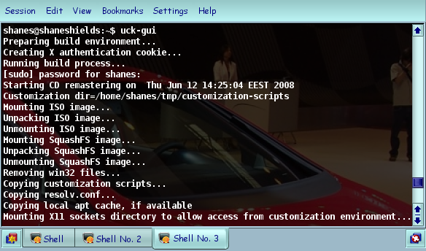
Yeni Dağıtım İşler Başladı.
Notes:
Here is a screen shot of what is showing in the console window while it is working. Explain what each line is doing.

Slide 13
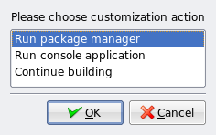
Kişiselleştirme Zamanı
Şimdi seçim zamanı
Üç seçenek var.
GUI Paket yönetimini başlat.
Konsol işleri yapabilirsiniz.
Devam et Abi!.
Notes:
Now that it has unpacked and prepared the source tree everything is ready for customisation.
Now comes time to choose what you wish to do. There are three choices.
You can start the gui packet manager. Which one starts depends on the source iso that you started off with.
You can start a console window (komut satırı) and go to war with the command line doing other tasks beside choosing packets
Or you can continue on with building. I would suggest that you do at least some customising work before continuing on or else why do it? (depending on audience do temel joke)
Temel in eski bir bmc kamyonu vardir. Yolda giderken kirmizi isik yanar ve frene basar. Kamyon durmaz önünde giden son model BMW ye çarpar. Temel hemen atlar, söföre yalvarir :
- Aman abi affet, sen zengin adamsin, seni etkilemez, ama ben ömür boyu çalissam ödeyemem.
Adam Temel e acir ve affeder. Yollarina devam ederler. Ileride yine kirmizi isik yanar. Temel kamyonu yine durduramaz. BMW yi hurdaya çevirir. Yine atlayip yalvarmaya baslar :
- Aman abi, benim çocuklarim var, affet. Zaten arabana çarpmistim, hasar biraz daha büyüdü sadece.
Adam Temel e yine acir ve :
- Tamam, gözüme görünme, bas git...
Yollarina devam ederler. Yine kirmizi isik yanar. Temel BMW ye yine gömer. Bu sefer kafasinicamdan çikarip, bagirir :
- Benim abi benim, devam et...

Slide 14
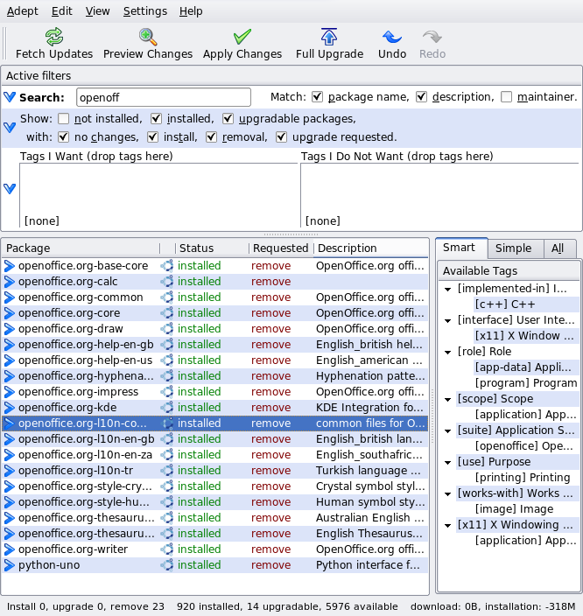
GUİ Paket Yönetimi.
KDE, “Adept” kullanıyor.
Gnome, “Synaptic” kullanıyor.
Örnek için “OpenOffice”i kaldırıyorum.
Notes:
Depending on which host distribution you use depends on which packet manager is shown.
Kubuntu distributions which I have used here have kde as their window manager and use the adept manager program
Ubuntu distributions use synaptic.
Which one you use is not important they both allow you to add and remove packages as well as update existing packages. As an example I am removing open office here as the final distribution doesn't need it.

Slide 15
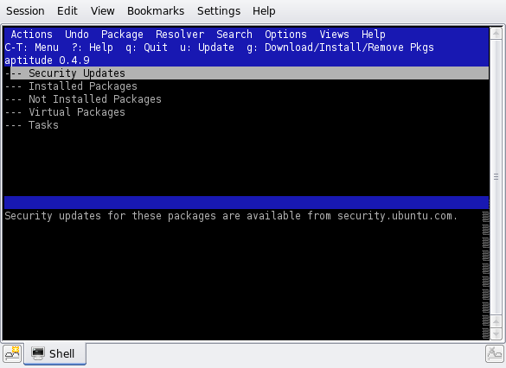
Konsoldan İşletmek
İstenirse konsolda aynı işler yapılabilir.
Paket yönetimi ismi “aptitude”.
Başka işler yapabilir.
Bütün haklara sahipsiniz.
Notes:
If you wish you can do exactly the same package management (update, install, remove etc) in a console window.
The package manager is called aptitude, good for remote management or low power machines without x windows.
You can do lots of other work like change boot scripts, add special programs that are not in the repositories, set up different run levels, pre configure config files for installed programs, change add or delete users. Change graphics around.
You have root level rights. In other words you have the right to do anything you want on that file system. Very easy to destroy everything. must know what you are doing.

Slide 16
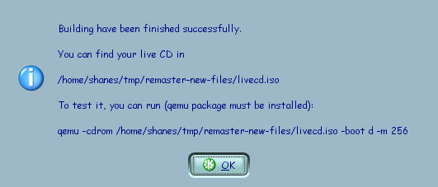
Başarılı Bitmiştir.
Çay/kahve bitince, yeni bir İSO hazır!
İstenirse, bir sanal makinada test edebilirsiniz.
Qemu, VMWare veya VirtualBox kullanabilirsiniz.
Notes:
Once you have finished one, two or more cups of coffee your new ready to burn iso is ready.
You can burn straight to a cd or test it in a virtual machine first. Unless you need some coaster (Bardak altlıği) you should test it in a virtual machine.
The program shows how to test in qemu or you can use vmware or virtualbox. I used virtualbox because I like it and it is easy to use.

Slide 17
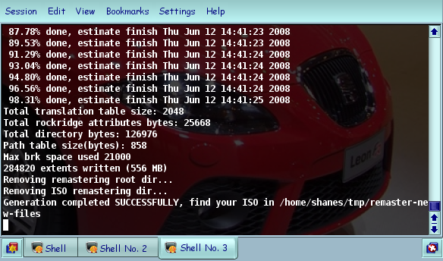
Başarılı Bitmiştir.
Notes:
Show the console output and explain various things.

Slide 18
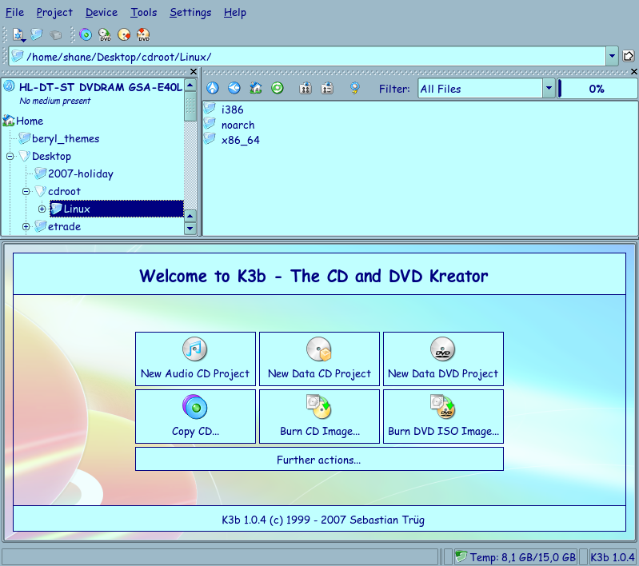
Şimdi CD/DVD Yazalım.
Artık en sevdiğiniz CD yazıcı programı ile CD veya DVD yazabilirsiniz.
Notes:
Depending on the size and how many packets you added or removed you could write to a cd or dvd. With care you could probably reduce it to a credit card sized cd and for advertising usage.
Use you favourite cd writing program to write the cd. Here I used k3b

Slide 19
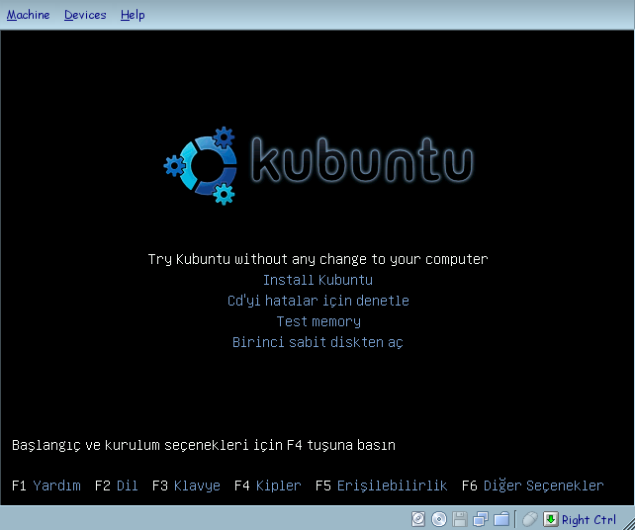
Sanal Makinada Test Ediyor.
Hazırlanmış CD VirtualBox sanal makinasında boot edildi.
Dikkat bu dağıtım tam olarak dilimizi desteklemiyor.
“Live” CD'den boot seçtim.
Notes:
As mentioned before I used virtual box to boot the iso image for testing purposes before writing to the cd or even test the written cd to make sure it works properly.
As you see the turkish language is not fully supported. There are a couple of lines that are still in english. As it is open source perhaps some volunteers would like to fix this which you could in the earlier console mode.
I decided to boot into the live cd instead of installing it as I had an installation that I didn't want to overwrite. Booting a live installation also shows how different the cd is from the standard distribution.

Slide 20
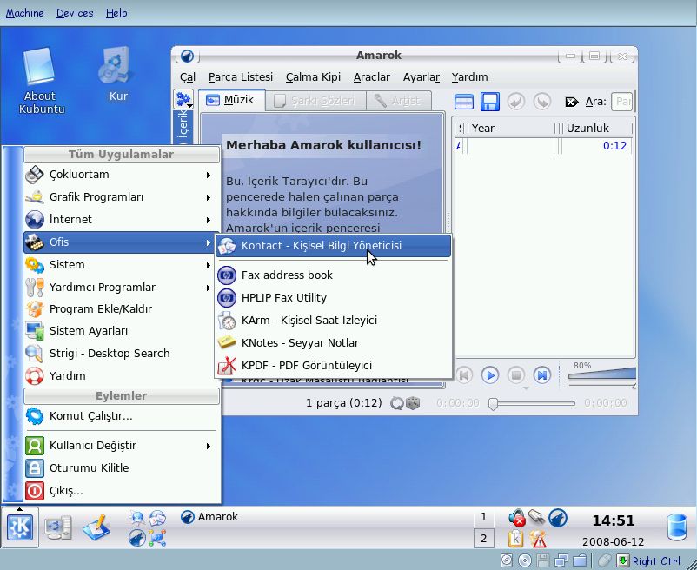
Sonuç.
Gördünüz gibi, “live” CD'den Türkçe hazırlanmış bir dağıtım.
Seçtiğim ve kaldırdığım “OpenOffice” görünmüyor!
Notes:
Point out the various points of turkish menus, installation icon, programs and mention that a standard live cd is in english not turkish.
Point out that open office has been removed while in the standard distro it is present.

Slide 21
Referanslar.
Http://uck.sourceforge.net/
Https://launchpad.net/uck
Http://blogs.ittoolbox.com/linux/locutus
Notes:
questions

