Slide 1
BUILDING WEB SERVICE PROVIDE STOCK INFORMATION
Group:
Nguyễn Minh Huy – 081667
Lương Ngọc Lan – 080838
Nguyễn Anh Khoa – 080835

Slide 2
Overview
Quick review of web service
Brief introduction about stock market
Explain the types of information our web service provide
Some experiences when implement web service with WCF

Slide 3
Agenda
Introduce Web Service
What is Stock Market?
Some issues in implementing
What is on our Service

Slide 4
Introduce Web Service
What is Stock Market?
Some issues in implementing
What is on our Service

Slide 5
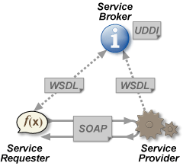
Web Service Definition
A Web service is a method of communication between two electronic devices over the web. ^{[1]}

Slide 6
Introduce Web Service
What is Stock Market?
Some issues in implementing
What is on our Service

Slide 7
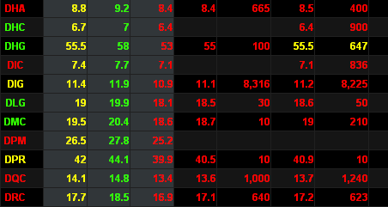

What is Stock Market?
A stock market or equity market is a public for the trading of company stock (shares) at an agreed price

Slide 8
Introduce Web Service
What is Stock Market?
Some issues in implementing
What is on our Service

Slide 9
Price Information
Present & Previous Transactions
Most Increase / Decrease
Most Traded

Slide 10
Finance Information
Financial Report
Financial Indicators

Slide 11
Forecast Price
Forecast
Confidence

Slide 12
Introduce Web Service
What is Stock Market?
Some issues in implementing
What is on our Service

Slide 13
Host Multiple Services
ServiceHost hostPrice = new ServiceHost(priceType);
ServiceMetadataBehavior hostPriceBehavior = new ServiceMetadataBehavior();
hostPriceBehavior.HttpGetEnabled = true;
hostPriceBehavior.HttpGetUrl = new Uri("http://localhost:90/StockPrice");
hostPrice.Description.Behaviors.Add(hostPriceBehavior);
hostPrice.AddServiceEndpoint(contractPrice, new BasicHttpBinding(), "http://localhost:90/StockPrice");

Slide 14
Separate Logic & Service
Statelessness
Performance

Slide 15
Maintenance
Developing send technical charts (image file) function.
Create a stock filter
Building recommend stock function
Implement fault contracts for Web Service such as: Overloading, Too many connections…

Slide 16

Thanks for your attention

Slide 17

Q & A

Slide 18
References
“Web Service”, source at http://en.wikipedia.org/wiki/Web_service
“Introduction to Web Service”, source at http://www.w3schools.com/webservices/ws_intro.asp

