Slide 1

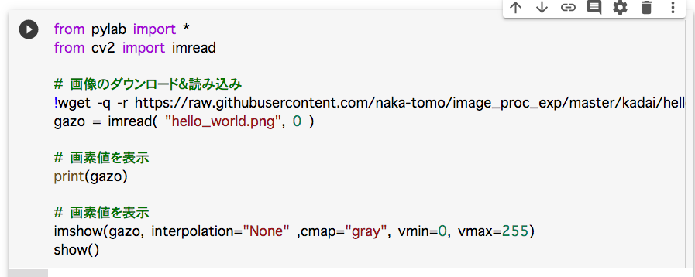

Slide 2
gazo[][] (変換前の画像)
 | x-1 y-1 | x y-1 | x+1 y-1
 | x-1 y | x y | x+1 y
 | x-1 y+1 | x y+1 | x+1 y+1
filter[][]（フィルタ）
(0, 0) | (1, 0) | (2, 0)
(0, 1) | (1, 1) | (2, 1)
(0, 2) | (1, 2) | (2, 2)
変換後の画素値
gazo2[y][x] = gazo[y-1][x-1] * filter[0][0] + gazo[y-1][x] * filter[0][1] + gazo[y-1][x+1] * filter[0][2]
+ gazo[y][x-1] * filter[1][0] + gazo[y][x] * filter[1][1] + gazo[y][x+1] * filter[1][2]
+ gazo[y+1][x-1] * filter[2][0] + gazo[y+1][x] * filter[2][1] + gazo[y+1][x+1] * filter[2][2]

Slide 3
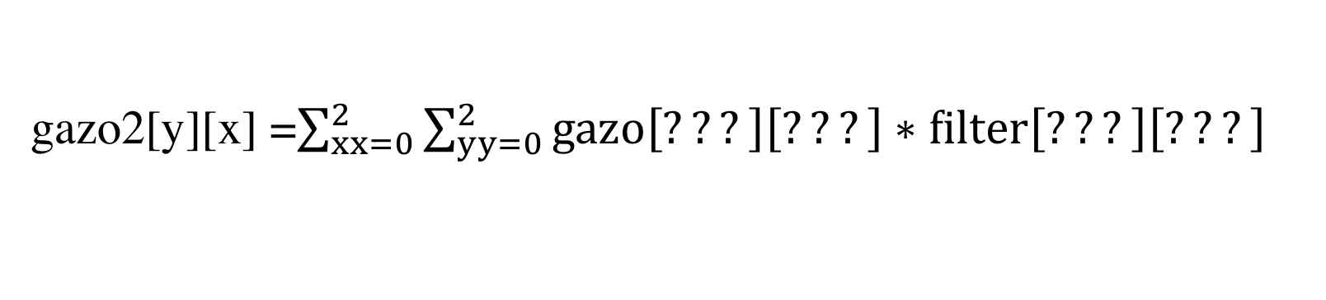

X座標が一つづつ増加
変換後の画素値
gazo2[y][x] = gazo[y-1][x-1] * filter[0][0] + gazo[y-1][x] * filter[0][1] + gazo[y-1][x+1] * filter[0][2]
+ gazo[y][x-1] * filter[1][0] + gazo[y][x] * filter[1][1] + gazo[y][x+1] * filter[1][2]
+ gazo[y+1][x-1] * filter[2][0] + gazo[y+1][x] * filter[2][1] + gazo[y+1][x+1] * filter[2][2]
Y座標が
一つづつ増加
総和（$Σ$）演算を使用して書き換えると…
gazo2[y][x] =$\sum_{xx=0}^{2}{\sum_{yy=0}^{2}{gazo\left[???\right]\left[???\right]∗filter\left[???\right]\left[???\right]}}$

