Slide 1
SUPERMARKET PURCHASING BEHAVIOR ANALYSIS
Association rule mining using Apriori algorithm
Name:
Registration Number:

Slide 2
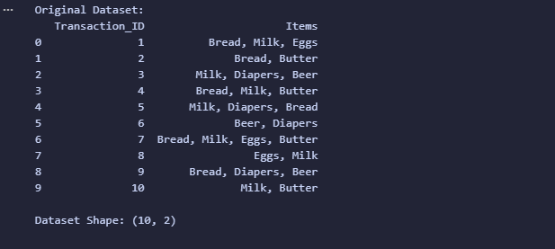
Introduction & Dataset
Objective: To analyze customer purchasing behavior to improve product placement and cross-selling.
Dataset Overview:
  Total Transactions: 10
  Unique Items: 6 (Bread, Milk, Eggs, Butter, Diapers, Beer)
Data Structure: Unstructured list of items per transaction ID.

Slide 3
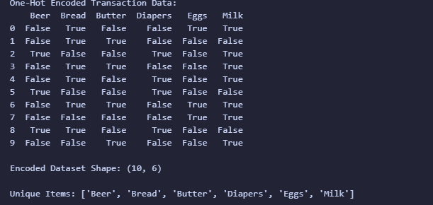
Data Preparation
Text (Top):
Preprocessing Steps:
  Converted string data into a list of lists (Transaction format).
  Applied One-Hot Encoding (Boolean True/False format) to make the
  Data suitable for the Apriori algorithm.

Slide 4
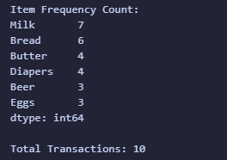
Methodology & Apriori Settings
Algorithm: Apriori
Parameters Used:
  Minimum Support: 0.2 (Item must appear in at least 20% of
  transactions).
  Minimum Confidence: 0.5 (Rule must be true at least 50% of the time).
Metrics Calculated: Support, Confidence, and Lift.

Slide 5
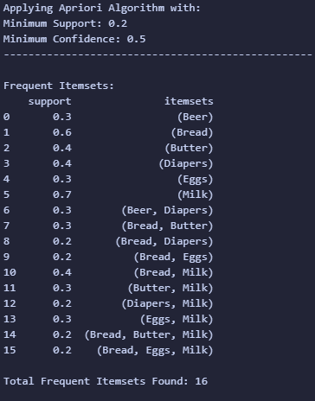
Frequent Itemsets Results
Key Findings:
  Milk is the most popular item (Support 0.7).
  Bread is the second most popular (Support 0.6).
  Strong co-occurrence found between Bread & Butter and Bread & Milk.

Slide 6
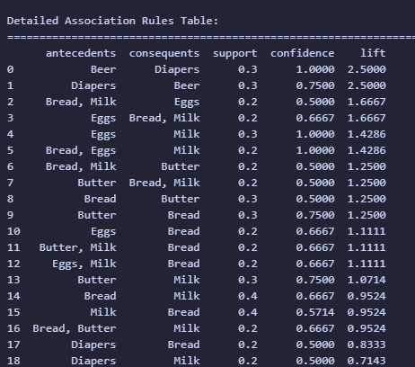
Generated Association Rules
Overview:
  Total Rules Generated: 19
  Filtered by Minimum Confidence > 0.5.
The table displays the Antecedents (IF), Consequents (THEN), and the strength of the relationship (Lift).

Slide 7
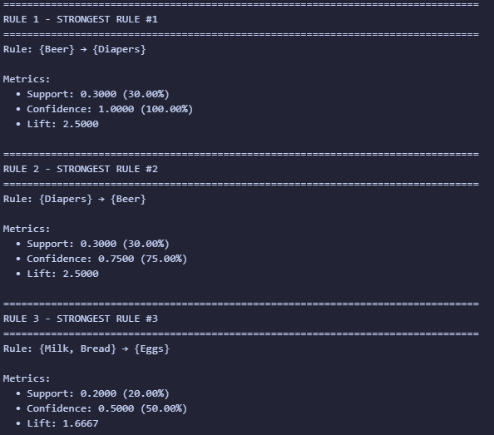
Top 3 Strongest Rules
Rule 1: {Beer} -> {Diapers}
Lift: 2.5 (Very Strong)
Insight: Customers buying beer are 2.5x
more likely to buy diapers.
Rule 2: {Diapers} -> {Beer}
Lift: 2.5
Insight: Inverse relationship holds true;
unexpected but strong correlation.
Rule 3: {Bread, Milk} -> {Eggs}
Lift: 1.67
Insight: Classic "Breakfast" combination

Slide 8
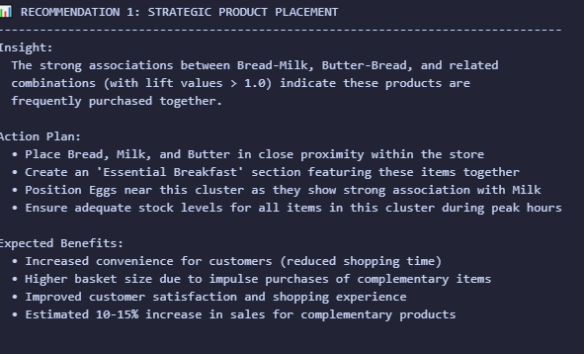
Business Recommendation 1
Strategy: Strategic Product Placement
Insight: High association between Bread, Milk, and Butter.
Action Plan:
  Create an "Essential Breakfast" zone.
  Place Eggs adjacent to the Milk section.
  Ensure high stock levels for this cluster.

Slide 9
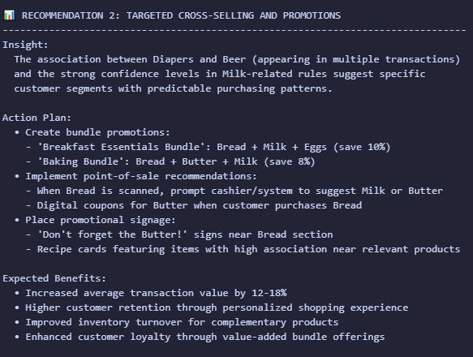
Business Recommendation 2
Strategy: Targeted Cross-Selling
Insight: The Beer & Diapers connection suggests a specific shopper demographic (likely young parents).
Action Plan:
  Bundles: "Breakfast Essentials Bundle" (Save 10%).
  Promotions: "Don't forget the Butter" signage near Bread.
  Impulse: Place premium beer snacks near the diaper aisle or vice-versa.

Slide 10
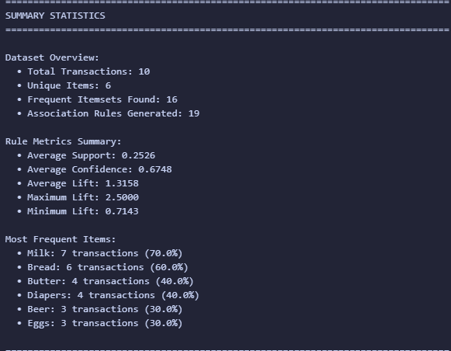
Conclusion
Summary:
  Analysis successfully identified key shopping patterns.
  Implementing placement changes for Breakfast items and cross-selling strategies for niche pairs (Beer/Diapers) can increase basket size.
Expected Impact: Estimated 10-15% increase in sales for complementary products.

