Slide 1
CLASS AND OBJECT
OBJECT ORIENTED PROGRAMMING CONCEPTS

Slide 2
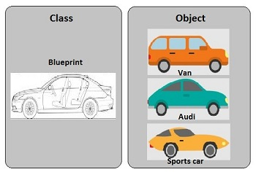
INTRODUCTION
Basic class definitions begin with the keyword class, followed by a class name, followed by a pair of curly braces which enclose the definitions of the properties and methods belonging to the class.
we can imagine our car made of different objects like wheel, steering, gear etc. we can create objects in php by using new keyword.

Slide 3

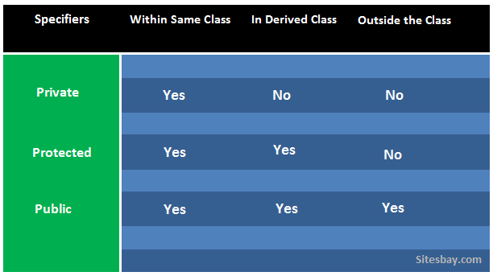

visibility
The visibility of a property, a method or (as of PHP 7.1.0) a constant can be defined by prefixing the declaration with the keywords public, protected or private.
Class members declared public can be accessed everywhere.
Members declared protected can be accessed only within the class itself and by inheriting and parent classes.
Members declared as private may only be accessed by the class that defines the member.
If the members are declared using var, the property will be defined by default as public.

Slide 4
PROPERTIES AND FUNCTIONS
Member Variable − These are the variables defined inside a class. This data will be invisible to the outside of the class and can be accessed via member functions. These variables are called attribute of the object once an object is created.
Member function − These are the function defined inside a class and are used to access object data.

Slide 5
INHERITANCE
Inheritance − When a class is defined by inheriting existing function of a parent class then it is called inheritance. Here child class will inherit all or few member functions and variables of a parent class.
Parent class − A class that is inherited from by another class. This is also called a base class or super class.
Child Class − A class that inherits from another class. This is also called a subclass or derived class.

Slide 6
POLYMORPHISM
Polymorphism − This is an object oriented concept where same function can be used for different purposes. For example function name will remain same but it make take different number of arguments and can do different task.
Overloading − a type of polymorphism in which some or all of operators have different implementations depending on the types of their arguments. Similarly functions can also be overloaded with different implementation.
Overriding - is process by which you can re-declare your parent class method in child class. So basic meaning of overriding in oop is to change behavior of your parent class method.

Slide 7
ABSTRACTION AND ENCAPSULATION
Data Abstraction − Any representation of data in which the implementation details are hidden (abstracted).
Encapsulation − refers to a concept where we encapsulate all the data and member functions together to form an object.

Slide 8
CONSTRUCTOR AND Destructor
Constructor − refers to a special type of function which will be called automatically whenever there is an object formation from a class.
PHP provides a special function called __construct() to define a constructor. You can pass as many as arguments you like into the constructor function.
Destructor − refers to a special type of function which will be called automatically whenever an object is deleted or goes out of scope.
You can define a destructor function using function __destruct(). You can release all the resources with-in a destructor.

