Slide 1



01
TECHWIZ 7 WEBSITE SHOWCASE
Ctrl+Alt+Defeat
presents BudgetBasics
Ahmed Abdulaziz Dahan
Ahmed Mujahed Al-Shabibi
Mohamed Saleh Al-Duais
Alaa Aldeen Kamel Anaam
APTECH · TECHWIZ 7 · AL-NASSER UNIVERSITY
Notes:
Aptech, TechWiz 7 and Al-Nasser University present BudgetBasics by team Ctrl+Alt+Defeat: Ahmed Abdulaziz Dahan, Ahmed Mujahed Al-Shabibi, Mohamed Saleh Al-Duais and Alaa Aldeen Kamel Anaam.

Slide 2
02
A STUDENT BUDGETING EXPERIENCE
BudgetBasics
Money skills, made clear.
LEARN
PRACTISE
EXPLORE
A frontend-only learning website for students and first-time budgeters
Notes:
BudgetBasics turns foundational money concepts into a clear learning and practice experience for students and first-time budgeters.

Slide 3
03
THE CHALLENGE
Budgeting can feel
overwhelming.
Too many rules. Too much jargon. Too little confidence.
Notes:
Budgeting often feels harder than it needs to. New learners face unfamiliar terms, rigid rules and little room to practise safely.

Slide 4
04
THE RESPONSE
Clear guidance.
No judgment.
Plain language, guided practice and honest privacy choices.
Everything runs locally in the browser.
Notes:
BudgetBasics uses plain language and guided practice. The learning content and interactive tools run locally in the browser.

Slide 5

05
MEET BUDGETBASICS
A friendly place to start
Start learning. Start planning.
Notes:
The home page welcomes learners with direct routes into learning, practice and visual resources. Calls to action lead to canonical pages without dead ends.

Slide 6
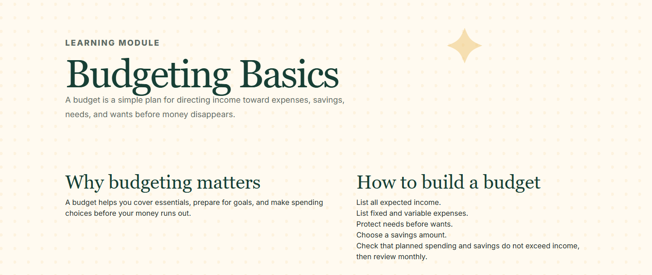
06
LEARN BUDGETING
Five lessons. One clear route.
/learn/{page}
Notes:
The Learn Budgeting dropdown opens five focused lessons. Each lesson lives under a clear /learn route and explains how to apply the idea.

Slide 7
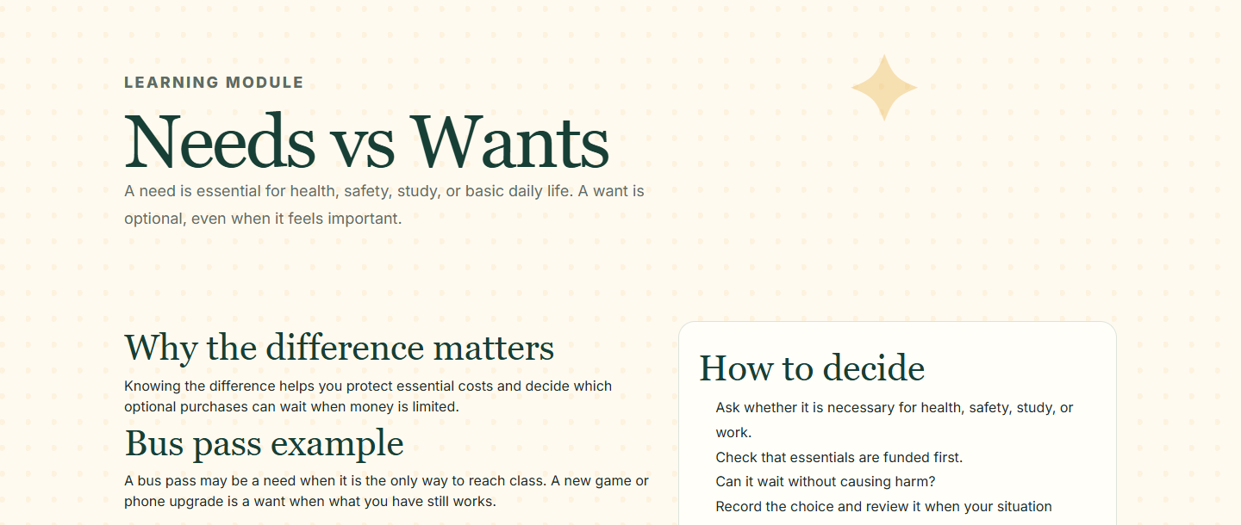
07
LEARNING IN CONTEXT
Needs or wants?
WHY?
The explanation matters more than the label.
Notes:
Needs versus Wants asks learners to classify examples, then explains the reason behind each answer. A decision guide connects necessity with affordability.

Slide 8
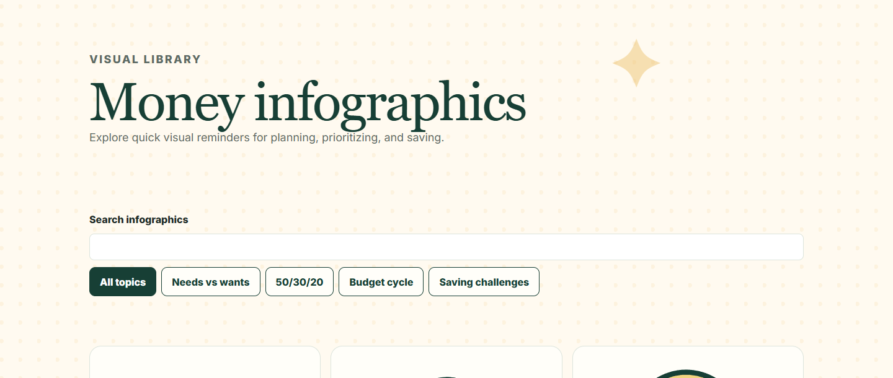
08
EXPLORE RESOURCES
Find the visual that helps
SEARCH · SORT · FILTER
Notes:
The resources gallery supports search, sorting and filters. Learners can narrow the locally bundled infographics and reset an empty state immediately.

Slide 9
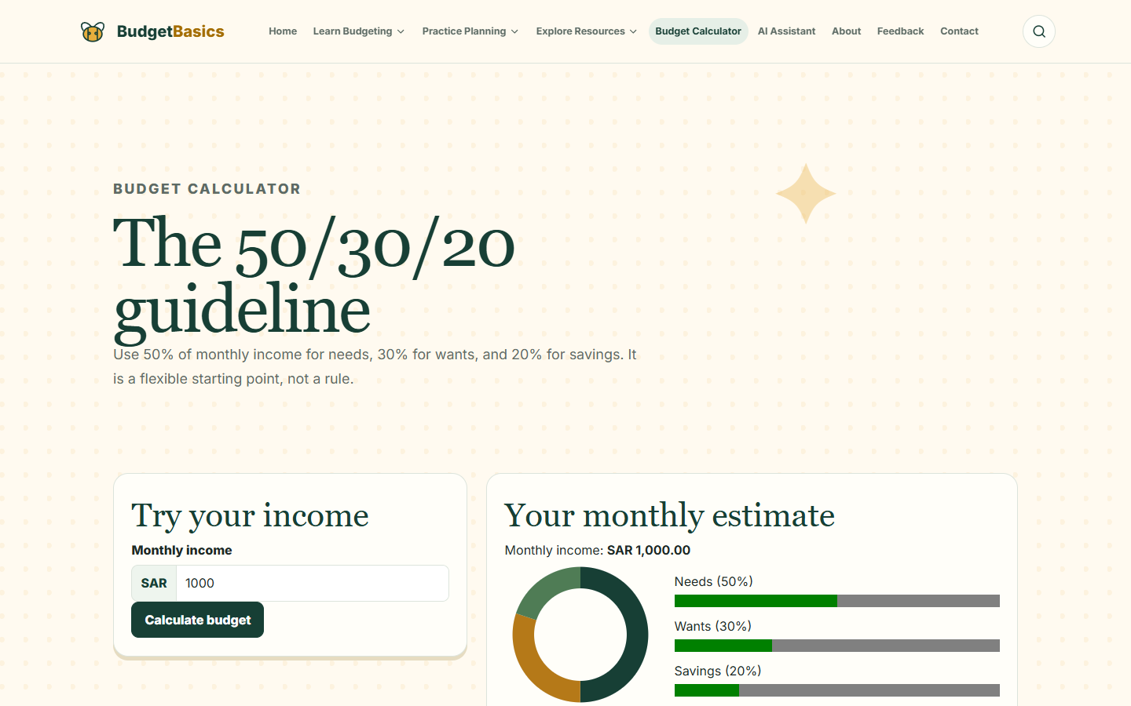
09
BUDGET CALCULATOR
Enter one number
1,000 SAR
See a simple 50–30–20 estimate.
Notes:
Enter 1,000 SAR. The calculator prepares an educational estimate based on the 50–30–20 guideline. It does not provide personalised financial advice.

Slide 10
10
INSTANT RESULT
500 · 300 · 200
Needs Wants Savings
50%
500 SAR
30%
300 SAR
20%
200 SAR
Notes:
The result shows 500 SAR for needs, 300 SAR for wants and 200 SAR for savings. Changing the input clears stale results, and invalid values never produce a false estimate.

Slide 11
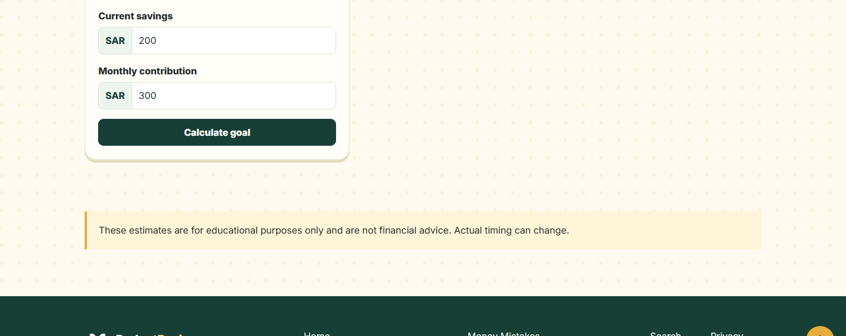
11
SAVINGS GOALS
Know the distance
4 MONTHS
Target 1,200 SAR. Current 200. Monthly 300.
Notes:
A 1,200 SAR target with 200 SAR already saved and 300 SAR added monthly leaves 1,000 SAR and an estimated four months. Progress caps at 100 percent.

Slide 12
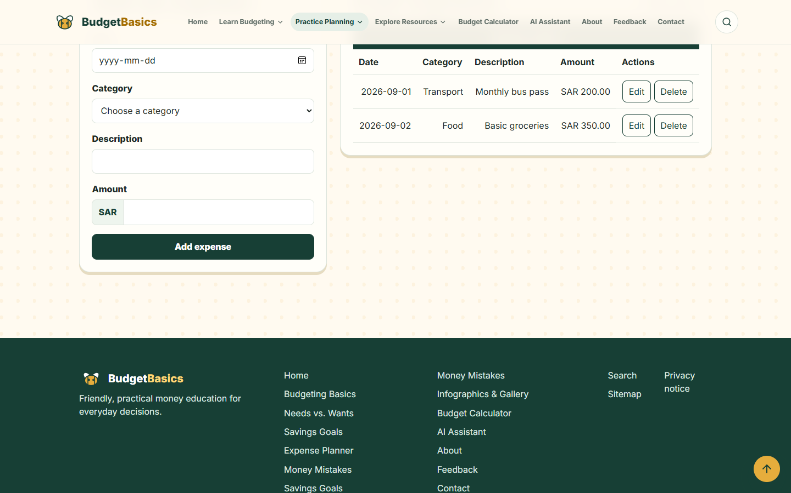
12
EXPENSE PLANNER
Every entry changes the picture
1,200 INCOME
550 EXPENSES
Notes:
The planner starts with 1,200 SAR income. Two sample expenses total 550 SAR, and every edit or deletion updates the balance immediately.

Slide 13
13
LIVE TOTALS
650 SAR remains
The balance stays visible as the plan changes.
550 SAR
total expenses
650 SAR
remaining
Notes:
The planner keeps total expenses and remaining income visible. Entries exist only in memory and disappear when the demonstration resets.

Slide 14
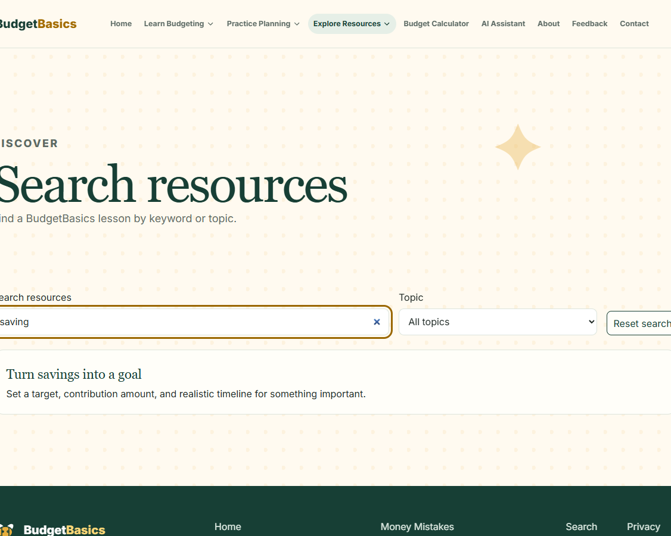
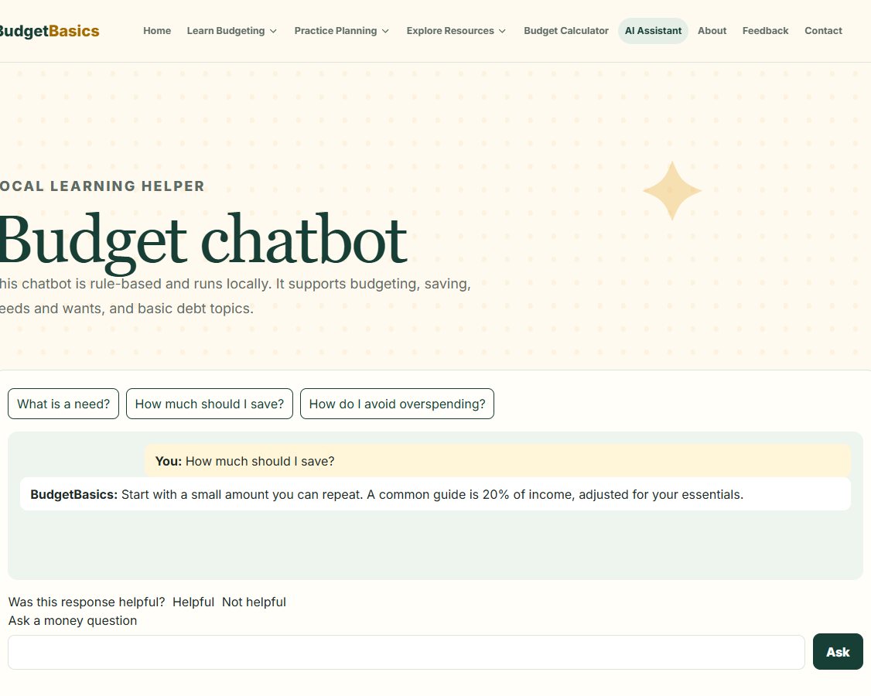
14
SEARCH AND ASSISTANT
Find it. Ask it.
Bundled search
Rule-based local assistant
Notes:
Search uses bundled content. The chatbot answers common budgeting questions with deterministic local rules. It is not a live generative AI service.

Slide 15
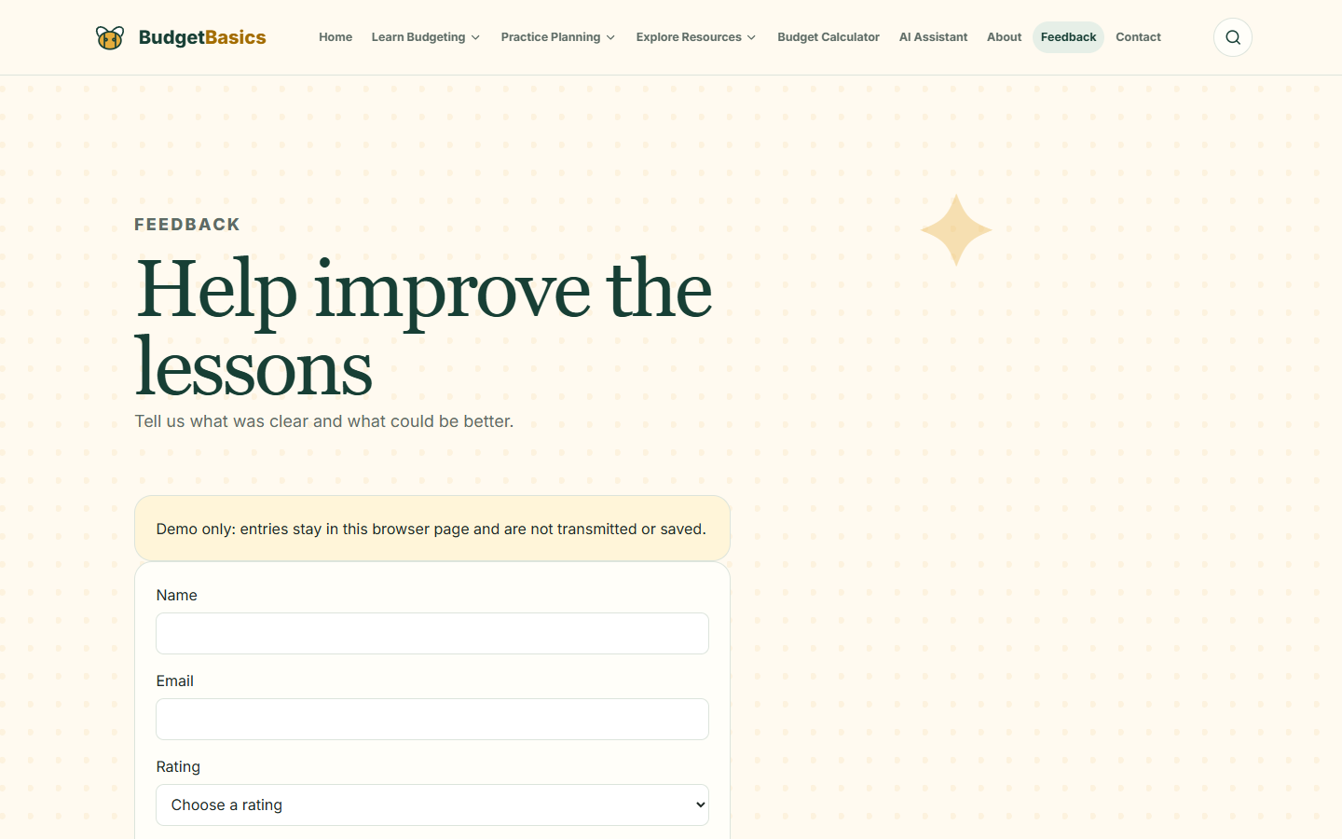
15
FEEDBACK AND PRIVACY
Your demo stays local
NO SERVER SUBMISSION
No permanent storage
No analytics
No banking data
Notes:
The feedback form demonstrates accessible validation and local confirmation. It sends nothing to a server and stores no personal or banking data.

Slide 16
16
PROJECT EVIDENCE
Built. Tested. Ready.
112
0
1
tests passed
lint findings
production build
No Lighthouse score claimed. No network submission claimed.
Reproducible repository evidence
Notes:
The project evidence records 112 passing tests, zero lint findings and a successful production build. The project makes no Lighthouse claim and no network submission claim.

Slide 17
17
BUDGETBASICS
Learn clearly.
Practise safely.
Keep control.
Money skills for a confident first step.
Notes:
BudgetBasics gives new learners a clear first step: understandable lessons, safe practice and control over their data.

Slide 18
18
THANK YOU
Ctrl+Alt+Defeat
BudgetBasics
Ahmed Abdulaziz Dahan
Ahmed Mujahed Al-Shabibi
Mohamed Saleh Al-Duais
Alaa Aldeen Kamel Anaam
TECHWIZ 7
budget basics, made practical
Notes:
Thank you from team Ctrl+Alt+Defeat and BudgetBasics.

