Slide 1

Dynamics of the Hippocampal Ensemble Code for Space:
A Critique
Matthew A. Wilson and Bruce L. McNaughton (1993)
Group B2
Katelyn Pirie
Koral Neil
Praveena Simopillai
Sara Silva
Nakul Ratra
Pavi Nantheeswarar

Slide 2
Outline
Background Information
Variables Failed to be Controlled for:
Orientation
Velocity
Odour
Age
Further Implications and Studies

Slide 3
Key Concepts
Sara
Place cells: principal neuron in the hippocampus that exhibit a high rate of firing whenever an animal is at a specific location in an environment corresponding to that cell’s place field
  Also known as pyramidal or complex spike (CS) cells
CA1 and CA3 Cells: area in the hippocampus that is densely packed with pyramidal cells
Theta Cells: inhibitory interneurons

Slide 4
Background Information
Sara
Wilson & McNaughton (1993)
AIM:
To describe dynamics of ensemble encoding of space in the hippocampus during a single episode of exploration in a novel environment
3 rats were implanted with micro-drive arrays, trained over 10 days to forage small chocolate pellets in a rectangular apparatus
Ensemble recording were used to accurately predict the rats movement through their environment

Slide 5
Background Information
Sara
Wilson & McNaughton (1993)
Conclusions:
The suppression of inhibitory interneurons facilitates the synaptic modification necessary to encode new spatial information
Ensembles of 50-100 cells can transmit enough information to pinpoint an animal’s location in space to within a few centimeters in 1 second
This opens the possibility of the interpretation of neuronal activity in the absence of explicit behaviours

Slide 6
Orientation & Direction
Praveena
In the study by Wilson & McNaughton, direction and orientation was not controlled for.
An earlier study done by McNaughton et. al. (1983), shows that direction and position affect the way in which Complex-Spike cells are activated.
Fuhs et al. (2005) conducted a study to assess the effects of interactions between angular path integration and visual landmarks on the firing of hippocampal neurons.

Slide 7
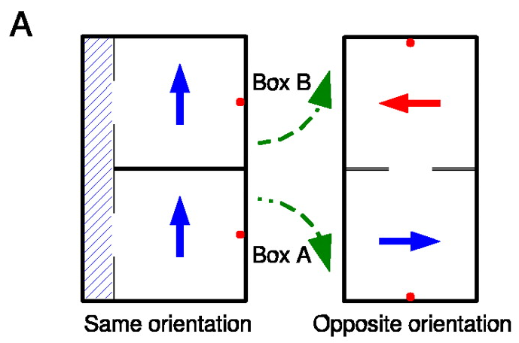
Orientation & Direction
Praveena
Fuhs et. al. (2005)
FIG. 1. In the same-orientation condition, the boxes were connected by a corridor; in the opposite-orientation condition, the corridor was removed and the boxes were rotated and joined.

Slide 8
Orientation & Direction
Praveena
Fuhs et al. (2005)
Results:
In same-orientation condition the place fields were not remapped.
In opposite-orientation condition they observed stable partial remapping of place fields
Conclusion:
When animals are able to maintain their inertial angular orientation, it can “profoundly affect the hippocampal map”

Slide 9
Orientation & Direction (cont’d)
Praveena
What does this all mean…?
McNaughton and Wilson paid little attention to orientation and direction as a factor of hippocampal activation
Other studies have found that these factors can do affect activation of the hippocampal region.

Slide 10
Velocity
Katelyn
Wilson and McNaughton (1993)
Speed doesn’t affect place cell firing
In phase 4 normal firing was resumed immediately
  characterized by a change in firing rate and running speed of rats
Contradicting

Slide 11
Velocity (cont’d)
Katelyn
McNaughton, Barnes, O’Keefe (1983)
AIM:
examined firing patterns of place and theta cells with respect to position, direction, and velocity of the rat
Cells measured with electrodes while rats performed forced choice tasks in an 8 arm radial maze

Slide 12
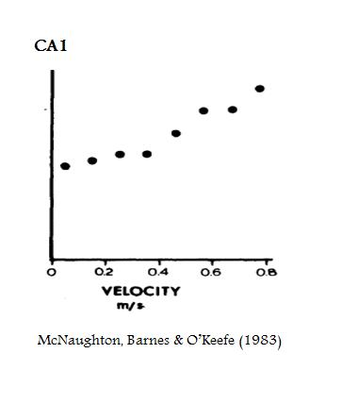
Velocity (cont’d)
Katelyn
McNaughton, Barnes, O’Keefe (1983)
Results:
Place cell firing rate increased with velocity

Slide 13
Velocity (cont’d)
Katelyn
Frank, Brown, & Stanley (2006)
Used speed as a measure of familiarity in a maze
Novel environment rats moved slowly
Expected faster movement in familiar environment
Moved slowly even after place fields stabilized

Slide 14
Velocity (cont’d)
Katelyn
What does this all mean..?
McNaughton and Wilson paid little attention to velocity as a factor to cause cell activity
Other studies found that velocity can affect place cell activation

Slide 15
Olfactory
An additional factor which could have been controlled for.
Study by Kulvicius, Tamosiunaite, Ainge, Dudchenko and Wörgötter (2008) :
Considered areas of study:
Olfactory place cell importance in goal navigation to food source within environment.
Importance of olfactory cues in place cell formation and firing.

Slide 16
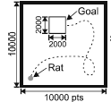
Olfactory (cont’d)
Rat explored environment via trial and error until it reached food source.
Rat marked location with a small, self-generated odour mark.
Subsequent runs: Rat went directly to the perceived scent mark and remarked with scent.
Rats were placed on same or different start positions.

Slide 17


Olfactory (cont’d)
Rat marked location with a small, self-generated odour mark.
Random Start Location
Same Starting Location

Slide 18
Olfactory (cont’d)
Place Cell Development
METHOD:
Number of omni-directional place cells were counted ie. cells that fire maximally at a given location, independent of the movement, direction or changes in velocity.
Rat explored environment randomly.
Place cell count to place prior to and after learning of environment from visual only stimuli and both visual and olfactory stimuli
Averaged results of 20 experiments were compared.

Slide 19
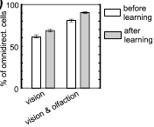
Olfactory (cont’d)
Results
Significant increase in no. of omnidirectional cells in combined stimuli environment compared to visual stimuli only.
Figure 3a

Slide 20
Olfactory (cont’d)
So what does this all mean?
Olfactory cues can be used to navigation and code enviromental space, not just visual cues – scent marks.
Presence of olfcatory stimuli has an affect on place cell growth and firing.
Therefore rats may have responded to changes in olfactory cues via onmi-directional cues, not change in visual environment.
Different firing seen between familiar box A and unfamiliar box B, due to chocolate and/or scent mark stimuli.

Slide 21
Age
Pavi
Shen, et al. (1997)
AIM:
determined whether experience-dependent expansion of place fields is altered by age
young and old rats ran around a rectangular track
EEG recordings and measurements were taken and combined every 5 laps
  lap 1, 5, 10, 15

Slide 22
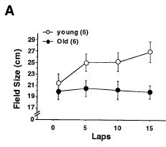
Age (cont’d)
Pavi
Shen, et al. (1997)
Results:
First session (lap 1)
  no significant difference
    initial sizes of the place fields were the same between ages
Later sessions
(lap 5,10, 15)
  significant difference
    place fields of young rats, but not old rats, expanded significantly

Slide 23
Age (cont’d)
Pavi
Shen, et al. (1997)
Conclusions:
age affects experience-dependent plasticity
loss of experience-dependent plasticity in the place fields of old rats
the aged hippocampus fails to show an experience-dependent increase in the amount of spatial information it transmits

Slide 24
Age (cont’d)
Pavi
Wilson, et al. (2005)
AIM:
compared spatial firing patterns of CA1 and CA3 neurons in aged rats vs. young rats as they explored familiar and novel environments
place cell recordings taken in a familiar environment and 1 of 3 novel environments

Slide 25
Age (cont’d)
Pavi
Wilson, et al. (2005)
Results:
CA1 cells of aged rats had firing properties similar to those of the young adults
Aged CA3 cells had higher firing rates in general & failed to change firing rates and place fields as much as CA3 cells of young rats in novel environment
Notes:
CA1 calls: both groups had overall similar firing rates & made adjustments in firing rates in response to a change in the environment

Slide 26
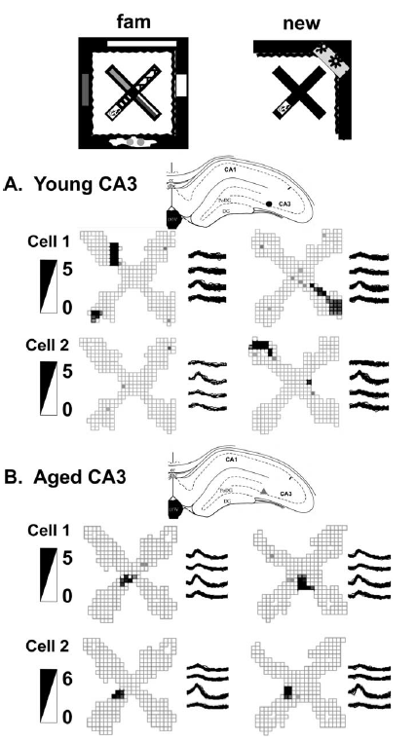
Age (cont’d)
Pavi
Wilson, et al. (2005)
Figure 3:
Young CA3 cells created new spatial representations & often some were active in only one environment
Aged CA3 cells used similar place field representations for both environments & scarcely changed their firing rates

Slide 27
Age (cont’d)
Pavi
Wilson, et al. (2005)
Conclusion:
aged CA3 cells failed to rapidly encode new spatial information compared to young CA3 cells
CA3 place cells plays a key role in the age-related changes that underlie spatial memory impairment.

Slide 28
Age (cont’d)
Pavi
What does this all mean..?
Older rats do not appear to learn new locations as quickly
Younger rats adapt more quickly and develop greater plasticity
But rats younger than 50 days do not appear to learn new locations as quickly
  Age is important in terms of plasticity
  Authors need to include age in the study as this can bias the results

Slide 29
Further Implications
Nakul
Dissociation study in article? There is no lesion rat to compare to as a control. How can they infer conclusions on localization of function in terms of memory within these parameter? Future study to prove localization?
Study shows that during phase 2- inhibition of interneurons was recorded, suggesting synaptic modification necessary to encode new spatial information

Slide 30
Further Implications
Nakul
Neurons containing GABA are inhibited, which gives excitatory input to NMDA receptors and results in synaptic enhancement.
During Alzheimer’s Disease- it is reported that there is a loss of GABA-ergic neurons resulting in Glutamate neurotoxicity over-activation in NMDA receptor.

Slide 31
Further Implications (cont’d)
Nakul
Shankar et al, 2008 studied effects of amyloid beta plaque dimers of AD on rodent hippocampus. It shows that soluble dimers of amyloid beta in AD reduces dendritic spines and excitatory synapses in pyramidal neurons of hippocampus, inhibiting LTP and enhancing LTD
Based on these inferences, inhibition of NMDA should help prevent Alzheimer’s
Parsons et al, 2007 show that Memantine is a NMDA receptor antagonist improves memory by restoration of homeostasis in the glutamatergic system--too little activation is bad, too much is even worse.

Slide 32
References
Barnes, C.A., McNaughton, B.L., & O’Keefe, J. (1983). The Contributions of Position, Direction, and Velocity to Single Unit Activity in the Hippocampus of Freely-moving Rats. Experimental Brain Research 52(1), 41-49. doi: 10.1007/BF00237147
Fuhs, M. C., VanRhoads, S. R., Casale, A. E., McNaughton, B., & Touretzky, D. S. (2005). Influence of path integration versus environmental orientation on place cell remapping between visually identical environments. Journal of Neurophysiology, 94(4), 2603-2616.
Kulvicius. T, Tamosiunaite. M, Ainge.J, Dudchenko. P and Wörgötter. F (2008). Odor supported place cell model and goal navigation in rodents, J Comput Neurosci. Vol. 25, p481–500.

Slide 33
References (cont’d)
Loren, Frank M., Brown, Emery N., & Stanley, Garrett B. (2006). Hippocampal and cortical place cell plasticity: Implications for episodic memory. Hippocampus, 16(9), 775-784. doi: 10.1002/hipo.20200
Martin, P. D., & Berthoz, A. (2002). Development of spatial firing in the hippocampus of young rats. Hippocampus, 12(4), 465-480.
McNaughton, B., Barnes, C., & O'Keefe, J. (1983). The contributions of position, direction, and velocity to single unit activity in the hippocampus of freely-moving rats. Experimental Brain Research, 52(1), 41-49.
Parsons, C.G, et al. (2007). Memantine: a NMDA receptor antagonist that improves memory by restoration of homeostasis in the glutamatergic system - too little activation is bad, too much is even worse. Neuropharmacology, 53(6), 699-723.

Slide 34
References (cont’d)
Shankar , et al. (2008). Soluble amyloid-beta oligomers and synaptic dysfunction in Alzheimer's disease. Dissertation abstracts international. B, The sciences and engineering, 69(1-B), 145.
Shen, J., Barnes, C. A., McNaughton, B. L., Skaggs, W. E., & Weaver, K. L. (1997). The effect of aging on experience-dependent plasticity of hippocampal place cells. The Journal of Neuroscience : The Official Journal of the Society for Neuroscience, 17(17), 6769-6782.
Wilson, I. A., Ikonen, S., Gallagher, M., Eichenbaum, H., & Tanila, H. (2005). Age-associated alterations of hippocampal place cells are subregion specific. The Journal of Neuroscience : The Official Journal of the Society for Neuroscience, 25(29), 6877-6886.
Wilson, M. A & Mcnaughton, B. L. (1993). Dynamics of the hippocampal ensemble code for space. Science, 261, 1055-1058.

