Slide 1
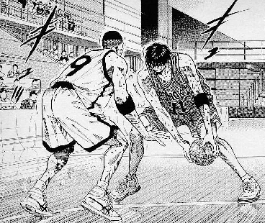
本日は 1on1 について思うことを述べます
（井上雄彦 スラムダンク）

Slide 2
自己紹介

Slide 3
早速 1on1 のデモ

Slide 4

今日はよろしくお願いします

Slide 5

はい、よろしくお願いします

Slide 6
最近暑いですよね

Slide 7
本当、暑いですね

Slide 8
安部さんやめてしまいますね

Slide 9
… ですね

Slide 10
次は進次郎？は、ないかな～

Slide 11
ないですね～

Slide 12
… ところで

Slide 13
プロジェクトの様子はどうですか？

Slide 14
粛々と進めている感じです

Slide 15
… そうですか

Slide 16
他に何か心配毎はありませんか？

Slide 17
はい、今のところありません

Slide 18
Q. この 1on1 で良いのか良くないのか？

Slide 19
Q. この 1on1 で良いのか良くないのか？
↓
Q. 目的 に対して合理的か否か？

Slide 20
例えばこんな目的

Slide 21
1on1 = 成長 + 守り + 攻め

Slide 22
1on1 = 成長 + 守り + 攻め

Slide 23
経験学習

Slide 24
内省支援 = 経験学習促進

Slide 25
内省支援 = 経験学習促進
進捗確認
コーチング・ティーチング・フィードバック

Slide 26
組織戦略
カスケードダウン
周囲との関係性
アドバイス
キャリアについて
意見交換
内省支援 = 経験学習促進
進捗確認
コーチング・ティーチング・フィードバック

Slide 27
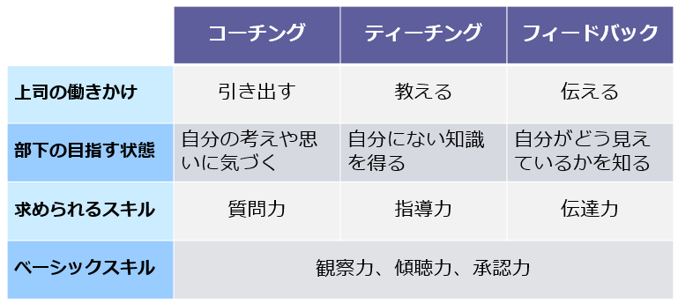

Slide 29


Slide 32
1on1 = 成長 + 守り + 攻め

Slide 33
Q. コロナ禍での働き方の変化は？

Slide 34
良い点

Slide 35
多様（時間、場所）な働き方の選択

Slide 36
人材フル活用 x 個のパフォーマンス最大化

Slide 37
Q. 新たな課題は？

Slide 38
業務
業務外
会議で同僚と話す内容
業務
業務外
オフィスで同僚と話す内容
業務
業務外
社外で同僚と話す内容

Slide 39
業務
業務外
会議で同僚と話す内容
業務
業務外
オフィスで同僚と話す内容
業務
業務外
社外で同僚と話す内容

Slide 40
業務
業務外
会議で同僚と話す内容
業務
業務外
オフィスで同僚と話す内容
業務
業務外
社外で同僚と話す内容

Slide 41
ノンバーバルな情報を得にくい
ちょっとしたことが共有されにくくなる （違和感や気づきなど）
関係性構築のハードルがあがる
ドラクエの難易度があがる
ハブになる人の情報収集ハードルがあがる

Slide 42
守り = 新たに発生した課題を補う手段

Slide 43
1on1 = 成長 + 守り + 攻め

Slide 44
時間を使う以上は新たな価値を！

Slide 45
「情報の交差点」
歴史が示す事実として価値創造の場

Slide 46
弊社 CEO も社内外で 1on1 を実施

Slide 47
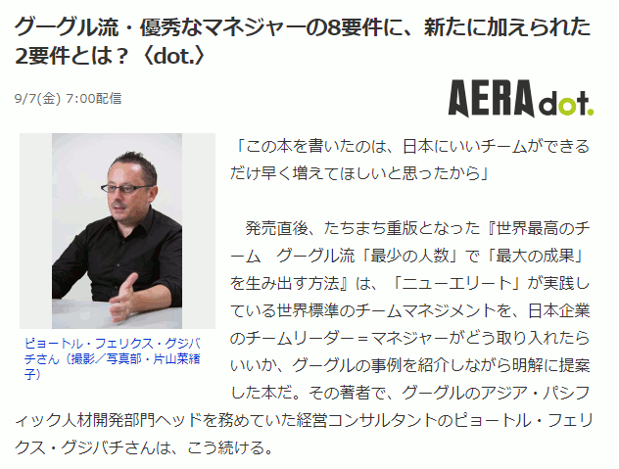

Slide 48
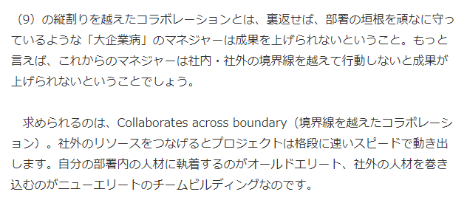

Slide 49
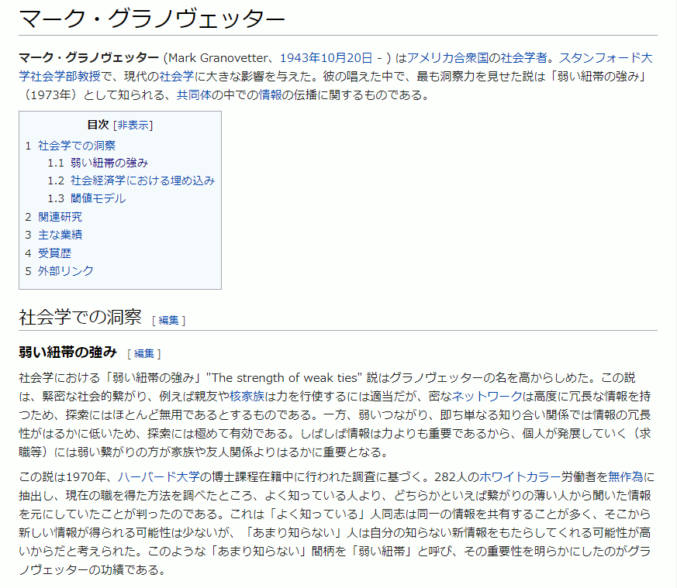

Slide 50
メンティーの例えば …

Slide 51
壁打ちを仕掛けてみる

Slide 52
コーチのエキスパートに聞いた話

Slide 53
メンターの例えば …

Slide 54
WHY を聞いてみる

Slide 55
On Hiring Technical PMs :
The right question is never "can you get it done faster?" It’s more like "okay, got it, 2–3 months… can you explain to me what you need to do?" Most of the time, you have an interesting conversation and you walk away better able to explain (eg, to management) why something that looks simple is in fact difficult. Some of the time, however, you learn that the thing that takes all the time and effort is not a hard requirement, and you come up with a much cheaper alternate solution. "Oh, we don’t actually need perfectly synchronized caching in this case, we can handle a couple of minutes of inconsistency." And you just saved someone two months of work.

Slide 56
On Hiring Technical PMs :
The right question is never "can you get it done faster?" It’s more like "okay, got it, 2–3 months… can you explain to me what you need to do?" Most of the time, you have an interesting conversation and you walk away better able to explain (eg, to management) why something that looks simple is in fact difficult. Some of the time, however, you learn that the thing that takes all the time and effort is not a hard requirement, and you come up with a much cheaper alternate solution. "Oh, we don’t actually need perfectly synchronized caching in this case, we can handle a couple of minutes of inconsistency." And you just saved someone two months of work.

Slide 57
On Hiring Technical PMs :
The right question is never "can you get it done faster?" It’s more like "okay, got it, 2–3 months… can you explain to me what you need to do?" Most of the time, you have an interesting conversation and you walk away better able to explain (eg, to management) why something that looks simple is in fact difficult. Some of the time, however, you learn that the thing that takes all the time and effort is not a hard requirement, and you come up with a much cheaper alternate solution. "Oh, we don’t actually need perfectly synchronized caching in this case, we can handle a couple of minutes of inconsistency." And you just saved someone two months of work.

Slide 58
On Hiring Technical PMs :
The right question is never "can you get it done faster?" It’s more like "okay, got it, 2–3 months… can you explain to me what you need to do?" Most of the time, you have an interesting conversation and you walk away better able to explain (eg, to management) why something that looks simple is in fact difficult. Some of the time, however, you learn that the thing that takes all the time and effort is not a hard requirement, and you come up with a much cheaper alternate solution. "Oh, we don’t actually need perfectly synchronized caching in this case, we can handle a couple of minutes of inconsistency." And you just saved someone two months of work.

Slide 59
On Hiring Technical PMs :
The right question is never "can you get it done faster?" It’s more like "okay, got it, 2–3 months… can you explain to me what you need to do?" Most of the time, you have an interesting conversation and you walk away better able to explain (eg, to management) why something that looks simple is in fact difficult. Some of the time, however, you learn that the thing that takes all the time and effort is not a hard requirement, and you come up with a much cheaper alternate solution. "Oh, we don’t actually need perfectly synchronized caching in this case, we can handle a couple of minutes of inconsistency." And you just saved someone two months of work.

Slide 60
On Hiring Technical PMs :
The right question is never "can you get it done faster?" It’s more like "okay, got it, 2–3 months… can you explain to me what you need to do?" Most of the time, you have an interesting conversation and you walk away better able to explain (eg, to management) why something that looks simple is in fact difficult. Some of the time, however, you learn that the thing that takes all the time and effort is not a hard requirement, and you come up with a much cheaper alternate solution. "Oh, we don’t actually need perfectly synchronized caching in this case, we can handle a couple of minutes of inconsistency." And you just saved someone two months of work.

Slide 61
中山的な例えば …

Slide 62
メンティーもメンターも
ほんの少しの準備をしてみる

Slide 63
メンティーは進捗のサマリ （+ good, bad）
メンターは ask すべきこと

Slide 64
ありがとうございました

