Slide 1

domain
owner
d-1.com
1st party
html@iframe
d-1.com
d-3.com
3rd party
（evil）
js

Slide 2


Slide 3

domain
owner
d-1.com
1st party
html@iframe
d-2.com
d-3.com
3rd party
（evil）
js

Slide 4
domain
owner
d-1.com
1st party
d-3.com
3rd party
（trusted）
js
js-2
js-3
d-x.com
3rd party
（evil）
js-4

Slide 5
domain
owner
d-1.com
1st party
d-3.com
3rd party
js
js-2
js-3
d-x.com
other 3rd party
js-4

Slide 6
domain
owner
d-1.com
1st party
html@iframe
d-1.com
d-3.com
3rd party
（evil）
js

Slide 7
domain
owner
d-1.com
1st party
html@iframe
d-1.com
d-3.com
3rd party
（evil）
js

Slide 8
domain
owner
1st.example
1st party
Web Application
evil.example
3rd party
（evil）
js

Slide 9
domain
owner
1st.example
1st party
Web Application
foo.example
html@iframe
evil.example
3rd party
（evil）
js

Slide 10
domain
owner
1st.example
1st party
Web Application
hoge.example
3rd party
js

Slide 11
domain
owner
1st.example
1st party
Web Application
hoge.example
3rd party
js
js
js
js

Slide 12
domain
owner
1st.example
1st party
Web Application
hoge.example
3rd party
js
js
js
evil.example
3rd party
（evil）
js

Slide 13
domain
owner
1st.example
1st party
CSP
Web Application
hoge.example
3rd party
js
js
js
evil.example
3rd party
（evil）

Slide 15
domain
owner
safe.example
1st-party
（CSP）
green
orange
html
green.example
3rd-party
js
orange.example
3rd-party
js
red.example
3rd-party
js

Slide 16
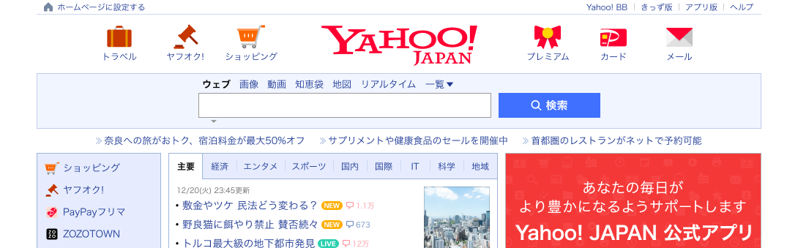
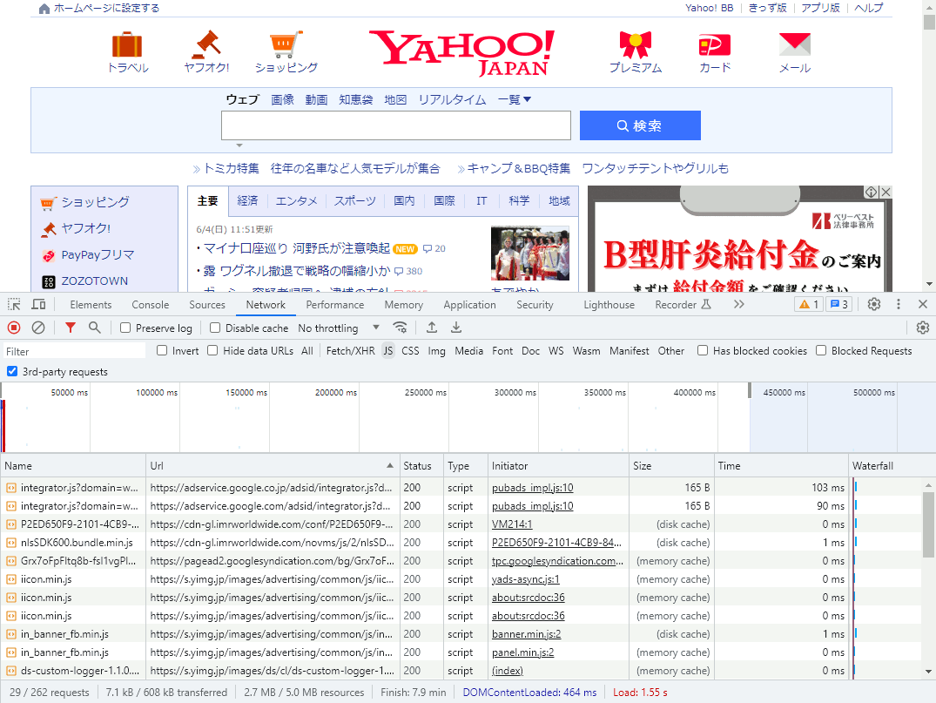

Slide 17
domain
owner
safe.example
1st-party
html
evil.example
3rd-party
（evil）
js

Slide 18
domain
owner
safe.example
1st-party
A
html
unsafe.example
B
html@iframe
evil.example
3rd-party
（evil）
js

Slide 19
domain
owner
safe.example
1st-party
（CSP）
trusted
html
trusted.example
3rd-party
(trusted)
js
evil.example
3rd-party
（evil）
js

Slide 20
domain
owner
safe.example
1st-party
html
html
green.example
3rd-party
js
orange.example
3rd-party
js
red.example
3rd-party
js

Slide 21
domain
owner
safe.example
1st-party
（CSP-RO）
html
request
param
green.example
3rd-party
response
request
param
orange.example
3rd-party
response
request
param
red.example
3rd-party
response

