Slide 1
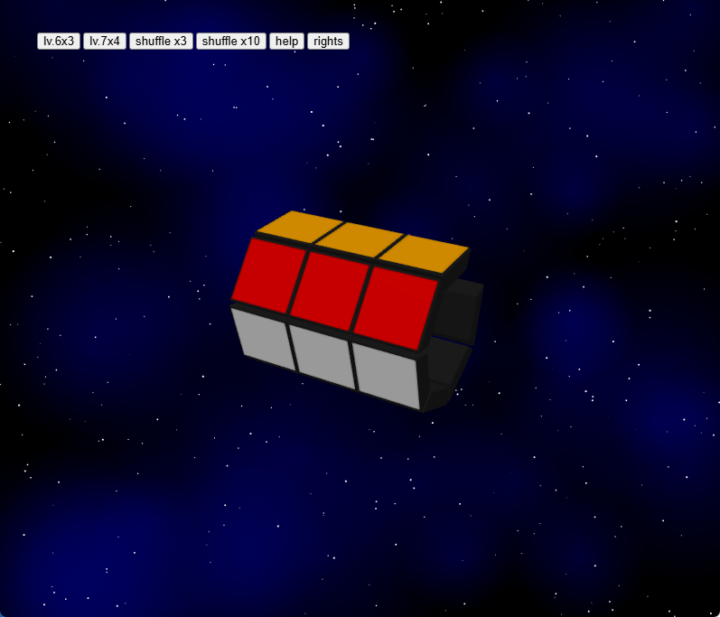
1. choose lower level

Slide 2
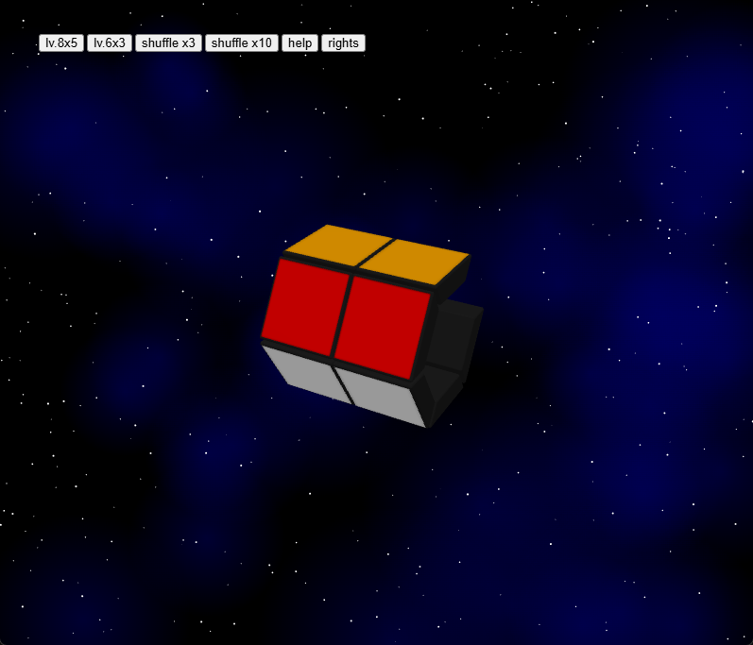
1. choose lower level

Slide 3
2. choose higher level

Slide 4
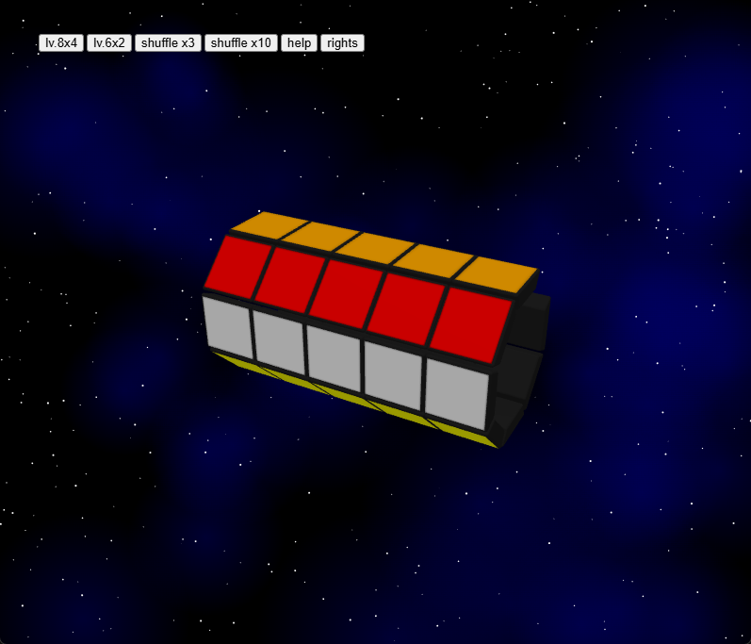
2. choose higher level

Slide 5
3. shuffle several times

Slide 6
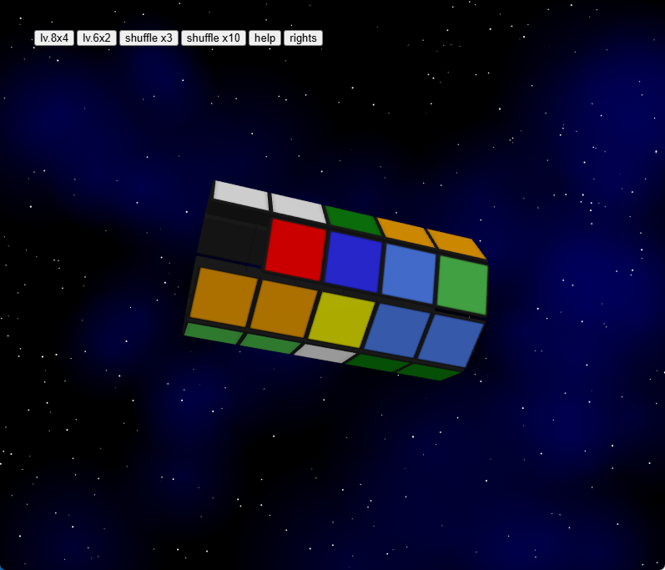
3. shuffle several times

Slide 7
4. try to complete

Slide 8
4. try to complete

