Slide 1
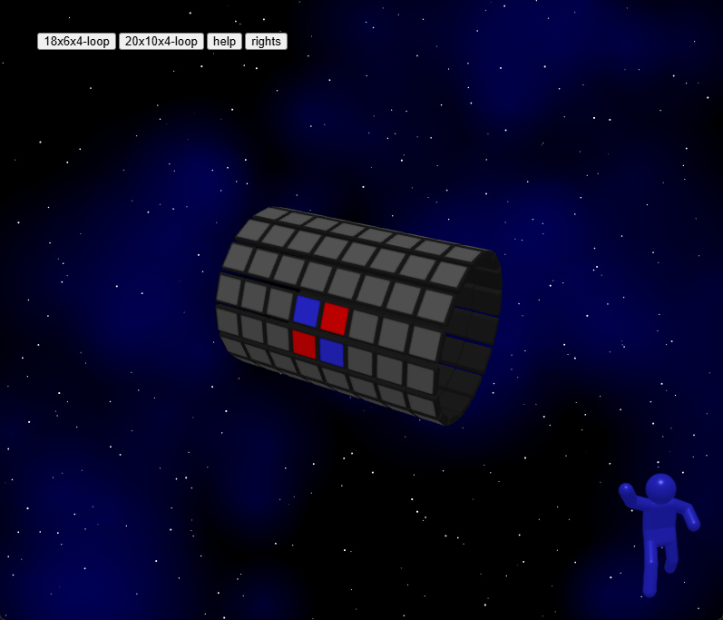
1. choose narrow board

Slide 2
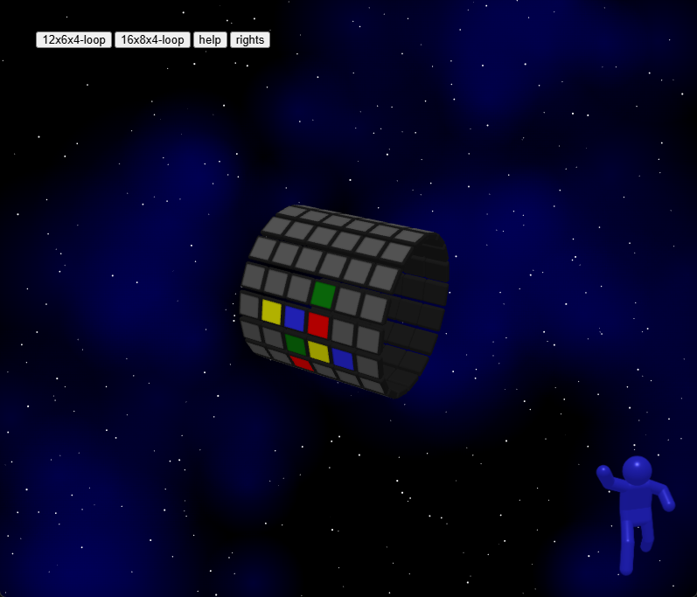
1. choose narrow board

Slide 3
2. choose wide board

Slide 4
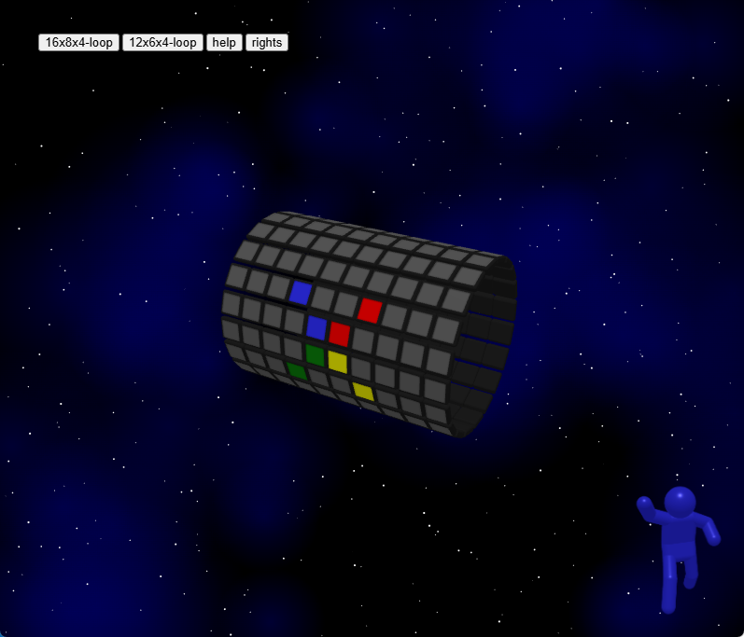
2. choose wide board

Slide 5
3. set zoom level

Slide 6
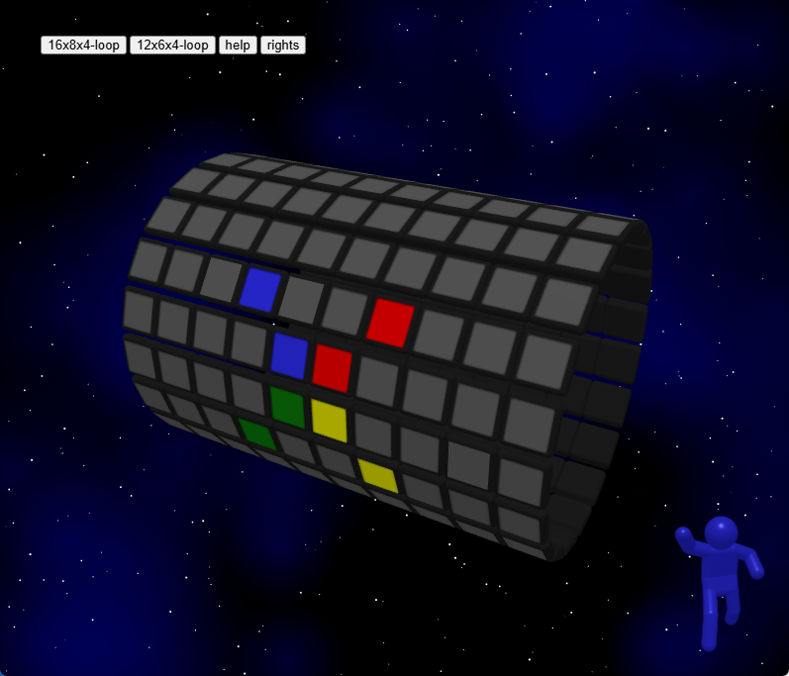
3. set zoom level

Slide 7
4. start 2 or 4 players reversi

Slide 8
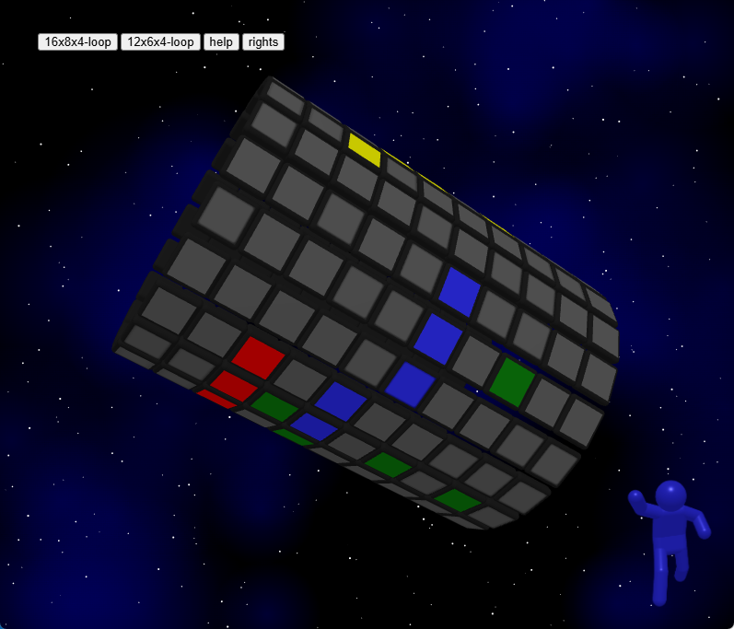
4. start 2 or 4 players reversi

