Slide 1
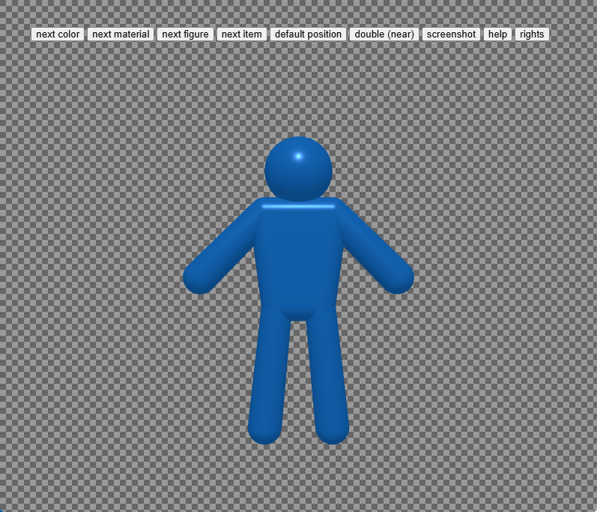
1. decide color

Slide 2
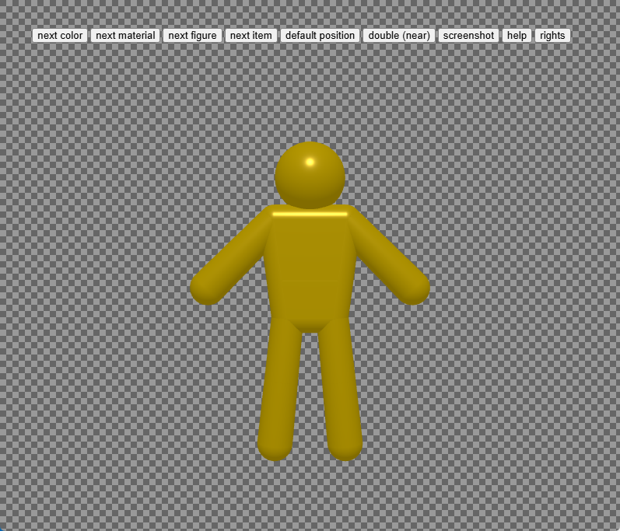
1. decide color

Slide 3
2. decide material

Slide 4
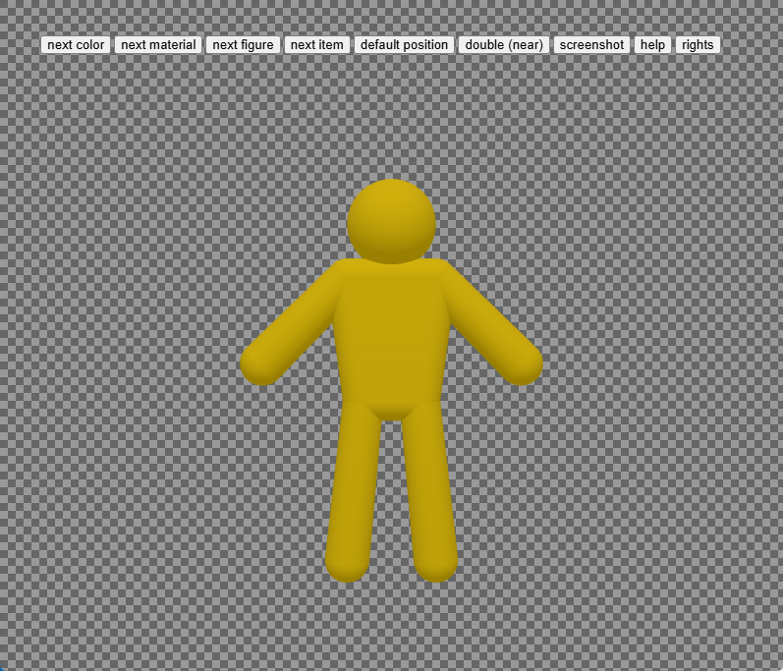
2. decide material

Slide 5
3. decide figure

Slide 6
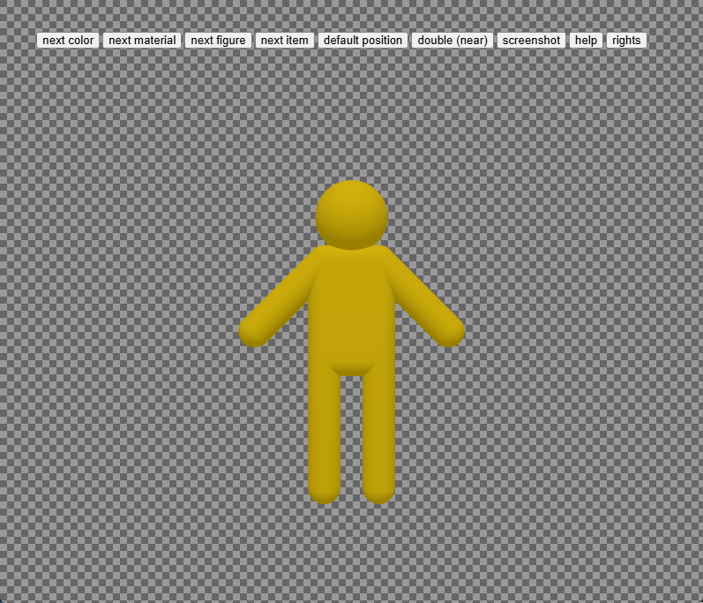
3. decide figure

Slide 7
4. decide item

Slide 8
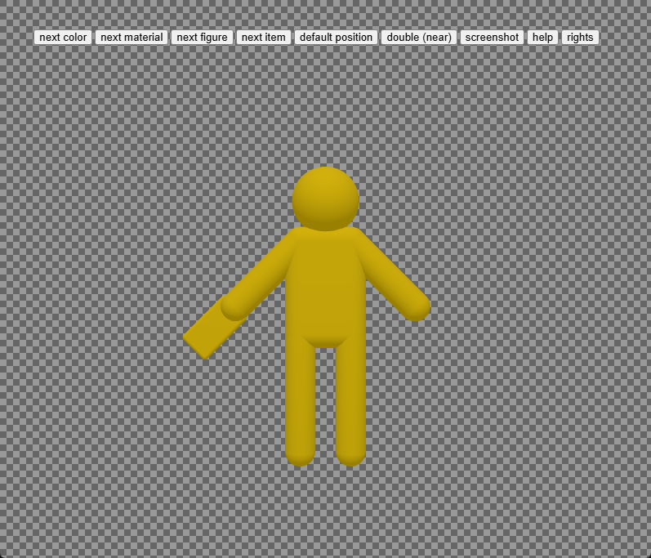
4. decide item

Slide 9
5. set your favorite pose

Slide 10
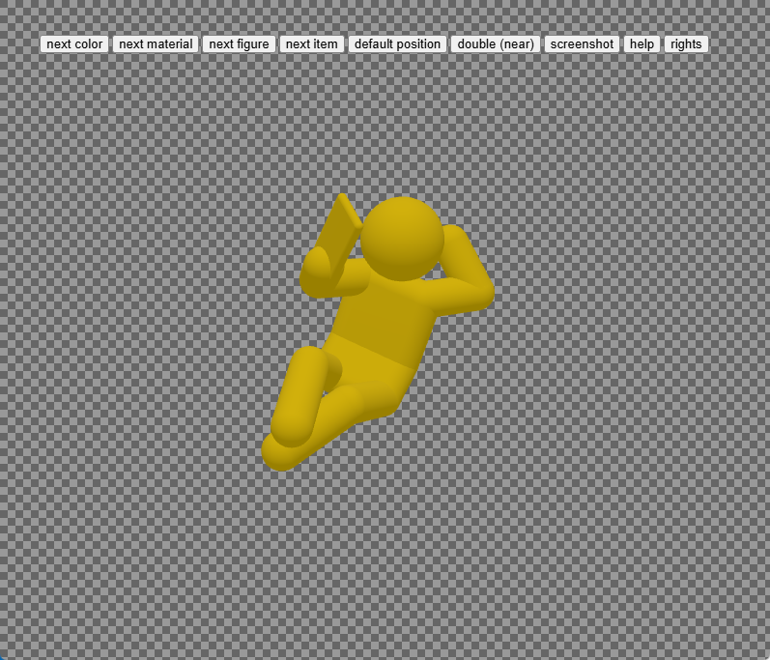
5. set your favorite pose

Slide 11
6. set zoom level

Slide 12
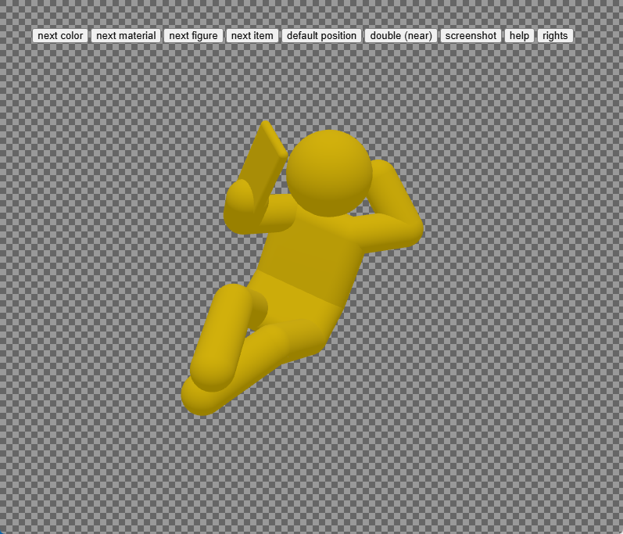
6. set zoom level

Slide 13
7. take screenshot

Slide 14
7. take screenshot

Slide 15

8. picture in your clipboard

Slide 16
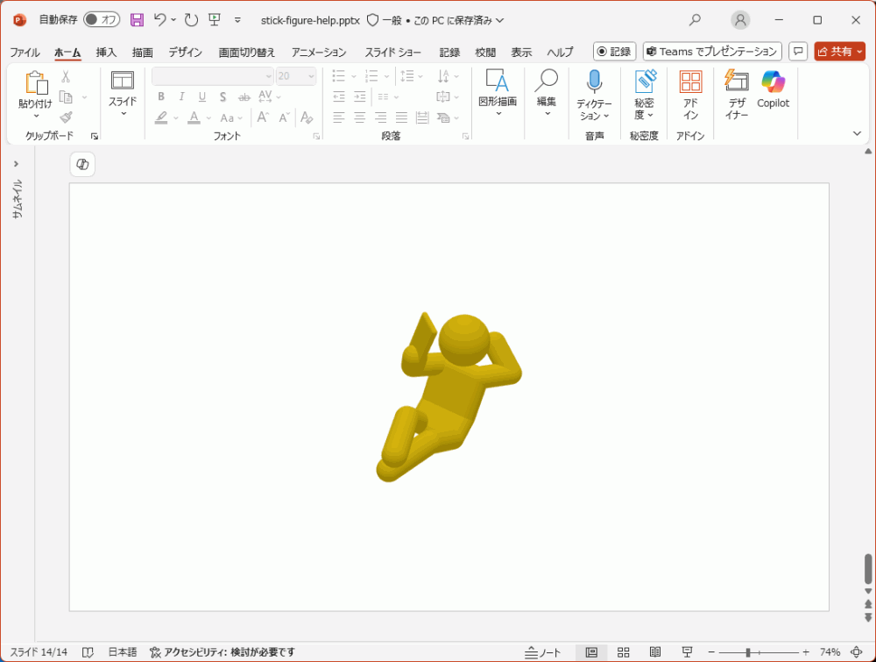
9. paste it to your slide

