Slide 1
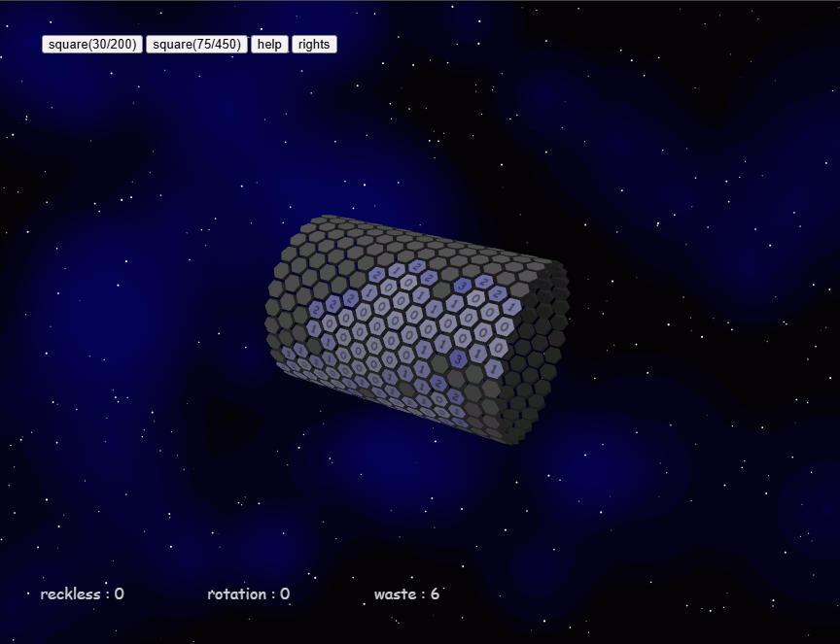
1. choose narrow board

Slide 2
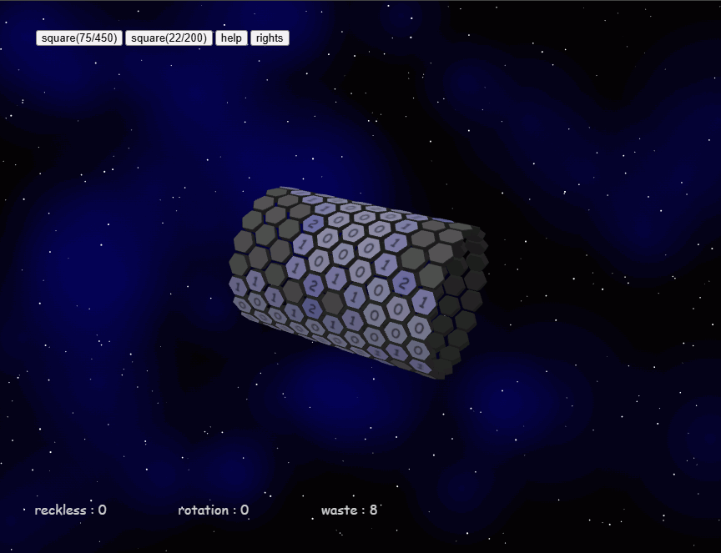
1. choose narrow board

Slide 3
2. choose wide board

Slide 4
2. choose wide board

Slide 5
3. set zoom level

Slide 6
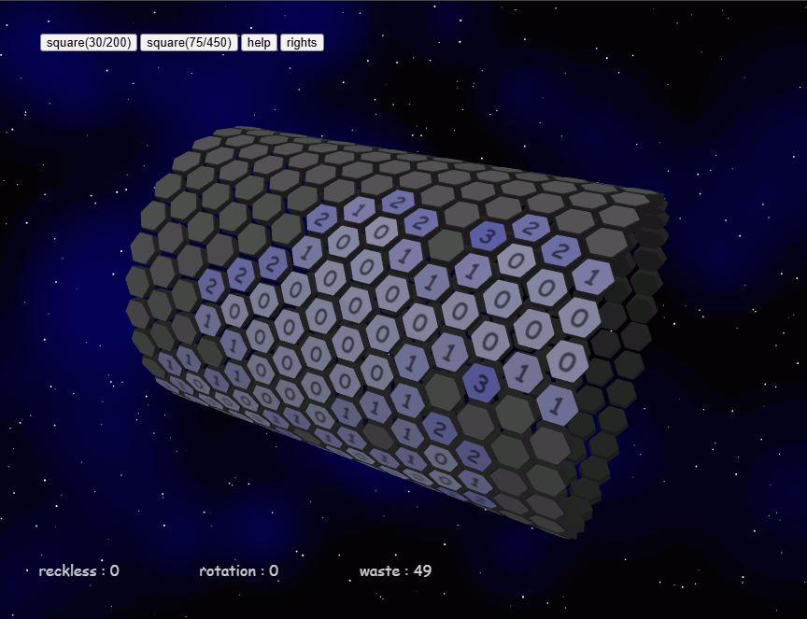
3. set zoom level

Slide 7
4. find safe area

Slide 8
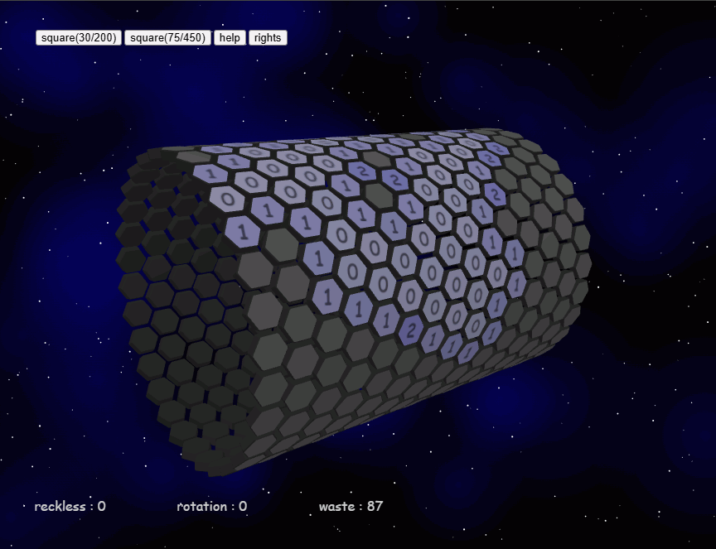
4. find safe area

Slide 9
5. "reckless" is the score which shows you took risk

Slide 10
6. "rotation" is the score which shows you used rotation-hint

Slide 11
7. "waste" is the score which shows your time to solve

