Slide 1
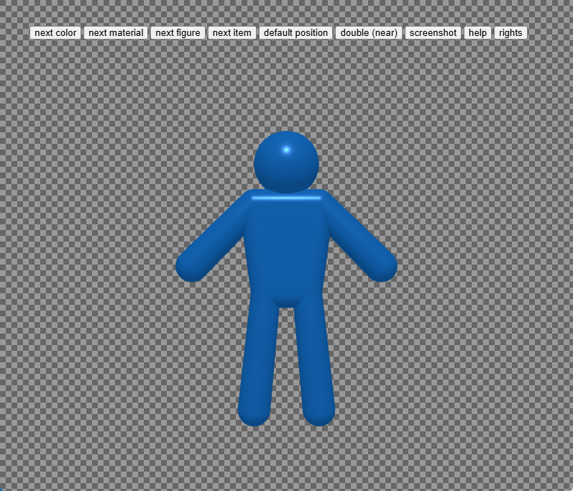
1. decide color

Slide 2
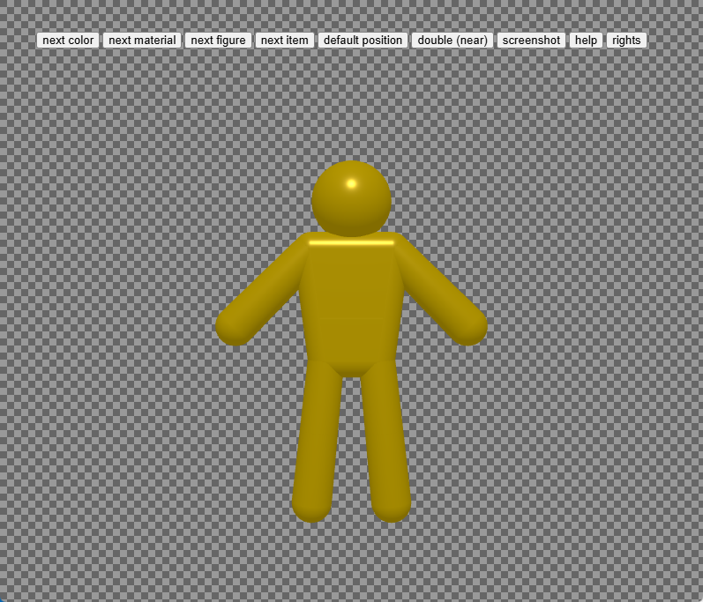
1. decide color

Slide 3
2. decide material

Slide 4
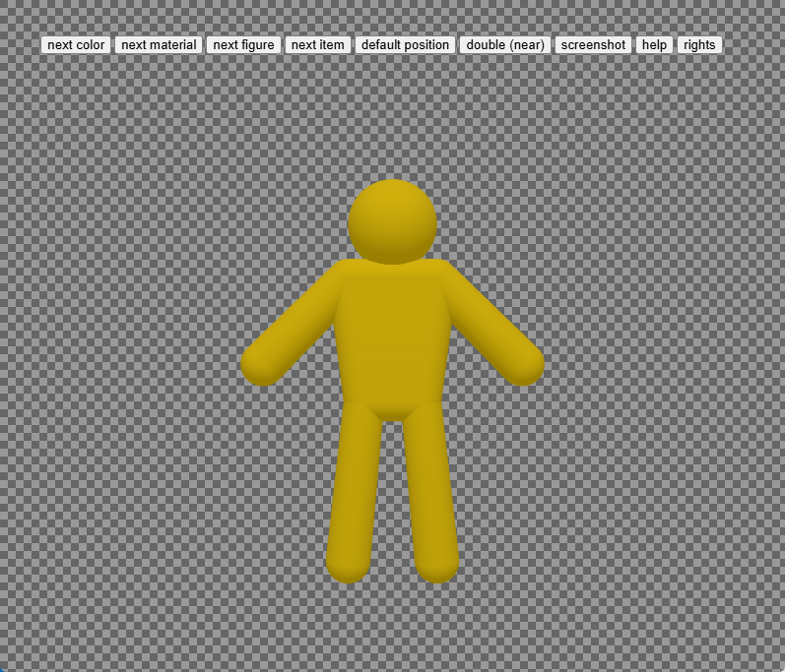
2. decide material

Slide 5
3. decide figure

Slide 6
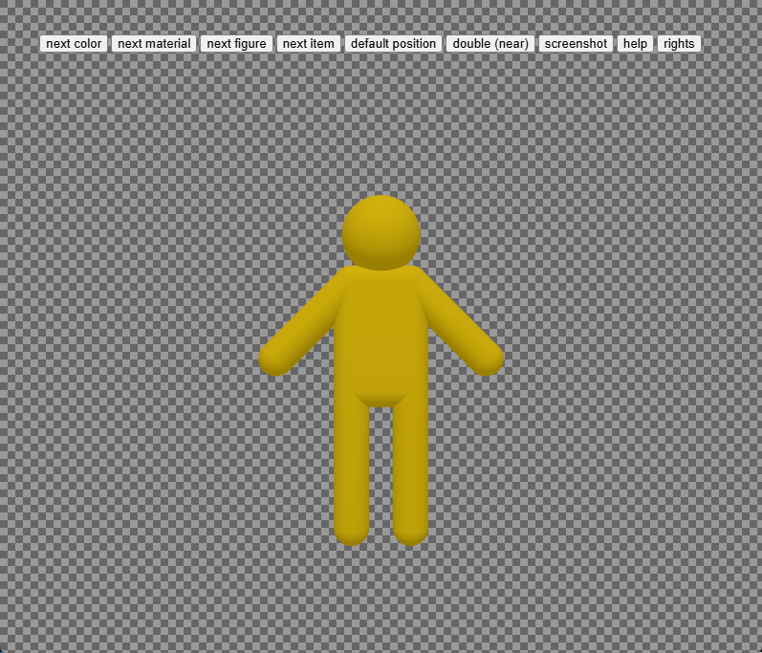
3. decide figure

Slide 7
4. decide item

Slide 8
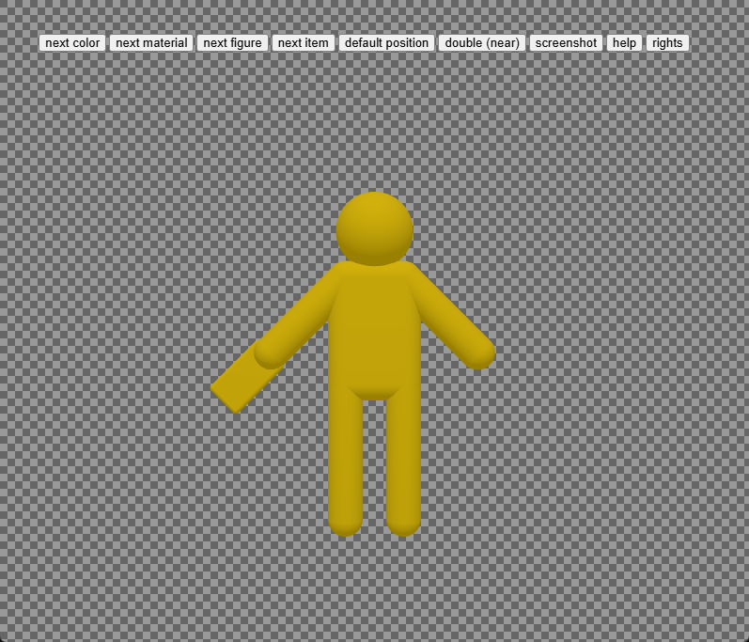
4. decide item

Slide 9
5. long push to handle wide range

Slide 10
5. long push to handle wide range

Slide 11
6. set your favorite pose

Slide 12
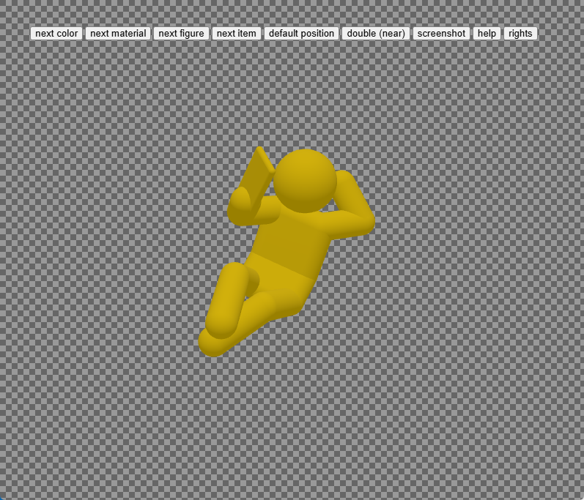
6. set your favorite pose

Slide 13
7. set zoom level

Slide 14
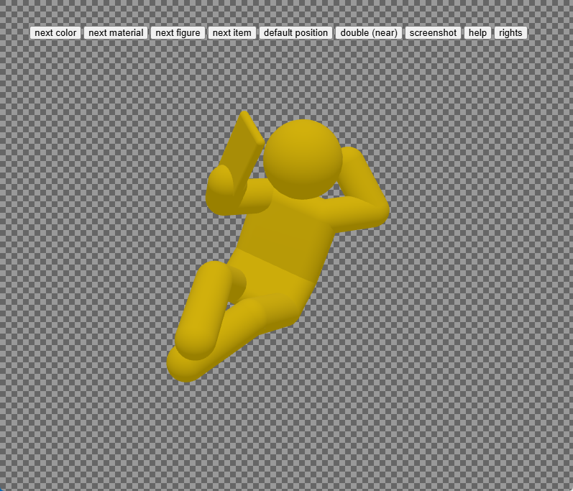
7. set zoom level

Slide 15
8. take screenshot

Slide 16
8. take screenshot

Slide 17
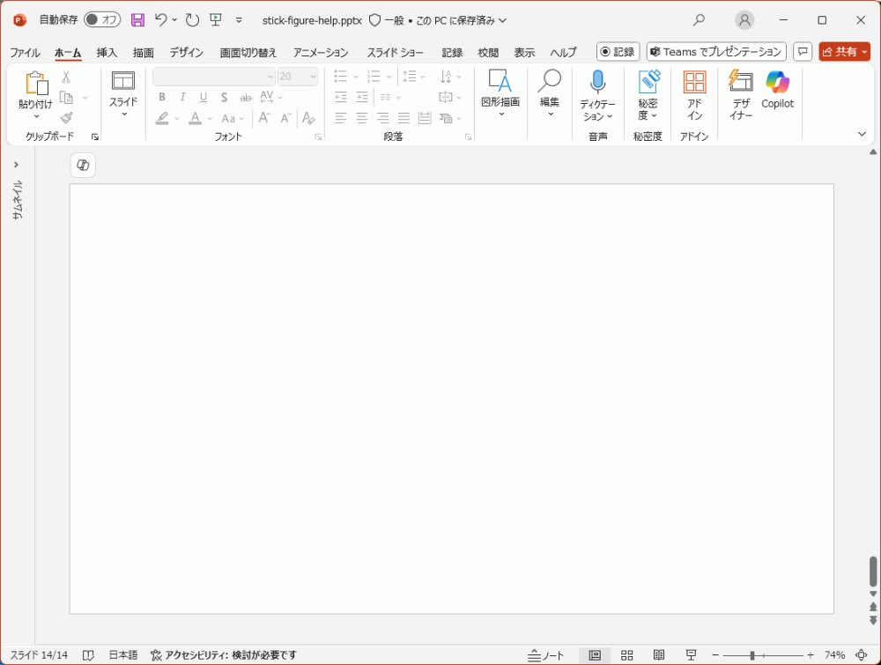
9. paste it to your slide

Slide 18

9. paste it to your slide

