Slide 1

Cluster and Cloud Computing Assignment 2 - #TheDeadlySins #2019
Victoria Social Media Analysis
Presented by team 52 :
Shreyas Walvekar - swalvekar@student.unimelb.edu.au
Nitish Mathur - nitishm@student.unimelb.edu.au
Nakia Silva - nakias@student.unimelb.edu.au
Yash Shinde - yshinde@student.unimelb.edu.au
Krishna Srinivas Sundararajan - ksundararaja@student.unimelb.edu.au

Slide 2
Overview
Cloud based social media data analytic system computes the correlation of twitter data with Aurin and helps us understand the impact of a TV Show on crime.
Hypothesis:
How we think we can prove it:
We believe that there is a positive correlation between the number of people that are aware about Game of Thrones, and the amount of violent crimes recorded in a particular region.
If only there was a way to just google it…
Viewing graphic content on television or internet streaming services influences people into committing violent crimes.

Slide 3

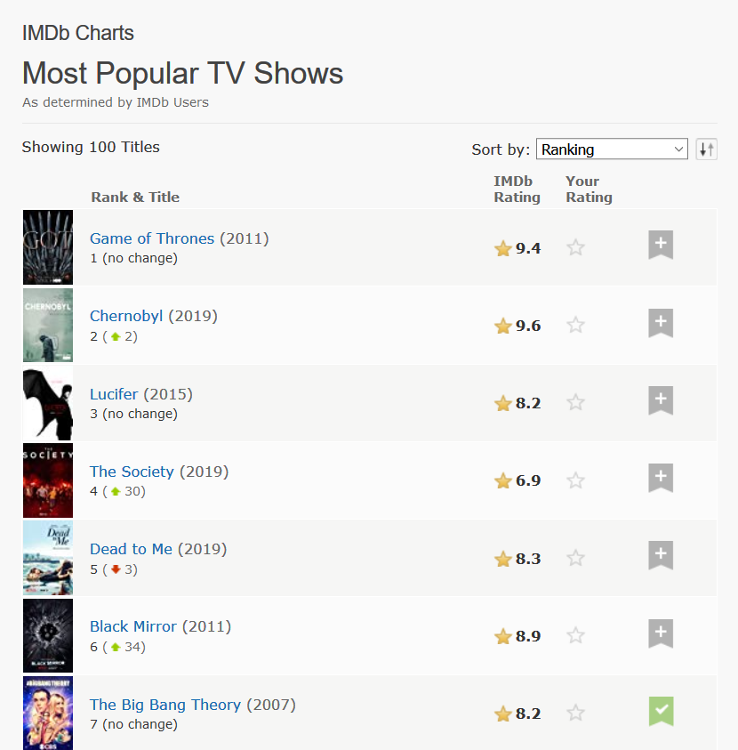
Game of Thrones is a great show. Arguably…

Slide 4
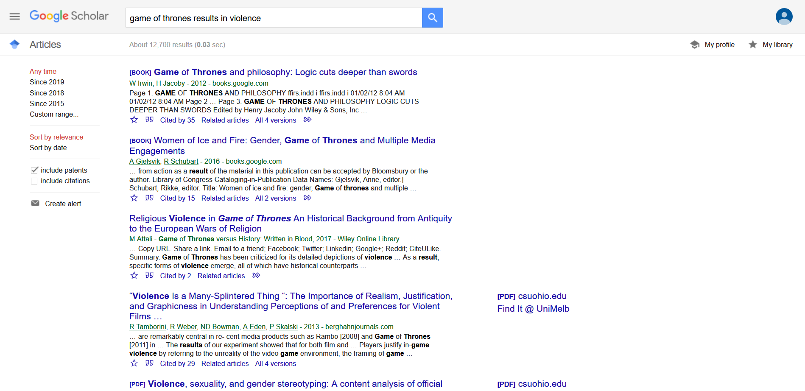
About 12,700 results

Slide 5
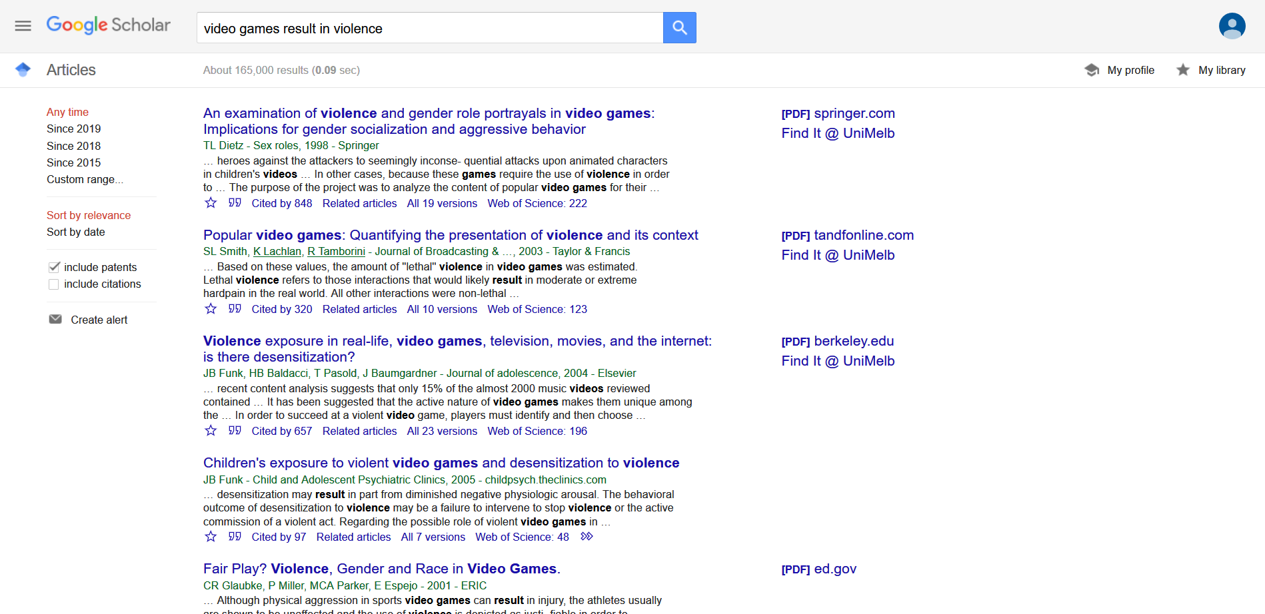
165,000 results !!!

Slide 6
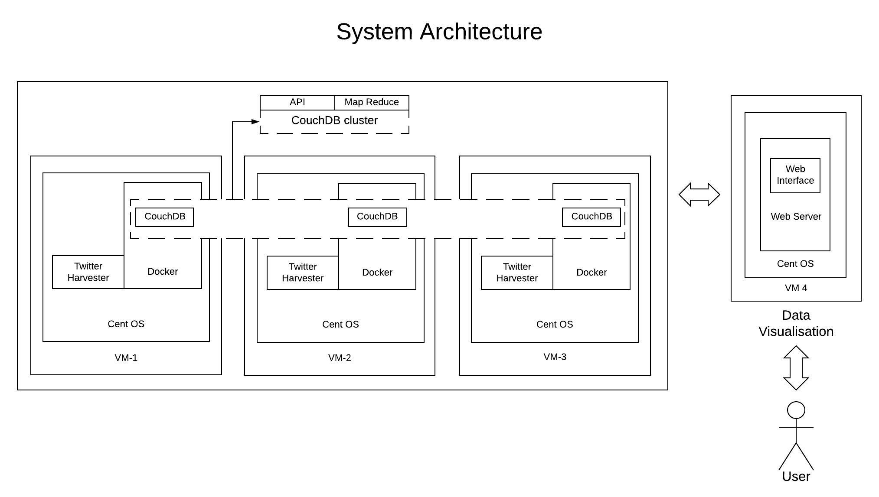

Slide 7
Aurin Data : Crime Statistics Agency
The Crime Statistics Agency (CSA) has developed this offence classification to assist in the production and analysis of summary crime and justice statistics in Victoria. It is largely based on the structure and principles of the Australian and New Zealand Standard Offence Classification (ANZSOC) produced by the Australian Bureau of Statistics, and has been modified to suit the legislative environment in Victoria.
The classification is comprised of three levels: divisions (the broadest level), subdivisions (the intermediate level) and groups (the finest level).
Available on Aurin from 2012 – 2016.

Slide 8
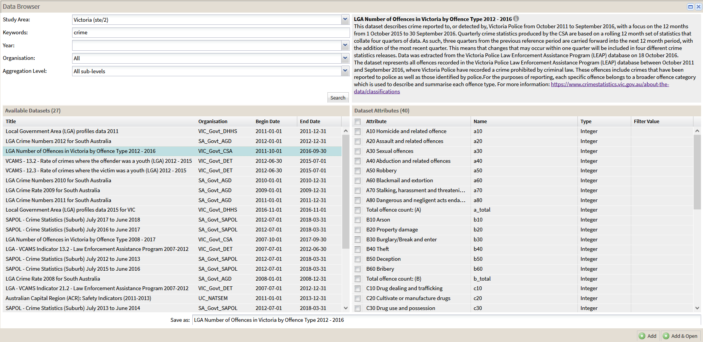

Slide 9
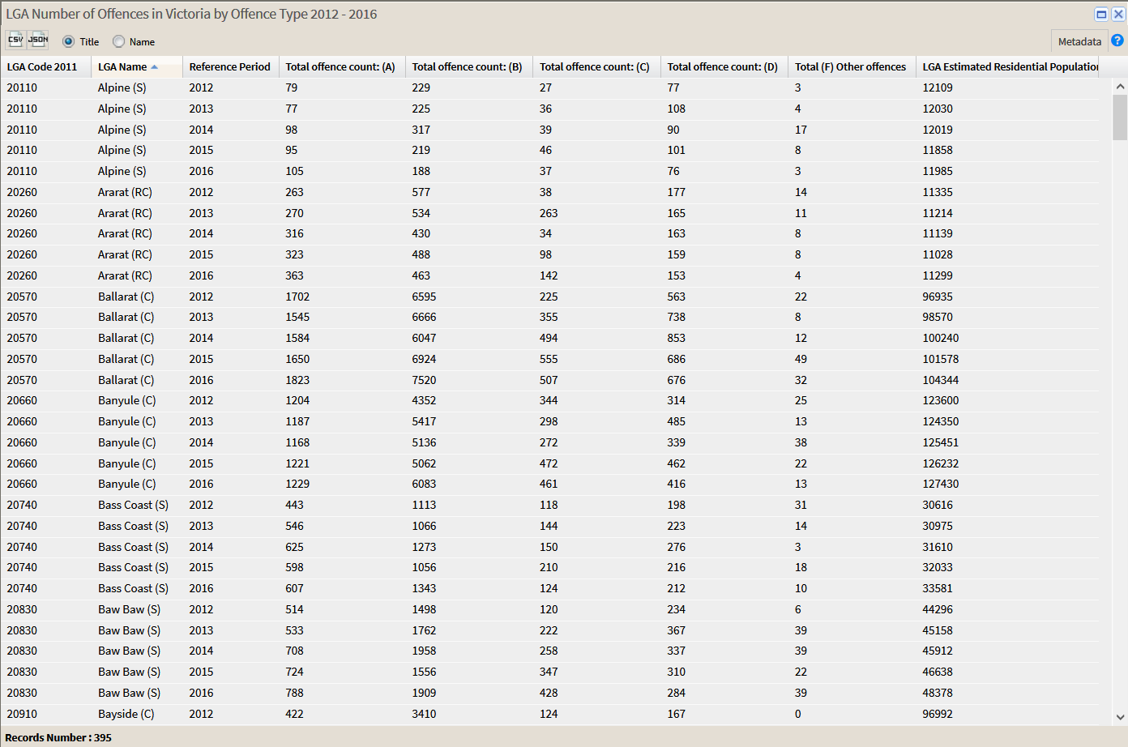

Slide 10
Classification

Slide 11
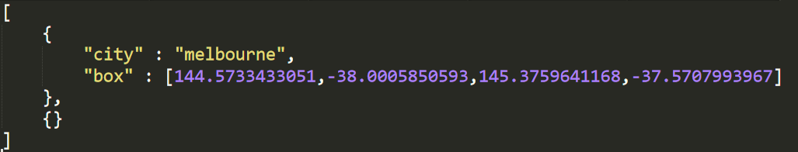
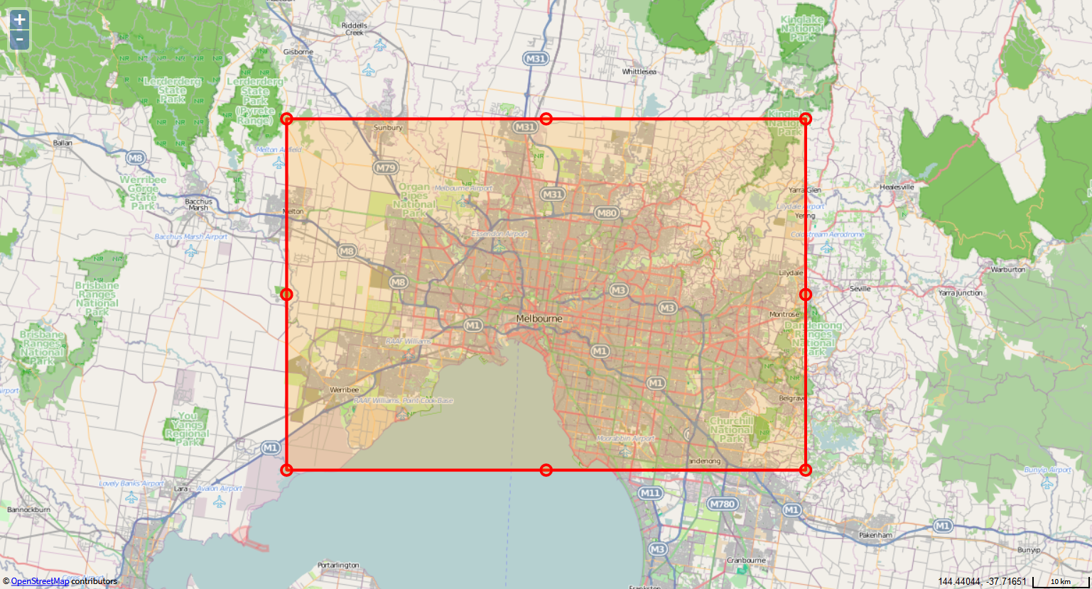

Slide 12
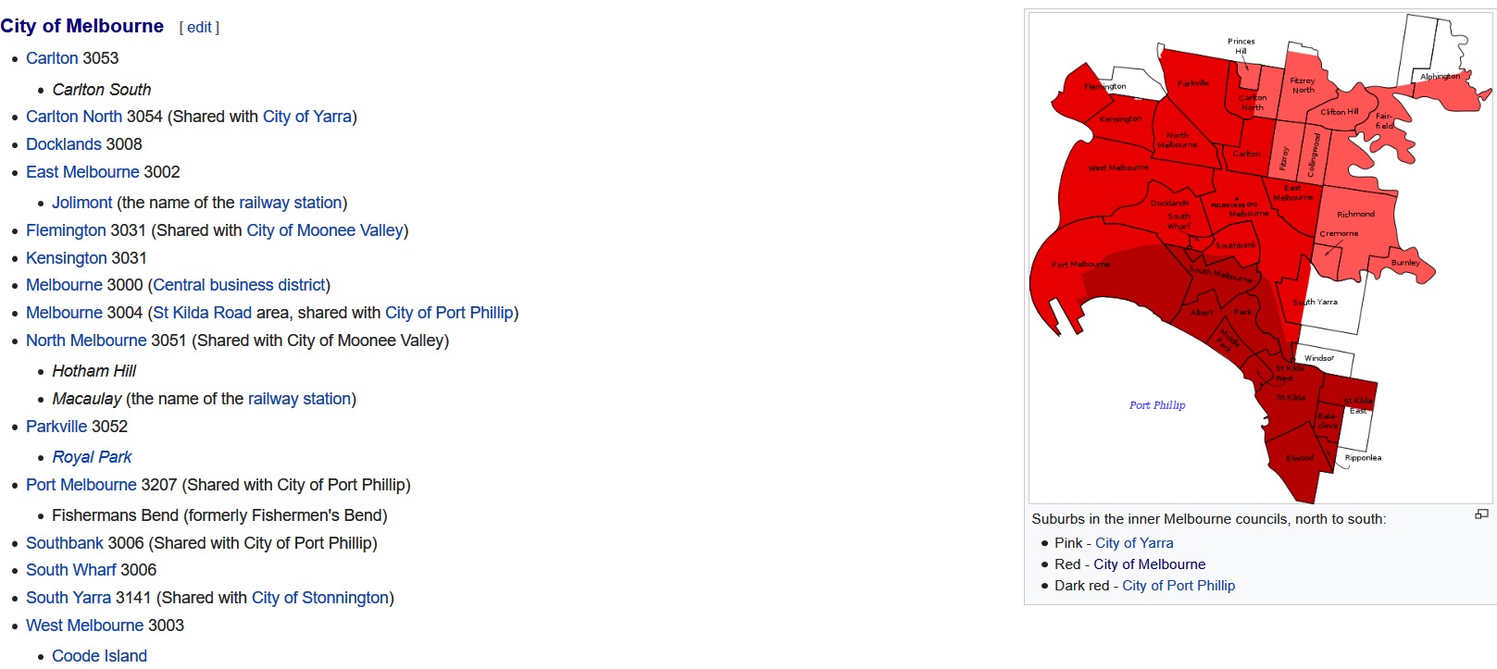

Slide 13
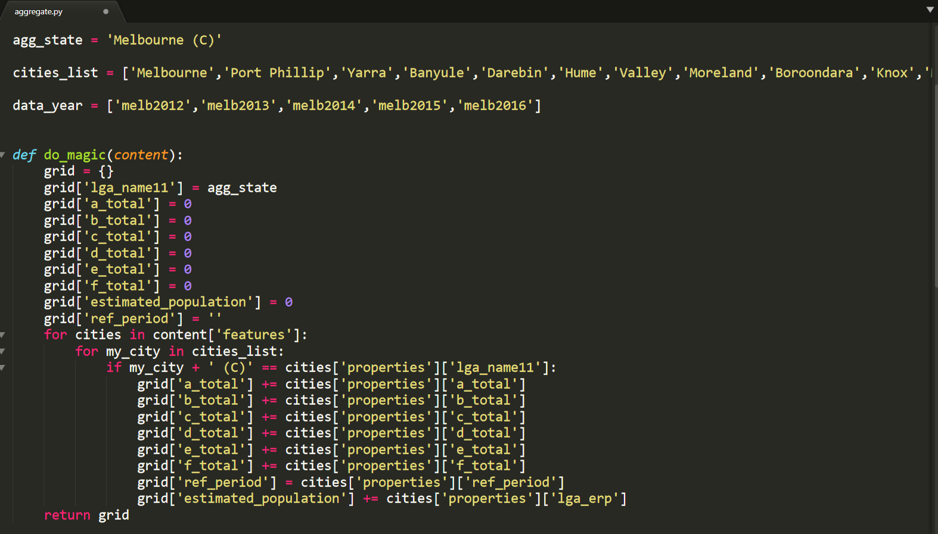

Slide 14
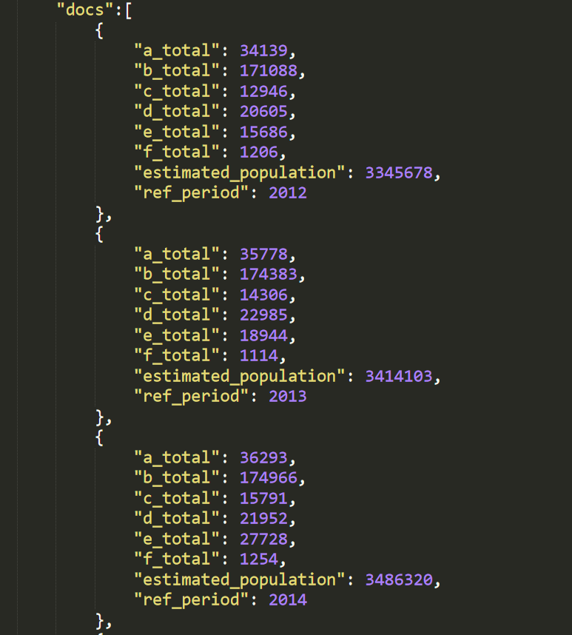
Aggregate Data

Slide 15
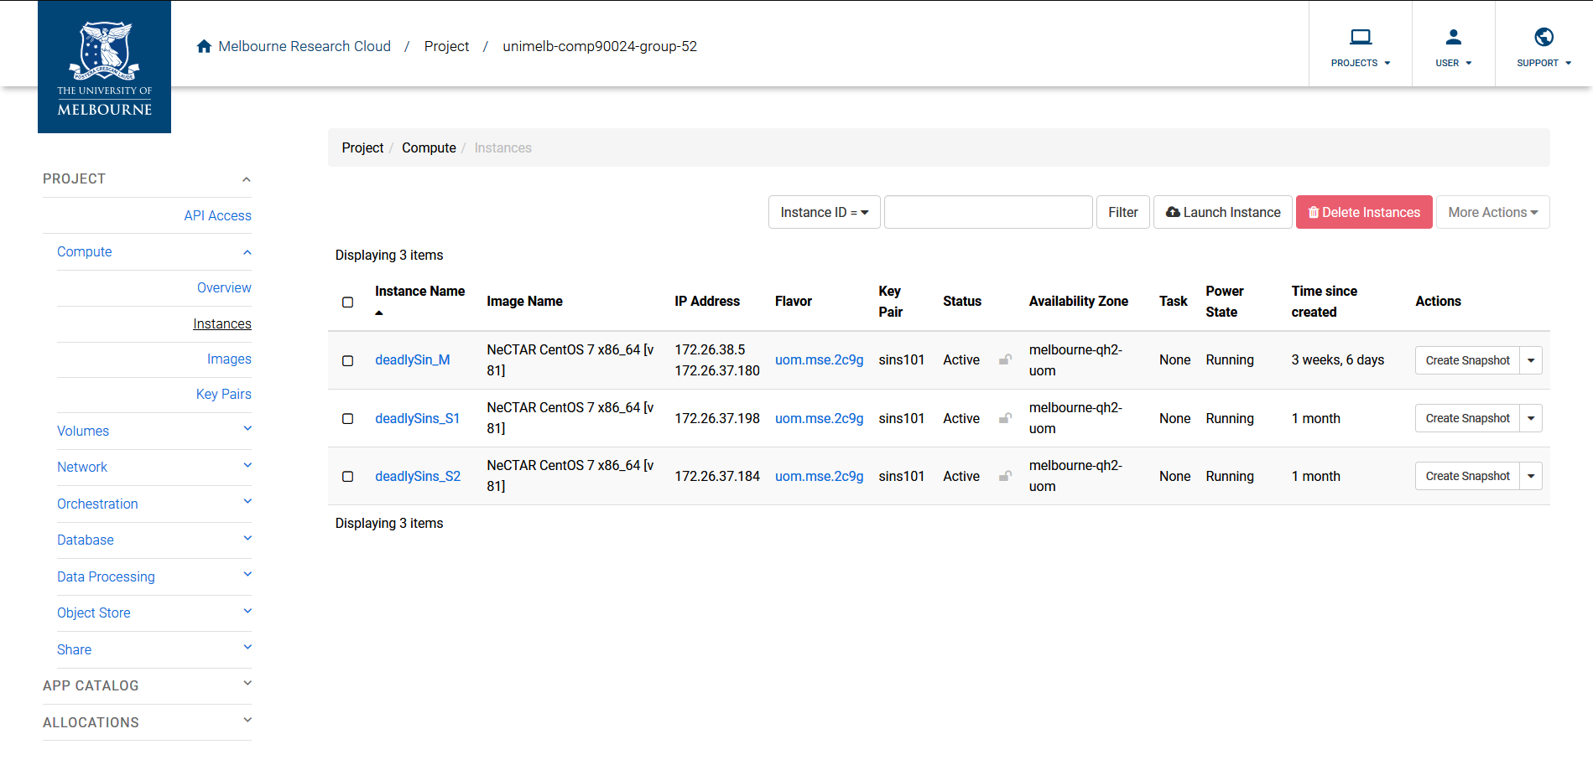
Instances

Slide 16
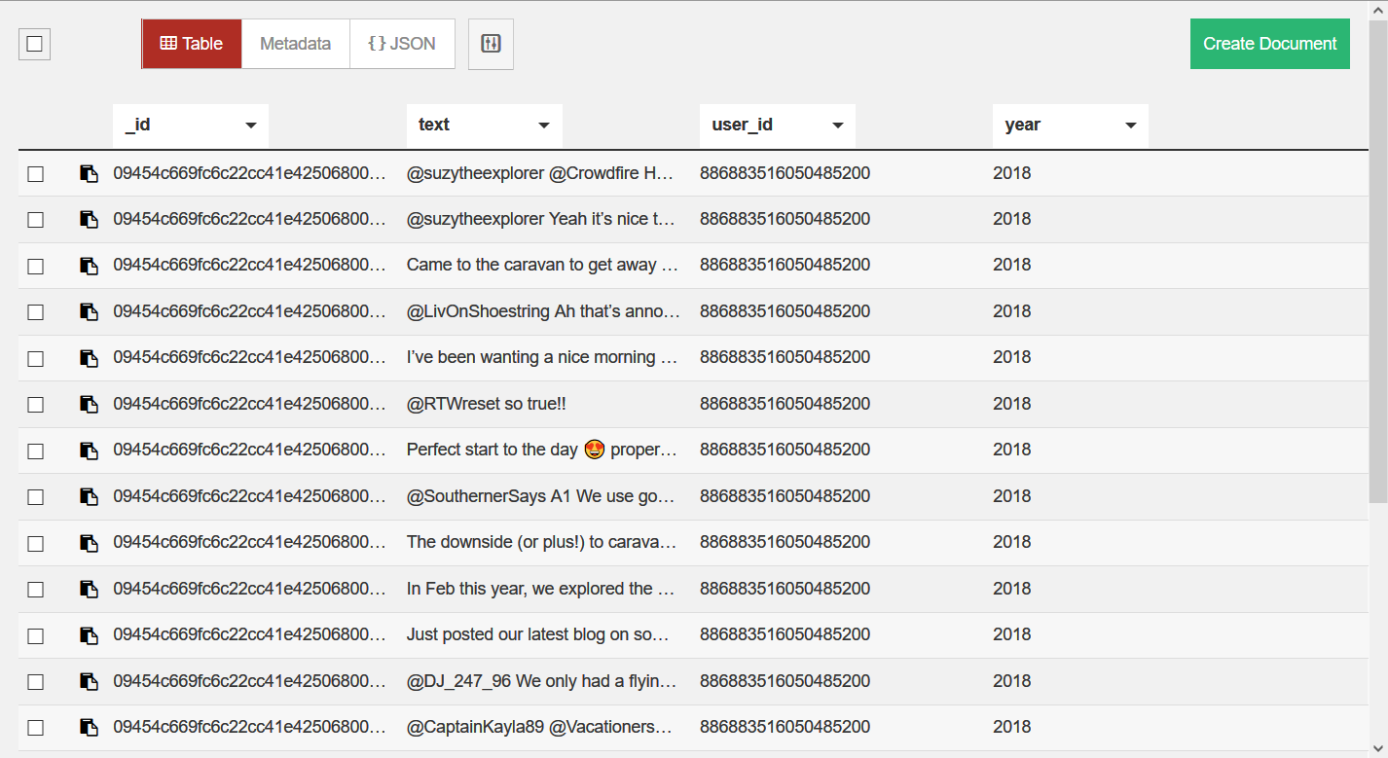

Slide 17
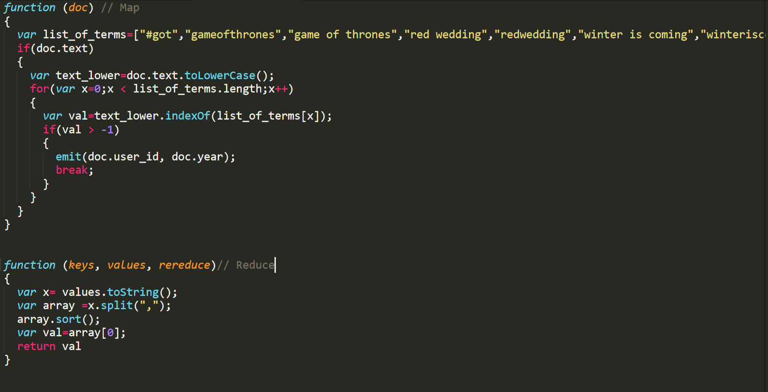

Slide 18
