Slide 1
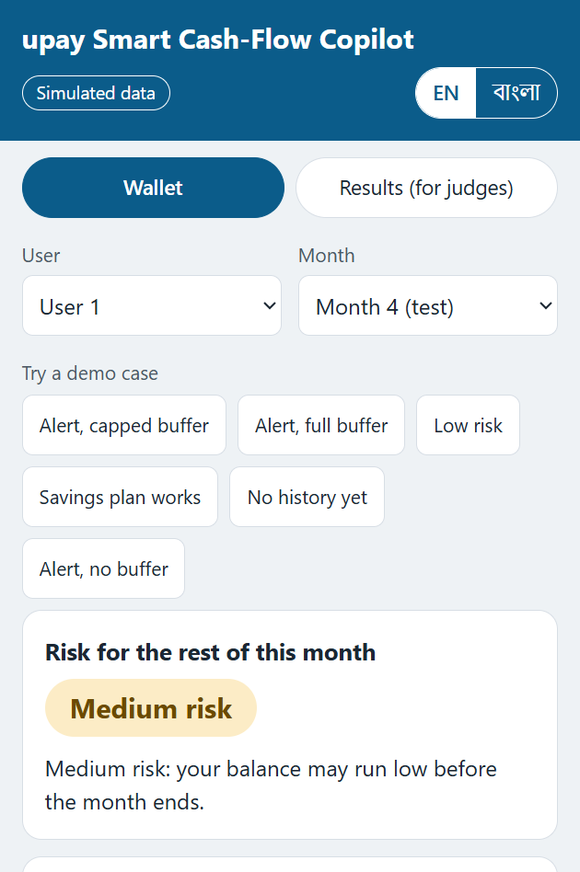
upay Smart Cash-Flow Copilot
A day-20 warning for month-end wallet shortfalls
TriStack
Mahmudul Hasan · Fahim Montasir · Ahsanur Rahman Nakib
Daffodil International University
AI Hackathon 2026 (DIU CPC × upay) · Track 03: Customer Innovation & Financial Independence
Notes:
The hackathon guideline asks a question on behalf of the customer: why do I always run short before month-end? We are TriStack, and we built a working answer to that question, then tested it honestly. Everything you will see runs on simulated data. We will show you what works, what does not, and what we would test next with upay.

Slide 2
“Why do I always run short before month-end?”
The guideline’s own example question
23.51%
of MFS transaction value was cash-out, October 2025
Bangladesh Bank via The Financial Express
1.4%
upay’s agent cash-out fee
upay’s official calculator, “Primary” type
No sourced rate for how often month-end shortfalls happen. We say so.
Notes:
Cash-out is big and it costs a fee. In October 2025 it was 23.51% of mobile money transaction value, and upay’s own calculator shows 1.4% on an agent cash-out. What we could not find is a sourced rate for how often wallets run short before month-end. So we did not guess. We built the problem as a simulation, and we say so on every slide.

Slide 3
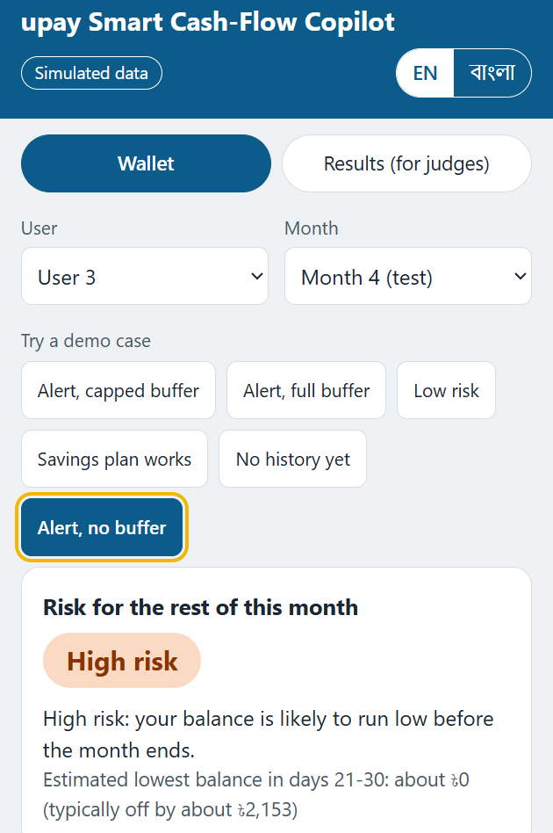
On day 20 the app says where the month is heading
Scroll down for up to 3 reasons, then suggestions. Suggestions only: the customer decides. Nothing moves money.
Demo case 6: the balance is already too low for a buffer.
2
1
Lowest-balance estimate, shown with its typical error.
Risk in words: low, medium or high. Never a probability.
3
Notes:
On day 20 the customer sees a risk band in words: low, medium or high. It is a band, never a probability, because our model is over-confident above 0.2. In the live demo we open case 1, then case 6, then case 4, where we press Make a plan. After that we switch the toggle to Bangla and finish on the Results tab.

Slide 4
One prediction a month, made at the end of day 20
Prediction: end of day 20
Days 1-20 the model sees the wallet history
Days 21-30 the outcome window
1
2
3
4
5
6
7
8
9
10
11
12
13
14
15
16
17
18
19
20
21
22
23
24
25
26
27
28
29
30
Shortfall: below 500 BDT on any of days 21-30.
1 day
Warning time is short. Earlier alert days are our first pilot experiment.
Median first dip of the 303 caught shortfalls: 1 day after day 20
Simulated. Mean 2.05 days. Not measured for the 98 predictive catches.
Notes:
We make one prediction per customer per month, at the end of day 20, using only days 1 to 20. A shortfall means the balance drops below 500 BDT on any day from 21 to 30. Warning time is short: for the 303 shortfalls we caught, the first dip came a median of 1 day later. Earlier alert days are our first pilot experiment.

Slide 5
AI predicts and explains. Rules decide what to suggest
Feature builder
days 1-20 only, leakage test
XGBoost risk model
risk band and alert
Fixed templates
English, Bangla
Helper model
lowest-balance estimate
Simulated transactions
seed 42
FastAPI service
Web page
Customer decides
SHAP
reasons for each alert
Rules
buffer, fee saver, savings plan
AI
Rule
Fixed template
No language model anywhere
Notes:
AI does two jobs here. An XGBoost model predicts the risk, with a helper model for the lowest balance, and SHAP explains each prediction. Everything the customer is told to do comes from a rule: the buffer, the fee saver and the savings plan. Every sentence on screen is a fixed template, in English or Bangla. There is no language model anywhere in the product.

Slide 6
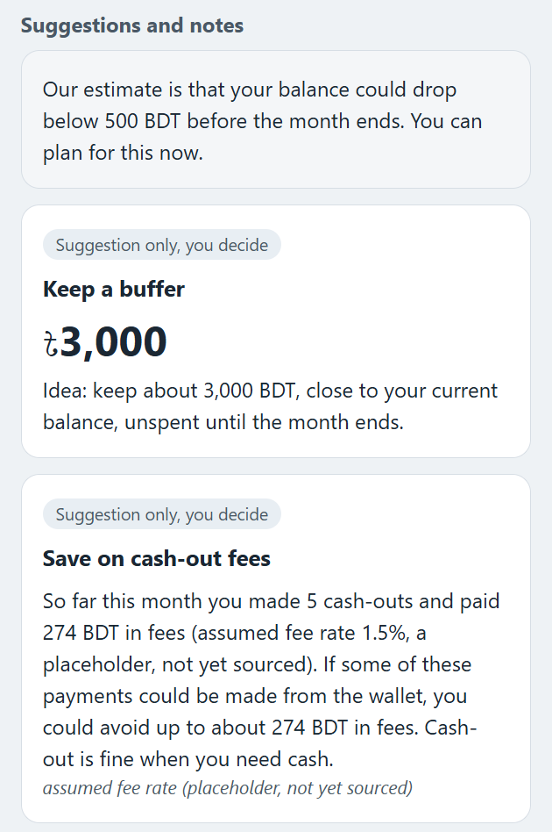
The buffer is arithmetic, and anyone can check it
Rule, not model output
Demo case 1, simulated user 1, month 4
1,292
3,876
4,000
3,000
1
BDT a day, average spending
× 3 days
rounded up to 500s
BDT buffer: capped by the 3,308 balance
Fee saver, same screen: 5 cash-outs, 274 BDT in fees at the 1.5% placeholder.
2
Notes:
Let us walk the chain for demo case 1. This customer spends 1,292 BDT a day on average. Three days of that is 3,876, which we round up to 4,000. The balance on day 20 is only 3,308, so the buffer is capped at 3,000 BDT. On the same screen the fee saver shows 5 cash-outs and 274 BDT in fees, at our 1.5% placeholder rate.

Slide 7
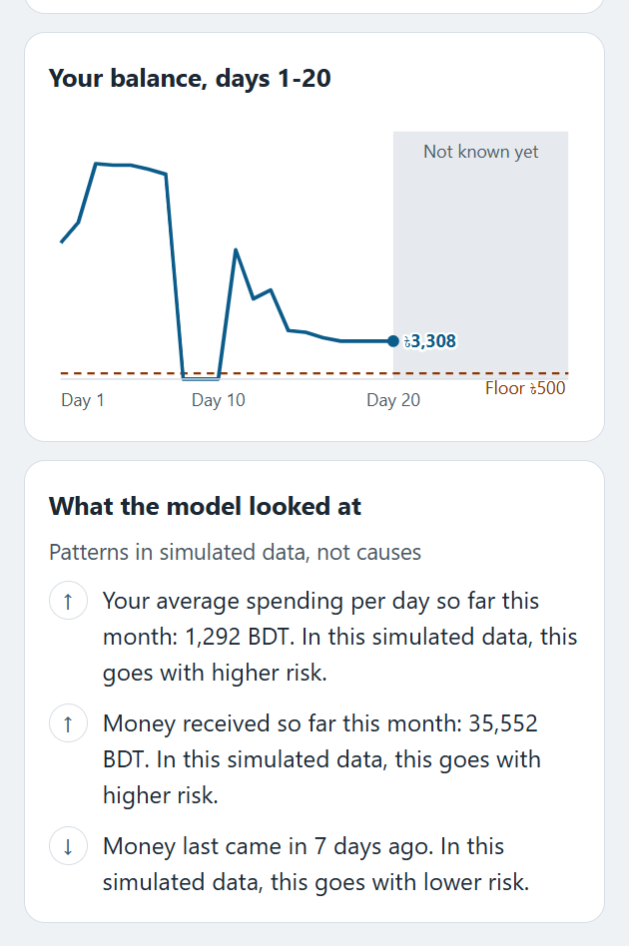
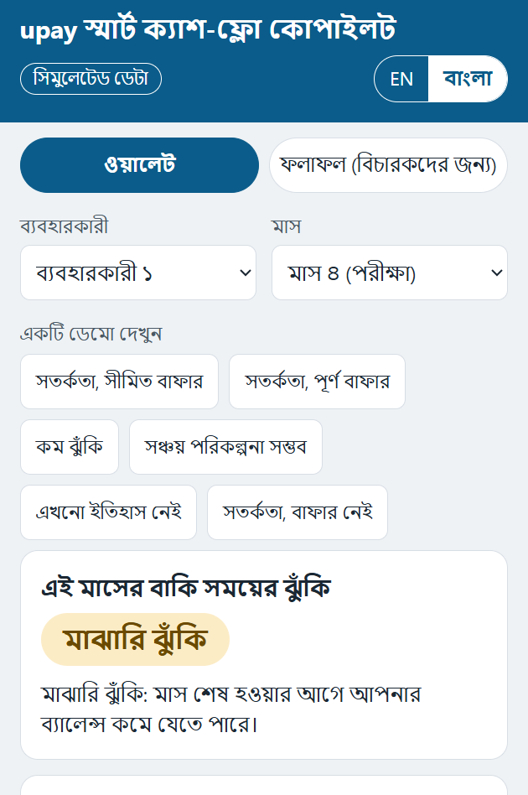
Each reason quotes the customer’s own numbers, in English and Bangla
0
invented numbers in 1,413 responses
Label: patterns, not causes
A self-check compares every number in every message with the response data.
1
2
A reason, built on the customer’s own number
English
The same tab in Bangla
Notes:
Each reason is a sentence built around the customer’s own number, and the whole tab switches to Bangla with one tap. We check every number in every message against the response data: in 1,413 responses we found 0 invented numbers. The card is also labelled clearly. These reasons are patterns in simulated data, not causes, and we never use causal words.

Slide 8
All data is simulated, and we show our hand
1,000 simulated users one dot each
Stress events chance per month
6 months × 30 days split by time
23.3% shortfall rate is a tuned setting, not a measurement.
0
1
2
3 · festival
4
5
train: months 0-3
test: months 4-5
Assumptions and what is not modelled: docs/synthetic_assumptions.md
Notes:
All of this runs on 1,000 simulated users over 6 months. We train on months 0 to 3, which include a festival month, and test on months 4 and 5, so the split is by time. Stress comes from four documented events. Our assumptions are written down, and so is what we do not model. The 23.3% shortfall rate is a setting we tuned, not a measurement.

Slide 9
The model’s lead over a simple balance rule is small, and not statistically clear
PR-AUC, simulated test months
Users not already below 500 BDT on day 20 (1,783 rows, 259 shortfalls)
Model minus rule
95% bootstrap intervals, simulated
0
PR-AUC
-0.002
+0.030
+0.069
Recall at equal alert volume
-0.010
+0.023
+0.061
Both intervals cross zero. A small lead, not statistically clear.
Notes:
Here is the main result on simulated test months. The simple day-20 balance rule is already strong. On PR-AUC the model scores 0.422 against 0.392 for the rule, a difference of +0.030. The interval runs from -0.002 to +0.069, so it includes zero. Recall at equal alert volume tells the same story. We call this a small lead, not a win.

Slide 10
Two thirds of the shortfalls the model caught were already visible on day 20
205
of 303 caught shortfalls
Simulated test months
205
98
Already below 500 BDT on day 20. The alert told them what they already knew.
Not yet low
Of 259 shortfalls among users not yet low, the model caught 98 (38%). About 6 in 10 alerts there were false alarms.
Notes:
This is the finding we lead with. The model caught 303 of 464 shortfalls, but 205 of those were customers already below 500 BDT on day 20. The alert told them what they already knew. That leaves 98 predictive catches out of 259, which is 38%, and about 6 in 10 alerts there were false alarms. This is why View 2 is our headline test.

Slide 11
What it does add: a lowest-balance estimate and a reason for every alert
Lowest-balance estimate
Mean error, BDT, simulated. Lower is better.
What drives the alerts
Mean |SHAP|, top 8 inputs. Patterns in simulated data, not causes.
Checks, simulated
0.0%
Direction check: adding 1,000 BDT never raised risk.
0.520
Test ROC‑AUC of a shuffled-label model.
PASS
Still large next to a 500 BDT floor
Leakage test.
Notes:
So what does the model add? An honest edge with honest limits. Its lowest-balance estimate is off by 2,152.8 BDT on average, against 3,040.3 for the naive guess, which is still large next to a 500 BDT floor. It also gives a reason for every alert. And our checks pass: more money never raised the risk, and a shuffled-label model scored 0.520.

Slide 12
Gaps are visible, and we do not call the model fair
Recall by group model alerts, simulated test months
Responsible AI status
Age band | Recall
18-25 | 0.617
26-35 | 0.638
36-50 | 0.664
51+ | 0.766
Income band | Recall
Low | 0.663
Mid | 0.657
High | 0.613
Region | Recall
Chattogram | 0.651
Dhaka | 0.640
Khulna | 0.703
Rajshahi | 0.615
Sylhet | 0.676
Privacy done. Simulated data only.
Explainability done
Transparency done
No harmful automation done
Fairness partly. Checked, not proven.
Security partly. Validation, generic errors and limited CORS built. Login, encryption, audit logs and rate limiting planned.
Largest gap 0.149
Likely sampling noise: no age effect in the simulator.
Largest gap 0.050
Unexplained.
Largest gap 0.088
Unexplained.
Human oversight partly. The customer decides. No operator review process built.
Re-check on real data. This check does not show the model is fair.
Notes:
We compared recall across age, income and region. The largest gap is age, at 0.149. Age has no effect in our simulator, so that gap is likely noise. The income and region gaps, 0.050 and 0.088, are unexplained, and we would re-check all of them on real data. We do not call the model fair. On the right is where each responsible AI principle stands today.

Slide 13
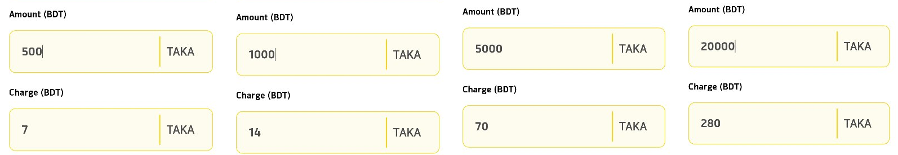
Impact today is a fee base, not savings
Simulated test months
12,001 BDT
cash-out fees already paid in those 213 user-months, at the 1.5% placeholder rate
27.0 BDT per alerted user-month
56.3 BDT per saver-shown user-month
upay’s published agent fee: 1.4% at all four tested amounts. At 1.4% the fee base is about 11,200 BDT (hand estimate).
Notes:
Our impact number is a fee base, not savings. In the simulated test months the app alerted in 445 user-months, and the fee saver would show in 213 of them. Those customers had already paid 12,001 BDT in cash-out fees at our 1.5% placeholder. Simulated users never react, so we cannot show savings. upay’s published rate is 1.4%, which gives about 11,200 BDT.

Slide 14
Next: replay on real history, then shadow mode, then a controlled test
0
1
2
Stage 0: offline replay
Governed, anonymised history. Re-run our leakage, fairness and direction tests. Compare day 20 with earlier alert days.
Stage 1: shadow mode
The model scores. Nobody sees alerts.
Stage 2: controlled test
Opted-in, consenting customers. Alerts and suggestions vs no alerts. At least 3 monthly cycles.
A proposal for discussion, not agreed with upay.
Primary metric: share of user-months below the floor on days 21-30.
We claim
A working end-to-end prototype; reasons in two languages; suggestions only; an honest evaluation.
We do not claim
A clear win over the simple rule; that shortfalls are common among upay customers; any amount saved; that the model is fair.
github.com/mahmudulhasanprotik47/upay-cashflow-copilot · TriStack: Mahmudul Hasan, Fahim Montasir, Ahsanur Rahman Nakib
Notes:
Our next step is a replay on governed data, not more modelling. Stage 0 re-runs our tests on anonymised history and tries earlier alert days. Stage 1 is shadow mode, where nobody sees alerts. Stage 2 is a controlled test with opted-in customers over at least 3 monthly cycles. This is a proposal for discussion, not something agreed with upay. We would be glad to take your questions.

Slide 15
Questions?
All results are simulated
+0.030
PR-AUC lead over the balance rule. Interval -0.002 to +0.069: not statistically clear.
Start with the weak spots. These are the numbers we expect to be asked about.
205 of 303
caught shortfalls were already below 500 BDT on day 20.
1 day
median warning time after day 20.
1.4%
github.com/mahmudulhasanprotik47/upay-cashflow-copilot
TriStack: Mahmudul Hasan, Fahim Montasir, Ahsanur Rahman Nakib
upay’s published agent fee. Our code uses a 1.5% placeholder.
Notes:
That is our talk, and we are happy to take questions. We would rather start with the weak spots, so the numbers on this slide are the ones we expect you to ask about: a lead of +0.030 that is not statistically clear, 205 of 303 catches that were already low, a median warning of 1 day, and a 1.5% placeholder against a published 1.4%.

