Slide 1
Department of Computer Science, COCIS
Makerere University
Lecturer: Ggaliwango Marvin
GRAPH ATTENTION MECHANISMS FOR MACULAR DEGENERATION DISEASE DIAGNOSIS USING SELF-ROUTING CAPSULE KNOWLEDGE DISTILLATION
OcuMed
Project Code: ML-D-31
Keywords: Age-Related Macular Degeneration, Optical Coherence Tomography, Graph Attention Networks, Capsule Networks, Knowledge Distillation, Vision Transformers
Team Members:
1) ABONYO MITCHELL NINA 23/U/0095
2) NAKIGULI ELIZABETH GLORIA 23/U/13736/PS

Slide 2
Contents of Presentation
Background and Introduction
Related work
Problem Statement
Research Questions and Objectives
Research Contributions
Methodology
System Architecture
Dataset Description
Experimental Results (EDA)
Explainable AI Results
Model Selection
Product Demonstration
Conclusions and Limitations
Future Works
References
Acknowledgment

Slide 3
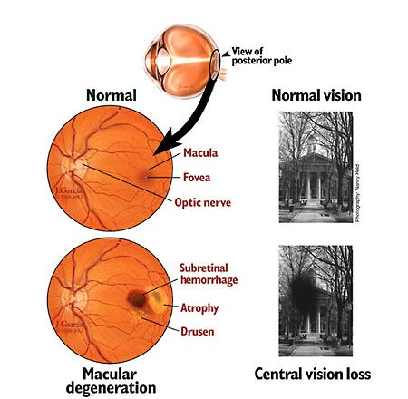
BACKGROUND AND Introduction
Macular Degeneration, also known as Age-related Macular Degeneration (AMD), is one of the leading causes of vision loss worldwide, and its prevalence is steadily increasing in Uganda.
However, the early detection of AMD remains a significant challenge.
This project explores the potential of machine learning models in addressing these challenges by enhancing early detection and improving diagnostic accuracy.

Slide 4
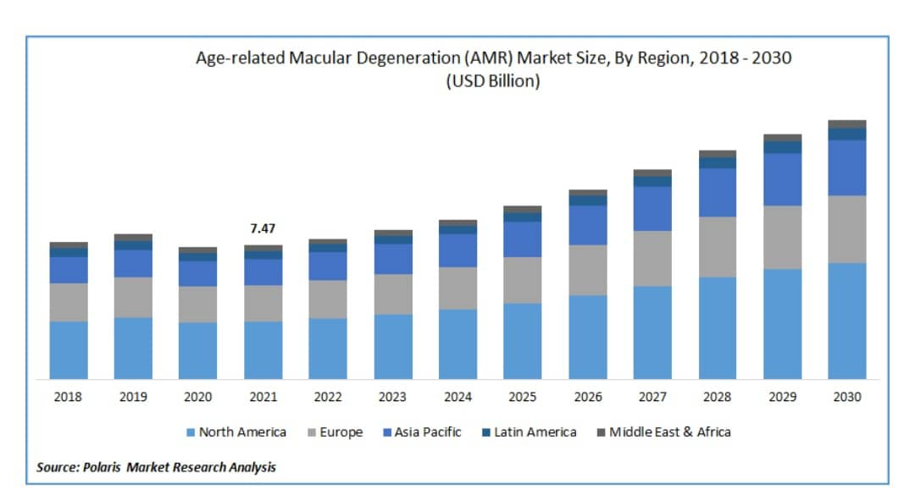
Related Works
In recent trends, various deep learning models such as Convolutional Neural Networks (CNN) have been widely used in different works for retinal scan image analysis in AMD detection.
Some of these include the Retina AI Health and the Eyenuk.
Retina AI Health and Eyenuk are both U.S.-based health technology companies that specialize in applying artificial intelligence to eye care.

Slide 5
Problem Statements
Domain Application problems
High cost of diagnosis
Diagnostic tools like OCT are expensive, making AMD screening inaccessible to many people.
Lack of localized AI models
The existing AI models are often trained on datasets from high-income countries and may not perform well for Ugandan patients due to genetic and environmental differences.
Computational constraints
Many healthcare facilities in Uganda have limited infrastructure and hardware, making it difficult to deploy computationally intensive AI models.

Slide 6
Problem Statements CONTINUED…
Computational problems
Method | Why method was implemented
Graph Attention Mechanisms | Retinal images have subtle features that are critical for AMD diagnosis. Graph Attention Mechanisms allow the model to focus on the most relevant regions by assigning attention weights, addressing the challenge of identifying subtle patterns.
Self-Routing capsules | AMD abnormalities have complex spatial structures. Self-routing capsules are used to capture these spatial hierarchies, solving the challenge of modeling relationships between features for precise segmentation.
Knowledge distillation | Segmentation models can be computationally heavy, but medical applications need efficiency. Knowledge Distillation transfers knowledge from a larger model to a smaller one, addressing the challenge of making the model practical for real-world use.

Slide 7
Research Objectives
To develop a machine learning model for the early detection of macular degeneration.
To improve diagnostic accuracy and speed of AMD.
To provide an accessible tool for medical professionals.
To increase diagnosis accessibility for patients in regions with limited healthcare resources.

Slide 8
Research Contributions
We developed a machine learning model that will improve the diagnostic accuracy and speed of macular degeneration.
We built a model that can be used on devices with low GPUs.

Slide 9
Methodology
Our project leverages deep learning techniques such as Graph Attention Mechanisms, Self-Routing Capsule Networks, and Knowledge Distillation to design an AI-driven support system for ophthalmologists.
The system will analyse retinal OCT scan images to aid the early detection of AMD.

Slide 10
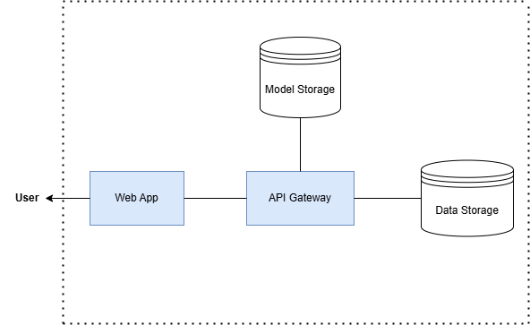
SYSTEM ARCHITECTURE

Slide 11
Dataset DESCRIPTION
We used a publicly available retinal image AMD-SD dataset.
It consists of 3049 Optical Coherence Tomography (OCT) images.
The images have a resolution of 570x380 pixels ensuring high detail for analysis.
Characteristic | Details
Dataset Name | AMD-SD Dataset
Number of patients | 138 patients
Number of Images | 3049 OCT B-scan images
Dataset Components | Images folder, Demographics file, Training text file, Validation file
Demographics considered | Patient ID, Eye ID, Eye category, Age, Sex, Time acquired

Slide 12
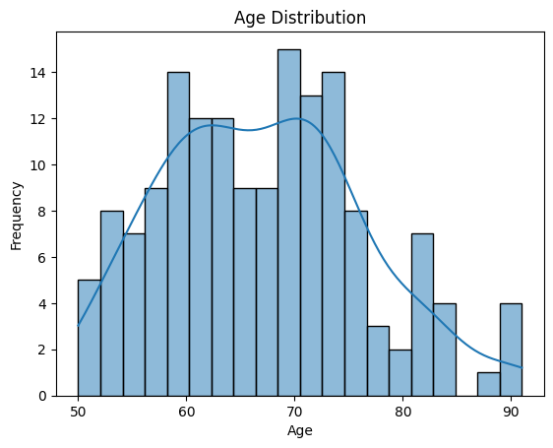
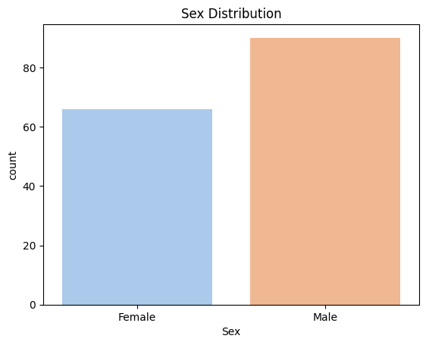
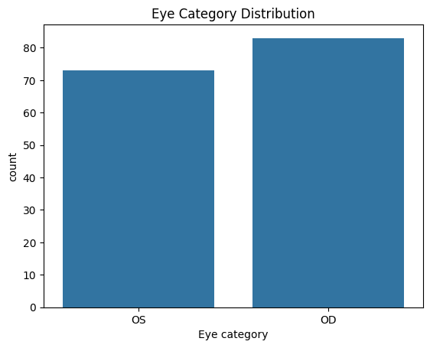
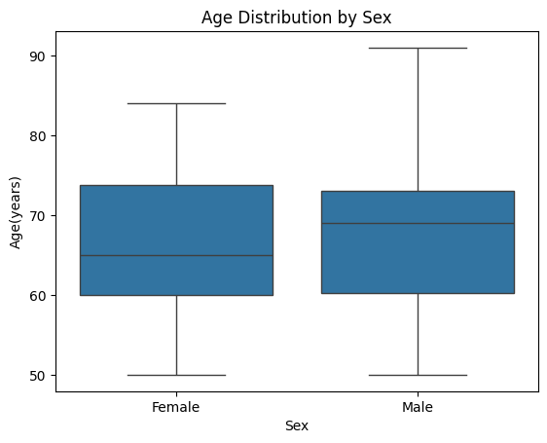
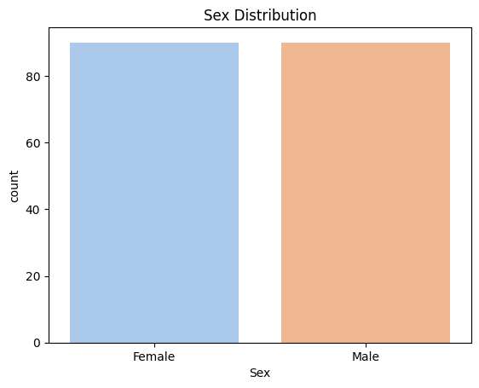
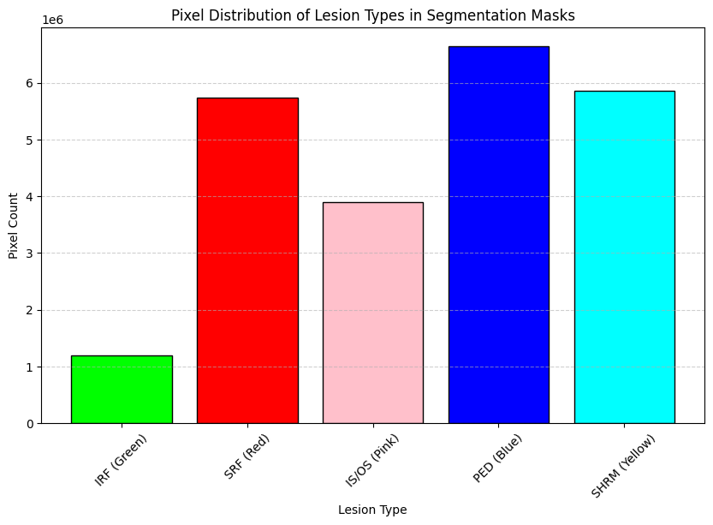
Exploratory data analysis (EDA) RESULTS

Slide 13
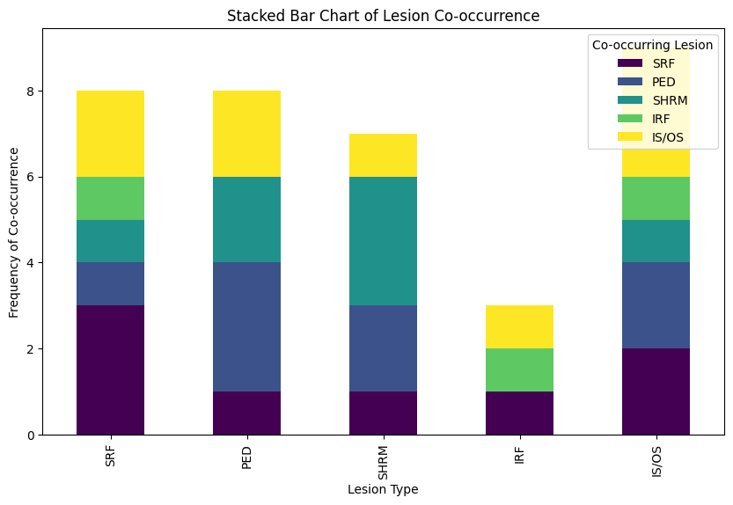
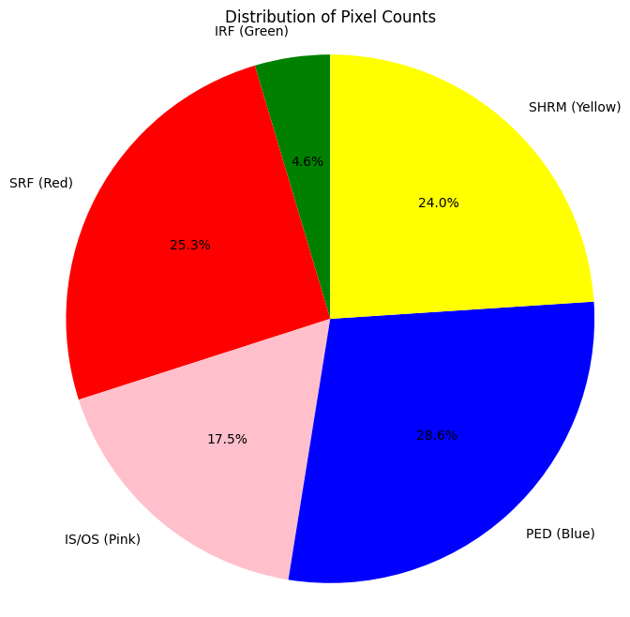
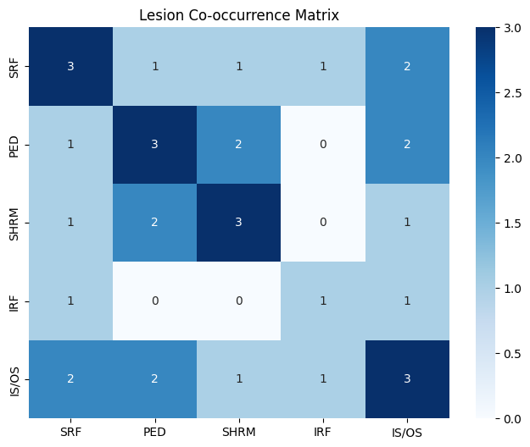
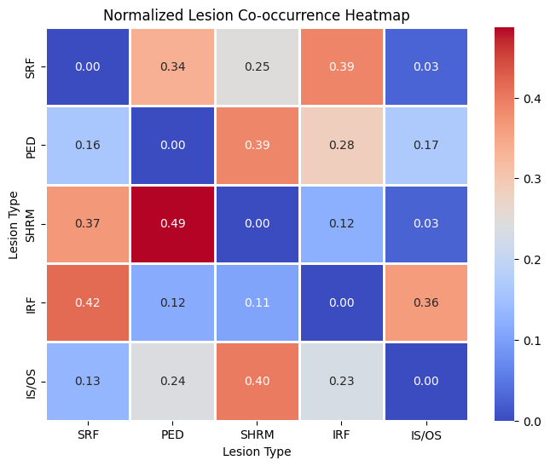
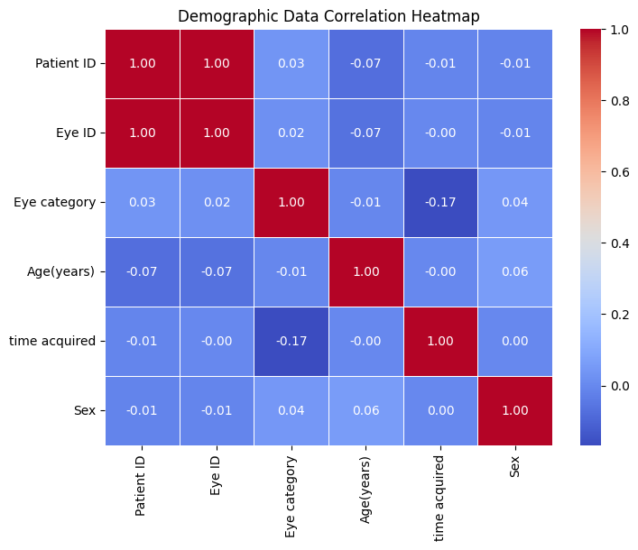

Slide 14
EXPLAINABLE AI
The aim of explainable AI (XAI) is to make the model operations transparent and understandable. The techniques used to determine the transparency of these models were the Grad-CAM and the Saliency Maps.
Grad-CAM, also known as Gradient-weighted Class Activation Mapping, works by generating a heatmap over the OCT scan, highlighting the most critical regions that influenced the model’s decision.
On the other hand, Saliency Maps compute the gradient of the model’s output for each pixel in the input image, identifying the most important regions at a finer level.

Slide 15
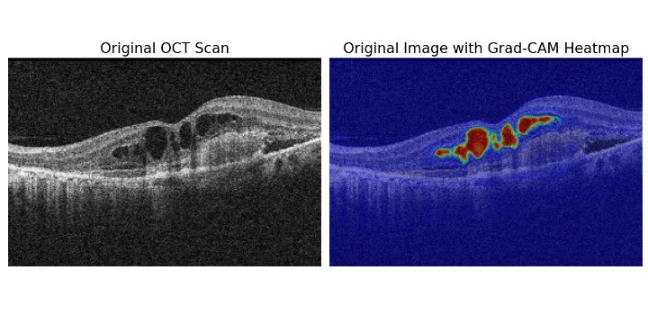
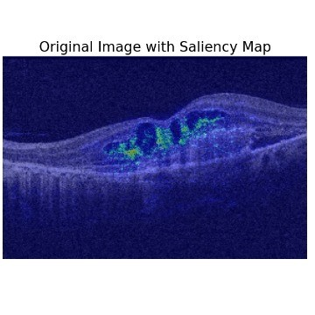
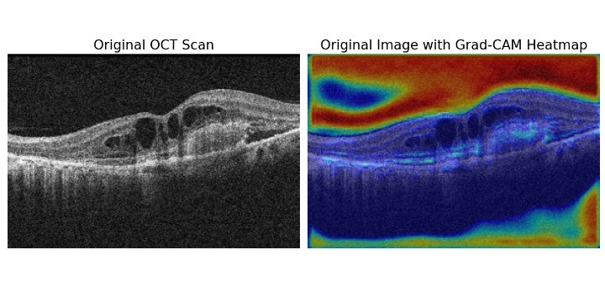
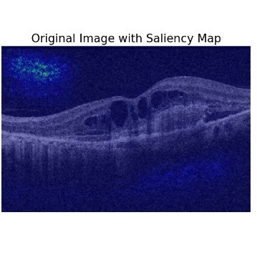
Explainable AI Results FOR THE RNN_CNN_KD MODEL - BEST MODEL
Explainable AI Results UNET++_CNN_ KD MODEL - 2nd BEST MODEL

Slide 16
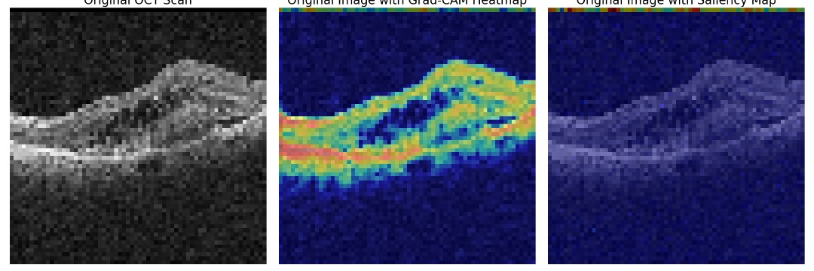
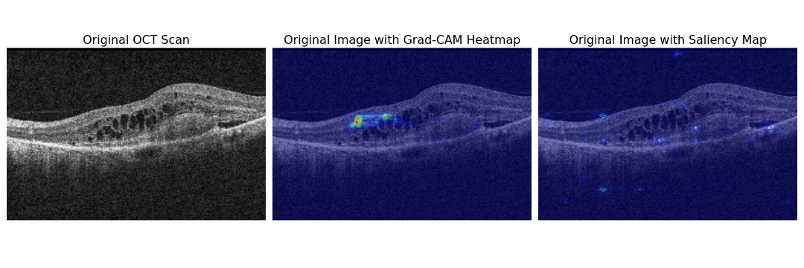
Explainable AI Results FOR THE UNET_GAT MODEL – WORST MODEL
Explainable AI Results UNET_VIT MODEL - 2nd WORST MODEL

Slide 17
Models Selection
MODEL | DICE SCORE | IoU | ACCURACY
U-NET | 0.81846 | 0.7891 | 0.9898
RESNET | 0.8854 | 0.8605 | 0.9943
U-NET_VITs | 0.78632 | 0.75848 | 0.9876
U-NET_GATs | 0.0009 | 0.0022 | 0.7844
RNN_CNN_KD | 0.9185 | 0.9637 | 0.9815
ATT_CNN_KD | 0.9186 | 0.9638 | 0.9816
U-NET++_CNN_KD | 0.9183 | 0.9634 | 0.9813
U-NET++_KD | 0.9799 | 0.9609 | 0.9801

Slide 18
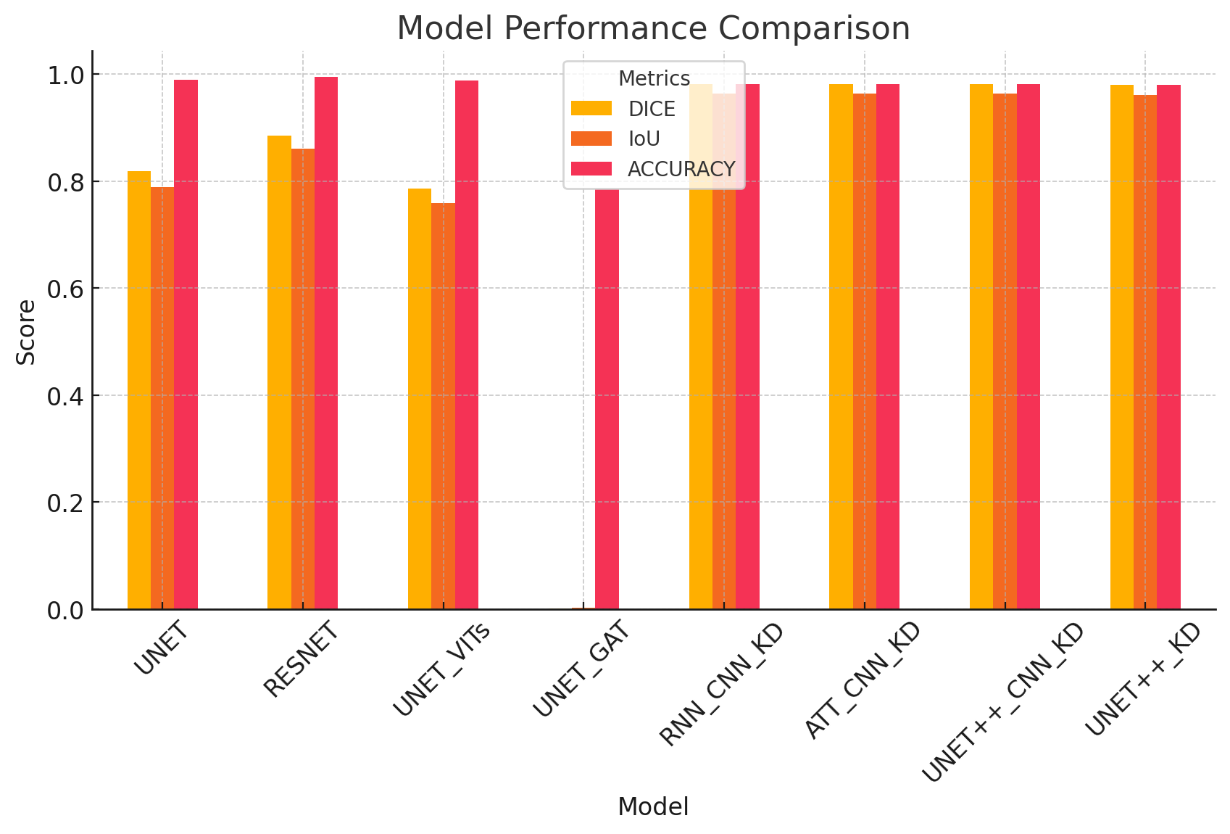
Results and Evaluation

Slide 19
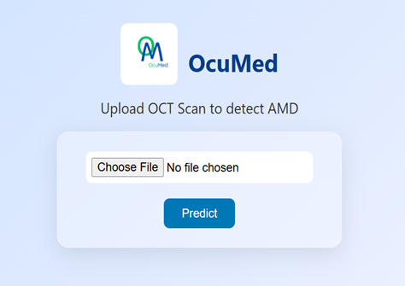
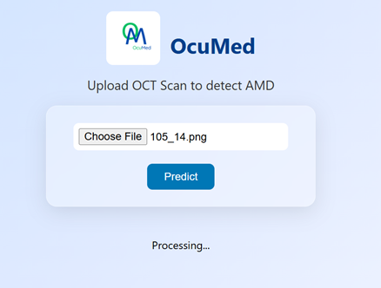
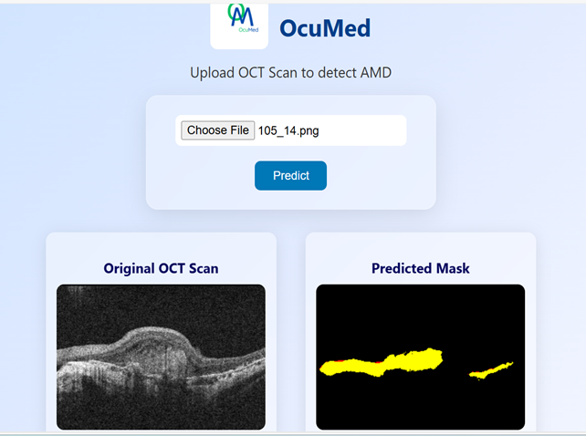
System Demonstration
Below are demo interface screenshots on how our model, once deployed would be applied in a real-world clinical setting:

Slide 20
Intellectual Property of system
Protection Type | Element in System
Patent | AI algorithms and techniques used
 | Software Code Implemented
 | System architecture (ensures that AI algorithms seamlessly integrate within the hospital systems through the use of APIs)
Copyright | Source code
 | UI design
 | Associated Documentation
Trademarks | System/Brand name
 | System/Brand Logo

Slide 21
Conclusions and limitations
Conclusions
Our project demonstrates the great potential of Artificial Intelligence (AI) in transforming ophthalmology by providing an affordable and efficient AMD detection system.
The integration of Graph Attention Mechanisms, self-routing capsule networks, and knowledge distillation helped us develop a model with robust feature extraction.
Future work will focus on enhancing model generalization by increasing dataset diversity and optimizing the model’s efficiency to contribute to the widespread adoption of AI in ophthalmology.
Limitations
High computational complexity, sensitivity to graph structure, and over-smoothing in deep layers.
High memory usage, complexity in tuning routing, and limited scalability for large images.
Because Capsule Networks struggle to scale to very large inputs, we had to downsample the images, potentially losing fine details critical for AMD diagnosis
Combining all the methods into a single architecture was technically challenging. This led to unstable training, where the model failed to converge or it produced inconsistent segmentation results.
Dataset limitations
Bias and lack of demographic diversity

Slide 22
Next Steps
Future efforts will focus on:
Deploying the model in real-world clinical settings to assess its practicality and impact on healthcare delivery.
Enhancing model accuracy with larger datasets.
Integration with electronic health record (EHR) systems.
Developing a user-friendly application or website.

Slide 23
REFERENCES
[38] Y. Hu, Y. Gao, W. Gao, W. Luo, Z. Yang, F. Xiong, Z. Chen, Y. Lin, X. Xia, X. Yin et al., “Amd-sd: An optical coherence tomography image dataset for wet AMD lesions segmentation,” Scientific Data, vol. 11, no. 1, p. 1014,2024.
[2] R. M. Hussain, B. A. Shaukat, L. M. Ciulla, A. M. Berrocal, and J. V. Srid-har, “Vascular endothelial growth factor antagonists: promising players in the treatment of neovascular age-related macular degeneration,” Drug Design, Development and Therapy, pp. 2653–2665, 2021.

Slide 24
Acknowledgements
We would like to acknowledge the following people and organizations, without whose help, we would not have reached this far:
Makerere University IP Management Office for IP training, registration, and protection.
Makerere University Innovation pod (UniPod) for helping us in the journey of bridging our research and innovation into commercialization.
Mr. Ggaliwango Marvin for his guidance and valuable feedback.
Makerere University for providing resources and facilities.

