Slide 1
Amazon Products - Office Electronics
OPIM348 Supply Chain Analytics
Alfred, Samuel, Kaslyn

Slide 2
Table of contents
01
02
03
04
05
06
Our Topic
Reading Product Photos
Market Map
Competitors & Price
Demand & Bestseller
Stock & Spend
Notes:
SAM (15 s): We'll cover why we chose this category, how we read product photos, the market map and our product's competitors and price, then demand, bestseller chance, how much stock to buy and what it costs.

Slide 3
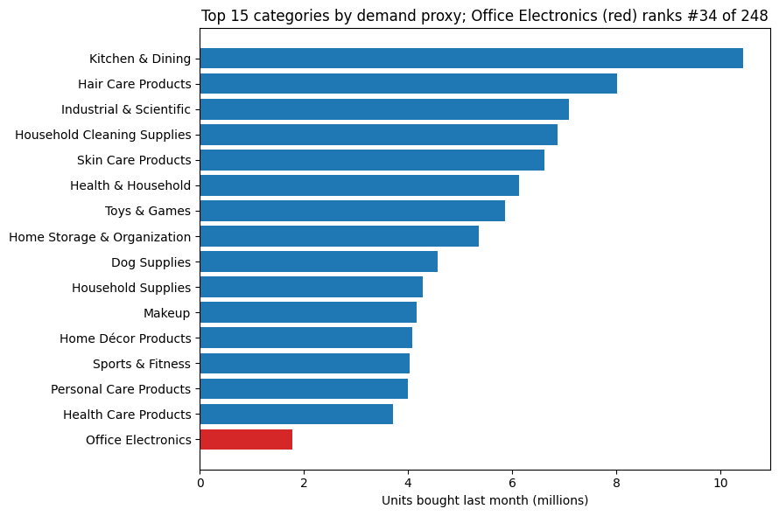
Why Office Electronics
9,220
products we studied
#34 of 248
Amazon categories by sales
$3 to $12,000
from pens to projectors
Sam
Notes:
SAM (1.5 min): We picked Office Electronics on Amazon: about 9,200 products after removing bad data. It's a mid-sized category, 34th of 248 by sales, but very varied, from $3 pens to $12,000 projectors. That variety makes it a good test of how to pick a new product to sell. Our sales measure is Amazon's 'bought in the past month' label, which is a rough count, not exact sales.

Slide 4
Our Question: What Should We Launch?
We are a new seller. Which product should we launch, and how many should we buy?
1
2
3
4
Read the photos
Map the market
Predict sales
Plan the stock
Turn every product photo into numbers a computer can compare
Group look-alike products and find a gap
Use similar products to estimate a new one's sales
Buy enough to sell, but not so much it's left over
Sam
Notes:
SAM (1 min): Imagine we're a new seller. We have to decide what to launch and how much stock to buy, before we've sold anything. Our plan has four steps: read the product photos, map the market, predict sales, and plan the stock. The goal isn't to copy the most popular product; it's to find a good opportunity once you count competitors and the risk of unsold stock.

Slide 5
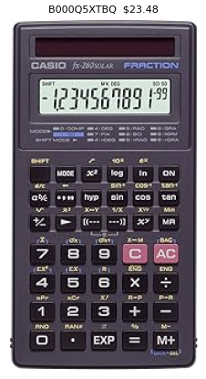
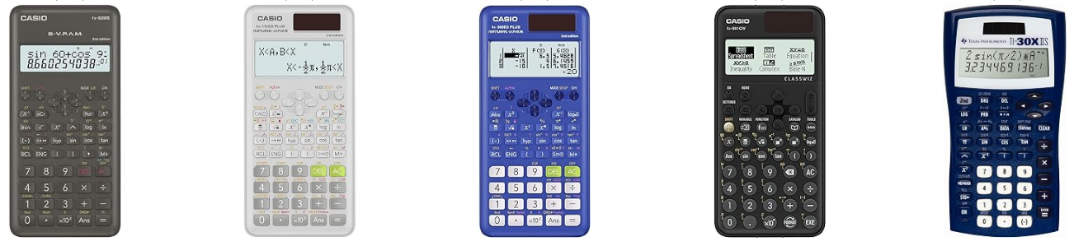
Reading Product Photos
Similar-looking products get similar numbers
AI model
looks at the photo and describes it as a list of numbers
Why: a new product has no sales yet, but it does have a photo, a name and a price.
So: we can find the existing products it looks most like, and learn from how they sell.
Sam
Notes:
SAM (1.5 min): A new product has no sales history, so how do we judge it? By what it looks like. We ran every product photo, all 9,220 of them, through a pretrained AI image model called DINOv2. It turns each photo into a list of 384 numbers, a kind of fingerprint. Products that look alike get similar fingerprints, so we can find any new product's closest look-alikes, like these calculators. We did the same with product names. Hand over to Kaslyn.

Slide 6
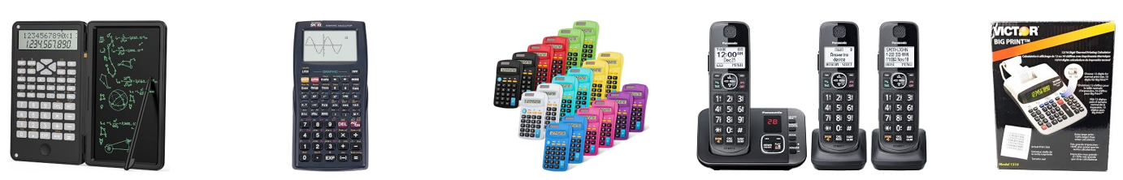
Market Map: Calculators Stand Out
753
305
products: the fewest rivals
sales per product: the highest
Ink and supplies sell a lot, but are crowded. Gadgets barely sell. Calculators have strong sales and fewer rivals.
Kaslyn
Notes:
KASLYN (2 min): Using those photo fingerprints, the computer sorted all products into six groups of look-alikes: gadgets, office machines, toner, calculators and phones, ink packs, and mixed supplies. We tried between 3 and 12 groups; six gave groups that made sense when we looked at the pictures. Ink packs sell the most in total, but there are over 2,000 of them competing. Gadgets barely sell. Calculators and phones have the fewest products and the highest sales per product, 305 a month. That's the gap we want: real demand, fewer rivals.

Slide 7
From 1,844 Products to One
1,844
products we tested as if they were new
1,702
expected to make a profit
987
likely to sell at least 50 a month
87
in the calculator group
78
not surrounded by near-identical rivals
1
most profitable: Casio FX-260
Kaslyn
Notes:
KASLYN (1 min): We set aside 1,844 products and treated them as new ideas whose sales we didn't know. Then we narrowed them down: products expected to make money, likely to sell at least 50 a month, inside the calculator group, and not crowded by near-copies. Of the 78 left, the most profitable was the Casio FX-260 Solar II scientific calculator.

Slide 8
Our Product and Its Closest Competitors
Ours: $23.48
Its 5 closest competitors
Casio & TI
$9 to $25
1,000 a month
scientific calculators, like ours
what our closest rivals charge
a typical rival's sales
Kaslyn
Notes:
KASLYN (1.5 min): Here's our product, the Casio FX-260 Solar II, on the left, and the five products it looks most like: Casio and Texas Instruments scientific calculators priced $9 to $25. A typical one sells about 1,000 a month, and the most popular sells 8,000. So there's proven demand here. These rivals matter twice: they tell us who we compete with, and their sales are how we'll predict ours.

Slide 9
Planned Price: $23.48
$23.48
The catch: shoppers can buy the same calculator for $9.49.
Still worth it: even at $9.49 we'd expect about $5,700 profit.
To charge more: bundle a case and spare battery, or launch for back-to-school.
our planned price
$9.49
the same calculator from another seller
Kaslyn
Notes:
KASLYN (1.5 min): We plan to sell at $23.48, the price in the listing. The honest catch: the same calculator already sells for $9.49 elsewhere. So we checked: if we had to match $9.49, we'd still expect about $5,700 profit in the first month. To justify the higher price, we'd add value, like bundling a case and spare battery, or launching for back-to-school. Hand over to Alfred.

Slide 10
Predicted Sales: 1,825 in the First Month
1,825
their average = our prediction
about 900 to 2,300
the likely range
Tested on 1,844 products we hid: our method beat a simple average guess, but it can't spot runaway hits.
Alfred
Notes:
ALFRED (1.5 min): How many will we sell? We look at the 10 products that look most like ours and average their sales: here they range from 50 to 8,000 a month, and the average is 1,825. That's our prediction, with a likely range of about 900 to 2,300. To check the method is sound, we tested it on 1,844 products whose sales we hid: it beat simply guessing the average for everyone. Its weakness is runaway hits: averaging can't predict a product that sells 8,000.

Slide 11
Chance of a Bestseller Badge: 0%
0 of 10
How: we check how many of our 10 closest rivals have Amazon's bestseller badge. None do, so our estimate is 0%.
Can we trust it? Not really. Bestsellers are rare, and in our test the model caught none of the 7 real ones.
So: we report it, but our decision doesn't rely on it.
closest rivals have the badge
35 of 9,220
products are bestsellers (0.4%)
0 of 7
hidden bestsellers our model caught
Alfred
Notes:
ALFRED (1 min): Next, the chance of becoming a bestseller. We check how many of our 10 closest rivals have Amazon's bestseller badge: none do, so our estimate is zero. To be upfront, this prediction isn't reliable: only 35 of 9,220 products are bestsellers, and when we tested on hidden products it caught none of the 7. The badge depends on reviews and sales ranking, which a new listing doesn't have. So we report it, but we don't base the decision on it.

Slide 12
Initial Stock: 1,385 Units
$12.91
$9.51
Running out costs a bit more than a leftover, so we stock a little above the middle of the likely range.
profit lost per sale we miss
money lost per unit left over
Likely first-month sales
898
2,265
Buy 1,385
covers demand 58% of the time
Forecast 1,825
Alfred
Notes:
ALFRED (1.5 min): How much to buy? It's a balance. Each sale we miss loses $12.91 of profit; each unit left over loses $9.51. Running out is a bit worse, so we buy a little above the middle of what we might sell. Using the standard newsvendor rule with the cost assumptions from the brief, that's 1,385 units, enough to cover demand about 58% of the time. It's below the 1,825 forecast because, when we tested the forecast on hidden products, it tended to run high at this level.

Slide 13
Procurement Spend: $14,634
$14,634
Does it work? We tested our method on 1,844 hidden products.
Result: it made $1.08M. Simply buying the forecast would have lost $0.88M.
to buy 1,385 units at $10.57 each
$14,130
expected profit in the first month
Already counts the cost of leftovers and missed sales.
Alfred
Notes:
ALFRED (1.5 min): Buying 1,385 units at $10.57 each costs $14,634, and we expect about $14,130 profit in the first month, after allowing for leftovers and missed sales. Does this approach actually work? We applied it to all 1,844 hidden products and compared with their real sales: it made $1.08 million, while simply buying the forecast amount would have lost $0.88 million, using more than twice the money.

Slide 14
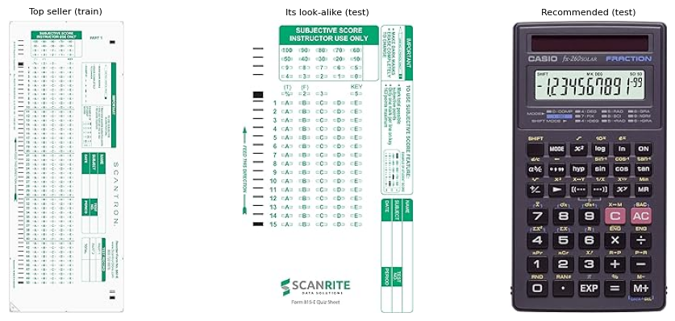
Why Not Copy the Best-Seller?
200 vs 9,000
monthly sales: look-alikes vs the top-selling answer sheet
Crowded
a copy joins a group of nearly 2,000 rivals
$2,111 vs $14,130
expected profit: copy vs our pick
Alfred
Notes:
ALFRED (1.5 min): Why not just copy the best-seller? The top seller is a Scantron answer sheet, 9,000 a month. But products that look like it sell about 200 a month: its sales come from its brand and reviews, which a copy doesn't get. A copy would join a crowded group of nearly 2,000 products, and at about $9 it would make around $2,111 against $14,130 for our calculator. And copying only works with hindsight; our choice uses only what a seller knows before launch.

Slide 15
Recommendation
Launch
Casio FX-260 Solar II scientific calculator
Price
$23.48 with a bundle, or nearer $9.49
Buy
1,385 units for $14,634
Expect
about 1,825 sales and $14,130 profit
Then
reorder once real sales come in
Casio FX-260 Solar II
Alfred
Notes:
ALFRED (45 s): To sum up: launch the Casio FX-260 Solar II from the calculator group, where demand is strong and rivals are fewer. Price at $23.48 only with something extra; otherwise closer to market. Buy 1,385 units for $14,634, expecting about 1,825 sales and $14,130 profit. Treat it as a test batch and reorder once real sales come in. Thank you; happy to take questions.

Slide 16
Thanks!
Do you have any questions?
Please keep this slide for attribution
Notes:
Questions. Keep this slide: Slidesgo's free licence requires the attribution.

