Slide 1

HR ANALYTICS PROJECT
Workforce Analysis and Employee Insights
Presented By
N Lokesh

Slide 2
Business Problem
The company has a large workforce and needs better visibility into employee data.
HR management wants to analyse employee demographics, hiring trends, workforce distribution, and diversity metrics.
Manual analysis of thousands of employee records is time-consuming and difficult.
An interactive HR Analytics Dashboard is required to support data-driven workforce planning and decision-making.

Slide 3
Dataset Overview
Total Employee’s Records:- Approximately 22,214
Data Source: HR Employee Database
Key Columns Used:-
Employee ID, Age, Gender, Department, State, Race, Hire Date, and Work Location (Remote/HQ)
Purpose:
To analyze workforce demographics, hiring trends, employee distribution, and diversity metrics.

Slide 4
Data Cleaning Process
Connected to the HR database and imported the dataset.
Standardized column names for consistency and readability.
Checked for missing values and found no missing records.
Checked for duplicate records and found no duplicates.
Validated data quality and prepared the dataset for analysis.

Slide 5
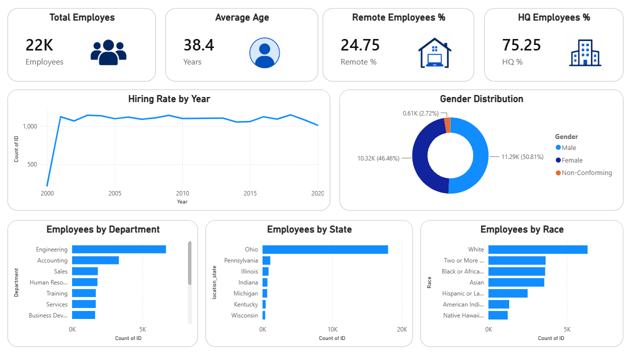
HR Analytics Dashboard

Slide 6
Key Business Insights
The organization has approximately 22,214 employees.
The average employee age is 38.4 years, indicating a mature workforce.
75.25% of employees work from headquarters, while 24.75% work remotely.
Hiring activity reached its peak in 2018 with 1,147 new hires.
Male employees represent 50.81% of the workforce, while female employees represent 46.46%.
Engineering is the largest department, indicating a strong focus on technical operations.
Ohio has the highest employee concentration, making it the primary workforce location.

Slide 7
Recommendations
Continue workforce planning based on hiring trends and department requirements.
Strengthen diversity and inclusion initiatives to improve representation across underrepresented groups.
Explore additional remote work opportunities to improve workforce flexibility and employee satisfaction.
Monitor workforce distribution across states to support future expansion and resource allocation.

Slide 8
Conclusion
The HR Analytics Dashboard successfully analyzed employee demographics, hiring trends, workforce distribution, and diversity metrics. The dashboard provided valuable insights into employee composition, hiring patterns, and workforce allocation across departments and states.
These insights can support data-driven HR decision-making, workforce planning, diversity initiatives, and future organizational growth.
Thank You!

