Slide 1
AWS CODEPIPELINE

Slide 2
What is AWS CodePipeline
AWS CodePipeline is a continuous delivery service you can use to model, visualize, and automate the steps required to release your software.
AWS CodePipeline automatically builds, tests and launches an application each time the code is changed.

Slide 3
Stages of AWS CodePipeline
Source (codecommit)
Build
Artifacts
Deploy
Pipeline

Slide 4
What is Source (codecommit)
AWS CodeCommit is a secure, highly scalable, managed source control service that hosts private Git repositories. It makes it easy for teams to securely collaborate on code with contributions encrypted in transit and at rest.

Slide 5
What is Build
AWS CodeBuild is a fully managed build service in the cloud. CodeBuild compiles your source code, runs unit tests, and produces artifacts that are ready to deploy. CodeBuild eliminates the need to provision, manage, and scale your own build servers. It provides prepackaged build environments for popular programming languages and build tools such as Apache Maven, Gradle, and more.
Amazon s3, GitHub, AWS codeCommit, Bitbucket and GitHub Enterprise.

Slide 6
buildspec.yaml
version: 0.1
phases:
install:
runtime-version:
nodejs: 10
commands:
- echo "install something"
pre_build:
commands:
- echo "This is the prebuild phase"
build:
commands:
- echo "This is the build phase"
- echo "perform some Test"
post_build:
commands:
- echo "This is the post build phase"

Slide 7
What is Artifacts
AWS CodeArtifact is a fully managed artifact repository service that makes it easy for organizations of any size to securely store, publish, and share software packages used in their software development process.

Slide 8
What is Deploy
AWS CodeDeploy is a service that automates code deployments to any instance, including Amazon EC2 instances and instances running on-premises. AWS CodeDeploy makes it easier for you to rapidly release new features, helps you avoid downtime during deployment, and handles the complexity of updating your applications.

Slide 9
What is Pipeline
AWS CodePipeline is a continuous delivery service you can use to model, visualize, and automate the steps required to release your software. You can quickly model and configure the different stages of a software release process. CodePipeline automates the steps required to release your software changes continuously.

Slide 10
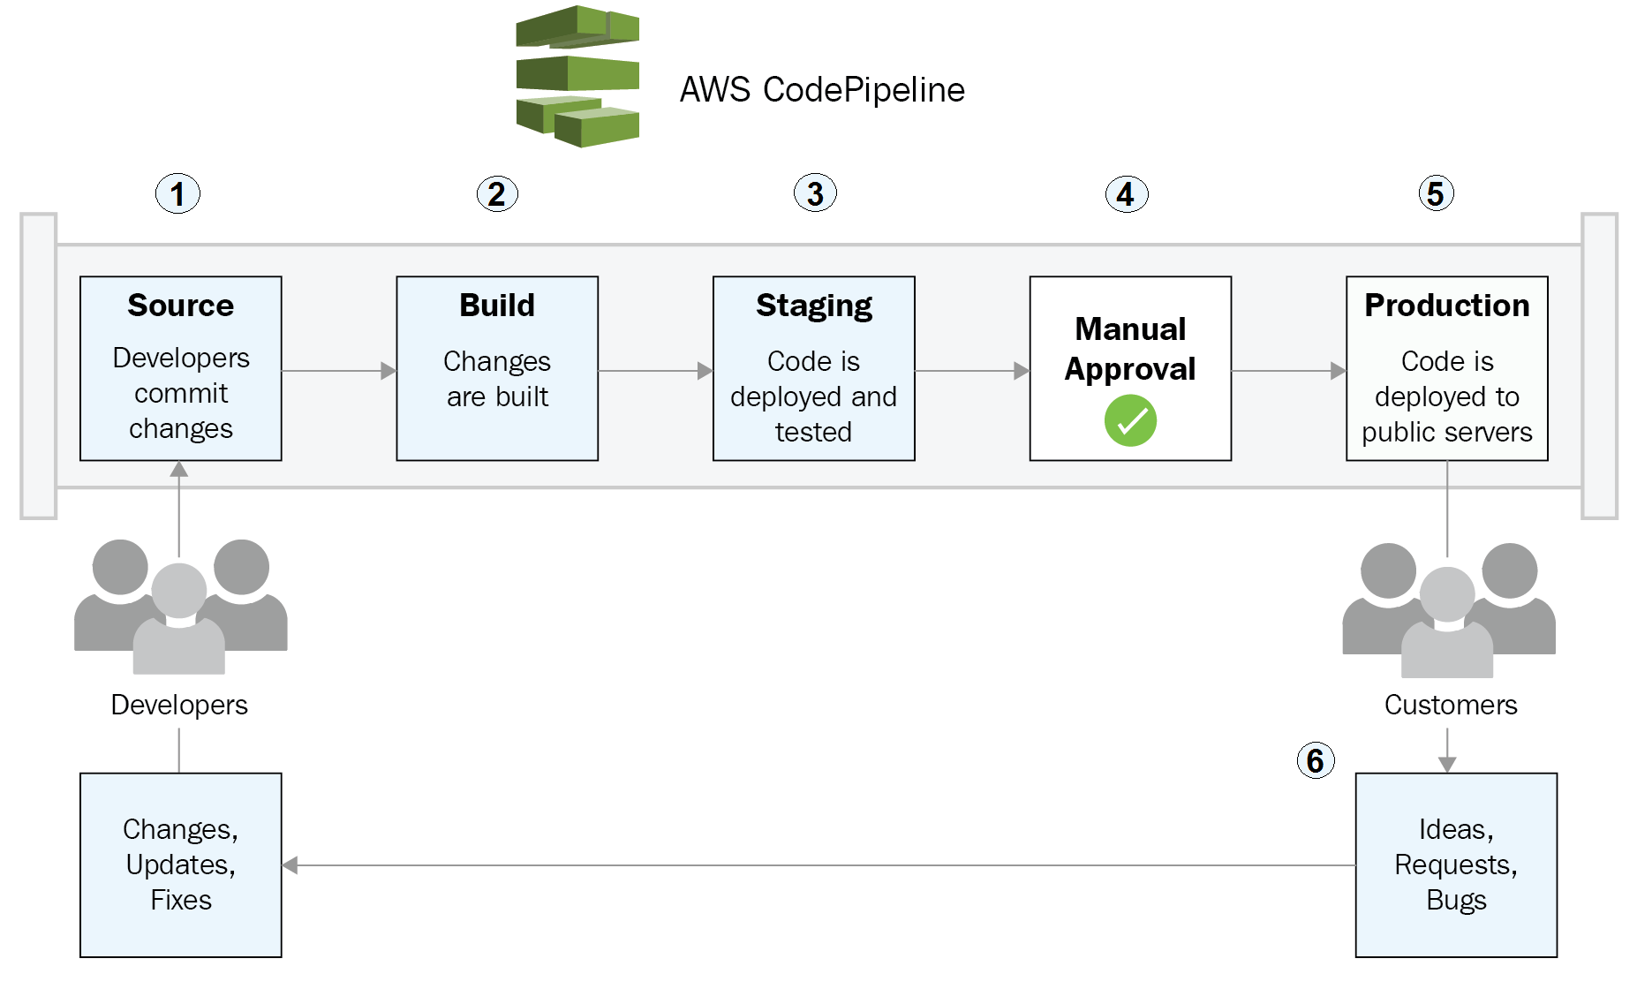

Slide 11
Thank you

