Slide 1

Relax, Just Do It – DITA Customization with RELAX NG
Marion Knebel & Frank Ralf
IN52

Slide 2
Notes:
Pflicht: We work for parson AG. parson AG offers technical communication and knowledge management services with offices in Hamburg, Berlin and Leipzig. We write technical documentation for various industries and also work as consultants to support our customers in introducing new documentation technologies or organizing their knowledge.
Optional:
(We also perform trainings for technical writers in our Hamburg-based training program called “Professional Technical Documentation”.)
Pflicht, Schluss
That's it as an introduction. For more information about our services and job offers, please visit our web site.

Slide 3
Fundamentals
DITA Architecture
Introduction to Customization
Configuration: Custom Concept Shell
Constraint: Custom Topic Body and Domain Constraint
Specialization: New Element
Conclusion
Notes:
This is today's agenda. We will try to cover a full customization if time allows. There are many more things that we could discuss in detail, please feel free to contact us afterwards if you have more questions.
USB sticks with installers and test license as well as oxygen projects and frameworks for the exercises.
Ask what kind of experience the people have with DITA customizations, have they done DTD before, do they know the architecture, ….?

Slide 4
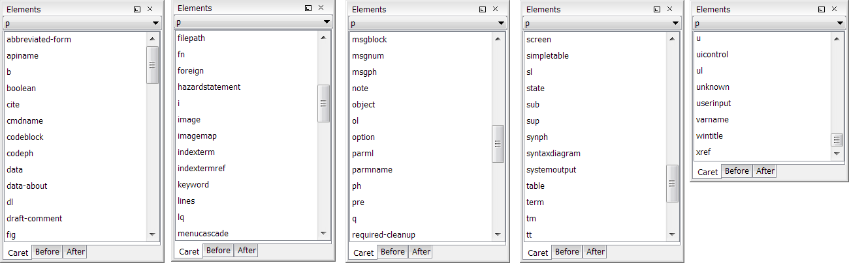
Why Customize DITA?
Huge number of elements/attributes, unnecessary complexity, authors confused, leads to inconsistencies
Customization is part of information architecture process
Default content of the <p> element:
Notes:
DITA is huge. Not only regarding its impact in technical writing but also quite literally. The first time that someone new to DITA looks at the DITA specification they are probably overwhelmed by the sheer amount of elements. At least that was our experience.
DITA 1.2 has over 500 elements, more than double the size of the first DITA version. That can make it difficult to move to DITA and also make it difficult for teams of technical writers to produce consistent output. In the worst case the complexity scares authors away or confuses them instead of providing guidance. That is why a lot of DITA authors use only a subset of the DITA standard. Such a subset can be defined by editing the DITA DTD.
In this workshop we are going to take a closer look at the DITA DTD, its modular structure and methods of editing.
With unlimited supply which flavor do you choose?
DITA 1.2 consists of more than 500 XML elements.
Assumptions:
Most authors only use a subset
Complexity confuses authors
Leads to inconsistent content
Lightweight DITA might be the way out
Currently no established standard
Companies create their own lightweight DITA
Jang Graat:
DITA is not just maybe getting too complicated, it is too complicated. Not just the number of elements, but the naming of some of these elements and the incredible amount of attributes associated with every element. It is more than would be useful, and this is why I feel that DITA constraints are going to save DITA’s future and a lot of tech writers their professional lives. If I had a documentation department to manage, I would immediately enforce constraints to rule out all those unnecessary elements that have been added simply because some tech writers on the DITA TC were too lazy to really think their concepts through. Horrible concepts like conref range or conref push should have never made it into the standard. An element for “long quote” is not necessary if there is already an element for “quote”. Elements like “b”, “i”, “tt” do not belong in a semantic system. If a table element for specific tabular information is defined, this should have been handled by attributes, not by multiplying all the elements in a table for every type of table people come up with (row, strow, relrow, chrow, topicSubjectRow). Where is the real need for an element “noconds”, “nosafety”, “nosupply”, “nosupequi”, “nospares” if a generic “none” element would have done for all these specific cases? And why not have intelligible names for all elements instead of a mix of acronyms for some (like “q”, “dl”, “dt”) and descriptive labels (like “glossAlternateFor”) for others? The existing standard is pretty messy if you ask me, and this makes the complexity worse for tech writers who need to learn a whole new jargon that is definitely not self-explanatory.
http://www.ditawriter.com/interview-with-jang-f-m-graat/

Slide 5
DTD, XSD, or RNG?
DTD = Document Type Definition
XSD = XML Schema Definition
Relax NG (RNG) = Regular Language Description for XML New Generation
Up to DITA 1.2 > DTD
XSD not recommended for DITA: “Generating constraints with XSD is essentially not possible in the general case.” (Eliot Kimber)
RNG = normative grammar as of DITA 1.3
Notes:
It was defined by a committee specification of the OASIS RELAX NG technical committee in 2001 and 2002, based on Murata Makoto's RELAX and James Clark's TREX,^{[2][3][4]} and also by part two of the international standard ISO/IEC 19757: Document Schema Definition Languages (DSDL).[
--------------------------------
The DITA Technical Committee chose the RELAX NG XML syntax for the following reasons:
Easy use of foreign markup
The DITA grammar files maintained by OASIS depend on this feature of RELAX NG in order to capture metadata about document-type shells and modules; such metadata is used to generate the DTD- and XSD-based versions of the grammar files.
The foreign vocabulary feature also can be used to include Schematron rules directly in RELAX NG grammars. Schematron rules can check for patterns that either are not expressible with RELAX NG directly or that would be difficult to express.
RELAX NG <div> element
This general grouping element allows for arbitrary organization and grouping of patterns within grammar documents. Such grouping tends to make the grammar documents easier to work with, especially in XML-aware editors. The use or non-use of the RELAX NG <div> element does not affect the meaning of the patterns that are defined in a RELAX NG schema.
Capability of expressing precise restrictions
RELAX NG is capable of expressing constraints that are more precise than is possible with either DTDs or XSDs. For example, RELAX NG patterns can be context specific such that the same element type can allow different content or attributes in different contexts.
If you plan to generate DTD- or XSD-based modules from RELAX NG modules, avoid RELAX NG features that cannot be translated into DTD or XSD constructs. When RELAX NG is used directly for DITA document validation, the document-type shells for those documents can integrate constraint modules that use the full power of RELAX NG to enforce constraints that cannot be enforced by DTDs or XSDs. The grammar files provided by the OASIS DITA Technical Committee do not use any features of RELAX NG that cannot be translated into equivalent DTD or XSD constructs.
The DITA use of RELAX NG depends on the RELAX NG DTD Compatibility specification, which provides a mechanism for defining default attribute values and embedded documentation. Processors that use RELAX NG for DITA documents in which required attributes (for example, the @domains and @class attributes) are not explicitly present must implement the DTD compatibility specification in order to get default attribute values.
“Customization: DTD, XSD, or RELAX NG?” - DITA Users Group
https://groups.yahoo.com/neo/groups/dita-users/conversations/topics/36666

Slide 6
Advantages of RNG
Self-integration
Easily combine multiple definitions of an element
Valid XML
Integration of foreign grammars > embed Schematron rules
Easier to learn
Data typing > not compatible with DTD conversion
Notes:
RELAX NG modules are self-integrating, which means that they automatically add to the content models and attribute sets they extend. This means that information architects do not have much work to do when assembling vocabulary modules and constraints into document type shells.
In addition to simplifying document-type shells, the self-integrating aspect of RELAX NG results in the following coding practices:
- Each specialized vocabulary module consists of a single file, unlike the two required for DTDs.
- Domain modules directly extend elements, unlike DTDs, which rely on an extra file and extensions within the document-type shell.
- Constraint modules directly include the modules that they extend, which means that just by referencing a constraint module, the document-type shell gets everything it needs to both define and constrain a vocabulary module.
RELAX NG grammars for DITA document-type shells, vocabulary modules, and constraint modules MAY do the following:
- Use the <a:documentation> element anywhere that foreign elements are allowed by RELAX NG. The <a:documentation> element refers to the <documentation> element type from the http://relaxng.org/ns/compatibility/annotations/1.0 as defined by the DTD compatibility specification. The prefix "a" is used by convention.
- Use <div> to group pattern declarations.
Include embedded Schematron rules or any other foreign vocabulary. Processors MAY ignore any foreign vocabularies within DITA grammars that are not in the http://relaxng.org/ns/compatibility/annotations/1.0 or http://dita.oasis-open.org/architecture/2005/ namespaces.
----------------------
Relax NG is all about patterns that match something: <element name="p"> matches an element that is called p.
If you plan to generate DTD- or XSD-based modules from RELAX NG modules, avoid RELAX NG features that cannot be translated into DTD or XSD constructs. When RELAX NG is used directly for DITA document validation, the document-type shells for those documents can integrate constraint modules that use the full power of RELAX NG to enforce constraints that cannot be enforced by DTDs or XSDs. The grammar files provided by the OASIS DITA Technical Committee do not use any features of RELAX NG that cannot be translated into equivalent DTD or XSD constructs.

Slide 7
RNG – Basic Syntax
<element name="p"> <oneOrMore> <choice> <text/> <element name="b"/> <element name="i"/> </choice> </oneOrMore> <zeroOrMore> <element name="fig"/> </zeroOrMore> <attribute name="importance"> <choice> <value>low</value> <value>high</value> </choice> </attribute> </element>
<grammar> <start> <ref name = "concept.element"/> </start> <define name = "concept.element"> <element name= "concept"/> <ref name="title"/> <optional> <ref name="shortdesc"/> </optional> <ref name="conbody"/> <ref name="related-links"/> </define> </grammar>
Notes:
http://relaxng.org/tutorial-20011203.html
A grammar element has a single start child element, and zero or more define child elements. The start and define elements contain patterns. These patterns can contain ref elements that refer to patterns defined by any of the define elements in that grammar element. A grammar pattern is matched by matching the pattern contained in the start element.
RELAX NG uses named patterns to address both modularity and recursion. Named patterns are reusable patterns that can be referenced by their name.
In the XML syntax, named patterns are defined using define elements.
When you define named patterns, you need a container to embed both the named pattern definitions and the definition of the root element of the named patterns. This definition of the root element, as well as definitions of all the patterns that may be used within it, is what RELAX NG calls a grammar. It uses the grammar element. When you use a grammar element, RELAX NG requires you to explicitly declare the root element or elements, using a start element.
Some compositors are hardly or not at all used for DITA RNG: interleave (for elements), group, mixed

Slide 8
Fundamentals
DITA Architecture
Customization - Introduction
Configuration: Custom Concept Shell
Constraint: Custom Topic Body and Domain Constraint
Specialization: New Element
Conclusion

Slide 9
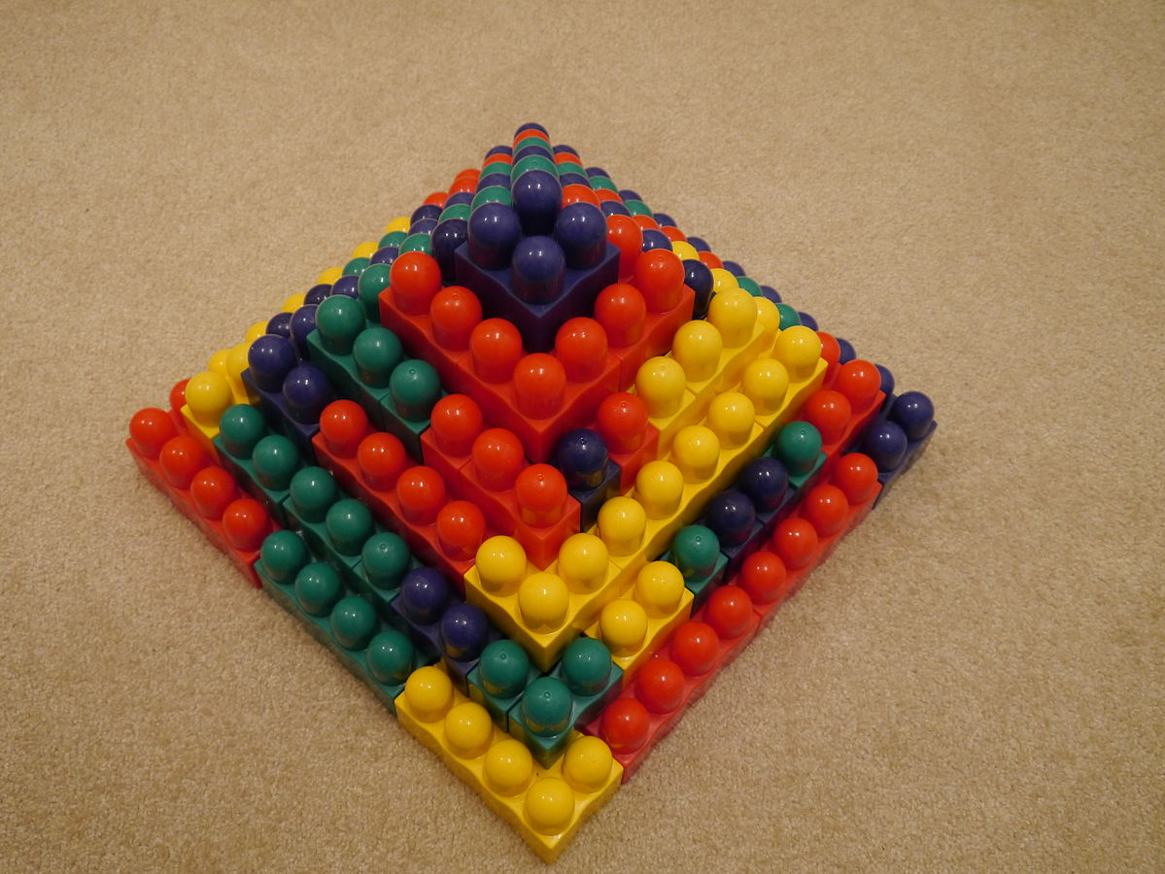
DITA Architecture Basics
Notes:
How do you organize something as big as the DITA standard? Break it down and modularize.
The DITA architecture is modularized.
attribute domain module
A domain module that defines a specialization of either the @base or @props attribute.
constraint module A set of declarations that imposes additional constraints onto the element or attribute types that are defined in a specific vocabulary module.
domain module A vocabulary module that defines a set of element types or an attribute type that supports a specific subject or functional area.
element domain module
A domain module that defines one or more element types for use within maps or topics.
structural module
A vocabulary module that defines a top-level map type or topic type. vocabulary module A set of element or attribute declarations.

Slide 10
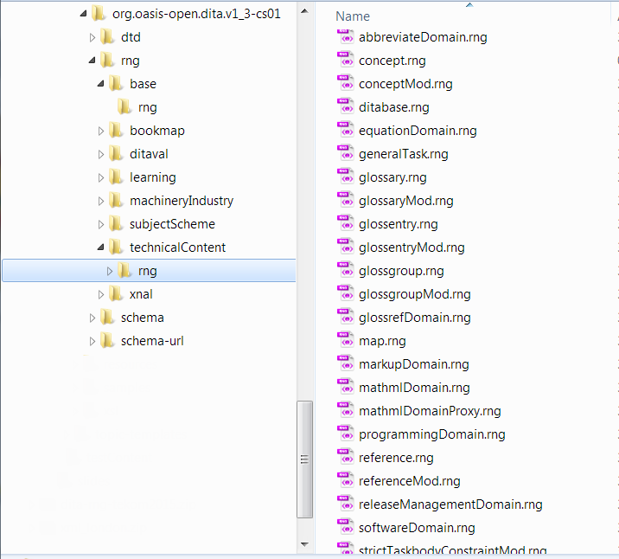
Modularization
Each document type has an associated RNG file called shell.
Element and attribute definitions are outsourced to Mod files.
Notes:
The first modularization takes place at file level, here we have nearly 150 files in 16 folders, and more than 1 MB total file size because of modular structure. (146 RNG files, plus catalogs)

Slide 11
Cascading Definitions
Content models of elements DITA RNG files use defines within defines.
<define name="p">
<define name="p.element">
<define name="p.content">
<define name="p.attlist">
<define name="para.content">
<ref name="basic.block">
<ref name="basic.ph">
…
<define name="p.attributes">
<ref name="univ-atts"/> …
Notes:
More modularization takes place within the vocabulary module files. Here we have hierarchical and cascading patterns that make the grammar very flexible and ready for reuse.
For most elements, we have a structure like this, with the element container at the top, and additional patterns for the element content.
In the para.content define, we do not find individual elements, but rather sets of elements (more modularization and reuse).
> Mention that the defines themselves are not nested, but refs are used!!!

Slide 12
Document Type Shells
XML grammar files that define which elements and attributes are allowed in a DITA topic.
Do not directly declare element or attribute types.
Integrate structural modules, domain modules, and constraint modules.
topic
general task
concept
map
learning map
learning overview
glossentry
strict task
reference
bookmap
learning plan
learning assessment
glossgroup
machinery task
trouble- shooting
subject scheme map
classify map
learning content
learning summary
Notes:
DITA 1.3 Specification
DITA document type
A unique set of structural modules, domain modules, and constraint modules that taken together provide the XML element and attribute declarations that define the structure of DITA documents.
DITA document-type shell
A set of DTD, XSD, or RELAX NG declarations that implement a DITA document type by using the rules and design patterns that are included in the DITA specification. A DITA document-type shell includes and configures one or more structural modules, zero or more domain modules, and zero or more constraint modules. With the exception of the optional declarations for the <dita> element and its attributes, DITA document-type shells do not declare any element or attribute types directly.

Slide 13
Document Type Shells
XML grammar files that define which elements and attributes are allowed in a DITA topic.
Do not directly declare element or attribute types.
Integrate structural modules, domain modules, and constraint modules.
topic
general task
strict task
machinery task
glossentry
map
bookmap
concept
reference
trouble- shooting
glossgroup
subject scheme map
classify map
Notes:
DITA 1.3 Specification
DITA document type
A unique set of structural modules, domain modules, and constraint modules that taken together provide the XML element and attribute declarations that define the structure of DITA documents.
DITA document-type shell
A set of DTD, XSD, or RELAX NG declarations that implement a DITA document type by using the rules and design patterns that are included in the DITA specification. A DITA document-type shell includes and configures one or more structural modules, zero or more domain modules, and zero or more constraint modules. With the exception of the optional declarations for the <dita> element and its attributes, DITA document-type shells do not declare any element or attribute types directly.

Slide 14
Structural Modules and Common Elements
Structural modules define map or topic types.
Contain actual topic or map content.
Common elements, metadata definitions and table elements are outsourced to separate files.
topicMod
taskMod
conceptMod
referenceMod
glossaryMod
…
mapMod
bookmapMod
subjectSchemeMod
…
learningPlan Mod
learning AssessmentMod
common ElementsMod
metaDeclMod
tblDeclMod
Notes:
A vocabulary module that defines a top-level map type or topic type.

Slide 15
Structural Modules and Common Elements
Structural modules define map or topic types.
Contain actual topic or map content.
Common elements, metadata definitions and table elements are outsourced to separate files.
topicMod
taskMod
conceptMod
mapMod
bookmapMod
subjectSchemeMod
referenceMod
glossaryMod
…
common ElementsMod
metaDeclMod
tblDeclMod
Notes:
A vocabulary module that defines a top-level map type or topic type.

Slide 16
Examples of Common Element Sets
Common element sets are reused in many element definitions.
<define name="basic.ph"> <choice> <ref name="boolean"/> <ref name="cite"/> <ref name="keyword"/> <ref name="ph"/> <ref name="q"/> <ref name="term"/> <ref name="text" dita:since="1.3"/> <ref name="tm"/> <ref name="xref"/> <ref name="state"/> </choice> </define>
<define name="basic.block"> <choice> <ref name="dl"/> <ref name="div"/> <ref name="fig"/> <ref name="image"/> <ref name="lines"/> <ref name="lq"/> <ref name="note"/> <ref name="object"/> <ref name="ol"/> <ref name="p"/> <ref name="pre"/> <ref name="simpletable"/> <ref name="sl"/> <ref name="table"/> <ref name="ul"/> </choice> </define>
Notes:
Some elements and definitions are reused in many different document types, container elements, or maps. These are collected in an additional vocabulary module file called commonElementsMod. (Separate files for metadata information and table definitions).
Be careful to check where a pattern is used when you modify it.

Slide 17
Domains
Provide semantic categories to group elements and attributes across document types.
Useful to remove or add whole groups of elements from or to document or map types.
svgDomain
hazardStatement Domain
softwareDomain
mapGroupDomain
mathMLDomain
highlightDomain
abbreviateDomain
glossRefDomain
…
programmingDomain
…
…
Notes:
Shells and Mod files = Technical structures.
DITA domains = semantic categories to group elements and attributes.
For example, the programming domain contains elements that can be used to add information about code snippets and API names to your DITA files. Quite often whole domains can be removed from shell files.
The domains that an author can use when writing DITA content are determined by the domains available in the shell file.

Slide 18
Reuse & Redefinition
Cascading defines allow reuse and redefinition in multiple places.
All specialized elements are automatically allowed where the base element is allowed.
commonElementsMod.rng
<define name="ph"> <ref name="ph.element"/> </define>
adds ph
highlightDomain.rng
<define name="ph" combine="choice"> <ref name="hi-d-ph"/> </define>
adds b, i, line-through, overline, sup, sub, tt, u
programmingDomain.rng
<define name="ph" combine="choice"> <ref name="pr-d-ph"/> </define>
adds codeph, synph
Notes:
Relax NG makes it easy to reuse an existing container element, by creating separate definitions and combining those. Here, we have a base element called "ph", which is defined in commonElementsMod. But there are also specialized versions of ph in some domains, that are integrated into ph. That way, they automatically become available where ph is allowed.
This mechanism is used for all specializations of base types.
The whole process is easier in RNG than DTD, because you do not have to add or remove entities from all your custom files. For example, when you remove a domain, you just remove the include from the topic shell, and you do not have to touch any other Mod file that previously used this domain.
For your specializations, you only create your element domain extension modules and add a value to the @domain attribute in the document type shell.
Consequences:
To exclusively use ph in a specific element, allow only "ph.element" in the content model for that element (or remove all the domains completely).
To exclusively allow the specialized versions, but not the base element, you can disallow "ph.element", while still allowing "ph".

Slide 19
Reuse Issues
Sometimes, reuse patterns are not obvious or semantically motivated.
Be careful to check where a pattern is used when you modify it.
<define name="prereq.content"> <zeroOrMore> <ref name="section.notitle.cnt"/> </zeroOrMore> </define>
<define name="context.content"> <zeroOrMore> <ref name="section.notitle.cnt"/> </zeroOrMore> </define>
<define name="steps-informal.content"> <zeroOrMore> <ref name="section.notitle.cnt"/> </zeroOrMore> </define>
<define name="tasktroubleshooting.content"> <zeroOrMore> <ref name="section.notitle.cnt"/> </zeroOrMore> </define>
<define name="postreq.content"> <zeroOrMore> <ref name="section.notitle.cnt"/> </zeroOrMore> </define>
<define name="result.content"> <zeroOrMore> <ref name="section.notitle.cnt"/> </zeroOrMore> </define>
Notes:
Folie evtl. weglassen

Slide 20
commonElementsMod
metaDeclMod
tblDeclMod
Structural Modules
topicMod
taskMod
conceptMod
referenceMod
mapMod
topic
task
concept
reference
map
Shells
mapGroupDomain
xmlDomain
taskreqDomain (task only)
xnalDomain
svgDomain
glossRefDomain
Domains
…
abbreviateDomain
highlightDomain
hazardStatement Domain
softwareDomain
…
Notes:
This graphic shows the whole picture and dependencies between shell, mod, and domain files.
Of course, it gets more complicated when you add your constraints and specializations to the picture…

Slide 21
Includes and Chaining
concept.rng
<include href: topicMod.rng>
<include href: conceptMod.rng>
<include href: highlightDomain.rng>
<include href: hazardDomain.rng>
<…>
topicMod.rng
<include href: commonElementsMod.rng>
<include href: metaDeclMod.rng>
<include href: tblDeclMod.rng>
commonElementsMod.rng
metaDeclMod.rng
tblDeclMod.rng
conceptMod.rng
highlightDomain.rng
hazardDomain.rng
…
Notes:
This shows more in details how the modules are integrated into a topic shell.
The topicMod is included by all topic types, and with it the three green files with the common elements.
Domains are included directly in the shells, so you can easily remove or add different domains to different shells. We will see later how this chaining of includes affects our customization.

Slide 22
XML Catalog Files
Map DITA topics to RNG files via URNs.
Include RNG files via URNs.
Separate catalog for customization files to resolve new identifiers.
Combine custom catalog with default DITA catalog > integrate both as DITA-OT plug-ins.
Observe DITA naming conventions for URNs.
catalog.xml
<uri name="urn:oasis:names:tc:dita:rng:concept.rng" uri="rng/concept.rng"/>
concept topic
<?xml-model href="urn:oasis:names:tc:dita:rng:concept.rng" schematypens="http://relaxng.org/ns/structure/1.0"?>
Notes:
Catalog files contain the mapping of document identifiers to the URIs of files of the DITA DTD. The catalog file also contains references to our customized shell files. Catalog files have the .xml file ending.
Similar to keywords, connect files with each other.
We will not discuss this in detail today, for our practical part, we have already set up the catalog files to resolve includes via URNs, not relative file paths.

Slide 23
Fundamentals
DITA Architecture
Customization - Introduction
Configuration: Custom Concept Shell
Constraint: Custom Topic Body and Domain Constraint
Specialization: New Element
Conclusion

Slide 24

DITA Customization
Modularization allows to use original parts and altered parts.
Configuration
Configure document type shells.
Constraints
Restrict content models and attribute lists.
Specialization
Create new elements and attributes.
Generalization
Reversing specializations > not covered today.
https://commons.wikimedia.org/wiki/File:Museo_Nazionale_del_Cinema,_Turin_%285282830195%29.jpg by André Ribeiro
Notes:
Configuration
Configuration enables the definition of DITA document types that include only the vocabulary modules that are required for a given set of documents. There is no need to modify the vocabulary modules. Configurations are implemented as document type shells.
Specialization
Specialization enables the creation of new element types in a way that preserves the ability to interchange those new element types with conforming DITA applications. Specializations are implemented as vocabulary modules, which are integrated into document-type shells.
Specializations are implemented as sets of vocabulary modules, each of which declares the markup and entities that are unique to a specialization. The separation of the vocabulary and its declarations into modules makes it easy to extend existing modules, because new modules can be added without affecting existing document types. It also makes it easy to assemble elements from different sources into a single document-type shell and to reuse specific parts of the specialization hierarchy in more than one document-type shell.
Generalization
Generalization is the process of reversing a specialization. It converts specialized elements or attributes into the original types from which they were derived.
Constraint
Constraint enables the restriction of content models and attribute lists for individual elements. There is no need to modify the vocabulary modules. Constraints are implemented as constraint modules, which are integrated into document-type shells.

Slide 25

Brand-new app
Do as your cat would: Go Nap!
Never again tired after work. Go Nap!

Slide 26

Napsor Documentation
Mobile help > short topics, no frills
Software only > no machinery stuff
Only semantic highlighting > no bold or italics
Fun!
Special request for a <thankyou> element

Slide 27
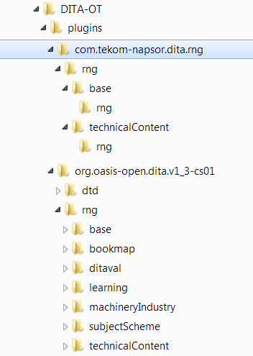
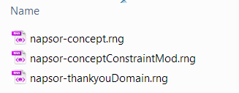
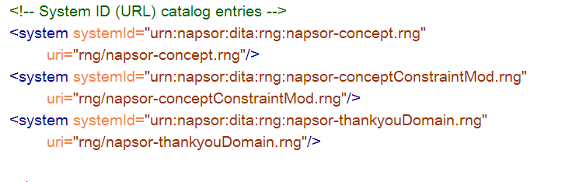
Preparations
Current version of DITA-OT, e.g. 2.0.1
DITA 1.3 CS01 RNG grammar
DITA-OT plug-in created and integrated
New plug-in = com.tekom-napsor.dita.rng
Already set up and integrated
Same folder structure as DITA 1.3 plug-in
Catalog files prepared for all exercises
Shell and Mod files prepared
All relative paths in @href attributes exchanged with URNs

Slide 28
Fundamentals
DITA Architecture
Customization - Introduction
Configuration: Custom Concept Shell
Constraint: Custom Topic Body and Domain Constraint
Specialization: New Element
Conclusion

Slide 29
Configuration – Custom Document Type
Create a shell file (RNG) for a new document type = napsor-concept.rng
Customization of default DITA concept topic
Preparation for modifying the actual content model of the document type
New shell = structural specialization
concept
concept
Default DITA
Napsor DITA
Notes:
In this exercise we will start by creating a new shell file for a customized topic or document type, based on the default DITA topic document type.
By preparing this shell file and using a custom topic that references this RNG file, we are setting everything up for modifying the actual content of the topic type.
The overall process for creating a document type shell is:
1. Find an existing shell that is close to what you want to end up with and copy it to a new location.
2. Add or remove references to constraint or vocabulary modules as needed.
3. Assign an appropriate public identifier or URN for the new shell.
4. Deploy the new shell so that it is available to authors and processing components
-----------------------------------------------
Document type shells that are not provided by OASIS MUST have a unique public identifier, if public identifiers are used. Document type shells that are not provided by OASIS MUST NOT indicate OASIS as the owner; the public identifier or URN for such document-type shells SHOULD reflect the owner or creator of the document-type shell.
Alternative:
Structural specialization
Structural specializations are developed from either topic or map types. Structural specializations enable information architect to add new document types to DITA. The structures defined in the new document types either directly use or inherit from elements found in other document types. For example; concept, task, and reference are specialized from topic, whereas bookmap is specialized from map.

Slide 30
Create Napsor Concept Topic
Copy concept.rng to the new plug-in folder and rename as napsor-concept.rng.
Modify napsor-concept.rng:
Set <moduleShortName> to napsor-concept and update metadata in header.
Set <rngShell> to urn:napsor:dita:rng:napsor-concept.rng.
Open napsor-documentation.dita and change the xml-model processing instruction to:
<?xml-model href="urn:napsor:dita:rng:napsor-concept.rng" schematypens="http://relaxng.org/ns/structure/1.0"?>
Validate the topic.
Result:
Base topic shell is ready. Topic validates against new shell.
Notes:
Erwähnen, dass man die Metadaten auch anders gestalten kann, Namensregeln von DITA vorgeschlagen, Hauptsache eindeutig.
Möglichkeit: Root-Knoten des Topics umbenennen, falls gewünscht.
xml-model processesing instruction identifies the document type (similar to Doctype declaration if DTD is used. Public or system identifier possible). Resolution via XML catalog.
Vorbereitung: leere Shell schon vorhanden, hrefs in URNs umgewandelt

Slide 31
Configuration – Domains
Remove domain from document type by commenting out the <include>.
Make hazard domain unavailable, not needed for app documentation.
napsor-concept.rng
hazardDomain.rng
Notes:
Alternative (only mention if time allows):
Constraining domains in the shell
Domains can be constrained to disallow some extension elements without the use of a separate module file. This is done by overriding the base type pattern within the reference to the domain module. In this case, the constraint represented by the pattern redefinition still must be declared in the @domains attribute; the @domains contribution should be documented in the document-type shell with the constraint. There is not a designated section of the document-type shell for this type of constraint; it can be placed either in Content constraint integration or Module inclusions.

Slide 32
Remove the Hazard Domain
Open napsor-concept.rng.
Search for MODULE INCLUSIONS.
Comment out <include href="urn:oasis:names:tc:dita:rng:hazardDomain.rng"/>.
Open napsor-documentation.dita and validate the topic.
Replace <hazardstatement> element with <note type="tip">.
Remove the hazard domain from the domains attribute:
<attribute name="domains" a:defaultValue="(topic abbrev-d) (topic concept) (topic equation-d) (topic hazard-d)
Result:
Elements from the hazard domain are unavailable in editor and do not validate.
Notes:
Steps need to be repeated for other document types.

Slide 33
Fundamentals
DITA Architecture
Customization - Introduction
Configuration: Custom Concept Shell
Constraint: Custom Topic Body and Domain Constraint
Specialization: New Element
Conclusion

Slide 34
Constraint Modules
Used to modify content models of elements and attributes:
Remove optional elements or attributes.
Make optional elements or attributes required.
Enforce a specific sequence of elements.
Limit available attribute values or define specific attribute values.
Example: Disallow unsemantic highlighting elements, such as <b> and <i>.
Notes:
Constraint
Constraint enables the restriction of content models and attribute lists for individual elements. There is no need to modify the vocabulary modules. Constraints are implemented as constraint modules, which are integrated into document-type shells.
Constraints
Constraint modules define additional constraints for vocabulary modules in order to restrict content models or attribute lists for specific element types, remove certain extension elements from an integrated domain module, or replace base element types with domain-provided, extension element types. See Constraints for more information.
A constraint module can perform the following functions:
Restrict the content model for an element
Constraint modules can modify content models by removing optional elements, making optional elements required, or requiring unordered elements to occur in a specific sequence. Constraint modules cannot make required elements optional or change the order of element occurrence for ordered elements.
For example, a constraint for <topic> can require <shortdesc>, can remove <abstract>, and can require that the first child of <body> be <p>. A constraint cannot allow <shortdesc> to follow <prolog>, because the content model for <topic> requires that <shortdesc> precedes <prolog>.
Restrict the attributes that are available on an element
Constraint modules can restrict the attributes that are available on an element. They also can limit the set of permissible values for an attribute.
For example, a constraint for <note> can limit the set of allowed values for the @type attribute to "note" and "tip". It also can omit the @othertype attribute, since it is needed only when the value of the @type attribute is "other".
Restrict the elements that are available in a domain
Constraint modules can restrict the set of extension elements that are provided in a domain. They also can restrict the content models for the extension elements.
For example, a constraint on the programming domain can reduce the list of included extension elements to <codeph> and <codeblock>.
Replace base elements with domain extensions
Constraint modules can replace base element types with the domain-provided extension elements.
For example, a constraint module can replace the <ph> element with the domain-provided elements, making <ph> unavailable.

Slide 35
Constraining the Topic Content
Create separate files for constraint modules.
Insert constraint modules in include chain.
Add values to domain contribution of document or map type.
napsor-concept.rng
conceptMod.rng
napsor-conceptConstraintMod.rng
conceptMod.rng
Notes:
Constraint
Constraint enables the restriction of content models and attribute lists for individual elements. There is no need to modify the vocabulary modules. Constraints are implemented as constraint modules, which are integrated into document-type shells.
Constraints
Constraint modules define additional constraints for vocabulary modules in order to restrict content models or attribute lists for specific element types, remove certain extension elements from an integrated domain module, or replace base element types with domain-provided, extension element types. See Constraints for more information.
A constraint module can perform the following functions:
Restrict the content model for an element
Constraint modules can modify content models by removing optional elements, making optional elements required, or requiring unordered elements to occur in a specific sequence. Constraint modules cannot make required elements optional or change the order of element occurrence for ordered elements.
For example, a constraint for <topic> can require <shortdesc>, can remove <abstract>, and can require that the first child of <body> be <p>. A constraint cannot allow <shortdesc> to follow <prolog>, because the content model for <topic> requires that <shortdesc> precedes <prolog>.
Restrict the attributes that are available on an element
Constraint modules can restrict the attributes that are available on an element. They also can limit the set of permissible values for an attribute.
For example, a constraint for <note> can limit the set of allowed values for the @type attribute to "note" and "tip". It also can omit the @othertype attribute, since it is needed only when the value of the @type attribute is "other".
Restrict the elements that are available in a domain
Constraint modules can restrict the set of extension elements that are provided in a domain. They also can restrict the content models for the extension elements.
For example, a constraint on the programming domain can reduce the list of included extension elements to <codeph> and <codeblock>.
Replace base elements with domain extensions
Constraint modules can replace base element types with the domain-provided extension elements.
For example, a constraint module can replace the <ph> element with the domain-provided elements, making <ph> unavailable.

Slide 36
Domains Attribute
RNG-based shells directly specify values for the @domains attribute.
The attribute values correspond to the integrated domains and structural types.
Each domain and constraint module MUST provide a value for use by the @domains attribute.
<define name="domains-att" combine="interleave"><optional> <attribute name="domains" a:defaultValue="(topic abbrev-d) (topic concept) (topic equation-d) (topic hazard-d) (topic hi-d) (topic indexing-d) (topic markup-d xml-d) (topic markup-d) (topic mathml-d) (topic pr-d) (topic relmgmt-d) (topic svg-d) (topic sw-d) (topic ui-d) (topic ut-d) a(props deliveryTarget) (topic concept napsor-concept-c)"/> </optional></define>
Notes:
RNG- and XML Schema-based shells directly specify values for the @domains attribute; these values reflect the details of the domains and structural types that are integrated by the document-type shell.
Each domain and constraint module MUST provide a value for use by the @domains attribute.
Contribution to the @domains attribute Each constraint that is integrated into a DITA document type MUST be declared in the @domains attribute for each structural type that is integrated into the document type. For DTDs, the contribution for the @domains attribute is specified in the constraint module file; for XSD and RELAX NG, the contribution to the @domains attribute is specified directly in the document type shell.
DITA domains attribute The document-type shell must list the domain or structural modules that are named as dependencies in the @domains attribute value. Unlike DTDs, a default value for @domains cannot automatically be constructed using RELAX NG facilities. Instead, the values used to construct @domains are taken from each vocabulary and constraint module, in addition to any domains contributions based on constraints implemented within the shell.
-------------------------------------
Document type shells collect the values that are provided by each module to construct the effective value of the @domains attribute. Processors can examine the collected values when content from one document is used in another, in order to determine whether the content is compatible.
For example, when an author pastes content from one topic into another topic within an XML editor, the application can use the @domains attribute to determine if the two topics use compatible domains. If not, copied content from the first topic might need to be generalized before it can be placed in the other topic.

Slide 37
Simplify the Concept Body (1)
Copy conceptMod.rng to the new plug-in folder and rename as napsor-conceptConstraintMod.rng.
Open napsor-conceptConstraintMod.rng.
Set <moduleShortName> to napsor-concept-c and update metadata in header.
Set <rngMod> to urn:napsor:dita:rng:napsor-conceptConstraintMod.rng.
Set <domainsContribution> to (topic concept napsor-concept-c).
Remove all defines from the file.

Slide 38
Simplify the Concept Body (2)
Add a div for the constraints with an include of the original concept mod:
<div><a:documentation>CONTENT MODEL OVERRIDES</a:documentation>
<include href="urn:oasis:names:tc:dita:rng:conceptMod.rng"> </include>
</div>
Add the following define for the <conbody> element in the include:
<define name="conbody.content"> <zeroOrMore> <choice> <ref name="basic.block"/> <ref name="draft-comment"/> </choice> </zeroOrMore> </define>
You can further restrict the conbody by resolving basic.block.
Save the file.

Slide 39
Prepare the Shell to Use the Constraint
Open napsor-concept.rng.
Comment out the include of the concept mod:
<include href="urn:oasis:names:tc:dita:rng:conceptMod.rng"><define name="concept-info-types"><ref name="concept.element"/></define></include>
Add a div for constraint modules with an include for the Napsor concept Mod constraint:
<div><a:documentation>CONSTRAINT MODULES</a:documentation>
<include href="urn:napsor:dita:rng:napsor-conceptConstraintMod.rng"/>
</div>
Add the module's short name to the domain contribution:
<attribute name="domains" a:defaultValue="(topic abbrev-d) … (topic concept napsor-concept-c)"
Open napsor-documentation.dita and validate the topic.
Convert the invalid <section> to something valid.

Slide 40
Constraining a Domain
Create separate files for constraint modules.
Insert constraint modules in include chain.
Add values to domain contribution of document or map type.
napsor-concept.rng
highlightDomain.rng
napsor-highlightDomainConstraint.rng
highlightDomain.rng
Notes:
Constraint
Constraint enables the restriction of content models and attribute lists for individual elements. There is no need to modify the vocabulary modules. Constraints are implemented as constraint modules, which are integrated into document-type shells.
Constraints
Constraint modules define additional constraints for vocabulary modules in order to restrict content models or attribute lists for specific element types, remove certain extension elements from an integrated domain module, or replace base element types with domain-provided, extension element types. See Constraints for more information.
A constraint module can perform the following functions:
Restrict the content model for an element
Constraint modules can modify content models by removing optional elements, making optional elements required, or requiring unordered elements to occur in a specific sequence. Constraint modules cannot make required elements optional or change the order of element occurrence for ordered elements.
For example, a constraint for <topic> can require <shortdesc>, can remove <abstract>, and can require that the first child of <body> be <p>. A constraint cannot allow <shortdesc> to follow <prolog>, because the content model for <topic> requires that <shortdesc> precedes <prolog>.
Restrict the attributes that are available on an element
Constraint modules can restrict the attributes that are available on an element. They also can limit the set of permissible values for an attribute.
For example, a constraint for <note> can limit the set of allowed values for the @type attribute to "note" and "tip". It also can omit the @othertype attribute, since it is needed only when the value of the @type attribute is "other".
Restrict the elements that are available in a domain
Constraint modules can restrict the set of extension elements that are provided in a domain. They also can restrict the content models for the extension elements.
For example, a constraint on the programming domain can reduce the list of included extension elements to <codeph> and <codeblock>.
Replace base elements with domain extensions
Constraint modules can replace base element types with the domain-provided extension elements.
For example, a constraint module can replace the <ph> element with the domain-provided elements, making <ph> unavailable.

Slide 41
Constrain the Highlight Domain (1)
Copy highlightDomain.rng to the new plug-in folder and rename as napsor-highlightDomainConstraint.rng.
Open napsor-highlightDomainConstraint.rng.
Set <moduleShortName> to napsor-highlightDomain-c and update metadata in header.
Set <rngMod> to urn:napsor:dita:rng:napsor-highlightDomainConstraint.rng.
Set <domainsContribution> to (topic hi-d napsor-highlightDomain-c).
Remove all defines from the file.

Slide 42
Constrain the Highlight Domain (2)
Add a div for the constraints with an include of the original highlight domain:
<div><a:documentation>CONSTRAINT MODULES</a:documentation> <include href="urn:napsor:dita:rng:napsor-highlightDomainConstraint.rng"/>
</div>
Add defines for the following elements:
<b.element>, <i.element>, <overline.element>, <line-through.element>, <tt.element>, <u.element>
Set the content model of the elements to <notAllowed/>.
Example: <define name="b.element"><notAllowed/></define>
Save the file.
Alternative: Remove elements from domain extension pattern hi-d-ph for better DTD compatibility.
Notes:
Alternative:
<define name="hi-d-ph"> <a:documentation>Remove non-semantic highlighting options</a:documentation> <choice> <!-- <ref name="b.element"/>--> <!-- <ref name="i.element"/>--> <!-- <ref name="line-through.element" dita:since="1.3"/>--> <!-- <ref name="overline.element" dita:since="1.3"/>--> <ref name="sup.element"/> <ref name="sub.element"/> <!-- <ref name="tt.element"/>--> <!-- <ref name="u.element"/>--> </choice> </define>

Slide 43
Prepare the Shell to Use the Constraint
Open napsor-concept.rng.
Comment out the include of the highlight domain:
<include href="urn:oasis:names:tc:dita:rng:highlightDomain.rng"/>
In the div for constraint modules, add an include for the highlight domain constraint:
<div><a:documentation>CONSTRAINT MODULES</a:documentation> <include href="urn:napsor:dita:rng:napsor-highlightDomainConstraint.rng"/>
Add the module’s short name to the domain contribution:
<attribute name="domains" a:defaultValue="(topic abbrev-d) … (topic hi-d napsor-highlightDomain-c)"
Open napsor-documentation.dita and validate the topic.
Remove the invalid <b> and <i> elements.

Slide 44
Constraining Common Elements
napsor-concept.rng
topicMod.rng
commonElementsMod.rng
metaDeclMod.rng
tblDeclMod.rng
napsor-concept.rng
napsor-topic ConstraintMod.rng
topicMod.rng
commonElementsMod.rng
metaDeclMod.rng
tblDeclMod.rng
napsor-concept.rng
napsor-topic ConstraintMod.rng
napsor-commonElements ConstraintMod.rng
topicMod.rng
commonElementsMod.rng
metaDeclMod.rng
tblDeclMod.rng

Slide 45
Fundamentals
DITA Architecture
Customization - Introduction
Configuration: Custom Concept Shell
Constraint: Custom Topic Body and Domain Constraint
Specialization: New Element
Conclusion

Slide 46
Element Specialization
Set up a container file.
Include the container file in the shell.
Define a new element.
Integrate the element into base element using @combine.
napsor-concept.rng
napsor-thankyouDomain.rng
Notes:
Declare and element specialization d.omain module

Slide 47
Specialization
Enables creation of new elements and attributes that are derived from existing base types.
Can be processed by DITA applications.
Implemented as vocabulary modules that are integrated into shells.
Notes:
base type
An element or attribute type that is not a specialization. All base types are defined by the DITA specification.
extension element
Within a vocabulary module, an element type that can be extended, replaced, or constrained for use in a DITA document type.
generalization
The process by which a specialized element is transformed into a less-specialized ancestor element or a specialized attribute is transformed into a less-specialized ancestor attribute. The original specialization-hierarchy information can be preserved in the generalized instance; this allows the original specialized type to be recreated from the generalized instance.
specialization
The act of defining new element or attribute types as a semantic refinement of existing element or attribute types
An element or attribute type that is a specialization of a base type
A process by which a generalized element is transformed into one of its more specialized element types or a generalized attribute is transformed into a more specialized attribute.
Specialization
The specialization feature of DITA allows for the creation of new element types and attributes that are explicitly and formally derived from existing types. This facilitates interchange of conforming DITA content and ensures a minimum level of common processing for all DITA content. It also allows specialization-aware processors to add specialization-specific processing to existing base processing. See Specialization for more information.
specialization hierarchy
The sequence of element or attribute types, from the most general to most specialized, from which a given element or attribute type is specialized. The specialization hierarchy for a DITA element is formally declared through its @class attribute.
---------------------------------
A specialized element type has the following characteristics:
A properly-formed @class attribute that specifies the specialization hierarchy of the element
A content model that is the same or less inclusive than that of the element from which it was specialized
A set of attributes that are the same or a subset of those of the element from which it was specialized
Values or value ranges of attributes that are the same or a subset of those of the element from which it was specialized
A specialized attribute has the following characteristics:
It is specialized from @props or @base.
It is declared as a global attribute. Attribute specializations cannot be limited to specific element types.
It does not have values or value ranges that are more extensive than those of the attribute from which it was specialized.
Its values must be alphanumeric space-delimited values. In generalized form, the values must conform to the rules for attribute generalization.

Slide 48
Create Thankyou Element (1)
In the technicalContent folder, create a new RNG file called napsor-thankyouDomain.rng.
Add a header similar to the highlight domain file, including the following:
<moduleShortName>napsor-thankyou-d</moduleShortName>
<rngMod>urn:napsor:dita:rng:napsor-thankyou.rng</rngMod>
<domainsContribution>(topic napsor-thankyou-d)</domainsContribution>
Add a new domain extension pattern that includes the thankyou element:
<define name="thankyou-d-ph"> <ref name="thankyou.element"/> </define>
Add a define for <ph> that integrates the new definition with the base type:
<define name="ph" combine="choice"> <ref name="thankyou-d-ph"/> </define>
Notes:
Vocabulary modules that define element domains must define an extension pattern for each element that is extended by the domain. These patterns are used when including the domain module in a document-type shell.
All vocabulary and constraint modules must document their @domains attribute contribution. The value of the contribution is constructed according to the rules found in domains attribute rules and syntax. The OASIS grammar files use a <domainsContribution> element to document the contribution; this element is used to help enable generation of DTD and XSD grammar files. An XML comment or <a:documentation> element can also be used.
For each element type that is extended by the element domain module, the module must define a domain extension pattern. The pattern consists of a choice group of references to element-type name patterns, with one reference to each extension of the base element type.
The name of the pattern uses the following format, where shortName is the short name for the domain, and elementName is the name of the element that is extended:
shortName-d-elementName
For each element type that is extended by the element domain module, the module extends the element type pattern with a @combine value of "choice" that contains a reference to the domain extension pattern. Because the pattern uses a @combine value of "choice", the effect is that the domain-provided elements are automatically added to the effective content model of the extended element in any grammar that includes the domain module.

Slide 49
Create Thankyou Element (2)
Add the following defines for the <thankyou> element:
<define name="thankyou"> <ref name="thankyou.element"/> </define> <define name="thankyou.element"> <element name="thankyou" dita:longName="Thank you"> <ref name="thankyou.attlist"/> <ref name="thankyou.content"/> </element> </define> <define name="thankyou.content"> <text/> </define>

Slide 50
Create Thankyou Element (3)
Add the following defines for the thankyou attributes:
<define name="thankyou.attlist" combine="interleave"> <ref name="thankyou.attributes"/> </define> <define name="thankyou.attributes"> <ref name="univ-atts"/> <optional> <attribute name="outputclass"/> </optional> </define>
Add the following define to declare the @class attribute:
<define name="thankyou.attlist" combine="interleave"> <ref name="global-atts"/> <optional> <attribute name="class" a:defaultValue="+ topic/ph thankyou-d/thankyou "/> </optional> </define>
Notes:
There are several reasons for keeping the @class attribute declaration separate from the main element and attribute declaration. By putting all the class attribute declarations together in one place, it makes it easier to find the declarations and see what the specialization hierarchy is. It also makes it easier to re-use the element declarations by cut and paste. (This pattern becomes much more critical in XSD-based specialization, where the re-use of base element type declarations is by reference rather than via cut and paste.)
<!-- ============================================================= --> <!-- SPECIALIZATION ATTRIBUTE DECLARATIONS --> <!-- ============================================================= -->
Values for the @class attribute have the following syntax requirements: An initial "-" or "+" character followed by one or more spaces. Use "-" for element types that are defined in structural vocabulary modules, and use "+" for element types that are defined in domain modules.
A sequence of one or more tokens of the form "modulename/typename", with each taoken separated by one or more spaces, where modulename is the short name of the vocabulary module and typename is the element type name. Tokens are ordered left to right from most general to most specialized.These tokens provide a mapping for every structural type or domain in the ancestry of the specialized element. The specialization hierarchy for a given element type must reflect any intermediate modules between the base type and the specialization type, even those in which no element renaming occurs.
At least one trailing space character (" "). The trailing space ensures that string matches on the tokens can always include a leading and trailing space in order to reliably match full tokens.

Slide 51
Prepare the Shell for the Specialization
Open napsor-concept.rng.
In the MODULE INCLUSIONS div, create a new div with an include for the thankyou element specialization:
<div> <a:documentation>SPECIALIZATION DOMAIN MODULES</a:documentation> <include href="napsor-thankyouDomain.rng"/> </div>
Add the module's short name to the domain contribution:
<attribute name="domains" a:defaultValue="(topic abbrev-d) … (topic napsor-thankyou-d)"
Open napsor-documentation.dita and replace the thank you comment with a <thankyou> element.

Slide 52
Napsor Customization – Result
napsor-concept.rng
napsor-conceptConstraintMod.rng
conceptMod.rng
napsor-thankyouDomain.rng
hazardDomain.rng
napsor-highlightDomain Constraint.rng
highlightDomain.rng

Slide 53
Fundamentals
DITA Architecture
Customization - Introduction
Configuration: Custom Concept Shell
Constraint: Custom Topic Body and Domain Constraint
Specialization: New Element
Conclusion

Slide 54
Tips & Tricks
Do not touch any of the original files.
Create a separate DITA-OT plug-in for your customization with new RNG files (shells) for your document types.
Stick to the rules set by the coding requirements for RNG grammar modules.
If in doubt, leave it out > start with fewer elements and expand if necessary.
Get rid of mixed content.
Use <notAllowed> to make elements or attributes generally unavailable.
To make a base type unavailable, but keep a specialized version, use <notAllowed> on the base type element.element define, e.g. <define name="ph.element">.
Beware of side effects > always check where a definition might be reused. Use Search & Replace in all DITA-RNG folders.

Slide 55
References
Official Relax NG website: http://relaxng.org
Relax NG (Eric van der Vlist): http://books.xmlschemata.org/relaxng/page2.html
XML Matters (David Mertz): “Kicking back with RELAX NG” www.ibm.com/developerworks/xml/library/x-matters25/index.html
“Relax NG, Compared” (Eric van der Vlist) www.xml.com/pub/a/2002/01/23/relaxng.html
“Customization: DTD, XSD, or RELAX NG?” https://groups.yahoo.com/neo/groups/dita-users/conversations/topics/36666
“Using DITA-OT with RNG files?"
https://groups.google.com/forum/#!topic/dita-ot-users/0XZAloq2cOY
https://code.google.com/p/dita-ng/source/browse/trunk/doc/DITA-NG.pdf

Slide 56

Questions or Comments?
Marion Knebel & Frank Ralf
Notes:
Ask whether people are interested in webinars, trainings, or online tutorials that cover the process in more detail.

Slide 57



Your opinion is important to us! Please tell us what you thought of the lecture. We look forward to your feedback via smartphone or tablet under
http://IN52.honestly.de
or scan the QR code
The feedback tool will be available even after the conference!

