Slide 1
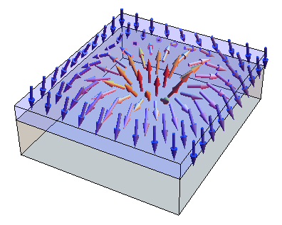



FERROMAGNET
SUPERCONDUCTOR
$$z$$
$$x$$
$$y$$

Slide 2
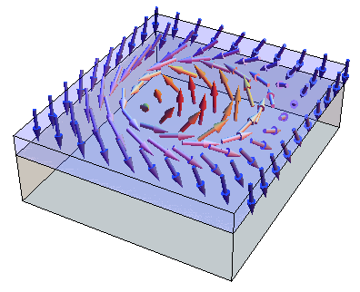
FERROMAGNET
SUPERCONDUCTOR
$$z$$
$$x$$
$$y$$

Slide 3
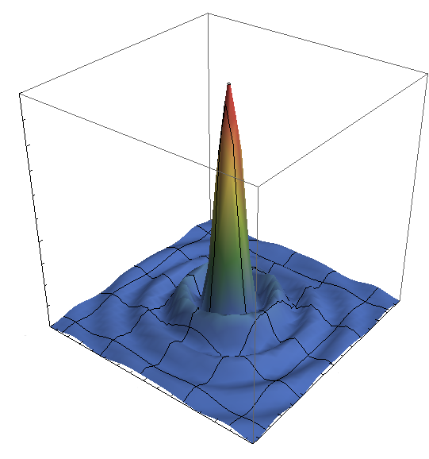








$$0.004$$
$$Ψ^{2}$$
$$0.002$$
$$0$$
$$10$$
-$10$
$$0$$
$$0$$
$$y/a$$
$$x/a$$
$$10$$
-$10$

Slide 4
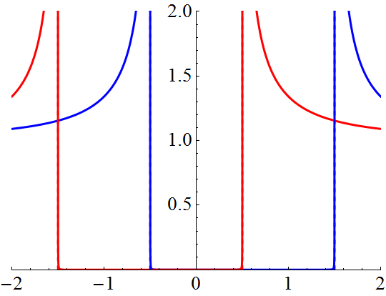




spin down
spin up
$$ρ(ω)/ρ_{0}$$
$$ω/Δ$$
$$2Δ$$
$$2S$$

Slide 5
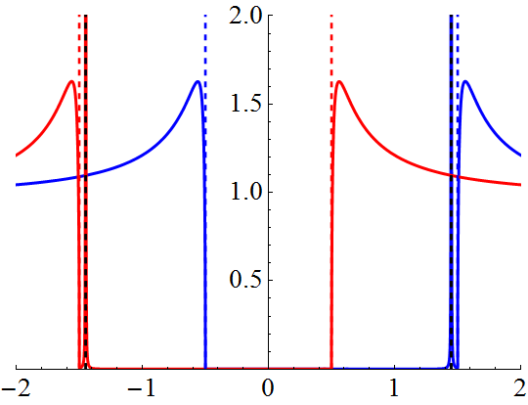
spin down
spin up
$$ρ(ω)/ρ_{0}$$
$$ω/Δ$$

Slide 6
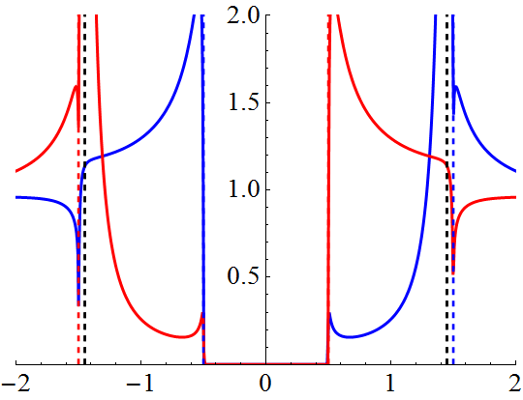
spin down
spin up
$$ρ(ω)/ρ_{0}$$
$$ω/Δ$$

Slide 7
spin down
spin up

Slide 8
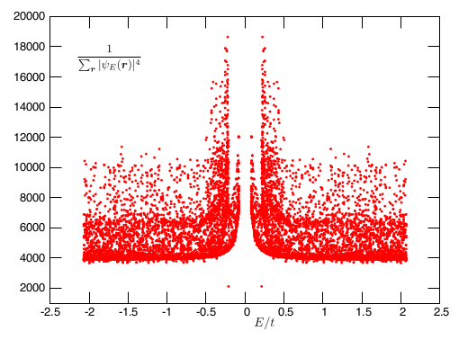

Slide 9
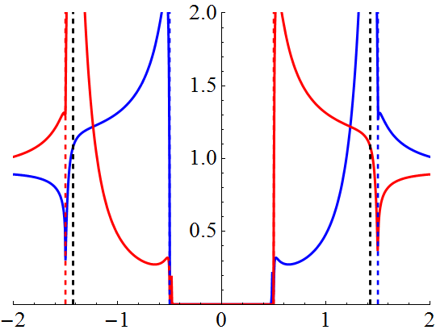
spin down
spin up
$$ρ(ω)/ρ_{0}$$
$$ω/Δ$$

Slide 10
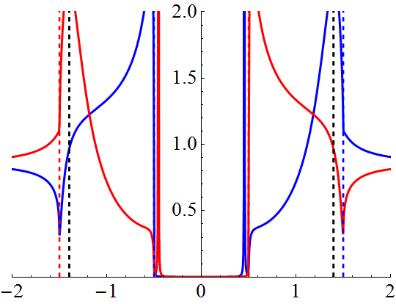
spin down
spin up
$$ρ(ω)/ρ_{0}$$
$$ω/Δ$$

Slide 11
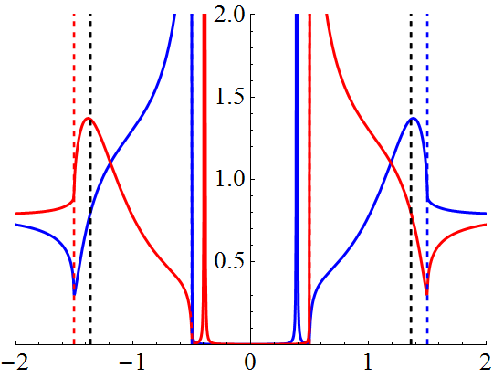
spin down
spin up
$$ρ(ω)/ρ_{0}$$
$$ω/Δ$$

